Slide 1
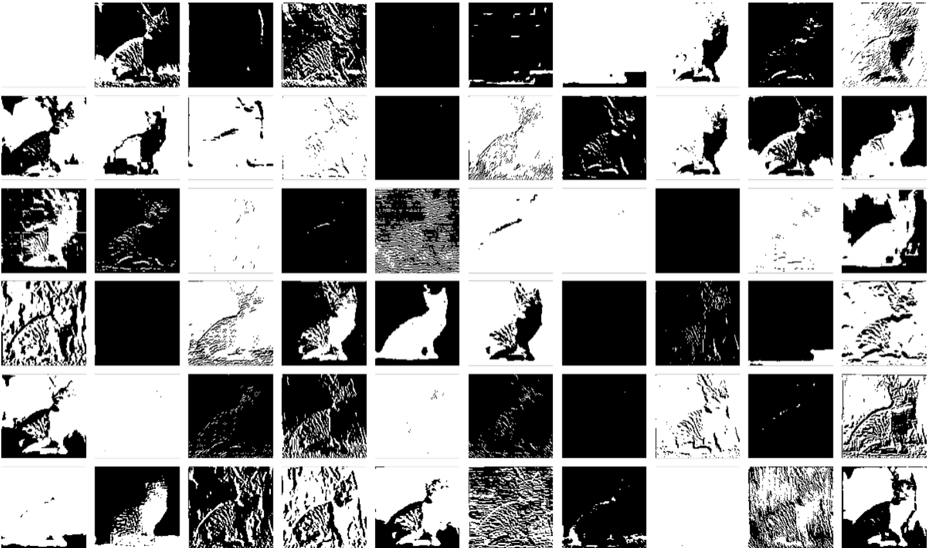
USING AI IN THE WRITING CLASSROOM
HUMANITIES TEXAS ONLINE 2023
Jason Crider
Assistant Professor
Department of English
Texas A&M University
jcrider@tamu.edu
jasoncrider.net

Slide 3
SCALE & VELOCITY
YOU ARE HERE

Slide 4
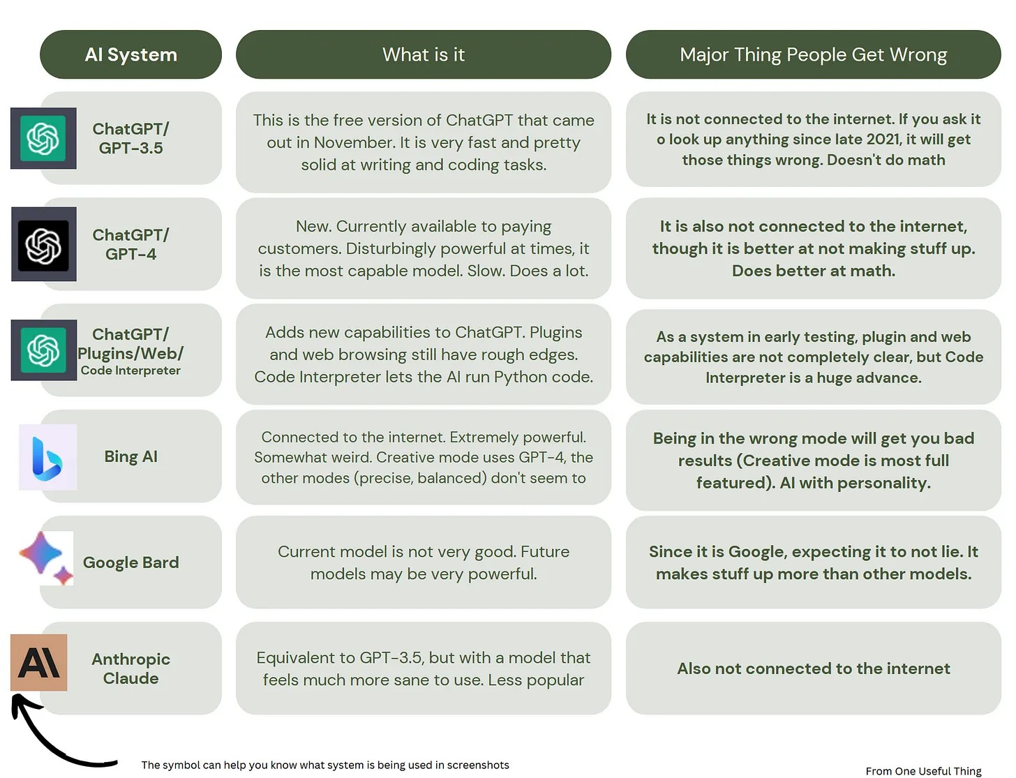
https://www.oneusefulthing.org/p/how-to-use-ai-to-do-practical-stuff

Slide 5
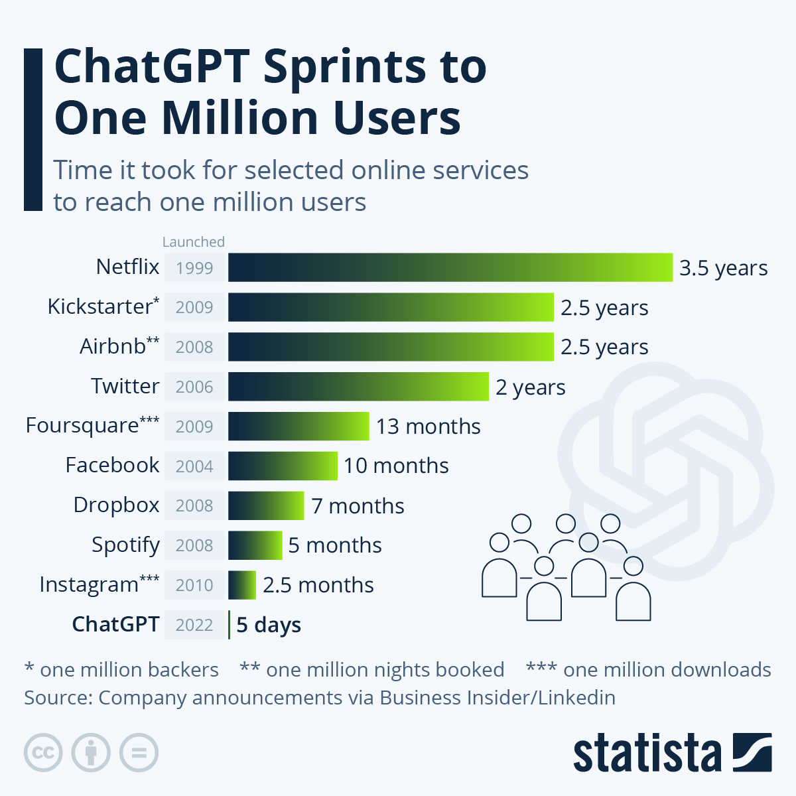
OpenAI’s public launch of ChatGPT set records for the fastest-growing user base in history
https://www.reuters.com/technology/chatgpt-sets-record-fastest-growing-user-base-analyst-note-2023-02-01/

Slide 6
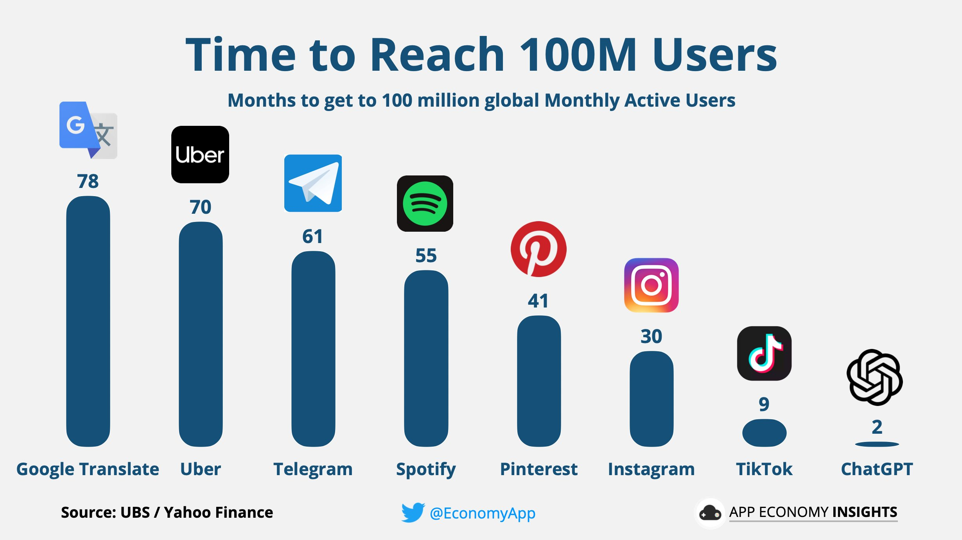

Slide 7
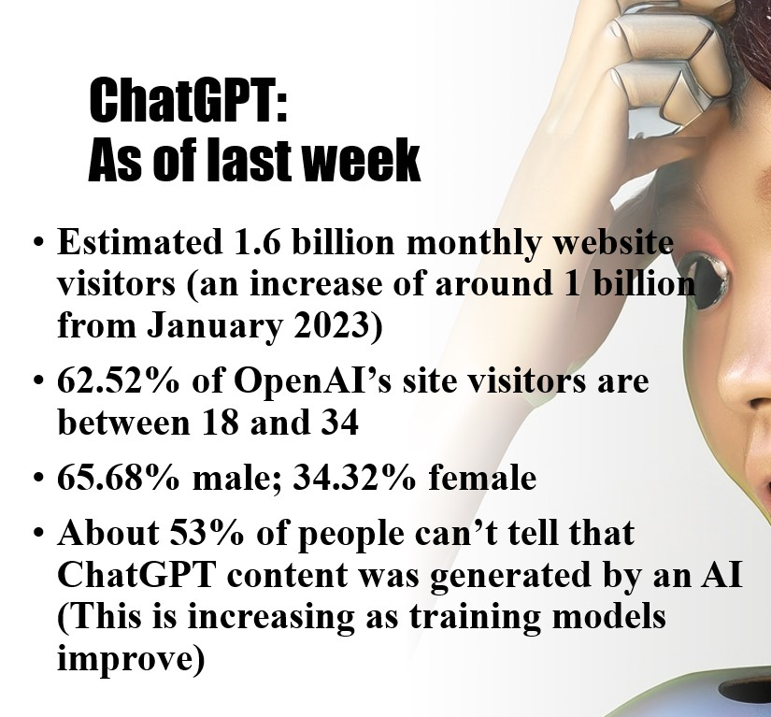

Slide 8
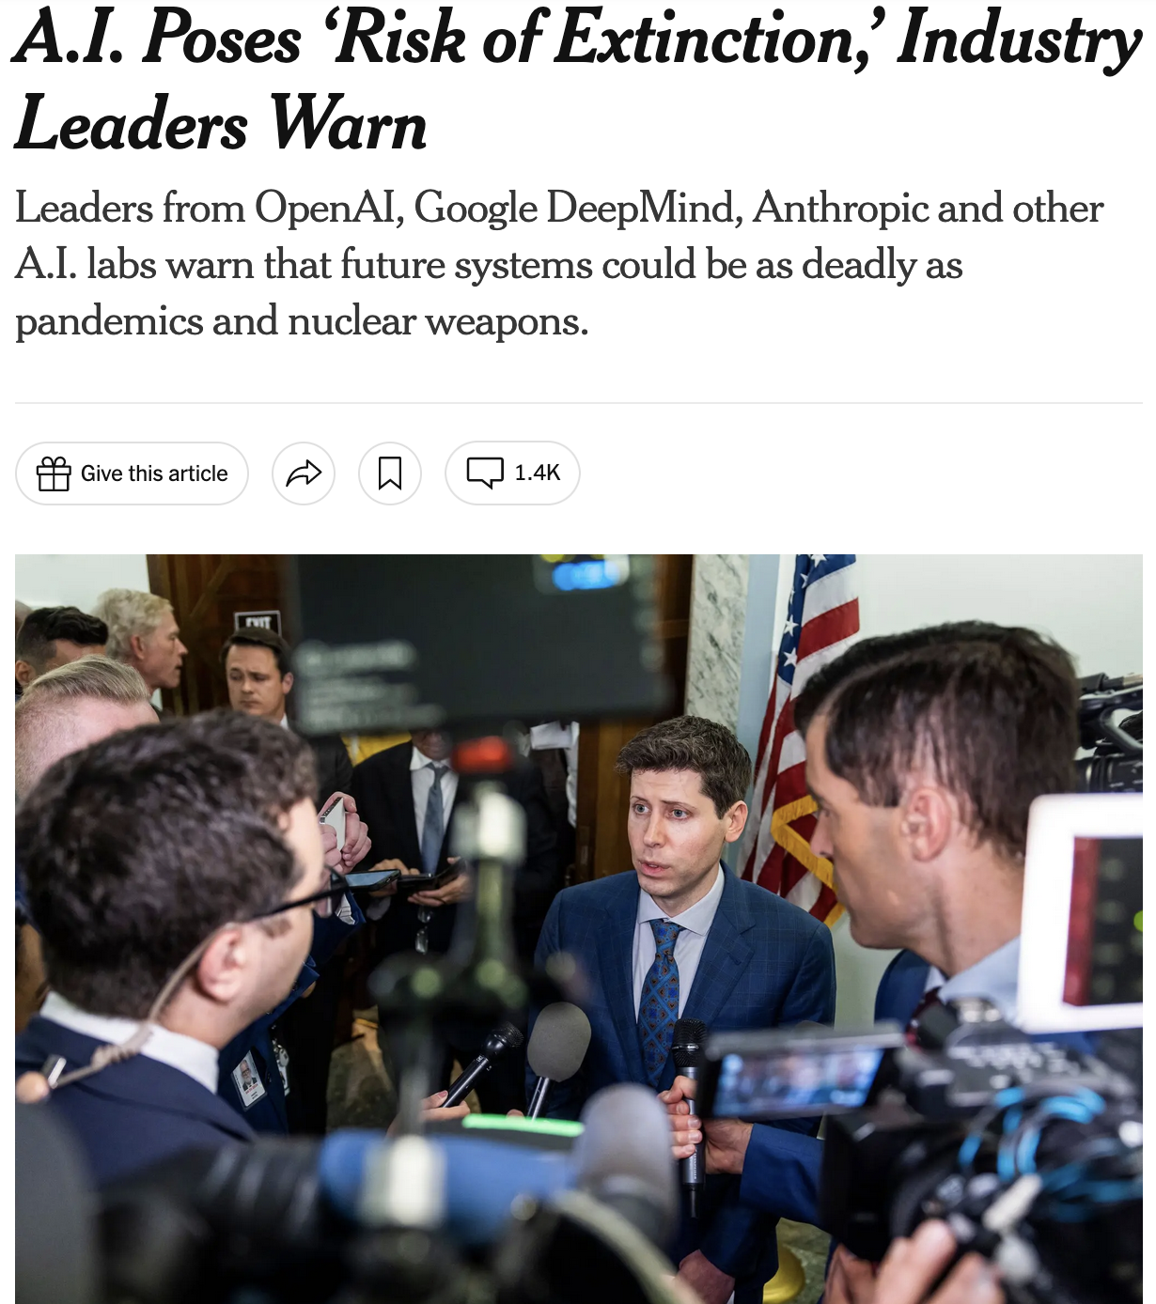
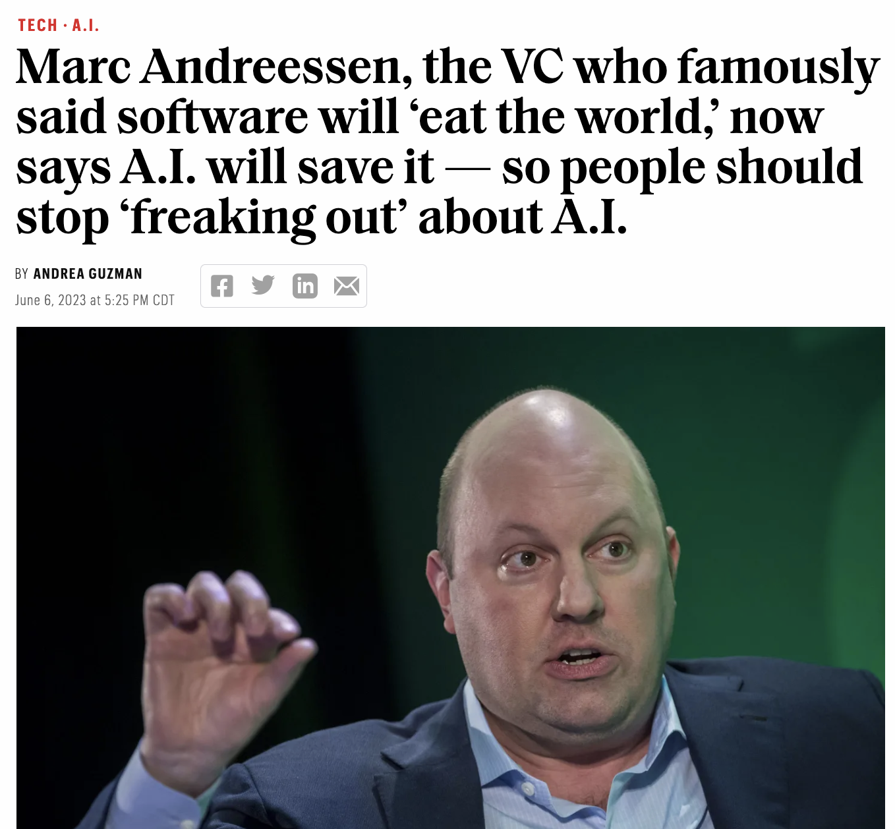
GENERATIVE AI NARRATIVES

Slide 9
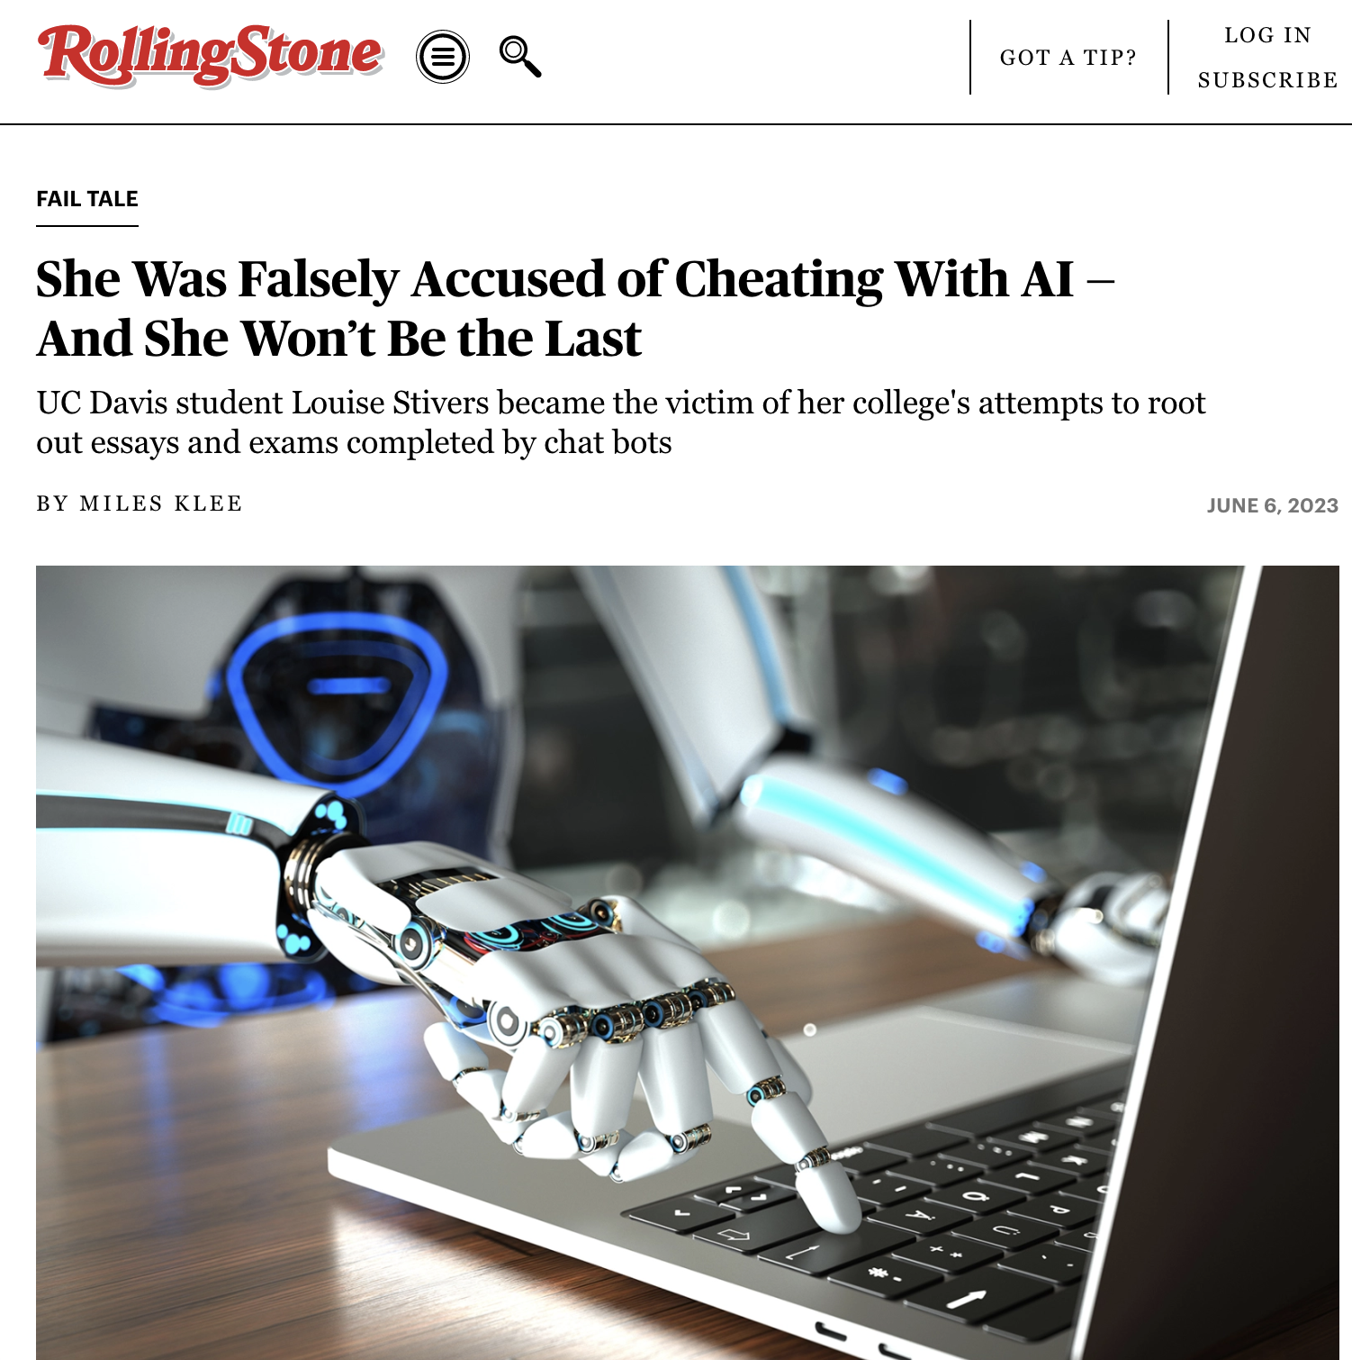

Slide 12
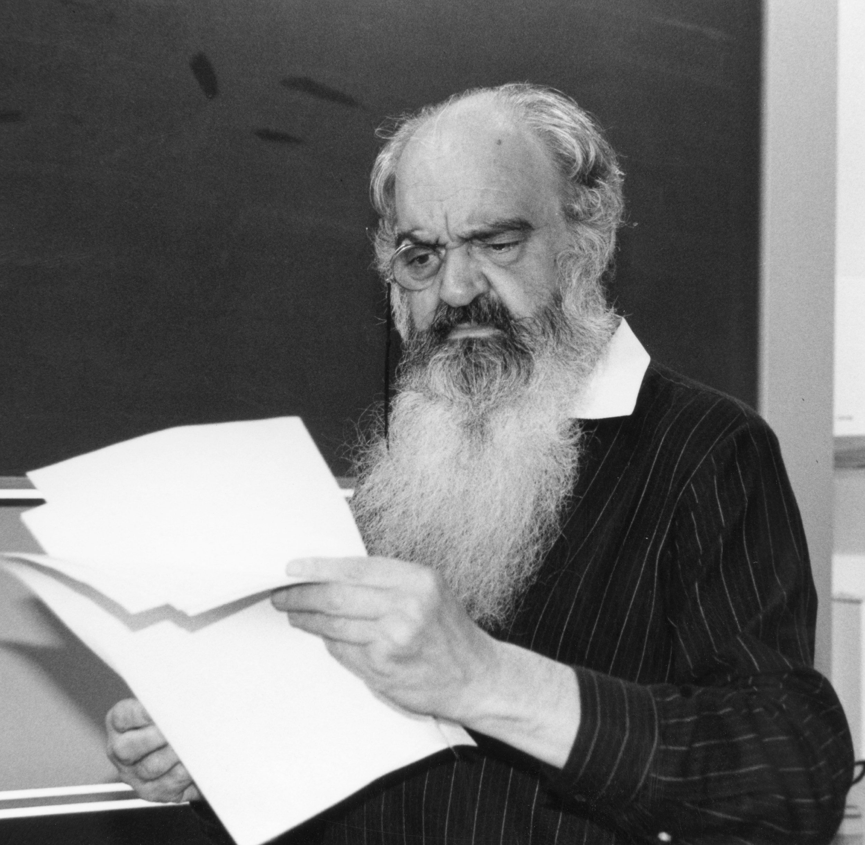
POSIWID
“THE PURPOSE OF A SYSTEM IS WHAT IT DOES”
Stafford Beer (1926-2002)
The “father of management cybernetics”
“There is no point in claiming that the purpose of a system is to do what it constantly fails to do”

Slide 13
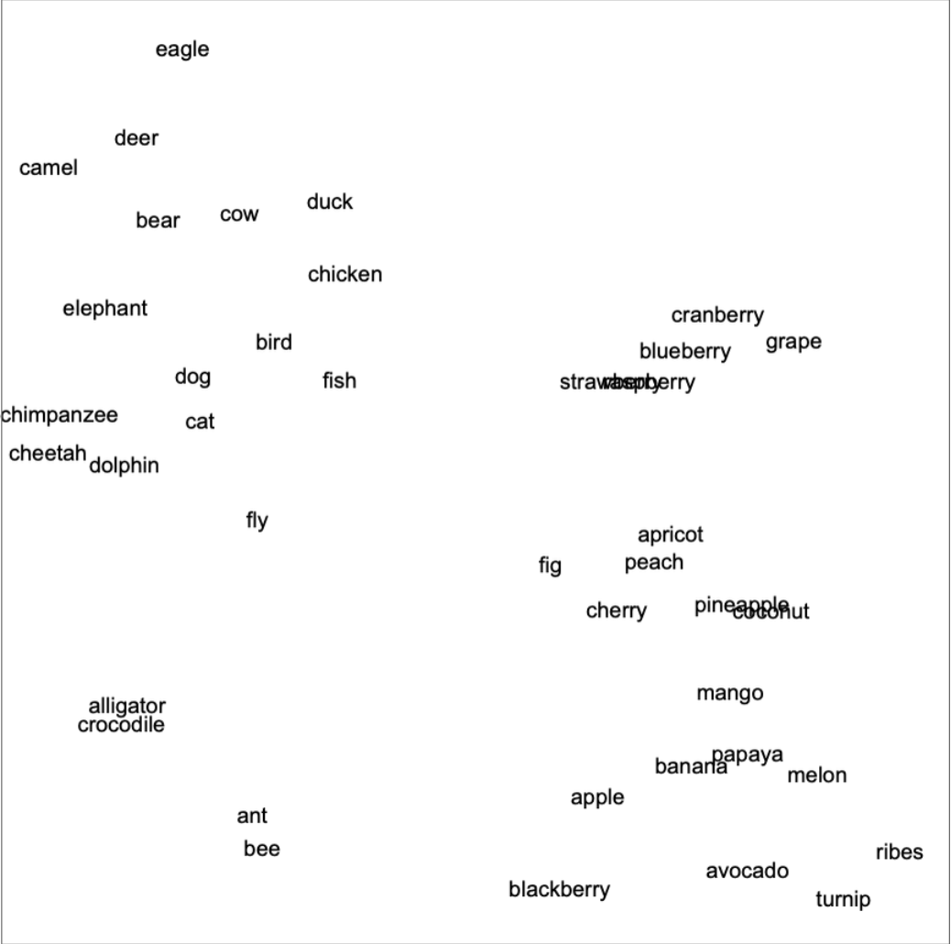
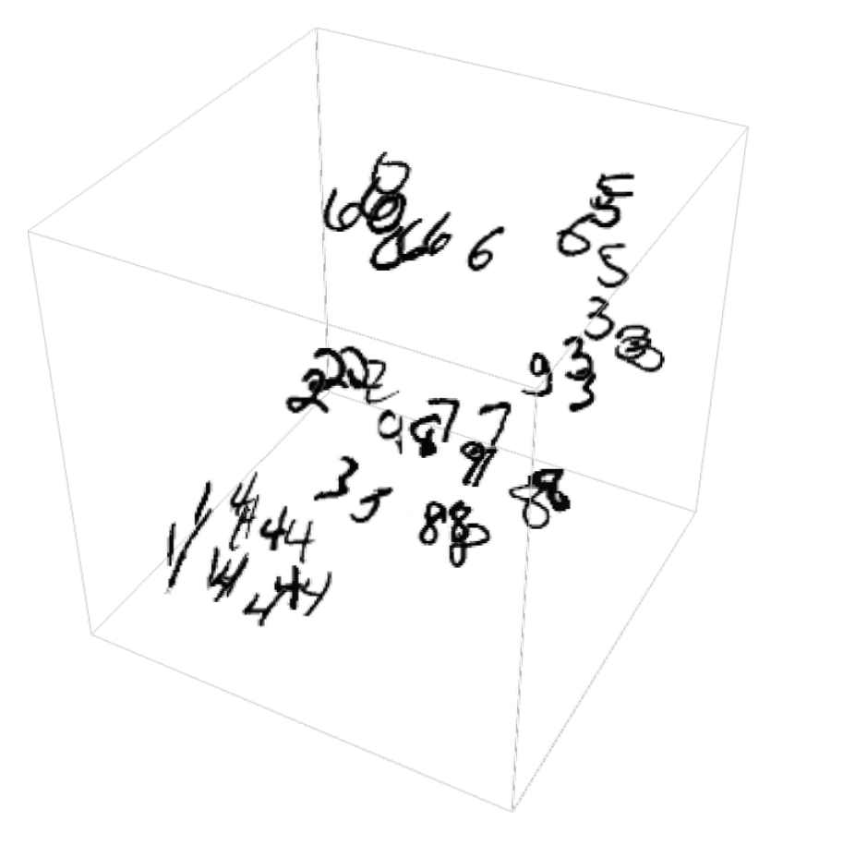
WHAT DO LLMS (LARGE LANGUAGE MODELS) DO (KINDA)?

Slide 14
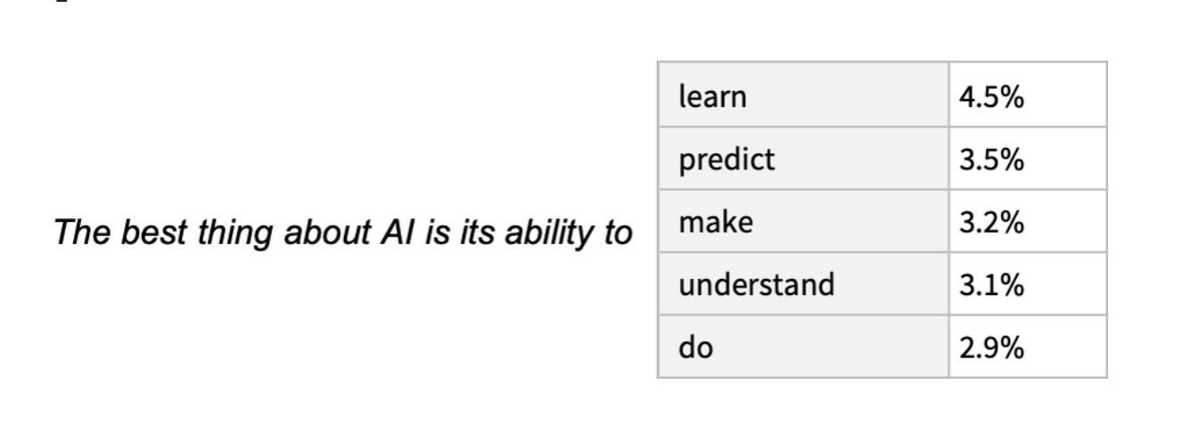
SPICY AUTOCOMPLETE
https://writings.stephenwolfram.com/2023/02/what-is-chatgpt-doing-and-why-does-it-work/

Slide 15
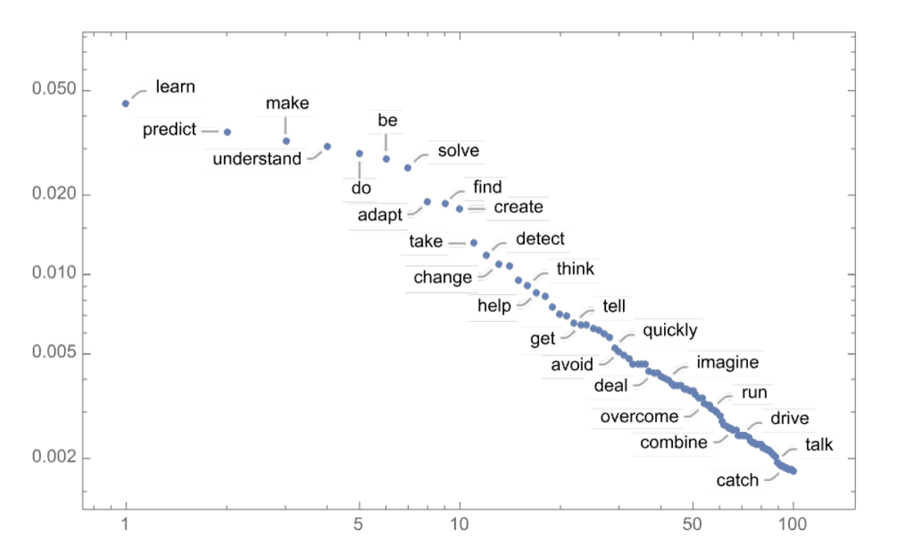

Slide 16
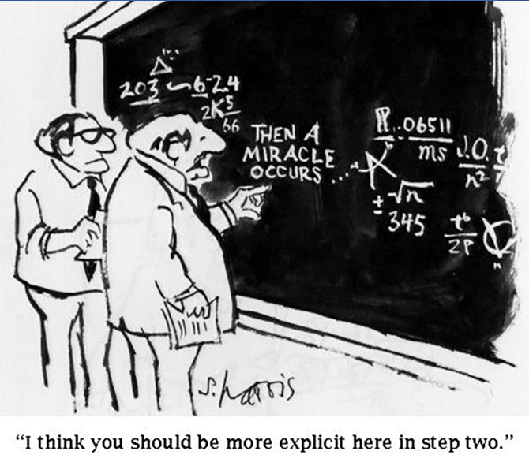
ETHICS AND AI
LLMs train on billions of images, words, writings, etc. without permission
Most AI systems use the material you upload to train on
Environmental impact
Biases in data models

Slide 17
GENAI & WRITING
Undetectable
Ubiquitous
Disruptive
Demanding of new literacies

Slide 19
TWO PRINCIPLES FOR GEN-AI WRITING
GIGO (Garbage In, Garbage Out)
Experiment with these tools yourself
Experiment with them in your classroom
Be Platform Agnostic
Gen-AI tech is unstable, unpredictable, unreliable, and inconsistent
Don’t teach “ChatGPT writing”
Teach how writing works alongside or in spite of AI

Slide 20
WHAT KINDS OF CONVERSATIONS ARE YOU HAVING ABOUT GEN-AI AT YOUR INSTITUTION?
Open discussion 1 of 2

Slide 21
HOW ARE YOU USING AI IN YOUR CLASSROOM?
Open discussion 2 of 2

Slide 22
TAKEAWAYS (1 OF 3)
POSIWID (Purpose Of a System Is What It Does)
Demystify the tech
Demystify writing
Consider the larger system (what am I asking students to do?)

Slide 23
TAKEAWAYS (2 OF 3)
Prioritize transparency and accountability
Understand the temptation; contextualize the approach
Resist blanket AI policies

Slide 24
TAKEAWAYS (3 OF 3)
Exceed the template
Be adaptable (and humble!)
Emphasize PROCESS over PRODUCT

Slide 25
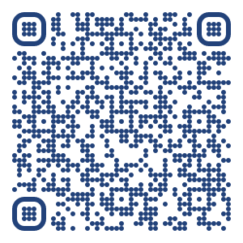
THANK YOU!
LINK TO SLIDES & RESOURCE LIST
jasoncrider.net
(Link at bottom of page)

Slide 26
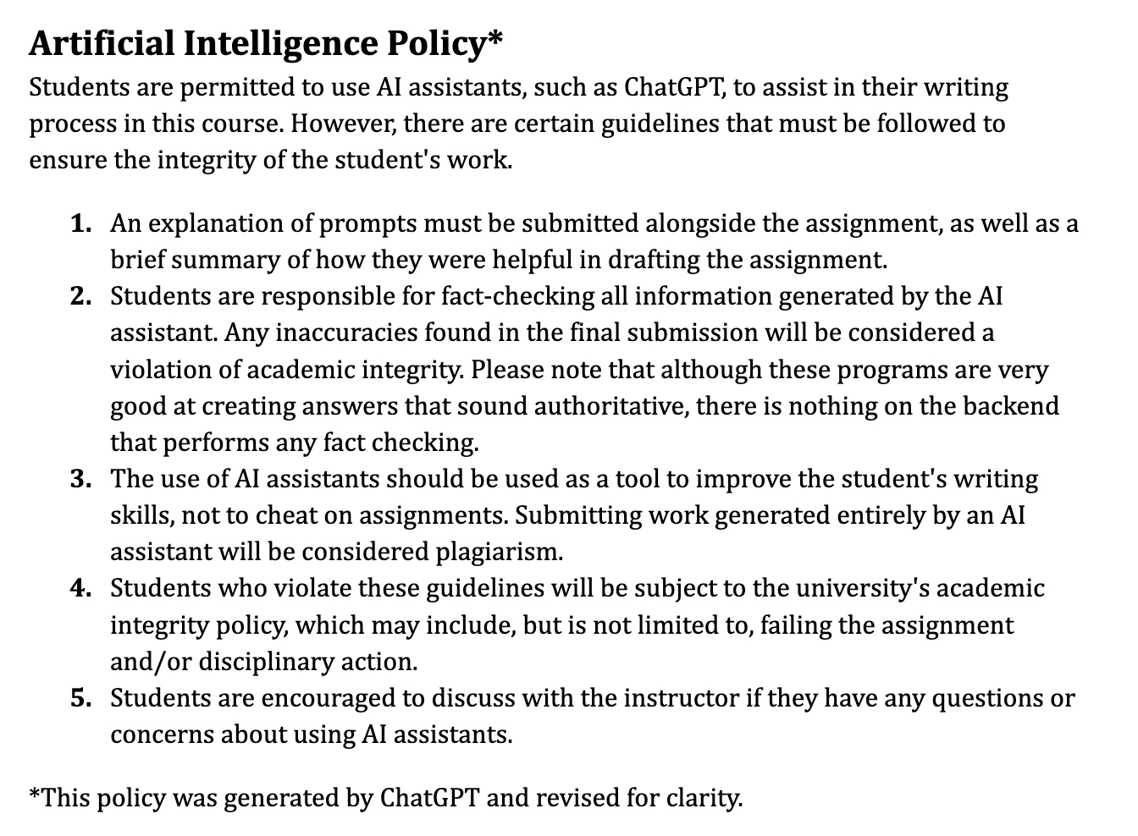
MY SPRING SYLLABUS AI POLICY

Slide 27
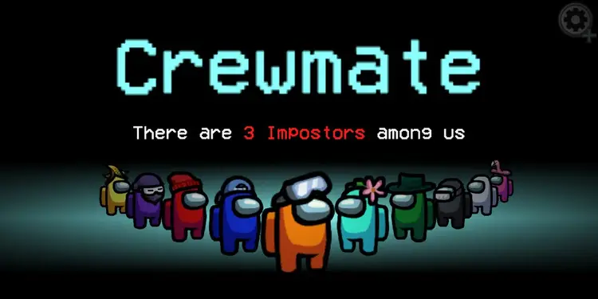
THE PARANOID MEMO

