Slide 1
It’s News To Me
Young Adolescents’ Perspectives on Journalism
Megan Fromm, PhD, MJE
Lecturer, University of Maryland
Affiliated Faculty, Emerson College
Curriculum Coordinator, Journalism Education Association
megfromm@gmail.com

Slide 2
Agenda
Map the field of young adults’ media use
Build foundational knowledge for teaching news and media literacy
Explore class structures and approaches for engaging students

Slide 3
What is news literacy?
“To be news literate is to build knowledge, think critically, act civilly and participate in the democratic process.”
— Robert R. McCormick Foundation
Notes:
Why are we here? Why does news literacy matter? News literacy embodies the principles we ask our student journalists to uphold every day. We ask them to build knowledge for others, to think critically as they gather facts, to be civil, respectful, compassionate and skeptical in their reporting, and to participate in one of the greatest displays of democracy—the freedom of the press.

Slide 4
News literacy is the process through which students learn to:
discern fact from fiction
assess material and personal bias
evaluate the quality of news
actively engage with news media.
Notes:
It’s easier to think of news literacy as a disposition gained from practicing certain critical thinking skills. In the process of learning about news literacy, students gain a skill set they utilize to be discerning producers and consumers of news. .

Slide 5
The ‘new’ literacies
Media literacy
News literacy
Digital literacy
Information literacy
Notes:
Many people use the terms media literacy and news literacy interchangeably, when in fact, news literacy is more accurately a subset of the greater umbrella approach of media literacy. Where media literacy concerns itself with all types of communication, from news to entertainment, from social media to traditional news media, news literacy focuses more exclusively on those mediums specifically publishing news.
Media literacy often focuses on people as news consumers, where as news literacy is aimed at consumers AND producers, so it can be more accessible for scholastic journalism programs. While our session today emphasizes news literacy, it’s important to note that you can’t discuss one without the other.

Slide 6
Why teach it?
Embrace 21st century skills
Provide tools for navigating increasingly mediated world
Encourage civic participation through critical thinking

Slide 7
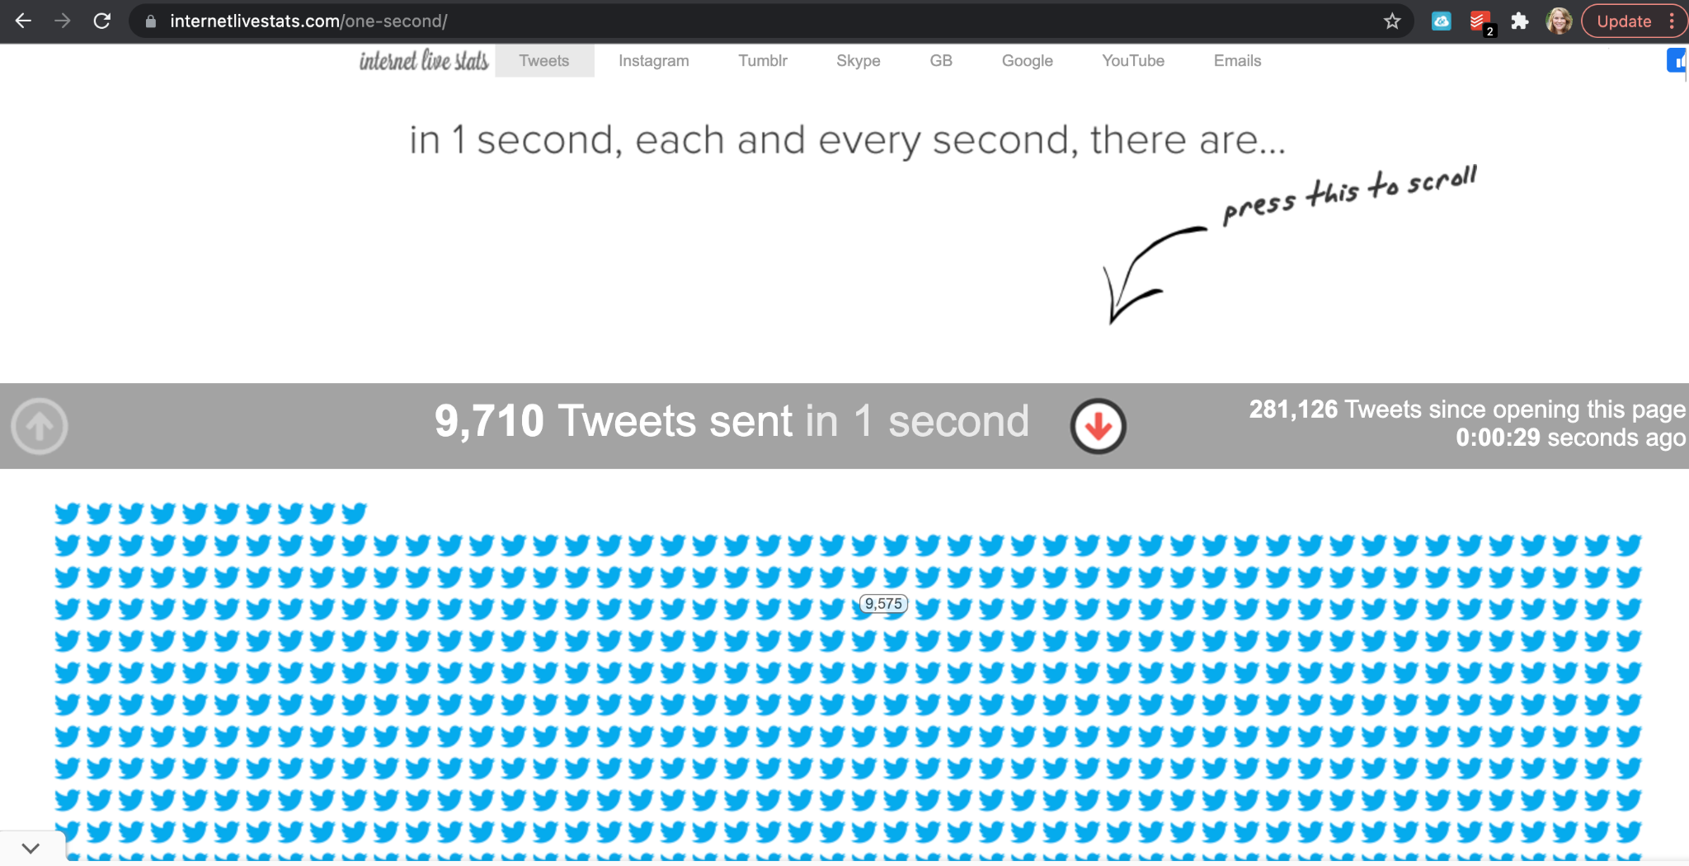

Slide 8
Main concepts of news literacy*
Informed citizens are essential to good government and free society.
Citizens must take a more active role in becoming well-informed and sharing accurate information.
It is important to be aware of one’s own biases and assumptions and seek out information that challenges one’s personal views.
It is important to be open-minded about new facts and ideas.
*Created by Baruch College Professor Geanne Rosenberg and Alan Miller, director of the News Literacy Project, in collaboration with Dean Miller, director of Stony Brook University’s News Literacy Center, and Tom Rosenstiel, founder and director of the Project for Excellence in Journalism.
Notes:
The following slide outlines the main conceptual takeaways for any news literacy program.

Slide 9
Learning outcomes
Students will distinguish verified information from opinion, agenda and spin.
Students will identify biased information sources.
Students will seek information that is contextual and thorough.
Students will understand the limitations of a 24-hour news cycle on truth and context.
Students will understand the greater democratic and ethical imperatives for producing and consuming factual information.
Students will engage in creative responses and meaningful interactions with the media.
Notes:
Then, we make sure that any news literacy programming aims for these learning outcomes.

Slide 10
And finally:
We teach news literacy so that our students learn to demand better, so they become part of the solution.

Slide 11
Critical questions
How are students engaging with media?
What do students think news is?
Where do students encounter and engage with news media?

Slide 12
Mapping the field of adolescent news consumption
Current research says...

Slide 13
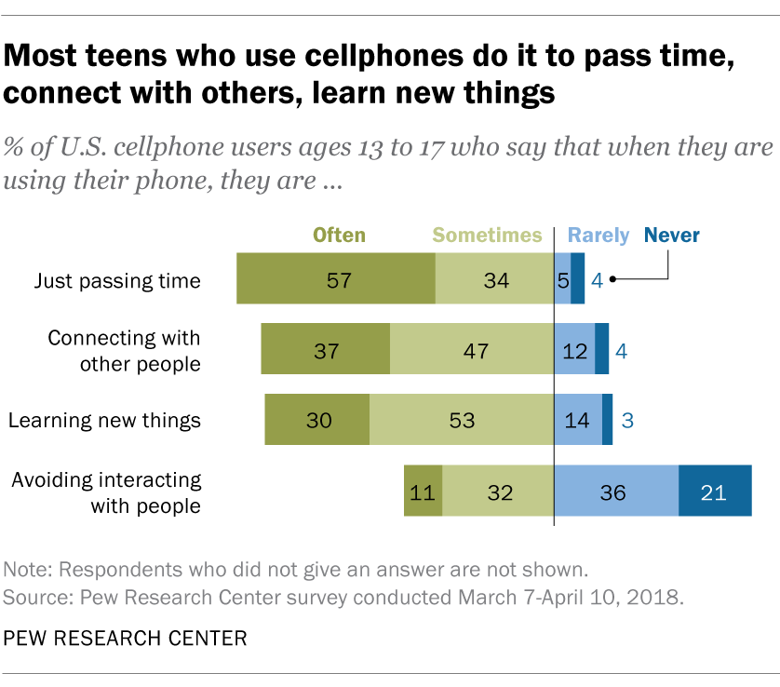

Slide 14
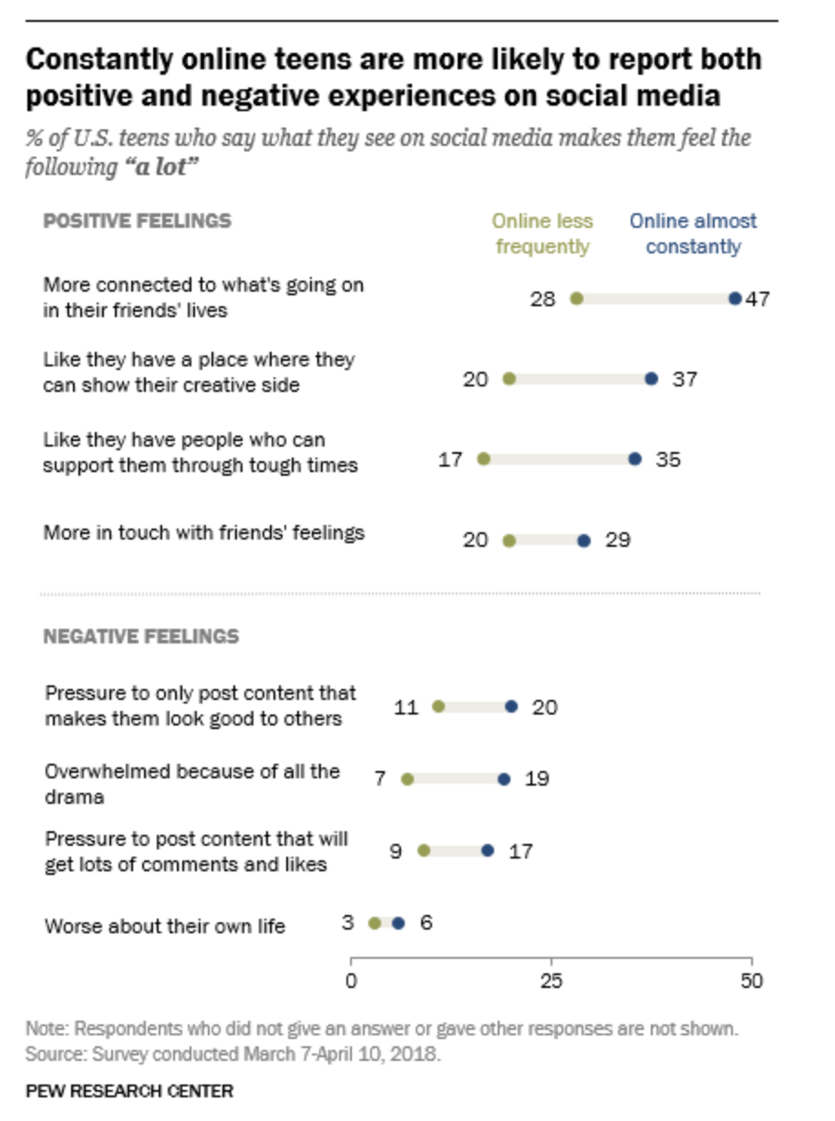

Slide 15
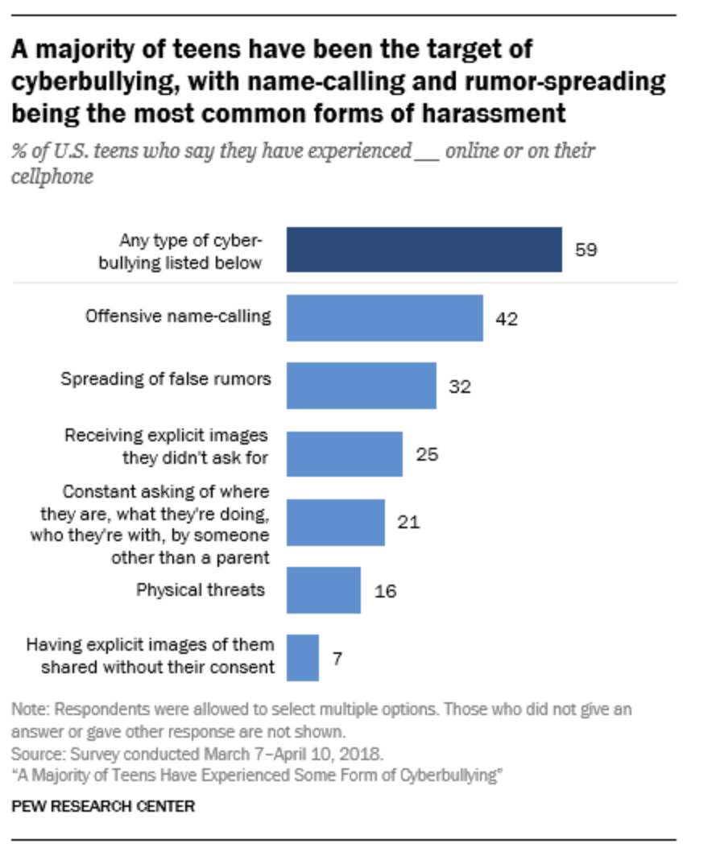

Slide 16
What does this data mean for us?
Teens experience both positive and negative impacts from media
Avoid negative / cynical entry point (deficit thinking)
Acknowledge what’s meaningful to them
Focus on critical literacy / informed citizenry

Slide 17
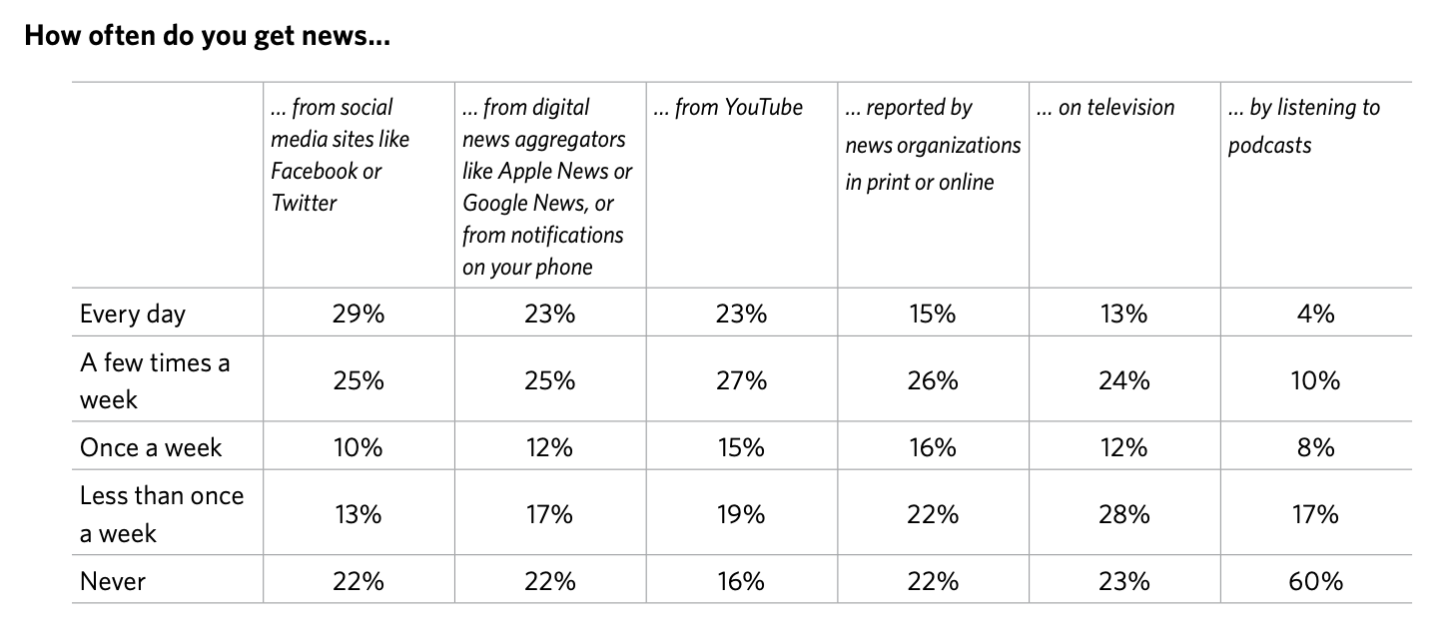
Notes:
https://www.commonsensemedia.org/sites/default/files/uploads/pdfs/2019_cs-sm_summarytoplines_release.pdf

Slide 18
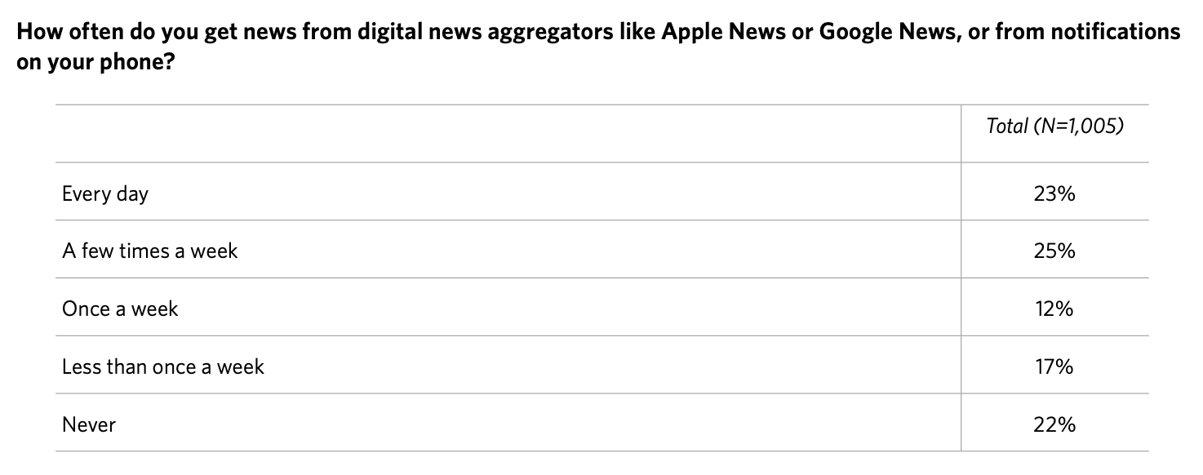
Notes:
https://www.commonsensemedia.org/sites/default/files/uploads/pdfs/2019_cs-sm_summarytoplines_release.pdf

Slide 19
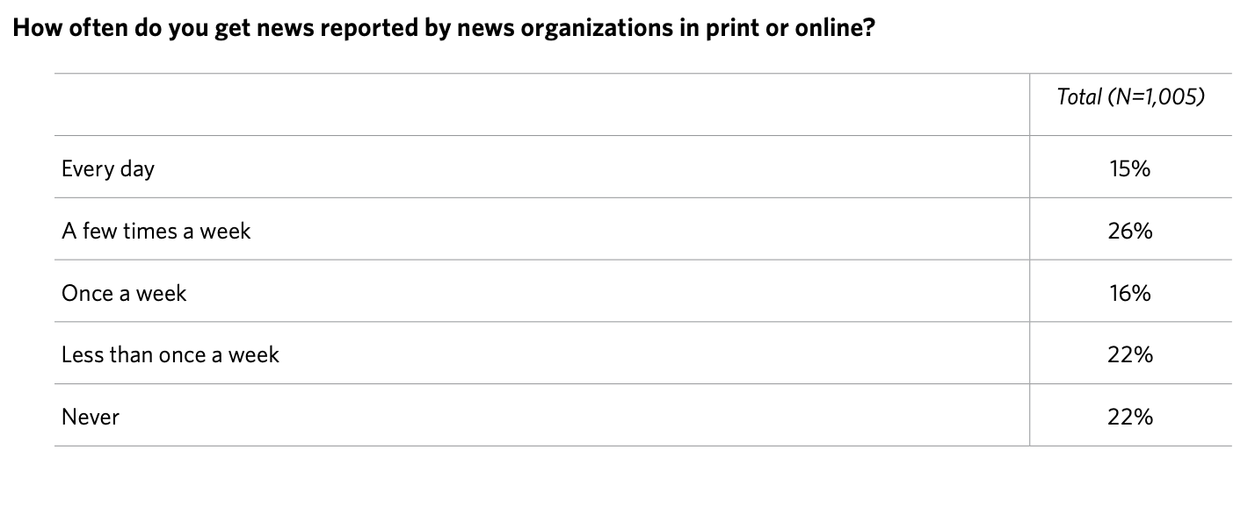
Notes:
https://www.commonsensemedia.org/sites/default/files/uploads/pdfs/2019_cs-sm_summarytoplines_release.pdf

Slide 20
Notes:
https://www.commonsensemedia.org/sites/default/files/uploads/pdfs/2019_cs-sm_summarytoplines_release.pdf

Slide 21
What does this data mean for us?
Teen habits are not ours (nor will they be)
Social media emphasis is vital
Visual literacy skills are paramount

Slide 22
What should I be teaching?
Foundational concepts

Slide 23
Foundational concepts
Media
Journalism
Misinformation
Sensationalism
Biased News
Propaganda
Partisan News
Fake News
Brain
Confirmation bias
Selective exposure
Hostile media
Conspiratorial thinking
Motivated reasoning

Slide 24
MEDIA TERMS
Journalism
Adheres to ethical and professional norms
Seeks to correct misinformation
Acts as tool for civic engagement and government watchdog
Sensationalism
Sensational news takes small bits of truth and spins them out of proportion by changing or ignoring context
Plays on your emotions
Biased News
Tells the story from a specific perspective or agenda to push a specific outcome or reaction
Uses loaded language, often perpetuating a dominant narrative
Uses rhetoric or frames that marginalize or decontextualize
Partisan News
News and media published from an organization with established OR perceived political ties
Fake News
Content packaged to look like real journalism (“native content”)
Can be proven false
Uses mechanisms such as clickbait and sensationalism to help the content spread far and wide
Motivations include profit and political persuasion
Propaganda
Meant to influence opinion, to build support for a cause and/or to demonize those against something (personal attacks)
Involves asymmetrical power dynamics
Misinformation
Content that, either intentionally or accidentally, hides or distorts the truth.

Slide 25
BRAIN
Motivated Reasoning
We use emotionally biased reasoning to justify attitudes or decisions that are most desired rather than those that accurately reflect the evidence.
Hostile Media
When we feel strongly about an issue, we tend to think any news media coverage of it is critical or negative
Selective Exposure
We seek out ideas or perspectives that support what we already believe
Confirmation Bias
We interpret new information in ways that support what we already believe (even if that information is meant to disprove what we know)
Conspiracy Theory
An explanation for a situation that blames secretive or sinister work of powerful groups when other explanations are more probable

Slide 26
Q & A time

Slide 27
How should I be teaching this in my classroom?
Ideas and best practices to discuss

Slide 28
Prepare students for discomfort
Norms for participation
Shared understanding of who is in the room
Notes:
You might have a discussion about overt racism in a news article. You might have a discussion on what makes an expert an authority source. You will most certainly have discussions about truth and fairness. These things can all be difficult for students who are often at the height of their “objective reality” experience. Try not to shatter it for them in one foul swoop, but instead gradually build your discussions to higher level of critical inquiry. There’s a subjective reality to many of the discussions involved in critiquing and understanding the news. Prepare your students to think and respond outside their comfort zones in respectful ways.

Slide 29
Setting norms for discussion
🗣️
No tough discussions until they can name every student in the room (this takes a couple weeks, so it must be a priority)
If doing small groups, students can only report out what someone else said (promotes active listening)
Help students identify their own strongly-held beliefs, but remind them the purpose of education isn’t persuasion (important for educators, too)
Know your own triggers
Teach strategies for engaging with controversial material

Slide 30
Strategies for tough discussions
“How did you come to know that?”
“I’d like us to come back to that discussion when we’re all a little more prepared for it.”
Triangulating a difficult discussion
What we know
What is disputed
What we want to know more about
What is your favorite phrase to diffuse a tense scenario in the classroom?
Click on the Padlet link
Click the pink plus sign at the bottom right to add your thought
Notes:
Strategies for tough discussions

Slide 31
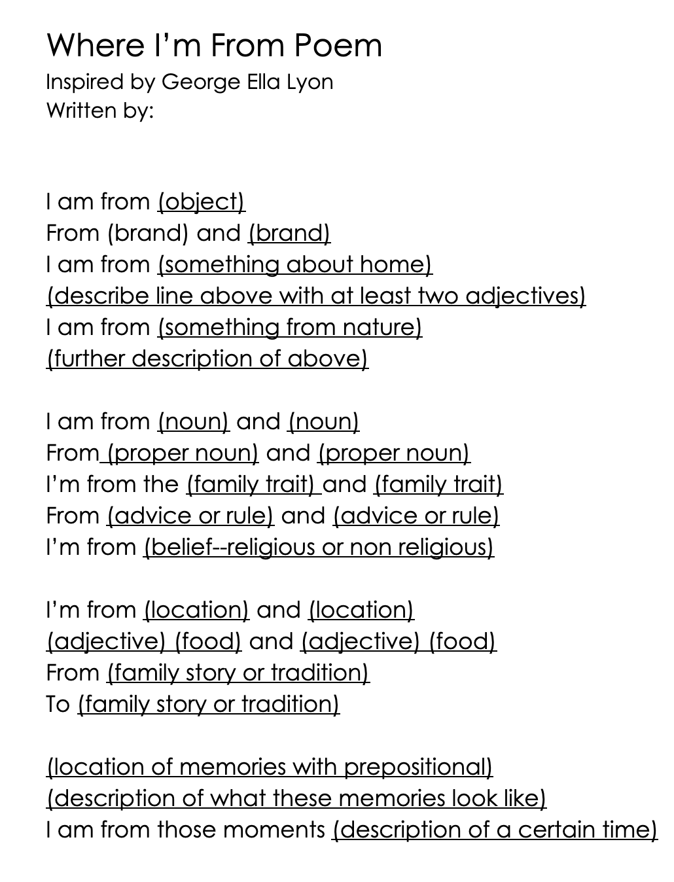
Let students tell their stories
🗣️
“I am from” poem (George Ella Lyon)
Notes:
https://padlet.com/megfromm/deqx5iglxzzfokyq

Slide 32
Where are you from?
Click on the Padlet Link
Take 5 minutes to tell us parts of your story using the model provided
Click the plus sign
Add your name as the “subject”
Type your story
As you finish, read others’ stories
Debrief: What can we learn about our cohort here based on this activity? What were some things that were shared that could impact how people view the world?
Notes:
Debrief: What can we learn about our cohort here based on this activity? What were some things that were shared that could impact how people view the world?

Slide 33
Use the
“I, You, Them, It” approach
How am I engaging with the news? What could I do differently? (I)
How are others engaging with the news? (you)
What are the creators of news and media doing behind the scenes? (them)
What are the bigger issues or systems that shape what I’m experiencing? (it)
Notes:
how other audiences engage, how news creators themselves contribute to a news product, and finally, how the greater political, economic and commercial systems in our country affect news content and reception.
This combination is an integral approach to any news literacy curriculum. You cannot simply look at this equation through any one lens and do justice to the tenets of news literacy. Students need to be pushed outside their linear view that Rupert Murdoch sits in his office and singularly decides the entire content, angle, and factuality of every piece of news in all his productions. It’s not that simple.

Slide 34
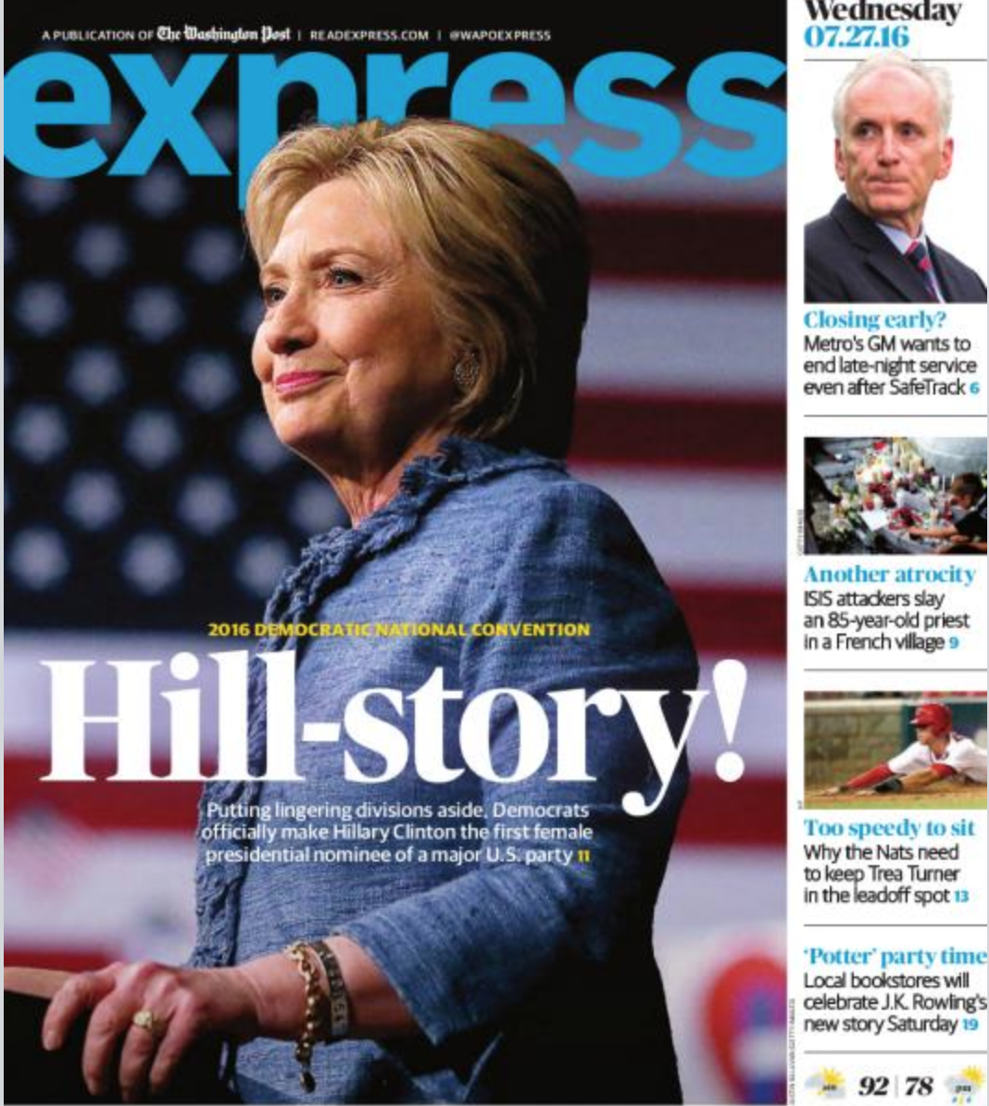
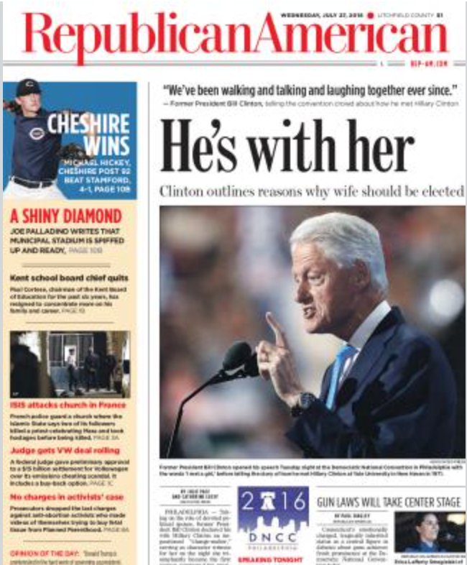
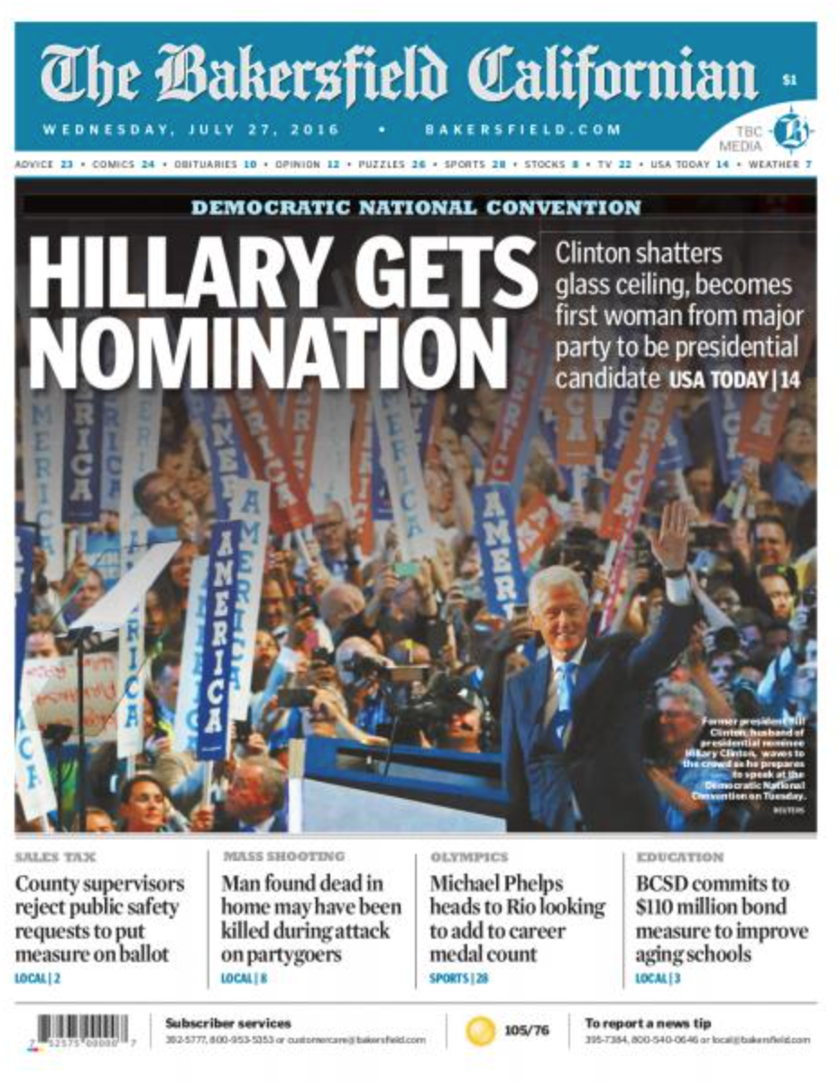
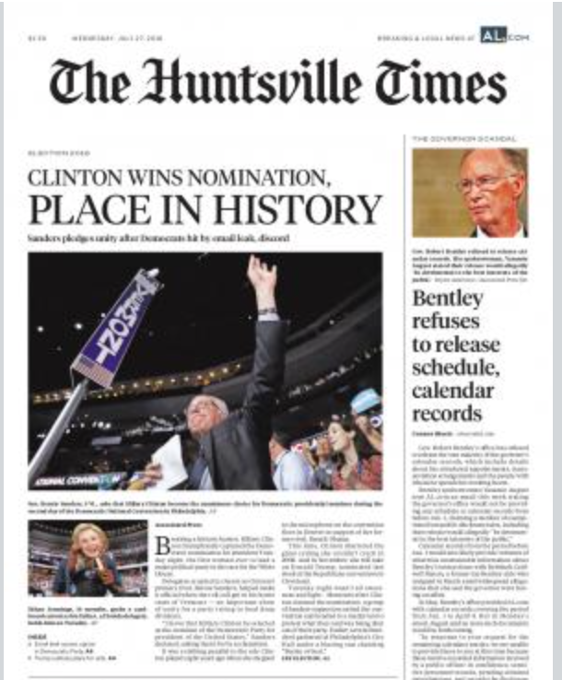
Framing exercise
🗣️
News media use frames (dominating narrative elements) to organize information and create entry points into content.
Framing is not the same as “spin”—it is a necessary tool to reduce complexity of an issue and accommodate for space or time constraints in communicating.
Frames can be related to bigger, systemic issues (composition of newsroom, funding issues, audience, implicit bias).
Notes:
Sept. 11 Front Page Gallery
A useful resource for understanding framing: https://www.pewresearch.org/wp-content/uploads/sites/8/legacy/framingthenews.pdf
Sept 11 Padlet

Slide 35
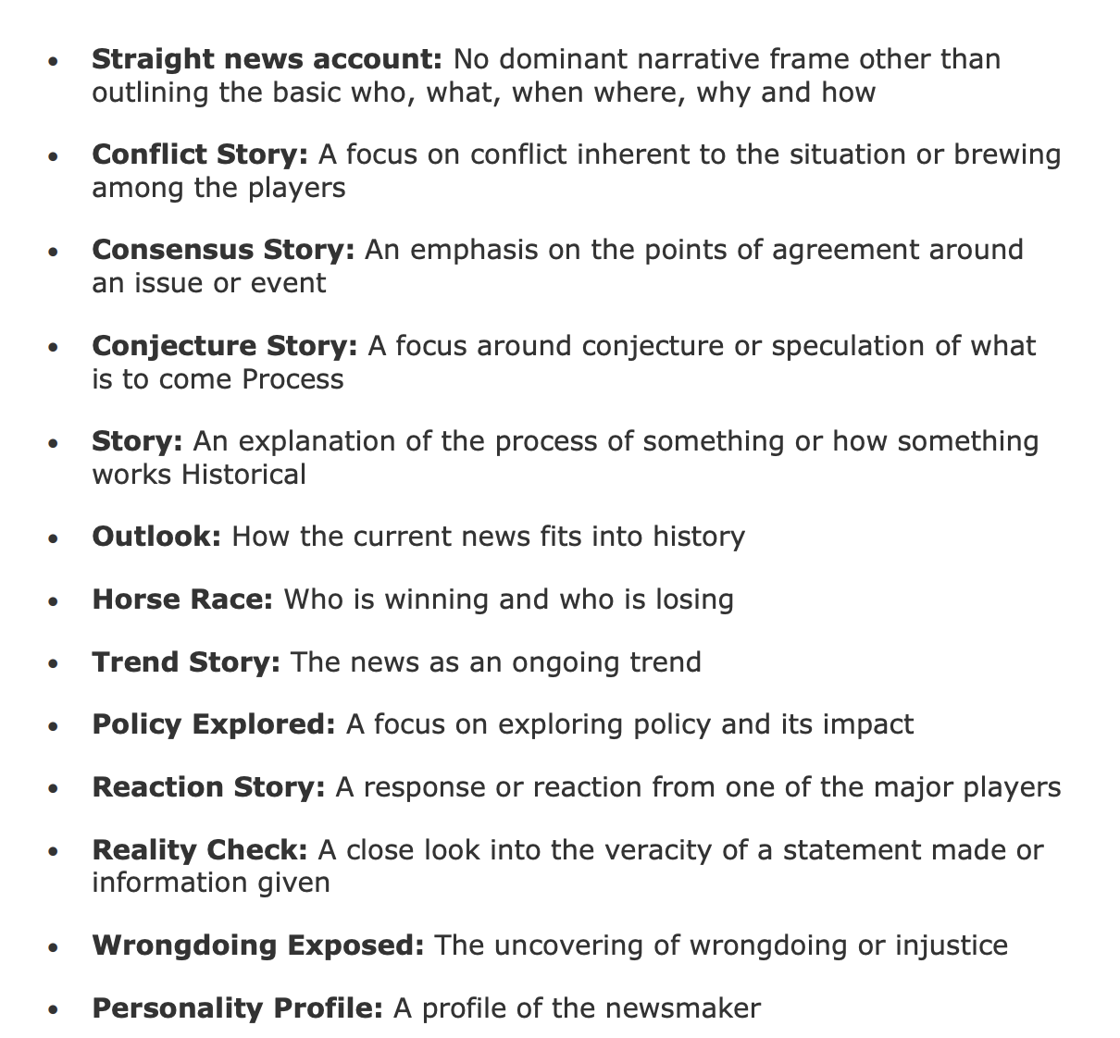
Common frames
—Pew Research Center
Notes:
Sept. 11 Front Page Gallery
A useful resource for understanding framing: https://www.pewresearch.org/wp-content/uploads/sites/8/legacy/framingthenews.pdf
Sept 11 Padlet

Slide 36
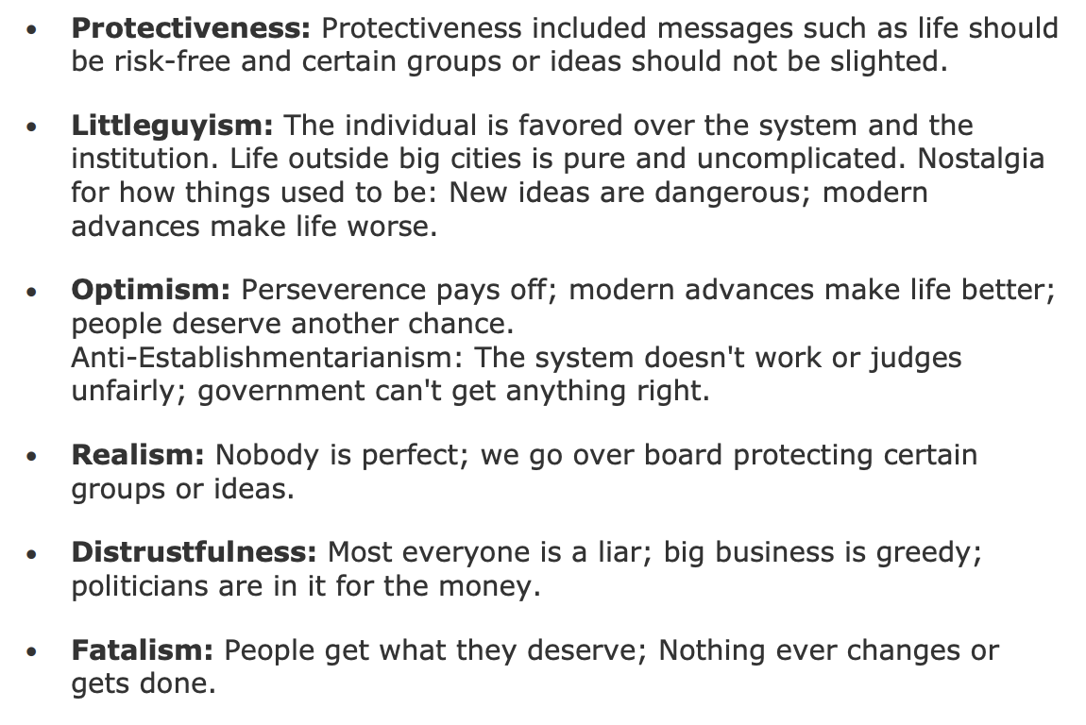
Common underlying messages
—Pew Research Center
Notes:
Sept. 11 Front Page Gallery
A useful resource for understanding framing: https://www.pewresearch.org/wp-content/uploads/sites/8/legacy/framingthenews.pdf
Sept 11 Padlet

Slide 37
Dissecting frames
Take a 5 minutes to explore the Sept. 11 front page gallery
Discuss:
Trigger: What triggered the news organization to cover the story. In other words, what made the event or issue news in the first place?
Topic: What story topics were covered on page one (in this case, the different angles covered regarding attack)?
Frame: What narrative device or approach was used by journalists in composing the story. For example, was the story built around the conflict inherent in an issue?
Underlying Message: Can we identify any underlying social or folkloric messages evoked in the story, consciously or unconsciously?
Debrief: What might explain the similarities in coverage and the differences?
Notes:
Sept. 11 Front Page Gallery
A useful resource for understanding framing: https://www.pewresearch.org/wp-content/uploads/sites/8/legacy/framingthenews.pdf
Sept 11 Padlet

Slide 38
Reflection is key
Start with basic habit development and assessment
What kind of news do they like to read?
What are their favorite sources?
What are some hurdles to accessing news?
Notes:
If you are teaching an entire unit, I recommend having students reflect at least 1-2x per week. This can be on a variety of prompts, or a free-response based on something they saw, read, or heard about in the media. The point is that they need to learn to be critically reflective of their own media practices, habits, dispositions and biases as they also discover these elements in the news they consume.

Slide 39
Media journal assignment
🙋‍♀️
Track media usage for 48 hours according to how much time they spend on different platforms
Watch “Filter Bubble” (Google: Filter Bubble, Eli Pariser)
Reflect on how much they think their media diet is information fruits and veggies or information dessert.
Create their own filter bubble visual representation of their media consumption

Slide 40
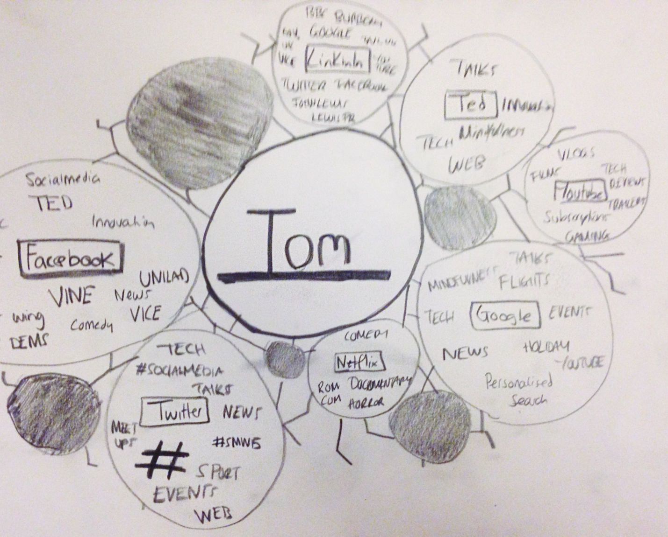
Draw your own filter bubble
On a sheet of paper, visualize your filter bubble—
What content is most common inside your bubble?
What content sometimes gets through?
What content never gets through?
Notes:
Gallery walk

Slide 41
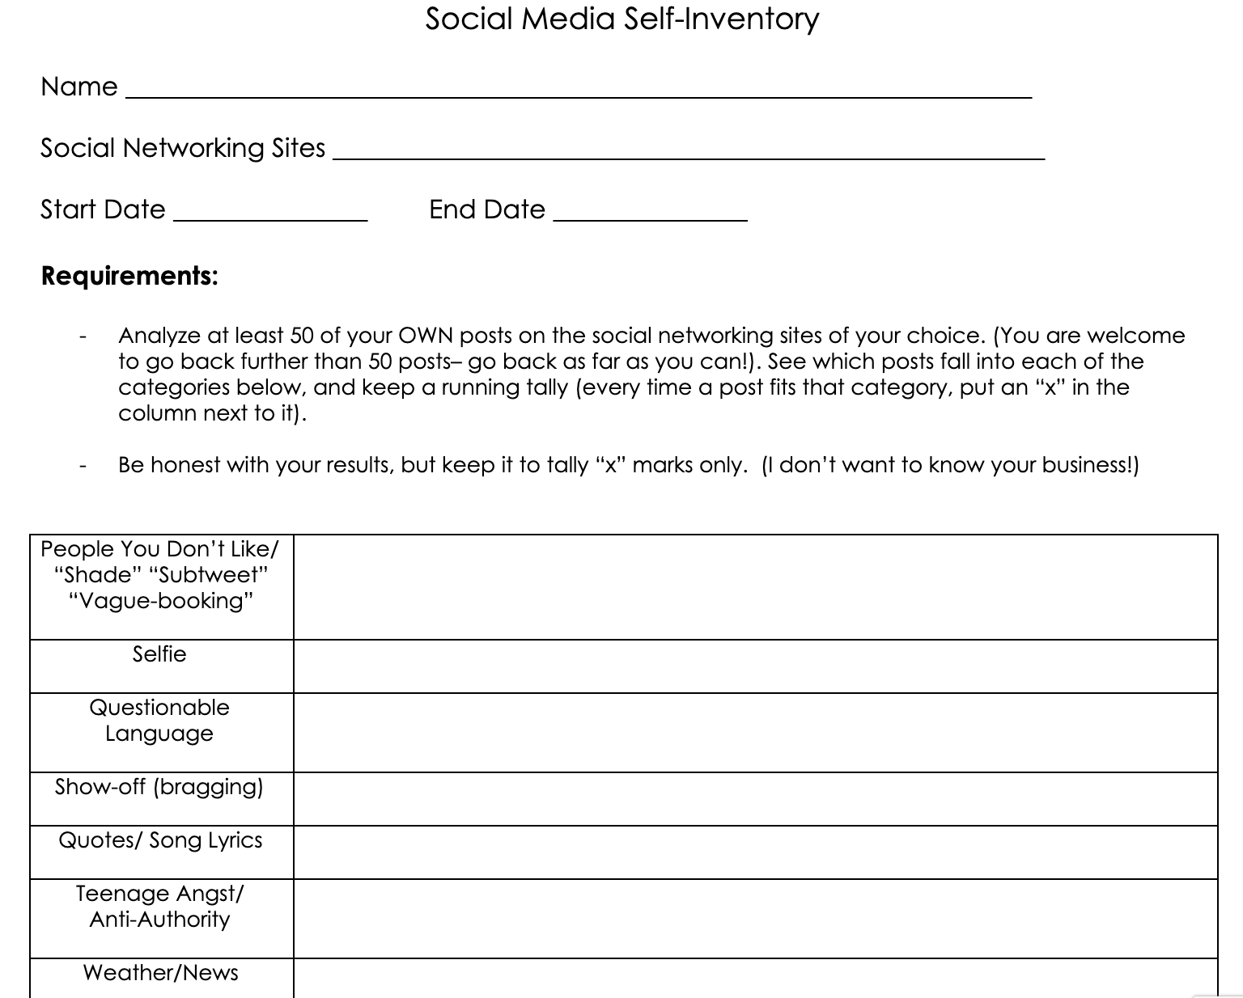
Social media inventory
🙋‍♀️
Analyze the type of content they post most often in their social media feeds, and discuss their motivations in posting that content and how others’ might perceive that content.
Notes:
Social Media Inventory

Slide 42
Social media inventory discussion
What surprised you about your tallies or type of content you share?
How do you think others would you them if they only got to know you through your social media?
What are some times something you’ve posted on social media has really helped you or resulted in a positive outcome?
What are some times something you’ve posted on social media has led to regret or a negative outcome?
Did doing this exercise make you want to change any of your social media habits? If so, how?

Slide 43
News every day, but embrace “slow” journalism
Current events quizzes/discussions
Read and respond
Letters to the editor
Follow a story
Article comparisons
News journals
Notes:
While we know students think they are exposed to what’s going on in the world through virtual osmosis (“I had my phone on me, so I can check the news if I wanted to”), we also know they aren’t reading a lot of news content on their own. I recommend starting each day with 10 minutes of silent news reading. If you have computers, rotate online access as other students use the daily newspaper. I HIGHLY recommend “slow” journalism--follow a topic or two in-depth and don’t try to force students to become breaking news consumers.

Slide 44
Should/want/need discussion framework
💡
I ask: “What are some stories you saw that we should know about because it helps us be informed about the world around us, that we need to know about to make better or important decisions about our day to day lives, and that we want to know about just because they are interesting to us?”
Notes:
Media 360 Project

Slide 45
End with engagement
Complete the literacy cycle
Always include opportunities for student engagement with news media.
What can we do, as consumers, to demand more and better from our news environment?
Notes:
Finally, the most important “best practice” to keep in mind is that this subject doesn’t exist in a bubble, nor can it be taught that way. You cannot teach these kinds of skills and hope for these kinds of learning outcomes by either constant direct instruction, or by plunking students down with news and telling them to read. On the contrary, they must be exposed to daily examples, should participate in case study examination, and should lead their own project-based inquiry.

Slide 46
Final thoughts
Favorite free resources for teaching news and media literacy:
Checkology and the News Literacy Project
Snopes
AllSides
PolitiFact
NAMLE
Journalism Education Association (member fee)

Slide 47
Thank you!
megfromm@gmail.com

