Slide 1
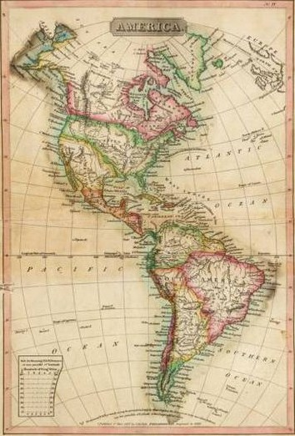
Foreign Relations in the Early American Republic:
The War of 1812 and the Monroe Doctrine

Slide 2
Core questions and learning objectives:
What were some of the primary causes and effects of the War of 1812?
(Standard 5d)

Slide 3
Core questions and learning objectives:
What were some of the primary causes and effects of the War of 1812?
(Standard 5d)
How did the War of 1812 and its aftermath intersect with Latin American independence? How did Latin American independence shape the United States?
(Standard 5e)

Slide 4
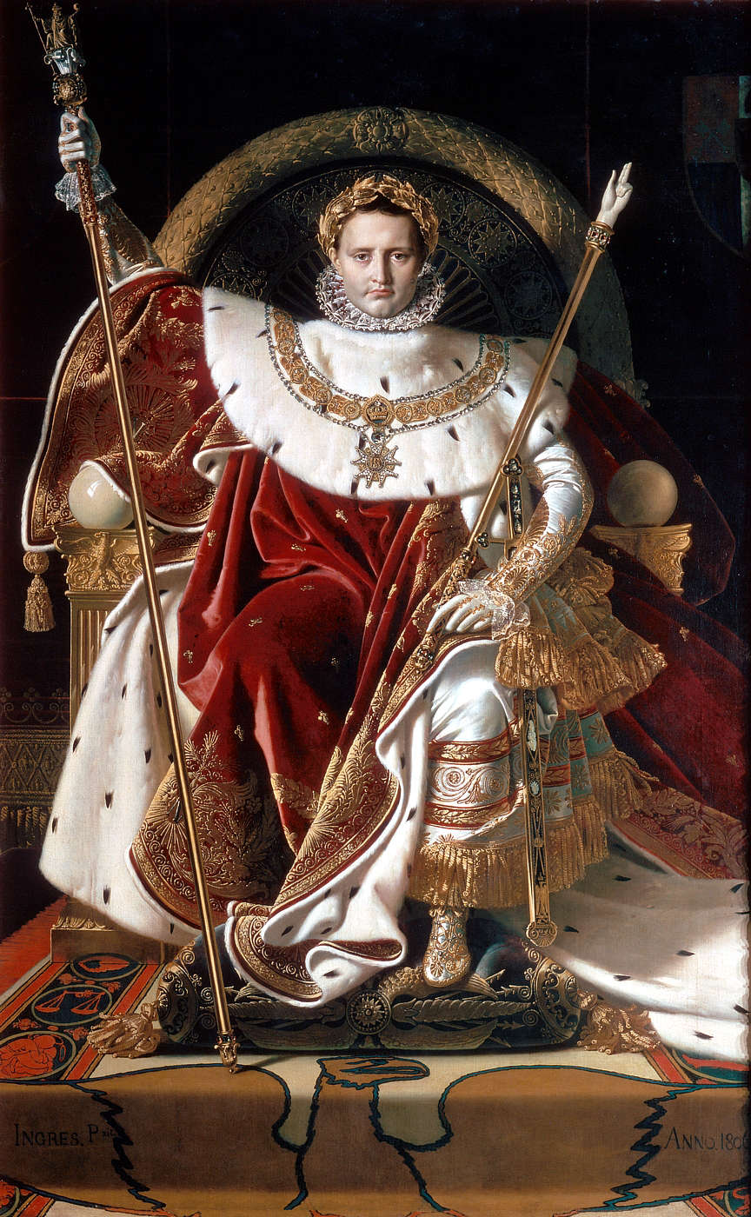
Napoleon Bonaparte

Slide 6
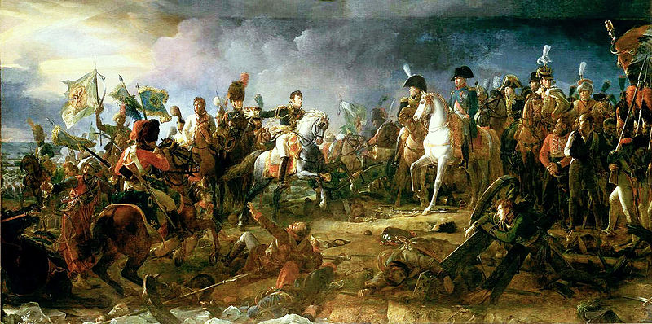
The Napoleonic Wars

Slide 7
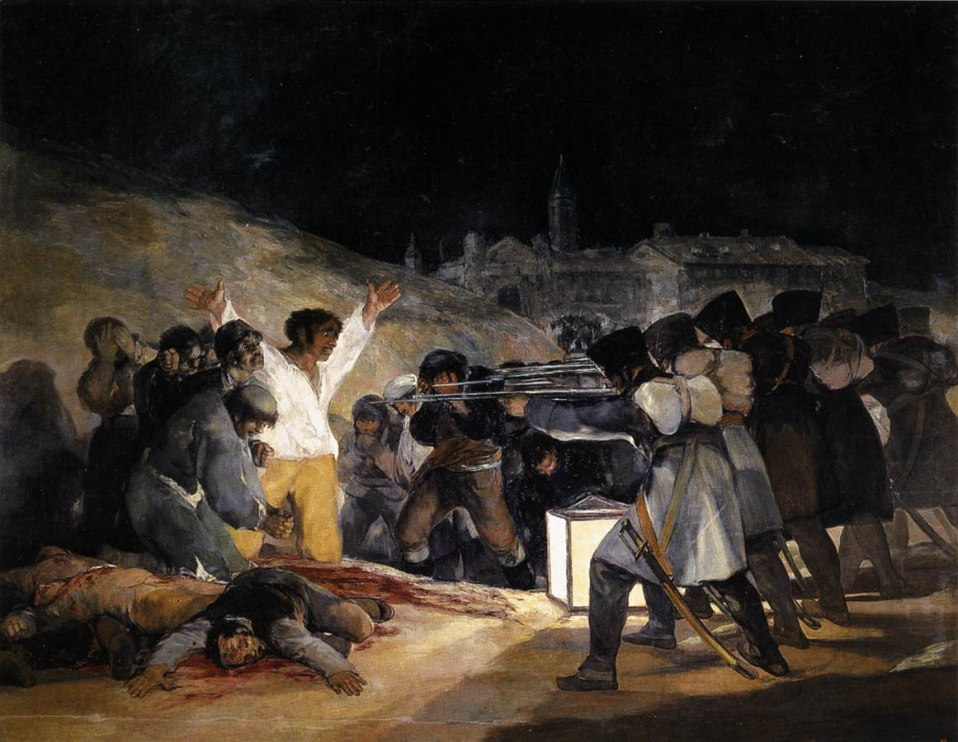

Slide 8
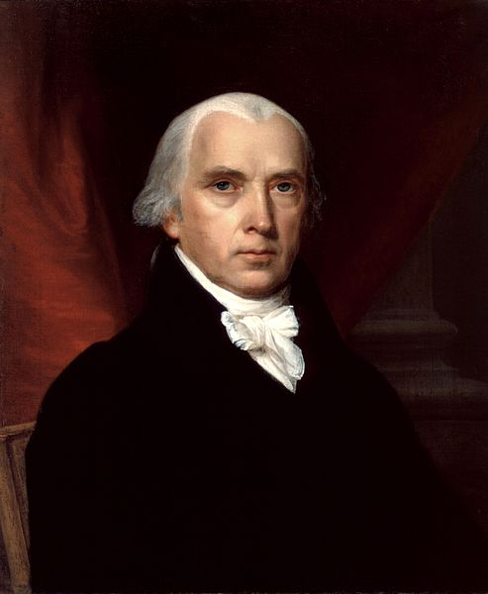

Slide 9
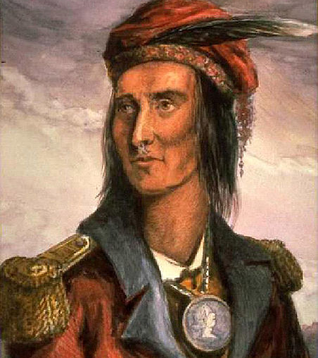
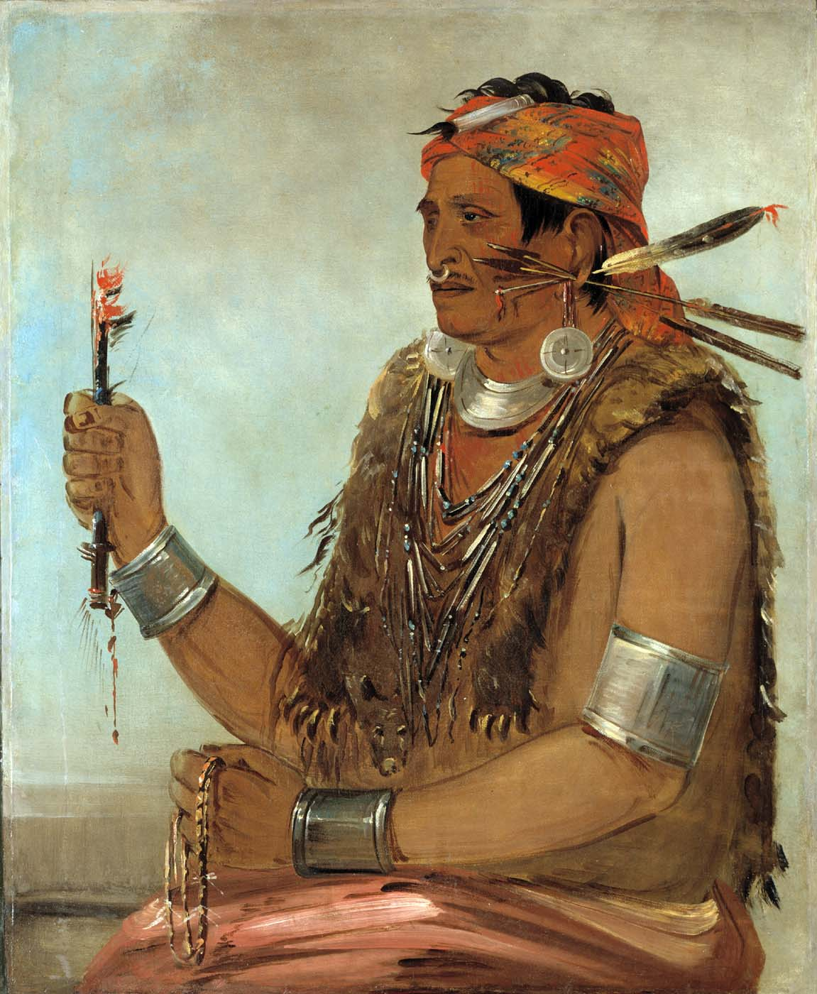
Tecumseh
Tenskwatawa,
the Prophet

Slide 10
Imperialism:
“A determination to expand geographically and economically, imposing an alien will upon subject peoples and commandeering their resources.”
--Daniel Walker Howe, What Hath God Wrought, 421
Question to consider: Although the United States was no longer a British colony, was it still a colonizing power in North America?

Slide 11
Core questions and learning objectives:
What were some of the primary causes and effects of the War of 1812?
(Standard 5d)
Causes
Atlantic causes (Napoleonic wars, impressments, trade restrictions)
Continental causes (US territorial expansion onto Indigenous lands)

Slide 12
Core questions and learning objectives:
What were some of the primary causes and effects of the War of 1812?
(Standard 5d)
Causes
Atlantic causes (Napoleonic wars, impressments, trade restrictions)
Continental causes (US territorial expansion onto Indigenous lands)
Effects
A draw between the US and Britain (1814 Treaty of Ghent)
Assault on Indigenous sovereignty; Indigenous resistance continues

Slide 13
Core questions and learning objectives:
What were some of the primary causes and effects of the War of 1812?
(Standard 5d)
→How did the War of 1812 and its aftermath intersect with Latin American independence?
How did Latin American independence shape the United States?
How does the Monroe Doctrine fit alongside a longer history of US expansion and empire?
(Standard 5e)

Slide 15
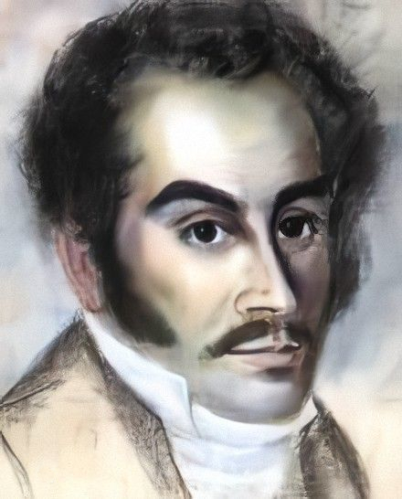
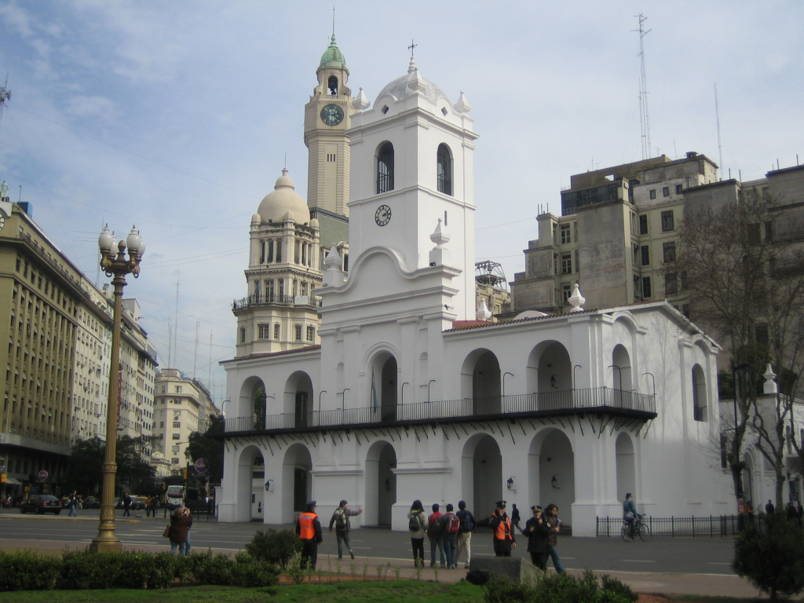
Simón Bolívar in Haiti, 1816
Buenos Aires cabildo

Slide 16
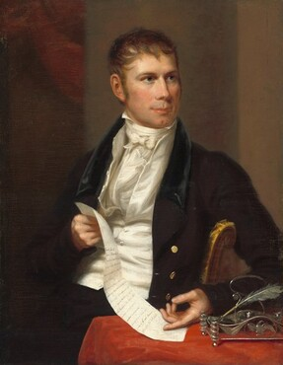
Speaker of the House Henry Clay, holding a copy of a resolution in support of Spanish American independence.
Charles Bird King, 1821, Corcoran Collection, National Gallery of Art

Slide 17
The Monroe Doctrine, 1823

Slide 18
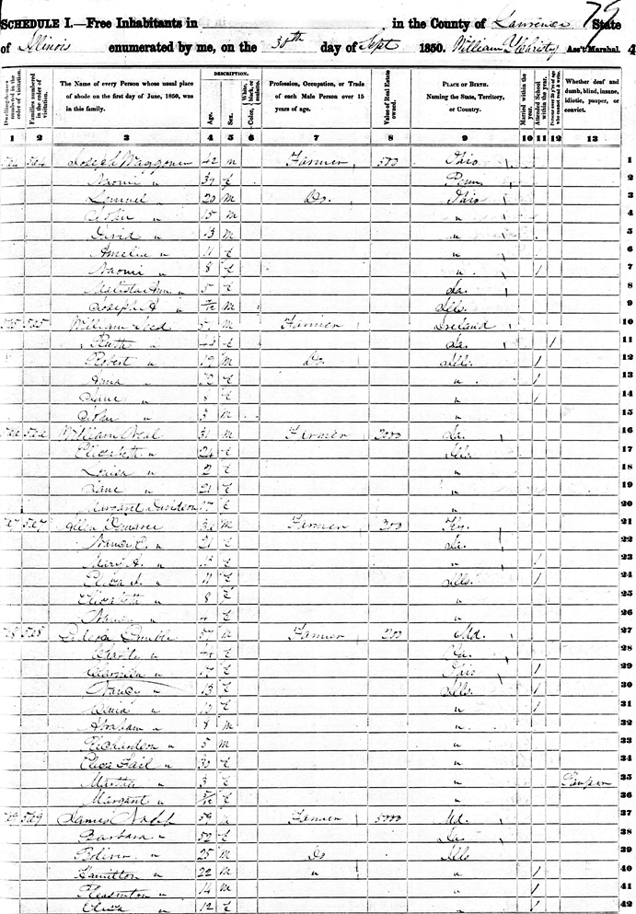
Source: Roll M432-15, p. 40a, img. 516. Avail. at www.ancestrylibrary.com.

Slide 19
Questions to consider in breakout rooms:
Who in your group has the next birthday? That person will be the group spokesperson when we reconvene as a whole group.
Please discuss:
What kind of document is this? What are you looking at?
What kind of information does this document contain? What does it tell you?
Why was this document created? How does that shape what kind of information it contains?
What kinds of questions might this enable you to answer?
Million dollar question: what does this document have to do with Latin American independence?

Slide 20
1850 Federal Census, Lawrence County, Illinois

Slide 21
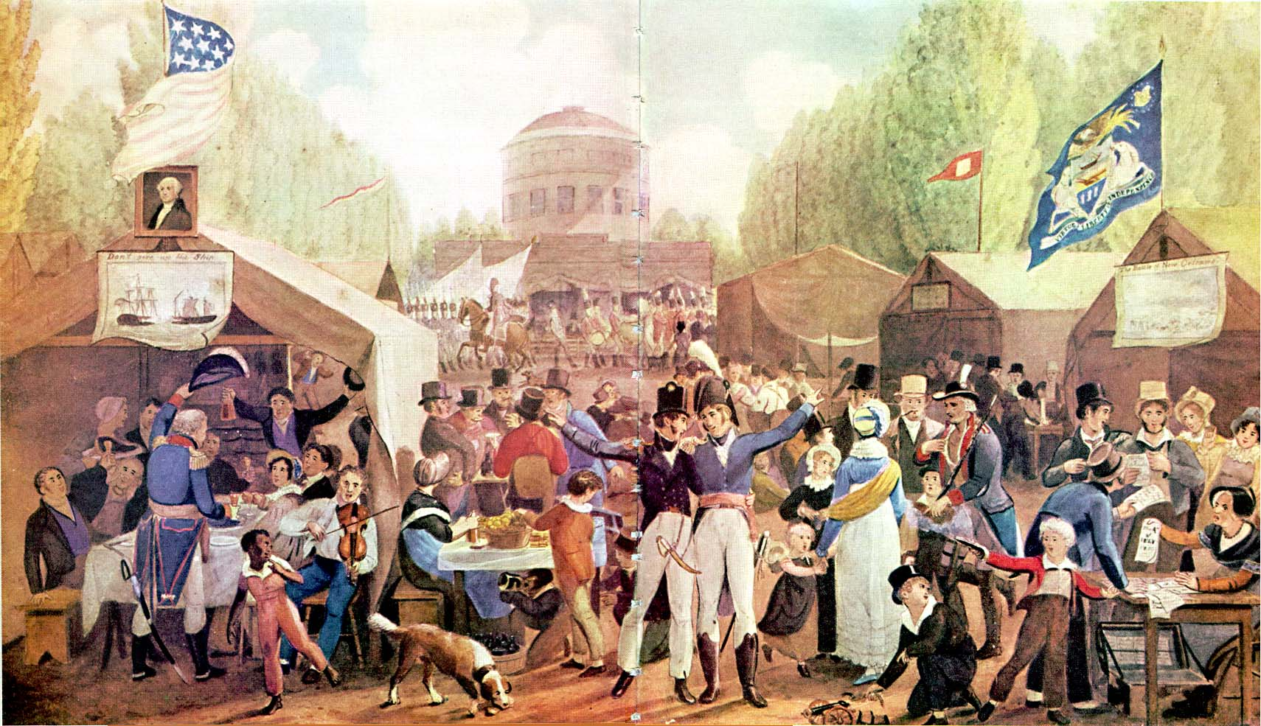
John Lewis Krimmel,
Independence Day at Center Square, 1819

Slide 22
From the Richmond Enquirer, July 8, 1825
RICHMOND CELEBRATIONS.
CAVALRY.
The Cavalry commanded by Captain Thomas Nelson, dined at Bacon Quarter Branch, with many Guests. Before Dinner the Declaration of Independence was read by Capt. Nelson; and … the following Toasts were given.
1. The fourth of July, 1776: May its returning Anniversary to the remotest time, find us in the full possession of political and religious freedom.
2. The memory of George Washington, the father of his country. Time but renders it more dear.
3. The Declaration of Independence: the talisman of freemen. The deed of American Emancipation.

Slide 23
4. The constitution of the United States: “If a more perfect union require it, let the powers of the Federal Government be extended; until they are extended, let us exercise such only as are clear and undoubted.”
5. The people: The source of all power. May this become the practical maxim of all the nations of the earth.
6. The Press: May it be always free, but never licentious.
7. The memory of the deceased officers and soldiers of the revolutionary army.
8. The University of Virginia: A monument to the genius of him who is its founder and to the liberality of the state.
9. La Fayette: This name is associated with every private virtue, and is found actively supporting liberal and free principles throughout the world: we love the man and admire and reverence the benefactor of our country.

Slide 24
10. Bolivar: The enlightened and virtuous champion of liberty. May his glory be consummated, and he be recorded in the pages of history as the equal of our Washington.
11. Our sister republics of South America: they have bravely fought and gallantly conquered. May they long enjoy the blessings of their free institutions.
12. Greece, suffering Greece! May the energy, union and virtue of her sons restore her to those inalienable rights of which she has been so long deprived.
13. Our fair countrywomen.
VOLUNTEERS.
… By P. V. Danish The march of freedom; may it be coextensive with the earth and durable as time.
By Judge Carr: Buzzarie, the Grecian hero,--he fell in the arms of Victory; and his last words were, ‘it is pleasant to die for freedom.”
… By Mr. McDonough: The American people.
Too proud to be oppressed, Too wise to be deluded,
Too honest to be corrupted, Too brave to be subdued.

Slide 25
July Fourth Toasts to Hemispheric Independence N = 895

Slide 26
Resources:
PBS documentary: We Shall Remain: Tecumseh’s Vision
(2009; also consider the other episodes in this five-part series for American history courses)
Jay Sexton, The Monroe Doctrine: Empire and Nation in Nineteenth-Century America (2011)
Daniel Walker Howe, What Hath God Wrought: The Transformation of America, 1815-1848 (2007)
Caitlin Fitz, Our Sister Republics: The United States in an Age of American Revolutions (2016)

