Slide 1
Implementing Oral Histories
Harnessing the spoken word as history and memory in the Humanities classroom.
Notes:
Us!

Slide 2
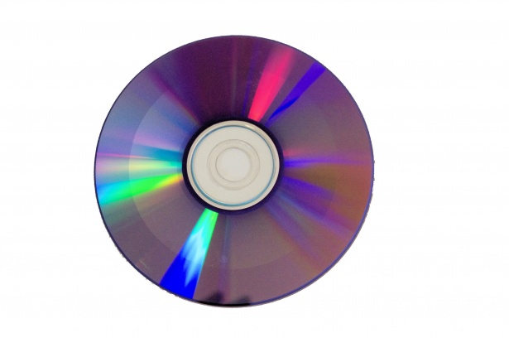
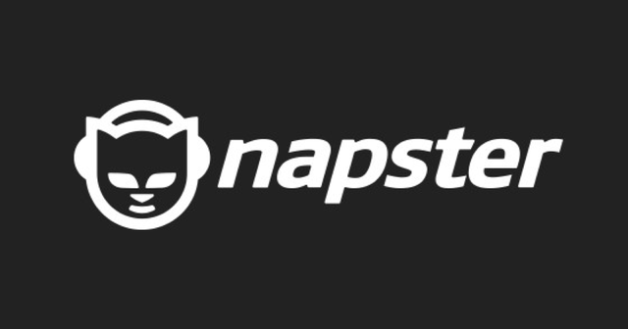
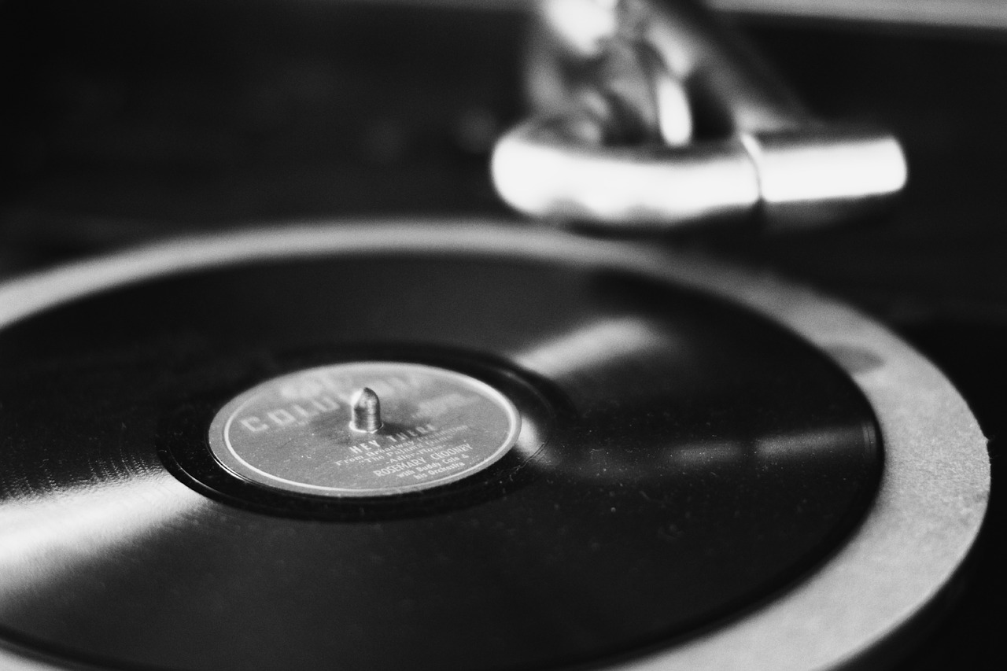
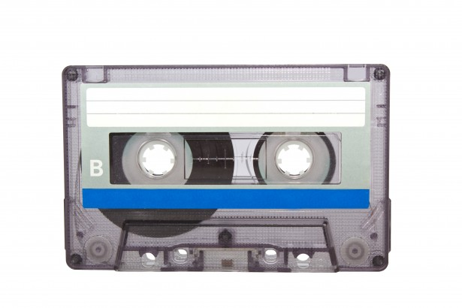
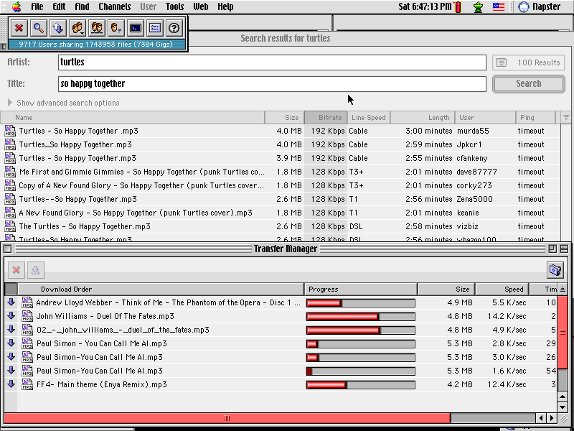
Warm Welcome
How do you remember first listening to music?
2 minutes, in the chat!

Slide 3
Oral Histories In the Classroom
REVIEW: if needed
Utilizing
Oral histories can serve as powerful primary sources when studying history.
Oral histories provide first-hand accounts of important events and time periods; events in which the narrator participated or witnessed.
Oral histories can deepen our understanding of how the past has impacted individuals and communities, as well as help shape our perspectives on the present.
Creating
Oral history can be adapted to many different types of projects, from family history, to personal narratives or memoir, to academic research.
Creating or collecting oral histories is a great opportunity for students to explore their identity and connect with others.
Collecting oral histories allows a unique experience: a moment for students to perhaps learn more about their community, family, or culture.

Slide 4
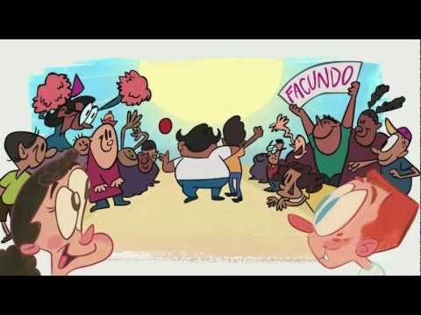
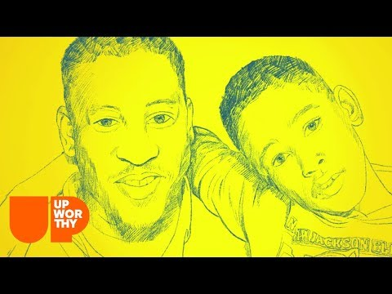
Animated Storycorps Excerpts
What is special about these stories? How do you think it feels to have your history or memories recorded (forever)?
How might this project help your students feel better connected to the classroom?

Slide 5
Families & Communities as ‘Funds of Knowledge*’
‘Funds of knowledge’ is basically the idea that all knowledge and strengths do not come from the same place.
Traditional knowledge = being good at school (which is great and fine… and why many of us become teachers).
Funds of knowledge are the historically accumulated and culturally developed bodies of knowledge and skills essential for household or individual functioning and well-being. See, Dad? Grad school was worth it.
Our unique life experiences, cultural backgrounds, family histories, and community identities provide us with differing ‘funds of knowledge.’ We want to tap into that with this project.
*Gonzalez, Moll, Amanti OG authors

Slide 6
StoryCorps Collections Links:
Celebrating AAPI Voices
Celebrating Hispanic Heritage Month
LGBTQ+ Voices to Honor this Pride Month
Stories to Celebrate Black History Month
Voices to Celebrate Women’s History Month
Voices to Honor for Indigenous Peoples’ Day
Bonus: Take Storycorps collections further!
(Ethnic Studies Classroom)
How can using these stories to uplift our historically (& currently) marginalized communities and have an impact in our classrooms?
How can we help foster identity-safe spaces with these stories?
What message does it send to our students about belonging in our classrooms?

Slide 7
Resources
The Great Thanksgiving Listen - Storycorps (Everything you need to implement this project in your classroom!)
Connecting the Past to Present with Oral History - Facing History (A lesson plan for utilizing oral history)
How to Do Oral History - The Smithsonian
Storycorps Project playlist of videos
Oral History Association
Feeling Radical? - Worship of the Written Word (Tema Okun)
Notes:
Holly

