Slide 1
Civil Rights, LBJ, and the Great Society
William P. Jones, University of Minnesota

Slide 2
“Everything’s in a state of suspension for the moment. The bullet that killed Kennedy paralyzed the civil rights drive.”
NAACP leader Roy Wilkins, November 25, 1963

Slide 3
“I had my first lessons in the high price we pay for poverty and prejudice right here.”
LBJ, Cotulla, TX, 1965

Slide 5
Johnson “made it very clear that he feels the fight on poverty and illiteracy is a vital part of the fight on discrimination,” James Farmer, CORE

Slide 6
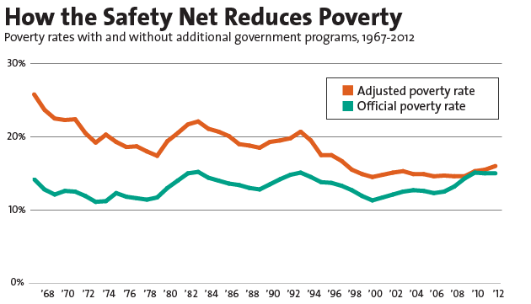
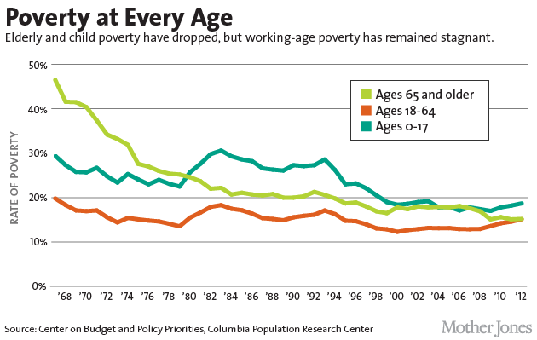
“The Federal Government declared war on poverty, and poverty won.” President Ronald Reagan, 1988
“Based on historical standards of material wellbeing and the terms of engagement, our War on Poverty is largely over and a success.” Council of Economic Advisors, 2018

Slide 7
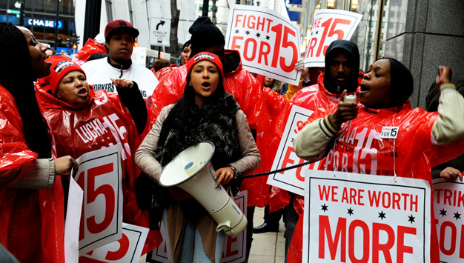
Ellora Derenoncourt and Claire Montialoux, “Minimum Wages and Racial Inequality,” The Quarterly Journal of Economics, 136: 1, (February 2021)
“The 1967 extension of the minimum wage can explain more than 20% of the reduction in the racial earnings and income gap during the civil rights era. Our findings shed new light on the dynamics of labor market inequality in the United States and suggest that minimum wage policy can play a critical role in reducing racial economic disparities.”

