Slide 1
U.S. Population (Millions)

Slide 2
Median Age of U.S. Population (Years)

Slide 3
U.S. Population Age Distribution

Slide 4
Life Expectancy at Birth in U.S. (Years)

Slide 5
Percent of Women in U.S. Workforce

Slide 6
Percent of Married Women in U.S. Workforce

Slide 8
Legal Immigration to U.S. By Region (Millions)

Slide 9
Foreign Born Percent of U.S. Population

Slide 10
Racial Composition of U.S. Population
1930
2008
*No Separate Census Category for Hispanic Ancestry

Slide 11
Urban Percent of U.S. Population

Slide 12
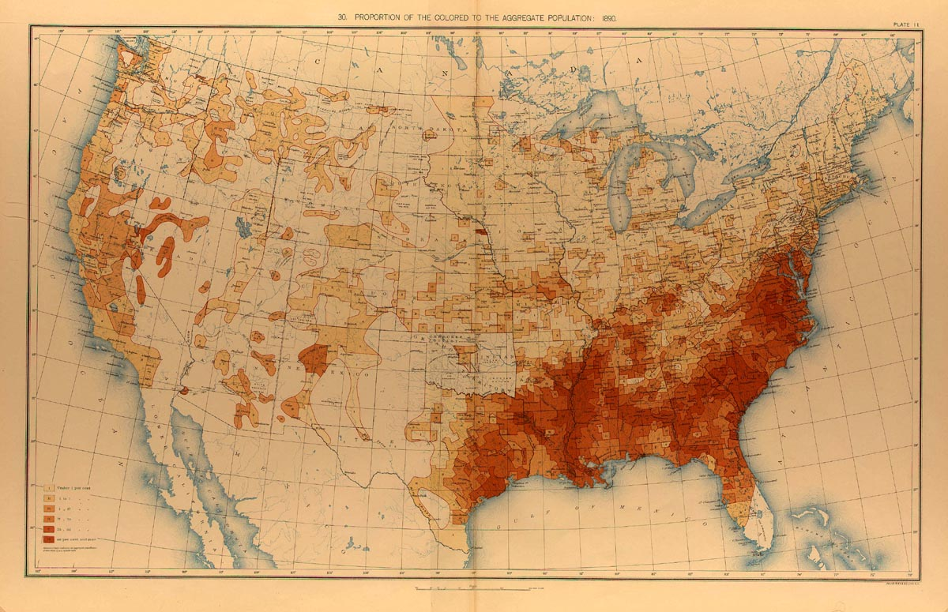

Slide 13
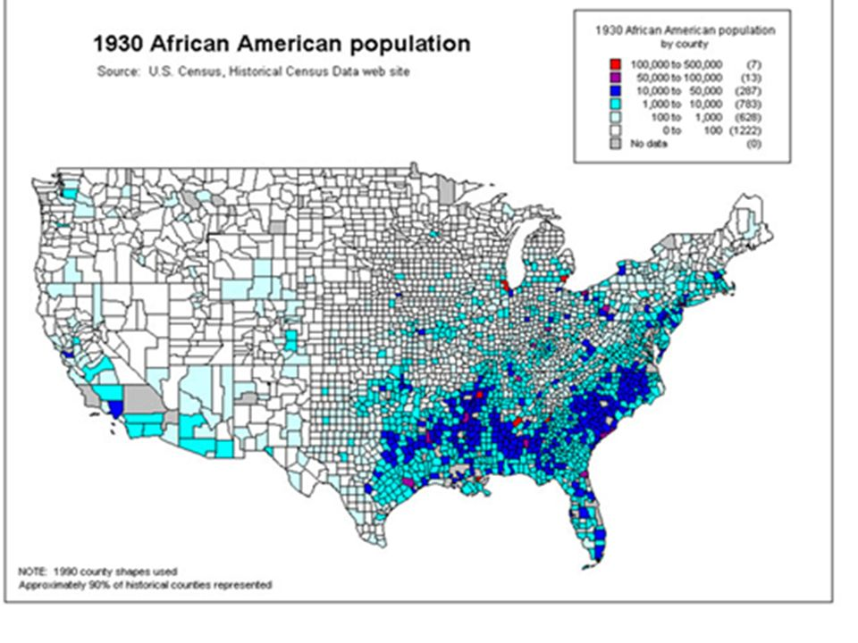

Slide 14
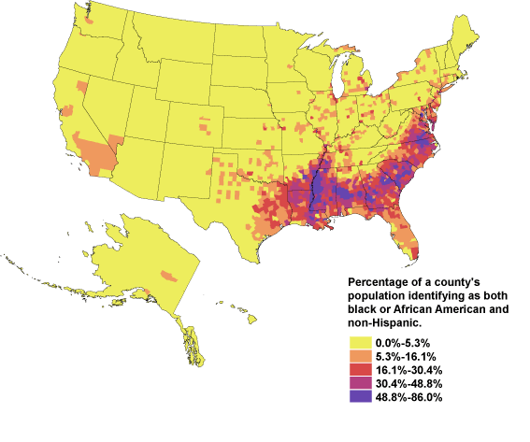
Distribution of Black Population 2000

Slide 15
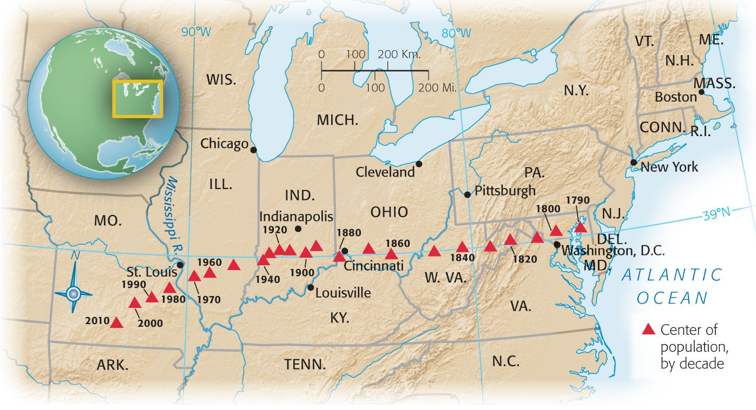

Slide 16
Ten Largest American Cities
Rank | 1900 |  | 1930 |  | 2007
1 | New York, NY | 3,437,202 | New York, NY | 6,930,446 | New York, NY | 8,274,527
2 | Chicago, IL | 1,698,575 | Chicago, IL | 3,376,438 | Los Angeles, CA | 3,834,340
3 | Philadelphia, PA | 1,293,697 | Philadelphia, PA | 1,950,961 | Chicago, IL | 2,836,658
4 | St. Louis, MO | 575,238 | Detroit, MI | 1,568,662 | Houston, TX | 2,208,180
5 | Boston, MA | 560,892 | Los Angeles, CA | 1,238,048 | Phoenix, AZ | 1,552,259
6 | Baltimore, MD | 508,957 | Cleveland, OH | 900,429 | Philadelphia, PA | 1,449,634
7 | Cleveland, OH | 381,768 | St. Louis, MO | 821,960 | San Antonio, TX | 1,328,984
8 | Buffalo, NY | 352,387 | Baltimore, MD | 804,874 | San Diego, CA | 1,266,731
9 | San Francisco, CA | 342,782 | Boston, MA | 781,188 | Dallas, TX | 1,240,499
10 | Cincinnati, OH | 325,902 | Pittsburgh, PA | 669,817 | San Jose, CA | 939,899

Slide 17
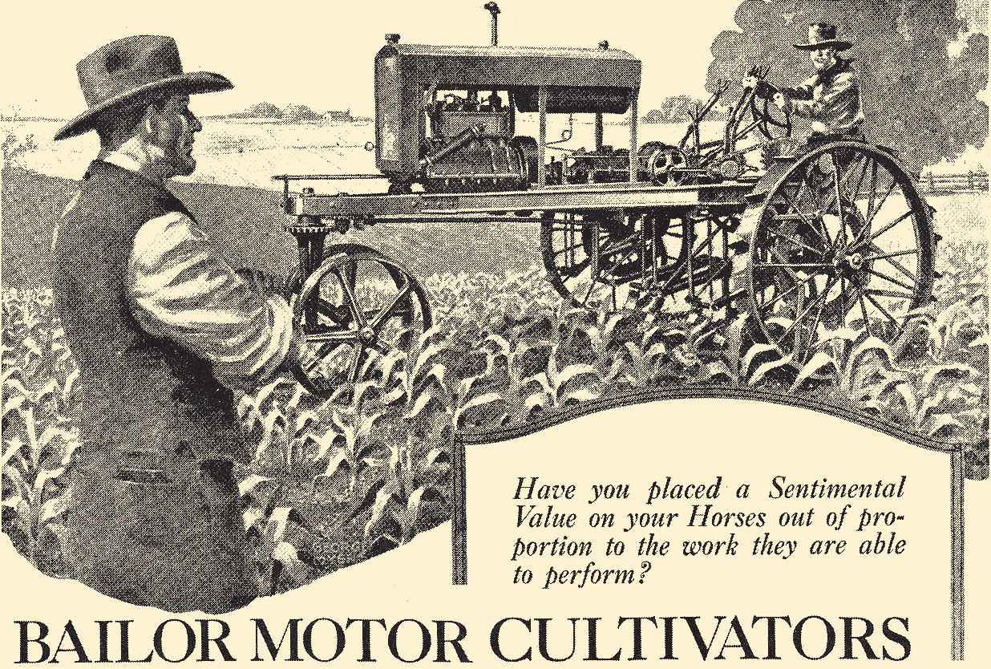
Mechanizing Agriculture

Slide 18
Percent U.S. Labor Force in Agriculture, 1900-1960

Slide 19
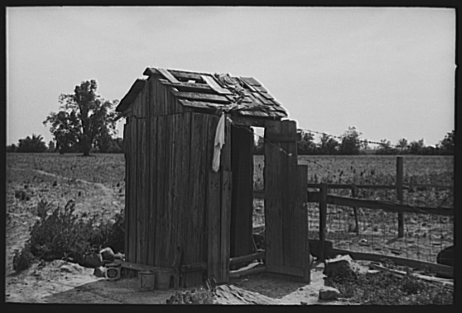
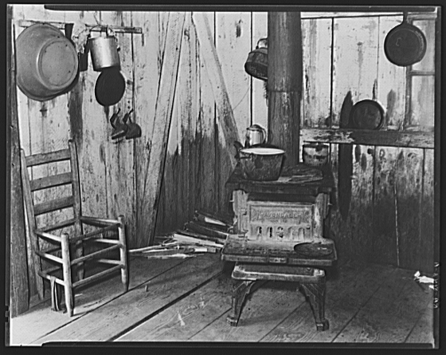
Rural Lack of Modern Conveniences, 1930s

Slide 20
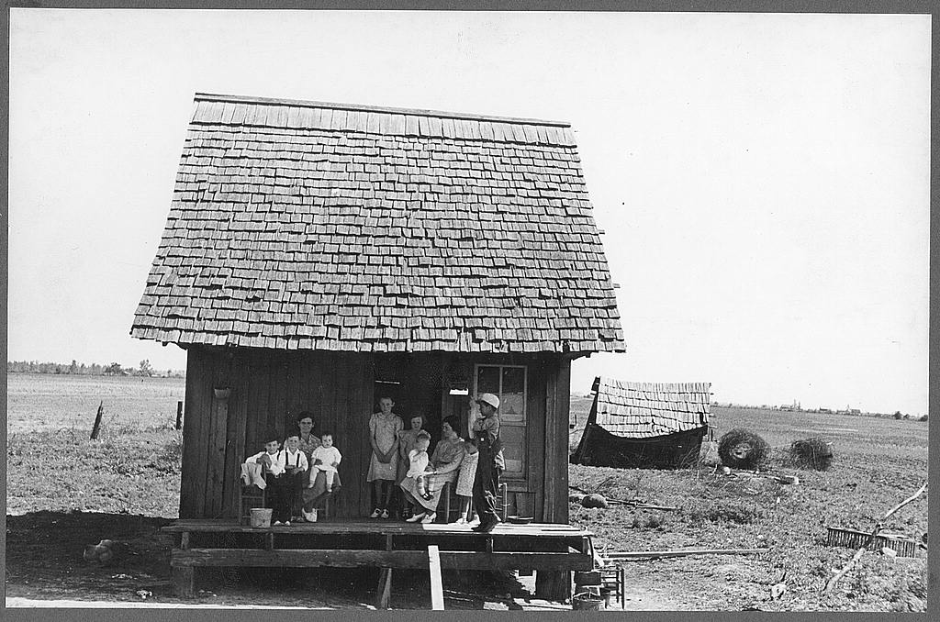
Missouri Homestead, 1938, by Russell Lee

Slide 21
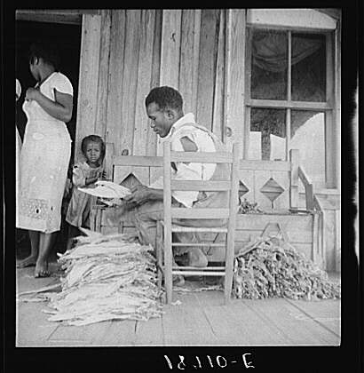
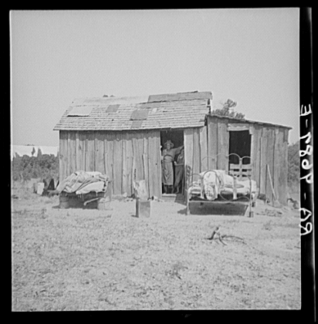
Sharecropper Life, 1930s, by Dorthea Lange
Georgia
Oklahoma

Slide 22
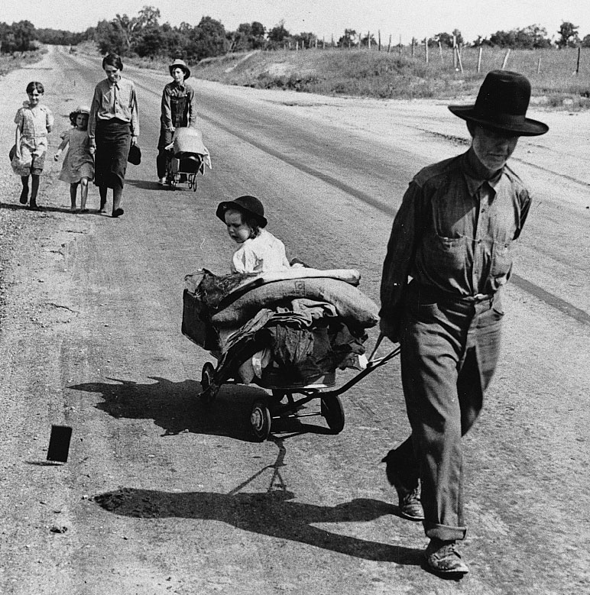
An Okie Family Hits the Road, 1930s

Slide 23
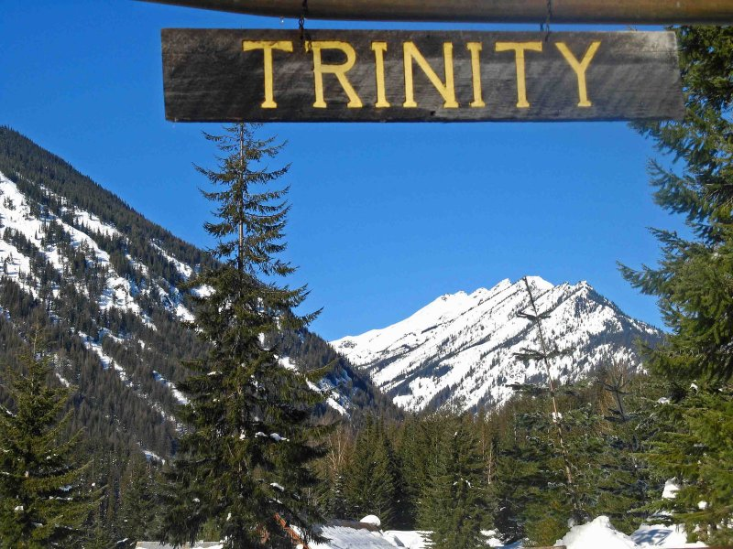

Slide 24
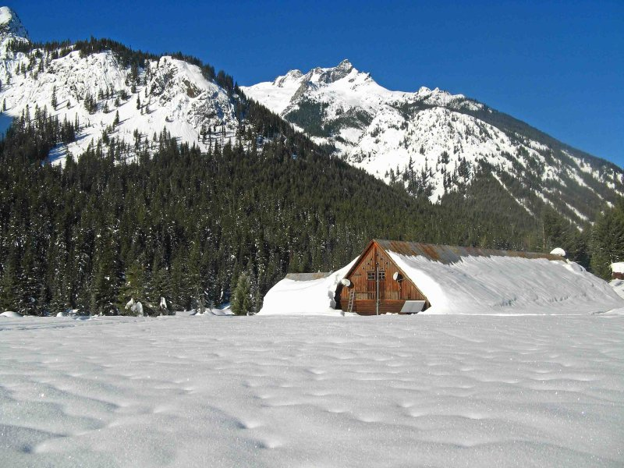

Slide 29
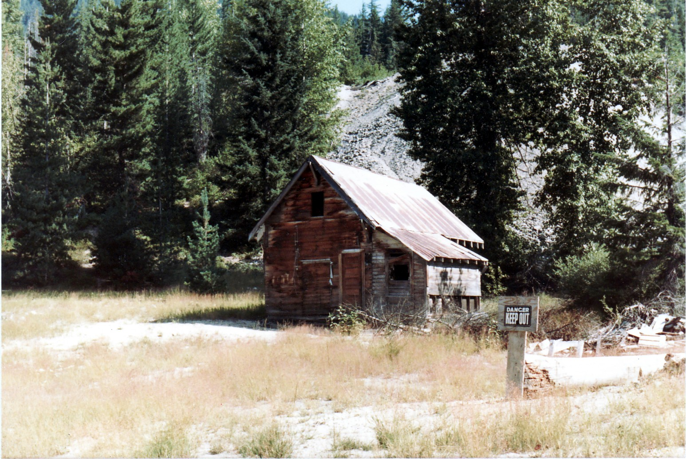

Slide 30
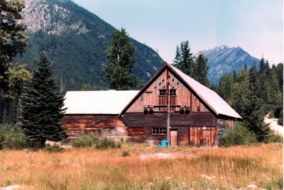

Slide 31
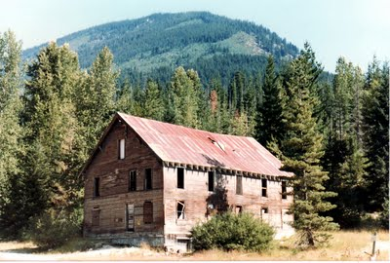

Slide 32
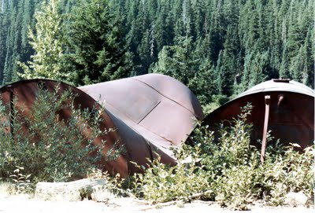

Slide 35
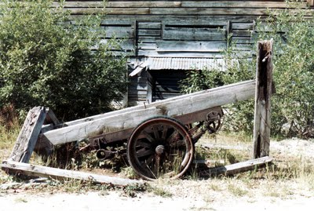

Slide 36
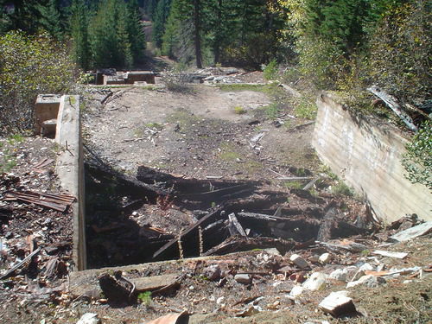
Stamping Mill Foundation, Trinity

Slide 37
Oil Tanks, Trinity

Slide 38
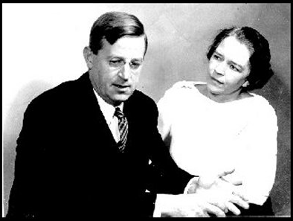
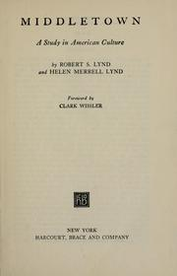
Robert and Helen Lynd

Slide 39
Total Government Spending as Percent of GDP

Slide 40
Federal Budget as Percent of GDP

Slide 41
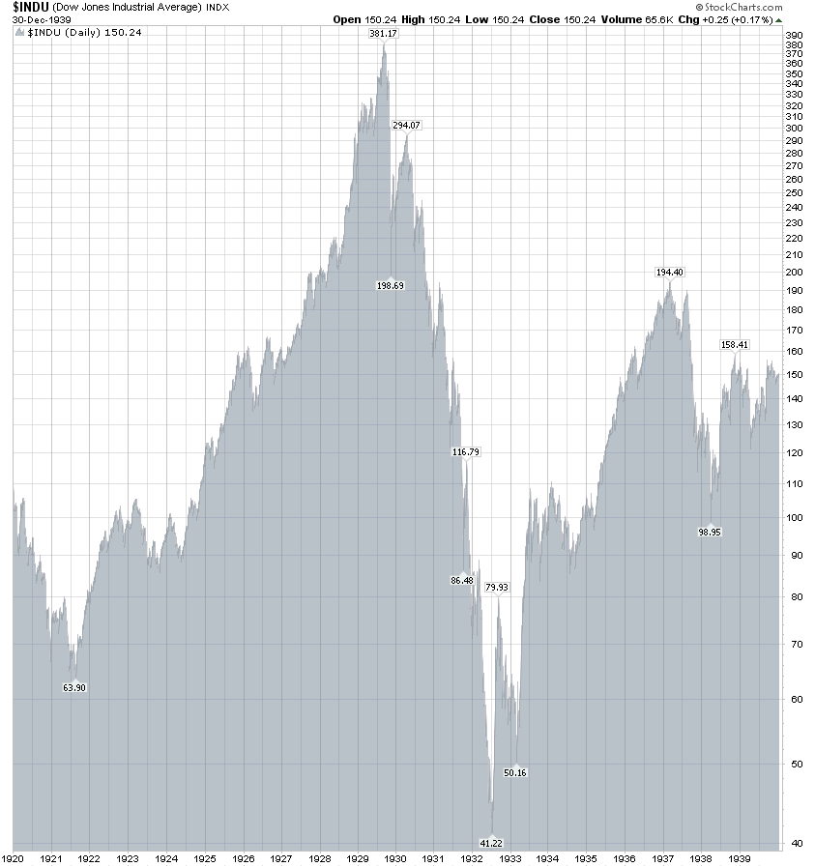
Dow Jones Industrial Average Index, 1920-1940

Slide 43
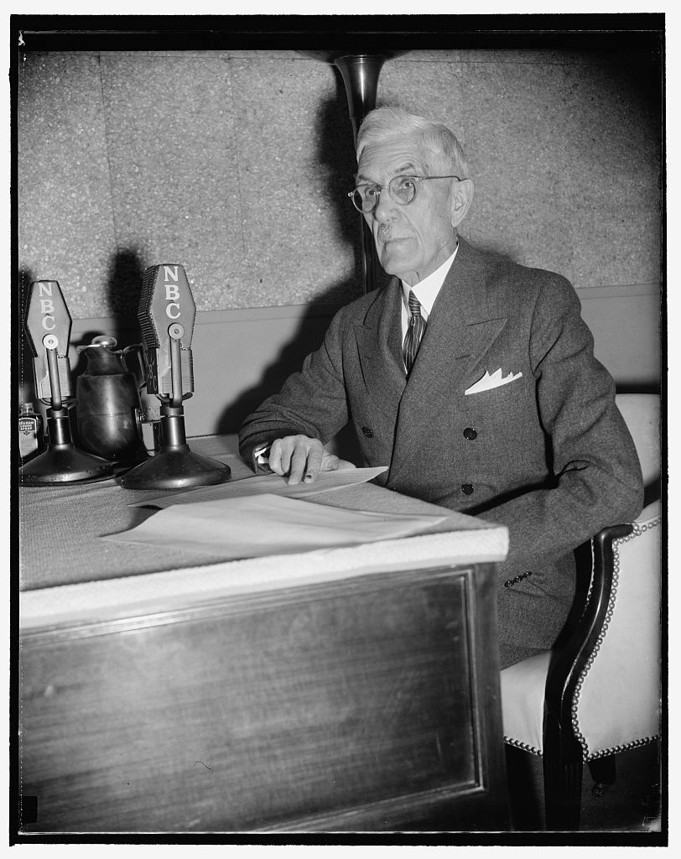
Dr. Francis Townsend (1867-1960)

Slide 44
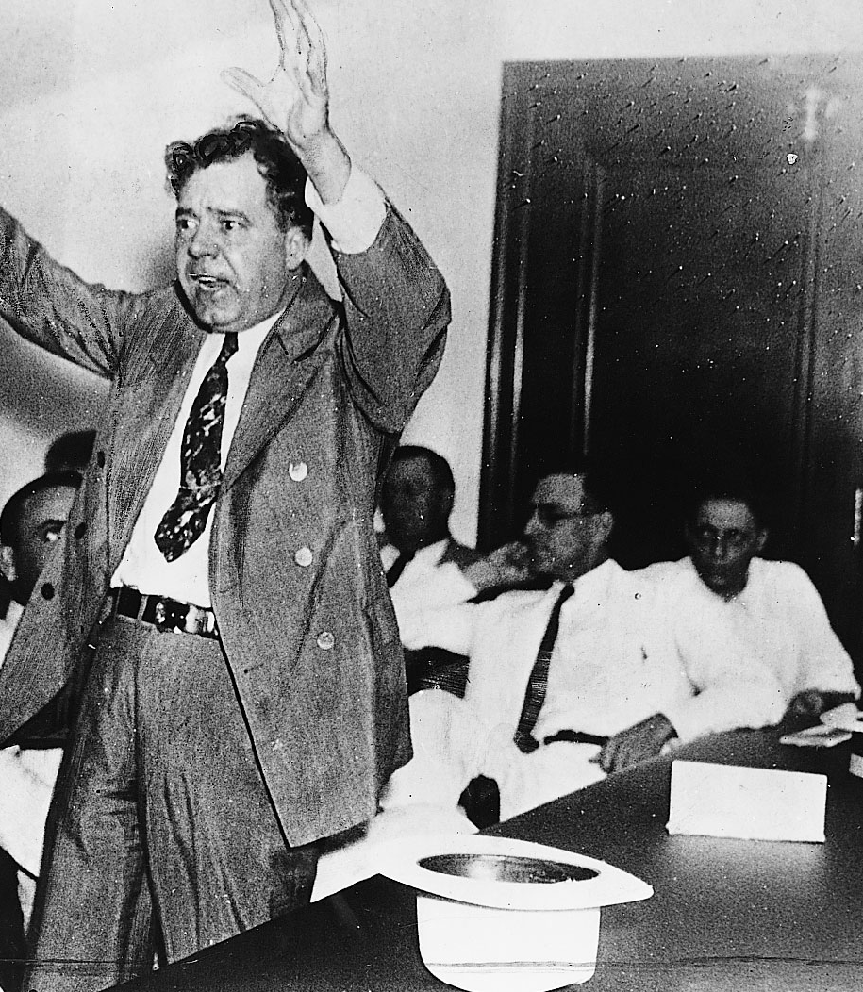
Huey Long (1893-1935)

Slide 45
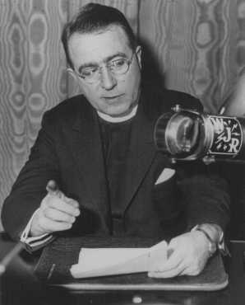
Father Charles E. Coughlin (1891-1971)

Slide 46
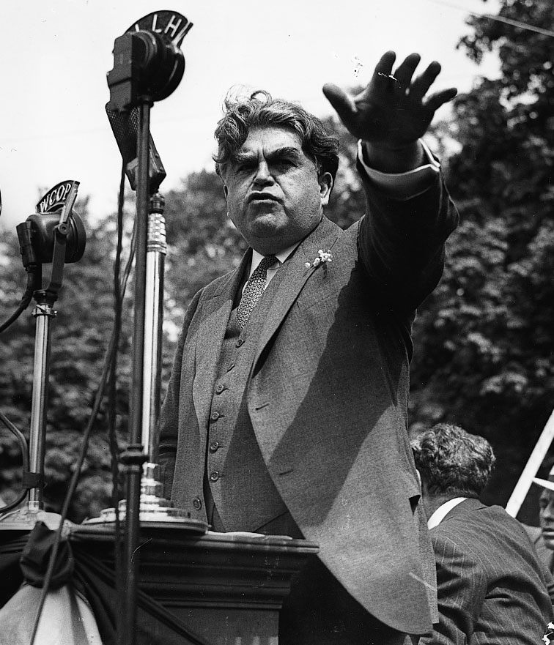
John L. Lewis Inciting Textile Workers to Strike, 1937

Slide 47
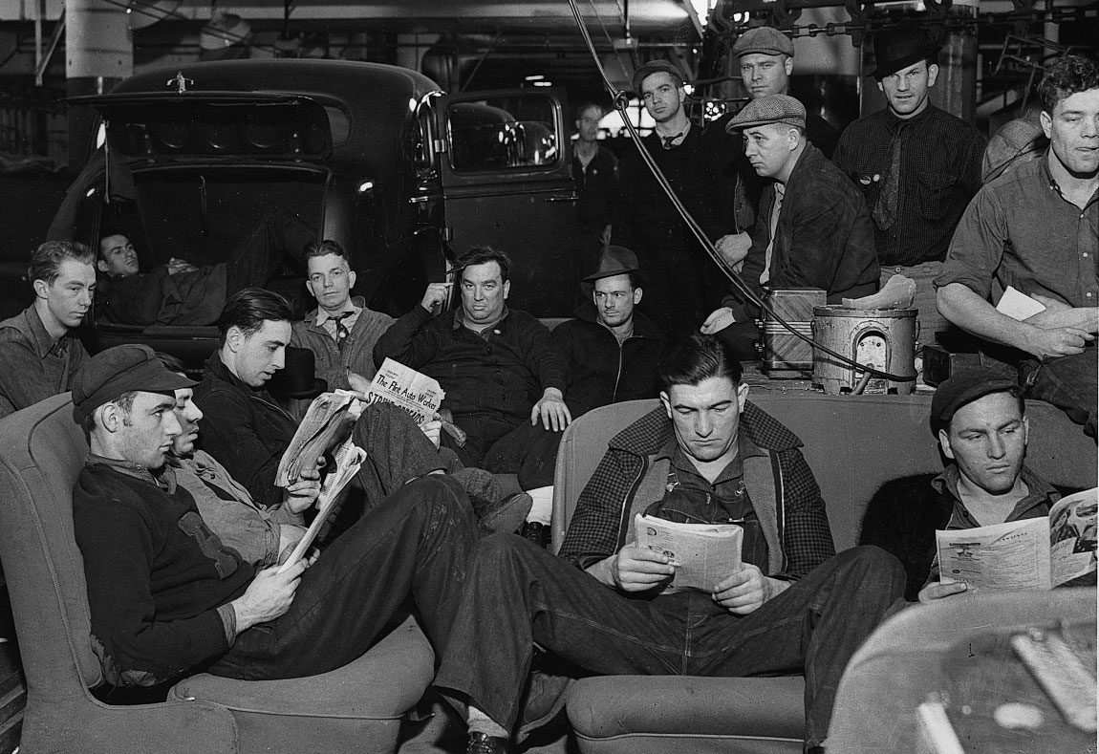
General Motors Strikers, Flint, Michigan, 1937

Slide 48
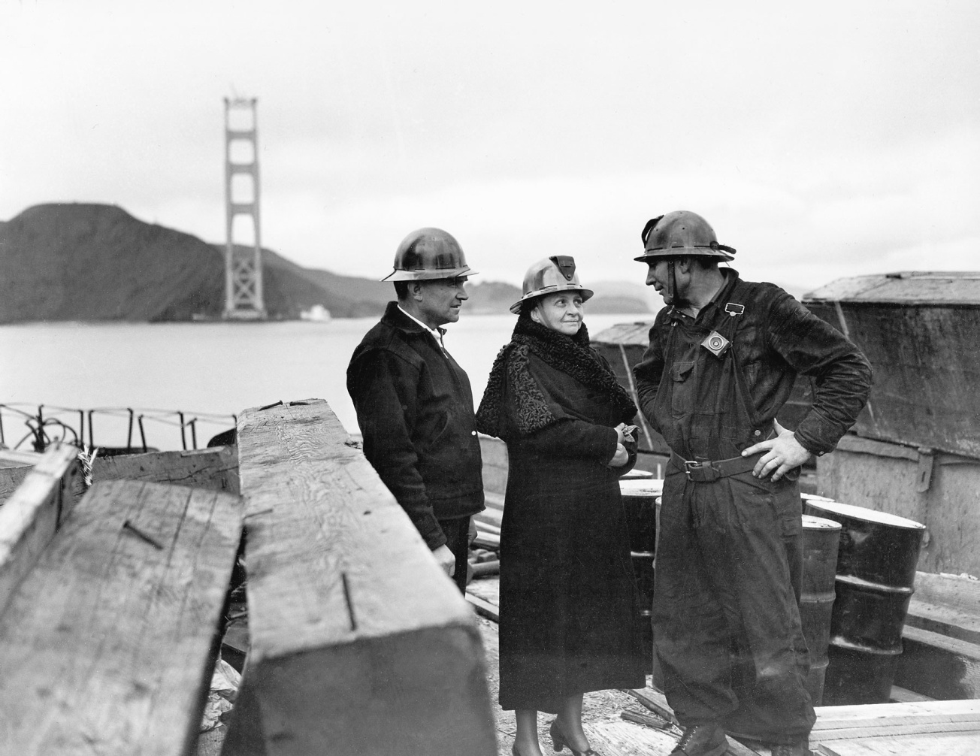
Francis Perkins at the Golden Gate Bridge Project Site, 1935

Slide 49
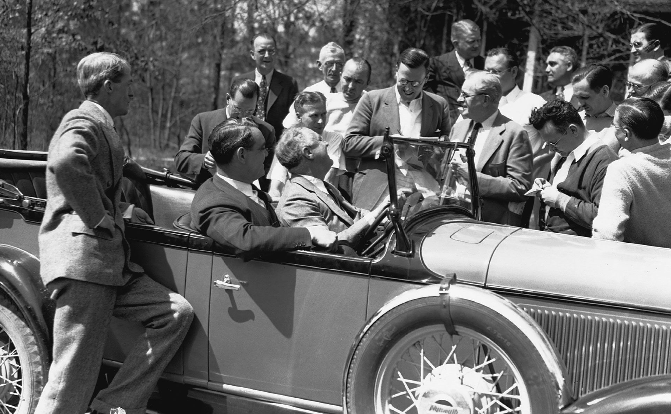
The Champ: FDR Chatting with Reporters

Slide 50
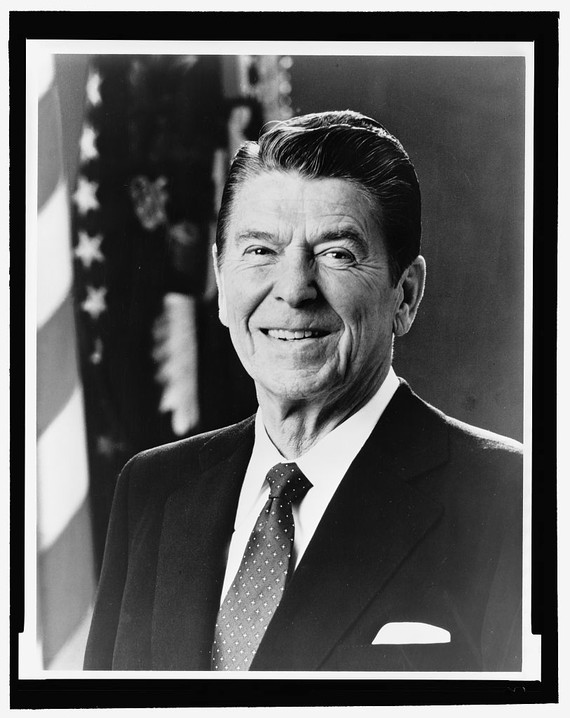
Ronald Reagan (1911-2004)

