Slide 1
Inventing the Court: John Marshall and the Creation of Judicial Nationalism
Joseph F. Kobylka
Altshuler Distinguished Teaching Professor Associate Professor of Political Science Southern Methodist University
jkobylka@smu.edu
Prepared for delivery at the Humanities Texas Teacher Workshop
19 June 2020

Slide 2
The
Judiciary’s
Home
in the
Constitution
https://www.archives.gov/founding-docs/downloads

Slide 3
Mapping the Constitution’s Parts
Snagged from Charles (Charlie) Flannigan, “Teaching 6 Big Ideas in the Constitution”
https://www.archives.gov/legislative/resources/education/constitution

Slide 4
Article III – The Judicial Article
Section 1
The judicial Power of the United States, shall be vested in one supreme Court, and in such inferior Courts as the Congress may from time to time ordain and establish. The Judges, both of the supreme and inferior Courts, shall hold their Offices during good Behaviour, and shall, at stated Times, receive for their Services, a Compensation, which shall not be diminished during their Continuance in Office.

Slide 5
Article III – Establishing Federal Courts
Section 1
The judicial Power of the United States, shall be vested in one supreme Court, and in such inferior Courts as the Congress may from time to time ordain and establish.
Judiciary Act of 1789
Established 12 Federal District Courts
Section 25
Today 94 Federal District Courts with 673 Judges
Judicary Act of 1891
Established 9 Federal Courts of Appeals
Today 12 with 179 Judges

Slide 6
Article III – Establishing Judicial Power
Section 2
The judicial Power shall extend to all Cases, in Law and Equity, arising under this Constitution, the Laws of the United States, and Treaties made, or which shall be made, under their Authority;--to all Cases affecting Ambassadors, other public Ministers and Consuls;--to all Cases of admiralty and maritime Jurisdiction;--to Controversies to which the United States shall be a Party;--to Controversies between two or more States;--between a State and Citizens of another State;--between Citizens of different States;--between Citizens of the same State claiming Lands under Grants of different States, and between a State, or the Citizens thereof, and foreign States, Citizens or Subjects.
In all Cases affecting Ambassadors, other public Ministers and Consuls, and those in which a State shall be Party, the supreme Court shall have original Jurisdiction. In all the other Cases before mentioned, the supreme Court shall have appellate Jurisdiction, both as to Law and Fact, with such Exceptions, and under such Regulations as the Congress shall make.
The Trial of all Crimes, except in Cases of Impeachment; shall be by Jury; and such Trial shall be held in the State where the said Crimes shall have been committed; but when not committed within any State, the Trial shall be at such Place or Places as the Congress may by Law have directed.

Slide 7
So What Made the Supreme Court Supreme?
Article III, §1 – “The judicial Power of the United States, shall be vested in one supreme Court…
Article VI, ¶ 2 – “This Constitution, and the Laws of the United States which shall be made in Pursuance thereof; and all Treaties made, or which shall be made, under the Authority of the United States, shall be the supreme Law of the Land; and the Judges in every State shall be bound thereby, any Thing in the Constitution or Laws of any State to the Contrary notwithstanding.”
Federalist Seventy-Eight - “The complete independence of the courts of justice is peculiarly essential in a limited Constitution. By a limited Constitution, I understand one which contains certain specified exceptions to the legislative authority; such, for instance, as that it shall pass no bills of attainder, no ex-post-facto laws, and the like. Limitations of this kind can be preserved in practice no other way than through the medium of courts of justice, whose duty it must be to declare all acts contrary to the manifest tenor of the Constitution void. Without this, all the reservations of particular rights or privileges would amount to nothing.”

Slide 8
Why Focus on John Marshall?
Great Chief Justice
Great Constitutional Force
Great creator and steward (though at times unenthusiastic and reactive) of the role of the Court
PBS, The Supreme Court, “One Nation Under Law”
Lesson Plans
Discussion Guide

Slide 9
Encapsulating Themes
Constitutional
Judicial Power
National Supremacy
Property Rights
Political
Judicial Politics (Politics of Separation of Powers)
Judicial Reality (The Limits of Judicial Power)

Slide 10
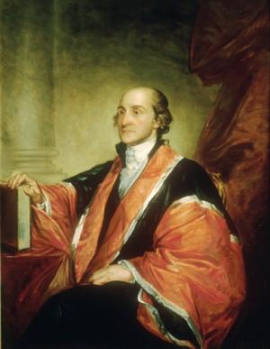
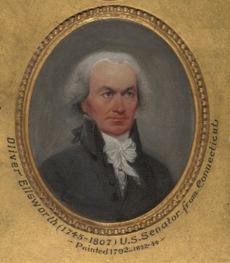
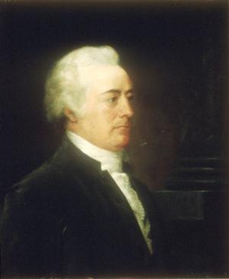
For the Court: An Inauspicious, Non-Supreme Beginning
No Formal “Office”
Three CJ’s in ten years
Justices Largely “Riding Circuit”
Chisholm v. Georgia (1793) &
Eleventh Amendment
John Jay to John Adams (1800): “The Court will never have the energy, weight, and dignity needed to be a co-equal institution of the national government.”
… until …

Slide 11
The “Revolution of 1800”
Jefferson Elected President
Republicans Capture House and Senate
Chief Justice Ellsworth Resigns
On the Way Out the Door, President Adams and the Federalists
Pass Judiciary Act of 1801
Make “Midnight Appointments”
Nominate/Confirm Chief Justice Marshall
Jeffersonian Republicans Respond
Pass Judiciary Act of 1802
Cancel 1802 Term of the Supreme Court
Refuse to Deliver Some Judicial Commissions

Slide 12
Federalists Fight from the Bench
Context: Tension with Jeffersonians
Federalist Political & Constitutional Goals
Nurturing of Judicial Power (Supremacy)
Facilitation of Broad National Power
Protection of Property Rights
Reinforcing Goals, but necessary to their achievement:
Judicial Power
Judicial Review
Contemporary Relevance: Still Dimensions of Debate to This Day

Slide 13
Goal #1: Judicial Power
The Concept of Judicial Review
Precursors to Judicial Review
Not Part of English Constitutional Law
State Constitutions and Courts
Federalist Seventy-Eight
Hylton v. U.S. (1796)
The Constitution (Article III)
Silent
Congressional Establishment of Federal Court System:
The Judiciary Act of 1789
Section 13: Authorizes the Supreme Court "to issue writs of mandamus, in cases warranted by the principles and usages of law, to any courts appointed, or persons holding office, under the authority of the United States."”

Slide 14
Goal #1: Judicial Power
Marshall’s Jurisprudential Genius: Marbury v. Madison (1803)
Facts of the Case
Disposition of Issues
The Judicial/Constitutional Hammer
“It is emphatically the province and duty of the judicial department to say what the law is. Those who apply the rule to particular cases, must of necessity expound and interpret that rule. If two laws conflict with each other, the courts must decide on the operation of each.”
“Between these alternatives there is no middle ground. The constitution is either a superior, paramount law, unchangeable by ordinary means, or it is on a level with ordinary legislative acts, and like other acts, is alterable when the legislature shall please to alter it…. If then the courts are to regard the constitution; and the constitution is superior to any ordinary act of the legislature; the constitution, and not such ordinary act, must govern the case to which they both apply.”

Slide 15
Goal #1: Judicial Power
Marshall’s Political Genius
Rendering a Decision that Couldn’t be Disobeyed
Create a Power
Create a Precedent from which to Build
Avoid “Emperor Has No Clothes” Problem
Jefferson Outraged: Departmental Theory of Constitutional Interpretation
Chase Impeachment Attempt
Marshall Response: Stuart v. Laird (1803)

Slide 16
Goal #1: Judicial Power
Marbury Creates the Basis of the Court’s Power
Limit Governmental Power
Legitimate Governmental Power – the “Double Negative”
Extended Over State Legislation and Judicial Decisions
Section 25 of the 1789 Judiciary Act
Martin v. Hunter’s Lessee (1816)
Cohens v. Virginia (1821)

Slide 17
Goal #2: National Supremacy
Remember Context of Marshall’s Appointment: What to do with Judicial Power?
Jeffersonians vs. Federalists
Source of Sovereignty
States (Jeffersonians)
People (Federalists)
Scope of National Power
Narrow (Jeffersonians)
Broad (Federalists)
Interpretation of Constitutional Powers
Textual (Jeffersonians)
Extra-Textual (Federalists)

Slide 18
Goal #2: National Supremacy
Source of Sovereignty
States (Jeffersonian)
Ratification
Tenth Amendment
People (Federalist)
Ratification
Preamble
Supremacy Clause of Article VI
Marshall’s Answer: The People
McCulloch v. Maryland (1819)
Cohens v. Virginia (1821)

Slide 19
Goal #2: National Supremacy
Scope of National Power
Narrow (Jeffersonian)
Enumerated Powers in Article I, Section 8
Tenth Amendment
Broad (Federalist)
National Purpose
Implied Powers
Article I, Section 8, Necessary and Proper Clause
Marshall’s Answer: Broad
McCulloch v. Maryland (1819)
Gibbons v. Ogden (1824)

Slide 20
Goal #2: National Supremacy
Interpretation of Constitutional Powers
Textual/“Strict” (Jeffersonian)
Limited Government
Tenth Amendment/Federalism
Textual/“Extra-Textual” (Federalist)
Nature of a Constitution
National Purpose
Marshall’s Answer: Extra-Textual
Marbury v. Madison (1803)
McCulloch v. Maryland (1819)

Slide 21
Goal #3: Protect Private Property
John Locke, The Second Treatise of Government
Man being born, as has been proved, with a title to perfect freedom, and an uncontrouled enjoyment of all the rights and privileges of the law of nature… not only to preserve his property, that is, his life, liberty and estate, against the injuries and attempts of other men…. [N]o political society can be, nor subsist, without having in itself the power to preserve the property… of all those of that society…. [T]he community comes to be umpire, by settled standing rules, indifferent, and the same to all parties; and by men having authority from the community, for the execution of those rules, decides all the differences that may happen between any members of that society concerning any matter of right. (Chapter VII)
Constitutional Text
Article I, Section 10: “No State shall… pass any … Law impairing the Obligation of Contracts”
Fifth Amendment: “nor shall private property be taken for public use, without just compensation.”

Slide 22
Goal #3: Protect Private Property
James Madison, Federalist Ten
The diversity in the faculties of men, from which the rights of property originate, is not less an insuperable obstacle to a uniformity of interests. The protection of these faculties is the first object of government.… If a faction consists of less than a majority, relief is supplied by the republican principle, which enables the majority to defeat its sinister views by regular vote. It may clog the administration, it may convulse the society; but it will be unable to execute and mask its violence under the forms of the Constitution. When a majority is included in a faction, the form of popular government, on the other hand, enables it to sacrifice to its ruling passion or interest both the public good and the rights of other citizens. To secure the public good and private rights against the danger of such a faction, and at the same time to preserve the spirit and the form of popular government, is then the great object to which our inquiries are directed.
Alexander Hamilton, Federalist Seventy-Eight
This independence of the judges is equally requisite to guard the Constitution and the rights of individuals from the effects of those ill humors, which the arts of designing men, or the influence of particular conjunctures, sometimes disseminate among the people themselves, and which, though they speedily give place to better information, and more deliberate reflection, have a tendency, in the meantime, to occasion dangerous innovations in the government, and serious oppressions of the minor party in the community.

Slide 23
Goal #3: Protect Private Property
Private Property Rights
Lesser Protection (Jeffersonian)
Tenth Amendment
State Sovereignty
Core Principles of Liberalism: Democracy
More Protection (Federalist)
Constitutional Text
Fundamental Law/Limited Government
Core Principles of Liberalism: Individual Rights
Marshall’s Answer: “More”
Fletcher v. Peck (1810)
Dartmouth College v. Woodward (1819)

Slide 24
Situating the Court in American Constitutional Politics
Marshall’s Phenomenal Success
But…
Federalist Seventy-Eight: Purse & Sword
Ecclesiastes 3:1-8
Lesson: The Court Must Be Judicious in Its Exercise of Judicial Review/Power
Marbury, Stuart, McCulloch, Gibbons
If not: Worchester v. Georgia … and Dred Scott
Marshall Knew, and Tended to, the Limits of Judicial Power
In this, He Became the Model Chief Justice

Slide 25
Why Focus on John Marshall?
Great Chief Justice
Great Constitutional Force
Great (though at times unenthusiastic and reactive) steward of the role of the Court
In John Marshall we see the fusion of constitutional law and constitutional politics … his genius: understanding principle and its relationship to the “art of the possible.”
In essence, he invented the Supreme Court.

Slide 26
In Q&A and tHe workshop…
Make Marshall Interesting
Contextualize
Humanize
Hamiltonize
Make Signal Supreme Court Opinions Interesting
Simplify
Contest-ize
Make Heritage Real and Relevant

Slide 27
Useful Legal Websites
The Supreme Court, PBS Series
lesson plans, timeline, history, case summaries
Exploring Constitutional Law, Douglas Linder
edited case opinions, descriptions of areas of law and interpretation
Oyez, Cornell Legal Information Institute
case descriptions, opinions, brief biographies of Justices
Oyez,Oyez, Oh Yay! Texas Bar Association
Videos, case descriptions, teacher resources, games

Slide 28
Fini
STAAR Standards Implicated
(1) History. The student understands traditional historical points of reference in U.S. history through 1877. The student is expected to
(A) identify the major eras and events in U.S. history through 1877, including … creation and ratification of the Constitution Readiness Standard
(C) explain the significance of the following dates: … 1787, writing of the U.S. Constitution; Supporting Standard
(4) History. The student understands significant political and economic issues of the revolutionary era
(D) analyze the issues of the Constitutional Convention of 1787, including the Great Compromise and the Three-Fifths Compromise; Supporting Standard
(5) History. The student understands the challenges confronted by the government and its leaders in the early years of the republic
(A) describe major domestic problems faced by the leaders of the new republic such as… creating a stable economic system, setting up the court system, and defining the authority of the central government. Readiness Standard
(B) summarize arguments regarding protective tariffs, taxation, and the banking system; Supporting Standard
(G) analyze the reasons for the removal and resettlement of Cherokee Indians during the Jacksonian era, including the Indian Removal Act, Worcester v. Georgia, and the Trail of Tears. Supporting Standard
(14) Economics. The student understands the origins and development of the free enterprise system in the United States. The student is expected to
(A) explain why a free enterprise system of economics developed in the new nation, including minimal g.. overnment intrusion, taxation, and property rights; Supporting Standard
(15) Government. The student understands the American beliefs and principles reflected in the Declaration of Independence, the U.S. Constitution, and other important historic documents. The student is expected to
(A) identify the influence of ideas from historic documents, including … the Federalist Papers, on the U.S. system of government;
(D) analyze how the U.S. Constitution reflects the principles of limited government, republicanism, checks and balances, federalism, separation of powers, popular sovereignty, and individual rights. Readiness Standard
(17) Government. The student understands the dynamic nature of the powers of the national government and state governments in a federal system. The student is expected to
(A) analyze the arguments of the Federalists and Anti-Federalists, including those of Alexander Hamilton…
(B) explain constitutional issues arising over the issue of states’ rights, including the Nullification Crisis and the Civil War. Readiness Standard
(18) Government. The student understands the impact of landmark Supreme Court cases. The student is expected to
(A) identify the origin of judicial review;
(B) summarize the issues, decisions, and significance of landmark Supreme Court cases, including Marbury v. Madison, McCulloch v. Maryland, and Gibbons v. Ogden; Supporting Standard
(22) Citizenship. The student understands the importance of effective leadership in a constitutional republic. The student is expected to
(A) analyze the leadership qualities of elected and appointed leaders of the United States such as John Marshall… Supporting Standard

Slide 29
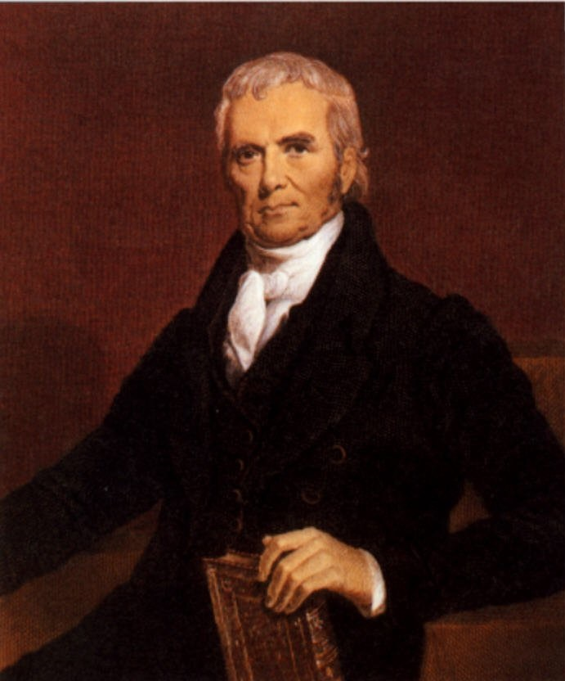
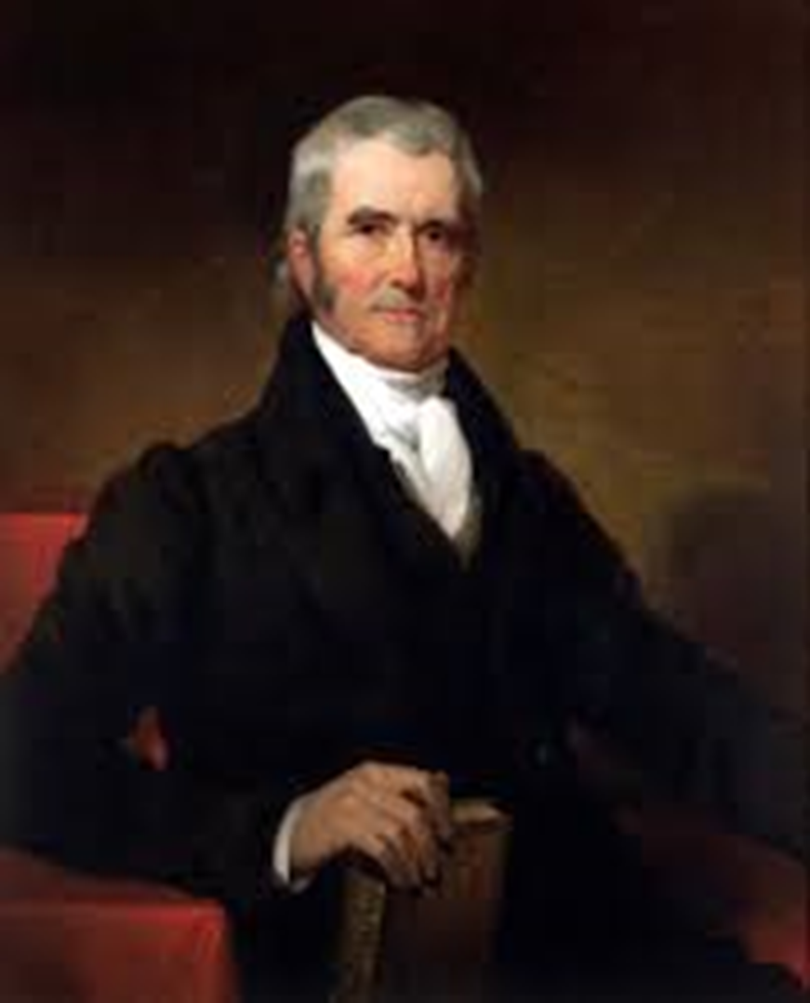
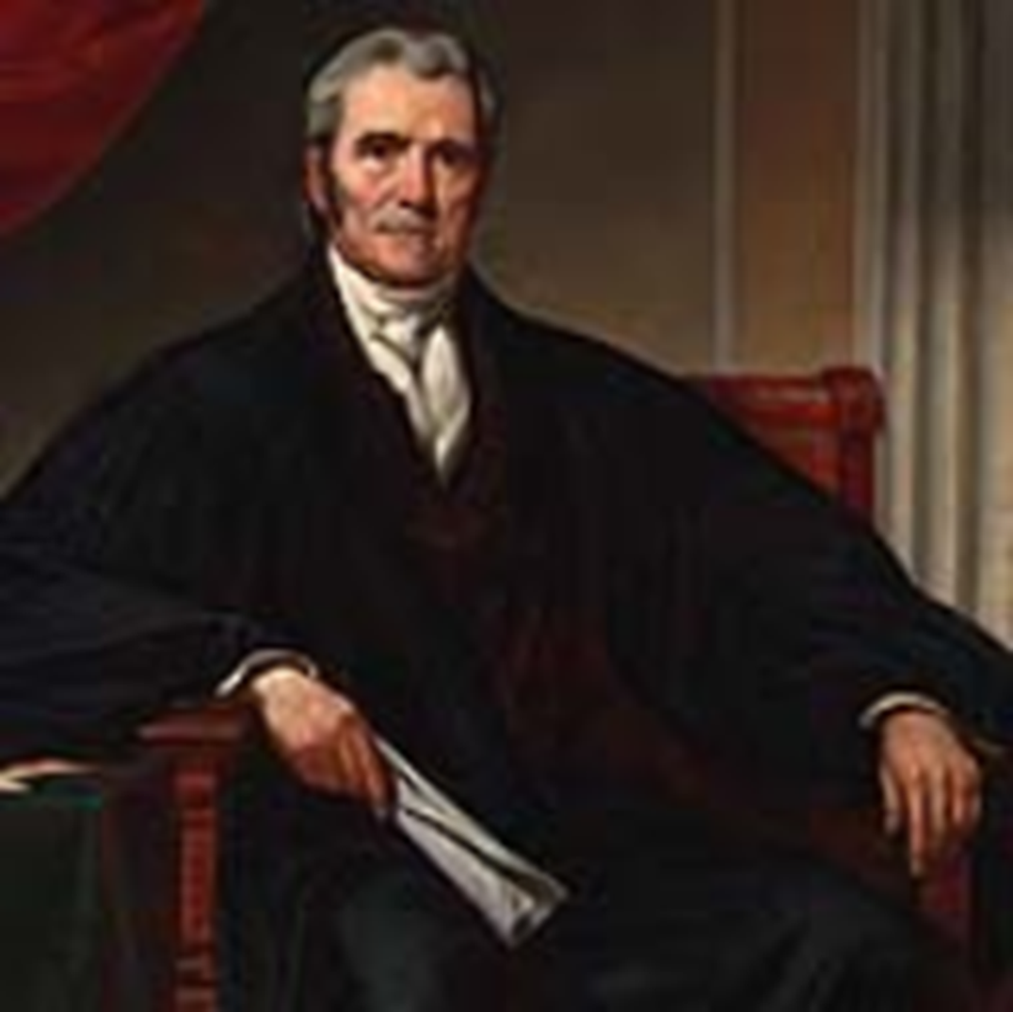
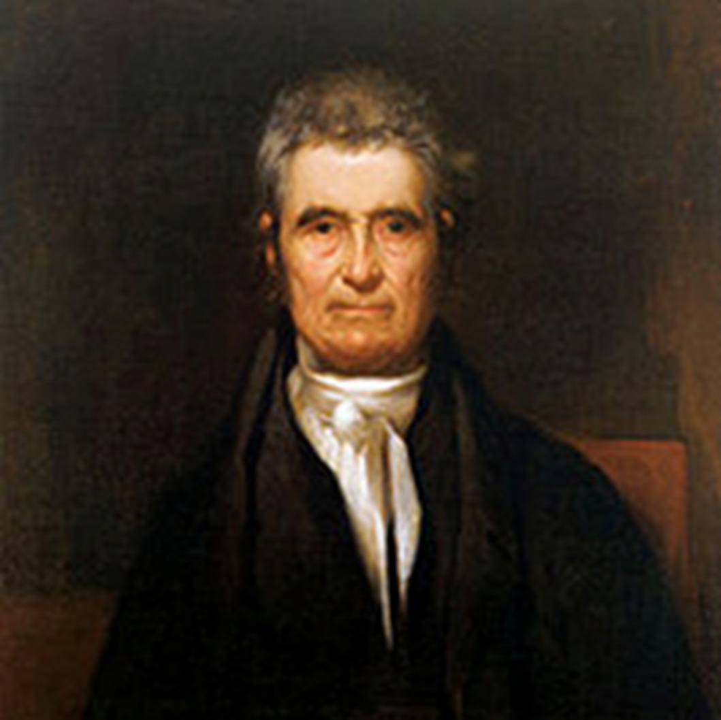
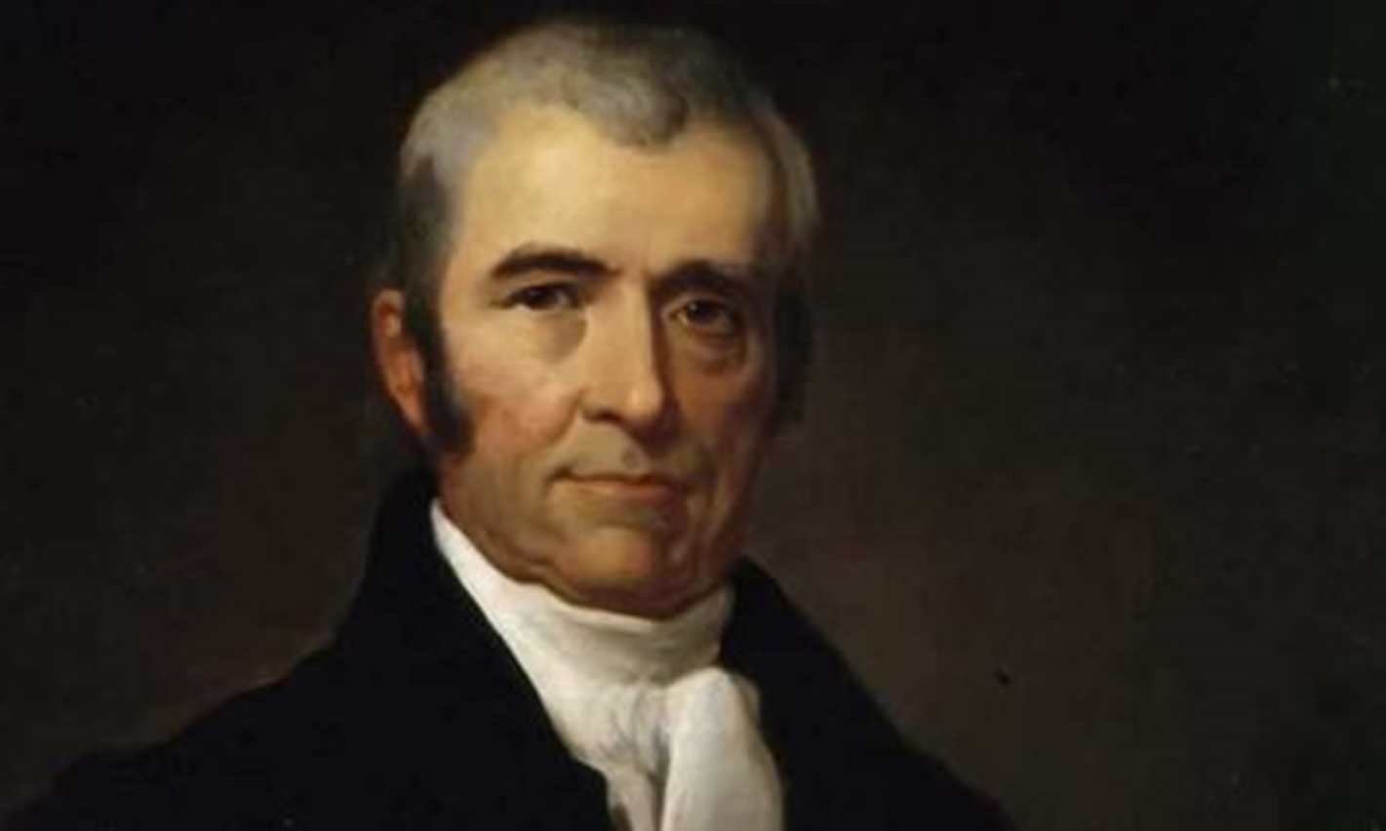
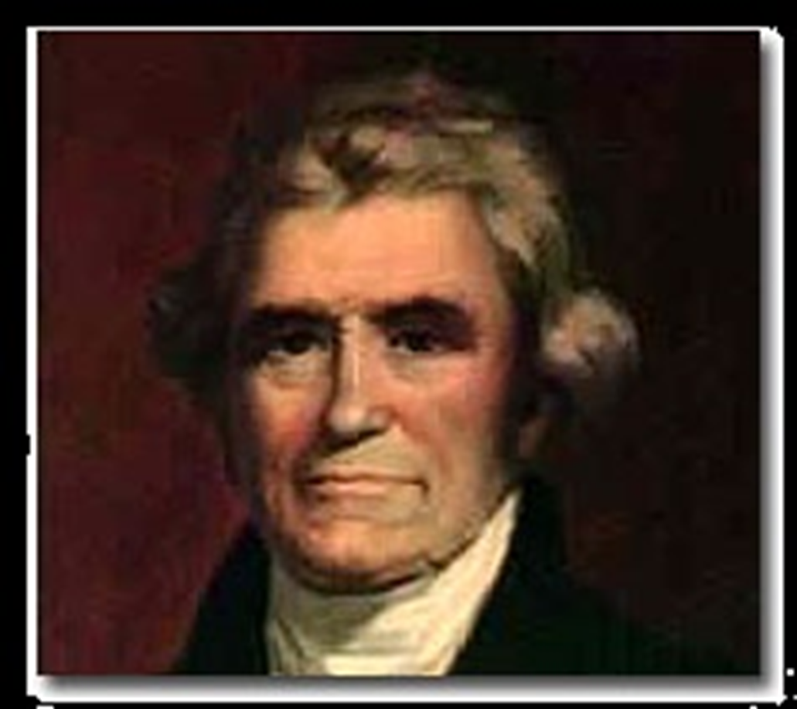
Q&A
Contact Information:
Joe Kobylka
Department of Political Science
Southern Methodist University
jkobylka@smu.edu

