Slide 1
CONSTITUTIONAL POLITICS:
CONSTRUCTING THE CONSTITUTION
Joseph F. Kobylka
Altshuler Distinguished Teaching Professor
Chair and Associate Professor of Political Science
Southern Methodist University
jkobylka@smu.edu
Prepared for delivery at the Humanities Texas Teacher Workshop:
Teaching the U.S. Constitution
18 September 2023

Slide 2
THE MYTHIC CIVICS VIEW
Divinely Inspired
Pre-Ordained Success
Product of Philosophers
Egalitarian
Democratic
At their best, this is what state curricular requirements
seek to address: teaching facts, not myths.

Slide 3
THE WORK OF POLITICIANS
“Perhaps the time has come, to borrow Walton Hamilton’s fine phrase, to raise the framers from immortality to mortality, to give them credit for their magnificent demonstration of the art of democratic politics.”
- John Roche, “The Founding Fathers: A Reform Caucus in Action” (1961)

Slide 4
AS A POLITICAL DOCUMENT
Context Informs Actions… and Meaning
  Massive National Debt
  State Currencies and Tariff Wars
  Annapolis Conference
  Shay’s Rebellion
Constitution a Response to This Context
  Occasioned Compromise Driven by
    Selfish/Sectional Interests
    Public/National Interests
  Goals of Delegates
    Create a Stronger National Government
    Agree Among One Another
    Agree on Something to which the States would Agree

Slide 5
POLITICAL COMPROMISES AT THE CONVENTION
Three Essential Approaches
  Punt
    New States
    Voting
  Split the Difference
    Election of President
    Slavery
    Representation
  Vagueness
    Federalism

Slide 6
COMPROMISES: PUNT
New States
Basic Question: Conditions for Admission
Political/Constitutional Tension:
  States Rights & Power
  Nationalism
  Slavery
No Consensus at Convention
  Compromise Type: Punt

Slide 7
COMPROMISES: PUNT
New States (Constitutional Text)
“New States may be admitted by the Congress into this Union; but no new State shall be formed or erected within the Jurisdiction of any other State; nor any State be formed by the Junction of two or more States, or Parts of States, without the Consent of the Legislatures of the States concerned as well as of the Congress.” (Art. IV §3 §§1)

Slide 8
COMPROMISES: PUNT
Right to Vote
Basic Question: Political Power
Political/Constitutional Tension:
  States Rights & Power v. Nationalism
  Equality and Consent
No Consensus at Convention
  Compromise Type: Punt

Slide 9
COMPROMISES: PUNT
Right to Vote (Constitutional Text)
“The House of Representatives shall be composed of Members chosen every second Year by the People of the several States, and the Electors in each State shall have the Qualifications requisite for Electors of the most numerous Branch of the State Legislature.” (Art. I §2 §§1)
“The Senate of the United States shall be composed of two Senators from each State, chosen by the Legislature thereof, for six Years; and each Senator shall have one Vote.” (Art. I §3 §§1)

Slide 10
COMPROMISES: SPLIT THE DIF
Election of President
Basic Question: Selection of National Executive
Political/Constitutional Tension:
  Congressional Power
  State Power
  Nationalism (nascent notion of “popular sovereignty”)
No Consensus at Convention
  Compromise Type: Split the Difference

Slide 11
COMPROMISES: SPLIT THE DIF
Election of President (Constitutional Text)
“The executive Power shall be vested in a President of the United States of America…, be elected, as follows: Each State shall appoint, in such Manner as the Legislature thereof may direct, a Number of Electors, equal to the whole Number of Senators and Representatives to which the State may be entitled in the Congress: but no Senator or Representative, or Person holding an Office of Trust or Profit under the United States, shall be appointed an Elector.
“The Electors shall meet in their respective States, and vote by Ballot for two Persons, of whom one at least shall not be an Inhabitant of the same State with themselves. And they shall make a List of all the Persons voted for, and of the Number of Votes for each; which List they shall sign and certify, and transmit sealed to the Seat of the Government of the United States, directed to the President of the Senate. The President of the Senate shall, in the Presence of the Senate and House of Representatives, open all the Certificates, and the Votes shall then be counted. The Person having the greatest Number of Votes shall be the President, if such Number be a Majority of the whole Number of Electors appointed; and if there be more than one who have such Majority, and have an equal Number of Votes, then the House of Representatives shall immediately chuse by Ballot one of them for President; and if no Person have a Majority, then from the five highest on the List the said House shall in like Manner chuse the President. But in chusing the President, the Votes shall be taken by States, the Representation from each State having one Vote; A quorum for this purpose shall consist of a Member or Members from two thirds of the States, and a Majority of all the States shall be necessary to a Choice. In every Case, after the Choice of the President, the Person having the greatest Number of Votes of the Electors shall be the Vice President. But if there should remain two or more who have equal Votes, the Senate shall chuse from them by Ballot the Vice President.” (Art. II §1 §§2)

Slide 12
COMPROMISES: SPLIT THE DIF
12th Amendment [Proposed 1803; Ratified 1804]
“The Electors shall meet in their respective states, and vote by ballot for President and Vice-President, one of whom, at least, shall not be an inhabitant of the same state with themselves; they shall name in their ballots the person voted for as President, and in distinct ballots the person voted for as Vice-President, and they shall make distinct lists of all persons voted for as President, and of all persons voted for as Vice-President, and of the number of votes for each, which lists they shall sign and certify, and transmit sealed to the seat of the government of the United States, directed to the President of the Senate; — The President of the Senate shall, in the presence of the Senate and House of Representatives, open all the certificates and the votes shall then be counted; — The person having the greatest number of votes for President, shall be the President, if such number be a majority of the whole number of Electors appointed; and if no person have such majority, then from the persons having the highest numbers not exceeding three on the list of those voted for as President, the House of Representatives shall choose immediately, by ballot, the President. But in choosing the President, the votes shall be taken by states, the representation from each state having one vote; a quorum for this purpose shall consist of a member or members from two-thirds of the states, and a majority of all the states shall be necessary to a choice. And if the House of Representatives shall not choose a President whenever the right of choice shall devolve upon them, before the fourth day of March next following, then the Vice-President shall act as President, as in the case of the death or other constitutional disability of the President. — The person having the greatest number of votes as Vice-President, shall be the Vice-President, if such number be a majority of the whole number of Electors appointed, and if no person have a majority, then from the two highest numbers on the list, the Senate shall choose the Vice-President; a quorum for the purpose shall consist of two-thirds of the whole number of Senators, and a majority of the whole number shall be necessary to a choice. But no person constitutionally ineligible to the office of President shall be eligible to that of Vice-President of the United States.”

Slide 13
COMPROMISES: SPLIT THE DIF
Slavery
Basic Question: Property and Freedom
Political/Constitutional Tension:
  Scope of National Power
  Scope of State Power
  Property Rights
  Human Rights
No Consensus at Convention
  Compromise Type: Split the Difference

Slide 14
COMPROMISES: SPLIT THE DIF
Slavery (Constitutional Text)
“Representatives and direct Taxes shall be apportioned among the several States which may be included within this Union, according to their respective Numbers, which shall be determined by adding to the whole Number of free Persons, including those bound to Service for a Term of Years, and excluding Indians not taxed, three fifths of all other Persons.” (Art. I §2 §§3)
“The Migration or Importation of such Persons as any of the States now existing shall think proper to admit, shall not be prohibited by the Congress prior to the Year one thousand eight hundred and eight, but a Tax or duty may be imposed on such Importation, not exceeding ten dollars for each Person.” (Art. I §9 §§1)
“No Person held to Service or Labour in one State, under the Laws thereof, escaping into another, shall, in Consequence of any Law or Regulation therein, be discharged from such Service or Labour, but shall be delivered up on Claim of the Party to whom such Service or Labour may be due.” (Art IV §2 §§3)

Slide 15
COMPROMISES: SPLIT THE DIF
Representation
Basic Question: Locus of Political Authority
Political/Constitutional Tension:
  States Rights & Power
  Nationalism
  Slavery
No Consensus at Convention
  Compromise Type: Split the Difference

Slide 16
COMPROMISES: SPLIT THE DIF
Representation (Constitutional Text)
“Representatives and direct Taxes shall be apportioned among the several States which may be included within this Union, according to their respective Numbers… The actual Enumeration shall be made within three Years after the first Meeting of the Congress of the United States, and within every subsequent Term of ten Years, in such Manner as they shall by Law direct. The Number of Representatives shall not exceed one for every thirty Thousand, but each State shall have at Least one Representative…” (Art. I §2 §§2)
“The Senate of the United States shall be composed of two Senators from each State, chosen by the Legislature thereof for six Years; and each Senator shall have one Vote. Immediately after they shall be assembled in Consequence of the first Election, they shall be divided as equally as may be into three Classes. The Seats of the Senators of the first Class shall be vacated at the Expiration of the second Year, of the second Class at the Expiration of the fourth Year, and of the third Class at the Expiration of the sixth Year, so that one third may be chosen every second Year.” (Art. I §3 §§1)

Slide 17
COMPROMISES: VAGUENESS
Federalism
Basic Question: Goldielocksian – Scope of Power
Political/Constitutional Tension:
  National Power
  State Power
  Slavery
No Consensus at Convention
  Compromise Type: Vagueness

Slide 18
COMPROMISES: VAGUENESS
Federalism (Constitutional Text)
“The Congress shall have Power To… make all Laws which shall be necessary and proper for carrying into Execution the foregoing Powers, and all other Powers vested by this Constitution in the Government of the United States, or in any Department or Officer thereof.” (Art. I §8, §§18)
“This Constitution, and the Laws of the United States which shall be made in Pursuance thereof; and all Treaties made, or which shall be made, under the Authority of the United States, shall be the supreme Law of the Land; and the Judges in every State shall be bound thereby, any Thing in the Constitution or Laws of any State to the Contrary notwithstanding.” (Art. VI §2)
“The powers not delegated to the United States by the Constitution, nor prohibited by it to the States, are reserved to the States respectively, or to the people.” (10th Amendment)

Slide 19
SUMMARY AND DISCUSSION
Context Informs Actions… and Meaning
Constitution a Response to Issues Arising Out of a Specific Context
  Nothing “Magical” About It
  Framers Not Philosophers
  Pragmatic Politicians Pragmatically Working Through Practical Problems
  No Reason to Think Their Solutions were Best or Unchangable
  But… That Said
    Pragmatism Can Be Guided By Knowledge
    Workshop Topic: The Federalist and The Science of Politics

Slide 20
STAAR 8TH GRADE SSTUDS ASSESSMENT
(1) History. The student understands traditional historical points of reference in U.S. history through 1877.
  (A) identify the major eras and events in U.S. history through 1877, including … creation and ratification of the Constitution; (Readiness Standard)
  (c) explain the significance of the following dates... 1787, writing of the U.S. Constitution (Supporting Standard)
(4) History. The student understands significant political and economic issues of the revolutionary era.
  (D) analyze the issues of the Constitutional Convention of 1787, including the Great Compromise and the Three-Fifths Compromise;
  (Readiness Standard)
(23) Culture. The student understands the relationships between and among people from various groups, including racial, ethnic, and religious groups, during the 17th, 18th, and 19th centuries
  (C) identify ways conflicts between people from various racial, ethnic, and religious groups were addressed; (Supporting Standard)
(15) Government. The student understands the American beliefs and principles reflected in the Declaration of Independence, the U.S. Constitution, and other important historic documents.
  (A) identify the influence of ideas from historic documents, including … the Federalist Papers … on the U.S. system of government; (Readiness Standard)
  (C) identify colonial grievances listed in the Declaration of Independence and explain how those grievances were addressed in the U.S. Constitution and the Bill of Rights; (Readiness Standard)
  (D) analyze how the U.S. Constitution reflects the principles of limited government, republicanism, checks and balances, federalism, separation of powers, popular sovereignty, and individual rights. (Readiness Standard)
(17) Government. The student understands the dynamic nature of the powers of the national government and state governments in a federal system.
  (A) analyze the arguments of the Federalists and Anti-Federalists, including those of Alexander Hamilton, Patrick Henry, James Madison, and George Mason; (Readiness Standard)
  (B) explain constitutional issues arising over the issue of states’ rights (Readiness Standard)
(18) Government. The student understands the impact of landmark Supreme Court cases.
  (A) identify the origin of judicial review; (Supporting Standard)
(20) Citizenship. The student understands the importance of voluntary individual participation in the democratic process
  (A) evaluate the contributions of the Founding Fathers as models of civic virtue; (Supporting Standard)
(21) Citizenship. The student understands the importance of the expression of different points of view in a constitutional republic.
  (C) summarize a historical event in which compromise resulted in a peaceful resolution. (Supporting Standard)
(29) Social studies skills. The student applies critical-thinking skills to organize and use information acquired through established research methodologies from a variety
  (D) identify points of view from the historical context surrounding an event and the frame of reference which influenced the participants;

Slide 21
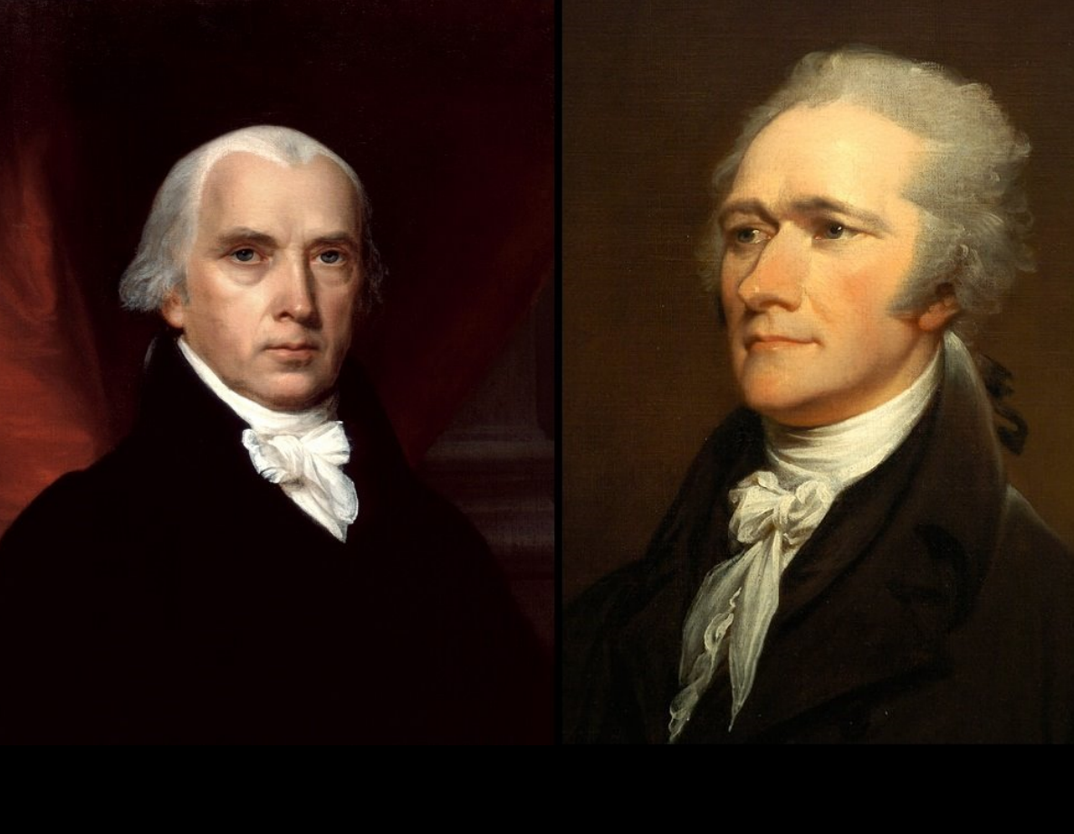
QUESTIONS & COMMENTS
No current known email
No current known email
jkobylka@smu.edu

