Slide 1
Turning Points of World War II in Europe
Prof. Arnold Krammer
Texas A&M University
Two Battles: Battle of Britain
Stalingrad
Two Technologies: Penicillin
P-47 Airplanes

Slide 2
STAAR TEST
Section 7: The student understands the domestic and intermational impact of US involvement in World War II. The student is expected to:

Slide 3
A) identify reasons for U.S involvement in World War II, including Italian German, and Japanese dictatorships and their aggression. Readiness Standard
((B) evaluate the domestic and intermational leadership of Franklin D. Roosevelt and Harry Trunan during World War II, including the U.S. relationship with its allies. Supporting Standard.
(D) analyze major issues of World War II. Readiness Standard
(E) analyze major military events of World War II, including the invasion of Normandy, fighting the war on multiple fronts, and the liberation of concentration camps; Supporting Standard
(F) evaluate the military contributions of leaders during World WAr II, including Omar Bradley, Dwight Eisenhower, Douglas MacArthur, Chester A. Nimitz, George Marshall, and George Patton. Supporting Standard

Slide 4
Battle of Britain
July, 1940 - May, 1941
If Britain had fallen:
1) Normandy Invasion would have been impossible;
2) Germany would have controlled North Atlantic;
3) The US would have lost its greatest trading partner
Notes:
Heaviest fighting was from July to October 1940. It continued with V1 and V2 Rocket attacks.

Slide 5
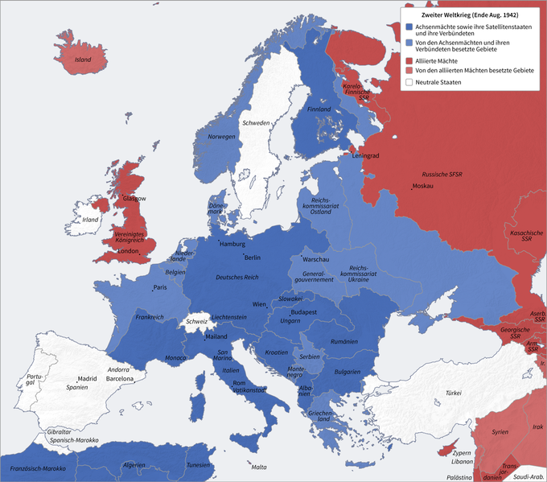

Slide 6
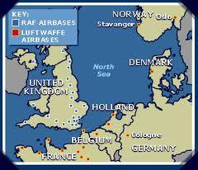

Slide 7
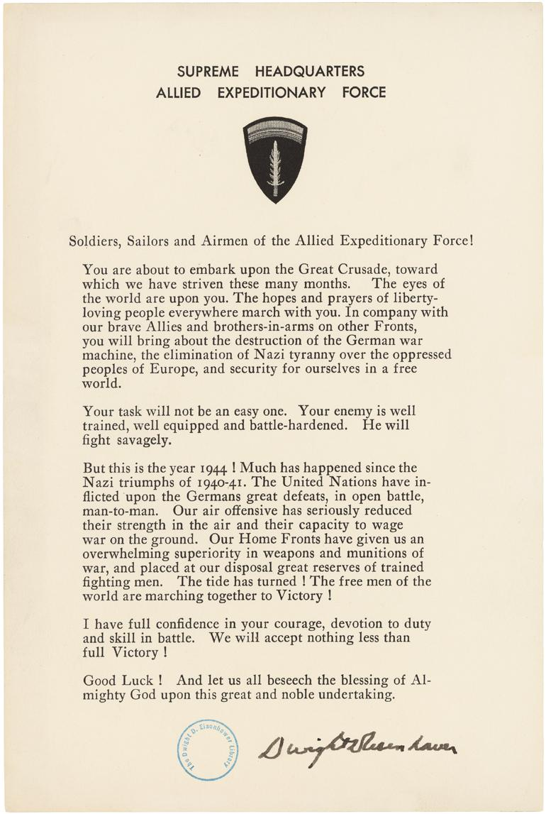
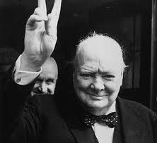

Slide 8
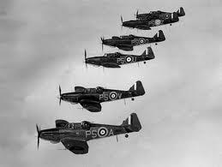

Slide 9
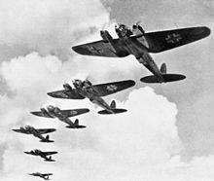

Slide 10
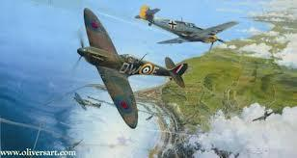

Slide 11
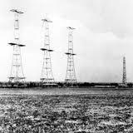

Slide 12
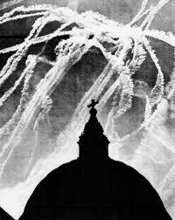

Slide 13
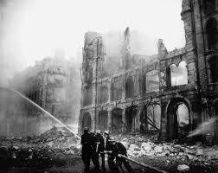

Slide 15
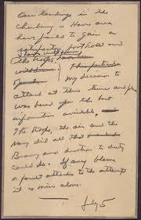

Slide 16
RECOMMENDED BOOKS:
James Holland, Battle of Britain:Five Months that Changed History. (St. Martin's Griffin, 2012. ISBN: 978-1250002150).
Tim Clayton and Phil Craig, Their Finest Hour: The Battle of Britain. (Simon & Schuster, 2009. ISBN: 978-0684869315).
Michael Korda, With Wings Like Eagles: The Untold Story of the Battle of Britain. (Harper Perennial Paperback, 2010. ISBN:
Richard Overy, The Battle of Britain: The Myth and Reality. (W.W. Norton, 2002. ISBN: 978-0393322972).

Slide 17
Battle of Stalingrad
1) Oil fields in the Caucasus were lost;
2) Hitler's southern campaign was halted;
3) The Volga River opened to traffic;
4) Hitler's plan to enter the Middle East was stopped;
5) Morale in Germany plummeted while it soared among the Allies.
Notes:
A quarter of a million men in the German 6th Army attacked the last major obstacle to Hitler's southern campaign; The anchor line was loose

Slide 18
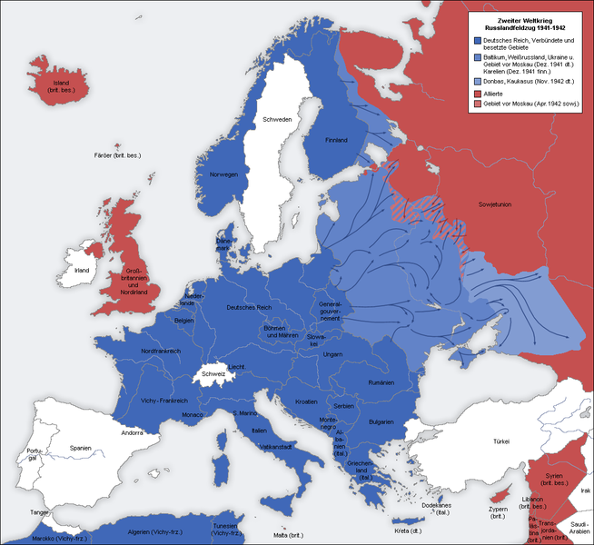

Slide 19
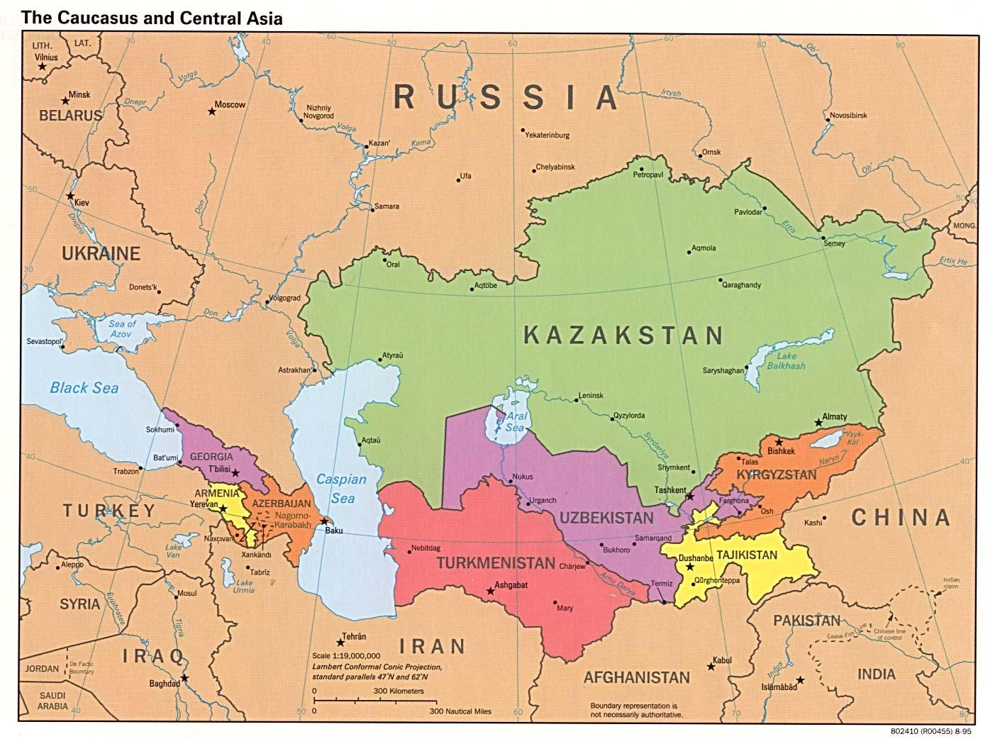

Slide 20
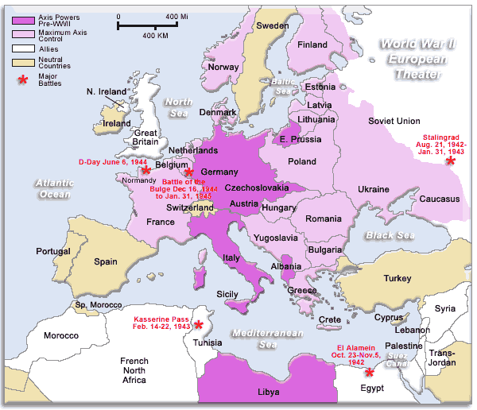

Slide 21
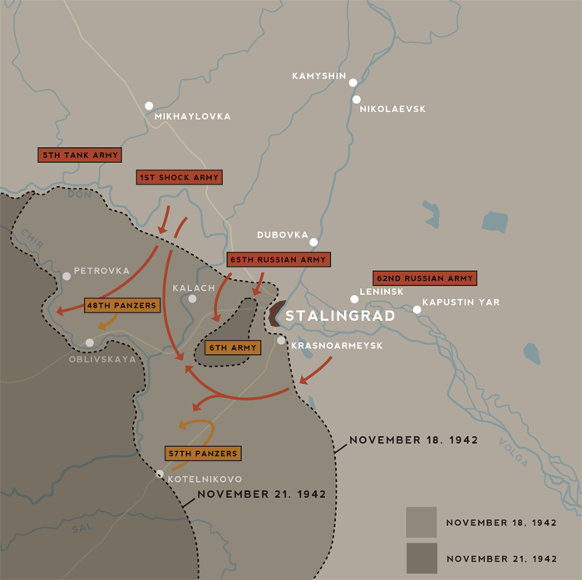

Slide 22
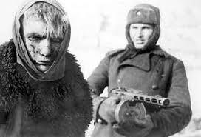

Slide 23
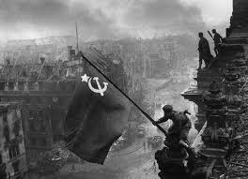

Slide 24
RECOMMENDED BOOKS:
Geoffrey Jukes, Barrie Pitt, David Mason, Stalingrad: The Turning Point. (Ballantine Books, 1978. ISBN: 978-0345279040).
Geoff
Antony Beevor, Stalingrad: The Fateful Siege, 1942-1943. (Penguin Books, 1999. ISBN: 978-0140284584).
Edwin R. Hoyt, 199 Days: The Battle for Stalingrad. (Forge Books, 1999. ISBN: 978-0312868536).

Slide 25
P-47 Thunderbolt
"The Jug"
Introduced in 1942
Destroyed:
9000 Locomotives
6000 Armored Vehicles
3752 Enemy Aircraft in the Air
3315 Enemy Aircraft on the Ground
86000 Railcars
(Robert Jackson, Aircraft of World War II p. 197)
Notes:
Thunderbolt was the heaviest (5 tons) and most successful aircraft in the European theater.
Bristled with guns, cleared the skies, turned the tide of war

Slide 26
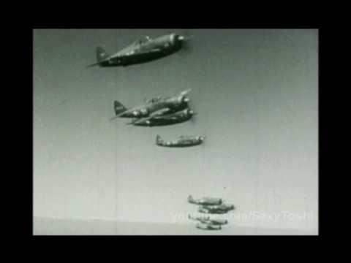

Slide 27
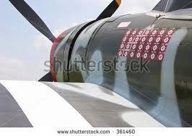

Slide 28
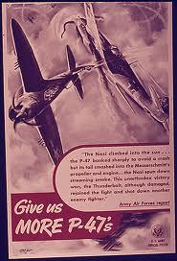

Slide 29
RECOMMENDED BOOKS:
Kent D. Miller, The 356th Fighter Group in W.W. II (Schiffer Military History Books, 2003. ISBN (13) 978-0764317682).
Cory Graff, P-47 Thunderbolt at War
(Zenith Paperback, 1997. ISBN (13) 978-0760329481).
Tom Glenn, P-47 Pilots: The Fighter-Bomber Boys (Zenith Paperback, 1998. ISBN (13) 978-0760305485).

Slide 30
Penicillin
Introduced in June, 1944, Penicillin
is estimated to have saved some
100,000 lives during the war.
Richard Conniff, "Penicillin: Wonder Drug of WWII," Military History, July, 2013 pp. 38 - 43.

Slide 31
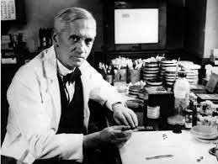
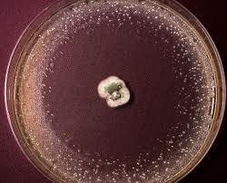
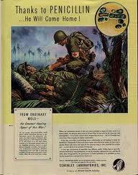

Slide 32
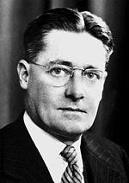

Slide 34
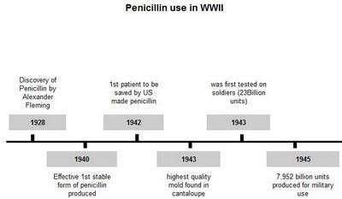

Slide 36
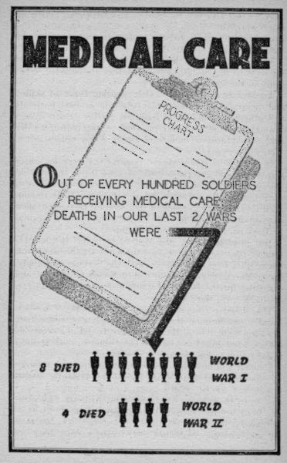

Slide 37
RECOMMENDED BOOKS:
Lauren Belfer, A Fierce Radiance: A Novel
(Harper Perennial Paperback, 2010. ISBN: 0061252522).
Dean Anderson, Praise the Lord and Pass the Penicillin (McFarland & Co., 2003. ISBN: 978-0786416707).
Eric Lax, The Mold in Dr. Florey's Coat: The Story of the Penicillin Miracle (Holt Paperback, 2004. ISBN: 978-0805077780).

