Slide 1
The Origins of the Cold War
Mark Lawrence
University of Texas at Austin

Slide 2
Three schools of thought
Orthodox: Soviet responsibility
Revisionist: U.S. responsibility
Post-revisionist: irreconcilable visions of the future

Slide 3
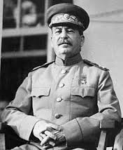
The Soviet vision
Control Eastern Europe
Weaken Germany
Cooperation if possible, confrontation if necessary to achieve 1 and 2

Slide 4
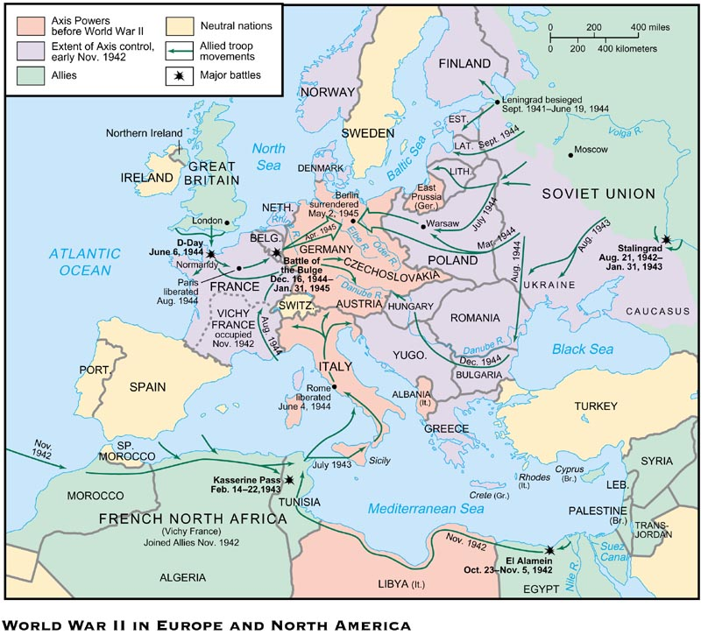

Slide 5
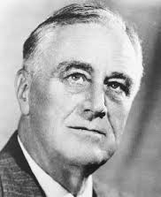
The U.S. vision
Open world economic order
Decolonization
Collective security if possible, reliance on allies if necessary

Slide 6
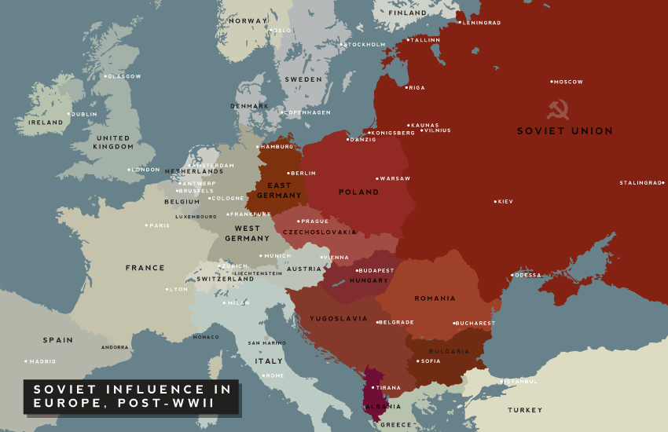
Points of Contention
Status of Eastern Europe
Status of Germany

Slide 7
Irritants
1. Turmoil in France, Italy, etc.
2. Chinese civil war
3. Soviet paranoia
Anticommunism in the United States

