Slide 1
AUTHOR’S PURPOSE AND CRAFT: FREDERICK DOUGLASS
ROBERT S. LEVINE
UNIVERSITY OF MARYLAND
rlevine@umd.edu

Slide 2
Statues at the Talbot County Court House
Talbot Boys
Frederick Douglass

Slide 3
A Douglass Chronology of His Pre-Civil War Career: Part 1
1818 Frederick Bailey born into slavery in Talbot County on the Eastern Shore of Maryland.
1826 Sent to live in Baltimore; moves back and forth between Baltimore and Talbot County over the next twelve years.
1838 Escapes from slavery, disguised as a sailor. Changes name to Douglass. Marries the free Black Anna Murray in New York, and they subsequently make their way to New Bedford, Massachusetts. Over the next few years Douglass works as a caulker at shipyards and also becomes a licensed preacher in the AME Church.
1841 Speaks at an antislavery convention in Nantucket; William Lloyd Garrison, the white abolitionist leader of the Massachusetts Antislavery Society, hires him as a lecturer for his organization.
1845 Publishes Narrative of the Life of Frederick Douglass. Because of its popularity, Douglass flees to the British Isles to escape from fugitive slave catchers.

Slide 4
DOUGLASS’S CORE BELIEFS AS A GARRISONIAN ABOLITIONIST
MORAL SUASION (i.e. nonviolence)
THE CONSTITUTION IS A PROSLAVERY DOCUMENT (therefore one should not vote in elections or otherwise participate in the political process)
IMMEDIATISM (slavery is immoral and must end immediately)

Slide 5
PASSAGES FROM TWO NOTABLE BLACK-AUTHORED TEXTS PUBLISHED BEFORE DOUGLASS’S 1845 NARRATIVE
From David Walker’s Appeal to the Colored Citizens . . . of the United States of America (1829):
“Kill or be killed.”
From Henry Highland Garnet’s “An Address to the Slaves of the United States” (1843):
“Let your motto be resistance! resistance! RESISTANCE! No oppressed people have ever secured their liberty without resistance.”

Slide 6
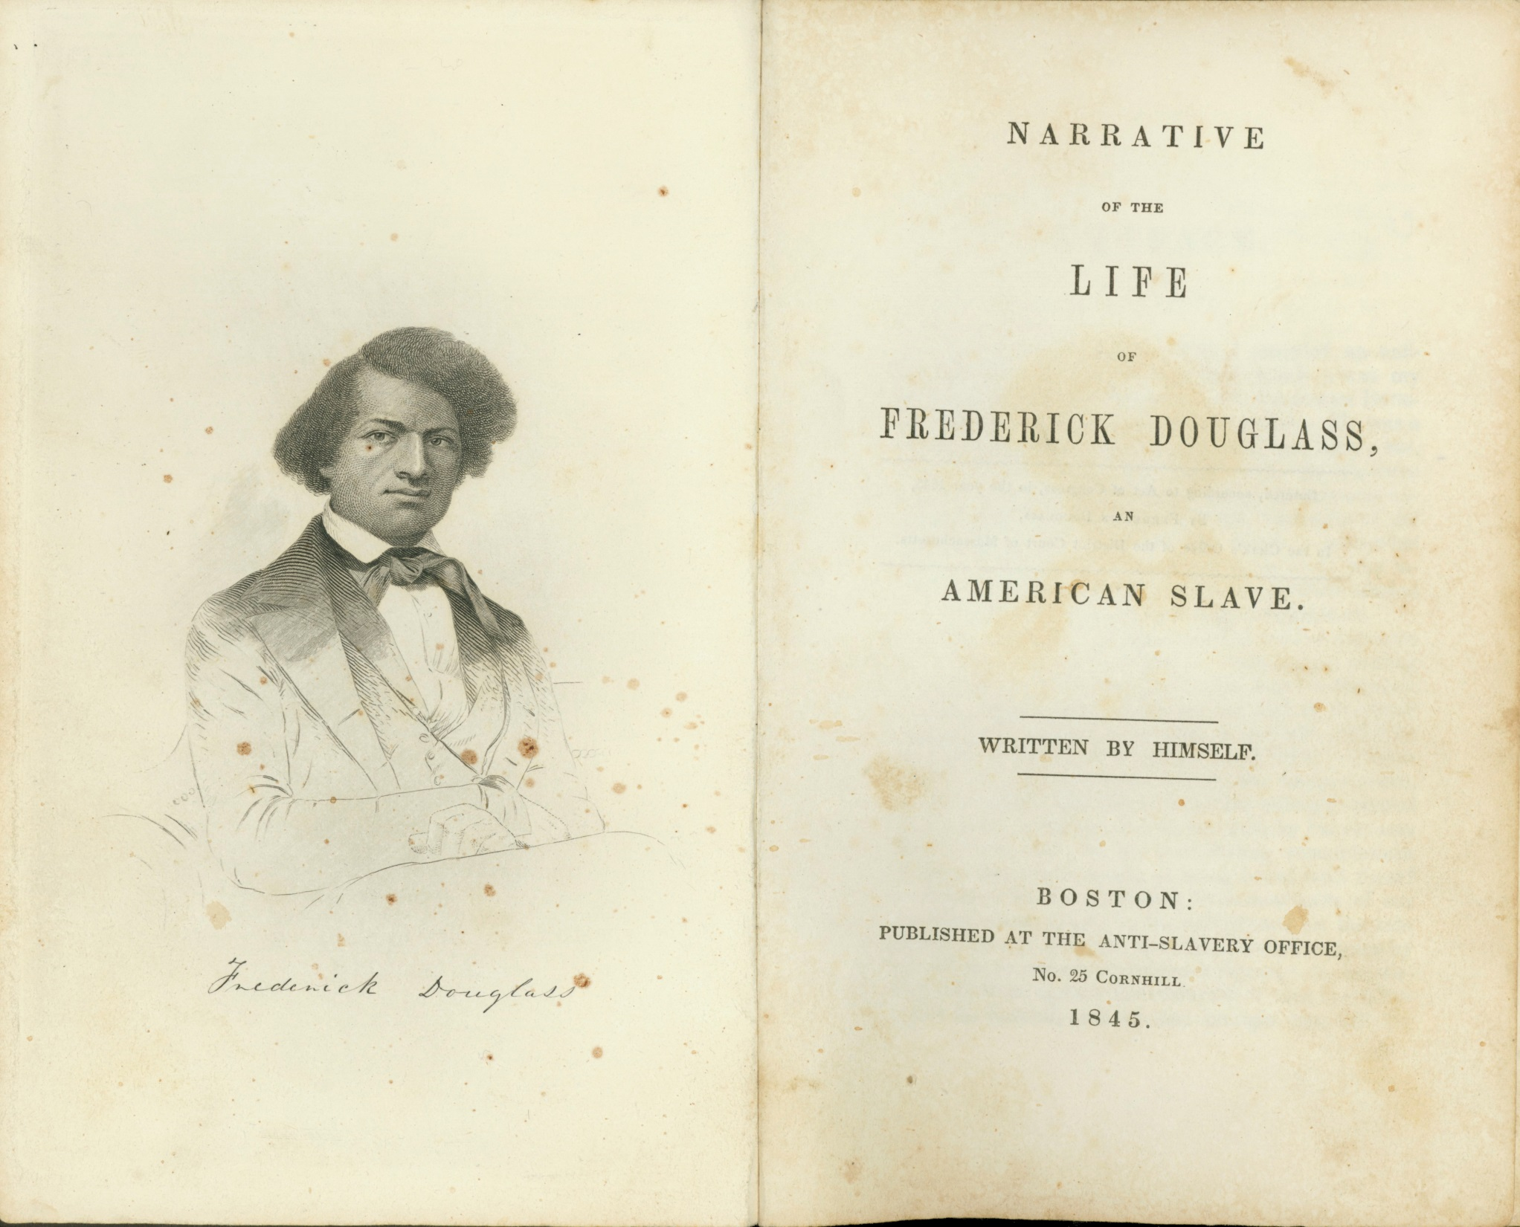

Slide 7
The opening paragraph of Douglass’s 1845 Narrative
I was born in Tuckahoe, near Hillsborough, and about twelve miles from Easton, in Talbot county, Maryland. I have no accurate knowledge of my age, never having seen any authentic record containing it. By far the larger part of the slaves know as little of their ages as horses know of theirs, and it is the wish of most masters within my knowledge to keep their slaves thus ignorant. I do not remember to have ever met a slave who could tell of his birthday. They seldom come nearer to it than planting-time, harvest-time, cherry-time, spring-time, or fall-time. A want of information concerning my own was a source of unhappiness to me even during childhood. The white children could tell their ages. I could not tell why I ought to be deprived of the same privilege. I was not allowed to make any inquiries of my master concerning it. He deemed all such inquiries on the part of a slave improper and impertinent, and evidence of a restless spirit. The nearest estimate I can give makes me now between twenty-seven and twenty-eight years of age. I come to this, from hearing my master say, some time during 1835, I was about seventeen years old.

Slide 8
A Douglass Chronology of His Pre-Civil War Career, Part 2
1847 Douglass’s British supporters buy him out of slavery; Douglass returns to Rochester, New York, where he establishes his own antislavery newspaper, The North Star. Garrison, the publisher of the antislavery newspaper The Liberator, is enraged.
1850 Douglass formally breaks with Garrison. The Compromise of 1850 includes a strengthened fugitive slave law, leading Douglass to adopt a more militant politics.
1852 Delivers “What to the Slave Is the Fourth of July?” in Rochester.
1855 Publishes My Bondage and My Freedom, which includes an abridged version of “What to the Slave Is the Fourth of July?”
1858-60 Meets with John Brown. After Brown attacks Harpers Ferry in October 1859, Douglass flees to England; he returns in 1860 and supports Lincoln for the presidency

Slide 9
DOUGLASS’S CORE BELIEFS
AFTER BREAKING WITH GARRISON IN 1850
THE CONSTITUTION IS AN ANTISLAVERY DOCUMENT (therefore one should participate in elections and the larger political process)
ANTISLAVERY VIOLENCE, IN SOME INSTANCES, IS A PROPER RESPONSE TO THE VIOLENCE OF SLAVERY

Slide 10
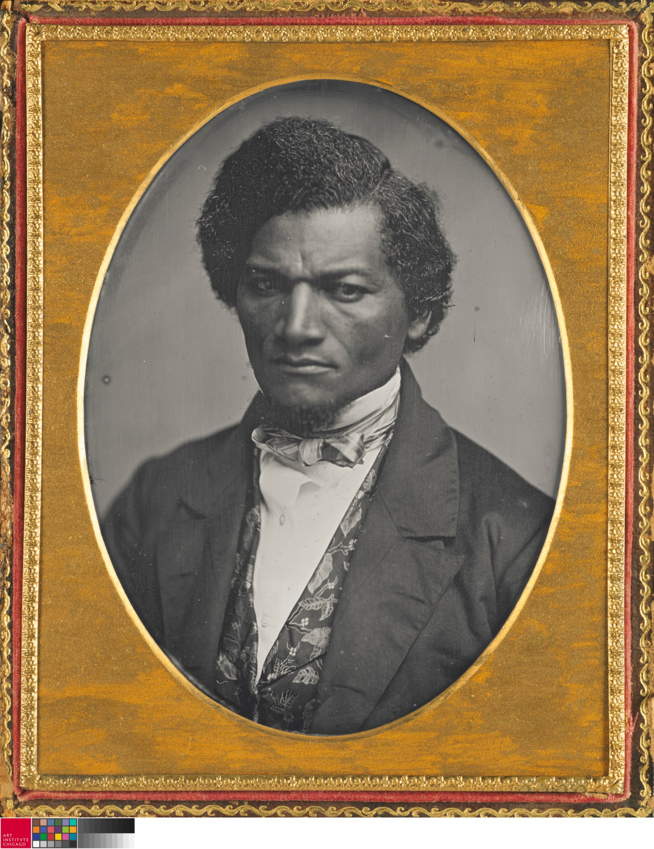
Douglass in 1852

Slide 11
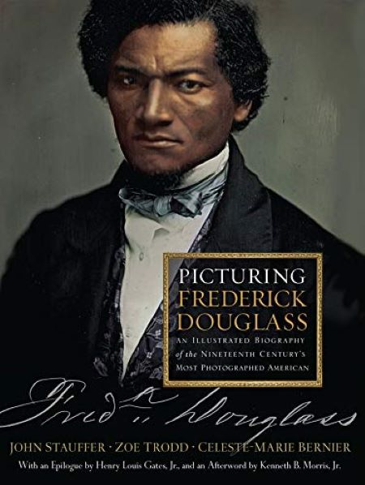

Slide 12
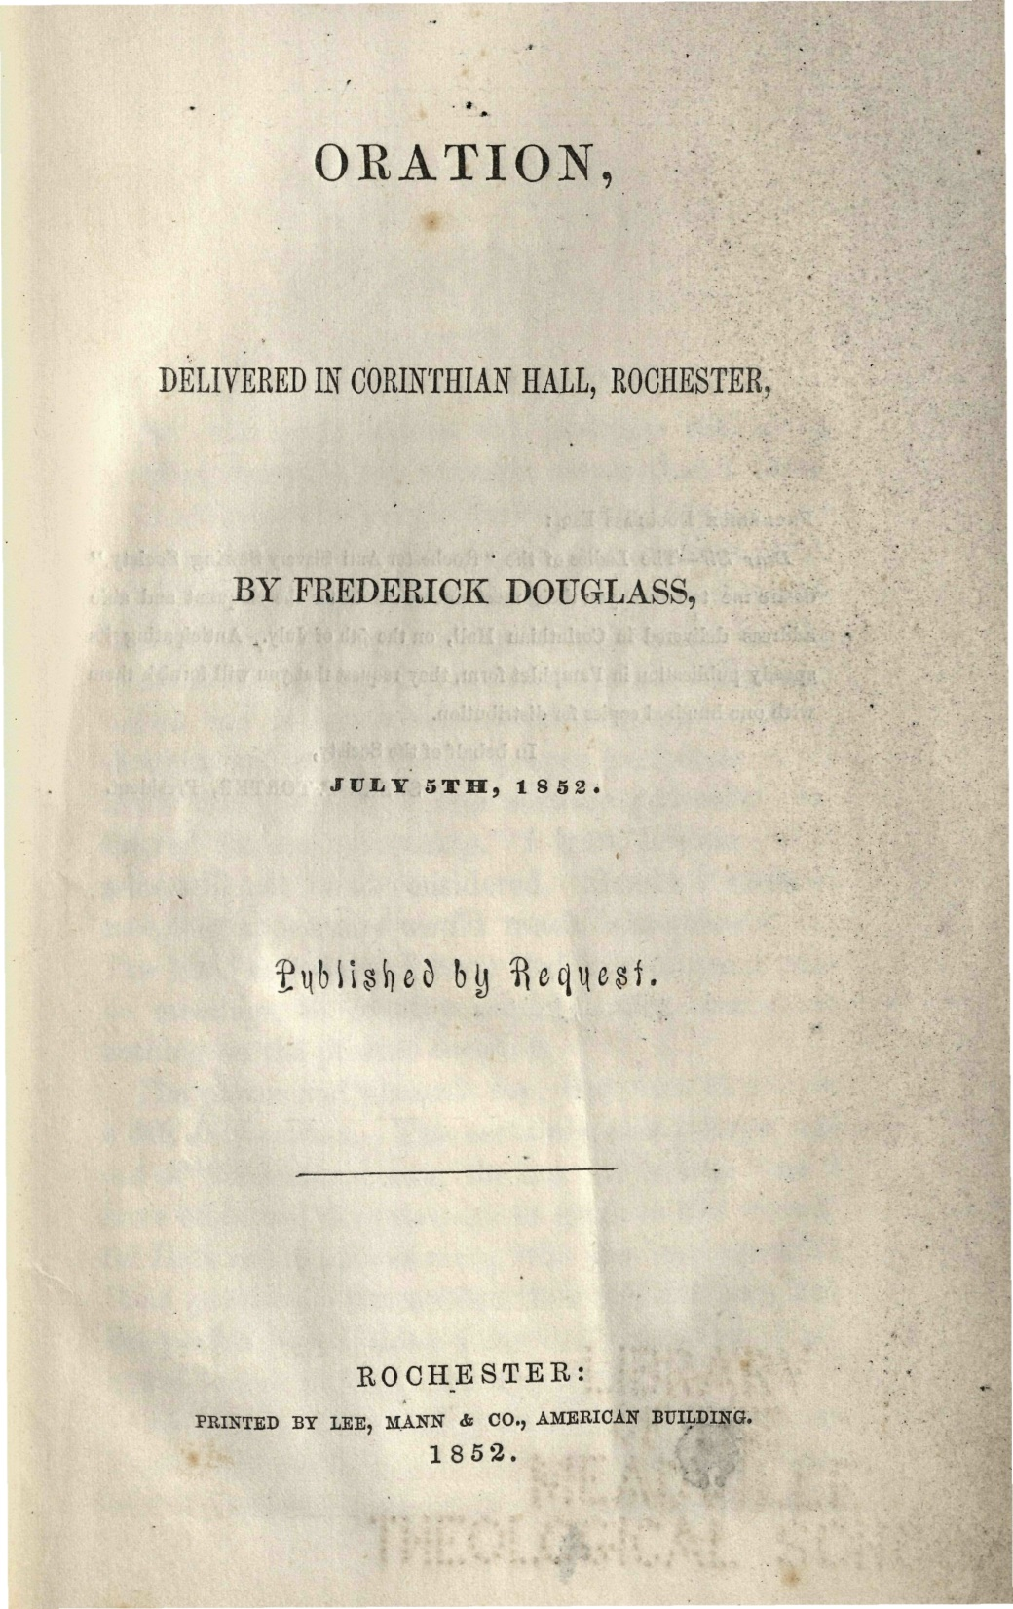

Slide 13
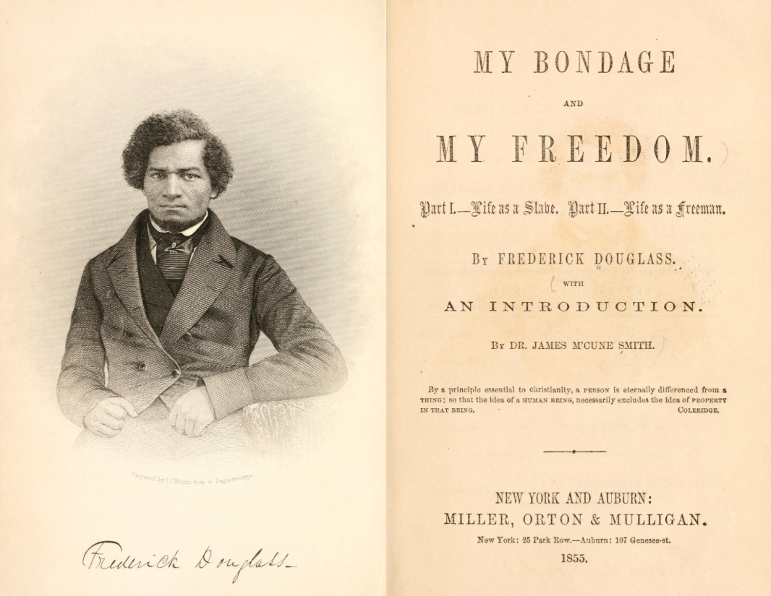

Slide 14
THE CONCLUDING PARAGRAPHS OF THE 1855 VERSION OF “WHAT TO THE SLAVE IS THE FOURTH OF JULY”
What, to the American slave, is your 4th of July? I answer, a day that reveals to him, more than all other days in the year, the gross injustice and cruelty to which he is the constant victim. To him, your celebration is a sham; your boasted liberty, an unholy license; your national greatness, swelling vanity; your sounds of rejoicing are empty and heartless; your denunciations of tyrants, brass-fronted impudence; your shouts of liberty and equality, hollow mockery; your prayers and hymns, your sermons and thanksgivings, with all your religious parade, and solemnity, are to him mere bombast, fraud, deception, impiety, and hypocrisy — a thin veil to cover up crimes which would disgrace a nation of savages. There is not a nation on the earth guilty of practices more shocking and bloody, than are the people of these United States, at this very hour.
Go where you may, search where you will, roam through all the monarchies and despotisms of the old world, travel through South America, search out every abuse, and when you have found the last, lay your facts by the side of the every-day practices of this nation, and you will say with me, that, for revolting barbarity and shameless hypocrisy, America reigns without a rival.

Slide 15
Douglass on the American Revolutionaries of 1776
From near the opening of the 1852 “What to the Slave Is the Fourth of July”:
They were peace men; but they preferred revolution to peaceful submission to bondage. They were quiet men; but they did not shrink from agitating against oppression. . . . With them, justice, liberty, and humanity were “final”; not slavery and oppression.

Slide 16
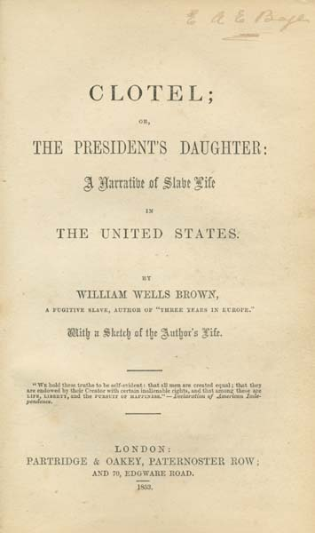

Slide 17
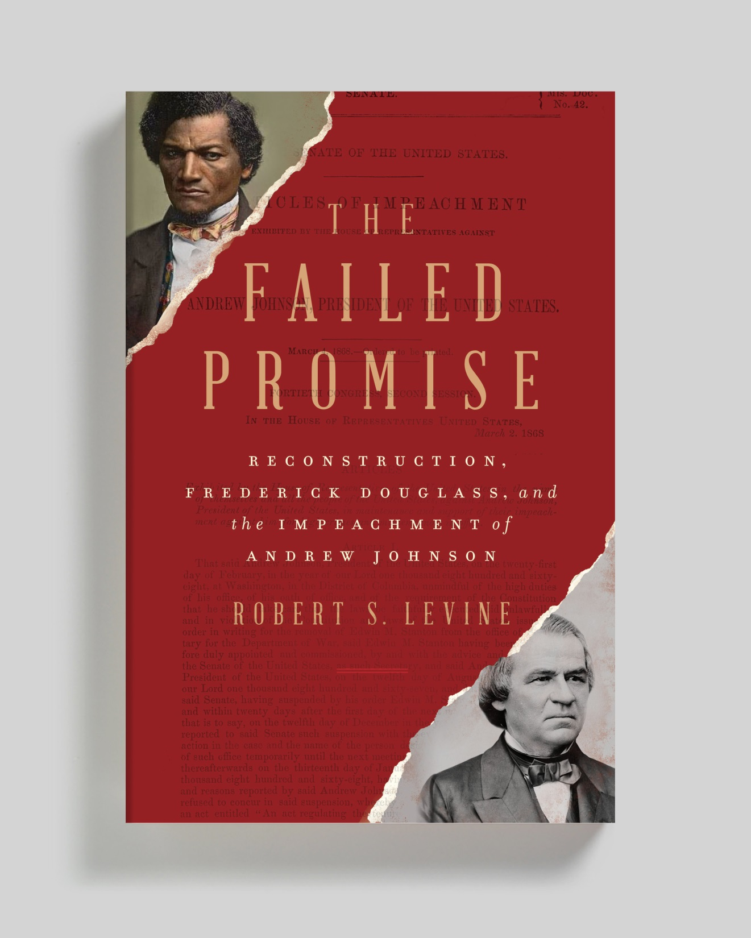
Forthcoming W. W. Norton,
August 2021

Slide 18
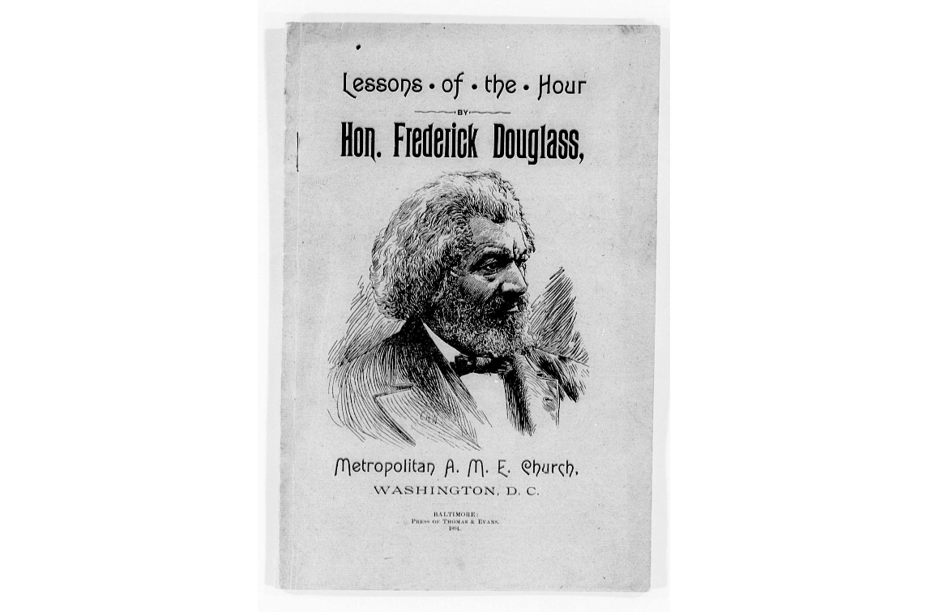

Slide 19
The closing words of Douglass’s 1894 “The Lessons of the Hour”
Put away your race prejudice. Banish the idea that one class must rule over another. Recognize the fact that the rights of the humblest citizen are as worthy of protection as those of the highest, and your problems will be solved; and, whatever may be in store for it in the future, whether prosperity, or adversity; whether it shall have foes without, or foes within, whether there shall be peace, or war; based upon the external principles of truth, justice, and humanity, and with no class having any cause of complaint or grievance, your Republic will stand and flourish forever.

Slide 20
Questions for the breakout groups
Douglass’s “What to the Slave Is the Fourth of July” is so critical of the United States that it almost seems anti-American. What are good strategies for teaching this essay, especially its concluding paragraphs, so that you wouldn’t have parents complaining about the anti-Americanism being brought into your classroom?
Why did Douglass give the initial lecture on July 5th? How would emphasizing that date help you to teach Douglass’s purpose and craft in this short essay version?

