Slide 1
Manifest Destiny and the U.S.-Mexico War
Humanities Texas
February 17, 2021

Slide 2
John Gast, American Progress (1862)

Slide 3
The Indian Frontier, c. 1840

Slide 4
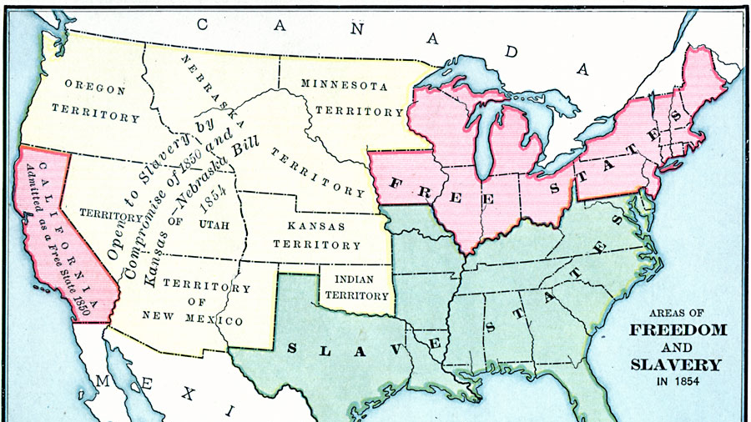
Free and Slave States at Mid-Century

Slide 5
James K. Polk (1795-1849)

Slide 6
Oregon Territory

Slide 7
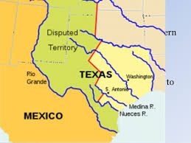
Disputed Boundary in Texas

Slide 8
Phases of the U.S.-Mexico War, 1846-48

Slide 9
Battle of Chapultepec Castle, Sept. 13, 1847

Slide 10
“In an Absolut World …”

