Slide 1
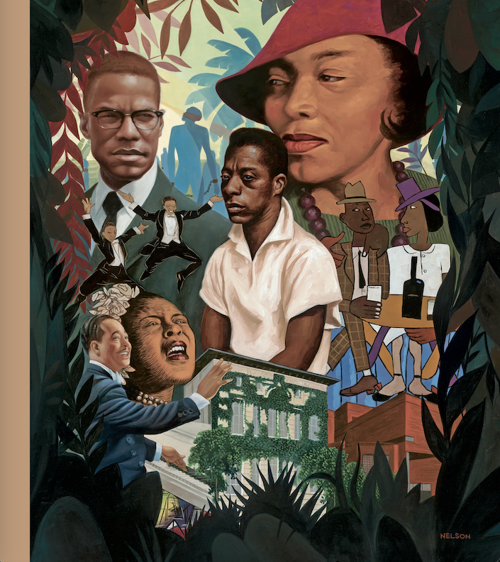
Centering Black Literature in the Classroom
Dr. Brandon Manning
Kadir Nelson

Slide 2
Central Questions:
How can we use Enslaved Black people’s writing in the classroom?
How can we teach about the history, literature, and culture of Black people without reproducing narratives of trauma and deficit thinking?

Slide 3
English Language Arts and Reading TEKS III
(8) Author's purpose and craft: listening, speaking, reading, writing, and thinking using multiple texts. The student uses critical inquiry to analyze the authors' choices and how they influence and communicate meaning within a variety of texts. The student analyzes and applies author's craft purposefully in order to develop his or her own products and performances. The student is expected to:
(A) analyze the author's purpose, audience, and message within a text;
(B) evaluate use of text structure to achieve the author's purpose;
(C) evaluate the author's use of print and graphic features to achieve specific purposes;
(D) evaluate how the author's use of language informs and shapes the perception of readers;
(E) evaluate the use of literary devices such as paradox, satire, and allegory to achieve specific purposes;
(F) evaluate how the author's diction and syntax contribute to the mood, voice, and tone of a text; and
(G) analyze the effects of rhetorical devices and logical fallacies on the way the text is read and understood.

Slide 4
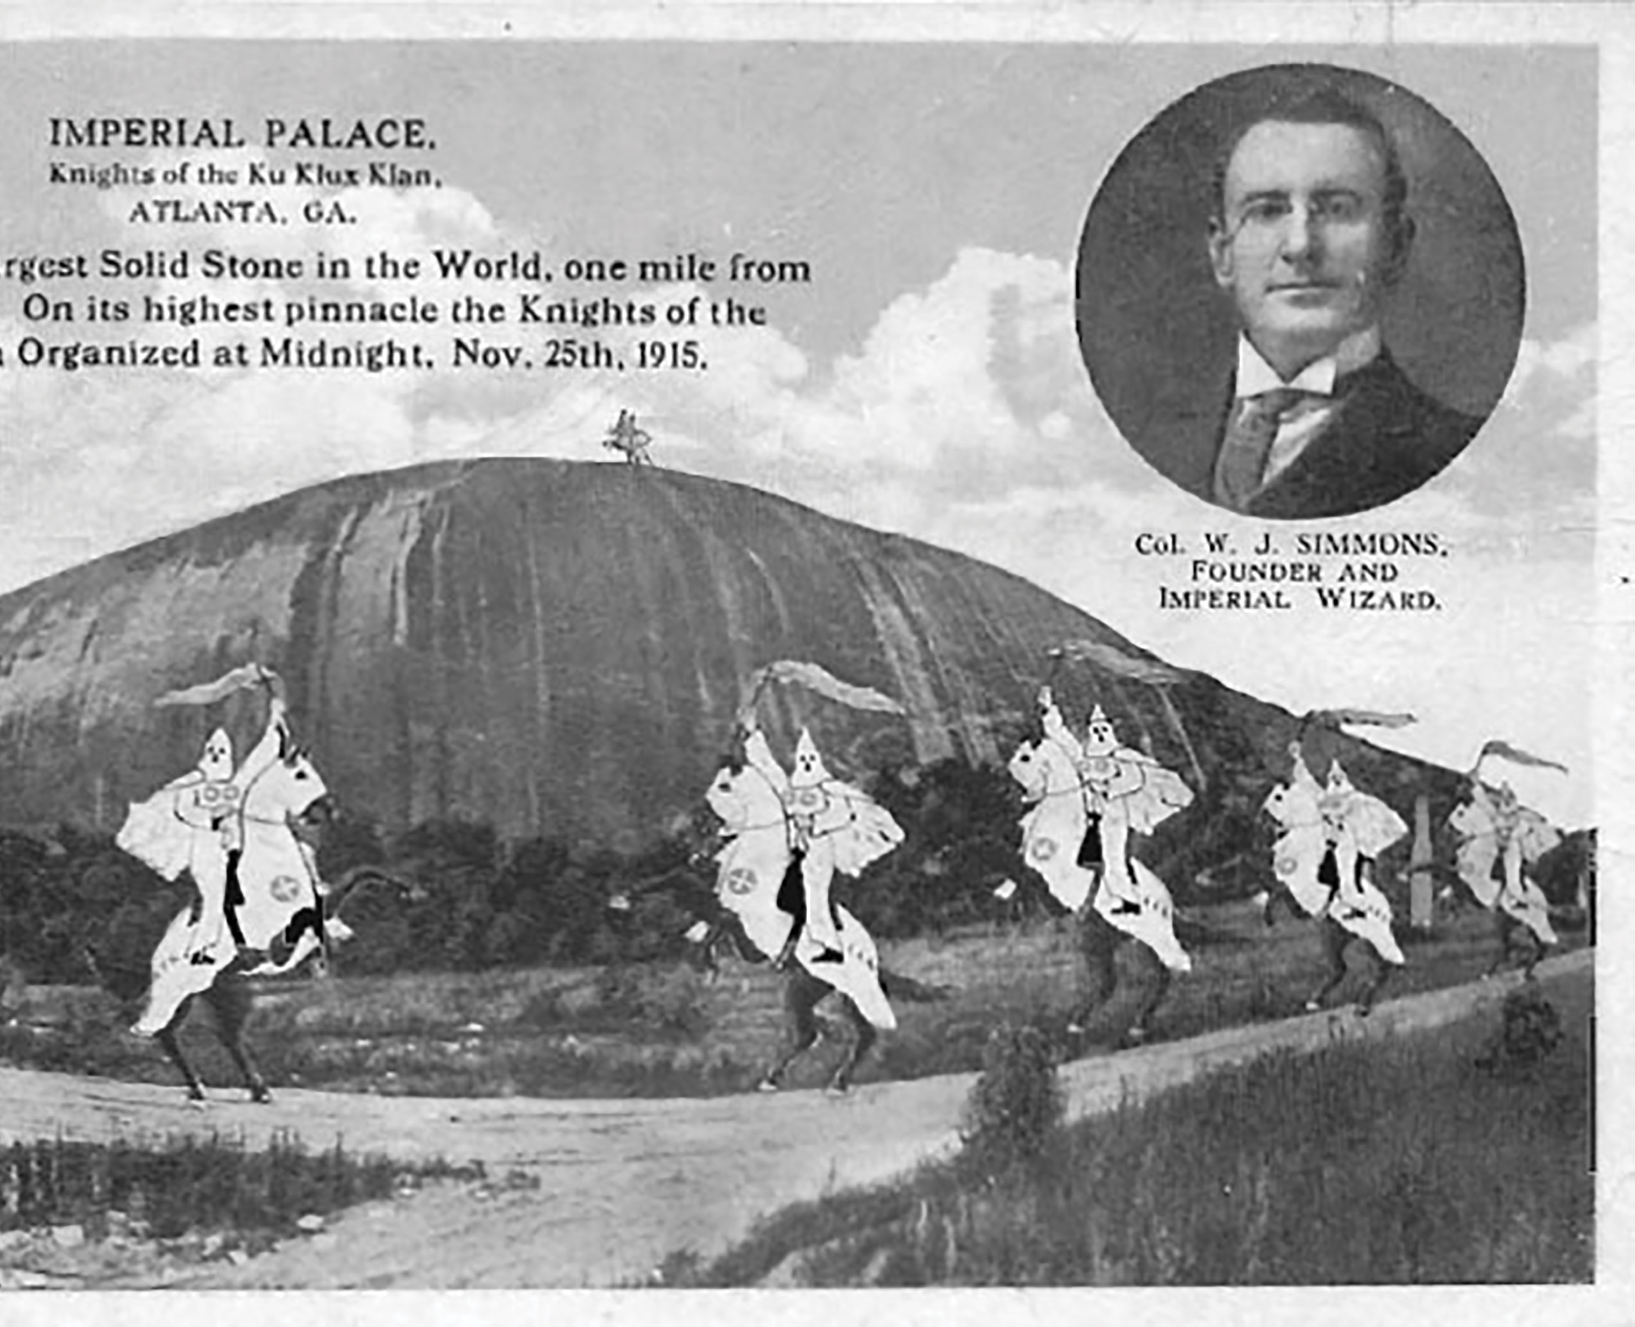

Slide 5
Guiding Principles
Power and Resistance
Structure and Agency
Representation and Performance

Slide 6
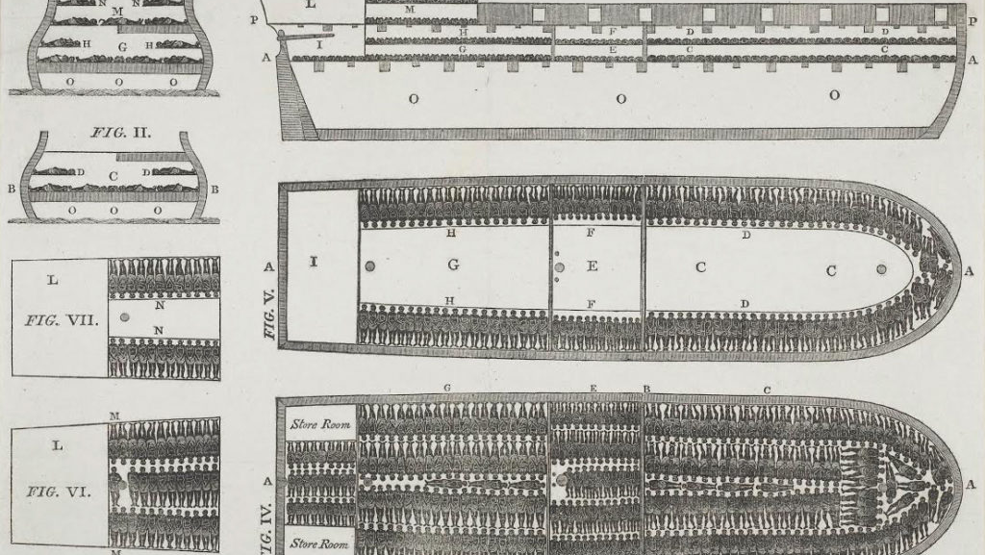
Intentional Language & Intentional Pedagogy

Slide 7
Empowering Students with Intentional Language
Enslaved Africans
Black people
White Southerners
White Plantation Owners
White Supremacy

Slide 8
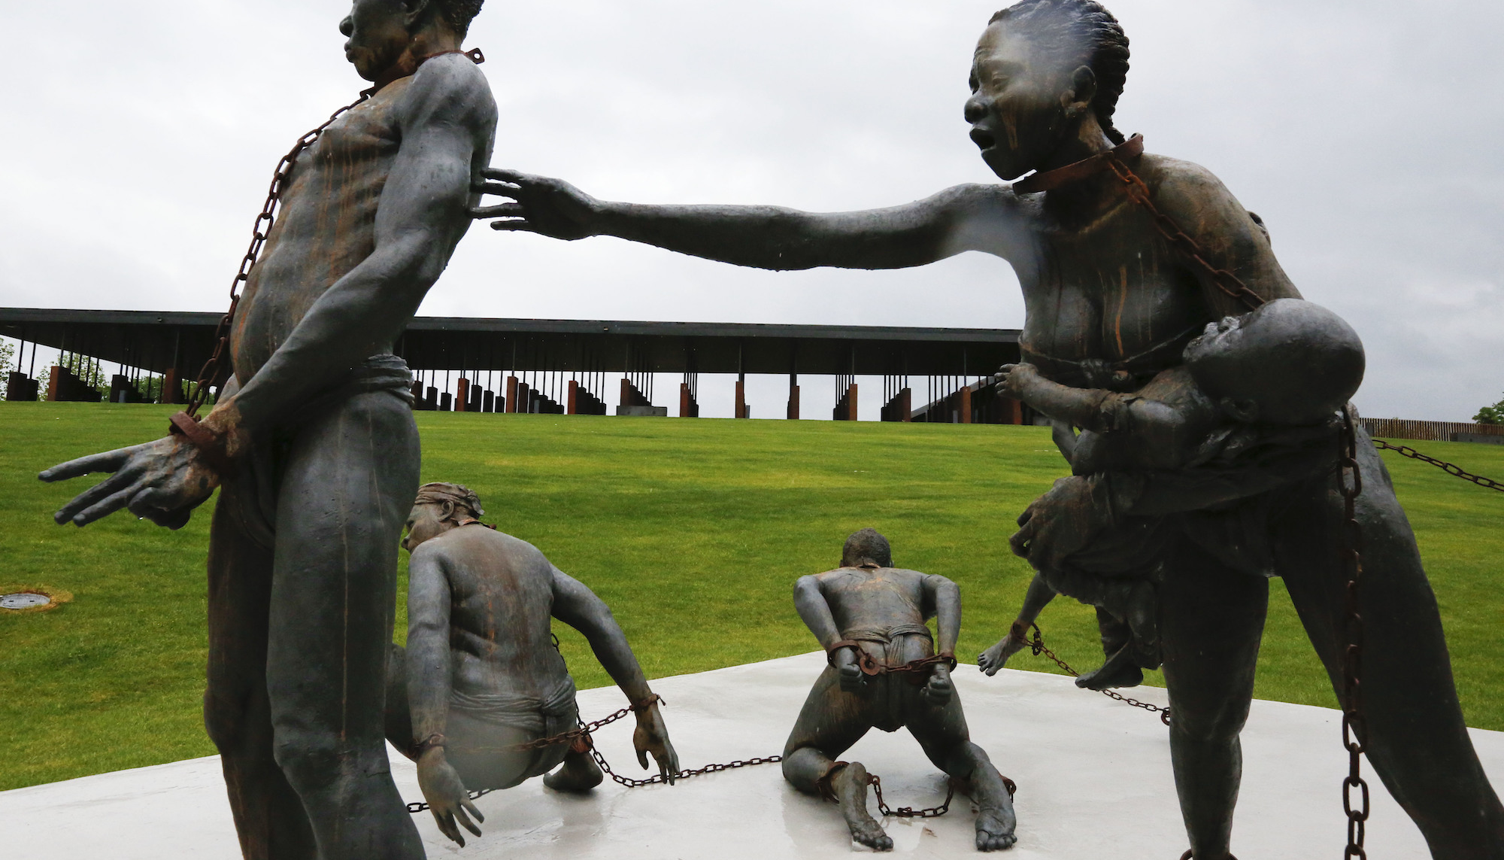
Teaching Antebellum Black Literature
Potential
Students get to go more in depth about a period and subject matter that is routinely glossed over in classrooms.
Pitfalls
Students are often tired of images and conversations around slavery.
Focusing on slavery could reinforce dominant narratives about race if it is not done properly.

Slide 9
The Slave Trade

Slide 10
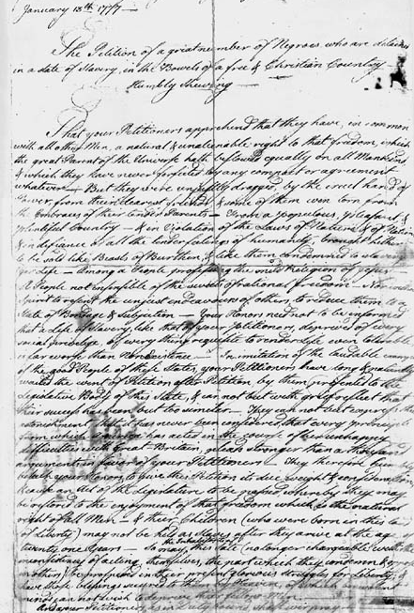
Antebellum and the Enlightenment
Notes:
In 1773 and 1774, both free and enslaved blacks submitted five different petitions to the Massachusetts General Court (the state House of Representatives), urging an end to slavery and the granting of certain rights. In 1777, Prince Hall and eight other black Bostonians presented yet another petition to the General Court, appealing to "A people Not Insensible of the Secrets of Rational Being Nor without spirit to Resent the unjust endeavors of others." Although very similar in language to the one rejected by Governor Thomas Gage in May 1774 -- a number of phrases, in fact, were lifted verbatim -- the new petition was quite different in tone, impatiently noting the fact that "your petitioners have Long and Patiently waited the Event of petition after petition." As it had five times before, the legislature failed to act affirmatively on the petition, referring it instead to the Congress of the Confederation.

Slide 11
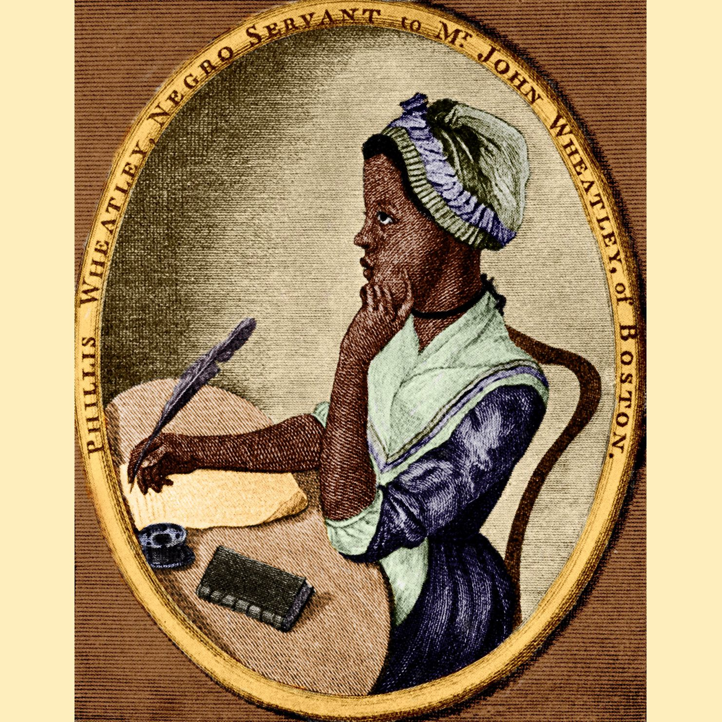
The Talking Book:
Slave Narratives and the Emergence of Black Voices

Slide 12
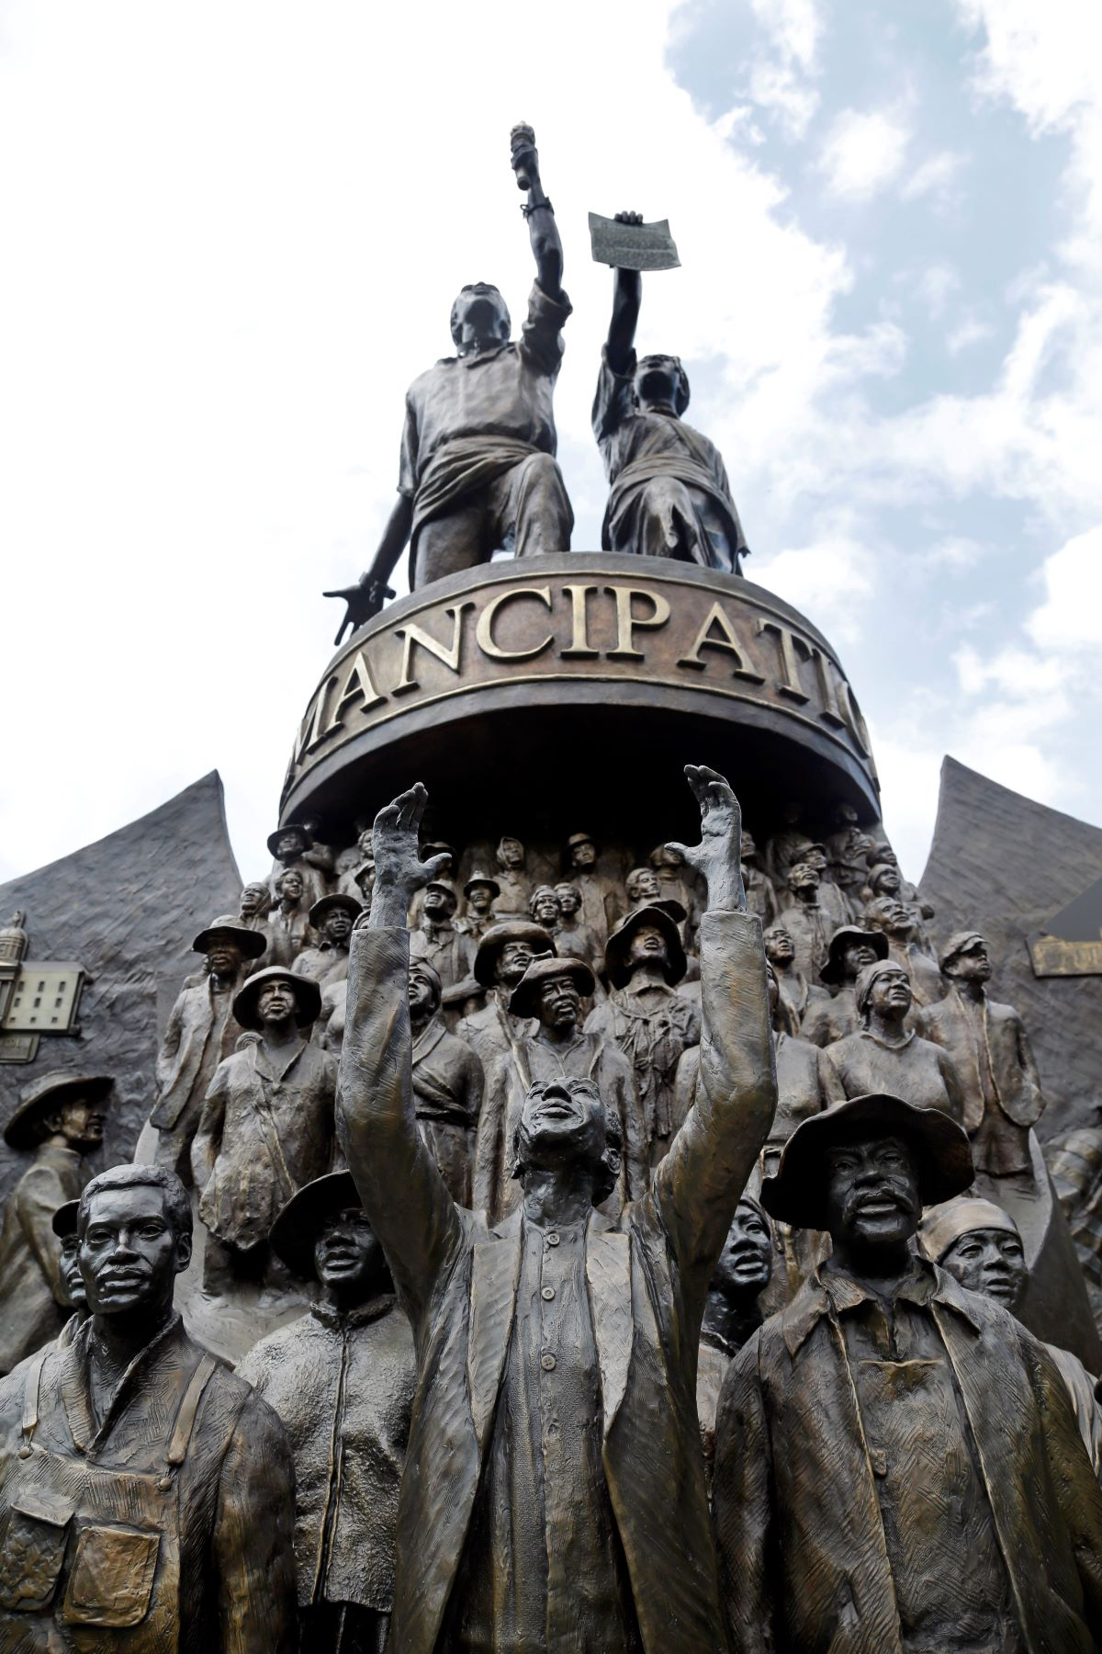
Possible Readings
What to the Slave is the 4th of July
Passages of Frederick Douglass’s Narrative of the Life of Frederick Douglass—especially with his time in Baltimore or his fight for freedom with Mr. Covey
Passages from Harriet Wilson’s “Our Nig”
Passages from Harriet Jacobs about her childhood or trials of girlhood
Passages from Oladauh Equiano—about the middle passage
Passages from Elizabeth Keckley’s Behind the Scenes
David Walker’s Appeal—preface and Article 1

Slide 13
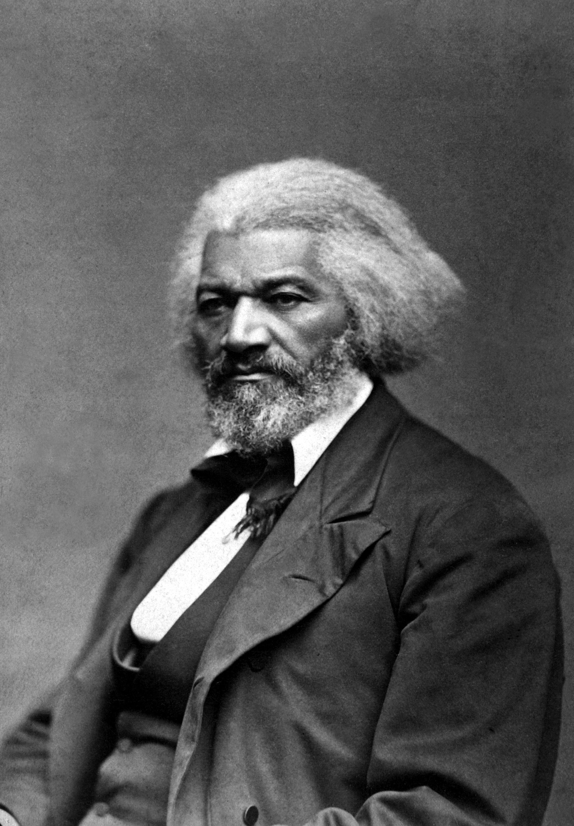
Components of (En)Slave Narratives
White Abolitionist in the preface
Abolitionist in nature—persuasive text
Ethnographic
Literacy narrative
Earlier slave narratives included conversion (Christianity) narratives
White Northern Readership

Slide 14
Key Terms
Abolitionism
Amanuensis
Antebellum/ Postbellum
Enslaved Person/People
Polygenesis
Manumission
Bondage
Peculiar Institution
Slave Narrative

Slide 15
Assignment:
If you were in the room with Phillis Wheatley how would you come to her defense? How would you defend an enslaved Black woman to prominent white Bostonian men who were determining her intellectual and creative genius? By extension, how would you use this opportunity to argue for abolitionism for Black people?

Slide 16
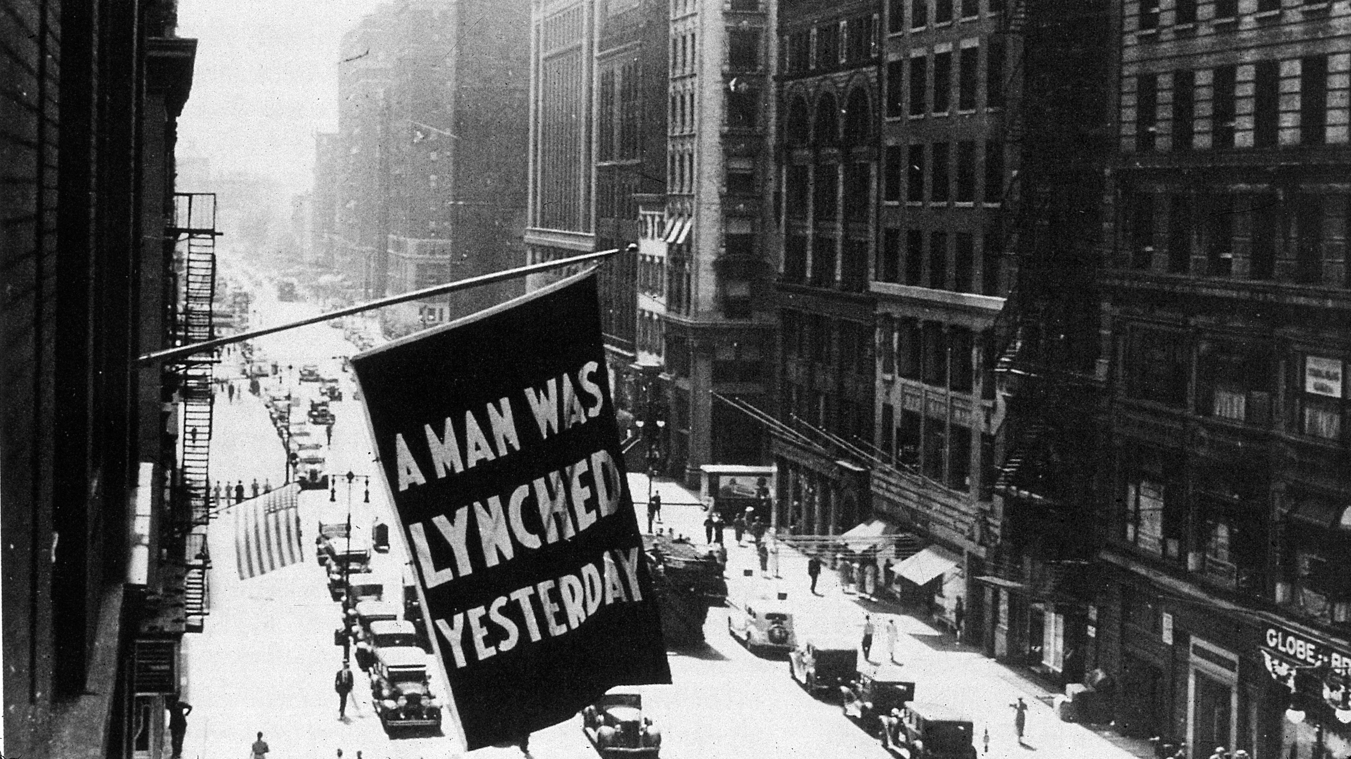
Lynching and Racial Terror
Early 20th Century African American Literature

Slide 17
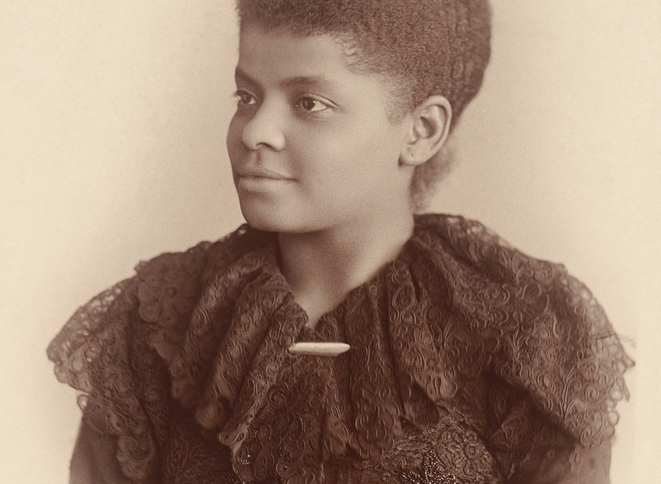
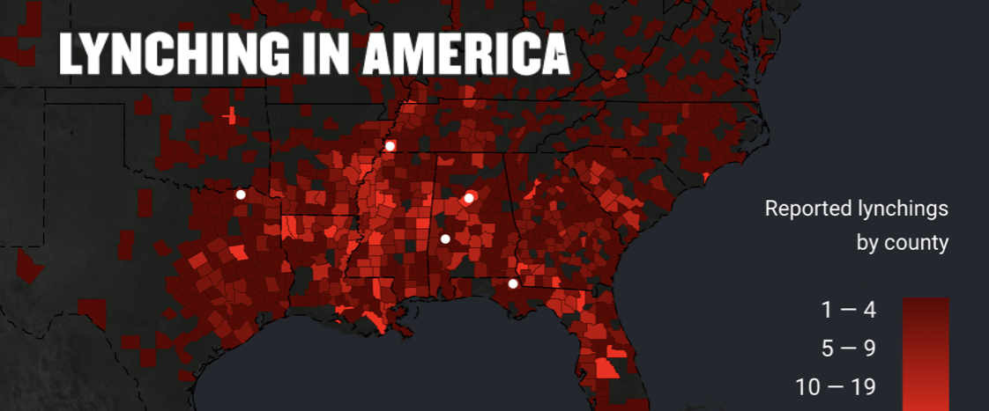
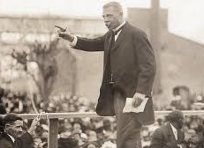
The Great Migration
Ida B. Wells and Booker T. Washington

Slide 18
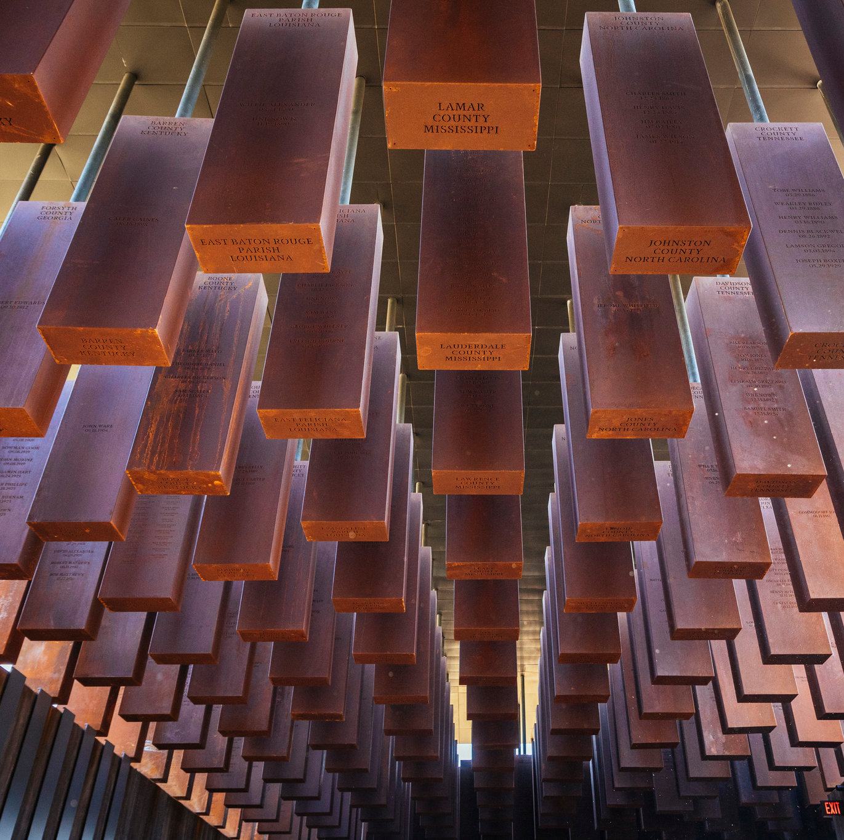
Possible Readings
Paul Laurence Dunbar’s “The Lynching of Jube Benson”
Langston Hughes’ “Home”
Jean Toomer’s poem “A Portrait in Georgia”
Claude McKay’s poem “If We Must Die”
Billie Holiday’s “Strange Fruit”

Slide 19
Resources
https://www.pbs.org/wgbh/aia/part2/2h32.html (PBS
https://www.youtube.com/watch?v=SKo-_Xxfywk (slate Middle Passage)
https://lynchinginamerica.eji.org/explore (lyncing map)
https://lynchinginamerica.eji.org/explore/migration (Great Migration Map)
https://docsouth.unc.edu (digital archive)

