Slide 1
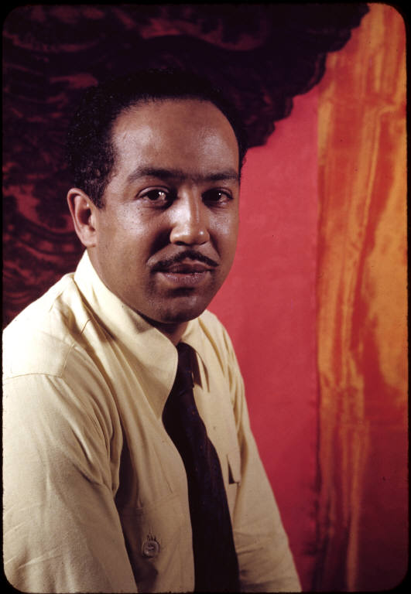
Langston Hughes on America
Dr. Regina Marie Mills
Assistant Professor, Texas A&M University
Humanities Texas Teacher Professional Development
October 20, 2020
This Photo by Unknown Author is licensed under CC BY-ND
Notes:
Thank you very much for the opportunity to present today on Langston Hughes, a truly multi-faceted artist whose work has been incredibly influential to American arts and letters overall, as well as our conceptions of what Black American literature is and should entail.

Slide 2
ELA TEKS
The lecture and workshop today could be used to teach the following TEKS:
7E (Multiple genres): analyze characteristics and structural elements of argumentative texts such as:
(i) clear arguable claim, appeals, and convincing conclusion;
(ii) various types of evidence and treatment of counterarguments, including concessions and rebuttals; and
(iii) identifiable audience or reader
8 (Author’s purpose and craft): all parts

Slide 3
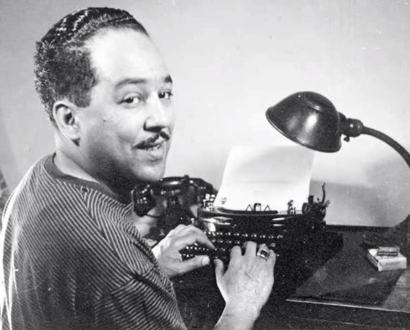
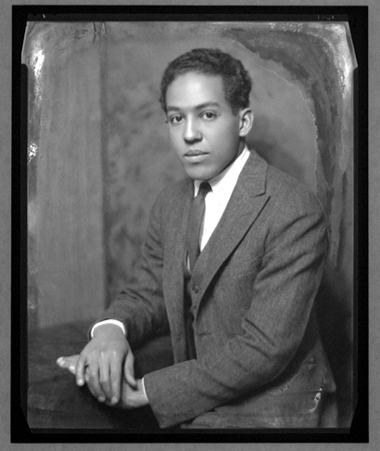
Langston Hughes (1902-1967)
Notes:
Born at the turn of the 20th century and comes of age during WW1. He dies at the end of Civil Rights movement and beginning of the Black Power movement and the Black Arts Movement, which also focused on racial pride but had a more uniformly radical and masculinist message. There were many conservative strains of the Harlem Renaissance, which were (for the most part) strongly rejected by BAM.

Slide 4
Langston Hughes
Hughes was born and raised in the Midwest but lived most of his adult life in Harlem.
A prolific writer throughout his life
First published poem, “The Negro Speaks of Rivers” when he was 19
His finances were dependent on patrons (upper class people who would support artists) and writing for survival, as he couldn’t get the money or prestige of white writers.
“Poet to Patron”
Notes:
Harlem was a changing place, impacted by the Great Migration, changing demographics

Slide 5
Top 3 Things to Know about Langston Hughes
One of the most well-known artists of the Harlem Renaissance
Known primarily for his poetry but he was also a playwright (writer of drama/theater/plays), serial writer, and novelist.
Writer of the working-class
Notes:
3 main points on Hughes:
1.When we think of the Harlem Renaissance, most of us think of Langston Hughes.
2. Renaissance man – he tried all the genres – short stories like his Simple sketches, plays, musicals, poetry, novels, and autobiographies
3. Part of that is because he wrote in a very accessible way, like many socialist and working-class writers. Hughes wrote poems on basically everything – from his poem about poetry, “Formula”: “Poetry should treat / of lofty things”
working-class: Hughes sympathized with Communism and wrote many poems extolling socialism. However, during the Red Scare (the time period during the Cold War [a bit before and after the 1950’s] in which fearmongering about a communist threat to the US led to censorship and blacklisting), Hughes distanced himself from leftist groups. During the Red Scare, he saw intellectuals like WEB DuBois destroyed by government campaigns against perceived socialists, especially socialists of color. For instance, despite having no evidence, the government took Du Bois to court for espionage. While he was found not guilty, he felt like he needed to leave the country and while he was traveling, the US government revoked his passport (which is why Du Bois died in Ghana since the US basically made him a stateless person). See this article: http://bostonreview.net/race-politics/andrew-lanham-when-w-e-b-du-bois-was-un-american

Slide 6
Langston Hughes
Hughes wrote in a variety of genres but today we’ll focus on two:
The Manifesto
“The Negro Artist and the Racial Mountain”
Poetry (for the workshop portion)
“Formula” and “Call to Creation”

Slide 7
“The Negro Artist and the Racial Mountain” (The Nation, 1926)

Slide 8
Context of Hughes’ Manifesto
published in The Nation in June 1926
a response to George Schuyler’s “The Negro-Art Hokum” published the week before
Hughes was early in his career, attending college at Lincoln University (PA) when the manifesto was published.
Had recently published his first book of poetry, The Weary Blues (1926)
Manifesto: a “document of an ideology, crafted to convince and convert” (Mary Ann Caws, Manifesto: a Century of Isms)
Notes:
Response to George Schuyler’s “The Negro-Art Hokum” published in The Nation
The manifesto provides the foundation of an artistic movement – its motives, intentions, values, and why it is necessary in that social and historical context.
This can be taught alongside other manifestos, as a way of talking through the genre and its conventions

Slide 9
Manifesto as Genre – 10 min
A manifesto is a form of nonfiction
a public declaration which points out an issue in society and puts forward a solution to that issue.
While often considered political (ex. Communist Manifesto), there have been many important art manifestos.
There are many structures that manifestos follow such as the list of grievances (ex. Declaration of Independence), which identifies the problems or complaints that a group has against another group and the proposed solution.
Art manifestos play with language, engage with other ideas and definitions of art, and put forth important questions to the art community.
Art manifestos answer questions like, “what is the purpose of art?” or “what is the role of the artist in society?” or “how can art affect the society at large?”

Slide 10
Hughes on Art
The manifesto genre and its role in art
Class, race, and art
What is the “racial mountain”?
What does “American” mean? What does “Black” mean?
What were the values of the artistic movement within the Harlem Renaissance?

Slide 11
The Hook
“One of the most promising of the young Negro poets said to me once, "I want to be a poet--not a Negro poet," meaning, I believe, "I want to write like a white poet"; meaning subconsciously, "I would like to be a white poet"; meaning behind that, "I would like to be white." And I was sorry the young man said that, for no great poet has ever been afraid of being himself. And I doubted then that, with his desire to run away spiritually from his race, this boy would ever be a great poet.”

Slide 12
Context of Hughes’ Manifesto Hook
The “young Negro poet” is Countee Cullen
Cullen’s 1924 quote from the Brooklyn Eagle:
If I am going to be a poet at all, I’m going to be POET, not NEGRO POET. This is what has hindered the development of artists among us. Their one note has been the concern with their race. That is all very well, none of us can get away from it. I cannot at times. You will see it in my verse. The consciousness of this is too poignant at times. I cannot escape it. But what I mean is this: I shall not write of negro subjects for the purpose of propaganda. That is not what a poet is concerned with. Of course, when the emotion rising out of the fact that I am a negro is strong, I express it. But that is another matter.
Notes:
“Yet Do I Marvel” as an example of this poem that is conscious of blackness and how blackness and art are seen as mutually exclusive.

Slide 13
What is the Racial Mountain?
“But this is the mountain standing in the way of any true Negro art in America--this urge within the race toward whiteness, the desire to pour racial individuality into the mold of American standardization, and to be as little Negro and as much American as possible.”
Notes:
Anti-blackness, the desire to be physically and culturally white
“American standardization” – erasure of difference, homogeneity of art; assimilation
To be “American” and not Black
What is the implied definition of American?

Slide 14
Class and the Racial Mountain
The Middle class: “people who are by no means rich yet never uncomfortable nor hungry--smug, contented, respectable folk, members of the Baptist church.”
The Upper class: “For racial culture the home of a self-styled "high-class" Negro has nothing better to offer. Instead there will be perhaps more aping of things white than in a less cultured or less wealthy home.”
The Lower class: “But then there are the low-down folks, the so-called common element, and they are the majority--may the Lord be praised! […] They furnish a wealth of colorful, distinctive material for any artist because they still hold their own individuality in the face of American standardization.”

Slide 15
What should Black American art value?
What is unique to blackness
jazz, blues, spirituals
Freedom and Racial Pride
not the approval of white gatekeepers or middle/upper-class Black people
The full humanity of Black people
“We know we are beautiful. And ugly too.”

Slide 16
Bonus – Jesse B. Semple Stories
If you’re interested in teaching students about serials and examining stories with attention to narration and characterization, the Simple stories are a great text to use.
“Banquet in Honor” can be paired well with “The Negro Artist and the Racial Mountain”
I’ve also included other stories I enjoy teaching
Here you can find 4 stories narrated by Ossie Davis.

Slide 17
Q&A
Feel free to contact me at rmills@tamu.edu if you think of additional questions

Slide 18
Workshop
Anticipation Question:
What do you think poetry is supposed to do? What purpose does it have?
(this is also a useful question for students)

Slide 19
Discussion Questions
What argument does the poem “Formula” make about what poetry “is” or should do?
How does “Formula” compare to “Call to Creation” – do they have similar or different views?
“Call to Creation,” published in 1931, mentions several countries outside of the US. What purpose do you think this serves? Is there anything you want to look up about the time period or Hughes that you think would help you understand the poem better?
As teachers, what other poets or poems do you think might be useful to pair with these ars poetica pieces?

