Slide 1
Native Americans in Mexican Texas, 1820-1835
Emigrant Indians

Slide 2
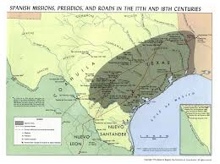

Slide 3
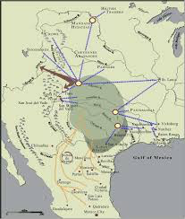

Slide 4
Emigrant Indians to Texas
Southeastern Texas:
Alabamas, Coushattas, Apalaches, Tensas,
Biloxis, Pascagoulas
Northeastern Texas:
Cherokees, Shawnees, Delawares, Kickapoos

Slide 5
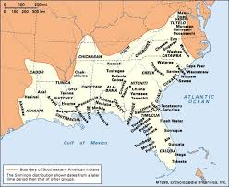

Slide 6
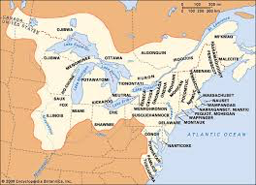

Slide 7
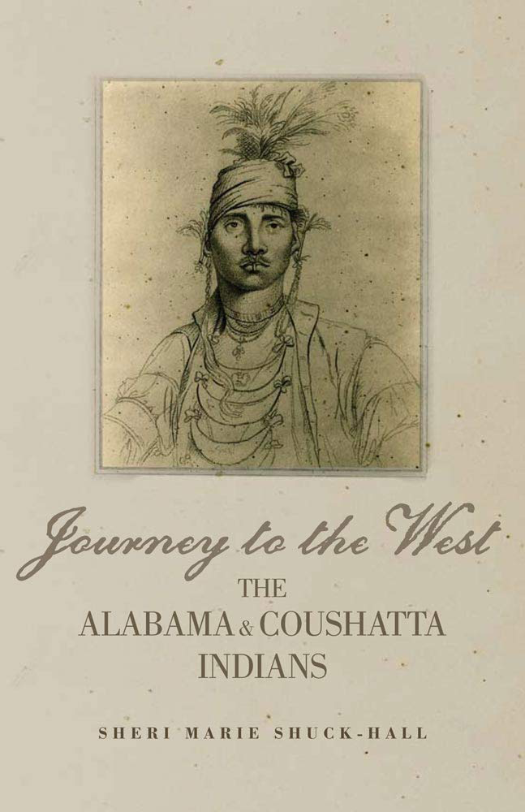

Slide 8
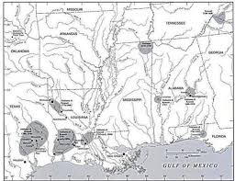

Slide 9
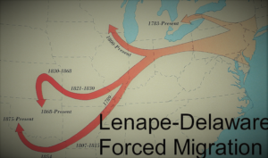

Slide 10
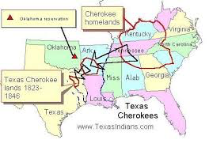

Slide 11
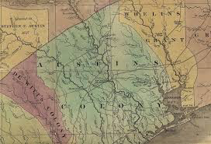

Slide 12
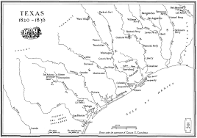

Slide 13
Emigrant Indian Timeline
1803-1812 Alabama-Coushattas, et al settle in SE Texas
1815-1825 Cherokees, et al settle in NE Texas
1822 Trespalacios-Fields Agreement
1826 Fredonian Rebellion
1828 Mier y Terán Meets Emigrants
1830 Attacks on Wacos and Tawakonis
1831 Terán Orders Land Grants for Emigrants
1832 Land Grants Stall
1833 Cherokees meet w/Gov. Veramendi
1836 Treaty of 2/23/26 w/Texas Revolutionaries
1837 Texas Senate Rejects Treaty of 2/23/36
1839 Cherokee War and Removal from Texas

Slide 14
