Slide 1
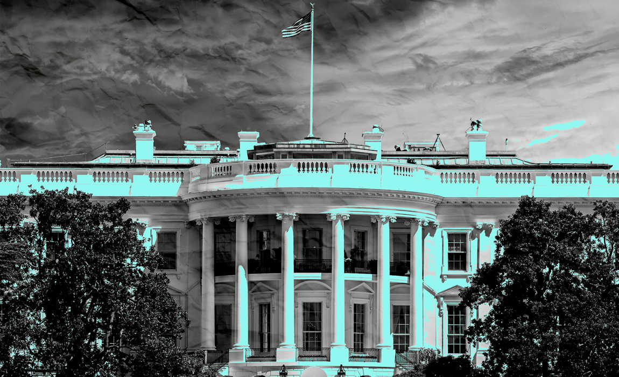
Richard Nixon and the Watergate crisis

Slide 2
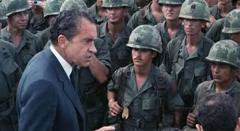
Nixon’s legacies: more than Watergate?

Slide 3
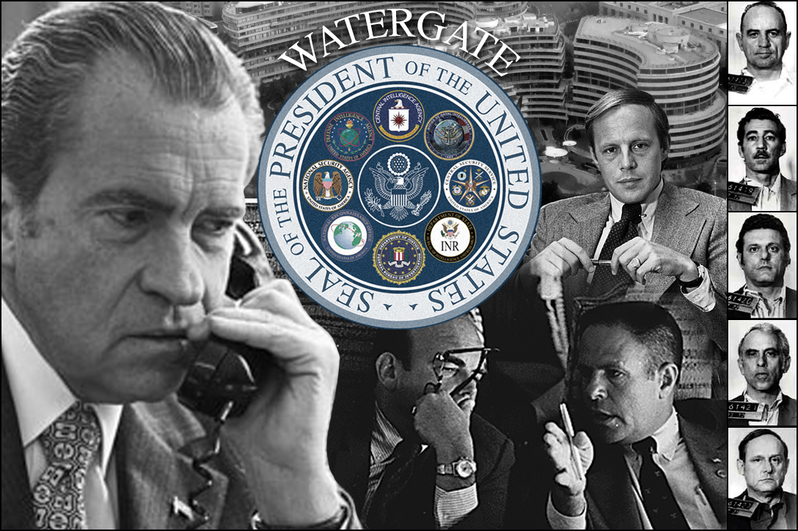
not just a “third-rate burglary”
greatest scandal in presidential history
greatest Constitutional crisis since the Civil War

Slide 4
Magnitude & scope of Nixon’s criminality
14 close aides would serve time
three AGs, his campaign manager, His Chief of Staff, White House counsel
Nixon himself an “unindicted co-conspirator”

Slide 5
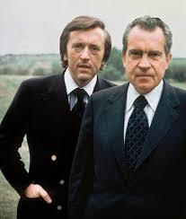
“If the president does it, that means that it is not illegal.”
—Richard Nixon

Slide 6
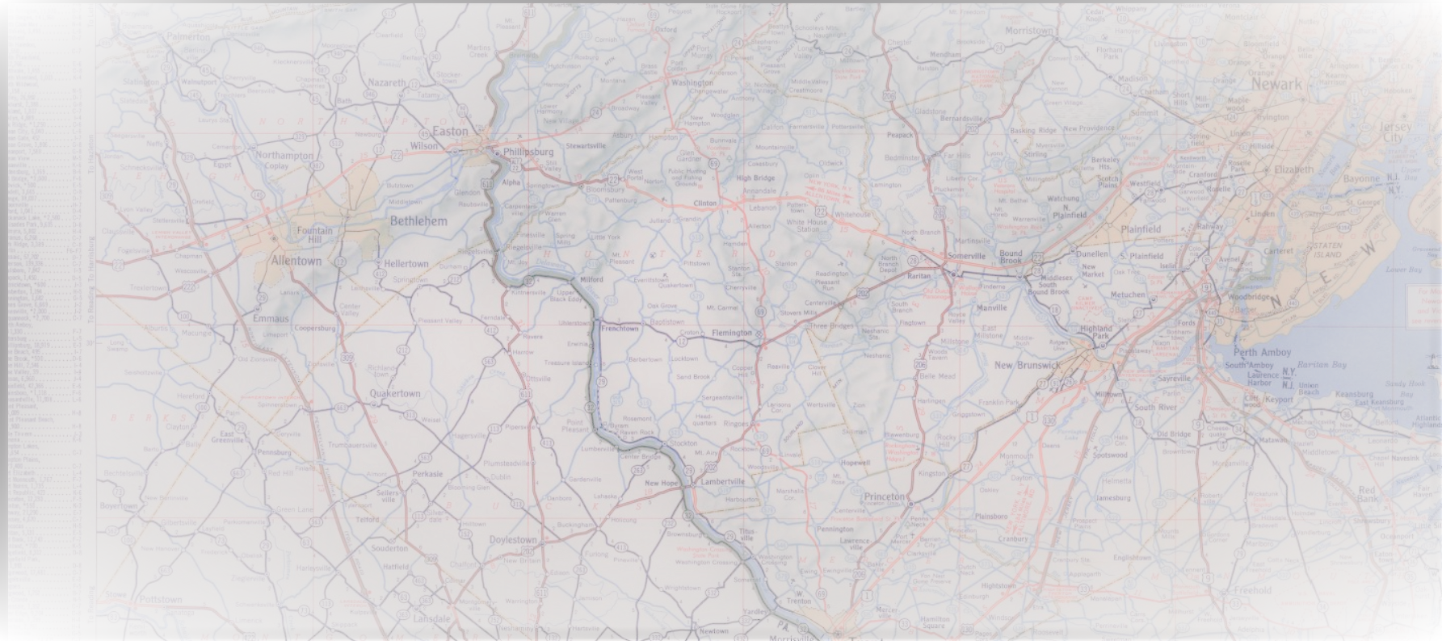
Today’s Road Map
Frameworks for understanding Watergate
“White House Horrors”
The break-in & cover-up
The unraveling
The meaning of Watergate

Slide 7
Today’s Road Map
Frameworks for understanding Watergate
“White House Horrors”
The break-in & cover-up
The unraveling
The meaning of Watergate

Slide 8
Today’s Road Map
Frameworks for understanding Watergate
“White House Horrors”
The break-in & cover-up
The unraveling
The meaning of Watergate

Slide 9
Today’s Road Map
Frameworks for understanding Watergate
“White House Horrors”
The break-in & cover-up
The unraveling
The meaning of Watergate

Slide 10
Today’s Road Map
Frameworks for understanding Watergate
“White House Horrors”
The break-in & cover-up
The unraveling
The meaning of Watergate

Slide 11
Watergate: Individual Personality?
Paranoid, vindictive personality
Creature of the age of public relations
Thrived on polarization

Slide 12
Watergate: or structural Forces?
Imperial presidency
Crisis of authority
Strife over Vietnam War

Slide 13
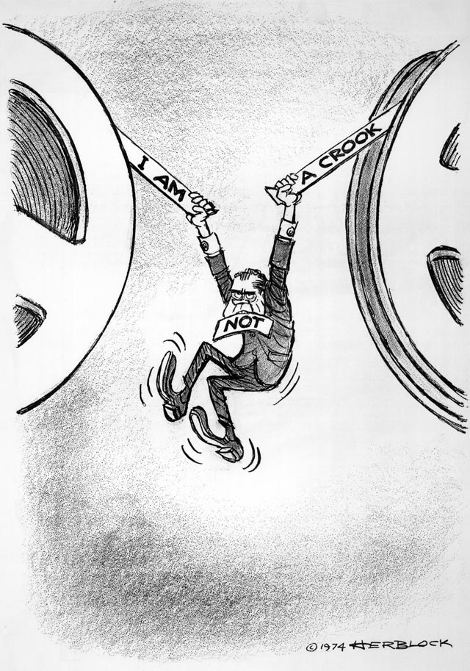
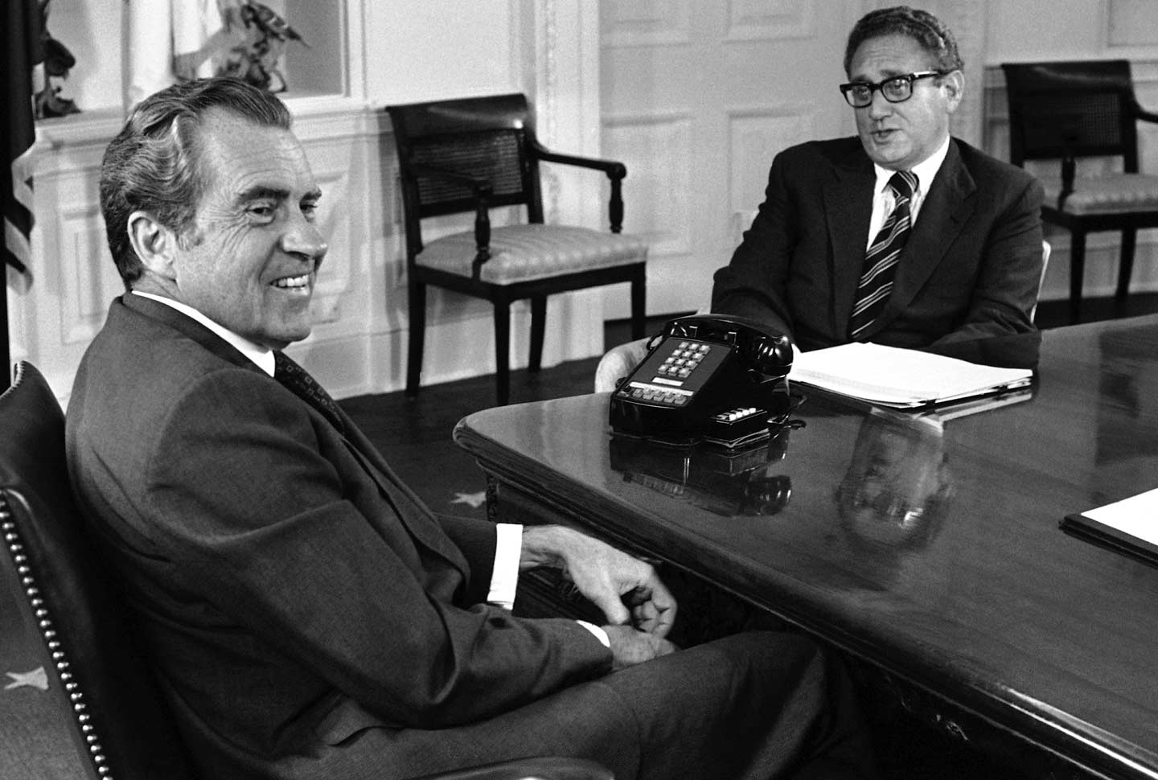
Before the break-in
Wiretaps
Secret White House Tapes
Plumbers Unit Burglaries
Ratf*cking
Discussed Killing Journalist
Abuse of FBI, IRS Against Nixon’s Enemies

Slide 14
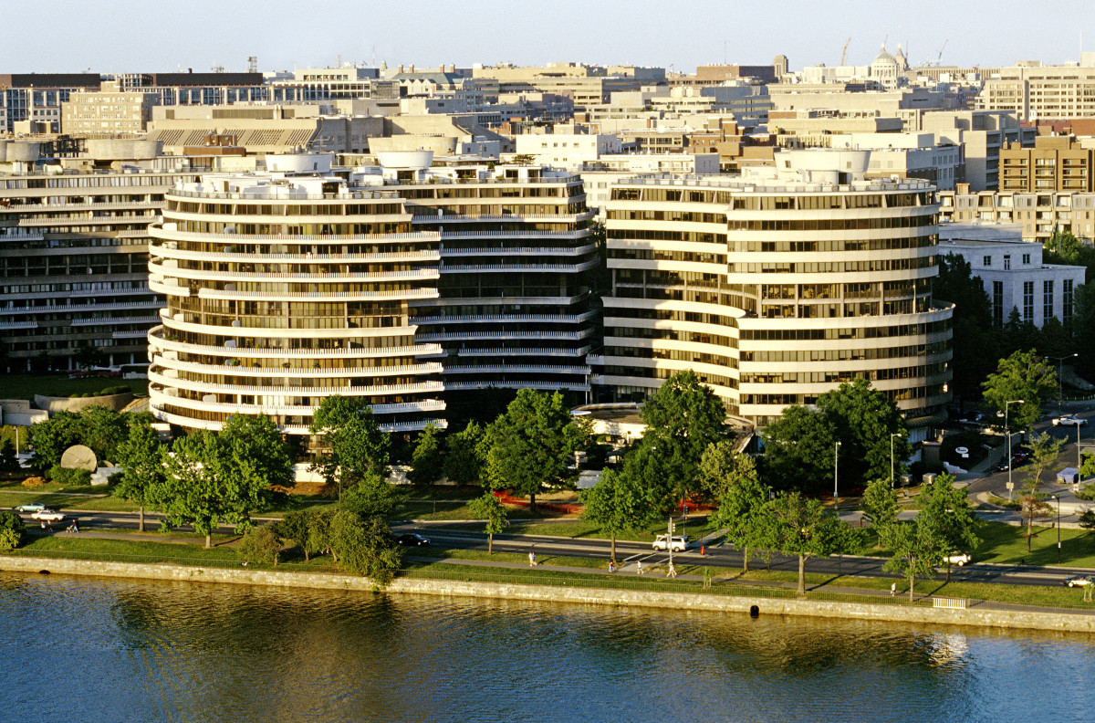
two break-ins at DNC HQ at the Watergate
placing wiretaps
June 17, 1972: 5 burglars caught; found to have White House ties
Did Nixon know?

Slide 15
cover-up (“obstruction of justice”)
Destruction of documents
Nixon meets with top aides to plot cover-up
Nixon has CIA tell the FBI not to investigate, falsely citing national security concerns
public cover-up: Nixon goes on TV, denies that he or anyone in the White House is involved
payment of hush money (bribes) to burglars
“And you could get it in cash. I know where it could be gotten. ... It would seem to me that would be worthwhile.”

Slide 16
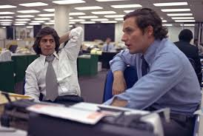
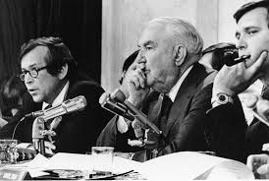
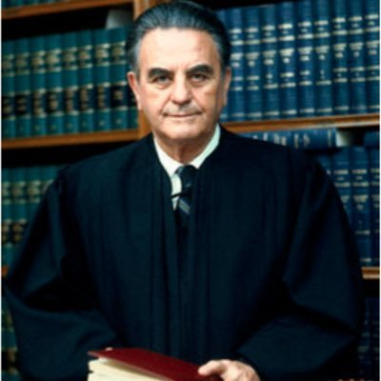
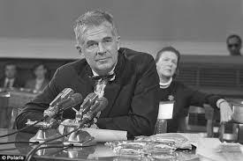
The UNraveling
the press
the Senate
the special prosecutor
the courts

Slide 17
I've welcomed this kind of examination, because people have got to know whether or not their President is a crook. Well, I'm not a crook!
—Richard Nixon

Slide 18
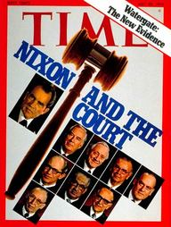
Congress and the Supreme Court:
Impeachment and Resignation
House Judiciary Committee considers impeachment
Court rules 8-0 against Nixon in tapes case
rejects counts on Cambodia and tax returns
Three counts: obstruction, abuse, defiance of subpoenas

Slide 19
Nixon resigns
Agnew previously resigned as vice president
Aug. 1974: After hearing the “smoking gun” tape, Congressional GOP leaders tell Nixon he’s finished
Vice President Gerald R. Ford: “Our long national nightmare is over.”
Weeks later, Ford pardons Nixon
loses to Jimmy Carter in 1976

Slide 20
The end of a Presidency
Rise of National Security State?
Nixon’s character?
Convergence of man and moment

