Slide 1
The Origins of the Cold War
Mark Lawrence
Lyndon B. Johnson Presidential Library
University of Texas at Austin

Slide 3
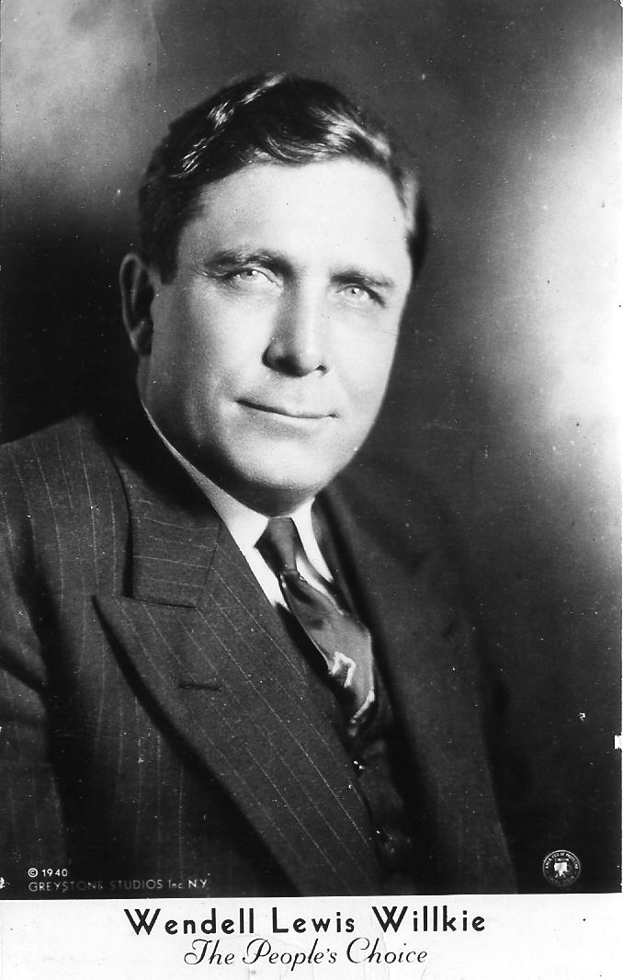
No, we do not need to fear Russia. We need to learn to work with her against our common enemy, Hitler. We need to learn to work with her in the world after the war. For Russia is a dynamic country, a vital new society, a force that cannot be bypassed in any future world.
-- Wendell L. Willkie, One World (1943)

Slide 4
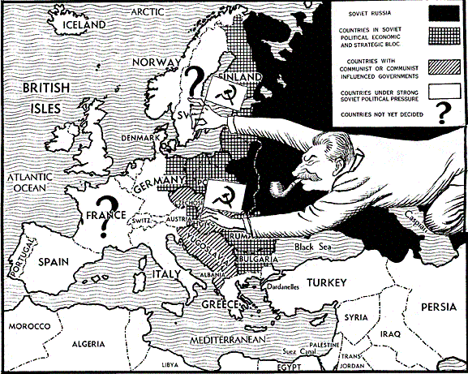

Slide 5
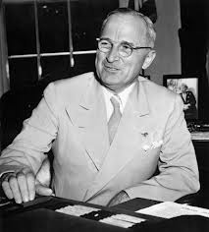
At the present moment in world history nearly every nation must choose between alternative ways of life. The choice is too often not a free one.
One way of life is based upon the will of the majority, and is distinguished by free institutions, representative government, free elections, guarantees of individual liberty, freedom of speech and religion, and freedom from political oppression.
The second way of life is based upon the will of a minority forcibly imposed upon the majority. It relies upon terror and oppression, a controlled press and radio; fixed elections, and the suppression of personal freedoms.
-- Harry Truman, March 1947

Slide 6
Tensions escalate
February & July 1945: Conferences at Yalta and Potsdam
March 1946: Churchill’s “Iron Curtain” speech
March 1947: Truman Doctrine speech
June 1947: Marshall Plan announced
February 1948: Communist coup in Czechoslovakia
June 1948: Berlin blockade begins
April 1949: NATO established
August 1949: Soviet atomic test
October 1949: communist victory in China
June 1950: outbreak of war in Korea

Slide 7
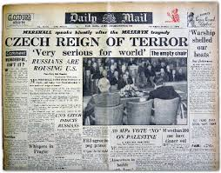
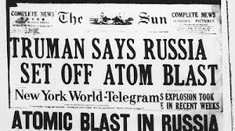
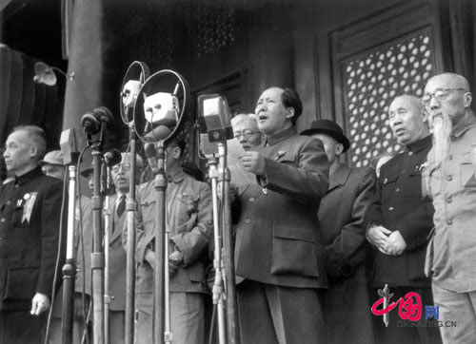

Slide 8
Explaining the U.S.-Soviet Antagonism: Three schools of thought
Orthodox: Soviet responsibility
Revisionist: U.S. responsibility
Post-revisionist: irreconcilable visions of the future

Slide 9
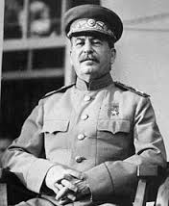
The Soviet vision
Control Eastern Europe
Weaken Germany
Cooperation if possible, confrontation if necessary to achieve 1 and 2
Opportunism elsewhere to extend Soviet influence

Slide 10
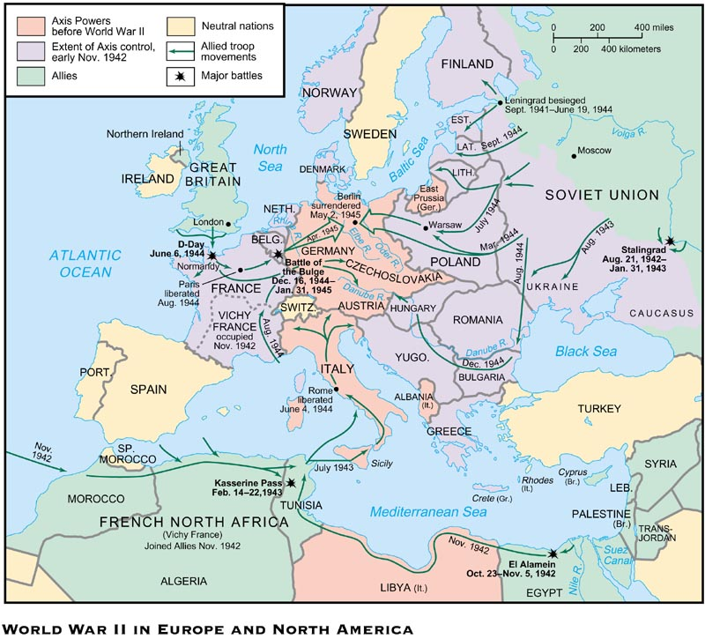

Slide 11
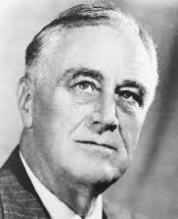
The U.S. vision
1. American leadership
2. Open world economic order
Decolonization
Collective security

Slide 12
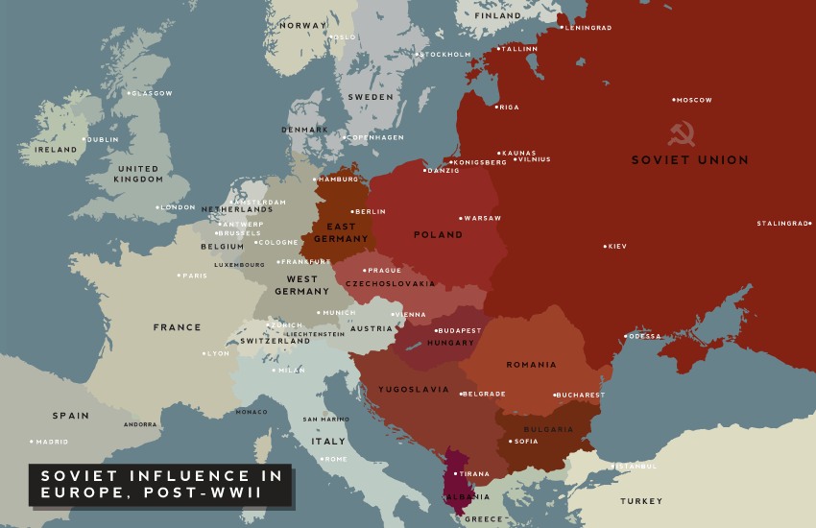
Points of Contention
Status of Eastern Europe
Status of Germany

Slide 14
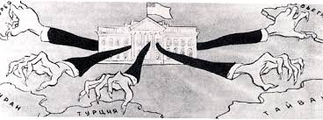

Slide 15
Irritants
1. Long-standing anticommunism
2. Wartime tensions
3. Atomic weapons

Slide 16
Globalization of the Cold War
Soviet probing around periphery
End of the Chinese civil war
Anti-colonial uprisings
Surging anti-communist in the US

