Slide 1
American Life Between the Wars
David Oshinsky, PhD
Director, Division of Medical Humanities
NYU Langone Health

Slide 2
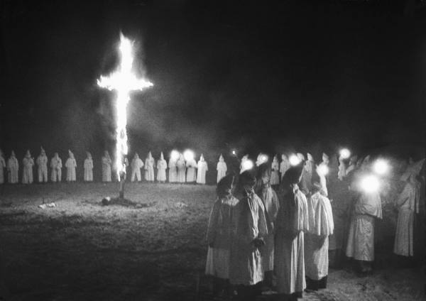
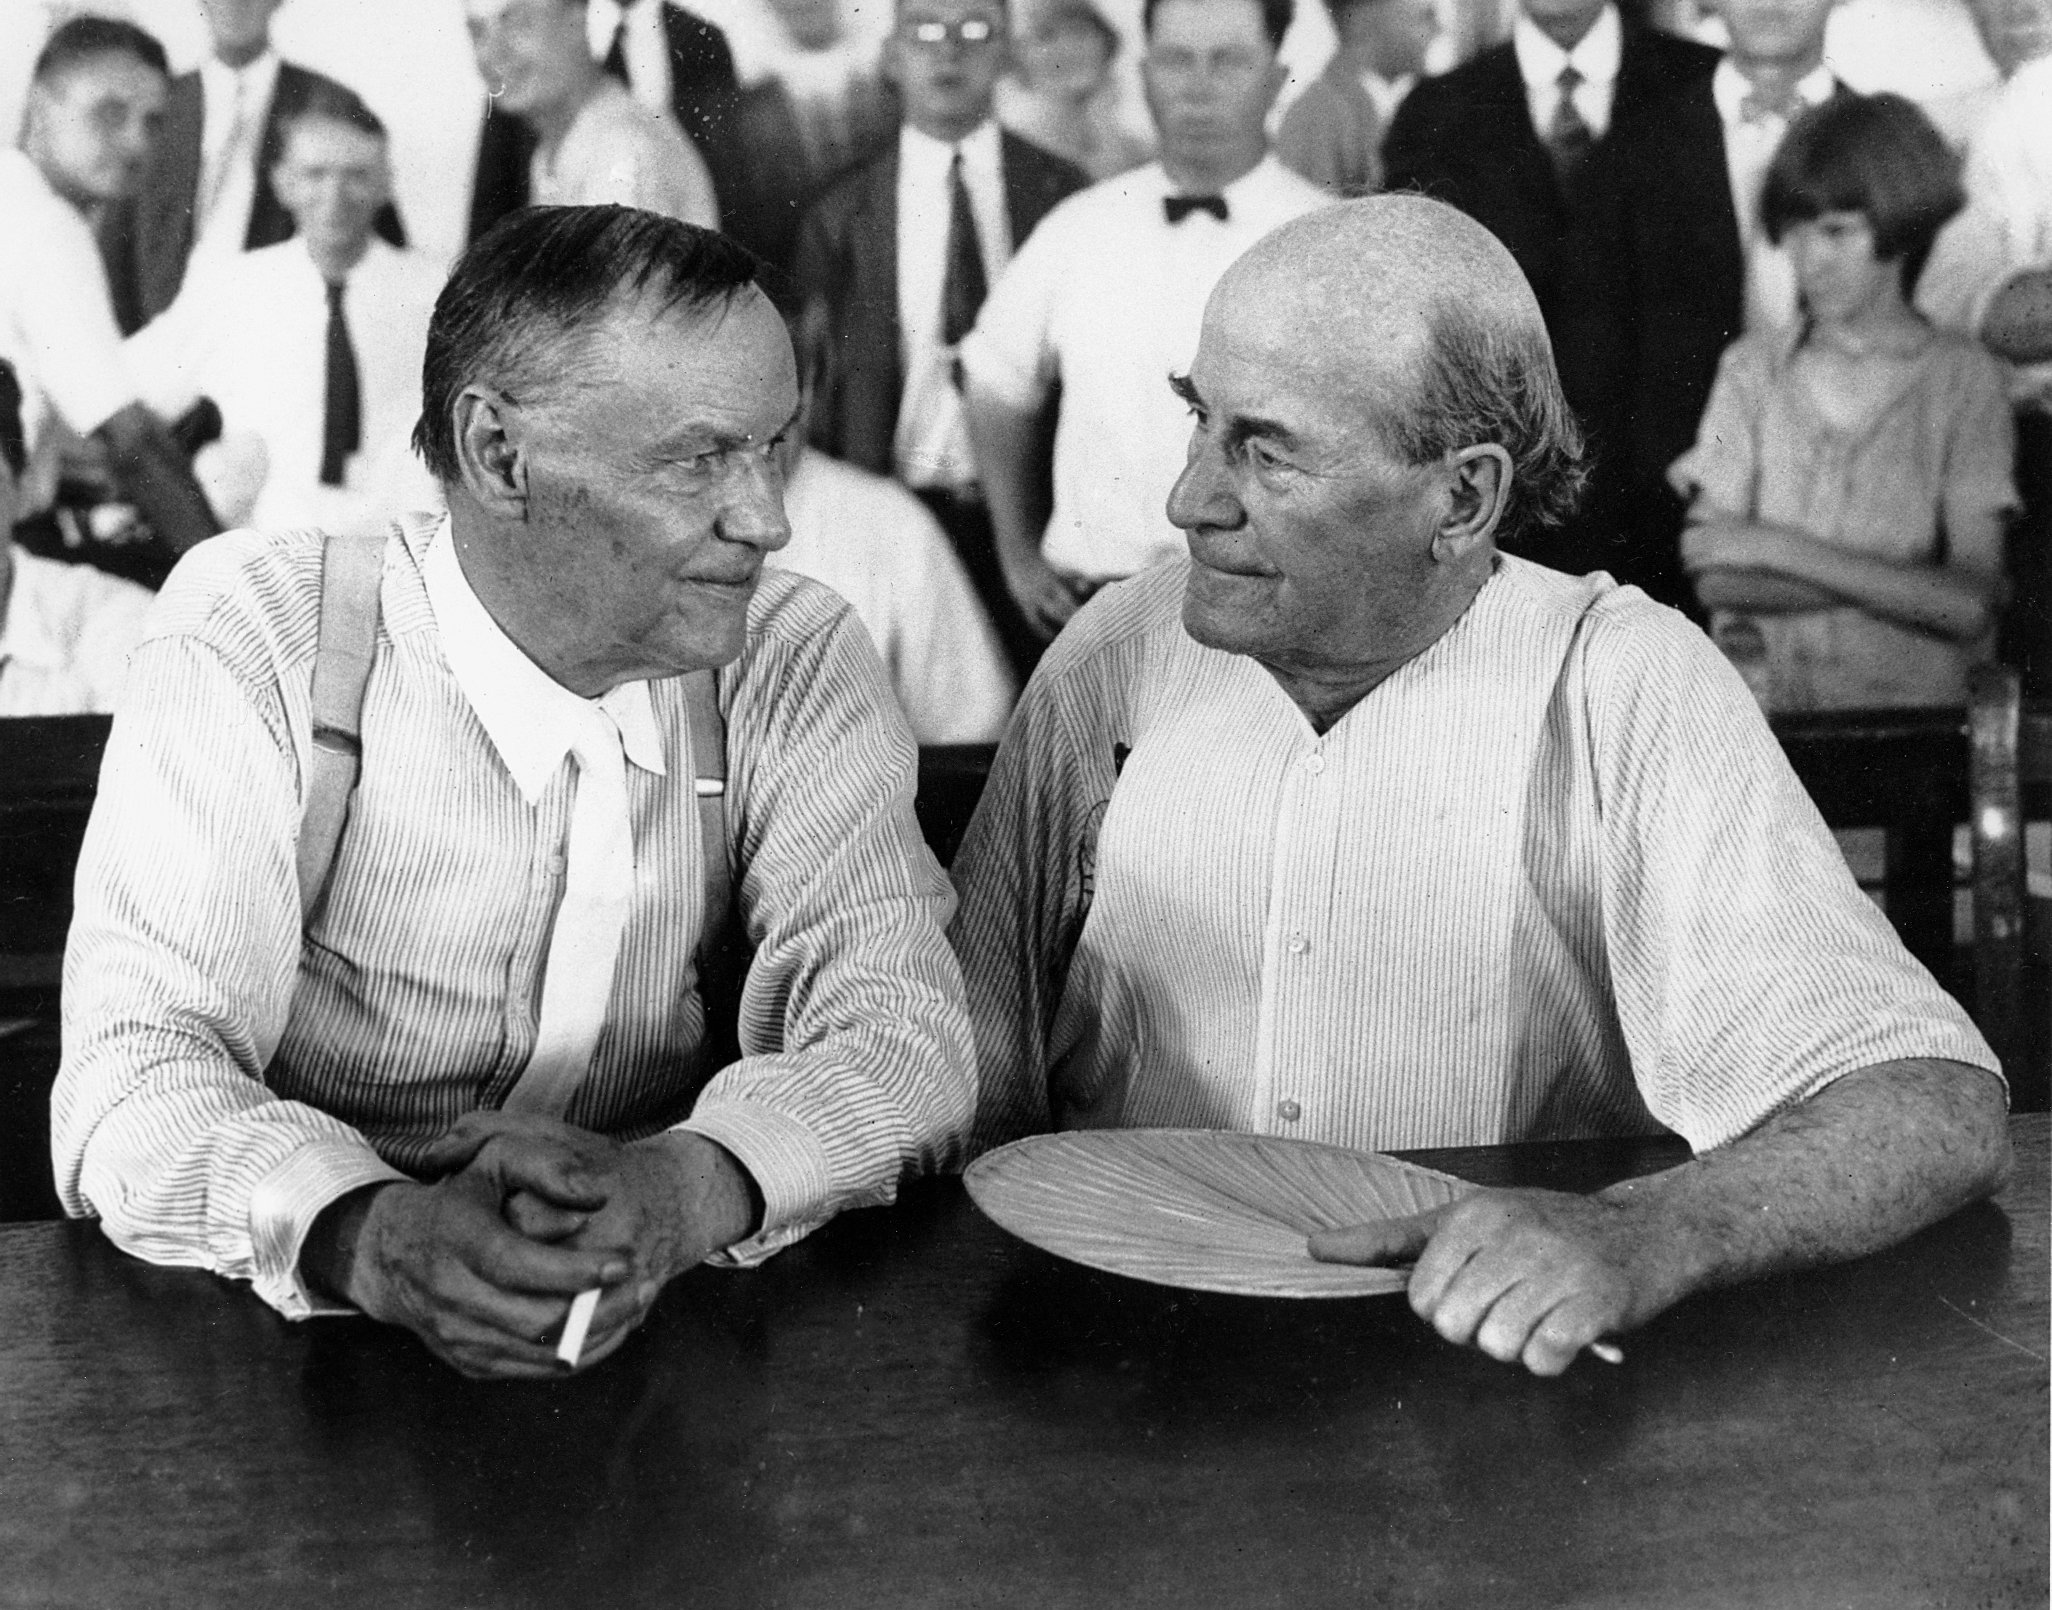

Slide 3
