Slide 1
March 3, 2021
Production and Power in Slave Societies
Big Questions:
1. How did labor shape the lives of enslaved people in the US South?
2. How did enslaved people struggle with their owners? What tools were available to enslaved people seeking power in their lives?

Slide 2
“The general features of slavery are the same everywhere; but the utmost rigour of the system is only to be met with on the cotton plantations of Carolina and Georgia, or in the rice fields which skirt the deep swamps and morasses of the southern rivers. In the tobacco fields of Maryland and Virginia, great cruelties are practised--not so frequently by the owners, as by the overseers of the slaves; but yet, the tasks are not so excessive as in the cotton region, nor is the press of labour so incessant throughout the year.”
Charles Ball, Slavery in the United States (1837), p. 56

Slide 3
“The general features of slavery are the same everywhere…”
- Charles Ball 1. people were treated as property
2. people were compelled to labor
3. slavery was always contested

Slide 4
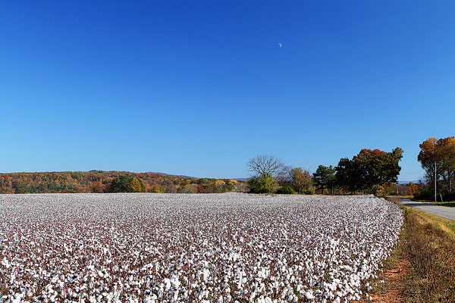

Slide 5
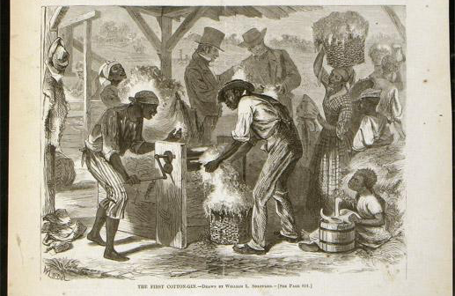
“The First Cotton-Gin,” Harper’s Weekly, December 18, 1869

Slide 6
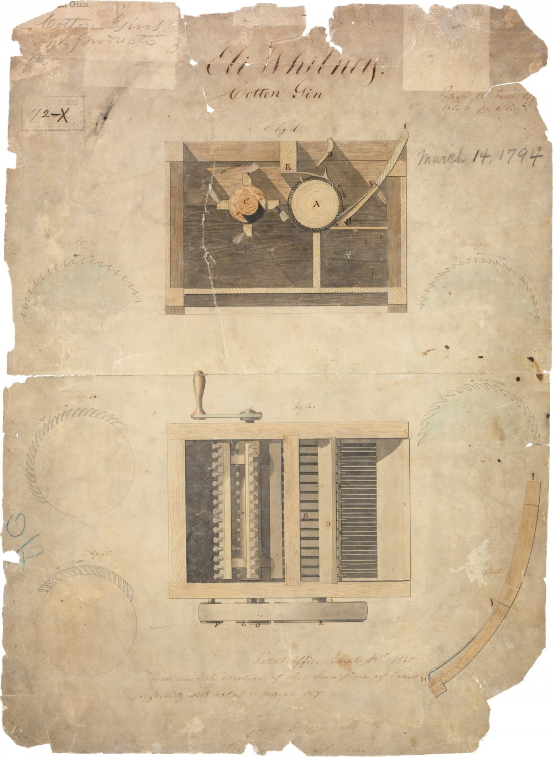
From Eli Whitney’s patent for his cotton gin

Slide 7
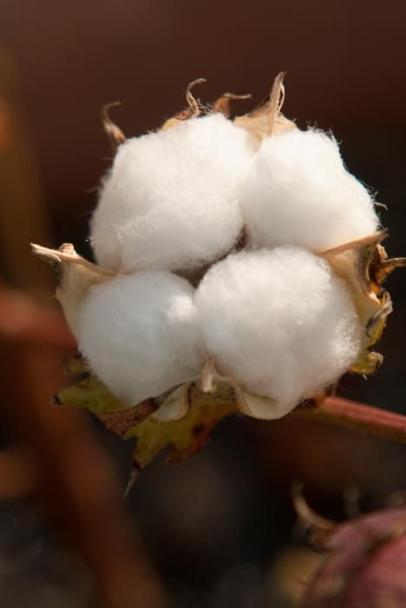

Slide 8
Now the whole space between the rows is ploughed, leaving a deep water furrow in the center. During all these hoeings the overseer or driver follows the slaves on horseback with a whip, such as has been described. The fastest hoer takes the lead row. He is usually about a rod in advance of his companions. If one of them passes him, he is whipped. If one falls behind or is a moment idle, he is whipped. In fact, the lash is flying from morning until night, the whole day long.
Solomon Northup, Twelve Years a Slave (1853), pp. 163-165

Slide 9
US Expansion and
Statehood

Slide 10
Cotton Production,
1820 and 1840

Slide 11
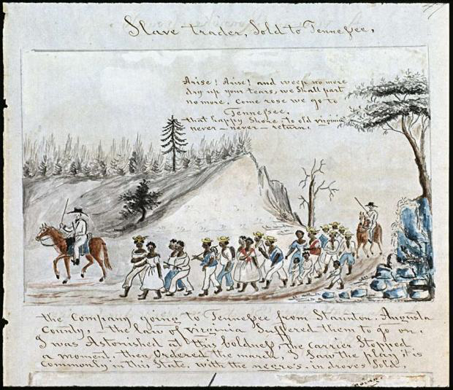
A coffle of slaves on the march from Staunton, VA to Tennessee; Lewis Miller (1853)

Slide 12
Late-nineteenth century depiction of a slave coffle in Washington, D.C. (1876)

Slide 13
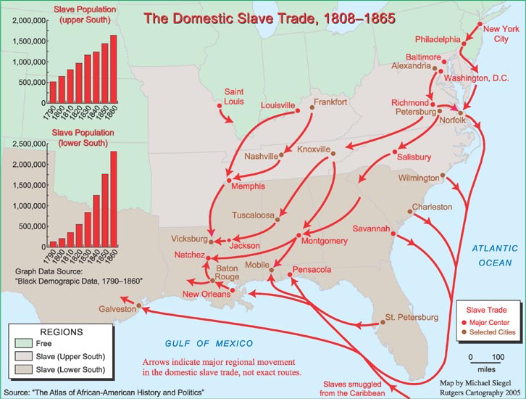

Slide 14
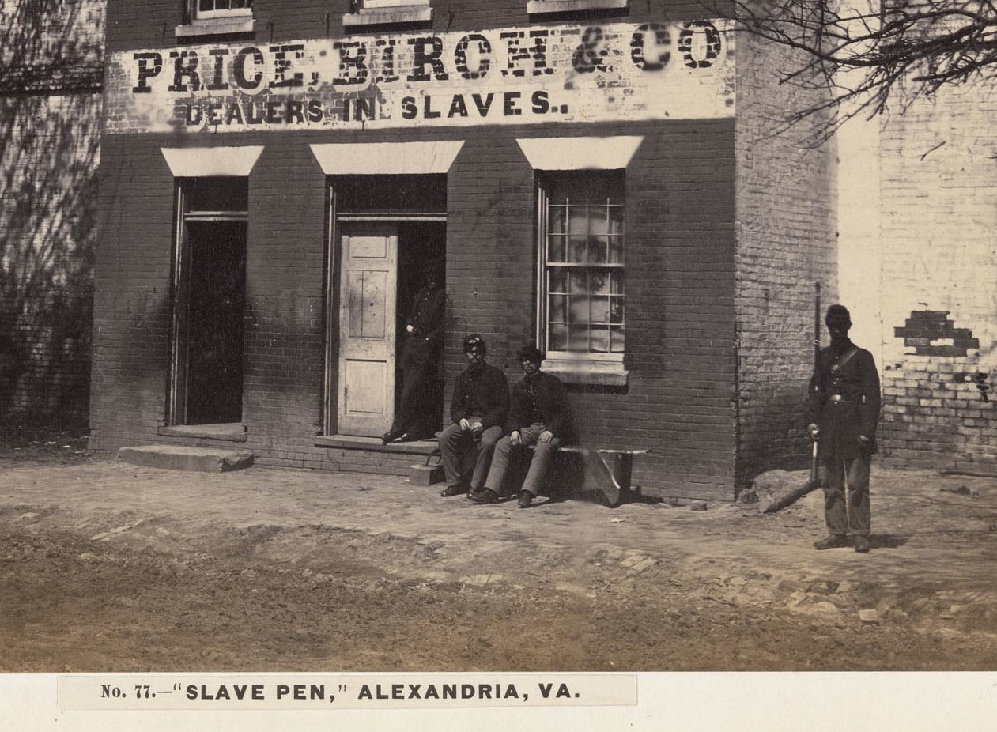
Civil War-era photograph depicting Union Army soldiers at a slave market in Virginia

Slide 15
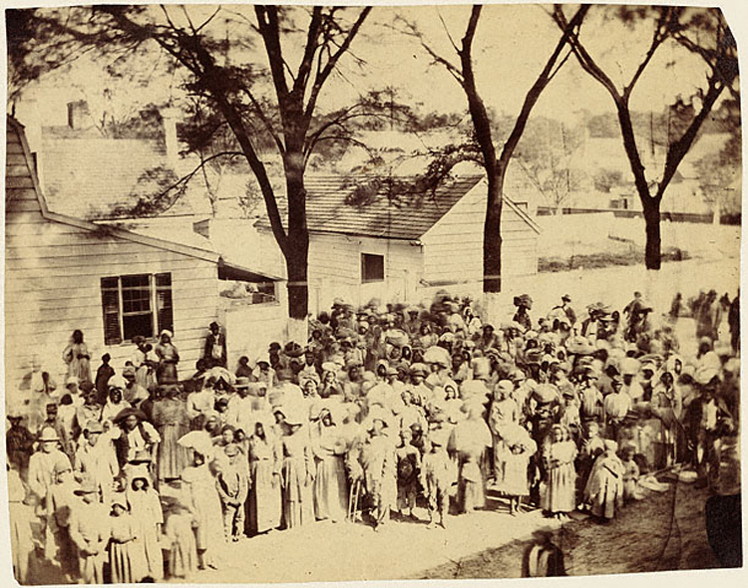
A South Carolina plantation, with people likely wearing cotton clothing (1862)

Slide 16
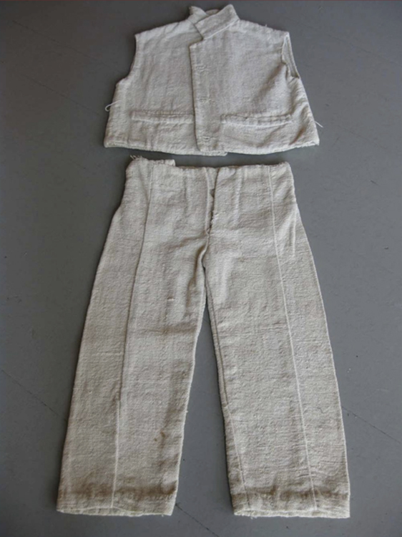
“slave cloth”outfit sized for a boy aged 10-15

Slide 17
1840 advertisement for a sale of enslaved people

Slide 18
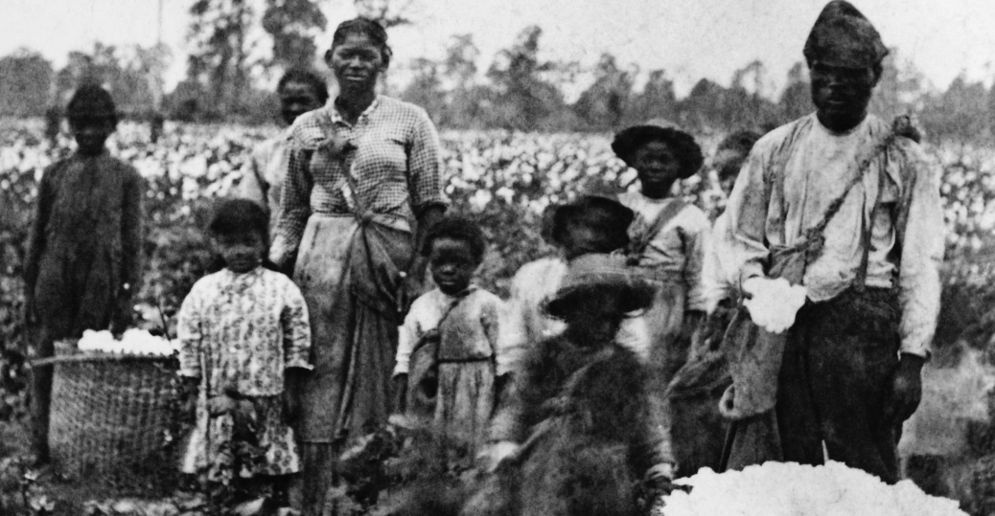

Slide 19
Now the whole space between the rows is ploughed, leaving a deep water furrow in the center. During all these hoeings the overseer or driver follows the slaves on horseback with a whip, such as has been described. The fastest hoer takes the lead row. He is usually about a rod in advance of his companions. If one of them passes him, he is whipped. If one falls behind or is a moment idle, he is whipped. In fact, the lash is flying from morning until night, the whole day long.
Solomon Northup, Twelve Years a Slave (1853), pp. 163-165

Slide 20
March 3, 2021
Production and Power in Slave Societies
Big Questions:
1. How did labor shape the lives of enslaved people in the US South?
2. How did enslaved people struggle with their owners? What tools were available to enslaved people seeking power in their lives?

