Slide 1
Race and Reform in the 1920s
Dr. Daina Ramey Berry
The University of Texas at Austin
Twitter: @DainaRameyBerry
Dr. Anthony Brown
The University of Texas at Austin
Dr. Keffrelyn Brown
The University of Texas at Austin
Twitter: @DrKeffrelynB

Slide 2
Introduction & Overview
What we are Doing
Historical Knowledge: Race in the Early 20th Century
Historical Knowledge: Key Constructs in Race and Racism
Breakout Session: Looking at Documents
Q/A

Slide 3
What We are Doing Today (5 min.)
Dr. Anthony Brown & Dr. Keffrelyn Brown

Slide 4
Race in the Early 20th Century (15 min.)
Dr. Daina Ramey Berry

Slide 5
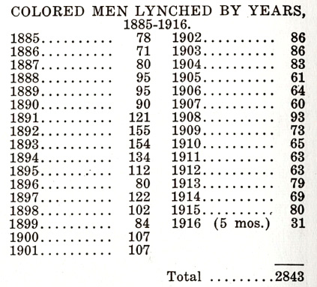
Racial Science and Racial Violence

Slide 6
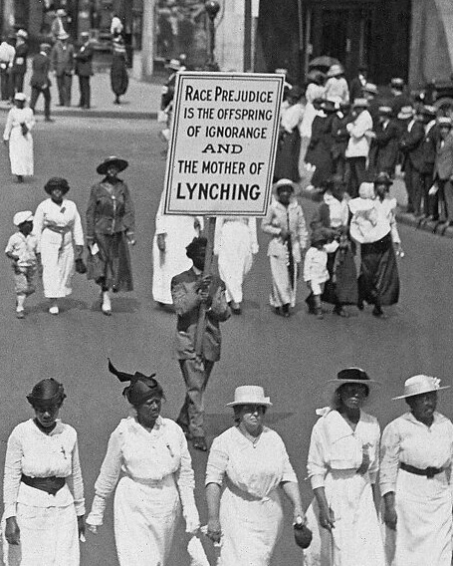

Slide 7
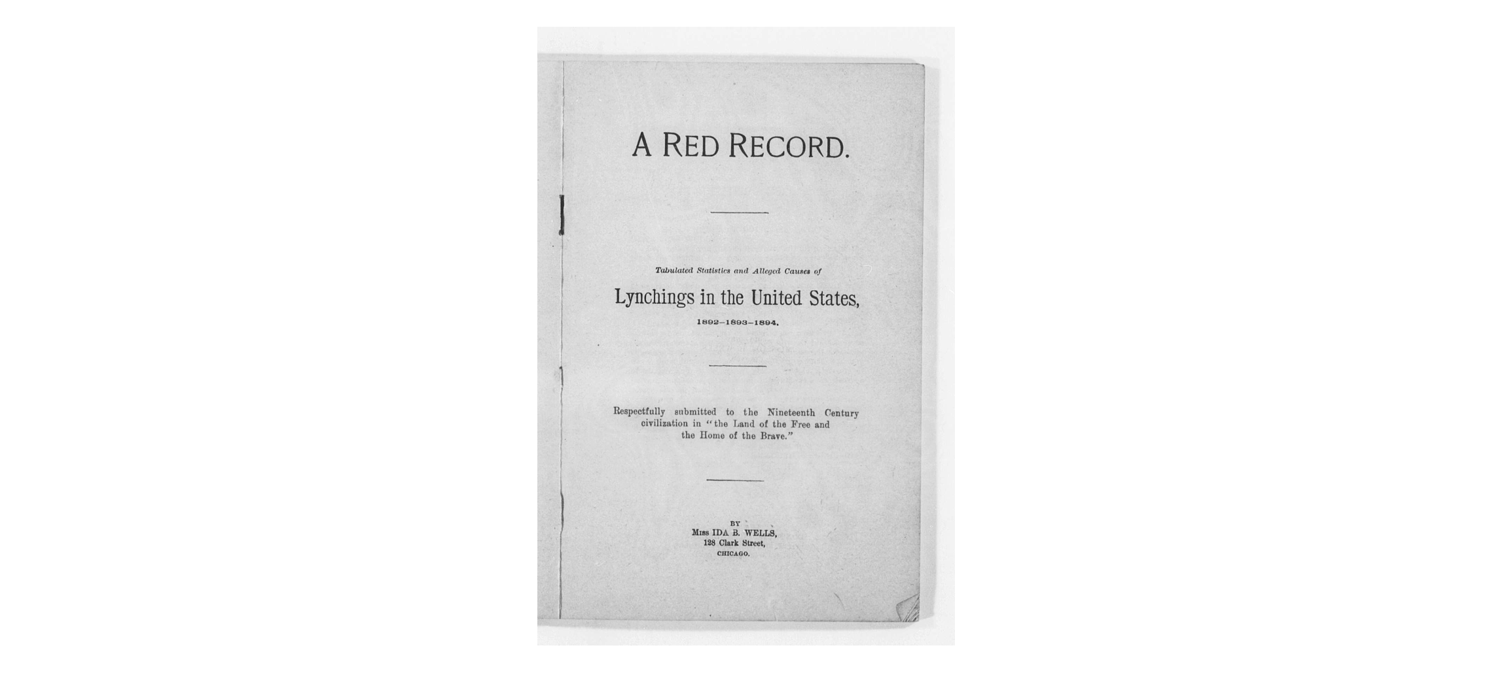
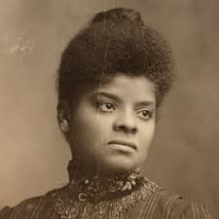

Slide 9
Film Clip
Tulsa Massacre

Slide 10
Houston Race Riot on 1917 – Black Soldiers
654 Black soldiers with all-White commanding officers reported to Houston to support the protection of a 7,600 acre National Guard Training Center.
Upon arrival, soldiers faced discrimination from citizens and the police.
AKA the Camp Logan Mutiny (riot or murder?) of August 23, 1917.
Black soldiers sought to protect themselves from police/civilian violence and an incident involving a Black woman in the 4th Ward.
156 soldiers of the 3rd Battalion, 24th Infantry of the Buffalo Soldiers= involved.
118 indicted in military tribunals; 110 found guilty; 19 hanged; 63 life sentences.

Slide 11
Key Constructs in the Study of Race & Racism (10 min.)
Dr. Anthony Brown & Dr. Keffrelyn Brown

Slide 12
Presence of Racism in U.S. History: Seeing Race
Jim Crow racism (legal, de jure)
Color-blind racism (post-Civil Rights)

Slide 13
Social Construction of Race
Science
Policy
Popular culture
Everyday practices
Laws
ideologies (stories)

Slide 14
Types of Racism
Racism
interpersonal racism (micro)
Structural/
institutional racism
(macro)
Internalized racism

Slide 15
Social construction of race
Material consequences of race

Slide 16
Antiblack racism
Black agency/resistance

Slide 17
Looking at Documents (15 min.)

Slide 18
Questions to Consider (10 min.)
How do the images in the slideshow and the documents provided illustrate antiblackness and Black agency/resistance?
What struck you when looking at the documents? Did you discover a new or deepened insight?
Find examples of the following race constructs:
Race as a social construction with material consequences
What questions or wonderings do you have after completing this activity?

Slide 21
Thanks!
Dr. Daina Ramey Berry
Email: drb@austin.utexas.edu
Twitter: @DainaRameyBerry
Dr. Anthony Brown
Email: alb@austin.utexas.edu
Dr. Keffrelyn Brown
Email: keffrelyn@austin.utexas.edu
Twitter: @DrKeffrelynB

