Slide 1
Reconstruction in Texas Ben Wright University of Texas at Dallas bgw@utdallas.edu

Slide 2
How did Texans respond to emancipation?
Was Reconstruction a success or failure?

Slide 4
Thirteenth Amendment
Section 1. Neither slavery nor involuntary servitude, except as a punishment for crime whereof the party shall have been duly convicted, shall exist within the United States, or any place subject to their jurisdiction.
Section 2. Congress shall have power to enforce this article by appropriate legislation

Slide 5
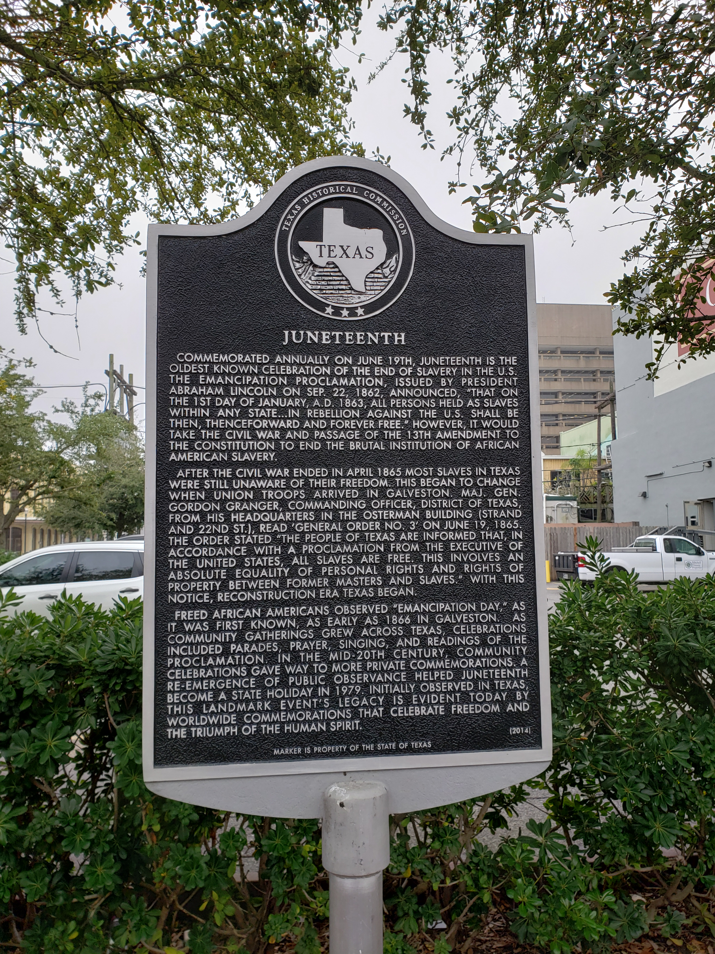

Slide 8
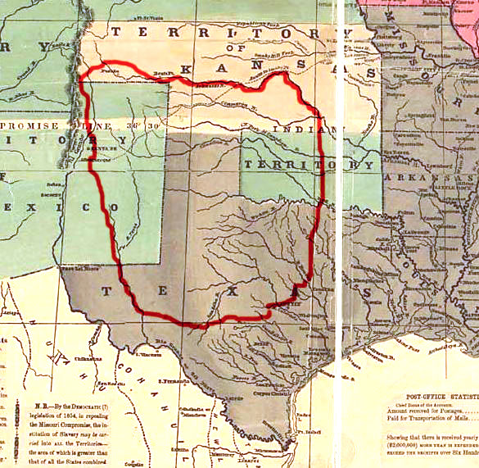

Slide 9
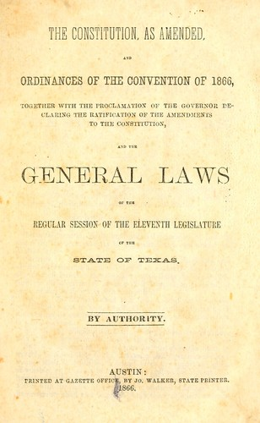

Slide 11
15th Amendment
Section 1. The right of citizens of the United States to vote shall not be denied or abridged by the United States or by any state on account of race, color, or previous condition of servitude.
Section 2. The Congress shall have power to enforce this article by appropriate legislation.

Slide 15
