Slide 1
Thirteenth Amendment
Section 1. Neither slavery nor involuntary servitude, except as a punishment for crime whereof the party shall have been duly convicted, shall exist within the United States, or any place subject to their jurisdiction.
Section 2. Congress shall have power to enforce this article by appropriate legislation

Slide 2
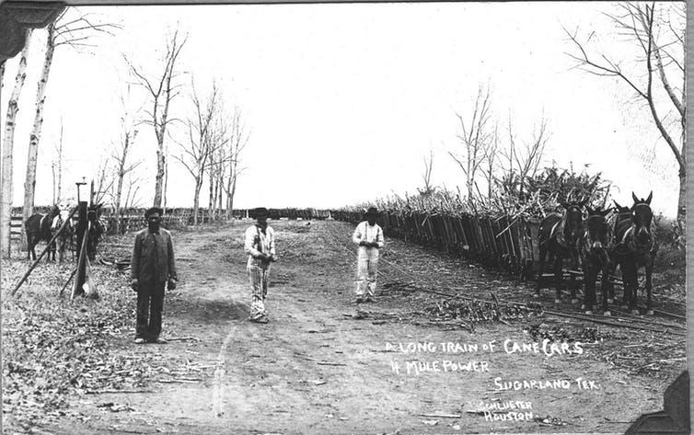

Slide 3
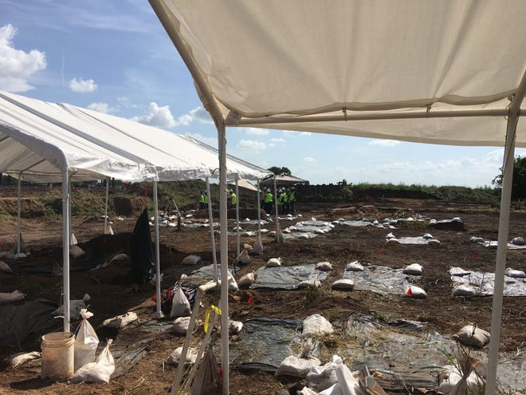

Slide 4
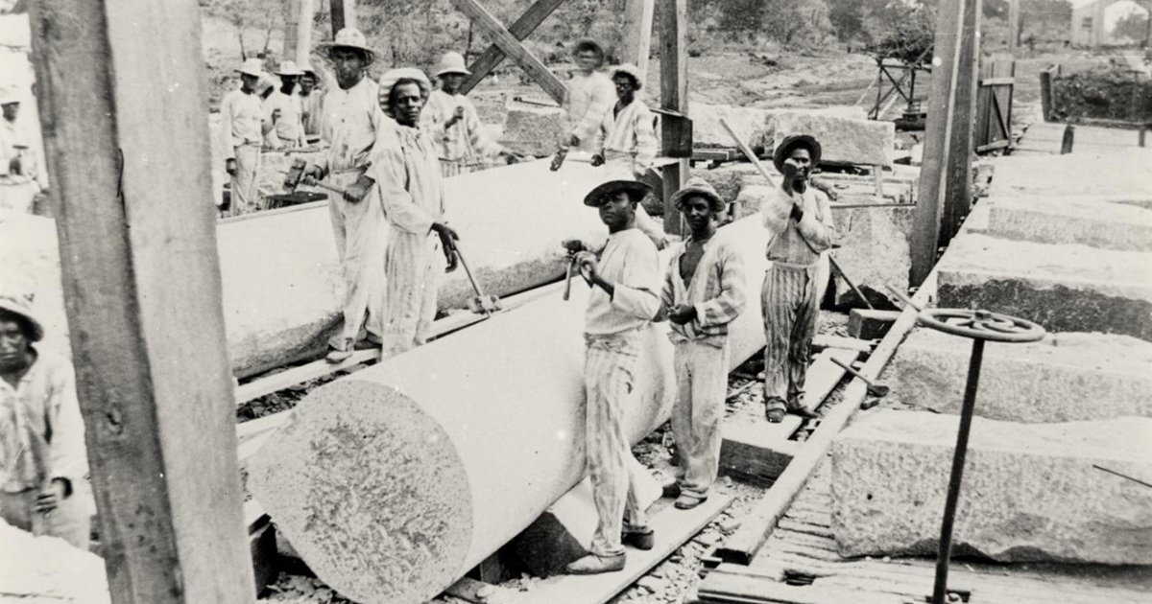

Slide 5
How did Americans respond to emancipation?
Was Reconstruction a success or failure?

Slide 7
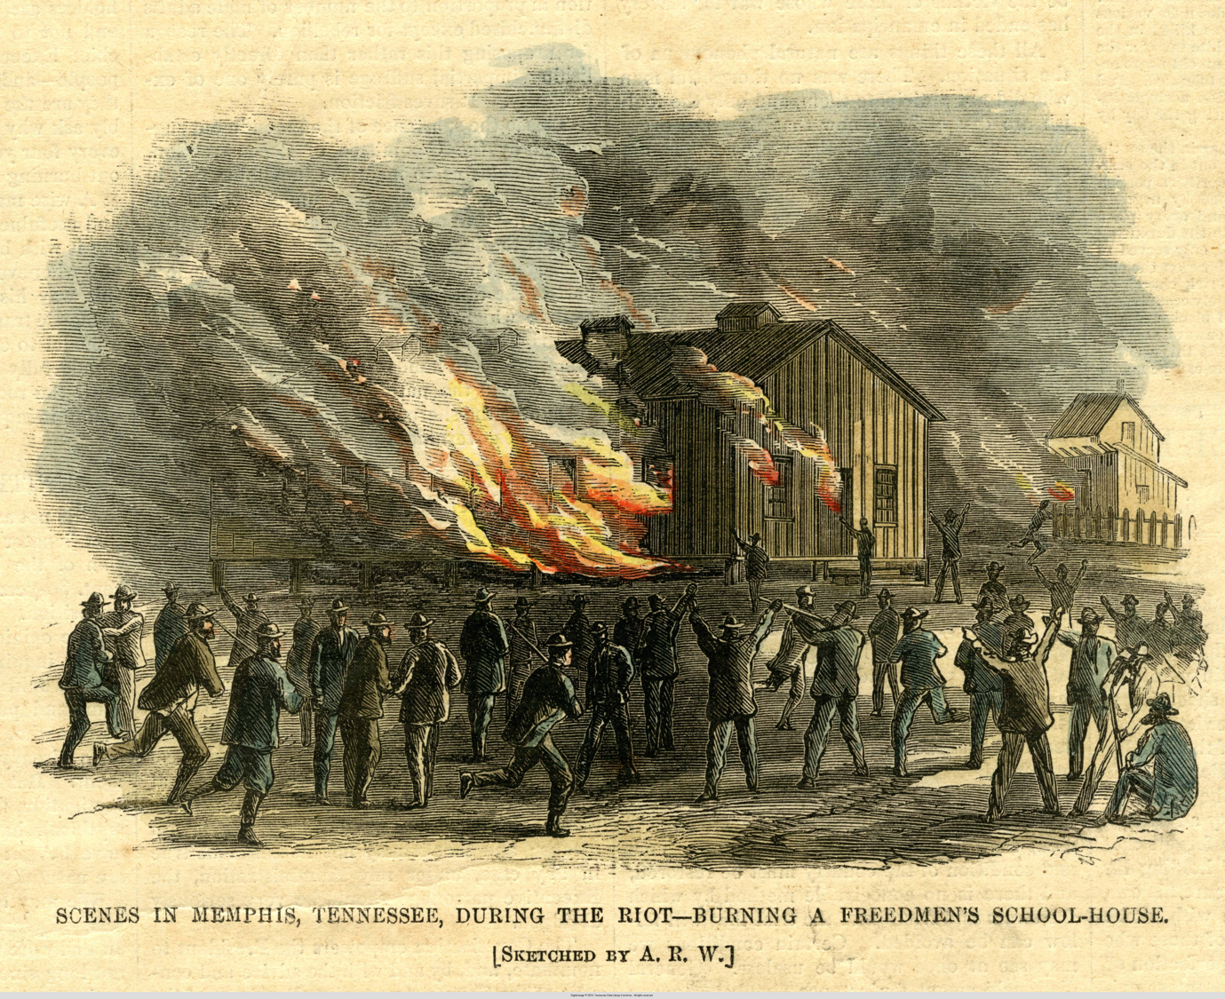

Slide 11
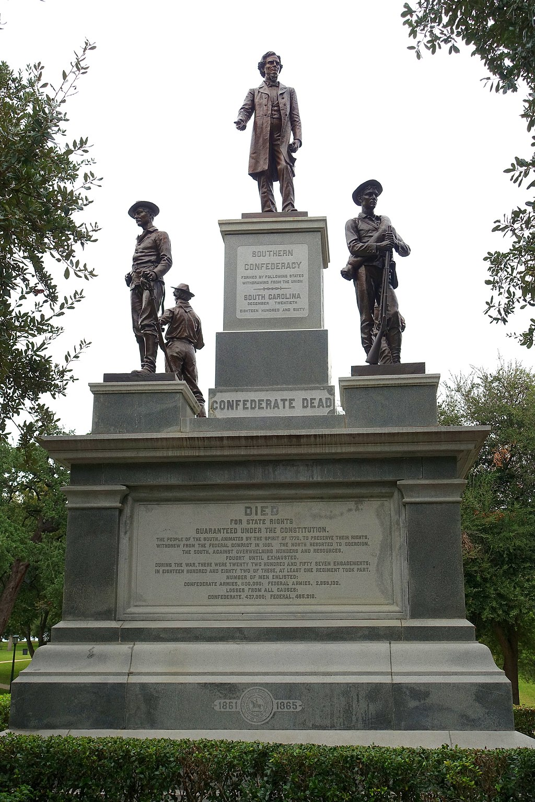

Slide 12
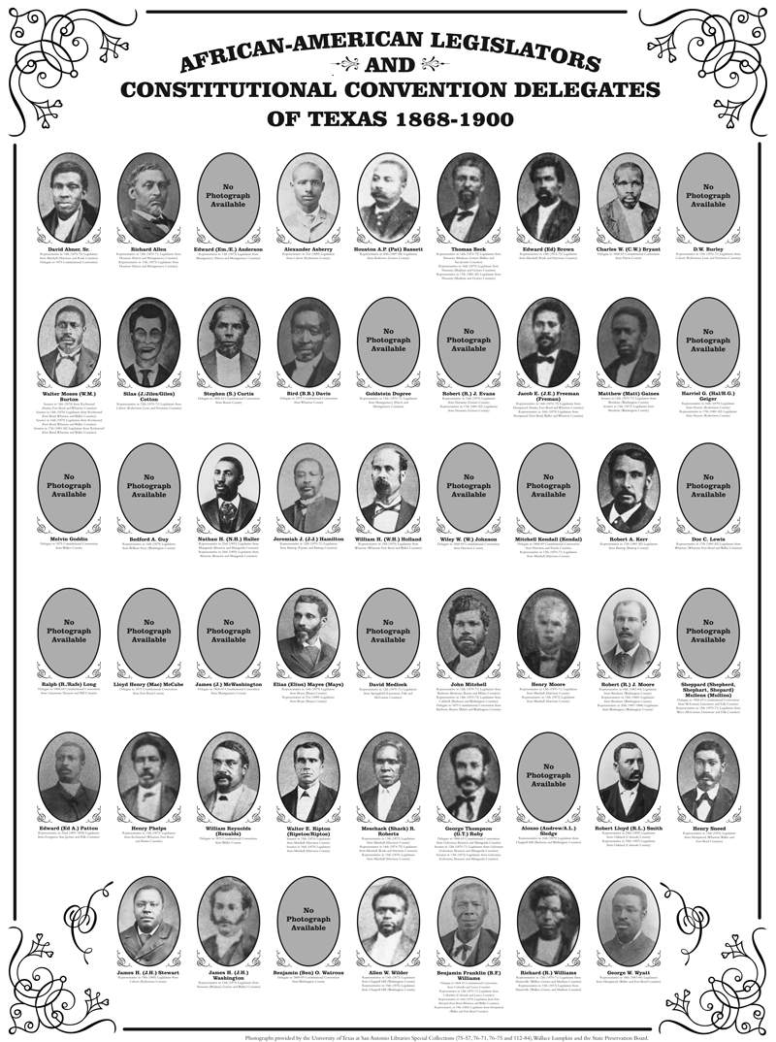
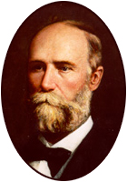

Slide 15
14th Amendment
All persons born or naturalized in the United States and subject to the jurisdiction thereof, are citizens of the United States and of the State wherein they reside. No State shall make or enforce any law which shall abridge the privileges or immunities of citizens of the United States; nor shall any State deprive any person of life, liberty, or property, without due process of law; nor deny to any person within its jurisdiction the equal protection of the laws. (Clause 1 of 4)

