Slide 1
The Road to Rebellion, 1830-1835
Linda English, PhD.
Associate Professor
University of Texas Rio Grande Valley

Slide 2
Was the Texas Revolution inevitable?
If yes, why? If no, why not?

Slide 3
Mexican Reaction
-General Manuel de Mier y Terán
-Law of April 6, 1830
Stephen F. Austin
Green DeWitt
-Slavery – Loopholes
-Cotton Expansion
”permanently indentured servants”

Slide 4
Aftermath of Law of April 6, 1830
Dichotomy #1: Liberals (Federalists) vs. Conservatives (Centralists)
Anahuac Disturbance – 1832
Juan (John) Davis Bradburn
Jose Francisco Madero
William Barret Travis and Patrick Jack
Battle of Velasco – Domingo de Ugartechea
Colonel José de las Piedras – Battle of Nacogdoches

Slide 5
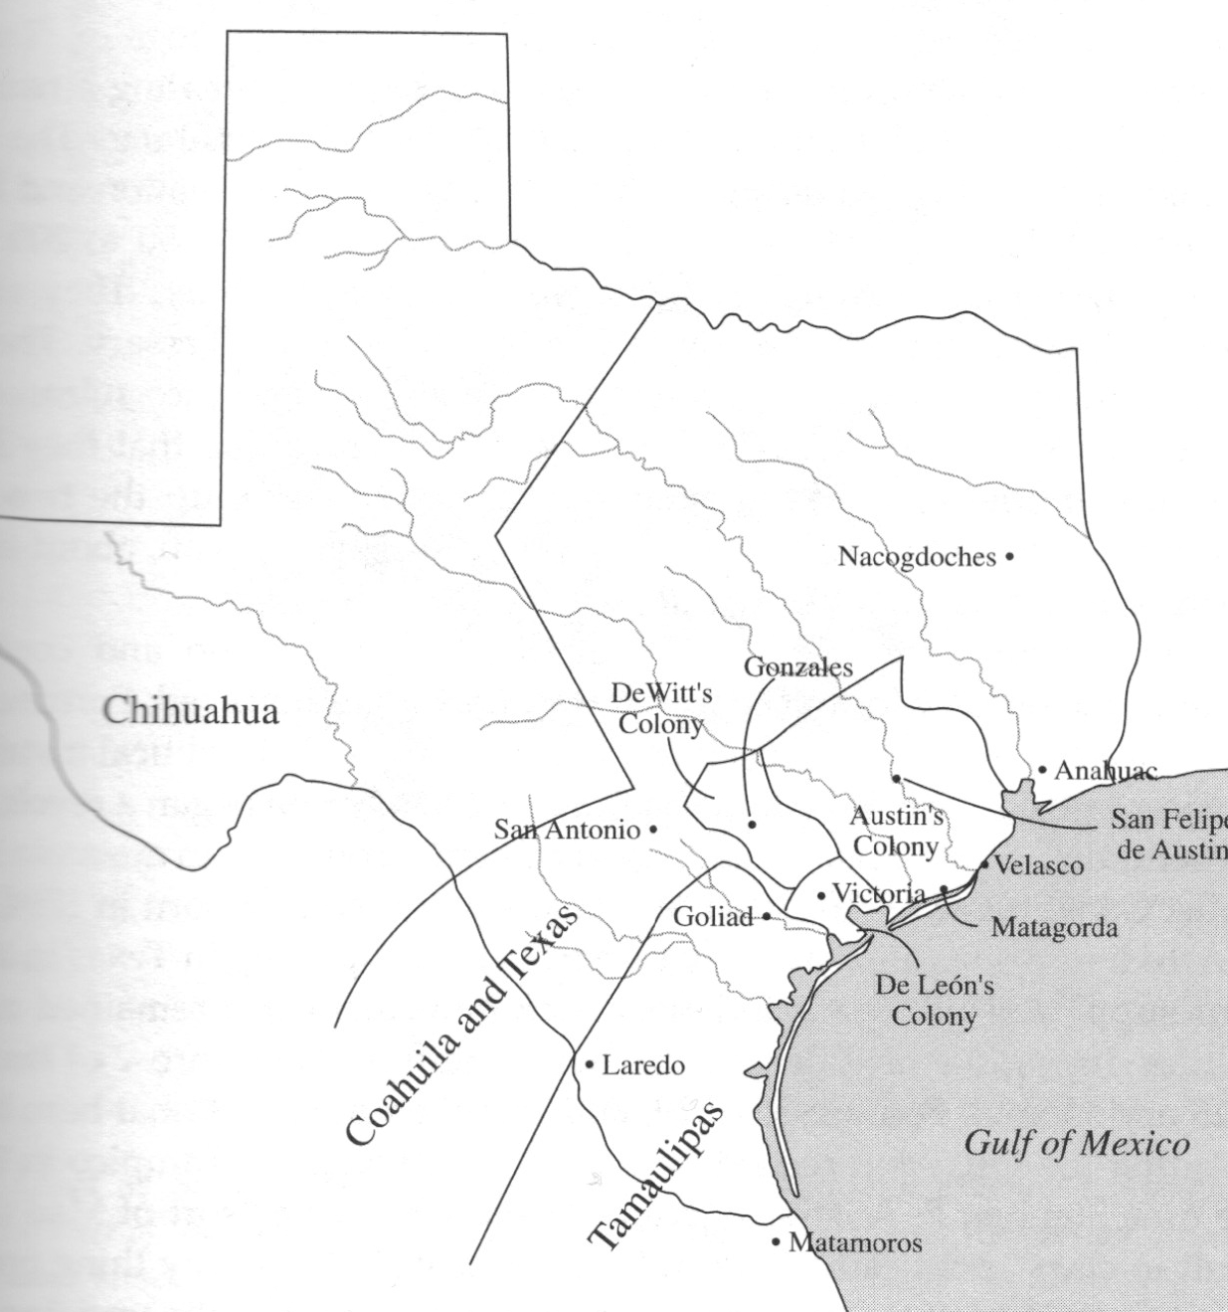
Map from Randolph B. Campbell, Gone to Texas

Slide 6
Articulating Grievances
Turtle Bayou Resolutions
Convention of 1832 – San Felipe
Series of Petitions
Separation Coahuila y Texas
Convention of 1833
Tejano Support – Seguins, Navarro
General Antonio López de Santa Anna
Dichotomy #2: “War Party” vs. “Peace Party”

Slide 7
Austin’s Dilemma
Peace Party
Trip to Mexico City (July 1833)
Mexican Concessions
Letter to San Antonio Ayuntamiento
Arrest and detainment (January 1834, Saltillo)
Return to Texas, shifting position

Slide 8
Mexico City in the Early 1830s

Slide 9
Santa Anna’s Shift
Fate of Federalism
Concessions to Texas
Santa Anna’s Centralism:
Abolished Constitution of 1824
Created Depts., installed new officials
Dissolved state governments
Second Anahuac Disturbance: William Barret Travis, 1835
Gonzales Incident: October 2, 1835 - Shots Fired

Slide 10
William Barret Travis, Agitator

Slide 11
War Begins

Slide 12
The Colonists
Continued immigration and colonization
Demographics
Frontier conditions
Native American attacks
Farms and plantations
Filling in the story – A woman’s perpective – Ann Raney (Thomas) Coleman

