Slide 1
American Literature(s):
Expanding Landscapes of Inquiry,
Shifting Foci for Humanities-Based Study

Slide 2
Three Illustrative Areas of Change and Debate
How to conceptualize and engage with historical periods; [TIME]
How to envision the geography or borders of American literature(s); [SPACE]
How to extend our commitment to who is represented in the curriculum we study. [PEOPLE]

Slide 3
Recurring Questions across all Three Entry Points of Study
What texts do we teach, and how?
What learning goals should we set?
(i.e., the “why” of American Literary study)

Slide 4
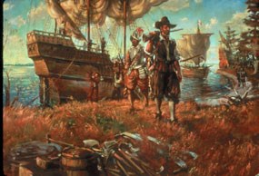
TIME: Time as an Organizing Principle
“-isms” and chronological organization
Romanticism (e.g., the New England Renaissance), Realism, Naturalism;
Focusing on particular eras/moments, such as “Civil War literature” or “Colonial literature”

Slide 5
Challenges to and Approaches for Complicating such Frameworks
“19th-century literature”: ideas like “the long 19th century” having an impact
Benefits of zeroing in on a time frame (such as the 1920s, as we will do) alongside the important push to honor complexity in any chronology
Asking, more broadly, what does it mean to “historicize” the literary?
Questions about how to guide students’ access to periods that seem so remote: cultivating empathy without erasing difference

Slide 6
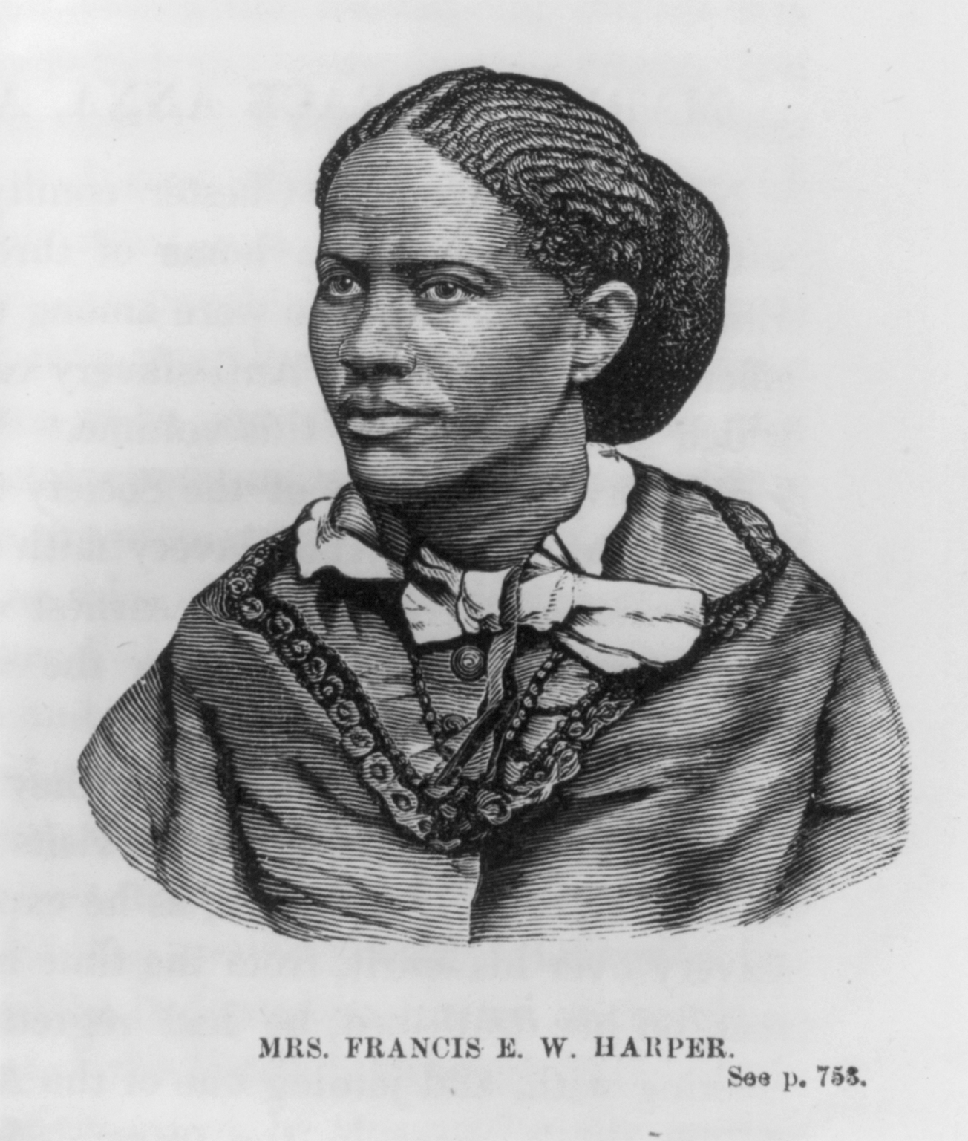
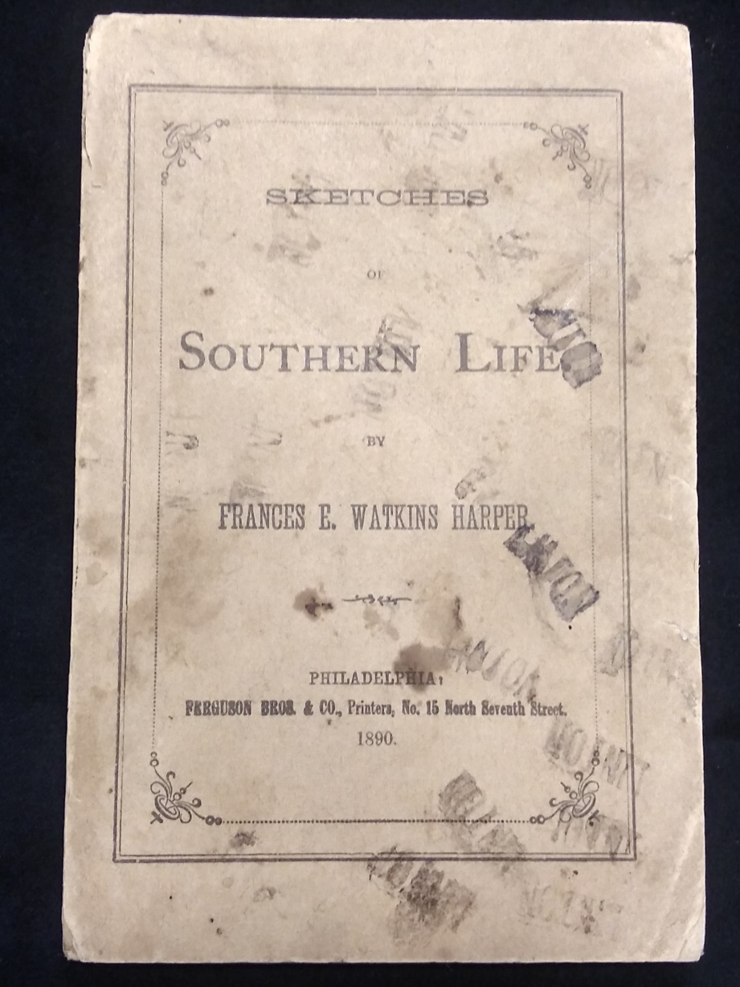
Example of how using “TIME” as framework
shapes teaching of a particular text:

Slide 7
TIME example text
We are all bound up together in one great bundle of humanity, and society cannot trample on the weakest and feeblest of its members without receiving the curse in its own soul. You tried that in the case of the Negro. You pressed him down for two centuries; and in so doing you crippled the moral strength and paralyzed the spiritual energies of the white men of the country.
Frances Harper’s “We Are All Bound Up Together” speech in connection with suffrage work
https://sarahruffingrobbins.com/2018/10/27/we-are-all-bound-up-together-embrace-the-powerful-heritage-of-frances-e-w-harpers-womens-suffrage-rhetoric/
Notes:
“We Are All Bound Up Together” May 1866: In May 1866, Harper addressed the Eleventh National Women's Rights Convention in New York, joining Elizabeth Cady Stanton, Susan B. Anthony, and Lucretia Mott, who were among the featured speakers.

Slide 8
TIME example text
From “Aunt Chloe” to “Learning to Read”
I remember, well remember, That dark and dreadful day, When they whispered to me, "Chloe, Your children's sold away!"
***
Then I got a little cabin A place to call my own— And I felt independent As the queen upon her throne.
Frances Harper’s cycle of poems in the voice of Aunt Chloe, in the time after the Civil War, looking back and forward
Notes:
Sketches from Southern Life-pub 1890; but relatively limited circulation; Frances Foster’s recovery of Harper and her writing led to edition of Harper’s writings, A BRIGHTER COMING DAY: a Frances Ellen Watkins Harper Reader, originally pub by Feminist Press in 1993

Slide 9
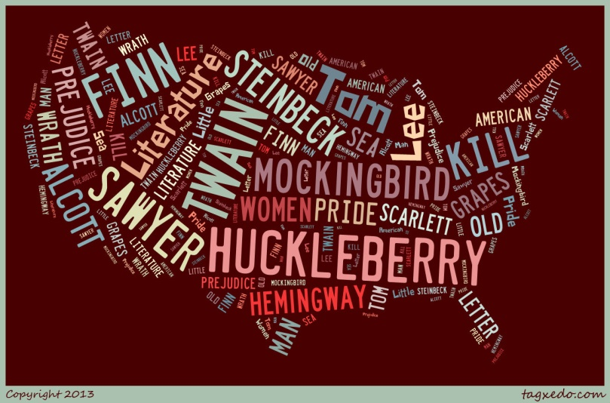
Adapting the SPACE(s)/Places for American Literature(s):

Slide 10
New England’s Domination of the Field
Where dominant institutions of higher-education were located as the field was first being defined +
How northeastern publishing sites that gained national prominence came into play +
What role political history played =
Why regions beyond New England were marginalized in curricular versions of AmLit.

Slide 11
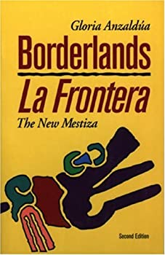
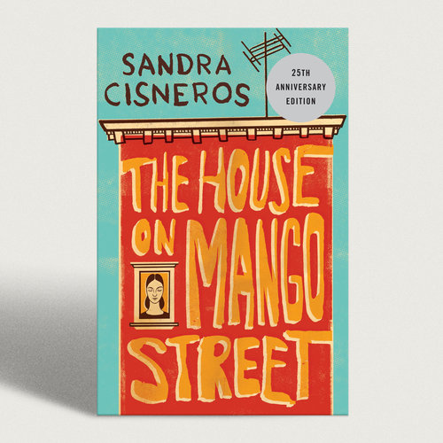
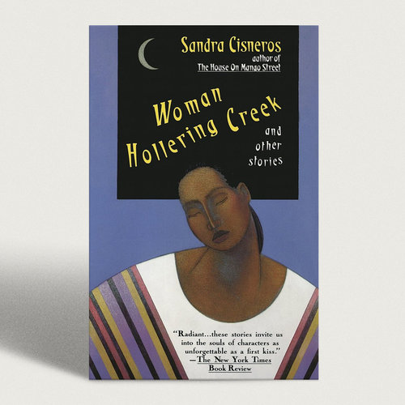
New Southern Studies
After decades of being both celebrated and dismissed as the exception within American exceptionalism, the South has emerged as central to debates about America’s identity historically and culturally, in fields such as American studies, African American studies, cultural studies, and postcolonial theory….[T]his series analyzes and assesses … central ideas of critical theory as it relates to the region and its various cultural identities: objecthood, identity, space, nation, region, abjection, the body, empire. The books in the series are interdisciplinary, methodologically rigorous, and iconoclastic.
Notes:
New Southern Studies: U of Ga Press;
Borderlands-pub 1987; Mango Street 1984; Woman Hollering Creek 1991; Caramelo 2002

Slide 12
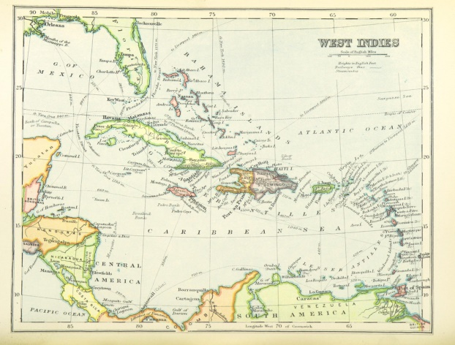
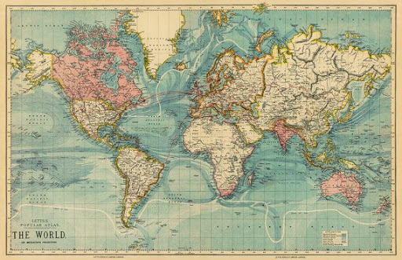
Globalizing SPACE/PLACE: Extending the borders of American Literature

Slide 13
Expanding Our Maps—e.g., Globalizing
Notes:
Black Atlantic published 1993; Hemispheric Am Studies pub 2007

Slide 14
Evolving Ways to Think about Region
Moving beyond a view of regionalism as focusing on eccentrics, as grounded in a provincial brand of rural life, as “Other,” and/or as a site of un-critical nostalgia
Cultivating a “critical regionalism” and a transnational regionalism recognizing the power of place—including the importance of the local environment—but also seeing links between the local and the global/the larger world

Slide 15
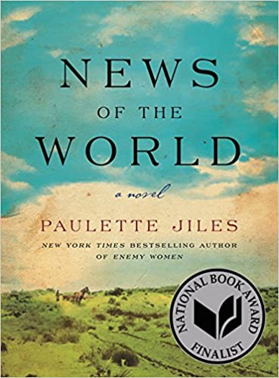
Written by a Texas author
Presenting a Texas setting as multicultural (portraying interactions among whites, Mexican Americans, Native Americans)
Engaging many social issues from a complex time period (post-Civil War in Texas)
Depicting a central character with a cosmopolitan viewpoint

Slide 16
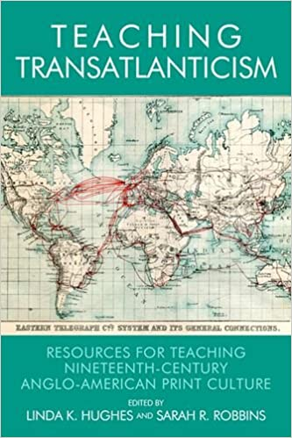
Linking TIME and SPACE as organizing frameworks
Examples of themes and texts:
“Migration and Settlement”:
Ben Franklin living in London
“Abolition and Aftermath”:
Frederick Douglass’s anti-slavery speeches in Dublin
“Nationalism & Cosmopolitanism”:
New York Times report on Ida B. Wells’ anti-lynching speeches in the UK in 1894

Slide 17
Ida B. Wells’s Personal Journeys
Wells’s Railroad Court Case
Wells-Barnett’s Life-long Activism
Notes:
Ida wells railroad court case against the Chesapeake, Ohio, and Southwestern Railroad Co began in 1883 on a train from Memphis to Woodstock TN and reached the State Supreme Court in 1885 where an earlier decision in her favor was overturned. Later in life, as a resident of Chicago, she remained a global citizen, as evidenced in her co-authorship of “The Reason Why the Colored American is Not in the World’s Columbian Exposition” w F Douglass and others

Slide 18
WHO BELONGS in American literature? How do identities of authors and characters shape reading & teaching?
Gender
Social Class
Race and Ethnicity
(Dis)ability and Age
Cultural Community Memberships (e.g., religious affiliation)

Slide 19
UNC-Chapel Hill, 1974-75
Edgar Allen Poe
Ralph Waldo Emerson
Henry David Thoreau
Nathaniel Hawthorne
Herman Melville
Walt Whitman
Samuel Clemens/Mark Twain
Henry James

Slide 20
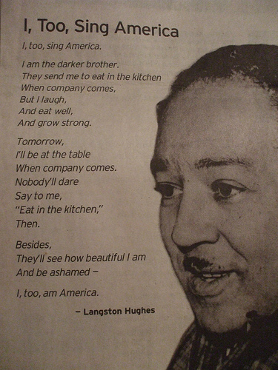
WHO BELONGS?
Walt Whitman
“I Hear America Singing”
I hear America singing, the varied carols I hear,
Those of mechanics, each one singing his as it should be blithe and strong,
The carpenter singing his as he measures his plank or beam,
The mason singing his as he makes ready for work, or leaves off work….

Slide 21
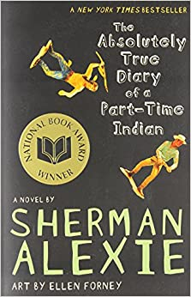
Which of these texts by Native American authors to teach, and why? And, once chosen, with what learning goals?

Slide 22
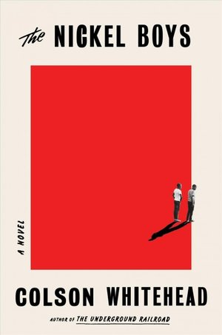
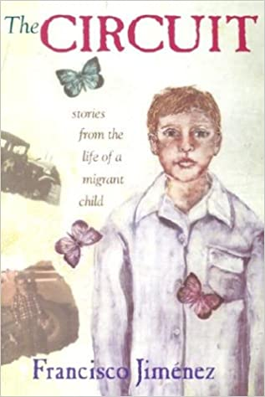
Why The Nickel Boys vs. The Underground Railroad?
Why The Circuit but with the added context of Jiménez’s recovery research and his later memoirs?
What happens when we pair/juxtapose such texts?

Slide 23
To ask WHAT and HOW we teach in American literature studies highlights moral choices we make and values we carry—which is one reason why situating our work within a “humanities” context can be so helpful to our decision-making—both the big-picture building of curriculum and the decisions that happen in a single day’s class session.

Slide 24
Why such questions matter:
“The humanities—including the study of languages, literature, history, jurisprudence, philosophy, comparative religion, ethics, and the arts—are disciplines of memory and imagination, telling us where we have been and helping us envision where we are going.”
—The Heart of the Matter (Report of the American Academy of Arts & Sciences Commission on the Humanities and Social Sciences to the U. S. Congress in June 2013)

