Slide 1
Using Social Annotation to Develop Critical Close Reading Skills
Texas Humanities Institute
Nov. 2023

Slide 2
Dr. Amanda Licastro
PhD in English Literature with a focus on Digital Humanities, Writing Studies, and Book History
Formerly Assistant Professor of English at Stevenson University
Andrew W. Mellon Fellow in Critical Bibliography
Certificate in Interactive Technology and Pedagogy
Pedagogical Director of the Book Traces Project
Digital Scholarship Librarian
alicast1@swarthmore.edu

Slide 3
Why Annotation?
A 2018 survey of 511 four-year institutions from the University of Indiana found that 97% of faculty believe it is “important” or “very important” that students come to class having completed their reading.
Statistics from the ACT indicate that only 51% of students are prepared for college level reading.

Slide 4
“Those who read with pen in hand form a species nearly extinct. Those who read the marginal notes of readers past form a group even smaller. Yet when we write in antiphonal chorus to what we’re reading, we engage in that conversation time and distance otherwise make impossible.”
William Logan,
“Mrs. Custer’s Tennyson,” The New Criterion.
Notes:
In my role as the Pedagogical Director of Book Traces I research the past, present, and future of annotation, and in one of my deep dives I came across this quote. It is easy to assume that the practice of annotating texts is a dying art. Take for example this claim by William Logan. But perhaps that is because Mr. Logan has limited his imagination to pen and paper.

Slide 5
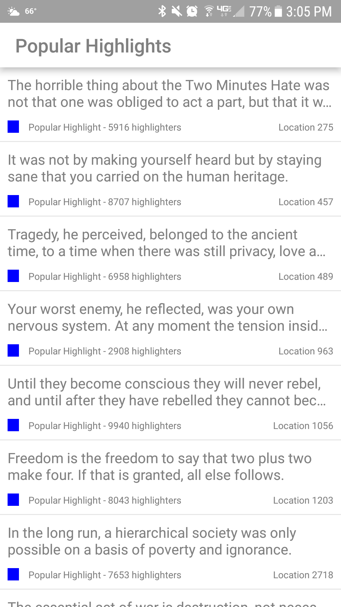
Notes:
Consider this screenshot from the Kindle app on my phone. It shows that 9940 people highlighted this text. I can’t imagine all of those readers were required to use this particular Kindle edition for a class assignment - although perhaps a small percentage are students. And this is a rather popular book, but certainly still considered “capital L” Literature. Can anyone identify the text from these snippets - if so, type it in the chat? These readers are, in Logan’s words “engaging in a conversation time and distance otherwise make impossible.” So I would like to shift the conversation from assuming students do not annotate, to exploring how and why students should annotate.
Yes, George Orwell’s 1984.
Following that opening quote in Logan’s article, he contradicts himself by voicing his displeasure at the discovery of annotations found in a book of poems he has purchased online. Logan deduces that these marks were made by a college student, and chastises the anonymous reader for using the margins to define words such as “patronizing.” The irony is not lost on me. What this reveals is that Logan - and perhaps many people - privilege certain kinds of annotations over others. We have a preset notion of what type of annotation is worthy of attention. But what is it that we value and how can we teach students to practice these habits effectively?

Slide 6
“...the notion of better understanding a text through others’ experience of it is arguably the foundational experience of most liberal arts classrooms…”
Jason Jones,
“There Are No New Directions in Annotations,” Web Writing.
Notes:
I agree with Jason Jones - who has written extensively on teaching annotation practices - that it is the conversational function, the act of discovery and sharing, that we align with our practices in the higher education. In this view, marginalia is not just a personal act, but a public act that can and should be archived and shared. In order to teach students to engage in conversational marginalia, it is helpful to provide models.

Slide 7
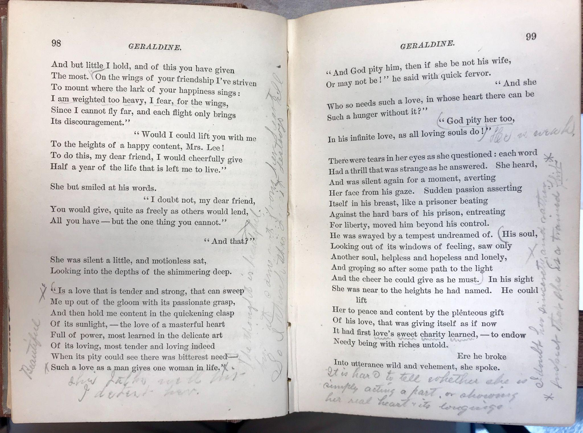
Notes:
We can see examples of marginalia that were written with the intention of being read in historical texts such as the Talmud, early modern Book of Hours, and those of many famous authors whose annotations we fetishize. We can also see this intention in the precinct visions of thinkers like Vannevar Bush and Doug Engelbart who predicted the need for a network of associated texts with a database of shared knowledge linked to each document. These examples have been explored in great depth elsewhere, but I want to focus on how I use these examples as models for students to support the close reading and comprehension of digital texts. Over the past decade, I have invited my students to actively engage in the Book Traces project as a way to substantiate and demonstrate the long-tail of social annotation practices. Book Traces is a library-focused initiative in which students search the stacks for pre-1923 texts featuring marginalia from 19th century readers. This time period is significant because paper was cheap, and many libraries hold multiple copies of popular literary, historical, and philosophical texts from this time, often acquired through donations. Over the last few years, the extant copies have been marked for deaccession, making it increasingly important to investigate any readerly marks that are in these copies. Here you can see an example found by students and documented in Andrew Stauffer’s scholarly monograph about the Book Traces project. Here we see a conversation unfold amongst multiple readers in the 19th century who are using the margins of this book to share information.

Slide 9
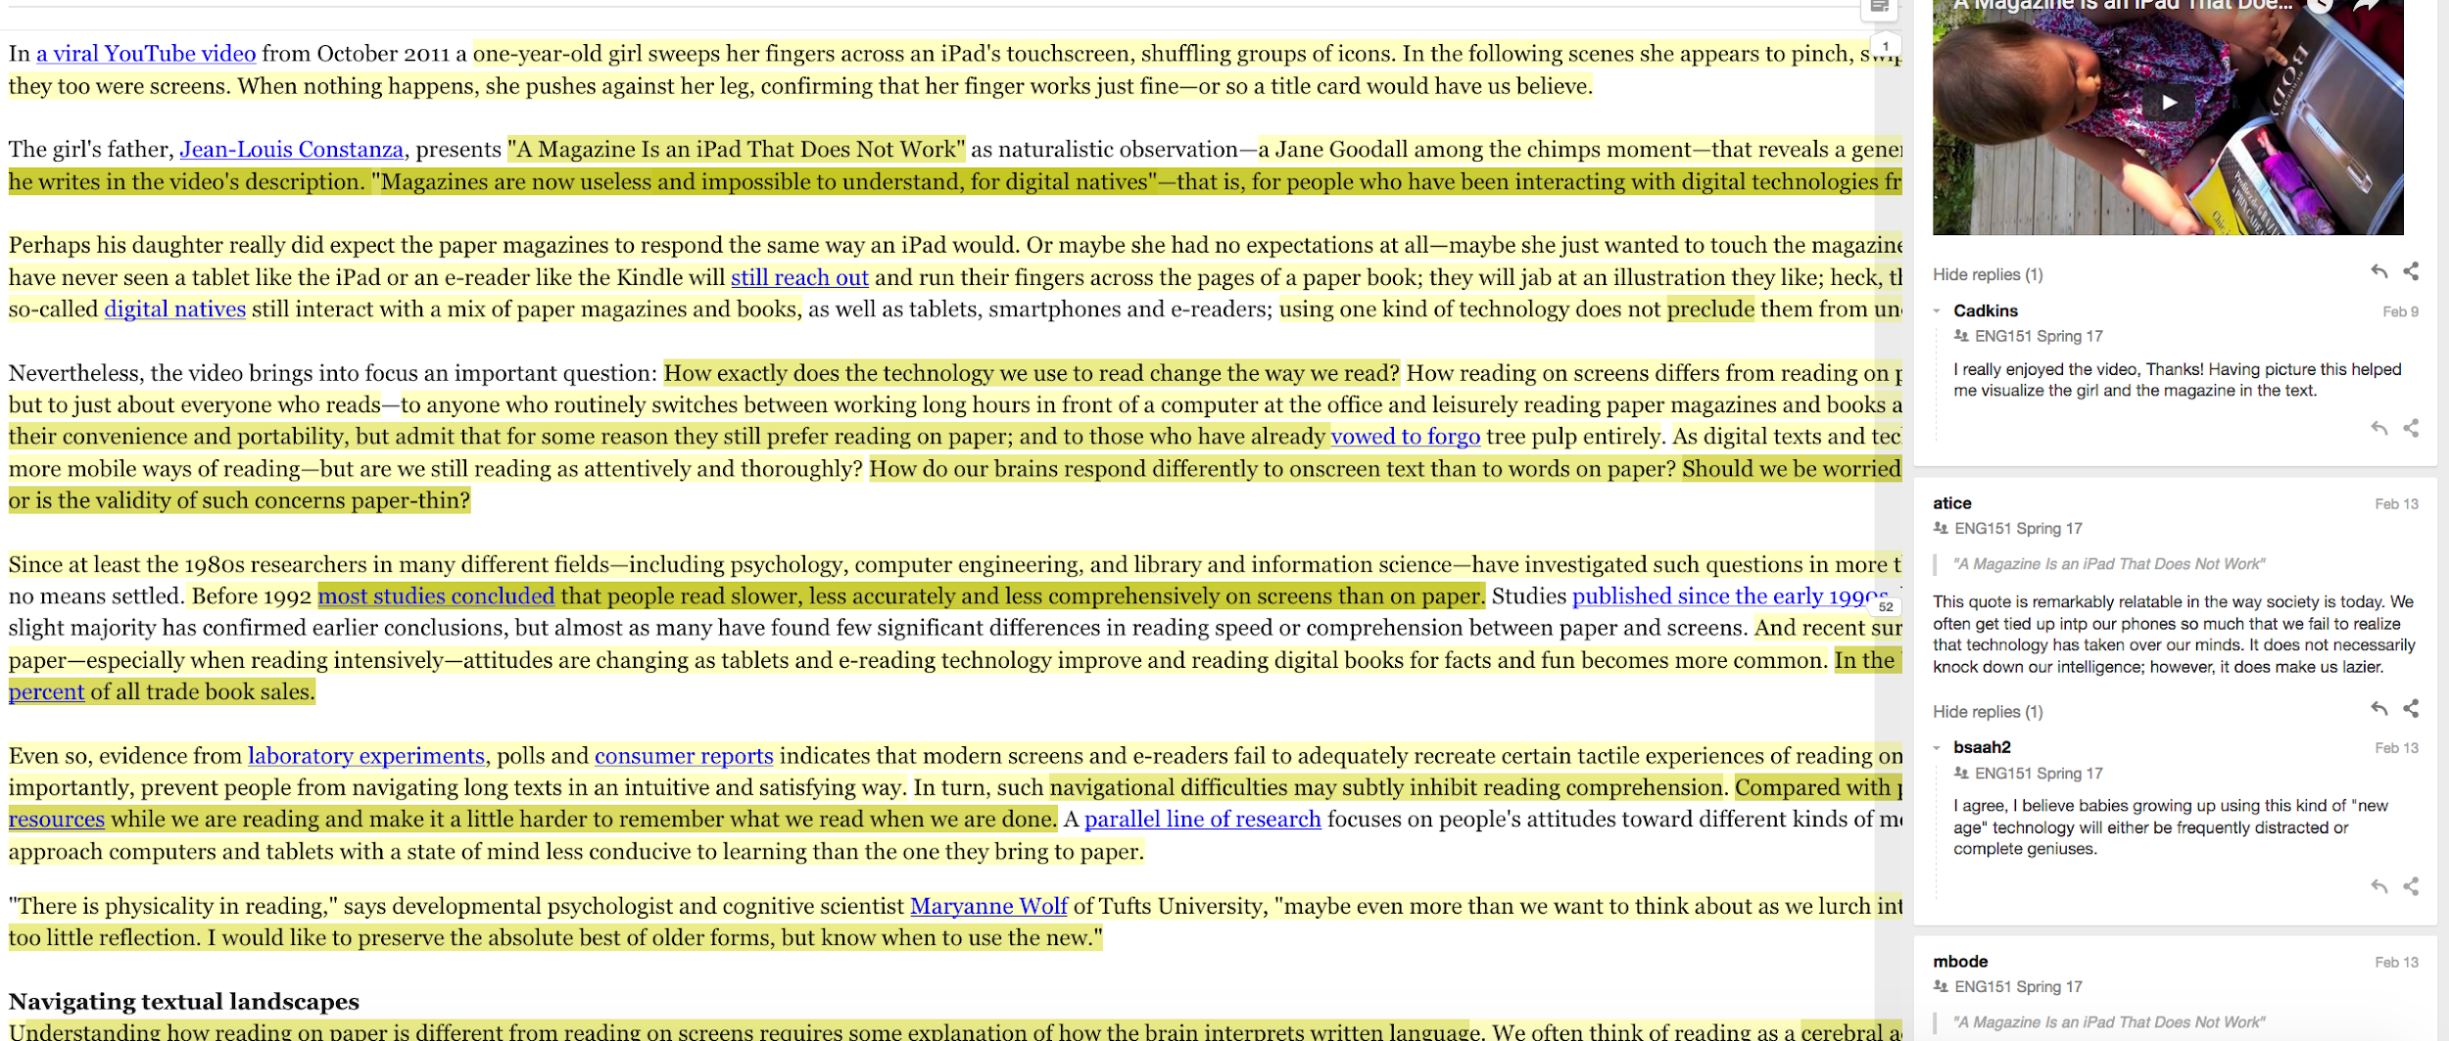
Notes:
To start this process, students read about the differences between reading online versus reading in print from a variety of perspectives. As Cathy Davidson argues in her book Now You See It, the ability to productively multitask is a vital 21st century skill. Students are asked to identify their own attention blindness and given tools that work with - not against - their natural inclinations to bounce from one task to the next.
One of tools I offer to students is an online annotation platform. After testing several platforms, including Annotation Studio and Google Docs, I am most impressed with hypothesis because it can be used with the LMS or as a stand alone product with your web browser, and most importantly for me - you can incorporate multimodal annotations. It is also open access, open source, and had built in accessibility functions. But I have also found tremendous success using Perusall and zotero annotation capabilities.

Slide 10
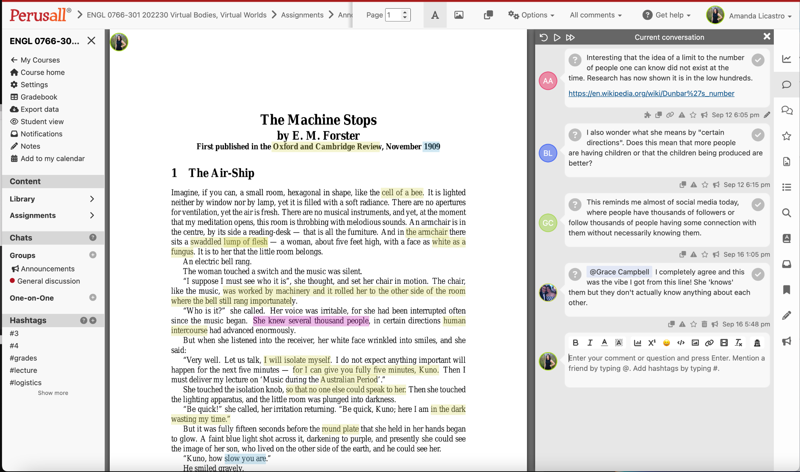

Slide 11
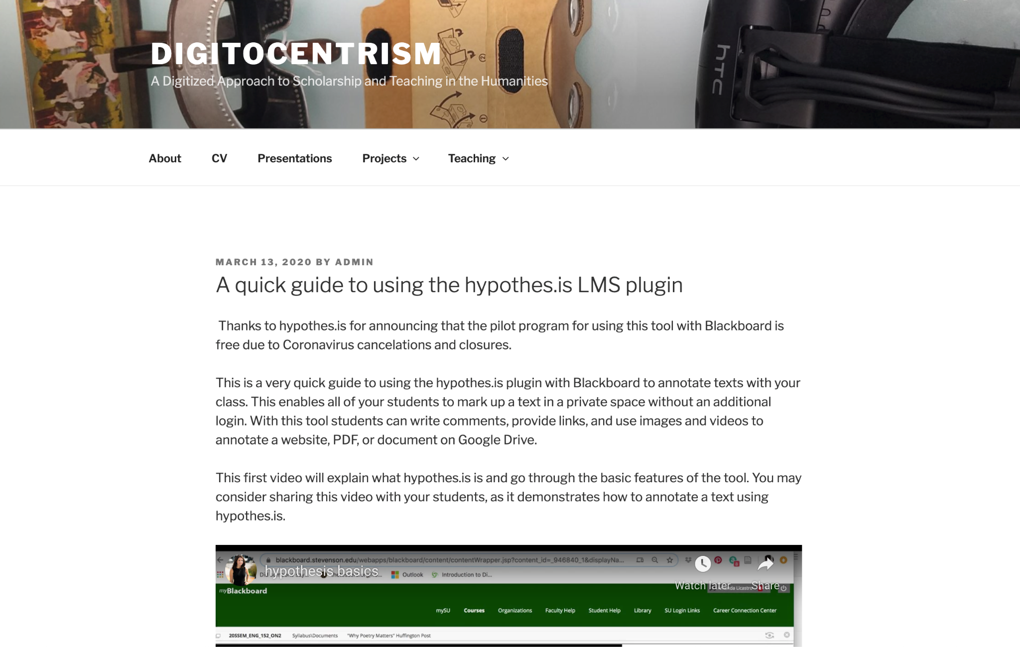
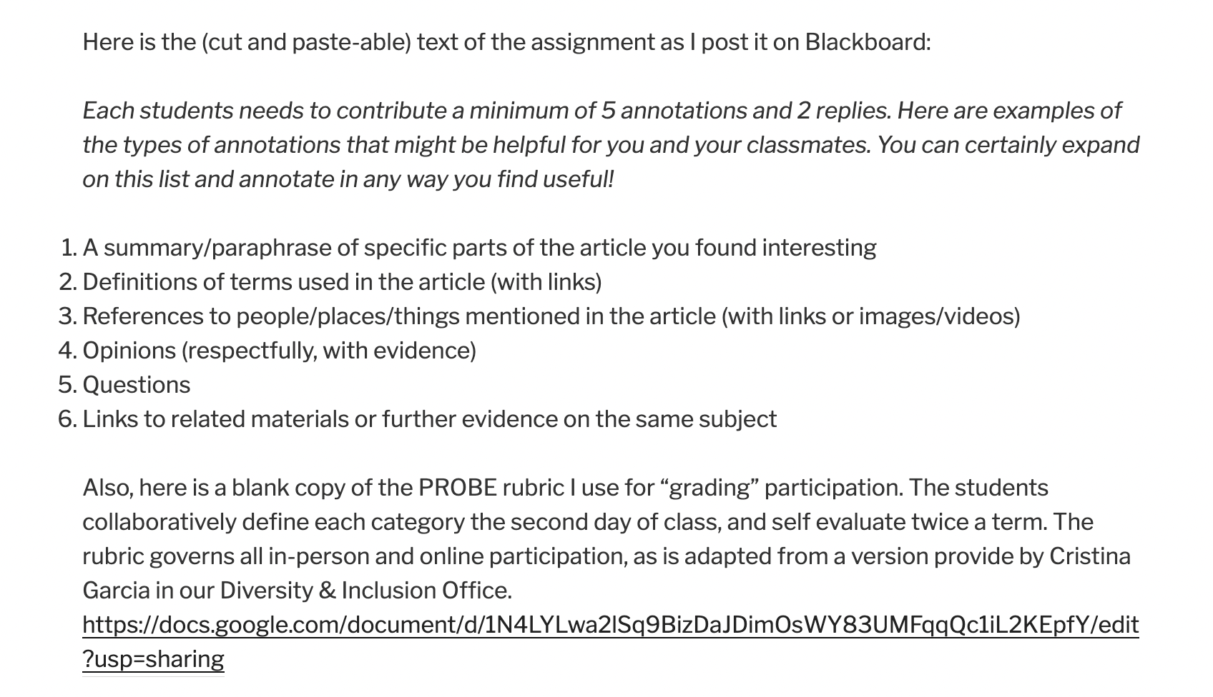
http://digitocentrism.com/teaching-2/a-quick-guide-to-using-the-hypothes-is-lms-plugin/
Notes:
Here is a template I provide for students and instructors to help guide their initial interactions using a social annotation tool. Note, this is not always the ideal tool for every assignment. When meeting with a instructor, I always discuss their learning objectives first, and then, if social annotation is a good match, we work together to customize this approach, and then I can refer them back to this tutorial. I also offer an example of how to assess annotations in order to privilege student-centered learning and non-punitive models of engagement.

Slide 12
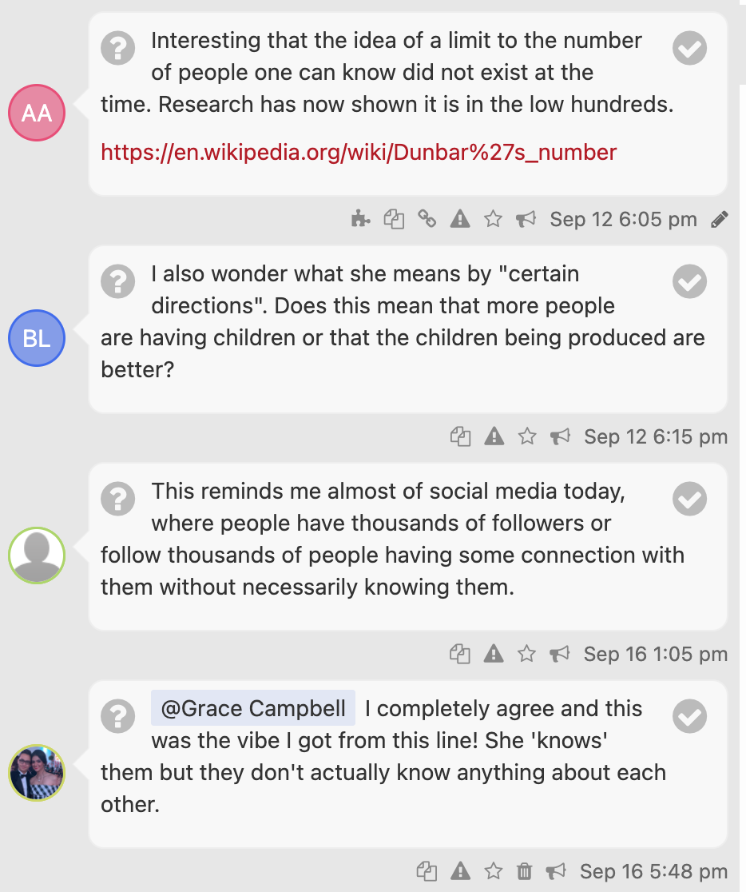
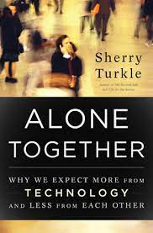
Notes:
Each week I would highlight their contributions, showcasing rich conversations and adding resources for further inquiry. This is just a sample slide from the first week, but you can imagine how I could tailor the content of each class based on the synergies that emerged online.

Slide 13
Notes:
And you are not limited to alphabetic texts! Here is an example of how you can use Perusall to collaboratively annotate a video, and the same is true for infographics and other visual sources of information.

Slide 14
Assignment Sequence
Annotate text - students respond (instructor can interject when needed)
Use student insights as slides in class (screenshot relevant conversations)
Provide further research for debates (ie: definitions, links to articles, quotes from course readings)
Derive low-stakes writing prompt (discussion board post) from most generative provocation - can be done in rotating groups
Student led discussion (ie: fish bowl) based on low-stakes writing task
Ask students to glean information and links for high-stakes (multimodal) essay
Notes:
https://docs.google.com/presentation/d/1idoV_vm4rBj_g8LoxU8qEe1IVT5kH6FqGMvhWww981c/edit?usp=sharing

Slide 15
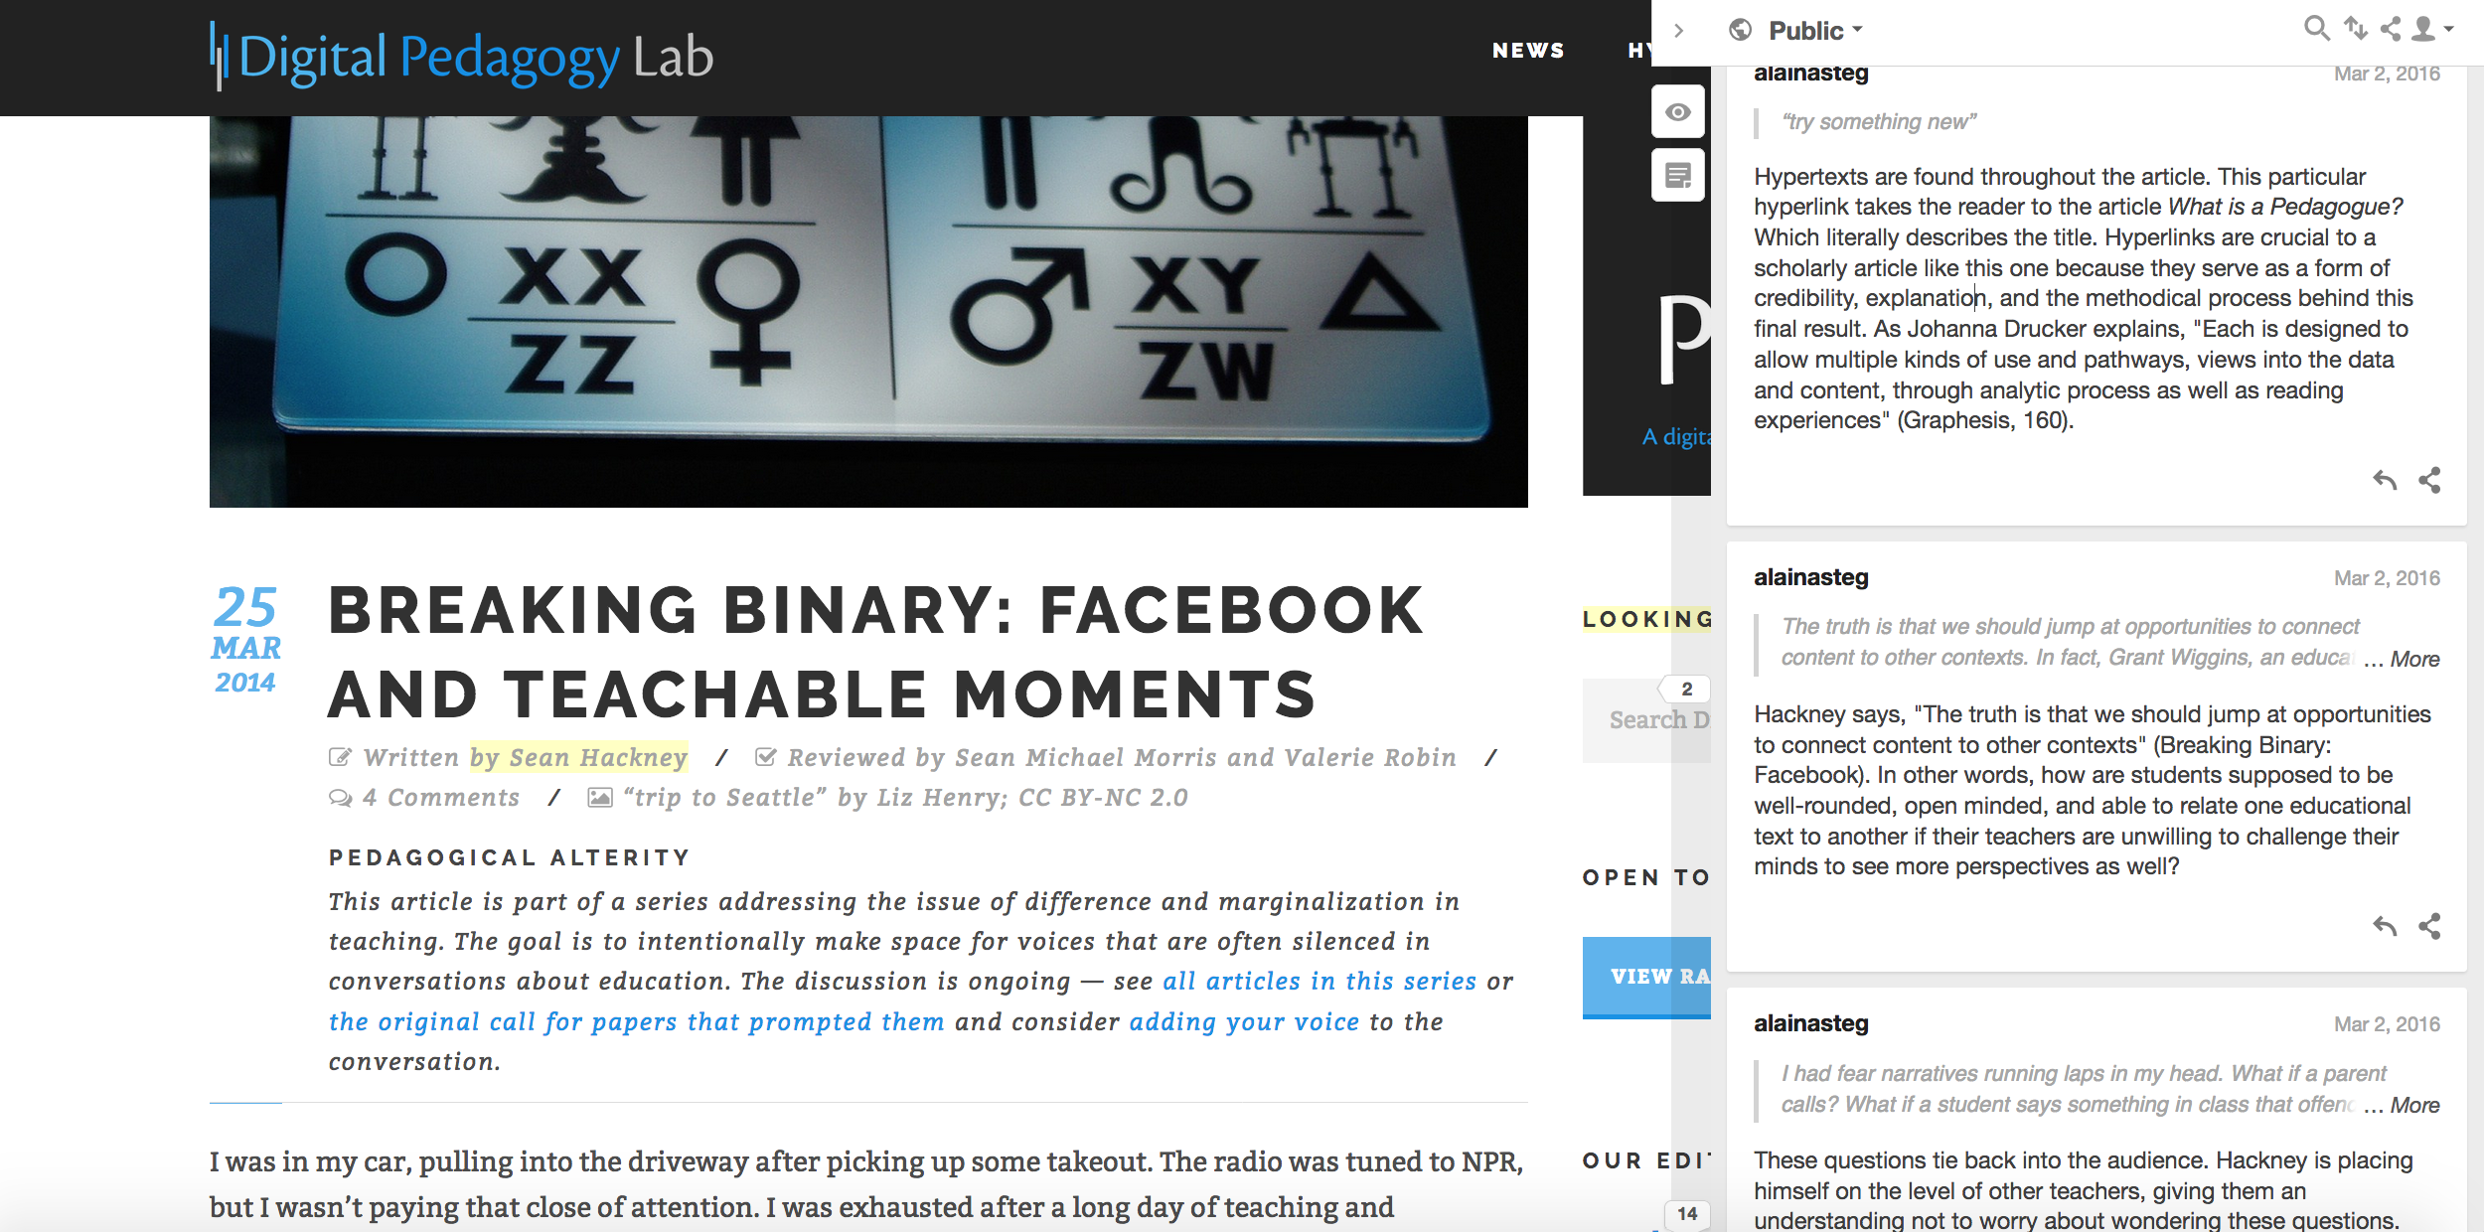
Notes:
I have also taught social annotation as tool for students to document their own research. In this example, I guide this process through the tenets of rhetorical analysis. The student selects an article from an online journal and uses hypothesis to identify how the site addresses audience, context, genre, and purpose, along with critiquing the interface and information architecture. In this way, we model how the tool can be used to organize notes across multiple texts on the same topic or for the same project. Students can utilize the tagging feature to group notes by theme or content, and can export those notes to other formats. If you head to the hypothesis blog, you can actually read about students who have used this method for their dissertation research.
As I previously mentioned, one particularly effective feature of tools such as hypothes.is and Perusall is that students can use the tool to reflect on design choices of a publications,, such as the font, color, layout, and multimodal elements of the digital text, along with the alphabetic text. By analyzing these elements in professional publications, they are better positioned to experiment with these affordances when composing their own multimodal projects. Students develop a sense of how visual rhetoric relates to the alphabetic text present on their screens. If you note in this example, my student Alaina Steg makes the astute connection between the use of hyperlinks in this article to Johanna Drucker’s theories of hypertext presented in Graphesis, which was also read as a part of her research project.

Slide 16
TEKS
(3) Developing and sustaining foundational language skills: listening, speaking, reading, writing, and thinking- self-sustained reading. The student reads grade-appropriate texts independently. The student is expected to self-select text and read independently for a sustained period of time.
(4) Comprehension skills: listening, speaking, reading, writing, and thinking using multiple texts. The student uses metacognitive skills to both develop and deepen comprehension of increasingly complex texts.
(5) Response skills: listening, speaking, reading, writing, and thinking using multiple texts. The student responds to an increasingly challenging variety of sources that are read, heard, or viewed.
(8) Author's purpose and craft: listening, speaking, reading, writing, and thinking using multiple texts. The student uses critical inquiry to analyze the authors' choices and how they influence and communicate meaning within a variety of texts. The student analyzes and applies the author's craft purposefully in order to develop his or her own products and performances.

Slide 17
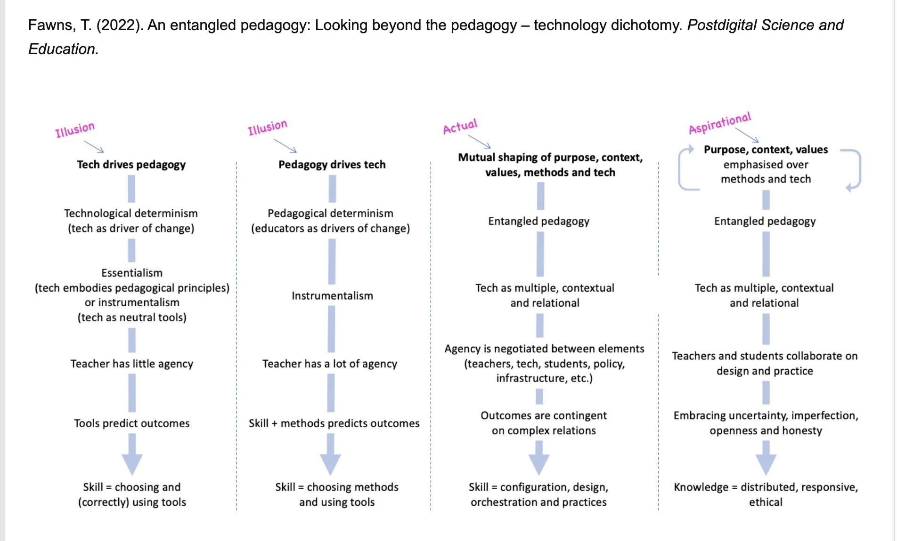

Slide 18
I also liked how we had to annotate texts a lot, because it really helped me as an annotator and has helped me in my other classes that I need to do this in as well.
The readings I found to be helpful throughout the course are the ones we read regarding technology in the classroom and if print reading should still be used. Reading these along with annotating using hypothesis was engaging and helpful. The tool hypothesis overall was a very fun and interactive way to read while keeping focus on the text and also being able to see and use other ideas and thoughts.
Throughout the semester we read a lot of
articles and a book that all thought outside the box and made us analyze so many things in life differently now. We also learned the proper way to cite, annotate, and also how to find scholarly journals
to support our claims and papers.
I thought the Hypothesis we used in class to annotate made it more interactive and better compared to writing on a normal reading.
This semester flew by so quickly. I really enjoyed reading and annotating all of the articles about reading on paper vs. screens and writing about that was very interesting and mentally challenging, in a good way.

Slide 19
Instructions
Join our private group here: https://hypothes.is/groups/Vx1PqP8n/texas-humanities-2023
Click on “The Reading Brain in the Digital Age” and “view annotations in context”
Make sure you are signed in on the upper right corner and make sure to select “Texas Humanities 2023” in the drop down
Highlight the text and click “annotate” to write a comment

Slide 20
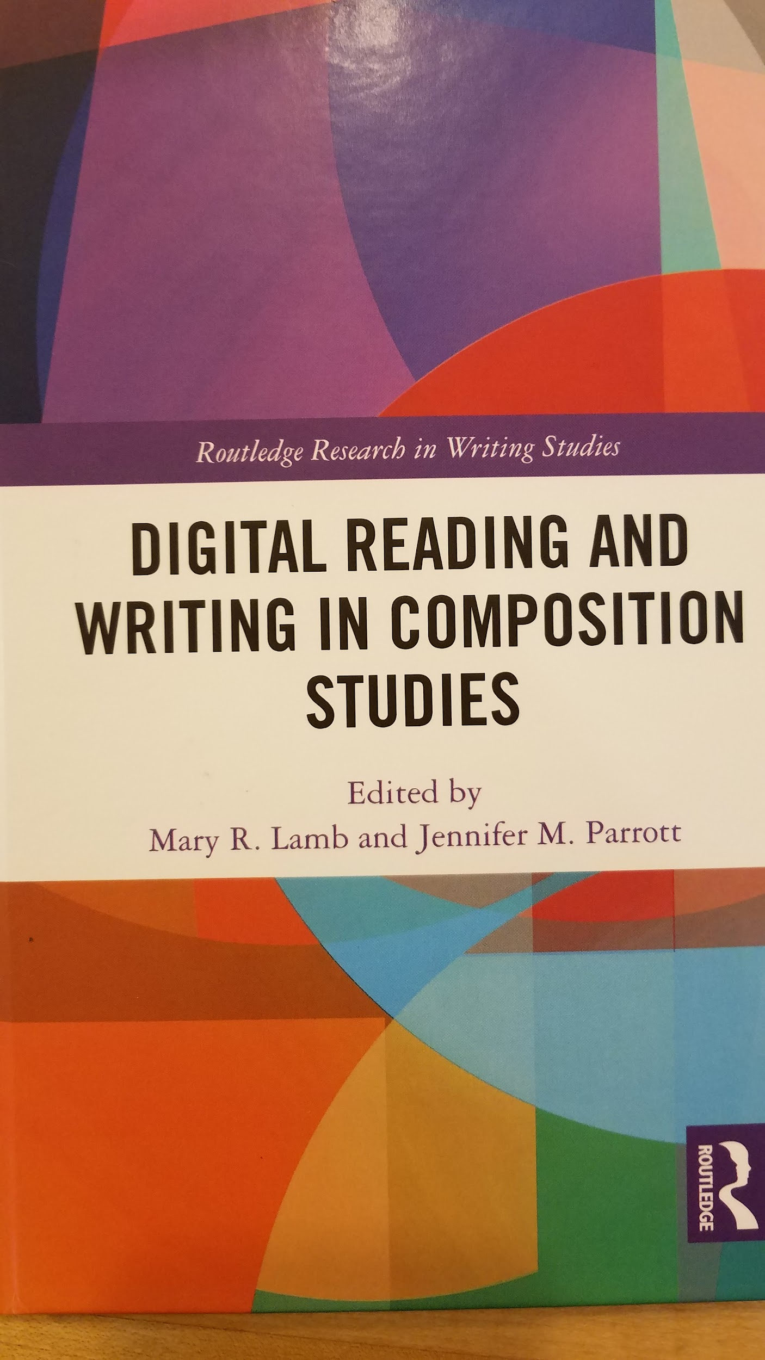
Amanda Licastro, PhD
alicast1@swarthmore.edu
@amandalicastro
Notes:
In conclusion, please reach out! This work has been published as a chapter in an anthology on digital reading, and, as I mentioned, you can find more resources on my blog.
Thank you.

