Slide 1
Spaniards and Mexicans in Indian Country, 1800-1835
Humanities Texas Webinar Series
September 2021

Slide 2
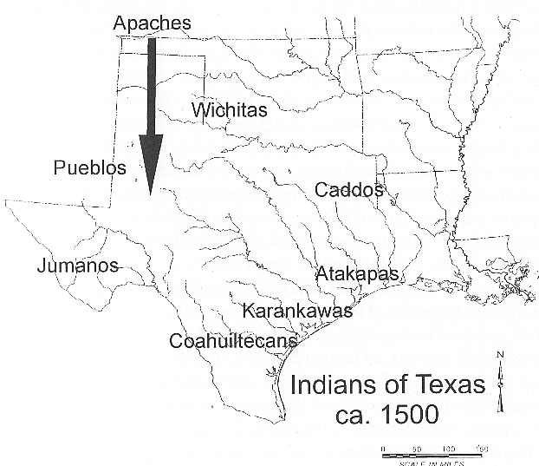

Slide 3
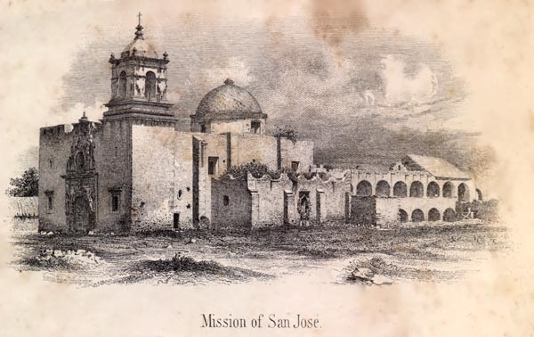

Slide 4
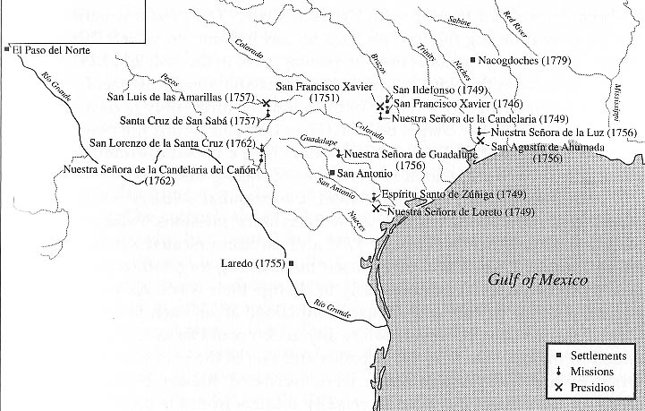

Slide 5
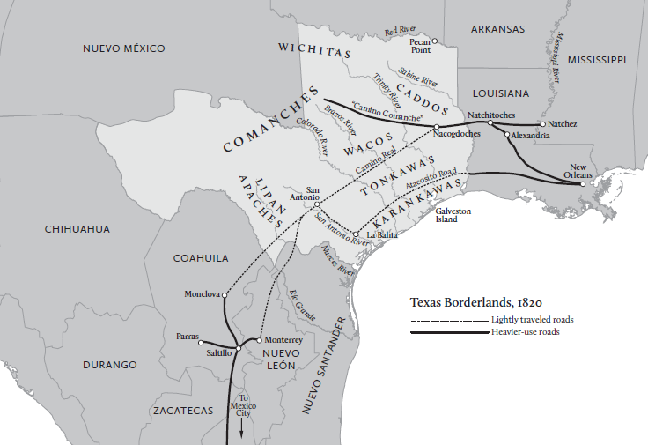

Slide 6
Essential Question #1:
How did American Indians contribute to the collapse of Spanish power in Texas?

Slide 7
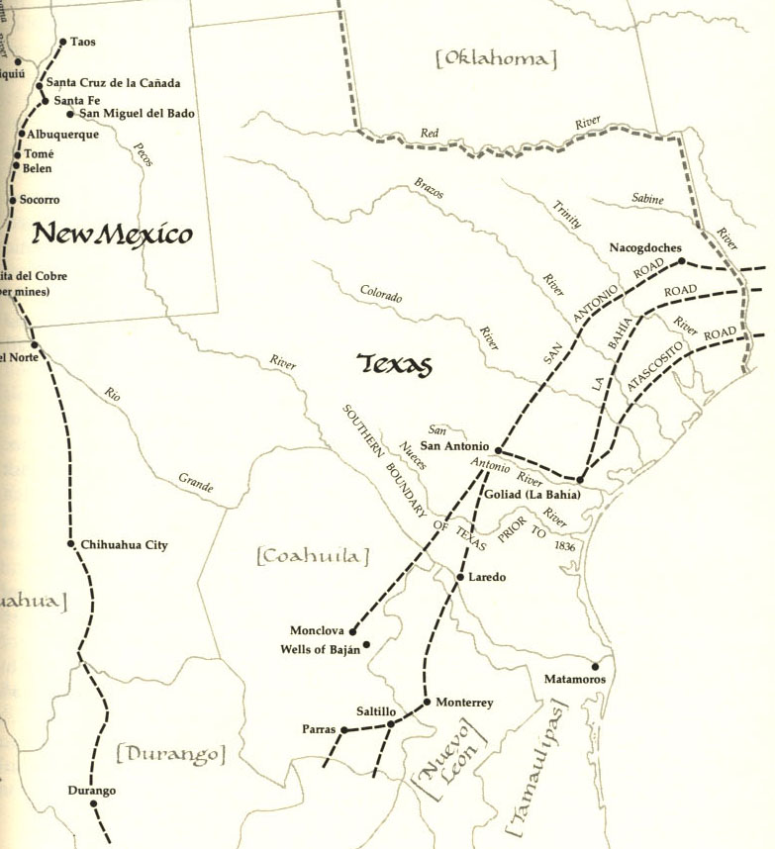

Slide 8
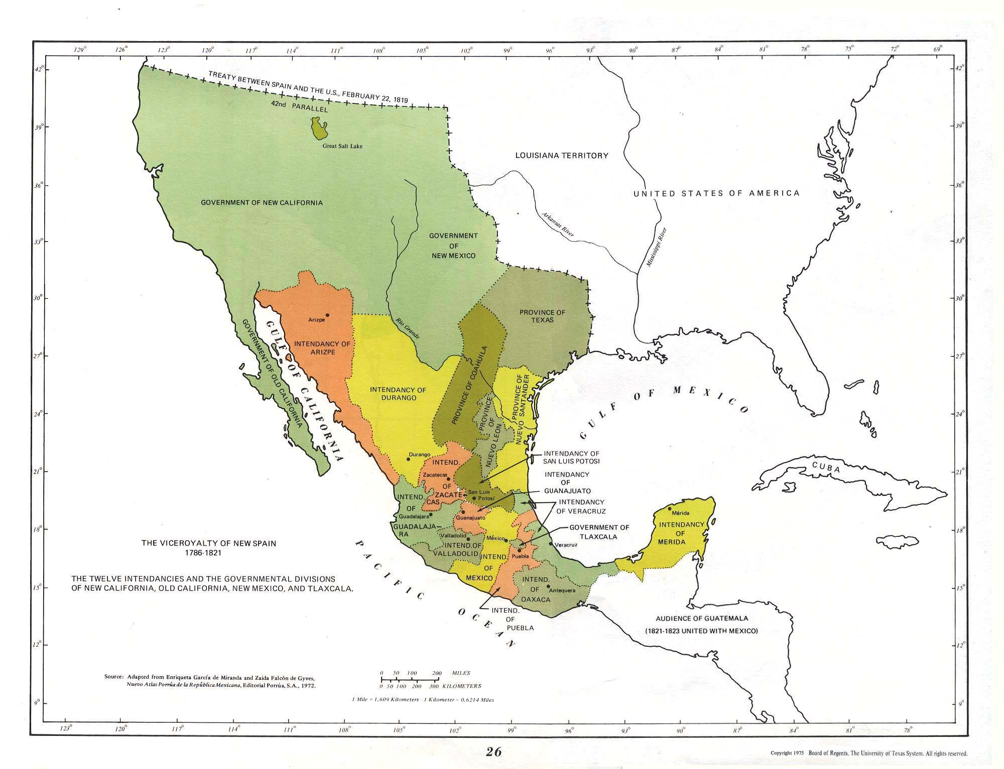

Slide 9
Mexico’s War for Independence (1810-1821) strengthened the power of Indians in Texas
in two critical ways:

Slide 10
Mexico’s War for Independence (1810-1821) strengthened the power of Indians in Texas
in two critical ways:
1. The chaos of the war in central Mexico badly disrupted the movement of trade goods to Texas.

Slide 12
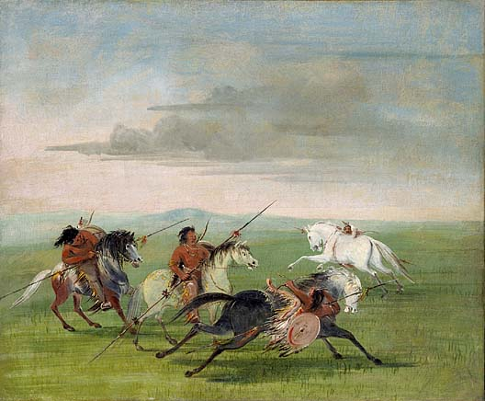

Slide 13
Mexico’s War for Independence (1810-1821) strengthened the power of Indians in Texas
in two critical ways:
1. The chaos of the war in central Mexico badly disrupted the movement of trade goods to Texas.

Slide 14
Mexico’s War for Independence (1810-1821) strengthened the power of Indians in Texas
in two critical ways:
1. The chaos of the war in central Mexico badly disrupted the movement of trade goods to Texas.
2. The violence that followed the Gutierrez-Magee Expedition badly weakened the Spanish position in Texas, and that made places like San Antonio deeply vulnerable to increased raiding by Comanches and Apaches.

Slide 17
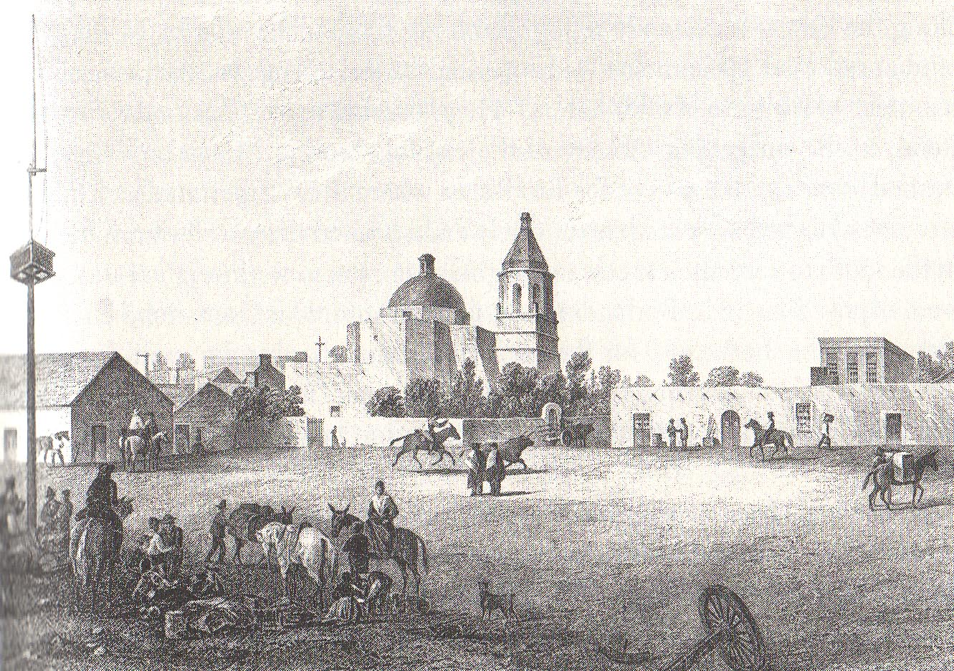

Slide 18
José Antonio Padilla, a Spaniard living in San Antonio, recorded in 1820:

Slide 19
José Antonio Padilla, a Spaniard living in San Antonio, recorded in 1820:
“The remainder of this extensive, immense, and spacious region composing the entire province is occupied by the different tribes of barbarous Indians, who, at all times, have been masters of the possessions and lives of the unfortunate inhabitants--but never with such tenacity and frequency as since the year 1813, at which time, after they had made away with the cattle, horses, and other property of the inhabitants within the space of a few days, killing and capturing a considerable number of persons of all ages, conditions, and sexes . . .”
[Source: Juan Antonio Padilla, “Report on the Barbarous Indians of the Province of Texas,” December 27, 1819, in Mattie Austin Hatcher, trans., "Texas in 1820," Southwestern Historical Quarterly 23:1 (July 1919): 47-68.]

Slide 20
And, at the same time, there was ANOTHER reason that Indians increased their raiding of Spanish settlements in Texas . . . .

Slide 21
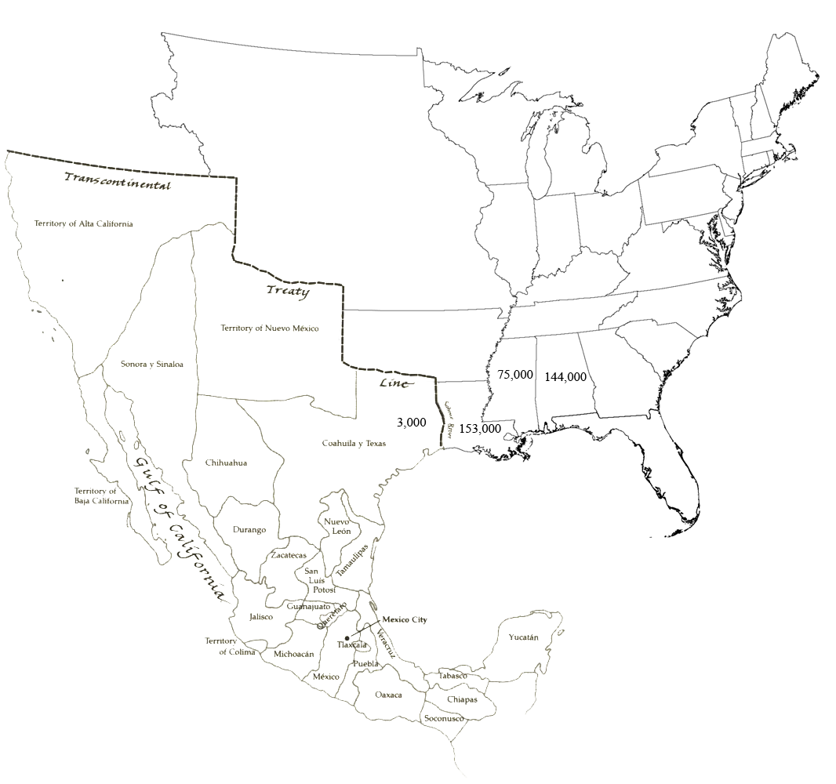

Slide 22
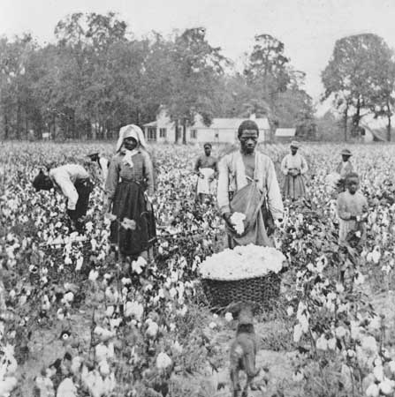

Slide 23
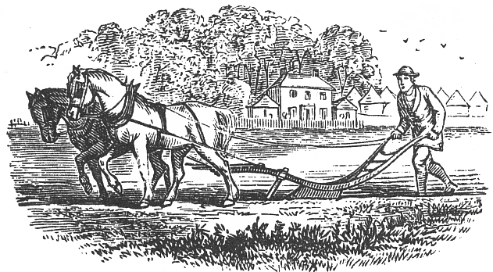

Slide 24
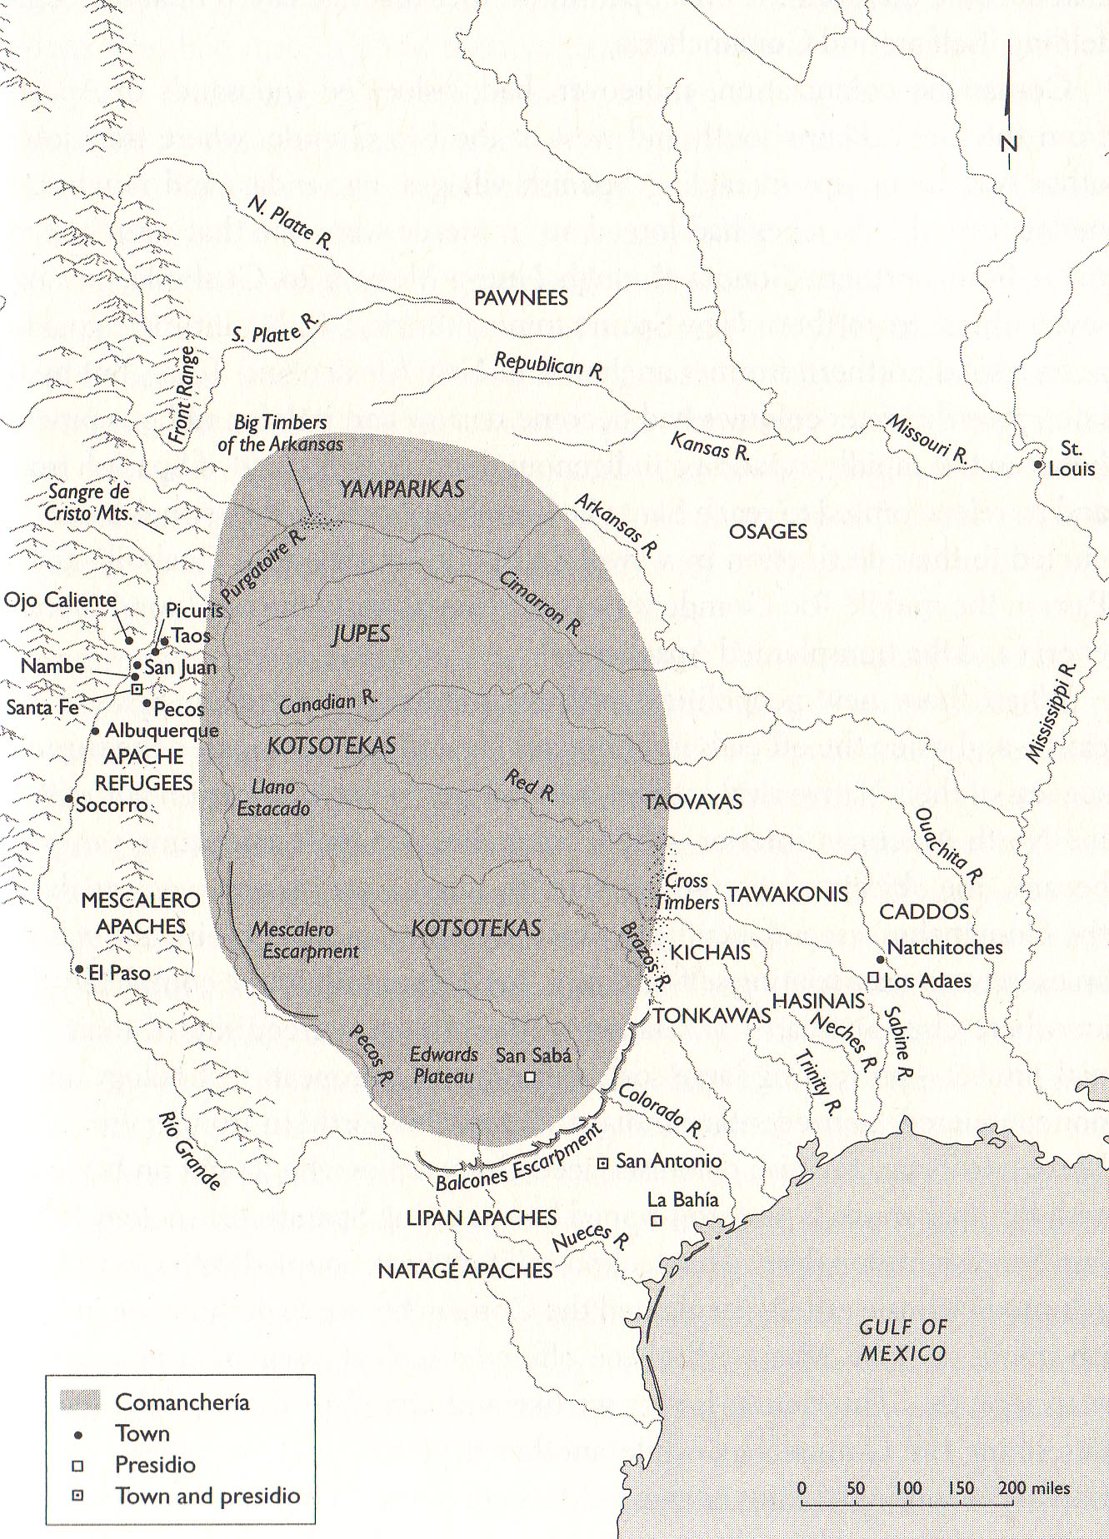

Slide 25
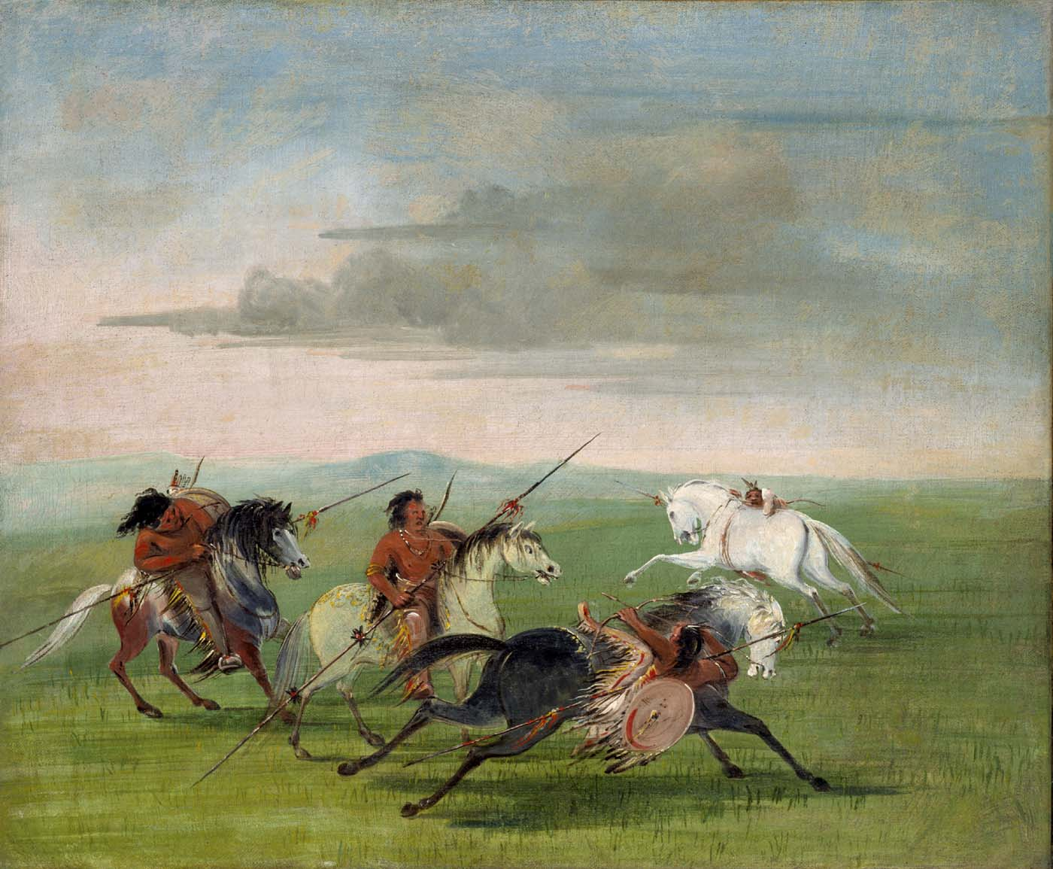

Slide 27
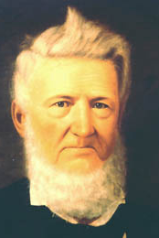
David G. Burnet

Slide 28
David G. Burnet, observing the Comanches in 1818:

Slide 29
David G. Burnet, observing the Comanches in 1818:
“They now are, and heretofore have been, peacefully disposed toward us [Americans]. They find the mules and horses of their ancient enemies, the provincial Spaniards, a more alluring quarry, than is presented by the scattered and humble hamlets of an American frontier.”

Slide 30
David G. Burnet, observing the Comanches in 1818:
“They now are, and heretofore have been, peacefully disposed toward us [Americans]. They find the mules and horses of their ancient enemies, the provincial Spaniards, a more alluring quarry, than is presented by the scattered and humble hamlets of an American frontier.”
“The number of mules and horses that these Indians capture annually from the Spaniards is immense, probably not less than 10,000”
[Source: David Burnet to John Jamison, writing from Nacogdoches, August 1818, reprinted in Ernest Wallace, ed., “David G. Burnet’s Letters Describing the Comanche Indians,” West Texas Historical Association Year Book Vol. 30 (October 1954): 115-140.]

Slide 31
David G. Burnet, observing the Comanches in 1818:
“The Comanchees conduct all their military operations on horseback. . . . . and are scarcely exceeded in the art of horsemanship, to which they are trained from early infancy. Both in war and hunting, they rely much on the speed of their horses, and are careful to select for their own use, the best and fleetest among their furtive herds.”
Comanches “always ride without saddles, and without any other encumbrance than the waist-cloth to their persons.—This lightness of apparel gives them a manifest advantage over their Spanish adversaries, whose horses are heavily caparisoned . . . Light shot guns, javelins, or lances, about 8 feet long, and bows and arrows, compose their weapons. For defence they wear on the left wrist, a shield made of Buffaloes hide . . . about two feet in diameter”
[Source: David Burnet to John Jamison, writing from Nacogdoches, August 1818, reprinted in Ernest Wallace, ed., “David G. Burnet’s Letters Describing the Comanche Indians,” West Texas Historical Association Year Book Vol. 30 (October 1954): 115-140.]

Slide 32
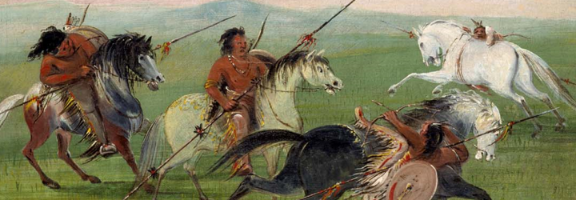

Slide 34
Governor Antonio Martinez to the Viceroy in Mexico City:
“The Indians become so insolent that they enter the town with the greatest nerve and kill these unfortunate inhabitants with impunity; no matter how quickly the troops come to their aid, the Indians, being well-armed and well-mounted, advance with ease and laugh at the efforts of these helpless soldiers who, though not cowards, have no physical strength or force.” – May 31, 1817

Slide 35
Governor Antonio Martinez to the Viceroy in Mexico City:
“The Indians become so insolent that they enter the town with the greatest nerve and kill these unfortunate inhabitants with impunity; no matter how quickly the troops come to their aid, the Indians, being well-armed and well-mounted, advance with ease and laugh at the efforts of these helpless soldiers who, though not cowards, have no physical strength or force.” – May 31, 1817
“I am not responsible for defending and controlling this province which has been placed under my protection; if within the briefest possible time, as circumstances urgently demand, I do not receive the aid necessary to save this garrison, then I have no means of preventing the catastrophe that I predict.” – November 26, 1820
[Source: Antonio Martinez to Viceroy Juan Ruíz de Apodaca, November 26, 1820, reprinted in Félix D. Almaráz, Jr., ed., Letters from Governor Antonio Martinez to the Viceroy Juan Ruíz de Apodaca (San Antonio: Research Center for the Arts and Humanities, University of Texas at San Antonio, 1983), p. 48.]

Slide 36
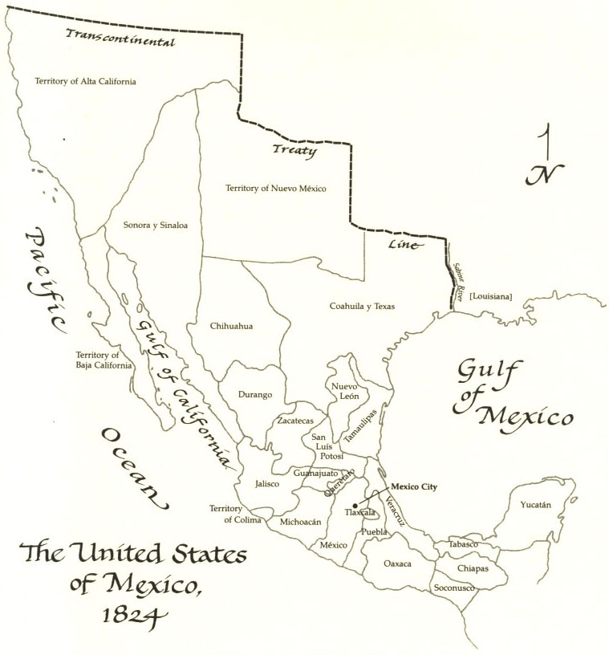
How did American Indians contribute to the collapse of Spanish power in Texas?

Slide 37
Essential Question #2:
How did the arrival of Americans in Texas change the situation for American Indians in the region?

Slide 39
“The most important problem is the security of the Province of Texas. It would be an irreparable loss to the Empire if this beautiful Province is lost. In order to save it there remains only one recourse—to populate it.”
--Mexico City commission, December 1821

Slide 40
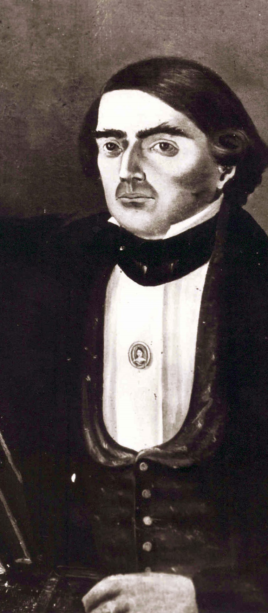
Francisco Ruiz

Slide 41
“I cannot help seeing the advantages which, to my way of thinking, would result if we admitted honest, hardworking people, regardless of what country they come from . . . even hell itself.”
Francisco Ruiz

Slide 42
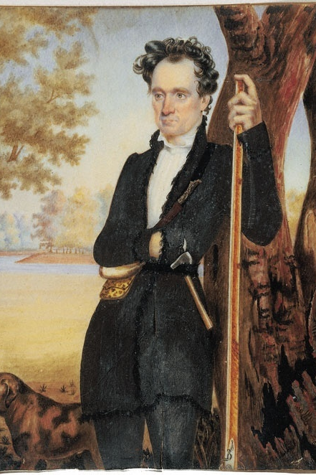

Slide 44
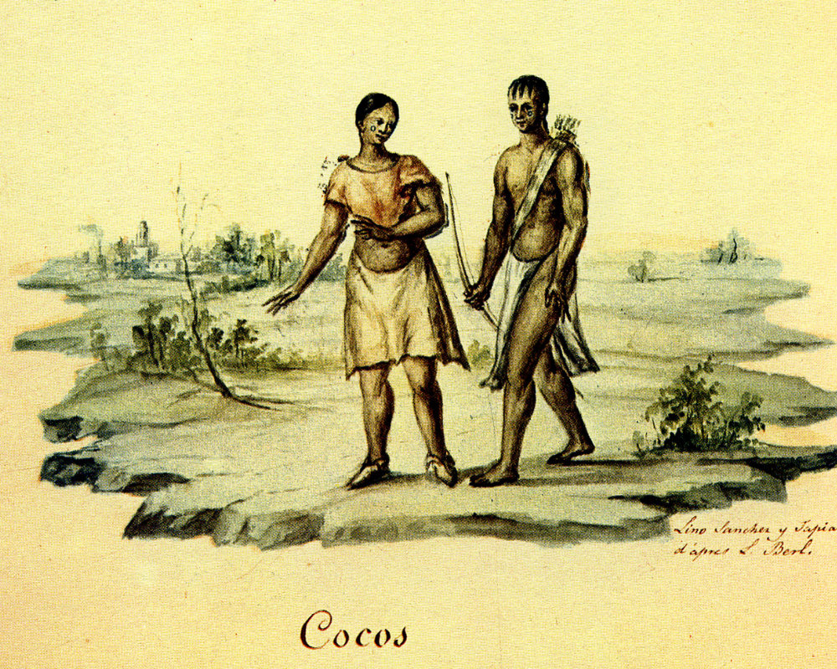

Slide 45
Stephen F. Austin’s entry in his journal after his first visit with Karankawa Indians:

Slide 46
Stephen F. Austin’s entry in his journal after his first visit with Karankawa Indians:
“These Indians were well formed and apparently very active and athletic men, their Bows were about 5 ½ to 6 ft long, their arrows 2 to 3 [ft long and] well pointed with Iron or Steel. [Some] of the squaws [women] were handsome & one of them quite pretty – they had Panther skins around their waist tho[ugh] they were naked – their breasts were marked or tatooed in circles of black beginning with a small circle at the nipple and enlarging as the breast swelled.”
[Source: “Journal of Stephen F. Austin on His First Trip to Texas, 1821,” Quarterly of the Texas State Historical Association 7 (April 1904): 304-305.]

Slide 48
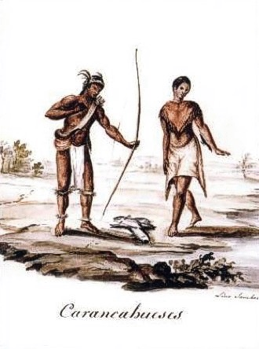

Slide 49
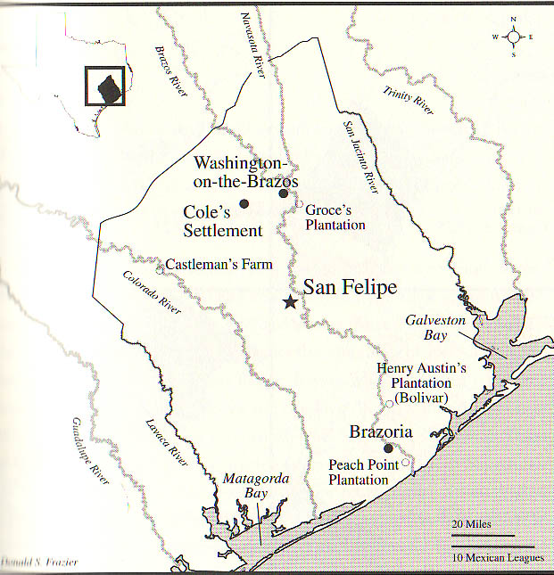

Slide 51
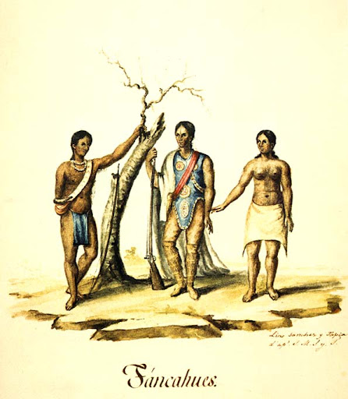

Slide 52
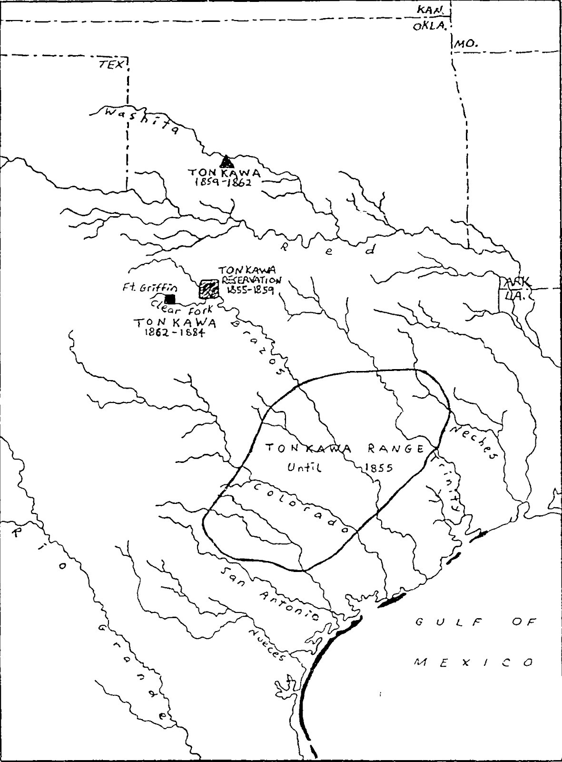

Slide 56
By 1825, Austin had settled 300 families -- that meant at least 3,000 Americans had moved into the bounds of his colony.

Slide 57
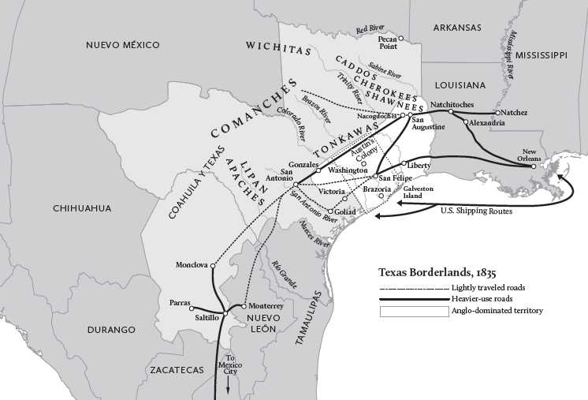

Slide 58
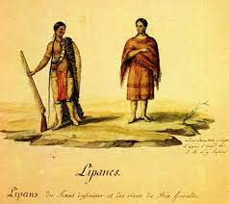

Slide 61
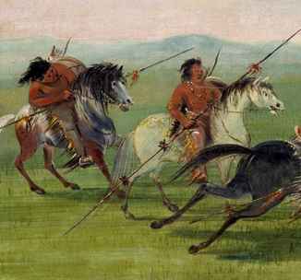

Slide 62
“when they found there were no Spaniards with me, they gave us back our Saddle bags, saddles, and everything else except 4 blankets, a bridle, my Grammar and Several other little things and all our provisions.”
[Source: SFA to J.E.B. Austin, March 23, 1822, Austin Papers, I, 487.]

Slide 63
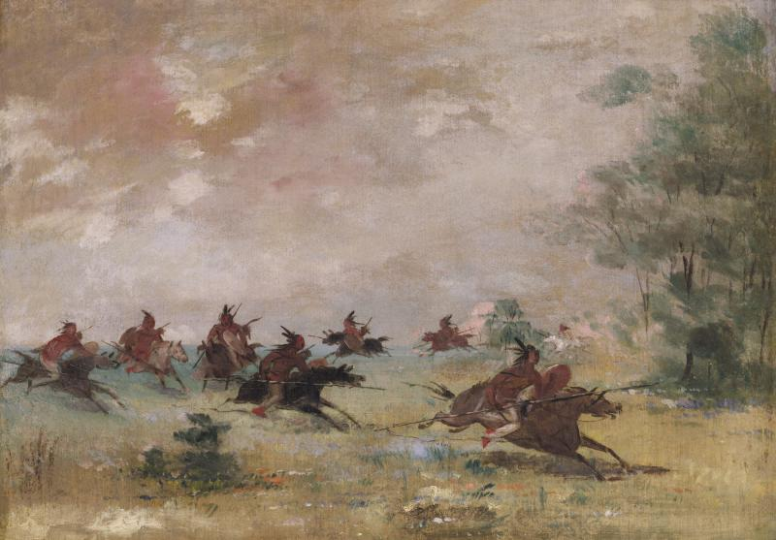

Slide 64
How did the arrival of Americans in Texas change the situation for American Indians in the region?

Slide 65
