Slide 1
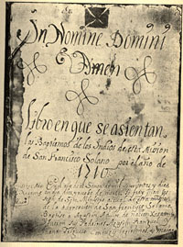
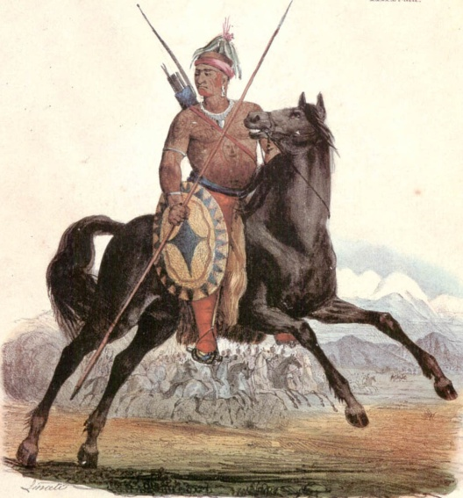
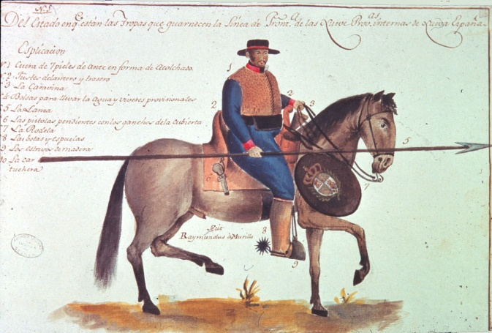
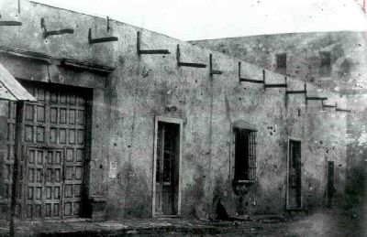
Spanish Texas

Slide 2
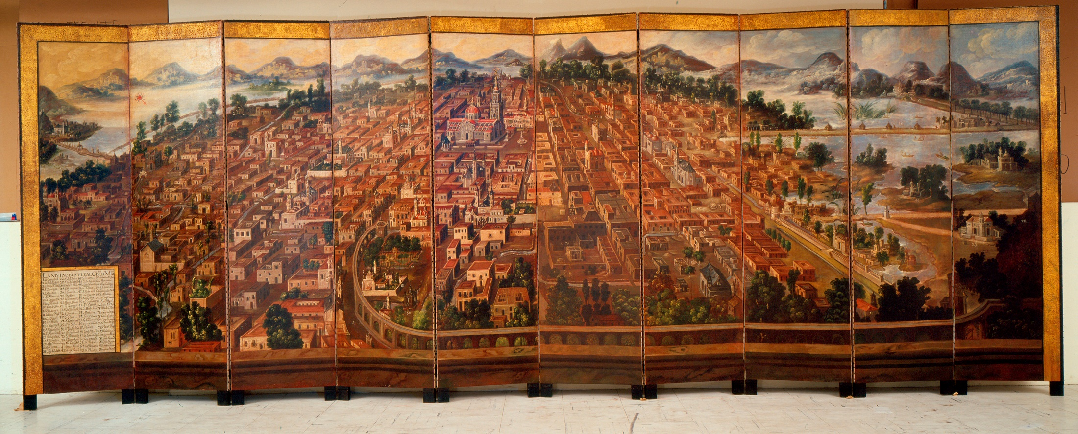
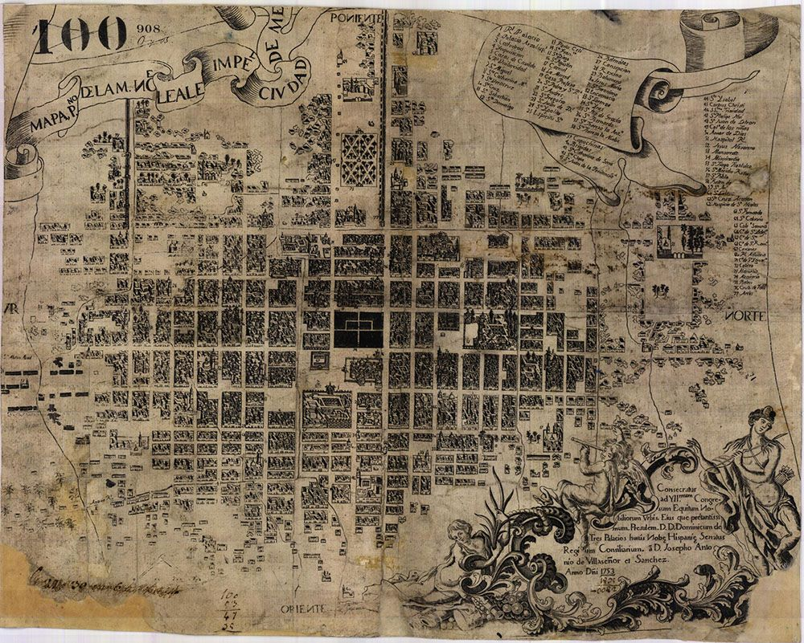
Biombo (folding screen): Muy noble y leal ciudad de México (ca. 1700)
Texas is not representative of the Spanish Empire in North America
1753 map of Mexico City

Slide 3
Texas as the Space behind the
backyard shed

Slide 4
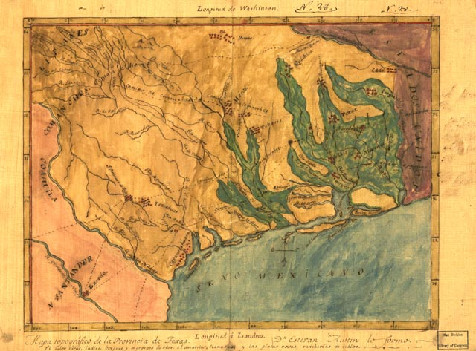
Stephen F. Austin’s map of Texas, ca. 1821.
Texas was not what it is today until 1848

Slide 5
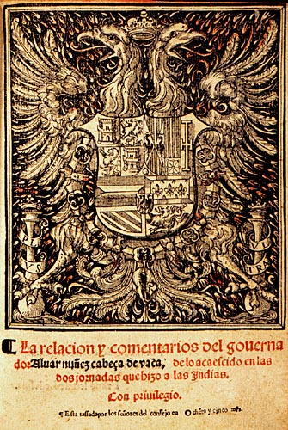
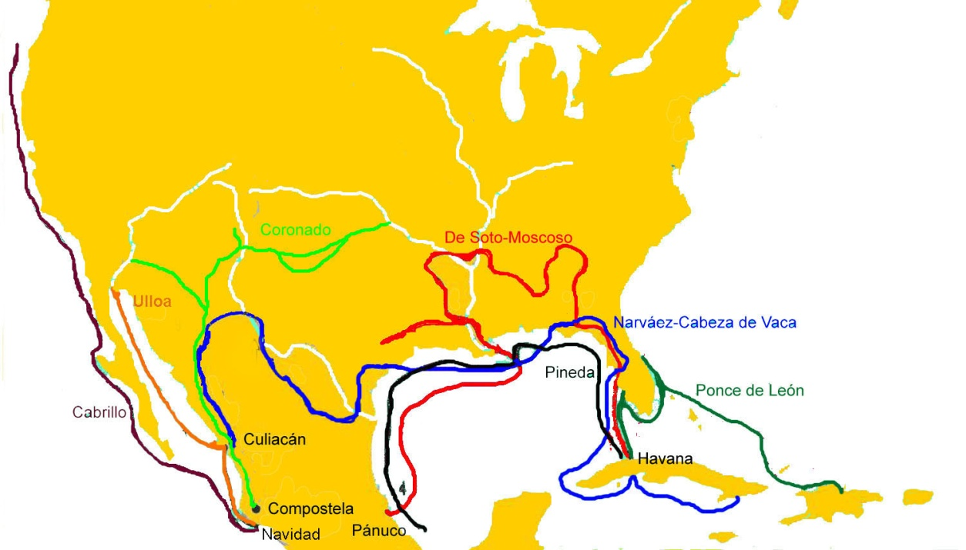
Texas as part of La Florida, 16th-17th centuries.

Slide 6
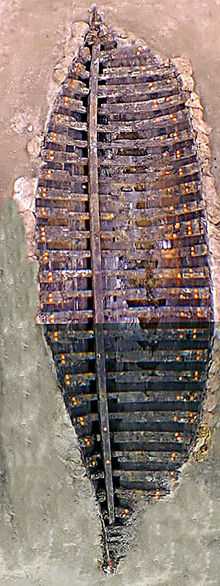
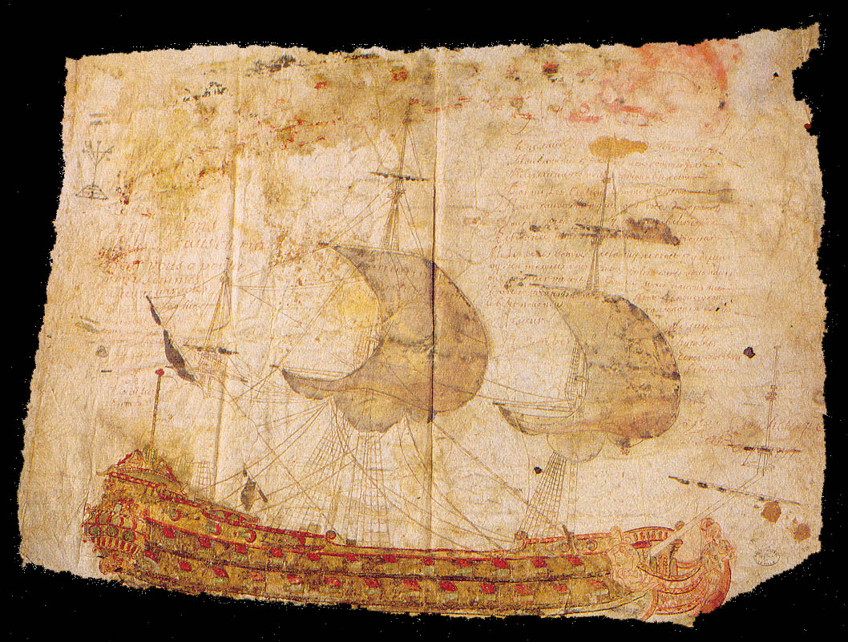
The story of Texas begins with Spanish efforts to make sure the French did not establish a presence there—stay out of our backyard!
Drawing of French frigate that contained message requesting help from La Salle expedition survivors.
One of La Salle’s cargo ships, La Belle, as unearthed in Matagorda Bay

Slide 7
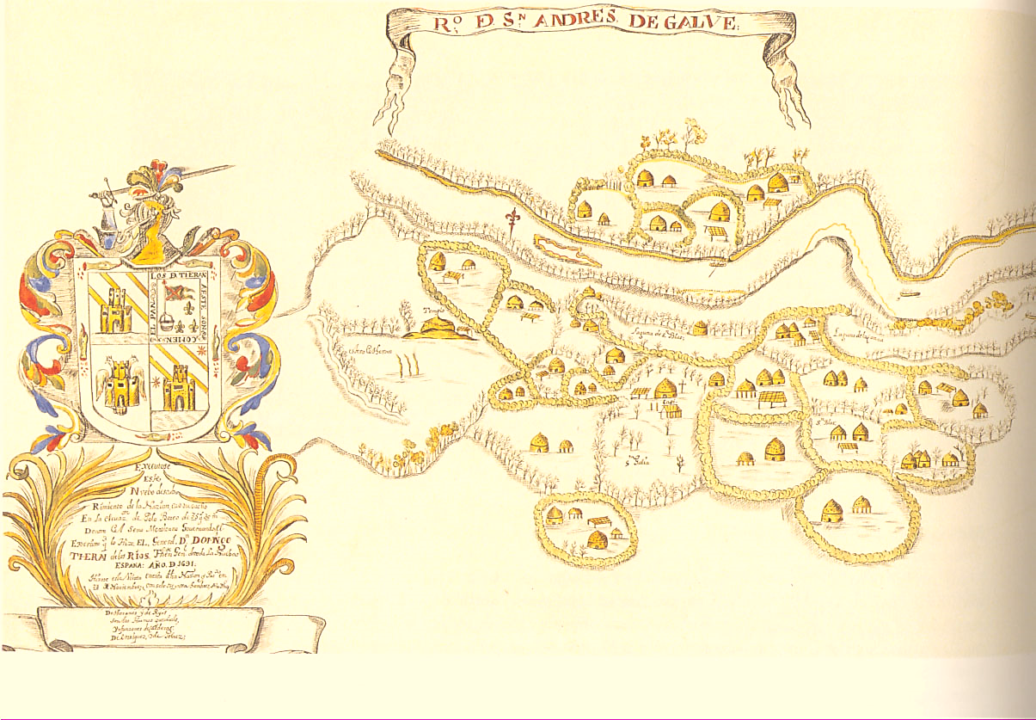
Domingo Terán de los Ríos’s representation of a Hasinai settlement on the Texas-Louisiana border
Texas is named for a Caddo word meaning something like “friend”

Slide 8
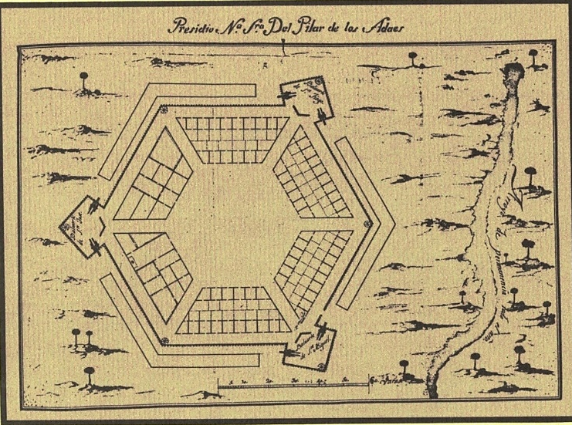
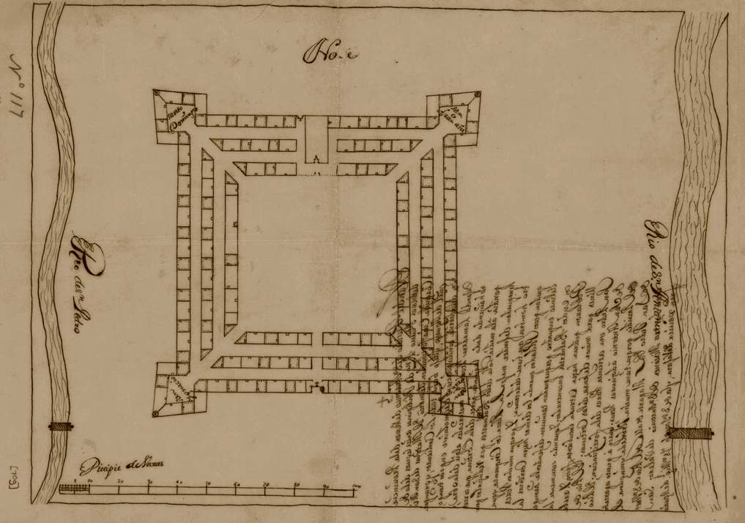
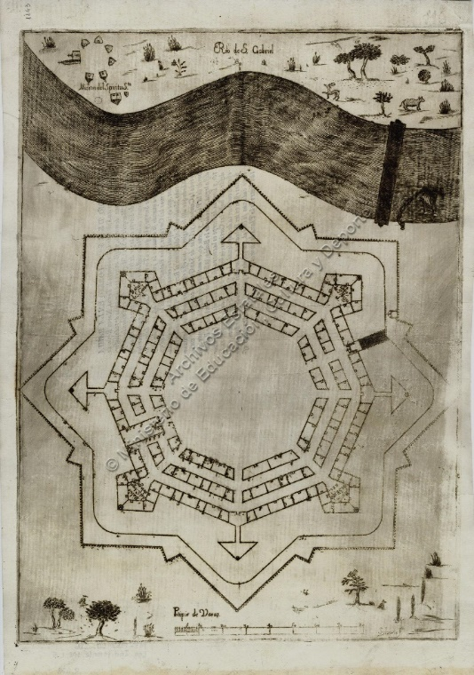
The Marqués de San Miguel de Aguayo’s plans for Texas fortifications, ca. 1721
From the beginning Texas a military province

Slide 9
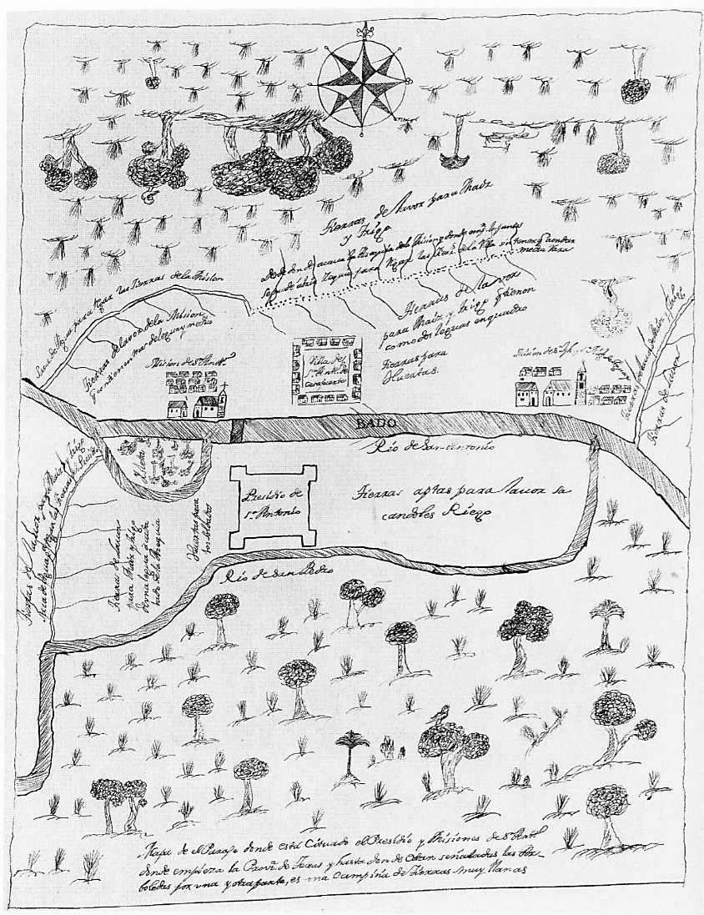
Aguayo’s map of the San Antonio area, ca. 1730.
The Canary Islander experiment

Slide 10
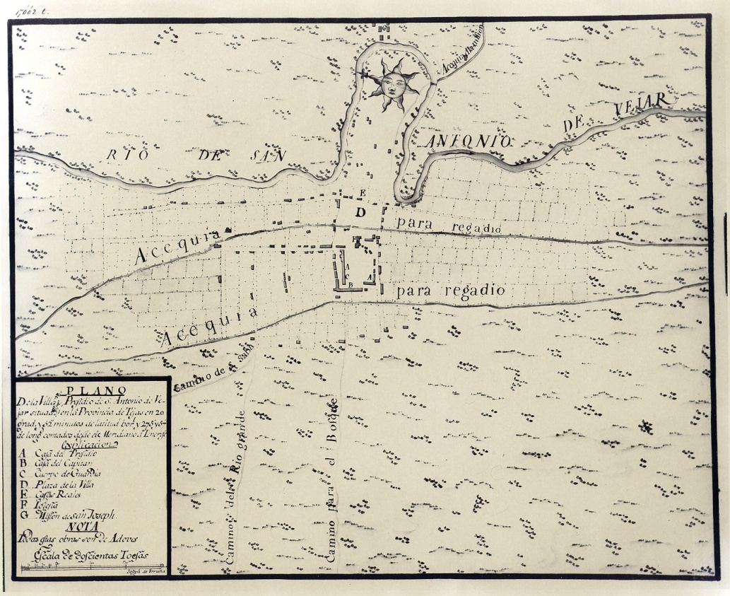
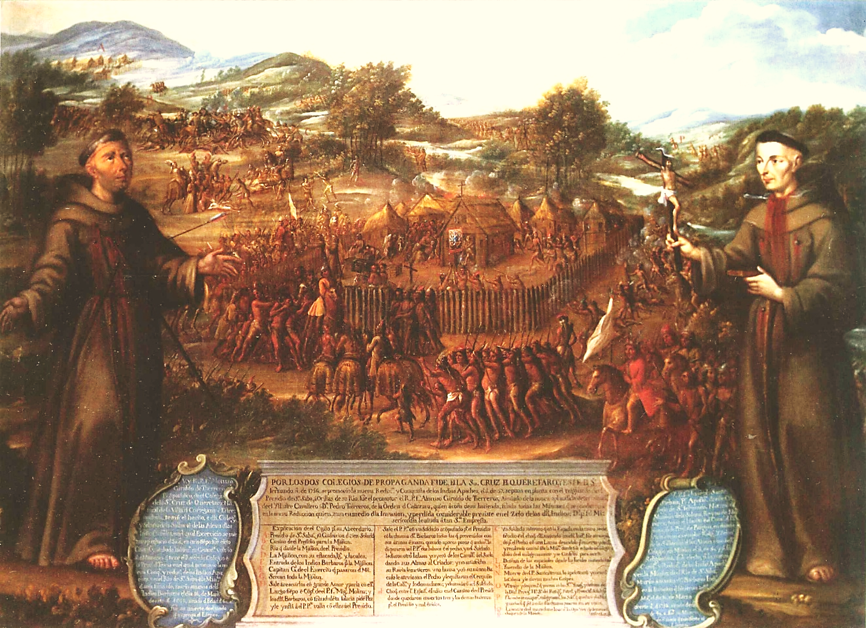
Lafora-Urrutia plat of the San Antonio area.
San Antonio is not the capital but is the most important Spanish Settlement in Texas
Destruction of Mission San Sabá, studio of Miguel Cabrera, ca. 1762

Slide 11
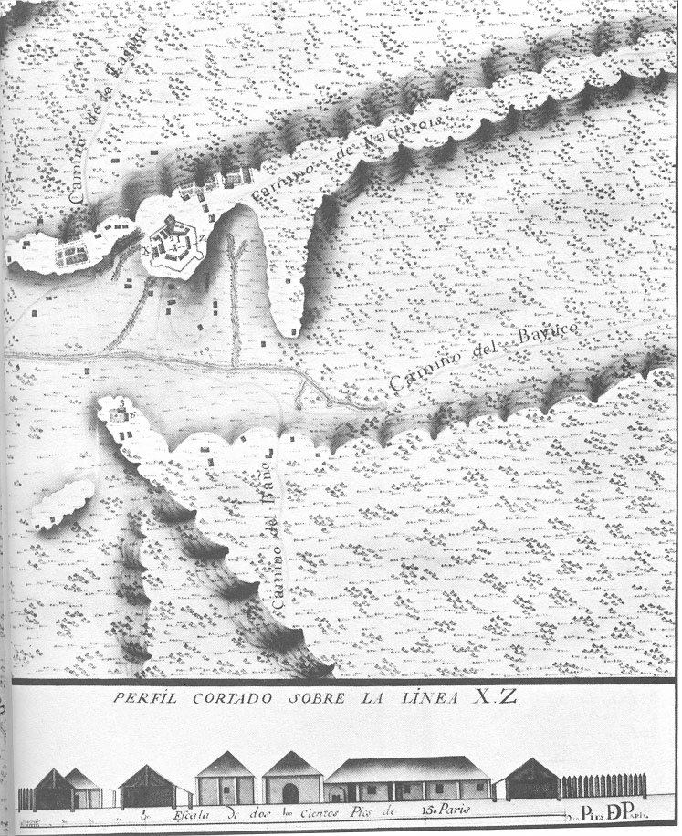
Above: Pre-1870 photograph of San Fernando church in San Antonio.
By 1770 Spain owned Louisiana
and Texas retrenched
Right: Nicolás Lafora’s and Joseph de Urrutia’s plat of Los Adaes just before decommissioning, ca. 1768.

Slide 12
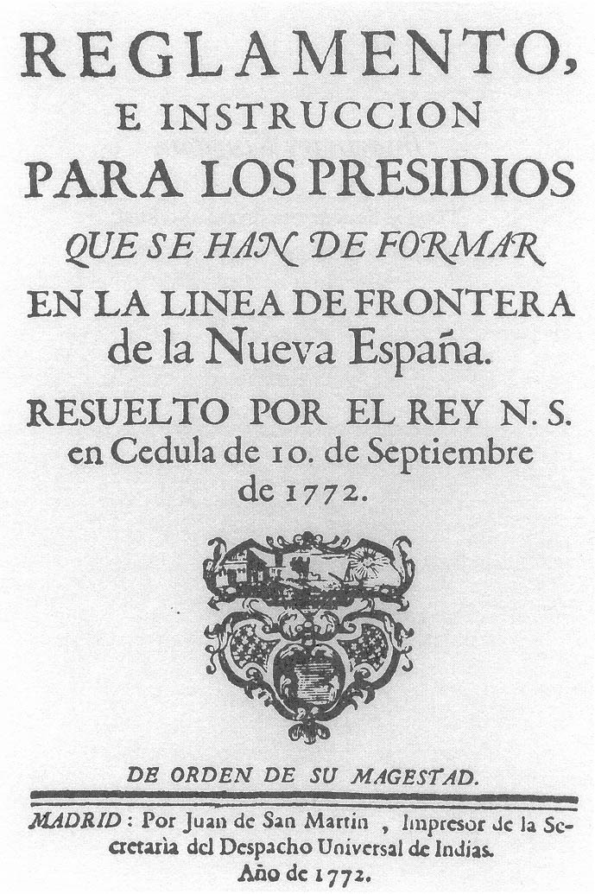
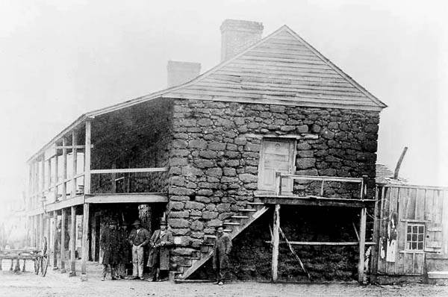
Regulations and Instructions for the Presidios that Form the Frontier Line of New Spain, as resolved by the king our lord by decree of September 10, 1772.
Late 18th century readjustments and the return to East Texas
Stone Fort, Nacogdoches. Home and store of Antonio Gil Ybarbo, who led the displaced Adaes settlers back to East Texas in 1779.

Slide 13
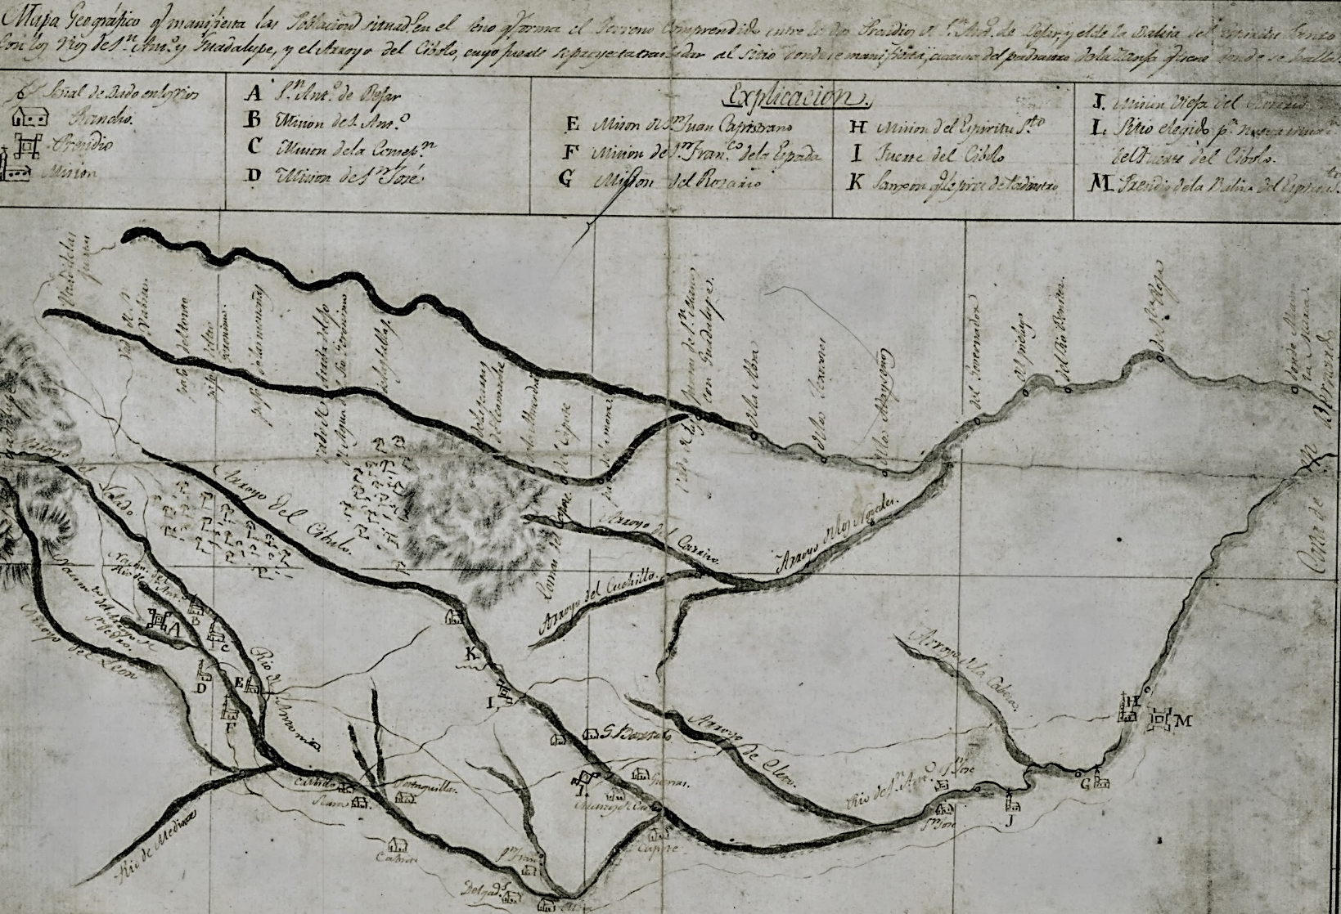
The San Antonio-Guadalupe basin, cradle of the Texas Cattle industry
Gov. Domingo Cabello’s map of the San Antonio-Guadalupe Rivers basin, ca. 1780.

Slide 14
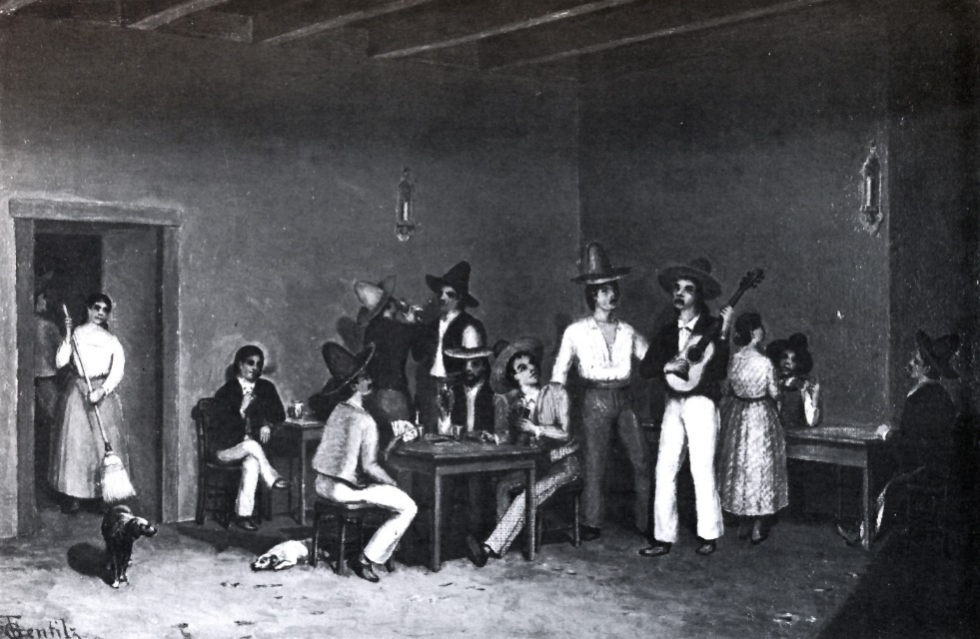
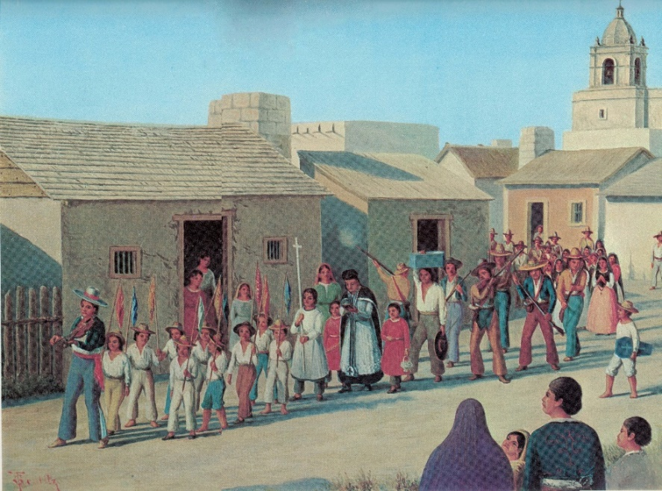
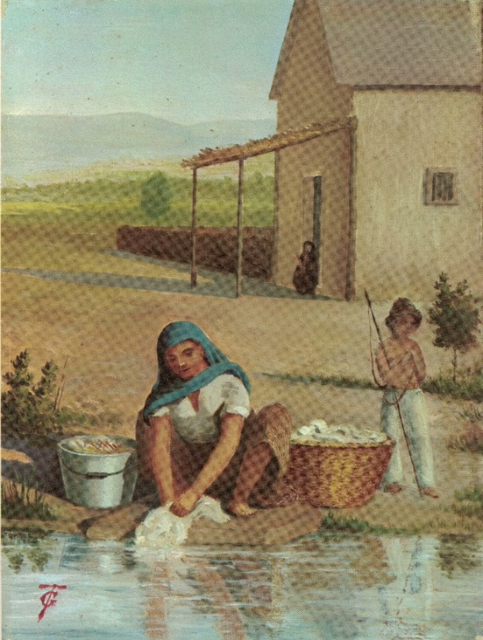
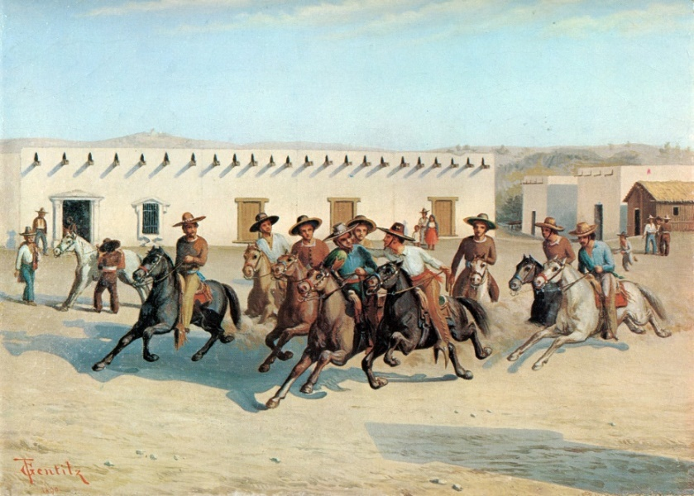
Theodore Gentilz paintings of everyday life in San Antonio, mid-19th century.

Slide 15
Soldado de cuera, or heavy cavalry trooper, by Ramón de Murillo ca. 1800
The Military Frontier at the end of the 18th century

Slide 16
Documents

Slide 17
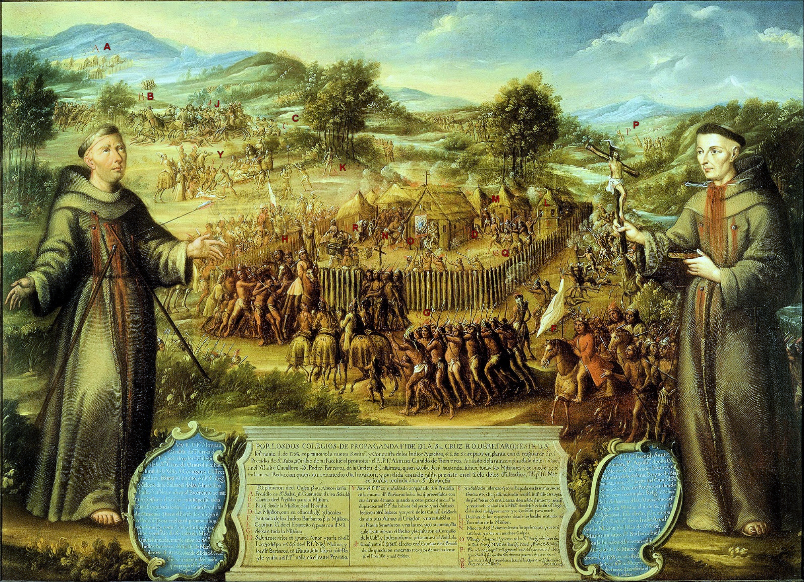

Slide 18
