Slide 1
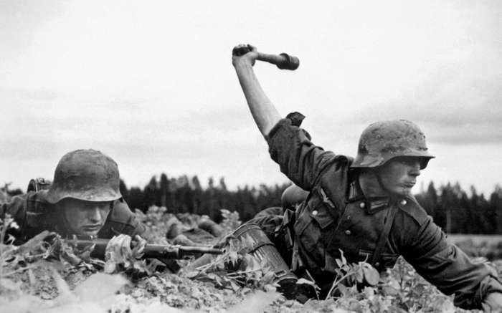
German troops in Operation Barbarossa (June 22nd, 1941)

Slide 2
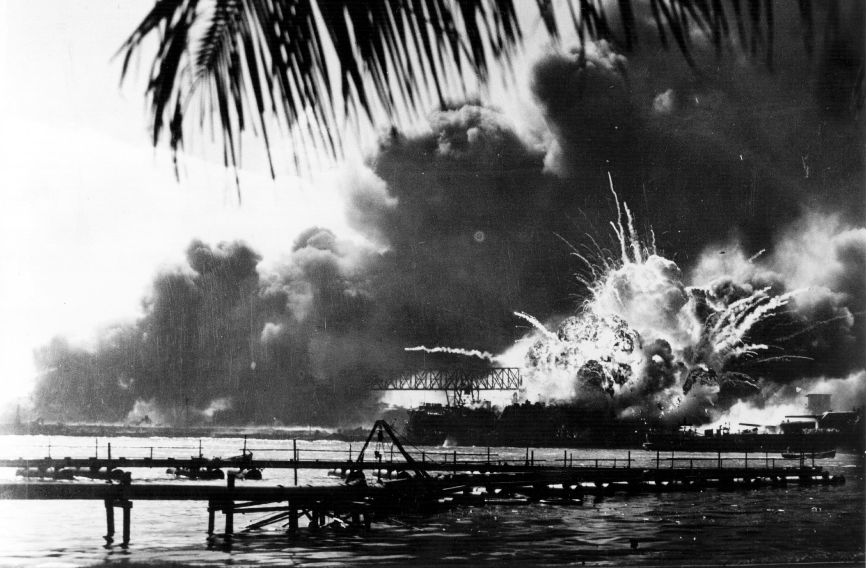
Pearl Harbor (December 7th, 1941)

Slide 3
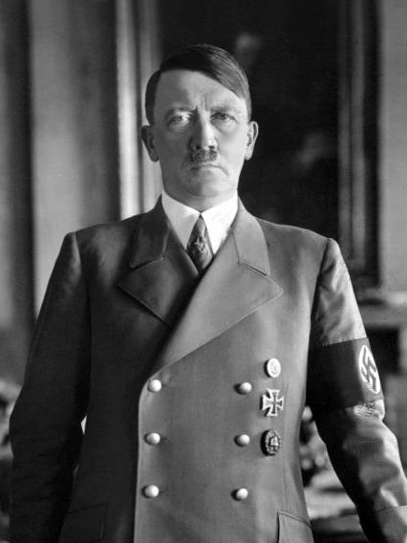
Adolf Hitler (1889-1945)

Slide 4
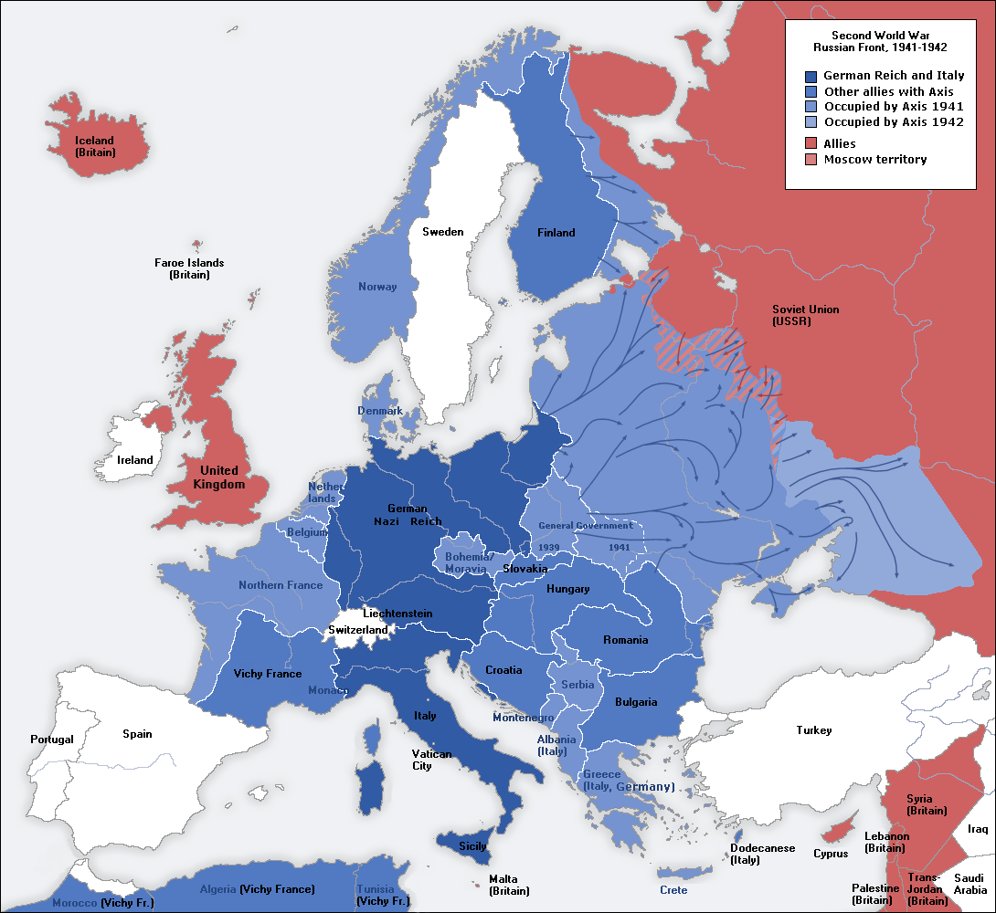
Europe Under Nazi Domination 1941

Slide 5
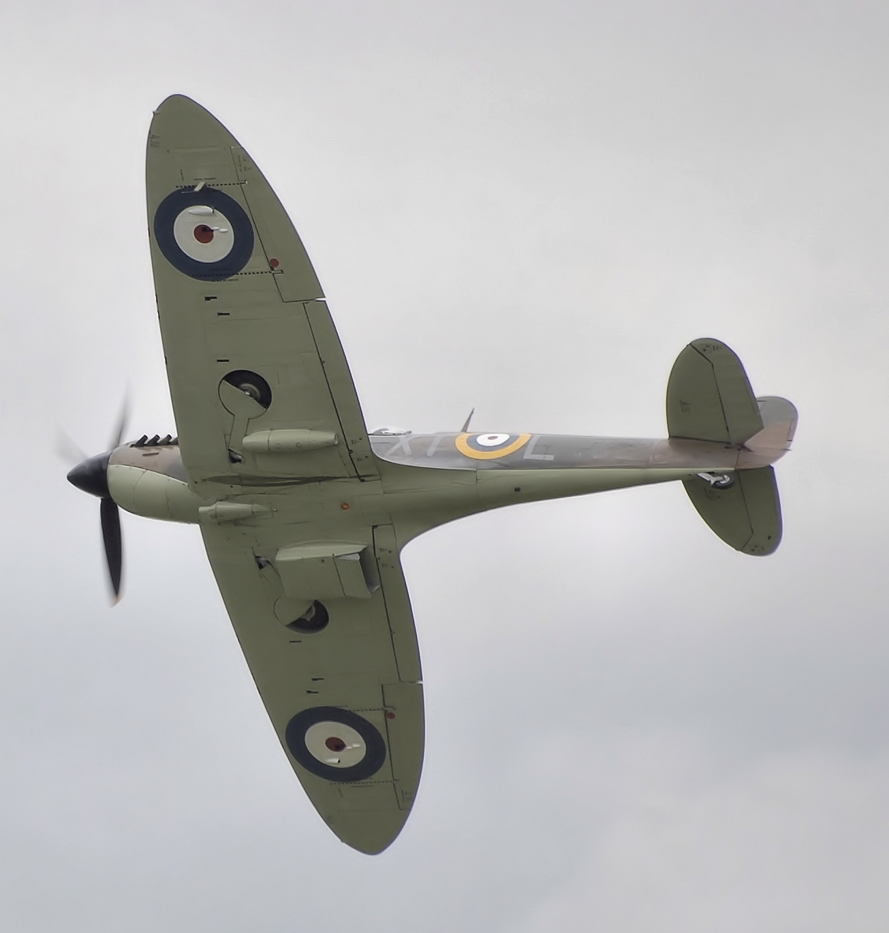
Fighting Hitler: RAF Spitfire over England

Slide 6
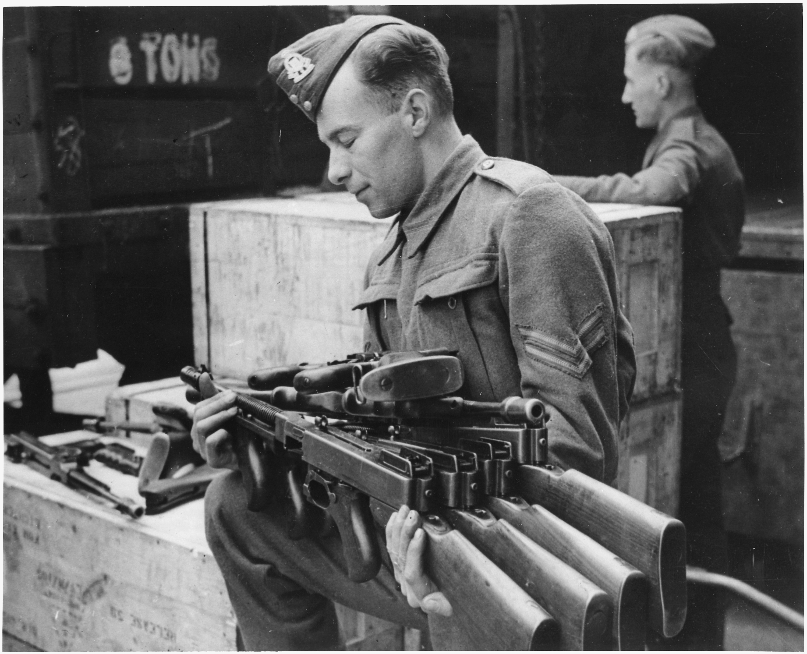
“If your neighbor’s house is on fire…”: Lend Lease to Great Britain

Slide 7
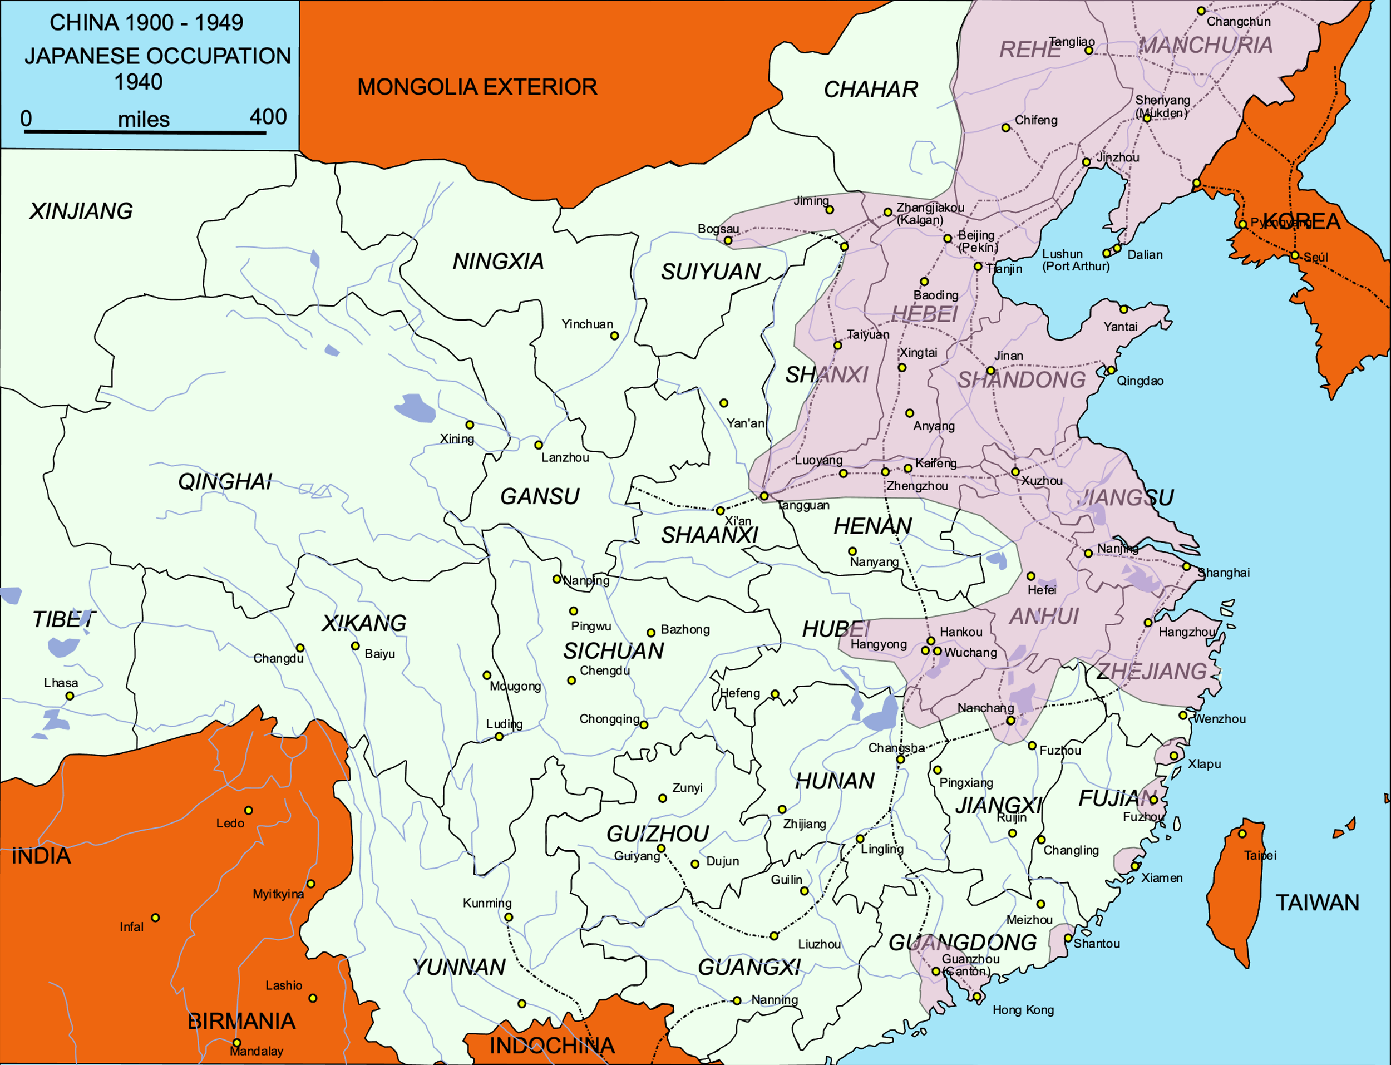
China Under Japanese Domination 1941

Slide 8
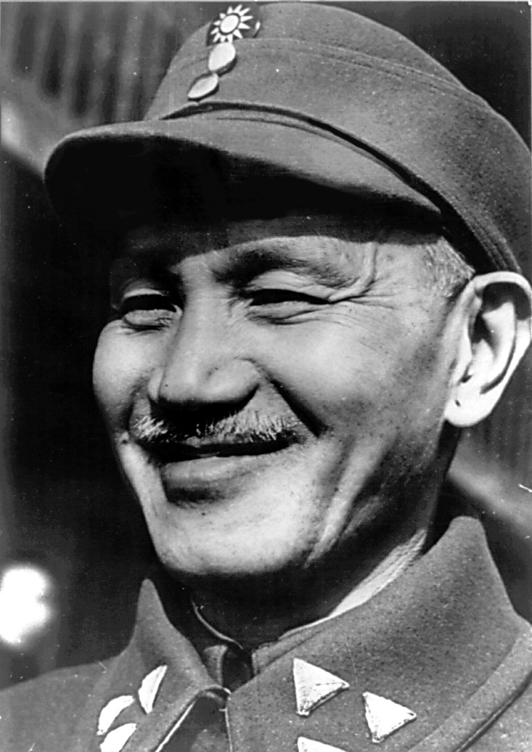
Chiang Kai-Shek, President of the Republic of China

Slide 9
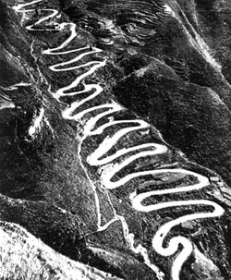
“Burma Road”

Slide 10
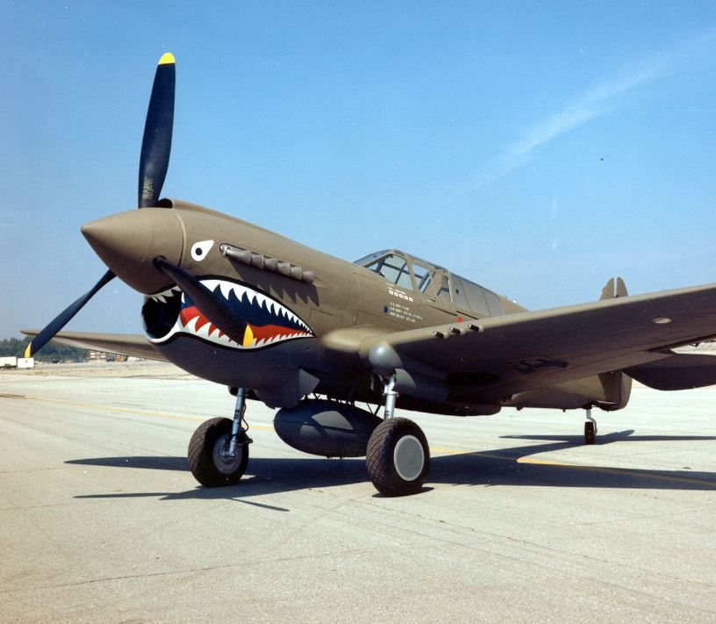
P-40 of the American Volunteer Group (“Flying Tiger”)

Slide 11
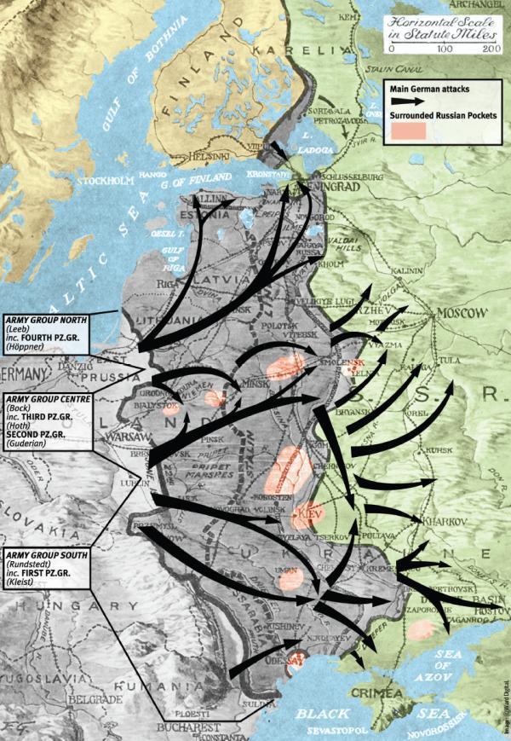
Operation Barbarossa (June 22nd, 1941)

Slide 12
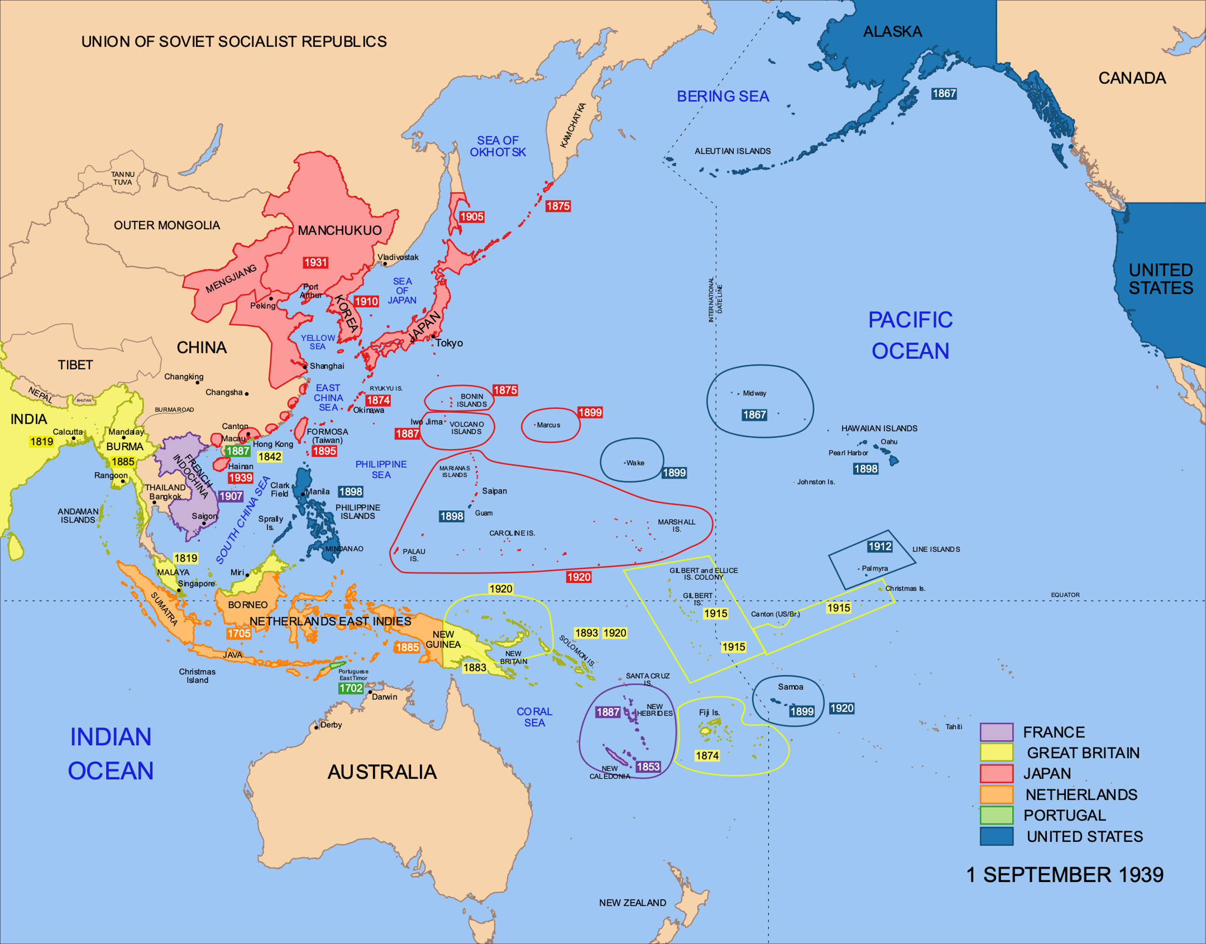
Ripe for the Picking: Western Empires in the Pacific (1941)

Slide 13
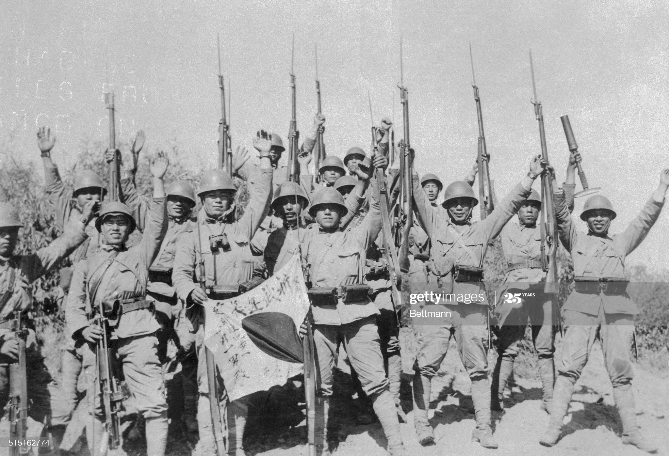
Japanese Troops on the March

