Slide 1
Teaching the Writings of Sandra Cisneros
Dr. Patricia M. García
The University of Texas at Austin
Humanities Texas Presentation
December 1, 2020

Slide 2
Why write?
"We do this because the world we live in is a house on fire and the people we love are burning.”
-Sandra Cisneros

Slide 3
Sandra Cisneros

Slide 4
Sandra Cisneros
Biography
Born 1954 (Chicago)
Novelist, poet, teacher, philanthropist.
One of the first female Mexican American writers to have her works published by a mainstream press.
Lived and worked in San Antonio for many years, currently resides in Mexico.
Established Macondo Foundation and Alfredo Cisneros del Moral Foundation to support the work of rising writers.
Works include The House on Mango Street (1984), “’Woman Hollering Creek’ and Other Stories” (1991), Caramelo (2002), A House of My Own (2015).
Awards include MacArthur Fellowship, National Medal of Arts, and PEN/Nabokov Award for international literature.

Slide 5
The House on Mango Street

Slide 6
“The Author Responds”
“I believe books are medicine. A library is a medicine cabinet. What can heal one person may not work for at all for somebody else. You know when something is helaing you, just as you know when somethings isn’t. And if my book isn’t doing the trick and doesn’t serve you, you’re not required to keep reading. But please allow it to remain on the library shelf for someone else who needs its particular medicine.”

Slide 7
“’Woman Hollering Creek’ and Other Stories

Slide 8
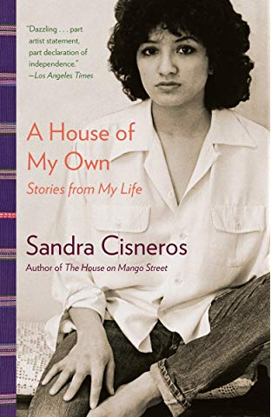
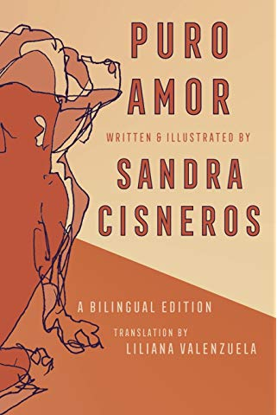
Other Works

Slide 9
Texas TEKS
(5) Response skills: listening, speaking, reading, writing, and thinking using multiple texts. The student responds to an increasingly challenging variety of sources that are read, heard, or viewed. The student is expected to:
(A) describe personal connections to a variety of sources, including self-selected texts
(8) Author's purpose and craft: listening, speaking, reading, writing, and thinking using multiple texts. The student uses critical inquiry to analyze the authors' choices and how they influence and communicate meaning within a variety of texts. The student analyzes and applies author's craft purposefully in order to develop his or her own products and performances. The student is expected to:
(A) analyze the author's purpose, audience, and message within a text;
(B) evaluate use of text structure to achieve the author's purpose;
(C) evaluate the author's use of print and graphic features to achieve specific purposes;
(D) evaluate how the author's use of language informs and shapes the perception of readers;
(E) evaluate the use of literary devices such as paradox, satire, and allegory to achieve specific purposes;
(F) evaluate how the author's diction and syntax contribute to the mood, voice, and tone of a text; and
(G) analyze the effects of rhetorical devices and logical fallacies on the way the text is read and understood.

Slide 10
Major Themes
Identity formation
Class, ethnicity, and sexuality
Bi-culturalism
Home and a sense of place
Rebellion and individualism
The development of a writer
“She stares at the ceilings and walls of her apartment the way she once stared at the ceilings and walls of the apartments she grew up in, inventing stories to go along with these pictures. At night, under the circle of light from a cheap mental lamp clamped to the kitchen table, she sits with paper and a pen and pretends she’s not afraid. She’s trying to live like a writer.” (“A House of my Own”: 25th Anniversary edition).

Slide 11
The House on Mango Street
Summary
Esperanza, the young narrator of the story, longs to line in a “real” home while growing up poor in the barrios of Chicago. She learns in the course of the novel that Mango street is an integral part of her identity.
Themes
Growing up
The endurance of the individual
Gaining agency through the creative process
Sense of place

Slide 12
The House on Mango Street
Symbolism
In English my name means hope. In Spanish it means too many letters. It means sadness, it means waiting. It is like the number nine. A muddy color. It is the Mexican records my father plays on Sunday mornings when he is shaving, songs like sobbing. (“My Name”)
Diction
At school they say my name funny as if the syllables were made out of tin and hurt the roof of your mouth. But in Spanish my name is made out of a softer something, like silver, not quite as thick as sister's name Magdalena--which is uglier than mine. Magdalena who at least- -can come home and become Nenny. But I am always Esperanza.
I would like to baptize myself under a new name, a name more like the real me, the one nobody sees. Esperanza as Lisandra or Maritza or Zeze the X. Yes. Something like Zeze the X will do. (“My Name”)

Slide 13
The House on Mango Street
Symbolism and Point of View
I like to tell stories. I tell them inside my head. I tell them after the mailman says, “Here’s your mail. Here’s your mail he said.
I make a story for my life, for each step my brown shoe takes. I say, “And so she trudged up the wooden stairs, her sad brown shoes taking her to the house she never liked.”
I like to tell stories. I am going to tell you a story about a girl who didn’t want to belong.
We didn’t always live on Mango Street. Before that we lived on Loomis on the third floor, and before that we lived on Keeler. Before Keeler it was Paulina, but what I remember most is Mango Street, sad red house, the house I belong but do not belong to.
I put it down on paper and then the ghost does not ache so much. I write it down and Mango says goodbye sometimes. She does not hold me with both arms. She sets me free. (“Mango Says Goodbye”)

Slide 14
The House on Mango Street
Style and Tone
She thinks stories are about beauty. Beauty that is there to be admired by anyone, like a heard of clouds grazing overhead.
She experiments, creating a text that is as succinct and flexible as poetry, snapping sentences into fragments so that the reader pauses, making each sentence serve her and not the other way round, abandoning quotations marks to streamline the typography and make the page as simple and readable as possible. (“A House of my Own”: 25th Anniversary edition)

Slide 15
“Woman Hollering Creek” and Other Stories
Summary
Short story collection (22 total) in 3 sections
“My Lucy Friend Who Smells Like Corn”
Stories of childhood, similar to Mango Street
“One Holy Night”
Stories of adolescence, more mature themes
“There Was A Man, There Was a Woman”
Stories of adulthood, romance, sexuality
Themes
Growing up
Class, ethnicity, and sexuality
Rebellion and individualism
Romance and heartache

Slide 16
“Eleven”

Slide 17
Why write?
“A House of my Own”: 25th Anniversary edition
How can art make a difference in the world? This was never asked at Iowa. Should she be teaching these students to write poetry when they need to know how to defend themselves from someone beating them up ?
“Mango Says Goodbye” (from The House on Mango Street)
One day I will pack my bags of books and paper. One day I will say goodbye to Mango. I am too strong for her to keep me here forever. One day I will go away.
Friends and neighbors will say, What happened to Esperanza? Where did she go with all those books and paper? Why did she march so far away?
They will not know I have gone away to come back. For the ones I left behind. For the ones who cannot out.

Slide 18
Why write?

Slide 19
For further reading
Short stories:
For students: “Mericans”: “Mexico, Next Right”
For you: “Never Marry a Mexican.”
Poetry
For students: “Peaches-Six in a Tin Bowl”; “My Wicked, Wicked Ways”
For you: “You Bring Out the Mexican in Me”
Essays
For students: “Only Daughter”
For you: “Hydra House”; “The Author Responds”

