Slide 1
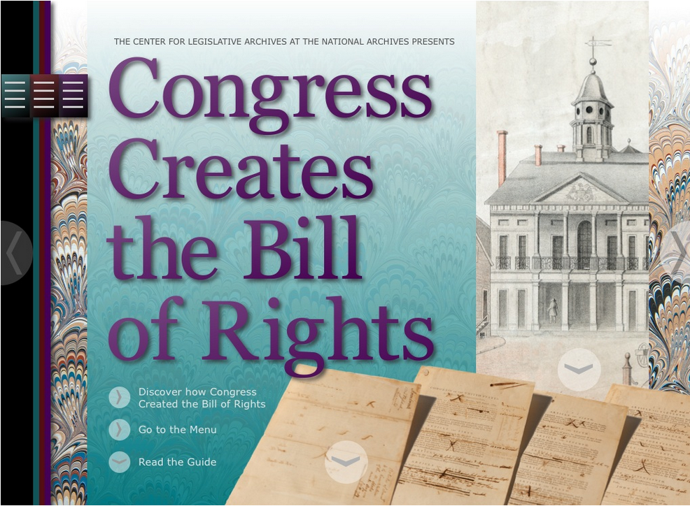
Teaching About the Bill of Rights
with Resources from
The National Archives &
The Center for Legislative Archives
Notes:
Today, I will talk with you on the topic of teaching about the Bill of Rights. Bringing this Charter of Freedom into your classroom is an essential element of a civics or history class. Schools are a critical venue for building civic knowledge and engagement, and your discussions with students are the foundation of their civic lives. For students to be the active and informed voters of tomorrow, teachers must engage them in the discussion of civics topics today.

Slide 2
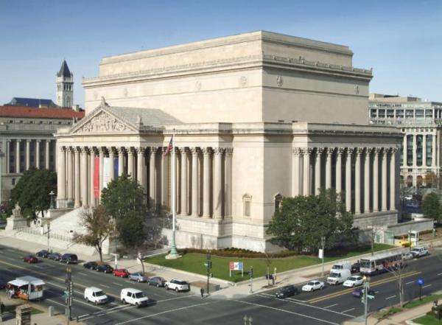
The National Archives and Records Administration:
An independent agency of the United States government preserves the historical records of the federal government.
Its14 billion records document the legacy of government by the people under the Constitution.
https://www.archives.gov
https://www.docsteach.org
Notes:
The National Archives is the governmental agency responsible for preserving and making available the records that document the story of government under the Constitution. NARA holds over 14 billion records at 43 centers across the country. Records exist on a wide range of topics and in many different media. You can easily access millions of records by visiting archives.gov.
NARA also presents a wide range of educational materials online. Go to www.docsteach.org to discover thousand of documents and hundreds of lesson plans made by teachers and NARA staff.

Slide 3
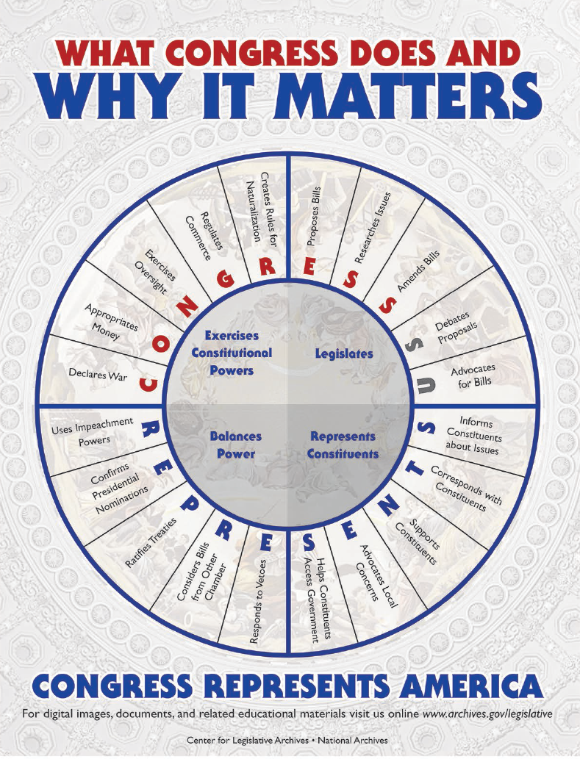
The Center for Legislative Archives
What Congress Does
&
Why it Matters
https://www.archives.gov/legislative
6 eBooks
48 Lessons
1 Digital app
Notes:
I work at the Center for Legislative Archives, the division of the National Archives which preserves and makes available the official records of the United States House of Representatives and Senate. The Center provides resources that will help your students understand our history and civic life.
We use the records of representative government to teach the public about how Congress has shaped our history and what it does today.

Slide 4
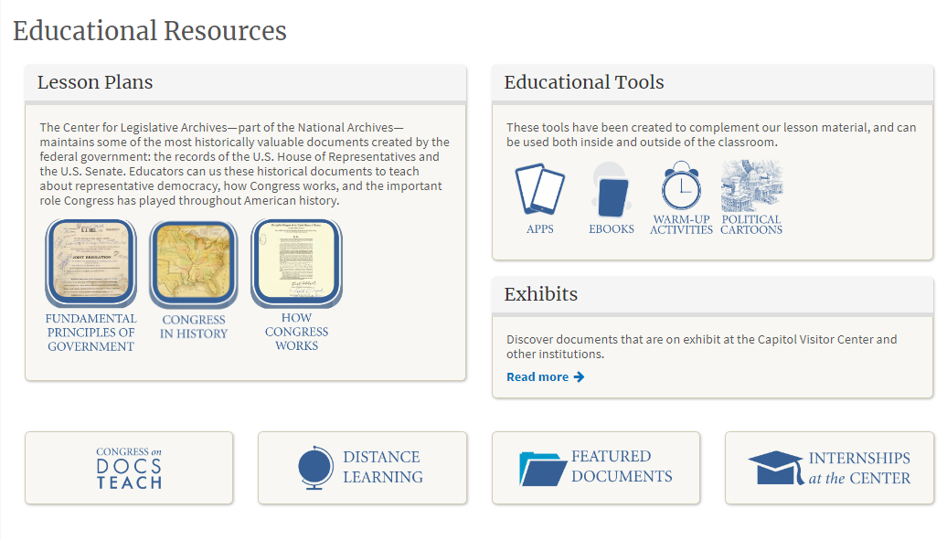
http://www.archives.gov/legislative
Notes:
Visit our website - at the address on this slide - and you will find lesson plans for teaching with the records of Congress which focus on:
The fundamental principles of government
Congress in history
&
How Congress works

Slide 5
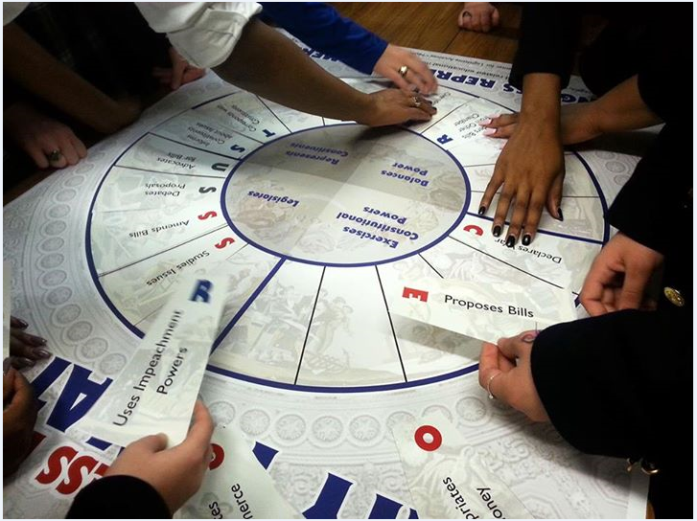
We make big ideas in Civics and History “sticky”
Notes:
We have a wide assortment of lessons on our website that engage students in studying history and civics through active collaboration and discussion.
Our goal is to make the big ideas in civics and history “sticky” by engaging students in hands-on learning.

Slide 7
(15) Government. The student understands the American beliefs and principles reflected in… important historic documents. The student is expected to:
(A) identify the influence of ideas from historic documents…on the U.S. system of government;
(C) identify colonial grievances listed in the Declaration of Independence and explain how those grievances were addressed in the U.S. Constitution and the Bill of Rights;
Lesson: Teaching Six Big Ideas in the Constitution
https://www.archives.gov/legislative/resources/education/constitution

Slide 8
(16) Government. The student understands the purpose of changing the U.S. Constitution and the impact of amendments on American society. The student is expected to:
(A) summarize the purposes for amending the U.S. Constitution; and
(B) describe the impact of the 13th, 14th, and 15th amendments.

Slide 9
(17) Government. The student understands the dynamic nature of the powers of the national government and state governments in a federal system. The student is expected to:
(A) analyze the arguments of the Federalists and Anti-Federalists, including those of Alexander Hamilton, Patrick Henry, James Madison, and George Mason

Slide 10
(19) Citizenship. The student understands the rights and responsibilities of citizens of the United States. The student is expected to:
(B) summarize rights guaranteed in the Bill of Rights;

Slide 11
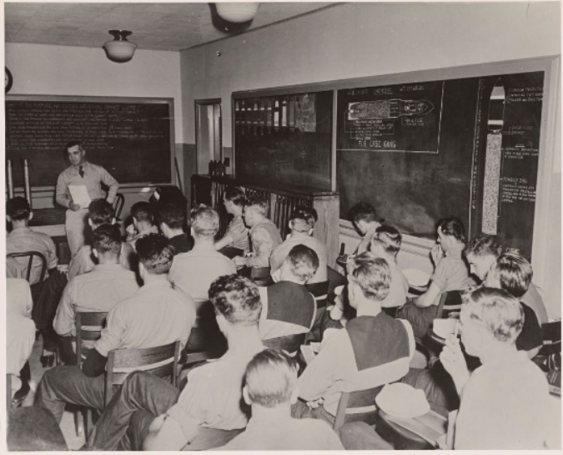
NAID
205582409
Students face three challenges when studying the Bill of Rights
Understanding the context of law in which rights exist
Defining what a right is
Using these understandings to read the Bill of Rights

Slide 12
Defining Rights: the context
A right is not freedom from law or authority.
John Locke:
“Where there is no law, there is no freedom”
“Where there is no law, there is no freedom: for liberty is, to be free from restraint and violence from others; which cannot be, where there is no law:
but freedom is not, as we are told, a liberty for every man to do what he (wishes)…
but a liberty to dispose, and order as he (wishes), his person, actions, possessions, and his whole property, within the allowance of those laws under which he is, and therein not to be subject to the arbitrary will of another, but freely follow his own.”
Second Treatise of Civil Government Sec. 57
Notes:
Students often think of rights as entitlements to do what they please. John Locke discussed this misunderstanding when he wrote on rights back in the 1600s.

Slide 13
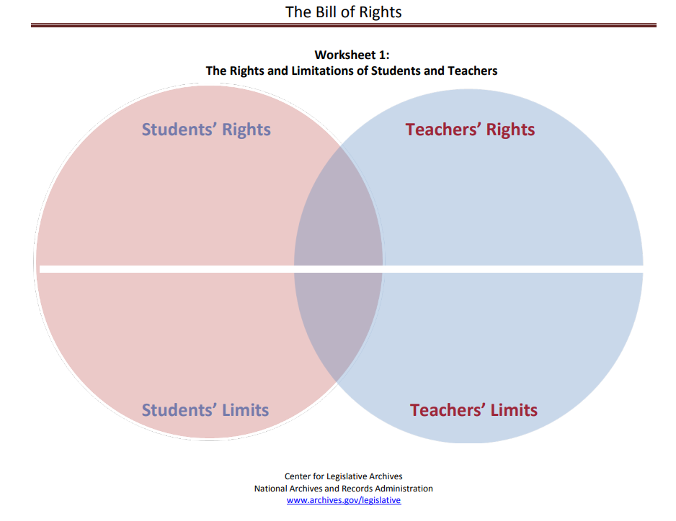
Defining Rights: the process
What is a right?
Lesson: Congress and the Bill of Rights in History and Today
https://www.archives.gov/legislative/resources/education/bill-of-rights
Notes:
It is essential that students narrow down the meaning of rights from a vague concept to something more concrete. This Venn diagram was created as a simple way to start a conversation about rights by considering the network of rights and reciprocal responsibility at the heart of a community. This example uses the classroom as a community of students.

Slide 14
A right to learn
A right to teach
safety
Can’t interfere with learning
Must teach all students

Slide 15
Identifying the Rights Included in the Bill of Rights
(Addressing TEKS 19 (B) summarize the rights guaranteed in the Bill of Rights)
How to do it:
Print a transcript of the Bill of Rights
Instruct the students to:
Highlight in orange or underline the phrases that show limits on what the federal government can do.
Highlight in green or circle the phrases (shown below in italics) indicating protected rights.
Draw from their work to create a table of rights.
Answer reflection questions.
To learn more about the National Archives’ Civics programming, visit https://www.archives.gov/education/civic-education
Notes:
Once students have formulated an understanding of what a right is, in their terms, they are ready to move to discussing the content of the Bill of Rights . In our national civics webinars with students, the National Archives staff often uses the following activity to engage students in analyzing the text of the Bill of Rights.

Slide 16
The Bill of Rights
Amendment I
Congress shall make no law respecting an establishment of religion, or prohibiting the free exercise thereof; or abridging the freedom of speech, or of the press; or the right of the people peaceably to assemble, and to petition the Government for a redress of grievances.
Amendment II
A well regulated Militia, being necessary to the security of a free State, the right of the people to keep and bear Arms, shall not be infringed.
Amendment IV
The right of the people to be secure in their persons, houses, papers, and effects, against unreasonable searches and seizures, shall not be violated, and no Warrants shall issue, but upon probable cause, supported by Oath or affirmation, and particularly describing the place to be searched, and the persons or things to be seized.
Orange = limits on government Green = protected rights
Notes:
On this and the following two screens you will see the amendments of the Bill of Rights color coded with the orange highlighting (and underling) showing limits on what the government can do. Phrases highlighted in green (or in italics) show rights that people have.

Slide 17
The Bill of Rights
Amendment V
No person shall be held to answer for a capital, or otherwise infamous crime, unless on a presentment or indictment of a Grand Jury, except in cases arising in the land or naval forces, or in the Militia, when in actual service in time of War or public danger; nor shall any person be subject for the same offence to be twice put in jeopardy of life or limb; nor shall be compelled in any criminal case to be a witness against himself, nor be deprived of life, liberty, or property, without due process of law; nor shall private property be taken for public use, without just compensation.
Amendment VI
In all criminal prosecutions, the accused shall enjoy the right to a speedy and public trial, by an impartial jury of the State and district wherein the crime shall have been committed, which district shall have been previously ascertained by law, and to be informed of the nature and cause of the accusation; to be confronted with the witnesses against him; to have compulsory process for obtaining witnesses in his favor, and to have the Assistance of Counsel for his defence.
Orange = limits on government Green = protected rights

Slide 18
The Bill of Rights
Amendment VII
In Suits at common law, where the value in controversy shall exceed twenty dollars, the right of trial by jury shall be preserved, and no fact tried by a jury, shall be otherwise re-examined in any Court of the United States, than according to the rules of the common law.
Amendment IX
The enumeration in the Constitution, of certain rights, shall not be construed to deny or disparage others retained by the people.
Amendment X
The powers not delegated to the United States by the Constitution, nor prohibited by it to the States, are reserved to the States respectively, or to the people.
Orange = limits on government Green = protected rights

Slide 19
The Bill of Rights
Rights of the People The people can: | Limits on the Federal Government The government can't:
Notes:
The students work in pairs to draw from their findings to complete this table, identifying rights of the people and limits on government embedded in the Bill of Rights

Slide 20
Rights of the People The people can: | Limits on the Government The government can't:
Assemble | Establish religion or prohibit religious practice
Petition the government | Limit freedom of speech or the press
Keep and bear arms | Station soldiers in people’s houses
Have a speedy and public trial with a jury of one’s peers | Search people or seize property without a warrant based on probable cause and an oath
Be secure in houses papers and effects from unreasonable search and seizure | Hold people for a crime without bringing charges from a grand jury
Have a lawyer represent them in a trial | Deprive people of life, liberty or property without due process of law
 | Try people twice for the same offense

Slide 21
Rights of the People The people can: | Limits on the Government The government can't:
Be informed of the specific nature and cause of accusations | Take private property without just compensation
Be confronted by witnesses in a criminal trial and can confront witnesses | Convict people accused of a crime without a fair trial
Compel defense witnesses to appear | Inflict cruel and unusual punishment
Have a trial by a jury in civil cases | Impose excessive bail of fines
Know that facts established by a jury can’t be re-examined except according to common law | Say these are the only rights you have
 | Take powers that belong to the states or the people

Slide 22
The Bill of Rights
Reflection Questions:
Whose rights are protected in the Bill of Rights?
2. What are the three most important limits on government?
3. How do limits on government also protect rights?
4. How does language from the Bill of Rights provide a means for responding to rights violations?
Notes:
The students then draw from their findings to answer reflection questions about rights and limits in the Bill of Rights. The ideal result would be if the students gain a better understanding of how the Bill of Rights is a mix of rights and limitations on government. Students might also consider how limits on government create rights for the people and how articulating rights of the people limits government. In all, we hope they gain a better understanding about how governmental authority and protected individual rights are balanced and interdependent.

Slide 23
The origin of the Bill of Rights:
Part 1
The Federalist – Anti-Federalist Debate over the Constitution
TEKS 17 (A)
Notes:
Teks 17 (A) requires students to know about how the Bill of Rights was shaped by the debate between the Anti-Federalists and Federalists about ratifying the Constitution. To make a complex story very simple, I will say that the Federalists were the faction that wanted to see the Constitution ratified in the way it was signed at the Constitutional Convention. The Anti-Federalists feared that the new Constitution gave the newly proposed government too much power. They preferred to see the states retain more of the authority they had under the Articles of Confederation. A second point made by the Anti-Federalists was that the Constitution should include a Bill of Rights.

Slide 24
Ideas about constitutional rights expressed in statements from ratifying conventions: December 1787 - July 1788
Broadside: Richmond, State of Virginia. In convention, Wednesday, the 25th of June, 1788. http://hdl.loc.gov/loc.rbc/rbpe.1790110a
Notes:
The debate between the two factions emerged between September 1787 when several delegates refused to sign the Constitution, and it grew after January, 1788 as states debated ratification of the Constitution at state conventions.

Slide 25
https://www.archives.gov/legislative/resources/bill-of-rights
Notes:
The Center for Legislative Archives has a free mobile app, Congress Creates the Bill of Rights, that details the process of how the Bill of Rights was created. The address on this slide shows where you can access it. The app was designed originally for the iPad, but there is also a pdf version of the content that contains all the same information.

Slide 26
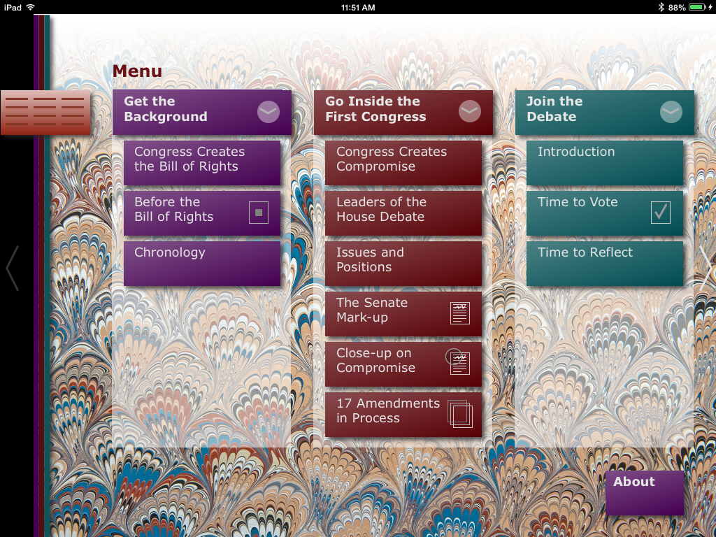
Notes:
You can find examples of proposed amendments offered by Anti-Federalists in state ratifying conventions in the app. This slide shows the main menu. You should look for the section entitled 17 Amendments in process. The iPad version makes this navigation very easy. The pdf is not as fancy, when you will see the link that will open this section of the app, select it and scroll down to the content you wish to study.

Slide 27
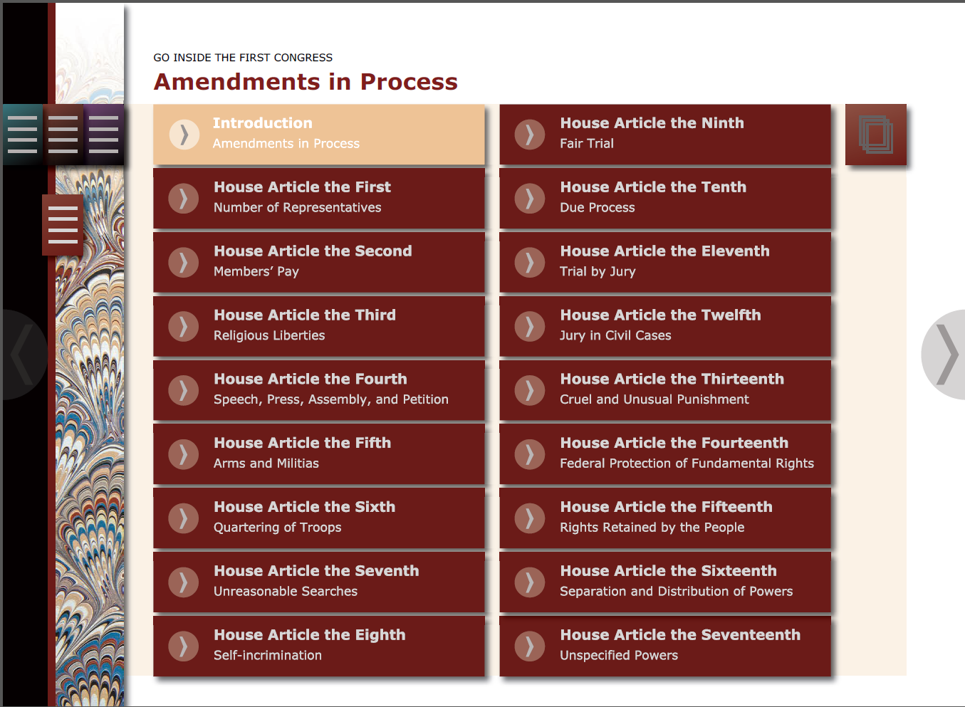
Notes:
This screen takes us a step further into the hunt. Here you see a link leading to information on each of the 17 articles of amendment that James Madison persuaded the House to pass in 1789.

Slide 28
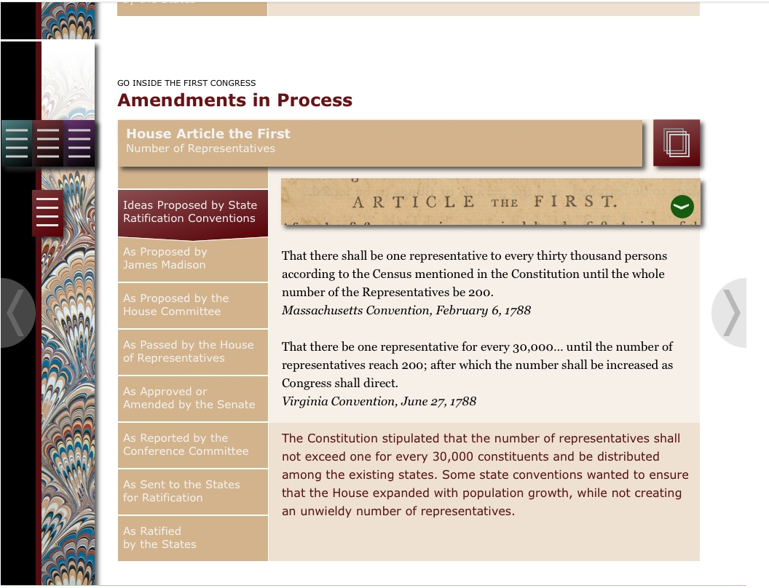
Notes:
The entry for each proposed article begins with examples of proposals sent to Congress from state conventions.

Slide 29
Virginia Convention, June 27, 1788:
“There are certain natural rights of which men, when they form a social compact cannot deprive or divest their posterity, among which are the enjoyment of life and liberty, with the means of acquiring, possessing and protecting property, and pursuing and obtaining happiness and safety.”
https://www.archives.gov/legislative/resources/bill-of-rights
(See: Amendments in Process, Article XV)
Notes:
Now that you know where to find the information, let's look at a few samples that illustrate points raised by Anti-Federalists that informed the debate over the Bill of Rights. Studying these proposals shows the thinking of the Anti-Federalists and gives you an opportunity to engage your students in assessing how much or how little impact the Anti-Federalists had on the Bill of Rights.

Slide 30
Earlier version: Virginia Declaration of Rights, June 12, 1776
Section 1. That all men are by nature equally free and independent and have certain inherent rights, of which, when they enter into a state of society, they cannot, by any compact, deprive or divest their posterity; namely, the enjoyment of life and liberty, with the means of acquiring and possessing property, and pursuing and obtaining happiness and safety.

Slide 31
Declaration of Independence
We hold these truths to be self-evident, that all men are created equal, that they are endowed by their Creator with certain unalienable Rights, that among these are Life, Liberty and the pursuit of Happiness.--
July, 1776

Slide 32
New York Convention, July 26, 1788
“That the Powers of Government may be reassumed by the People, whensoever it shall become necessary to their Happiness; that every Power, Jurisdiction and Right, which is not by the said Constitution clearly delegated to the Congress of the United States, or to the departments of the Government thereof, remains to the People of the several States or to their respective State Governments to whom they may have granted the same….”
See Amendments in Process, Article XV

Slide 33
Virginia Convention, June 27, 1788
“That the people have a right to keep and bear arms; that a well regulated militia composed of the body of the people trained to arms is the proper, natural and safe defense of a free state. That standing armies in times of peace are dangerous to liberty, and therefore ought to be avoided ... That any person religiously scrupulous of bearing arms ought to be exempted upon payment of an equivalent to employ another to bear arms in his stead.”
See Amendments in Process, Article V

Slide 34
The Origin of the Bill of Rights:
Part 2
The Federalist – Anti-Federalist congressional debate about proposed constitutional amendments
TEKS 16 (A)
Notes:
The app contains many more examples of proposals from state ratifying conventions. But, your next challenge is to engage your students in the next chapter of the Federalist - Anti-Federalist debate: what happened in Congress.

Slide 35
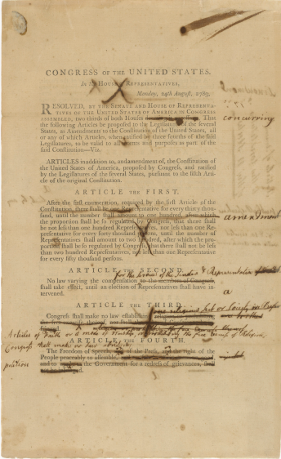
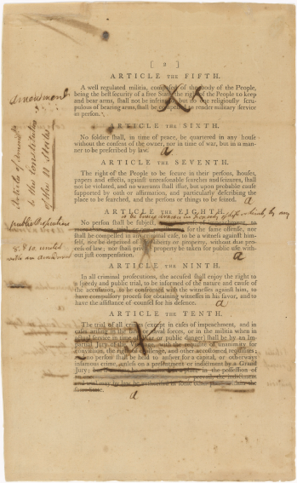
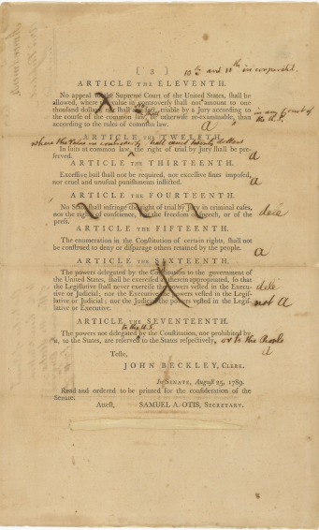
Senate Revisions to House Proposed Amendments to the U.S. Constitution NAID 3535588
Notes:
This remarkable document is a congressional record known as a mark-up. A markup is an ordinary type of congressional records showing a committee at work, but this markup is truly extraordinary. From September 2 – 9, 1789, The Senate debated seventeen proposed constitutional amendments that had been passed by the House of Representatives on August 24. The amendments passed by the House form the printed text you see. The handwritten annotations were added as the Senate debated the House versions of the amendments and show the changes they proposed to make. The Senate was closed to the public at that time, and transcripts of debates were not taken down. As a result, this document takes us behind the locked doors of the Senate by preserving evidence of how the debate unfolded.

Slide 36
Notes:
It was the Senate markup that inspired us to create the app. We studied the original document, kept under lock in our vault, and asked how we might bring it into the classroom. To our eyes, this document was valuable because the layers of information recorded on it showed Congress debating our fundamental ideas about rights and limits on government. How could we open up the magic of this historical artifact to students?
Retuning to the main menu, we can see that it shows the architecture or landscape of the app. The column to the left gives the historical context for Congress’s debate. The middle column takes a student inside the First Congress, and the right-hand column invites the students to reflect on the significance of Congress’s work.

Slide 37
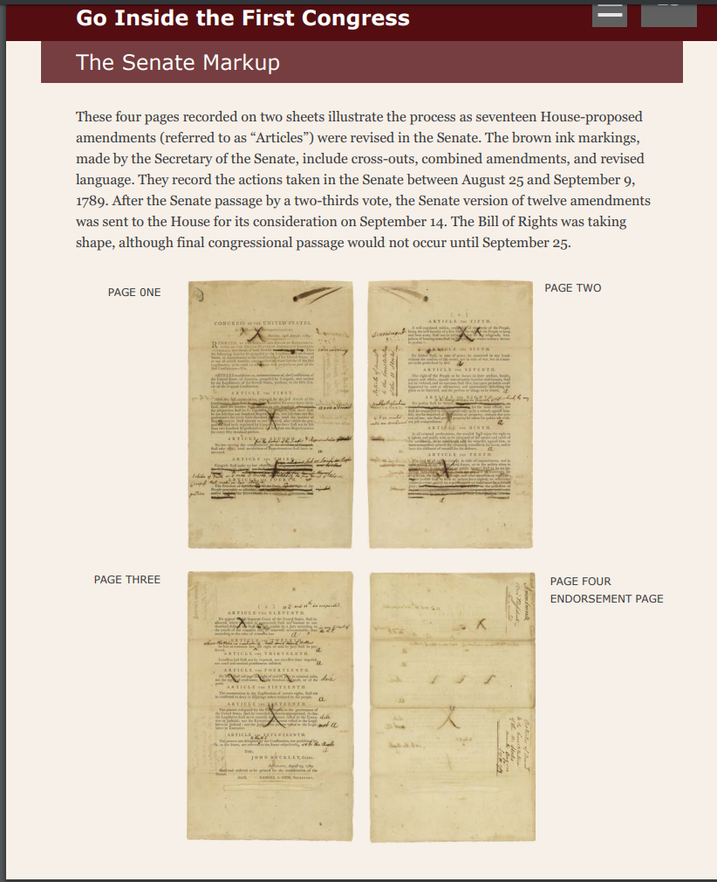
Notes:
The four-page Senate markup preserved the work of both Houses at a critical moment, and it is the heart of the app. Studying its contents is the major focus of the app.

Slide 38
Notes:
The technology of the mobile computer app enables us to open out the Senate markup and bring the Senate debate into the classroom in a unique way. We came up with a way to peel off layers of writing and show the sequence in which changes were proposed and adopted in the Senate.
This screen, for example, shows the text of what we know at the First Amendment. We treasure this amendment as a fundamental statement of our civic lives, but how many people know the process by which it was created? Was it a self-evident statement of truth that sprang from the mind of James Madison and was agreed to by all. Or, was the First Amendment the product of a series of debates and compromises?

Slide 39
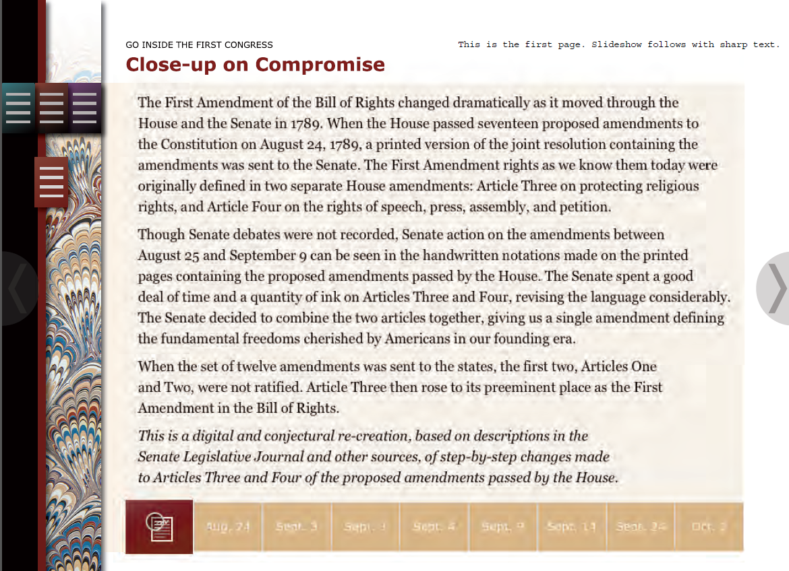
Notes:
Congress Creates the Bill of Rights will enable your students to see for themselves how the First Amendment came to be. The section of the App creates an illustrated timeline of the Senate debate in which the First Amendment was changed in several ways. It is important to keep in mind that James Madison, as a House member was not a participant in this chapter of the story. Also, as no records were kept of the actual debate, this document and the notes Senate Secretary Samuel Otis wrote on it are the only evidence of the process that took place.

Slide 40
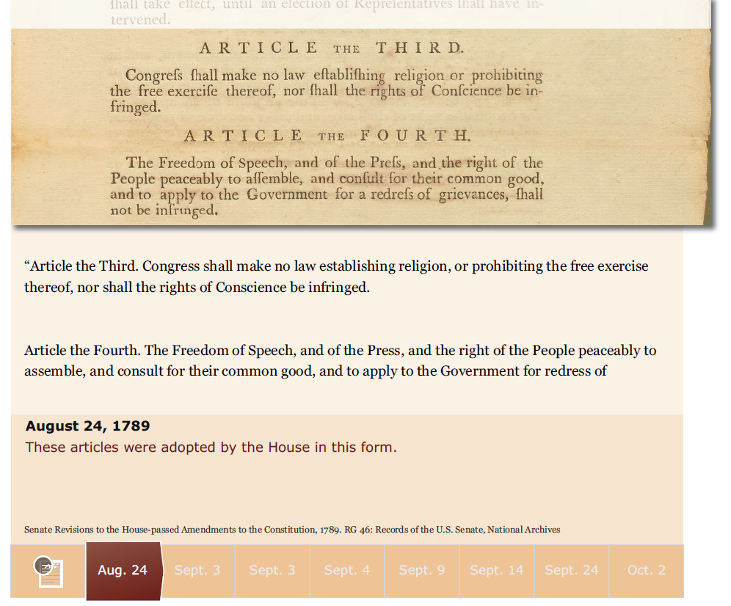

Slide 42
Notes:
By following the menu horizontally, one can see the revisions and compromises in the Senate and between the two houses that merged two House-passed articles into one amendment and sent to the states for ratification.

Slide 43
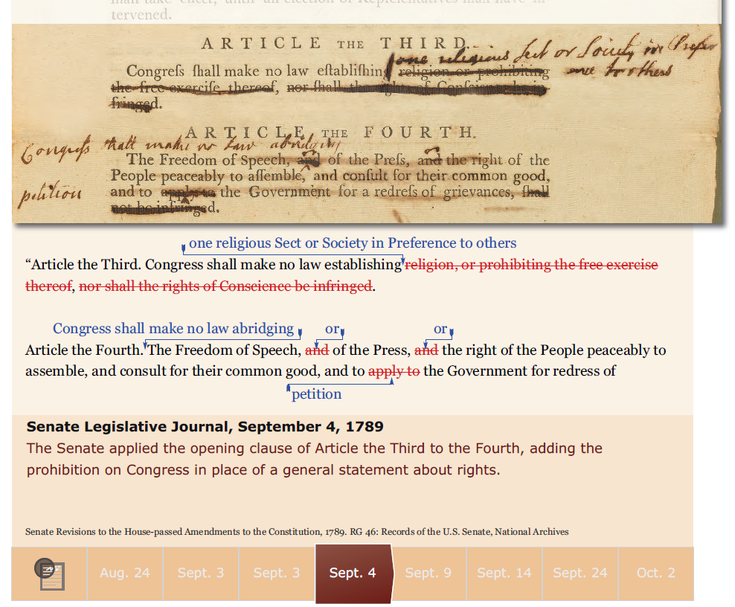

Slide 44
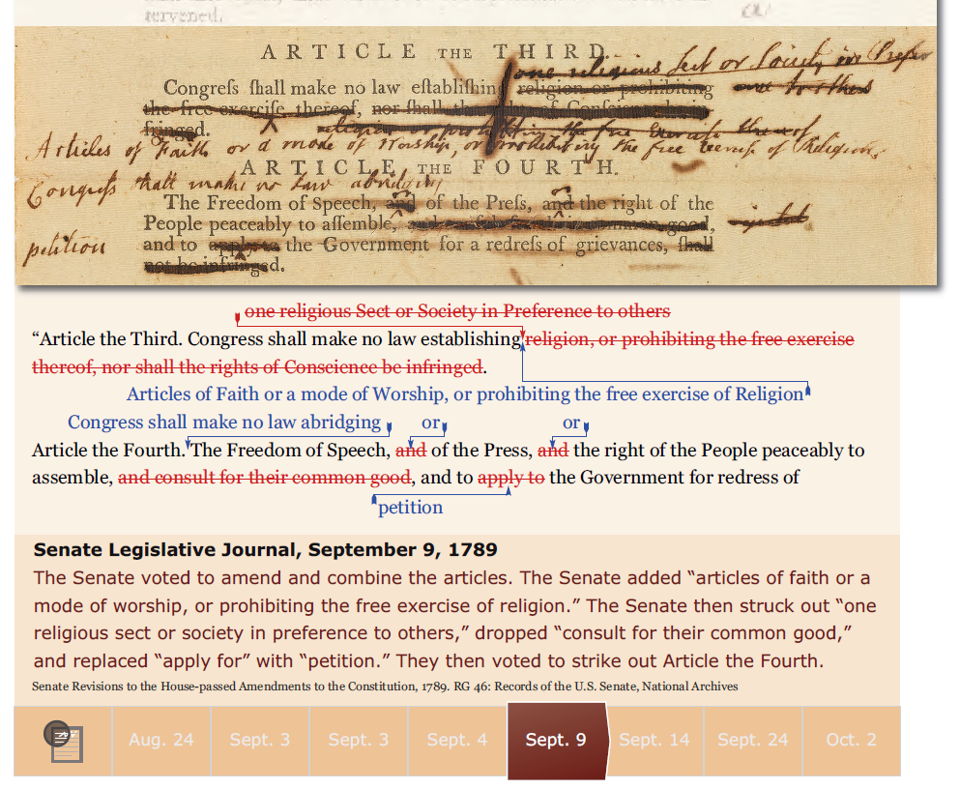

Slide 46
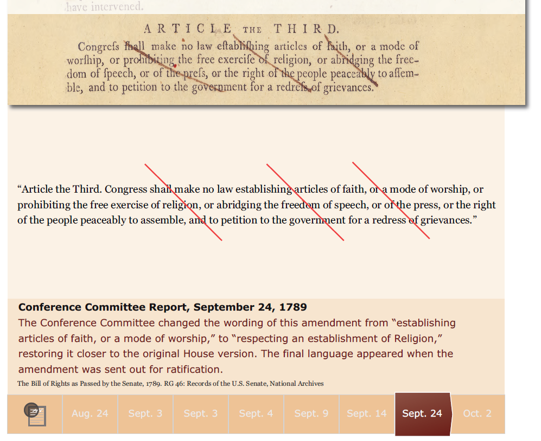

Slide 47
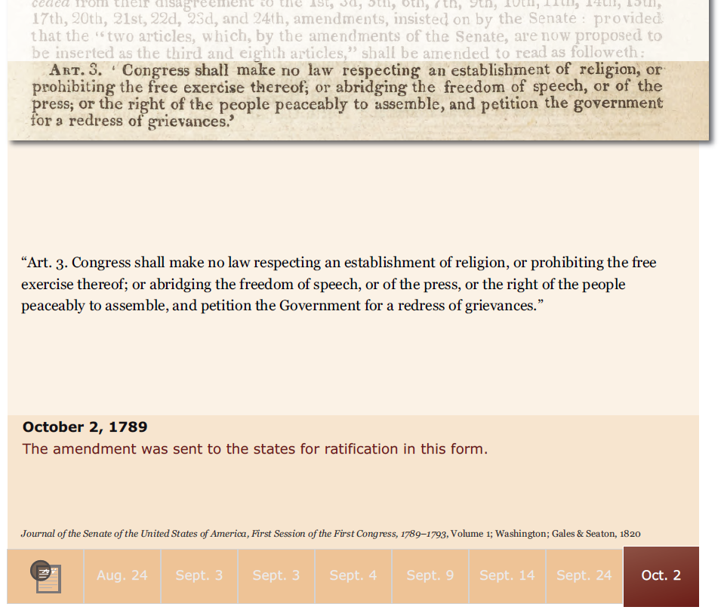

Slide 48
https://www.archives.gov/legislative/resources/bill-of-rights
Notes:
Again:
The app is available for download on iPad at the App Store.
The eBook is available for download on the National Archives website

Slide 49
A question not answered when the Bill of Rights was ratified in 1791:
To whom do the listed rights and protections apply?

Slide 50
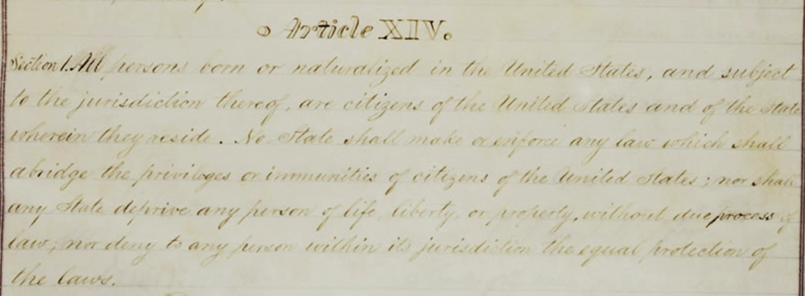
Joint Resolution Proposing a 14th Amendment (1868)
Section 1. NAID 1408913
Notes:
This primary source comes from the General Records of the United States Government.
National Archives Identifier: 1408913
Full Citation: Joint Resolution Proposing the Fourteenth Amendment to the United States Constitution; 6/13/1866; Enrolled Acts and Resolutions of Congress, 1789 - 2011; General Records of the United States Government, Record Group 11; National Archives Building, Washington, DC. Online Version, https://docsteach.org/documents/document/fourteenth-amendment

Slide 51
Amendment 14
Section 1
All persons born or naturalized in the United States, and subject to the jurisdiction thereof, are citizens of the United States and of the State wherein they reside.
No State shall make or enforce any law which shall abridge the privileges or immunities of citizens of the United States;
nor shall any State deprive any person of life, liberty, or property, without due process of law;
nor deny to any person within its jurisdiction the equal protection of the laws.

Slide 52
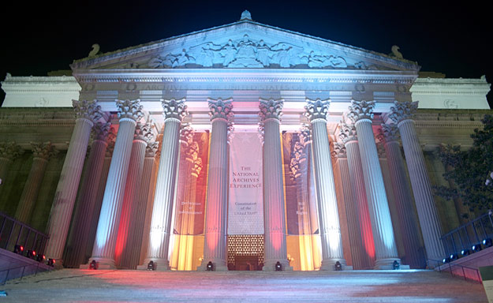
Center for Legislative Archives
www.archives.gov/legislative

