Slide 1
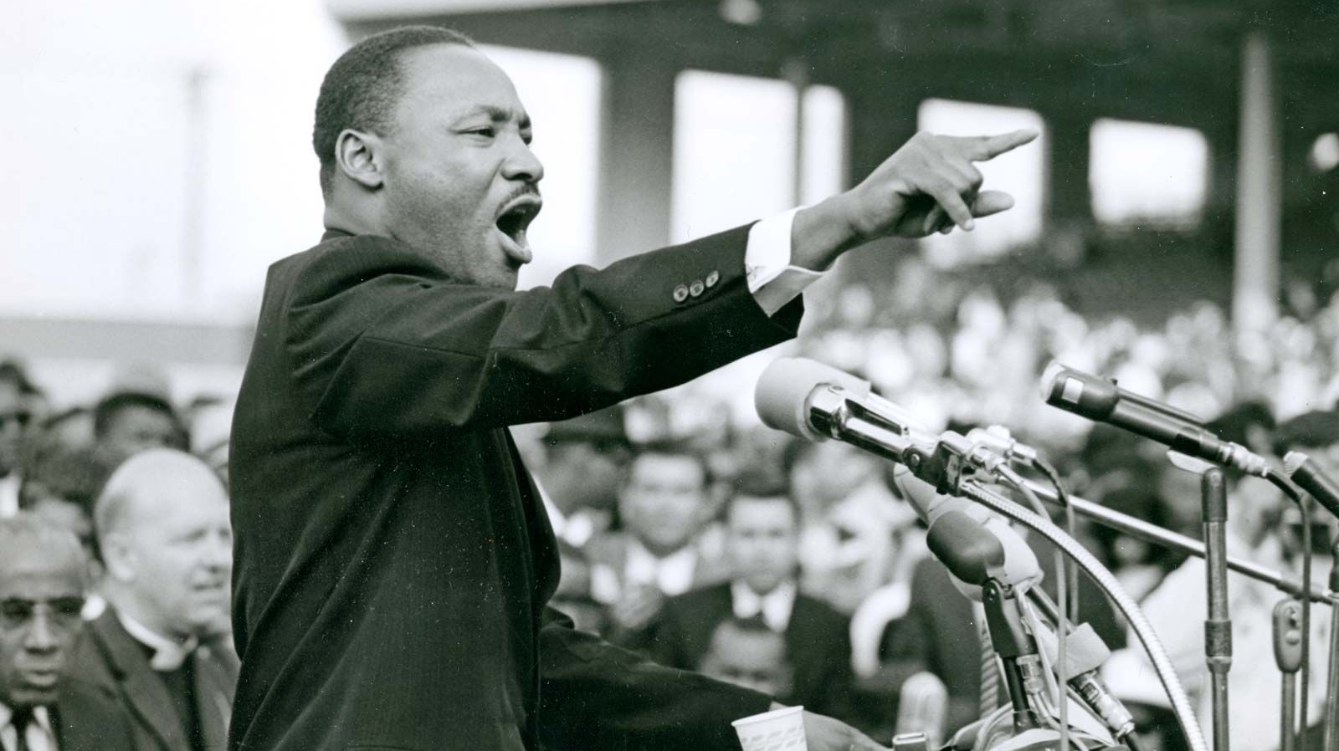
Teaching the Speeches of Martin Luther King
Aram Goudsouzian Humanities Texas November 30, 2022

Slide 2
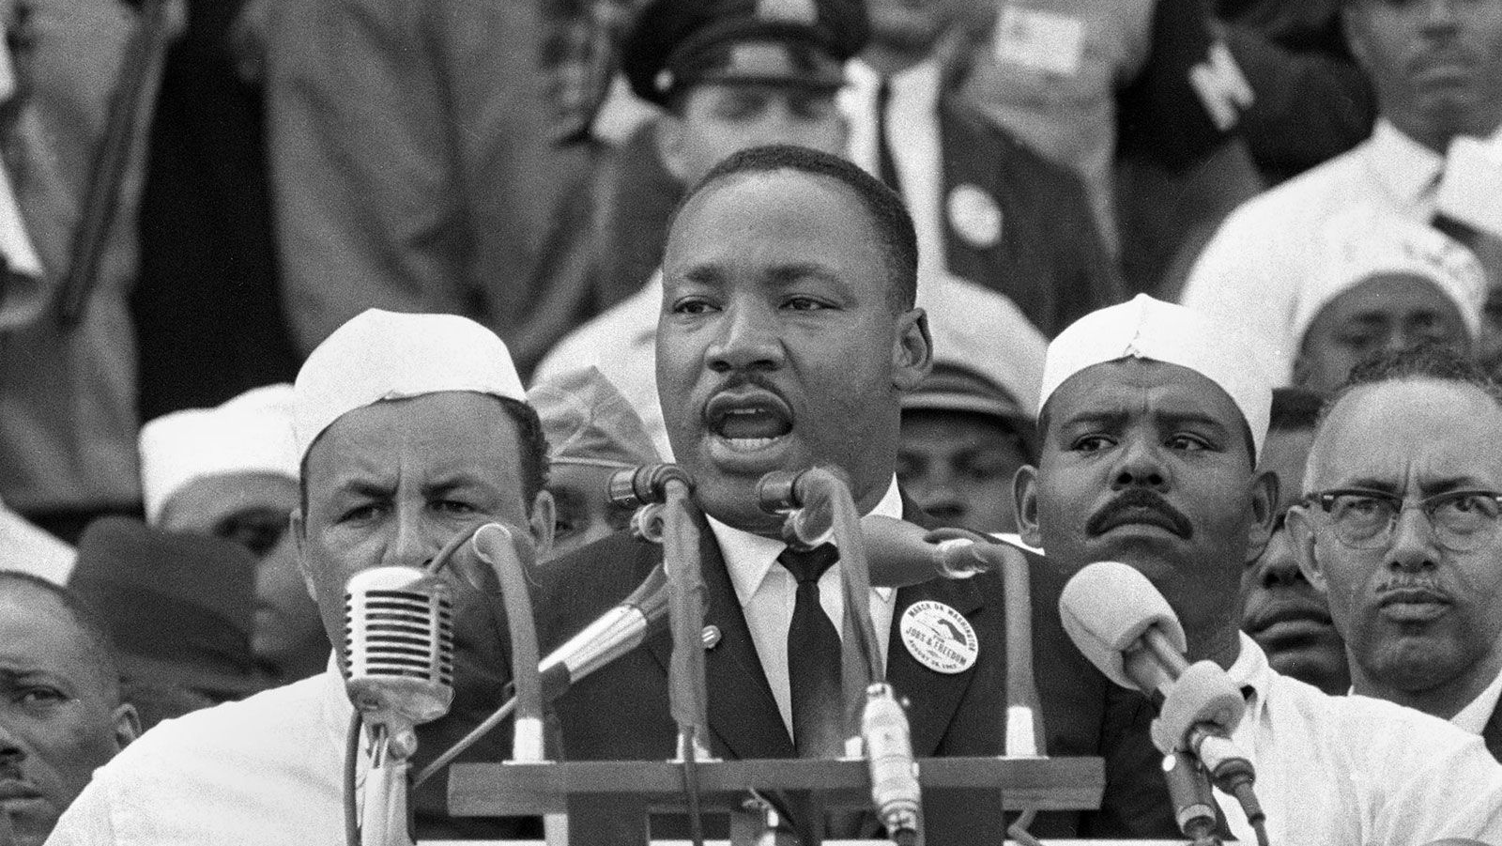

Slide 3
Some guiding questions
What are King’s strategies and talents as an orator?
What are King’s priorities? His sources of moral and political authority?
How does King tailor his message based on his audience and his circumstance?
How does King evolve over the course of his lifetime?
Is King a liberal or a radical?

Slide 4
Becoming MLK
The Black church
Intellectual influences
Walter Rauschenbusch and the Social Gospel
Reinhold Niebuhr and the persistence of sin
Nonviolent direct action

Slide 5
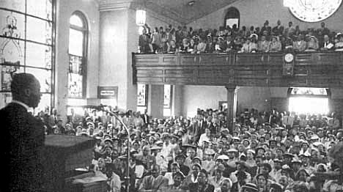
Mass meeting, Holt Street Baptist Church

Slide 6
Themes
Democracy and race in Montgomery
Rosa Parks as community symbol
Nonviolence as active, confrontational
Civil rights struggle as Christian, righteous
Without love, boycott “a meaningless drama on the stage of history”

Slide 7
Fusing American democracy and Christian righteousness
“This is the glory of America, with all of its faults. . . If we were incarcerated behind the iron curtains of a Communistic nation we couldn’t do this. . . But the great glory of American democracy is the right to protest for right.”
“If we are wrong, the Supreme Court of this nation is wrong. If we are wrong, the Constitution of the United States is wrong. If we are wrong, God Almighty is wrong. If we are wrong, Jesus of Nazareth was merely a utopian dreamer that never came down to earth. If we are wrong, justice is a lie.”

Slide 8
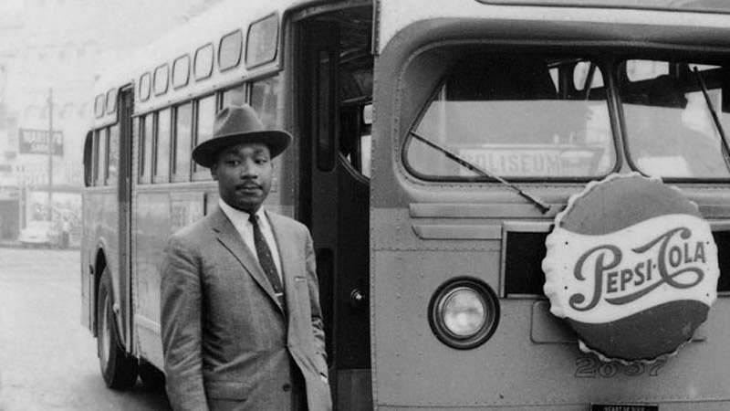

Slide 9
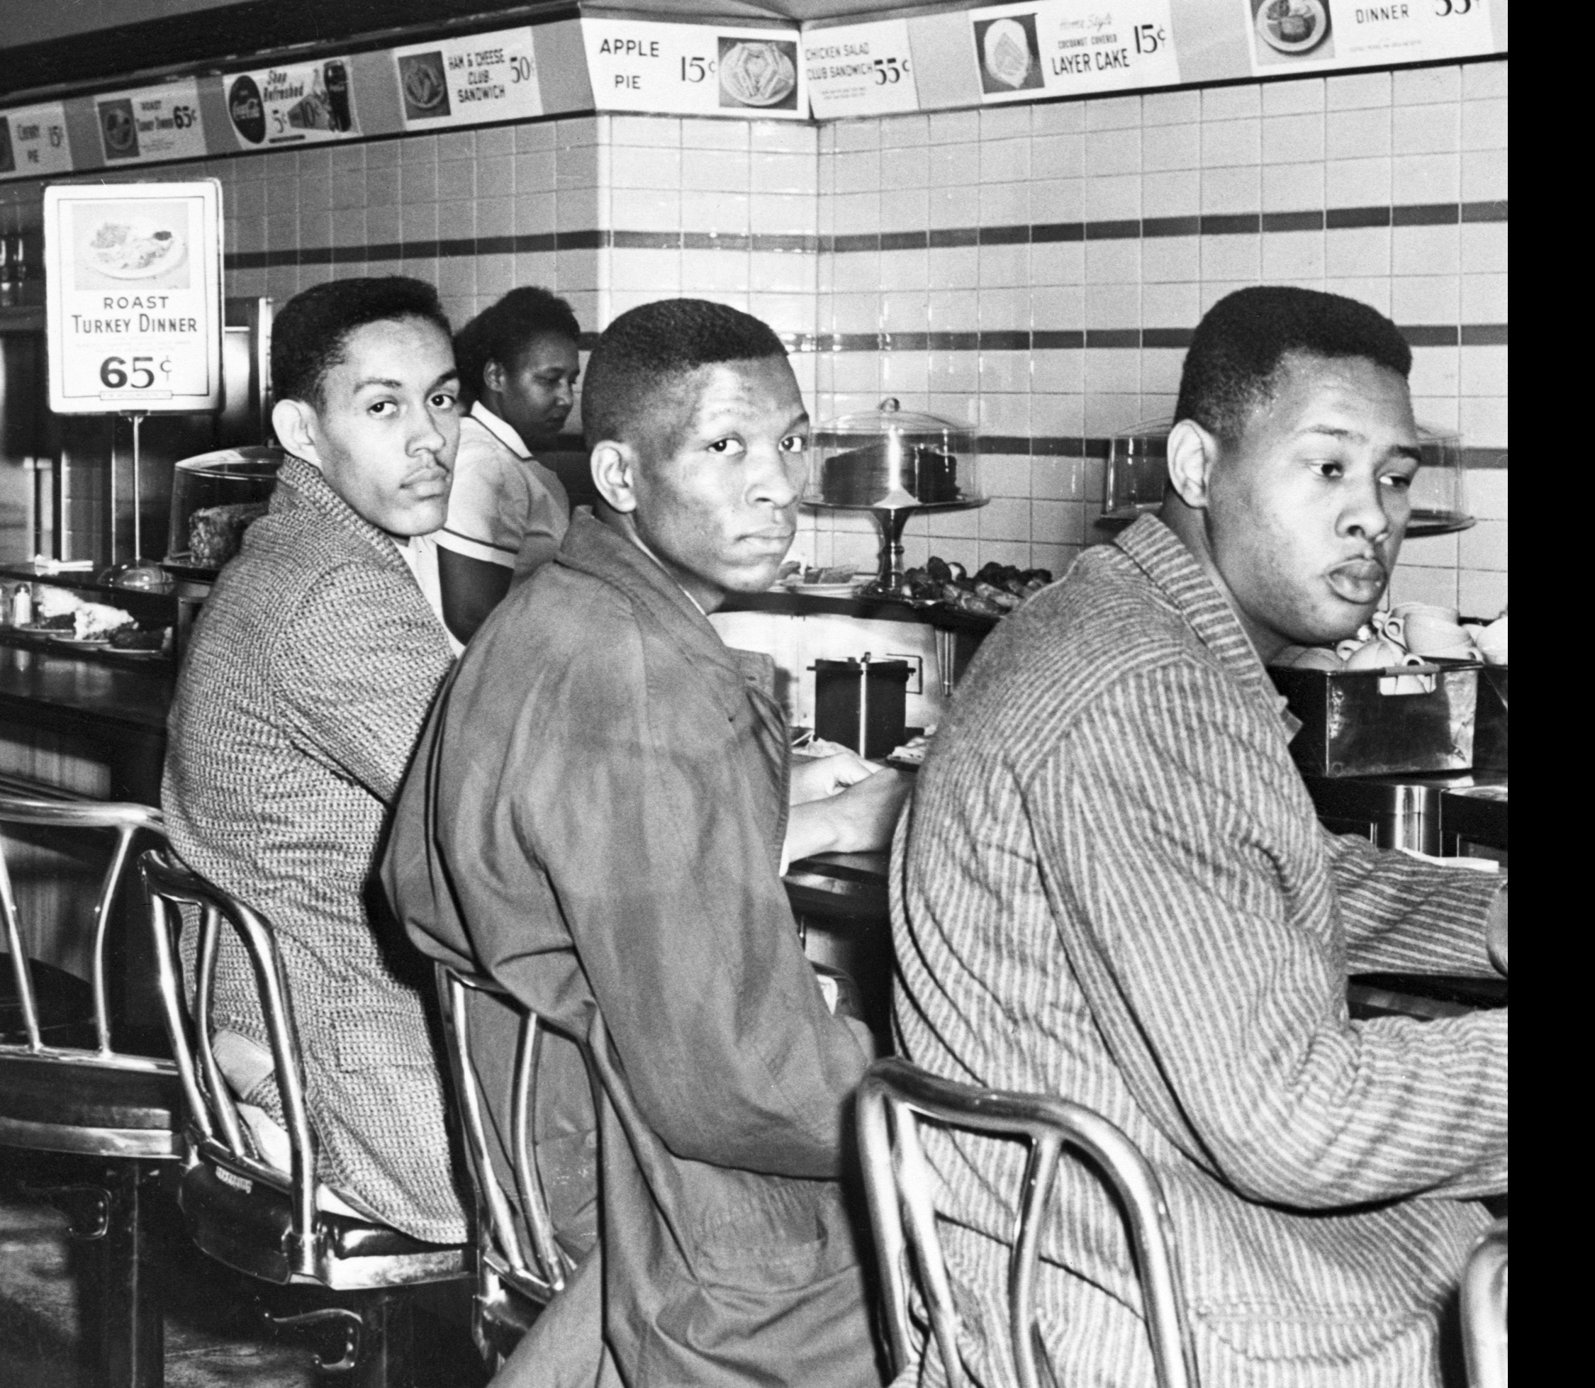
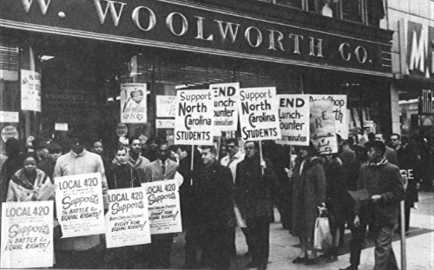
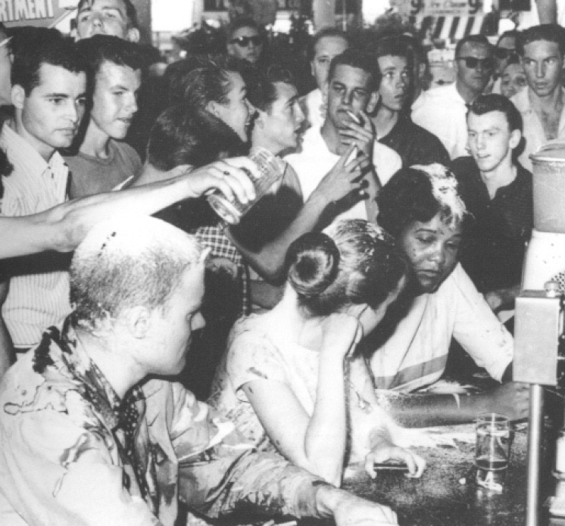
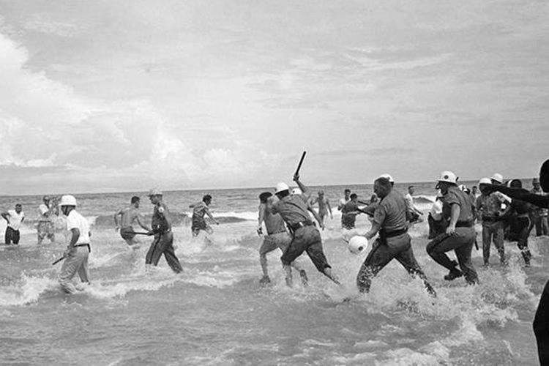
The Sit-in Movement of 1960

Slide 10
MLK, “The Rising Tide of Racial Consciousness”
Casting message to audience
Explaining the sit-in movement
Facing “massive resistance”
Calling upon federal government
“It is noteworthy that both political parties have emerged with the strongest civil rights platforms in their history. They have signed huge promissory notes. But we must not be content with empty promises.”

Slide 11
Connecting South and North
“There is a pressing need for a liberalism in the North which is truly liberal, a liberalism that firmly believes in integration in its own community as well as in the deep South. There is need for the type of liberal who not only rises up with righteous indignation when a Negro is lynched in Mississippi, but will be equally incensed when a Negro is denied the right to live in his neighborhood, or join his professional association, or secure a top position in his business. This is no day to pay mere lip service to integration, we must pay life service to it.”

Slide 12
The Birmingham Campaign of 1963
Downtown demonstrations
“Letter from Birmingham Jail”
The Children’s Crusade
National impact
JFK: “a moral issue . . . as old as the Scriptures and as clear as the American Constitution”

Slide 13
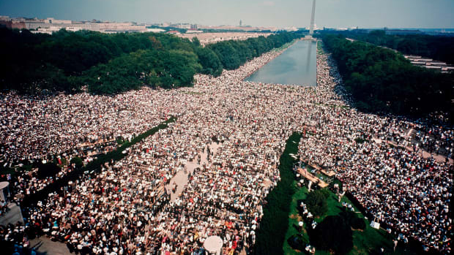
The March on Washington, August 1963

Slide 14
Malcolm X and the “Farce on Washington”
“Whoever heard of angry revolutionists swinging their bare feet together with their oppressor in lily-pad park pools, with gospels and guitars and ‘I Have a Dream’ speeches?”

Slide 15
King’s “Dream”
Casting it in tumult of 1963
Framing it in political imperative for a civil rights bill
Understanding it as reaching multiple audiences

Slide 16
“I Have a Dream”
Analogy of the “promissory note”
“But 100 years later, the Negro still is not free. One hundred years later, the life of the Negro is still sadly crippled by the manacles of segregation and the chains of discrimination. One hundred years later, the Negro lives on a lonely island of poverty in the midst of a vast ocean of material prosperity. One hundred years later the Negro is still languished in the corners of American society and finds himself in exile in his own land. And so we've come here today to dramatize a shameful condition. In a sense we've come to our nation's capital to cash a check.”
Messages to whites
1963 as a beginning, not an ending
“rude awakening” for whites who see “business as usual”
Messages to Blacks
Celebrating white allies
Cannot “satisfy our thirst for freedom by drinking from the cup of bitterness and hatred”

Slide 17
Multiple meanings
Economic justice
Systemic racism
Individual rights
“We cannot be satisfied as long as the Negro's basic mobility is from a smaller ghetto to a larger one.”
“We can never be satisfied as long as the Negro is the victim of the unspeakable horrors of police brutality.”
“I have a dream that my four little children will one day live in a nation where they will not be judged by the color of their skin but by the content of their character.”

Slide 18
The language of the Dream
Metaphor
“I have a dream that one day even the state of Mississippi, a state sweltering with the heat of injustice, sweltering with the heat of oppression will be transformed into an oasis of freedom and justice.”
“With this faith we will be able to transform the jangling discords of our nation into a beautiful symphony of brotherhood.”
Empathy
“I have a dream that my four little children will one day live in a nation where they will not be judged by the color of their skin but by the content of their character. I have a dream today.”
“I have a dream that one day down in Alabama with its vicious racists, with its governor having his lips dripping with the words of interposition and nullification, one day right down in Alabama little Black boys and Black girls will be able to join hands with little white boys and white girls as sisters and brothers. I have a dream today.”
Biblical imagery
“I have a dream that one day every valley shall be exalted, every hill and mountain shall be made low, the rough places will be made plain, and the crooked places will be made straight, and the glory of the Lord shall be revealed, and all flesh shall see it together.”
“This is our hope. This is the faith that I go back to the South with. With this faith, we will be able to hew out of the mountain of despair a stone of hope.”

Slide 19
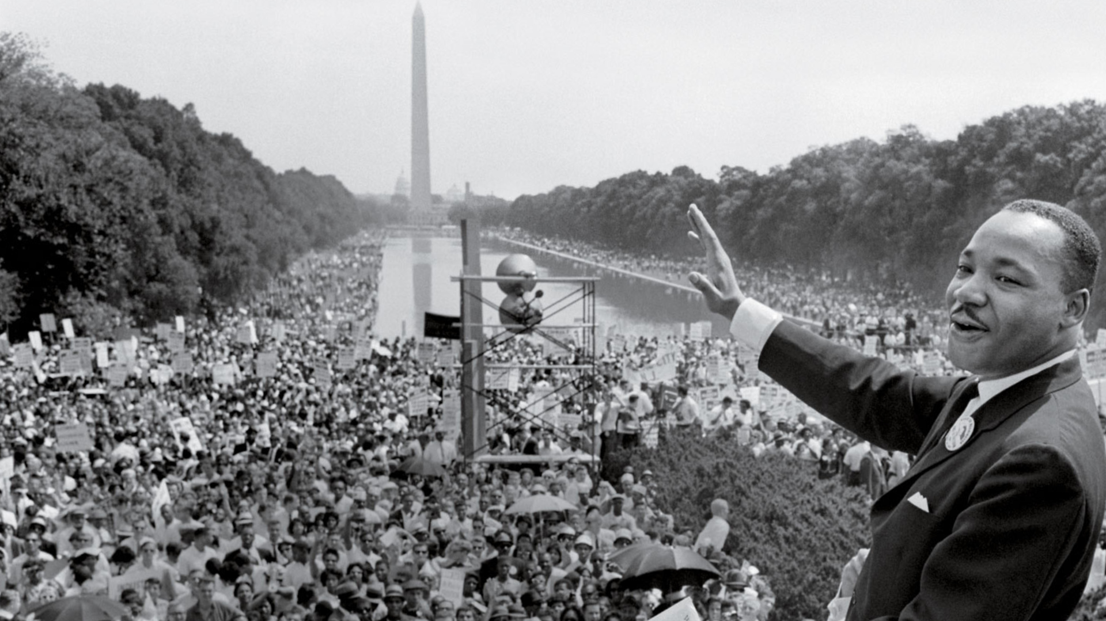
Fusing American democracy and Christian righteousness
“This will be the day when all of God's children will be able to sing with new meaning: My country, 'tis of thee, sweet land of liberty, of thee I sing. Land where my fathers died, land of the pilgrims' pride, from every mountainside, let freedom ring.”
“And if America is to be a great nation, this must become true. And so let freedom ring from the prodigious hilltops of New Hampshire. Let freedom ring from the mighty mountains of New York. Let freedom ring from the heightening Alleghenies of Pennsylvania. Let freedom ring from the snowcapped Rockies of Colorado. Let freedom ring from the curvaceous slopes of California. But not only that, let freedom ring from Stone Mountain of Georgia. Let freedom ring from Lookout Mountain of Tennessee. Let freedom ring from every hill and molehill of Mississippi. From every mountainside, let freedom ring.”
“And when this happens, and when we allow freedom ring, when we let it ring from every village and every hamlet, from every state and every city, we will be able to speed up that day when all of God's children, Black men and white men, Jews and Gentiles, Protestants and Catholics, will be able to join hands and sing in the words of the old Negro spiritual: Free at last. Free at last. Thank God almighty, we are free at last.”

Slide 20
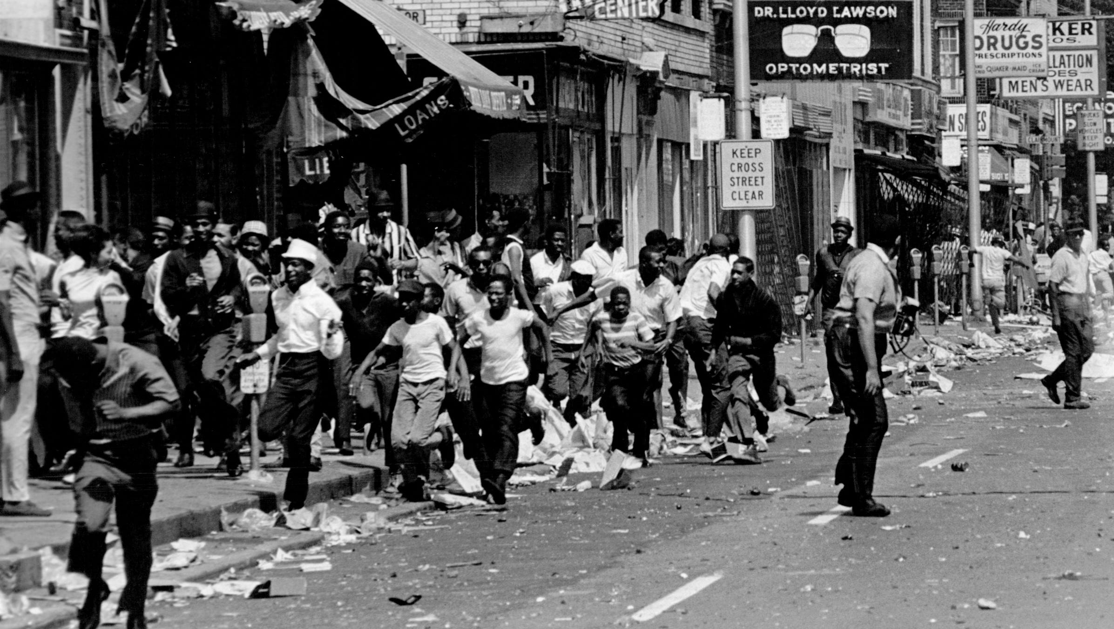
King at the crossroads
Triumphs of the movement
Rise of Black Power
The Chicago campaign
The urban crisis

Slide 21
“Beyond Vietnam”
The escalating war and King’s critique
The Ramparts article and King’s priorities
The Riverside speech and King’s conscience
“A time comes when silence is betrayal”

Slide 22
“To Save the Soul of America”
“I believe that the path from Dexter Avenue Baptist Church – the church in Montgomery, Alabama, where I began my pastorate – leads clearly to this sanctuary tonight.”
Reasons for speaking out
National priorities
Spirit of nonviolence
Role of the minister

Slide 23
“A revolution of values”
“I am convinced that if we are to get on the right side of the world revolution, we as a nation must undergo a radical revolution of values. We must rapidly begin...we must rapidly begin the shift from a thing-oriented society to a person-oriented society.”
Three evils
Racism
Militarism
Materialism

Slide 24
MLK and Memphis
The Poor People’s Campaign
The Sanitation Strike
“I See the Promised Land”

Slide 25
“A dangerous unselfishness”
Continuing power of nonviolence
Calls for economic justice
Sense of his own martyrdom

Slide 26
“Well, I don't know what will happen now. We've got some difficult days ahead. But it doesn't matter with me now. Because I've been to the mountaintop. And I don't mind. Like anybody, I would like to live a long life. Longevity has its place. But I'm not concerned about that now. I just want to do God's will. And He's allowed me to go up to the mountain. And I've looked over. And I've seen the promised land. I may not get there with you. But I want you to know tonight, that we, as a people will get to the promised land. And I'm happy, tonight. I'm not worried about anything. I'm not fearing any man. Mine eyes have seen the glory of the coming of the Lord.”

Slide 27
Questions to Consider

Slide 28
King’s core ideals
How does King fuse the ideals of American democracy with the obligations of Christian faith?
Why does King pursue this strategy in his speeches?
What are his goals?
How is he appealing to his audiences?
How is he responding to specific moments in the Black freedom struggle?

Slide 29
King’s speeches across time
Compare and contrast King’s speeches.
In what ways are his language, goals, and values consistent?
In what ways does he evolve in response to new circumstances?

Slide 30
“I Have a Dream”
Analyze Martin Luther King’s speech at the March on Washington.
What was the specific historical context of the civil rights movement in 1963?
What were King’s political goals at the time of this speech?
How did other Black leaders interpret the March on Washington?
Why did King begin his speech with the metaphor of the promissory note?
How did King address his speech to multiple audiences?
Why is the ending “Dream” section so powerful? How is this section rooted in traditions of the Black church? How is it connected to a longer tradition of American democracy?
What is the ultimate impact of the “I Have a Dream” speech?

Slide 31
The final years
Pair together “Beyond Vietnam” and “I See the Promised Land.”
What do these speeches reveal about King’s priorities in his final years?
How is he responding to the changing context of the Black freedom struggle in the late 1960s?
What illnesses in American life is he diagnosing? What are his prescriptions?

Slide 32
Assessing King
“Did Martin make the movement, or did the movement make Martin?”
Was Martin Luther King a liberal or a radical?
A liberal believes in the essential stability of the society’s institutions but sees the necessity of reforms to preserve that society.
A radical believes that the society rests on an unstable foundation and needs to be entirely rebuilt.

Slide 33
Resources

Slide 34
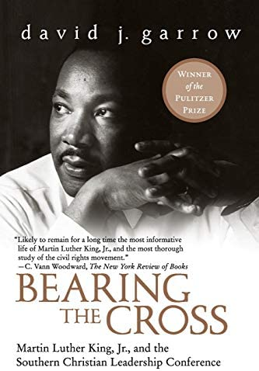
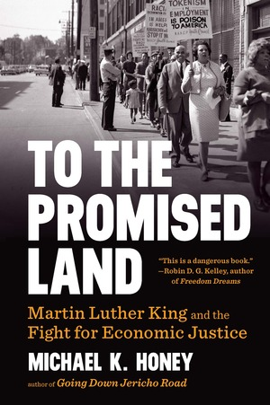
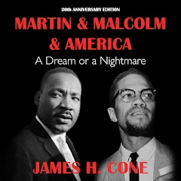
Some MLK Books

Slide 35
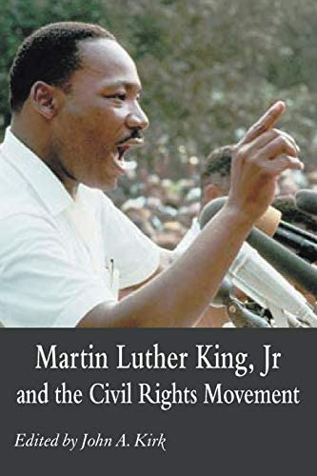
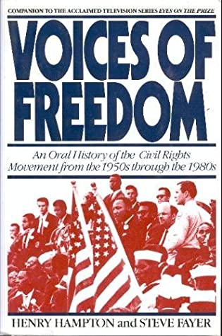
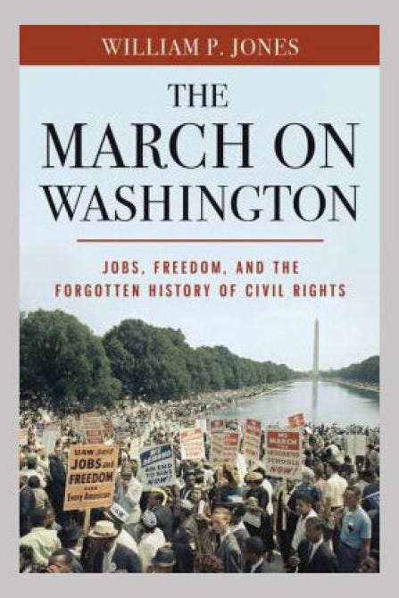
Some other useful books

Slide 36
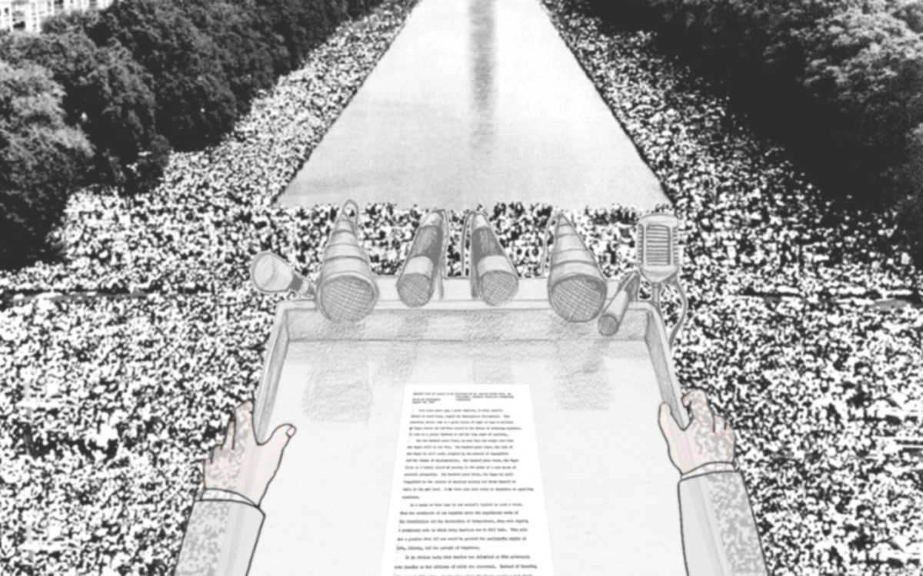
Multimedia: Freedom’s Ring

