Slide 1
Tejanos and Future Mexican Americans in the Mexican National Period
§113.19. Social Studies, Grade 7, Adopted 2018.
(b) Knowledge and skills.
(2) History. The student understands how individuals, events, and issues through the Mexican National Era shaped the history of Texas. The student is expected to:
(D) identify the individuals, issues, and events related to Mexico becoming an independent nation and its impact on Texas, including Father Miguel Hidalgo, Texas involvement in the fight for independence, José Gutiérrez de Lara, the Battle of Medina, the Mexican federal Constitution of 1824, the merger of Texas and Coahuila as a state, the State Colonization Law of 1825, and slavery;
(E) identify the contributions of significant individuals, including Moses Austin, Stephen F. Austin, Erasmo Seguín, Martín De León, and Green DeWitt, during the Mexican settlement of Texas; and
(F) contrast Spanish, Mexican, and Anglo purposes for and methods of settlement in Texas.

Slide 2
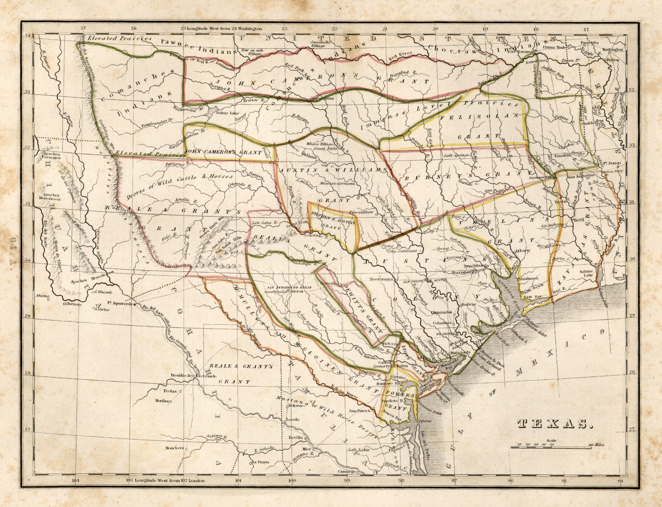
Nacogdoches
Defining Tejano and Mexican American
1. The Geography of Northern Mexico
Paso del Norte
San Antonio de Béxar
The geography of northern Mexico was still unfamiliar even to most Mexicans. For Tejanos and Mexicans in general, one thing was clear, Texas extended only as far south as the Nueces and Medina rivers and east to the Sabine, which had been traded away to the U.S. by the Spanish in the last years of the colonial period.
Victoria
Goliad
Laredo
1835 Bradford Map of Texas, Wikimedia Commons: https://images.app.goo.gl/FTyUZVup8MbzNKZT8

Slide 3
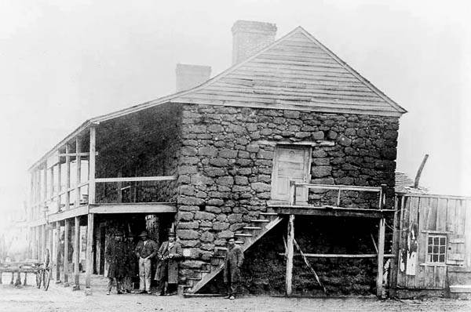
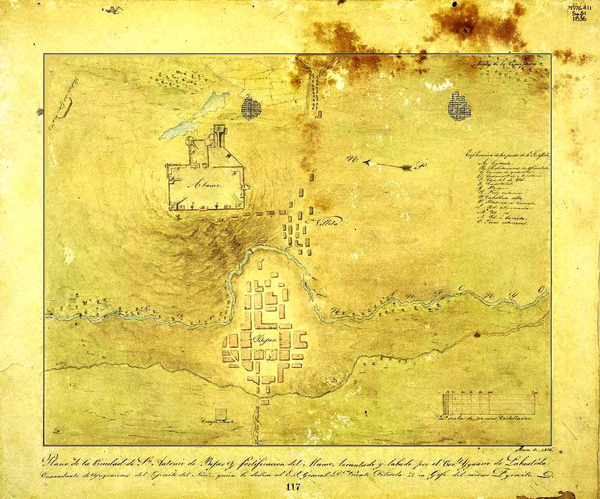
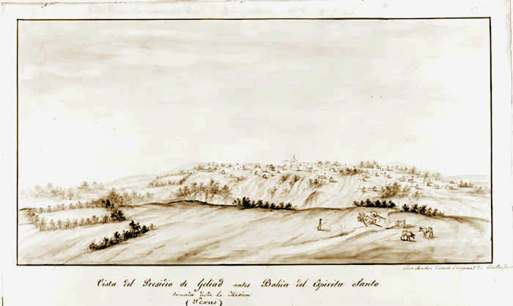
Defining Tejano and Mexican American
2. The Tejano Population Centers
San Antonio
La Bahía-Goliad-Victoria
Nacogdoches
East Texas Tejanos lived isolated from their fellow Mexican Texans by hundreds of miles. As Anglo American settlers came to surround them, they became a small minority in their own homeland.
In 1835 San Antonio remained a town of about 2,500 residents, still the largest town in Texas and the heart of still Tejano dominant southern part of Texas.
Although considerably inland, La Bahía, which became Goliad in 1829, was founded and remained a military post tasked with defending the Gulf coast.

Slide 4
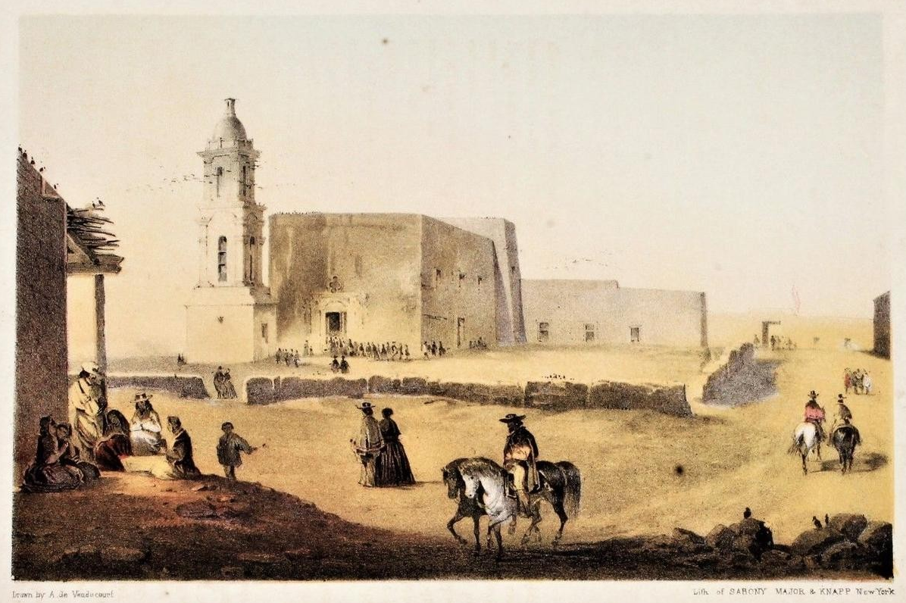
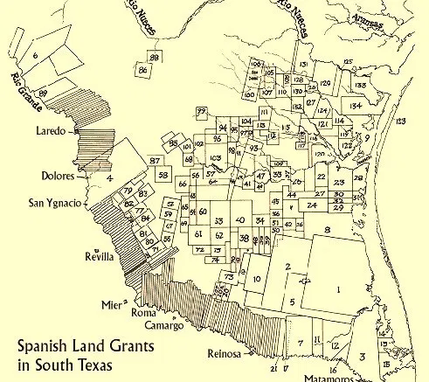
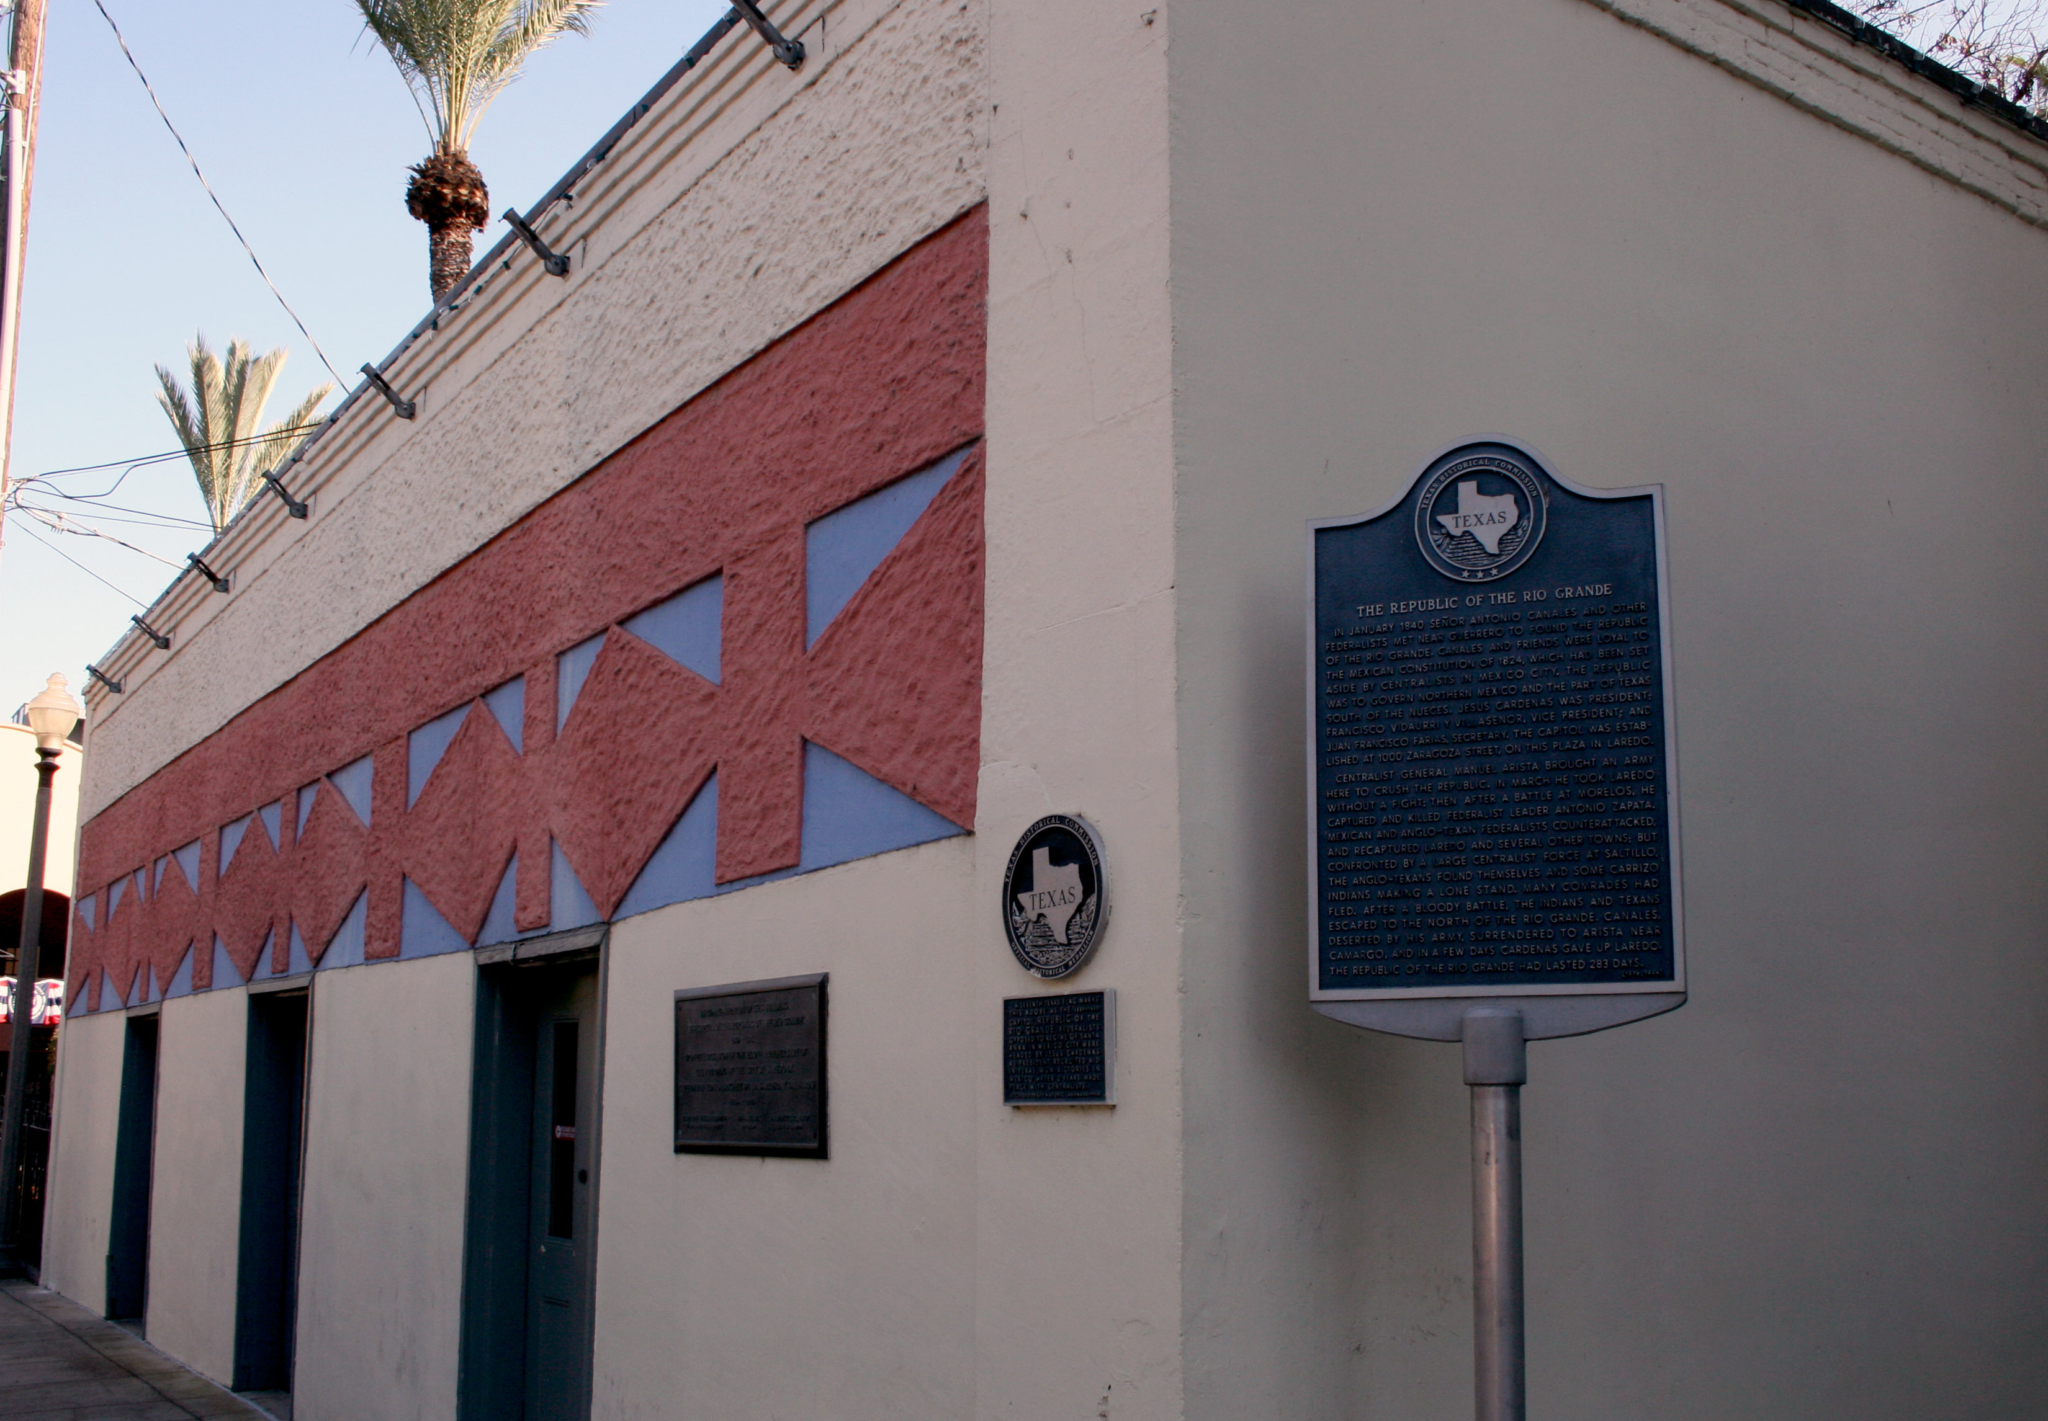
Defining Tejano and Mexican American
2. Mexican Population Centers that became Texas Mexican
Paso del Norte-El Paso
Laredo
The Lower Valley
In 1821 Paso del Norte (now Juárez) belonged to the province of New Mexico, although it would shortly be attached to new state of Chihuahua. Until 1848 there were no direct communications between Paso del Norte and Texas.
South of the Nueces the developing ranching economy was tied to the towns on the Rio Grande that were part of the new state of Tamaulipas. Only Laredo was located on the north bank.

Slide 5
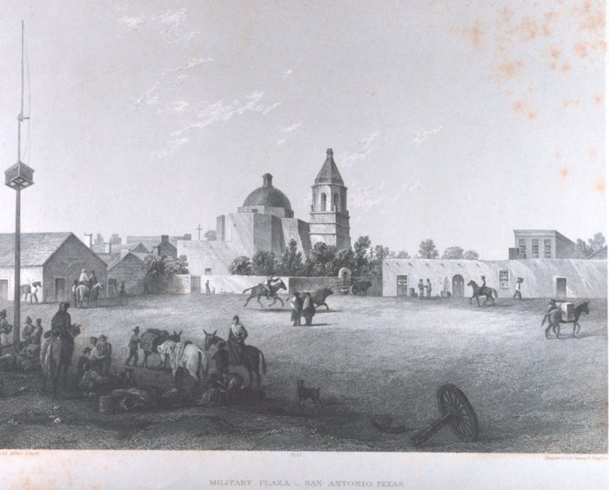
Tejanos and Mexican Independence
Two failed revolts in 1811-13 had left Tejanos wary of supporting the Plan of Iguala and the province’s three population centers heavily damaged. Nacogdoches was almost totally abandoned and La Bahía and San Antonio with significant destruction. They believed they understood their problems and they saw in American immigration an important tool of development.

Slide 6
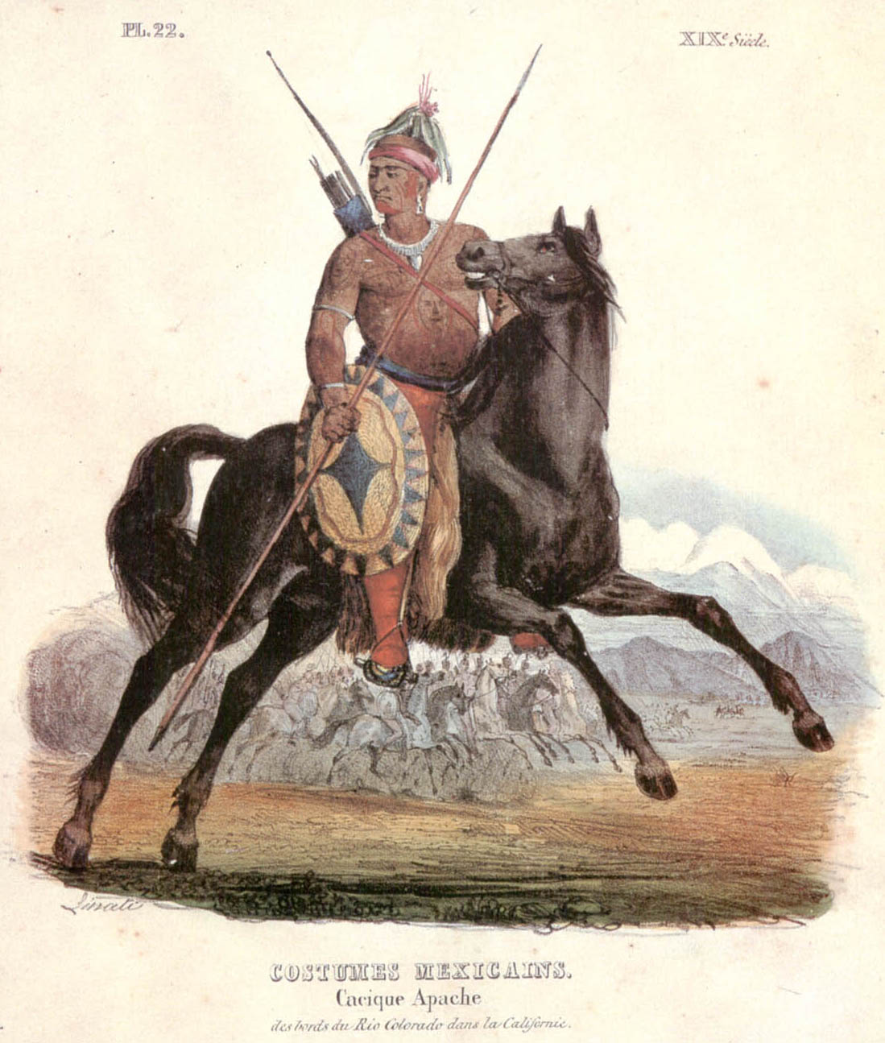
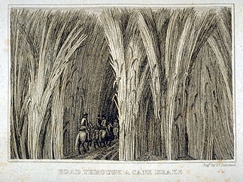
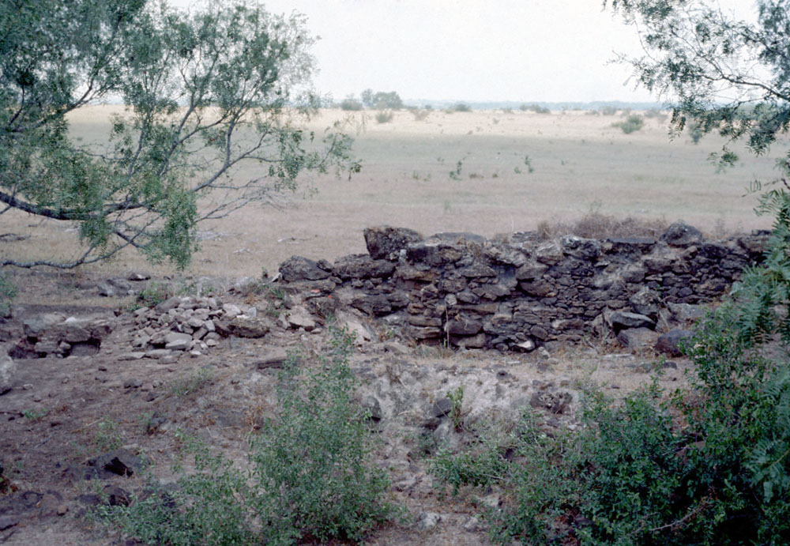
Tejanos and the Problems of the Texas Frontier
1. Native American Challengers
2. Remoteness from Markets
3. Absence of Attractions
Autonomous Indian groups, Apaches and Comanches in particular, remained a threat to Tejano communities and the development of western Texas.
Oil was still almost a century away from becoming a valuable resource and so the only resource Tejanos had to bank on to bring economic development to Texas was land.
The Spanish government had been content to keep Texas undeveloped as a way of keeping imperial rivals at bay, but the result was a complete lack of infrastructure and economic development.

Slide 7
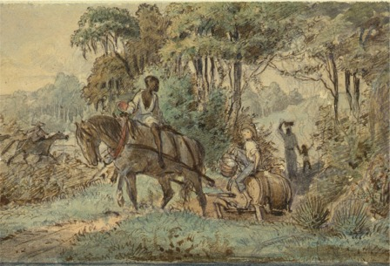
The Anglo-American Answer
Some Tejanos, such as José Francisco Ruiz, were familiar with U.S. chattel slavery, having spent considerable time in Louisiana in the years before Mexican independence.

Slide 8
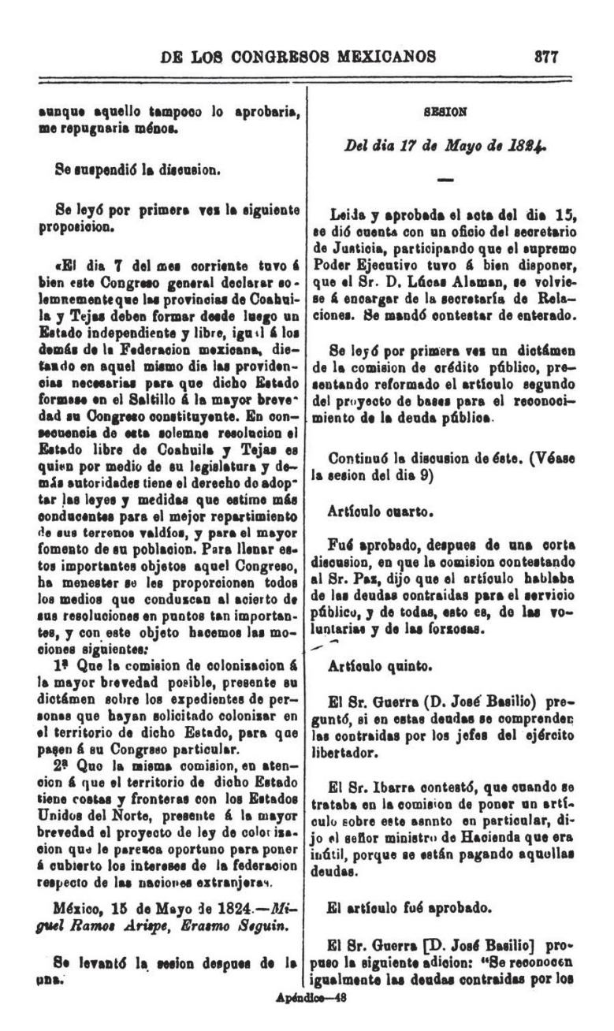
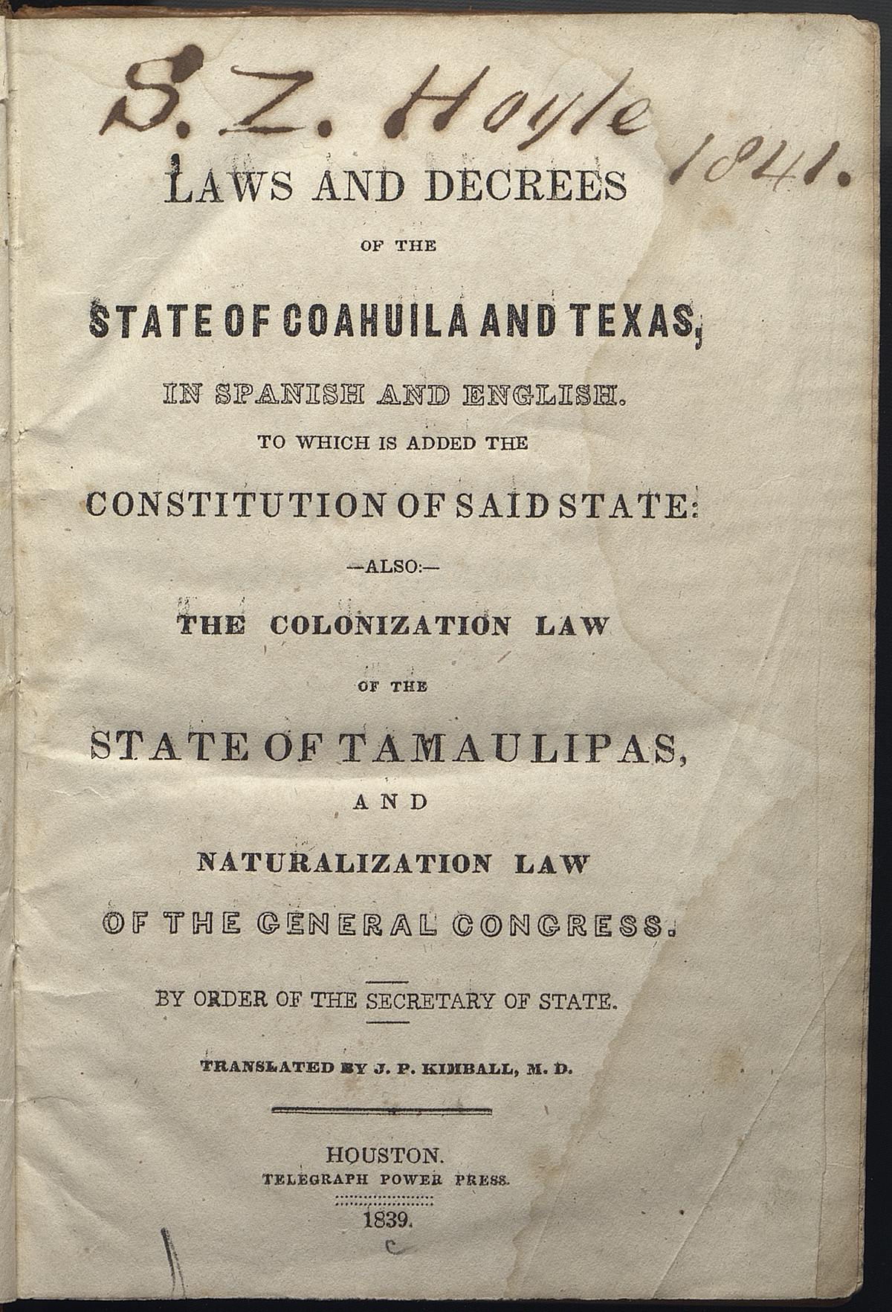
Tejanos in Mexican National Politics
Proposal by Miguel Ramos Arizpe of Coahuila and Erasmo Seguín of Texas asking, in light of Congress having joined Coahuila and Texas into a single state, that the colonization committee produce all petitions for empresario contracts before it so they can be turned over to the new state legislature; and that because of the extensive coast line and border with the U.S., the colonization committee complete work on a law to address what is in the national interest on the matter.
The union of Coahuila and Texas meant a loss of autonomy for Tejanos. Like the Anglo-American settlers, Tejanos were never happy with Texas’s status as the junior partner in the dual-state, although many Tejanos had family, business, and military connections in Coahuila.

Slide 9
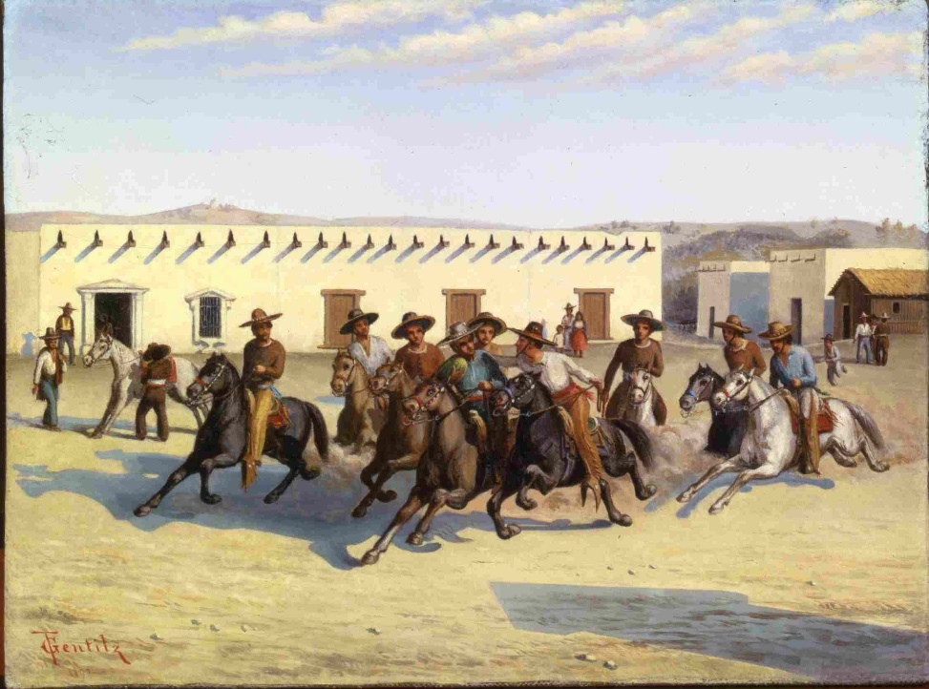
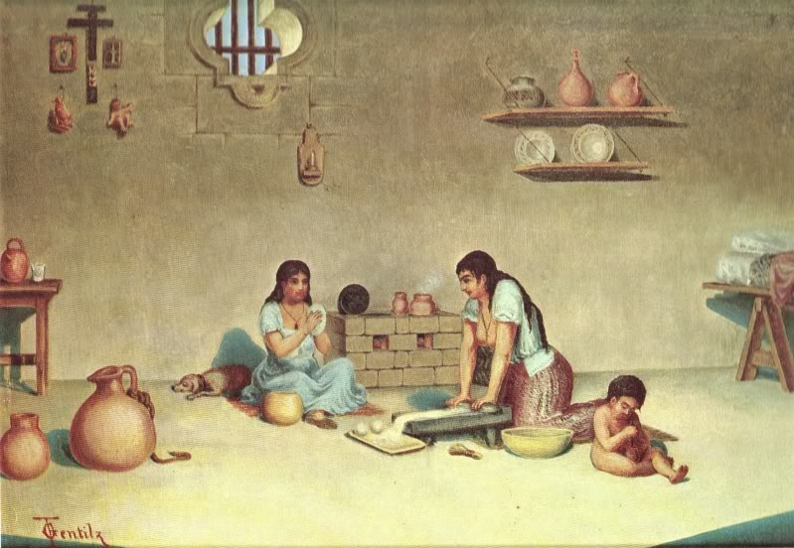
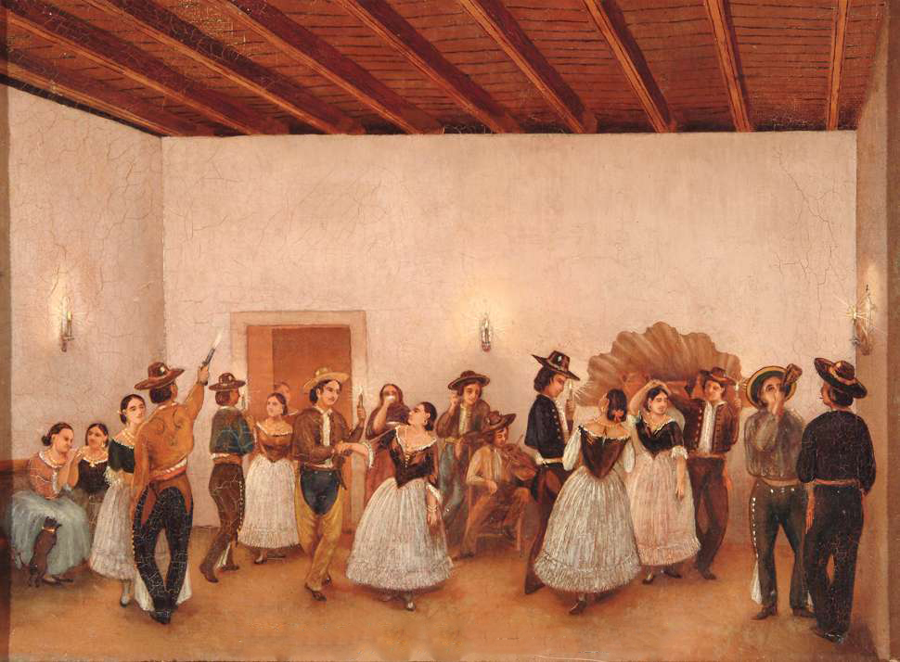
Tejano Life and Society in Transition
Paintings by Theodore Gentilz
Equestrian society
Corn-based economy
Spanish-Mexican customs

Slide 10
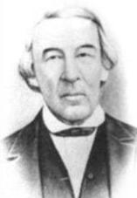
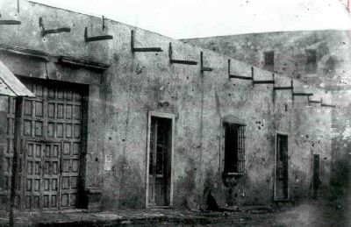
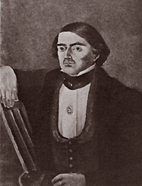
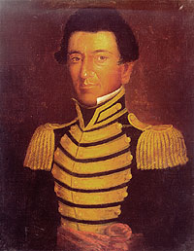
Tejano Federalism and the Texas Cause
Home of Juan Martín Veramendi
José Antonio Navarro, polititian and merchant
Juan Seguín at the top of his popularity, right after independence
José Francisco Ruiz, military officer, Indian agent, school teacher, signer of Declaration of Independence

