Slide 1
Teaching the Philadelphia (Constitutional) Constitution Lorri Glover Saint Louis University

Slide 2
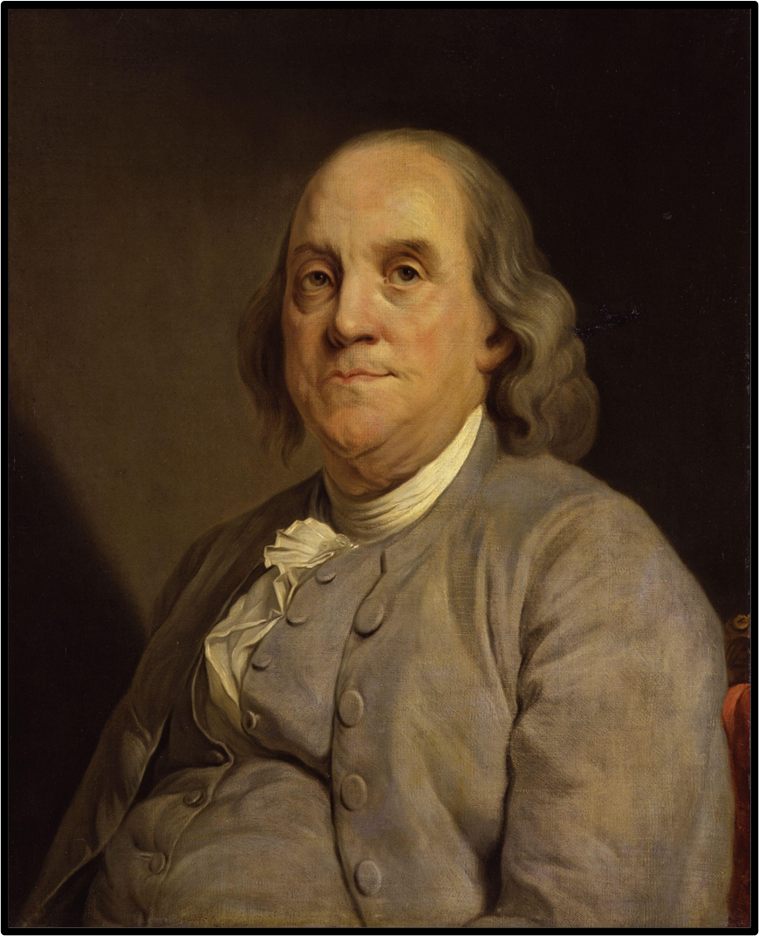
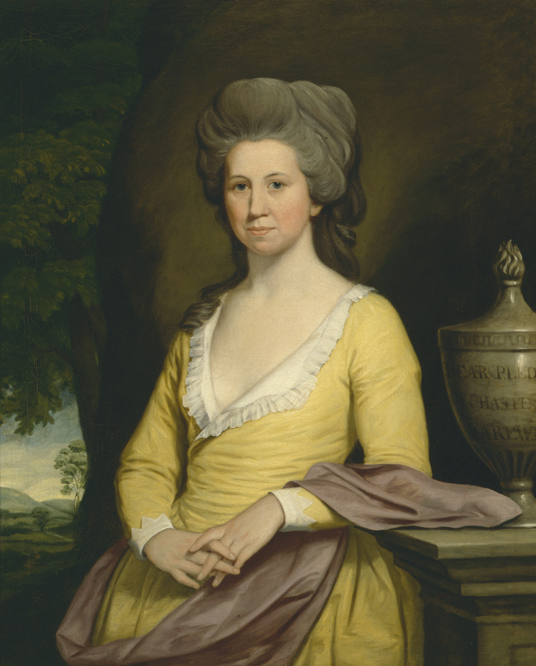

Slide 3
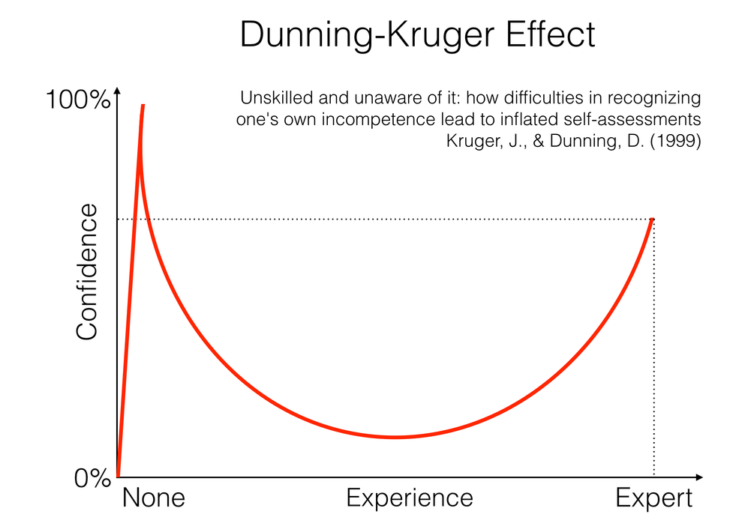

Slide 4
U.S. Constitution, Article 1, Section 8: “To make all laws which shall be necessary and proper for carrying into execution the foregoing powers, and all other powers vested by this Constitution in the government of the United States, or in any department or officer thereof.”

Slide 6
Philadelphia Convention, 1787 Ratification Debates, 1787-1788 First Congress, 1789-1790

Slide 7
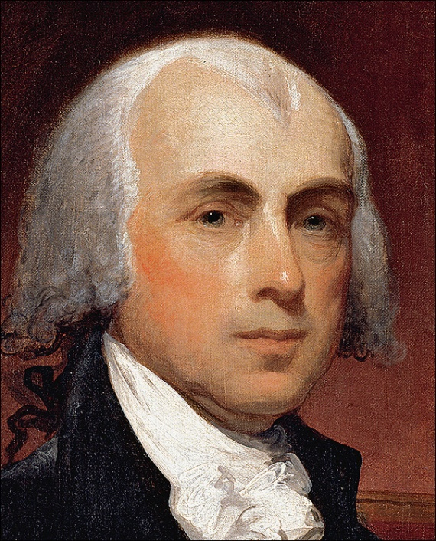

Slide 8
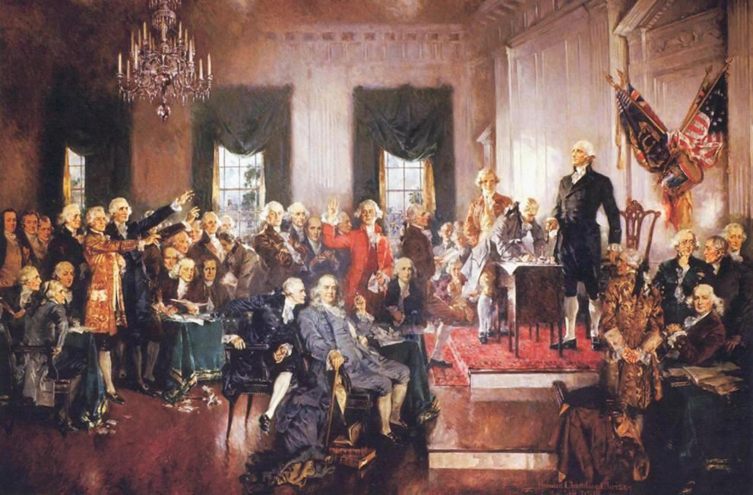

Slide 9
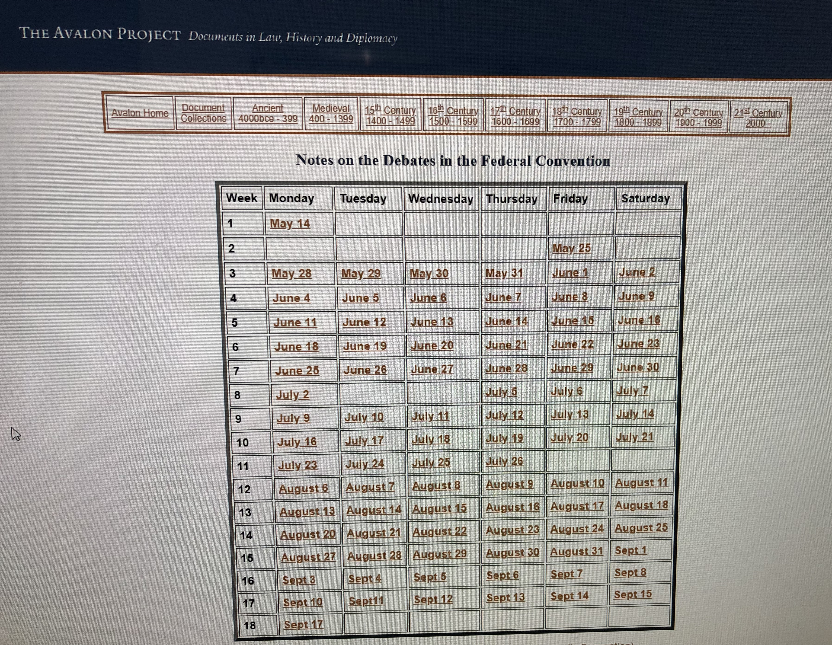
https://avalon.law.yale.edu/subject_menus/debcont.asp

Slide 10
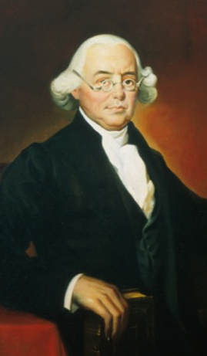
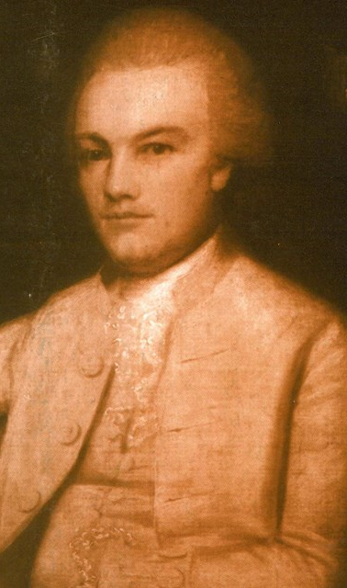
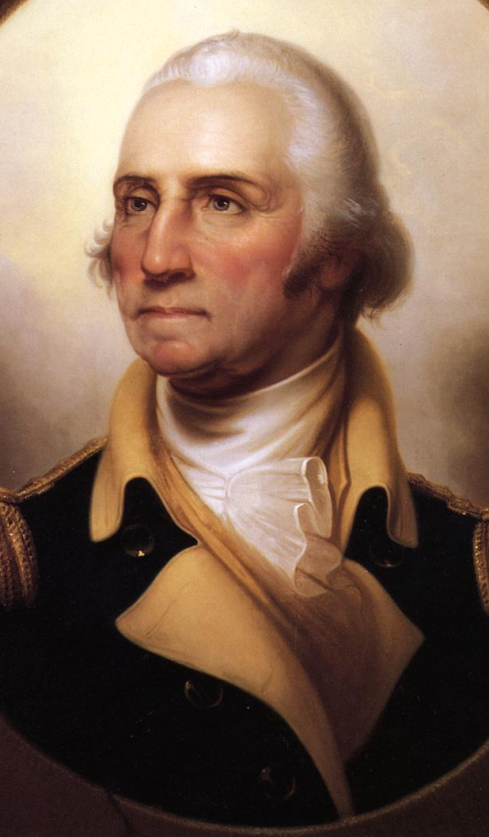
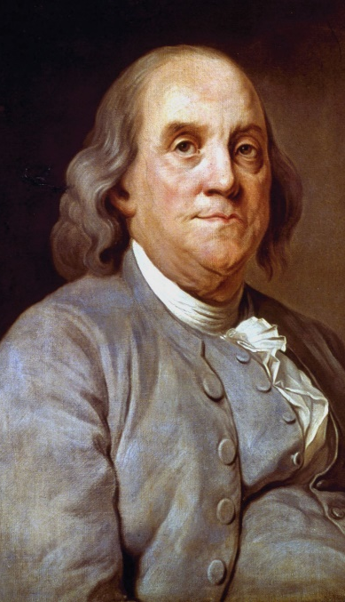
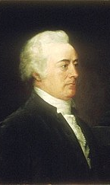
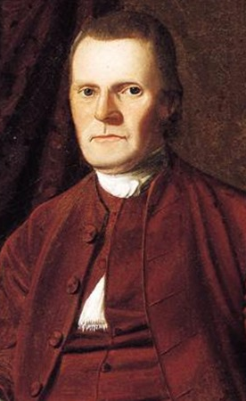
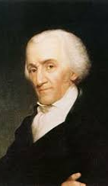
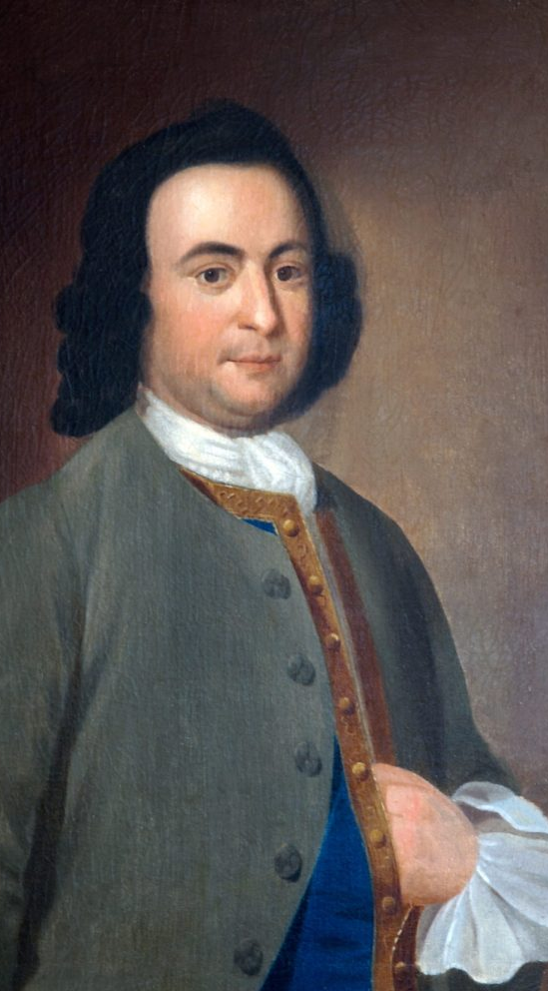

Slide 11
Philadelphia Convention, 1 June 1787 (edited and paraphrased excerpts) For full text, see https://avalon.law.yale.edu/subject_menus/debcont.asp The Committee of the Whole turned to resolution 7: “that a national Executive be instituted, to be chosen by the national Legislature, for the term of ____ years and to be ineligible thereafter.” JAMES WILSON (Pennsylvania) I move that the executive consist of a single person. CHARLES PINKNEY (South Carolina) I second the motion. A considerable pause ensued. GEORGE WASHINGTON (Virginia) Shall I call the question? BENJAMIN FRANKLIN (Pennsylvania) This is a point of great importance and I wish that the gentlemen would deliver their sentiments on it before the question is put to a vote. JOHN RUTLEDGE (South Carolina) Gentlemen are shy on this and other subjects. They appear to suppose themselves precluded, by having frankly disclosed their opinions, from afterwards changing them. I do not take this to be at all the case. ROGER SHERMAN (Connecticut) I consider the executive magistracy as nothing more than an institution for carrying the will of the legislature into effect, the person or persons ought to be appointed by and accountable to the legislature only, which is the depositary of the supreme will of the society. JAMES WILSON (Pennsylvania) I prefer a single magistrate, as giving most energy, dispatch, and responsibility to the office. ELBRIDGE GERRY (Massachusetts) I favor the policy of adding a council to the executive in order to give weight and inspire confidence. JAMES WILSON (Pennsylvania) I move that the blank for the term of duration should be filled with three years. While I prefer this short period, I assume that a re-eligibility would be provided for. CHARLES PINKNEY (South Carolina) I move for seven years. ROGER SHERMAN (Connecticut) I support three years and am against the doctrine of rotation as it throws out of office the men best qualified to execute its duties. GEORGE MASON (Virginia) I recommend seven years at least, but I favor prohibiting a re-eligibility.

Slide 12
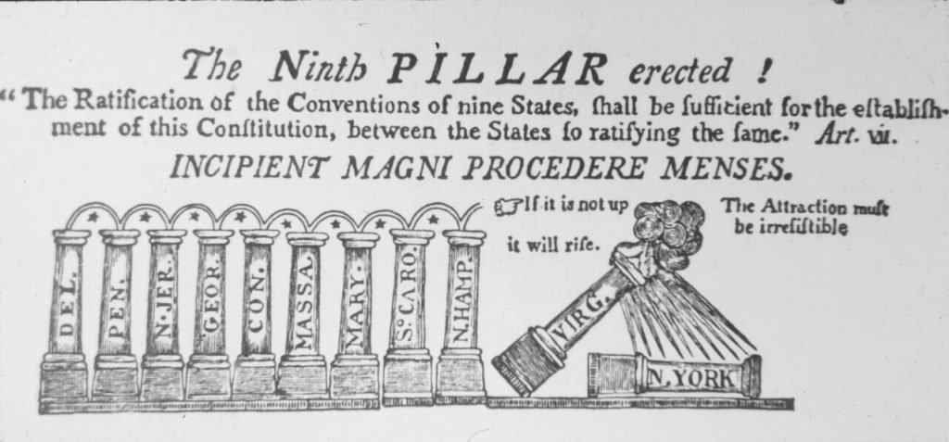
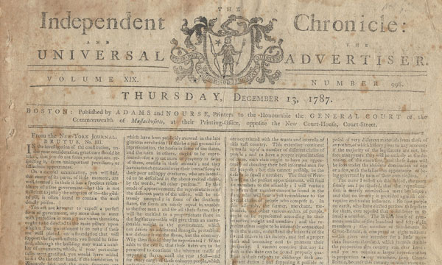

Slide 13
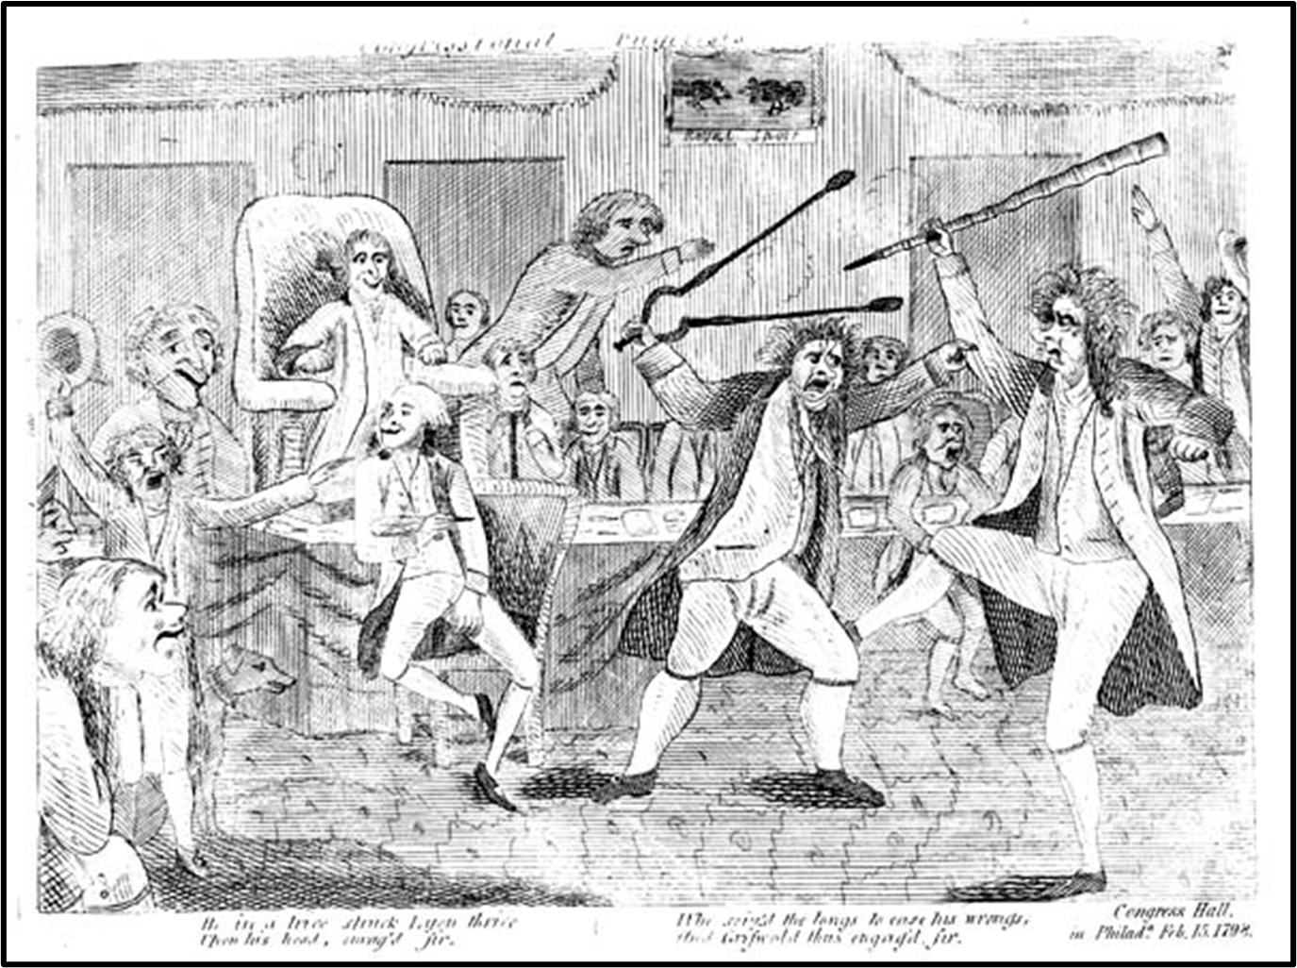

Slide 15
Checks and Balances
Executive Legislative
Veto Power (“Negative”) Override Veto
Recess Appointments Approve Appointments
Commander in Chief Enact Taxes & Allot Money
Appoint Judges Impeachment
Pardon Initiate Amendments
Judiciary
Judicial Review
To What End?
Checking the power of the federal government
Ensuring that sovereignty rests with the people
Protecting the rights of citizens, individually and collectively
Promoting a just republic, which advances the interests of the nation as a whole

Slide 16
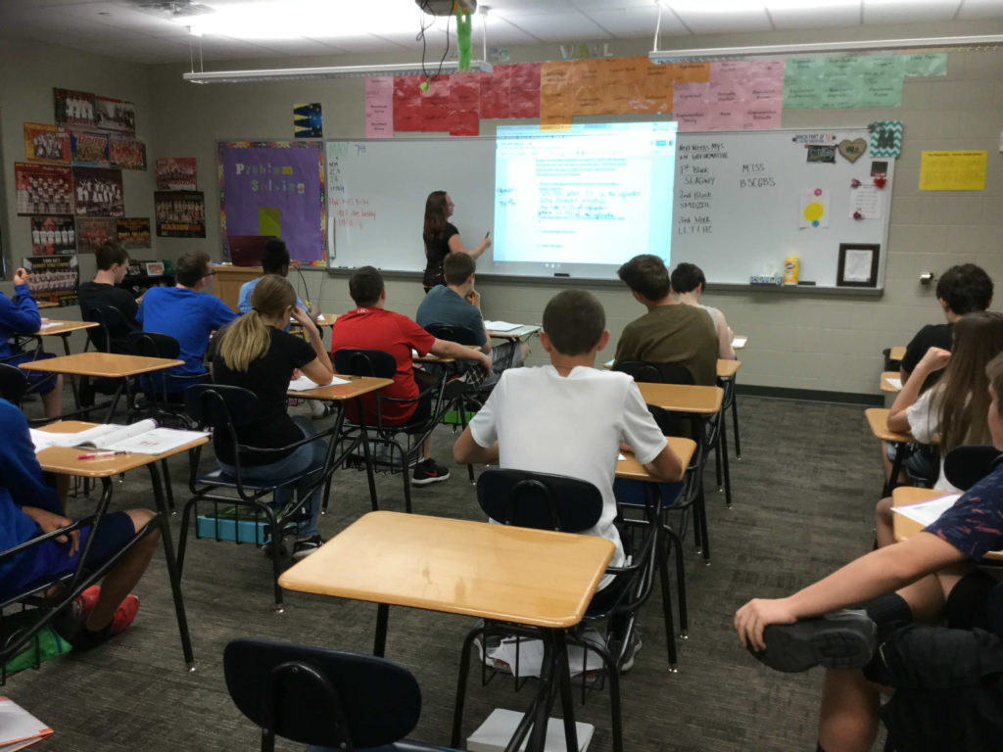

Slide 17
Representation, 2010 https://www.census.gov/prod/cen2010/briefs/c2010br-01.pdf
Texas Oklahoma
25,145,561 residents 3,751,351 residents
36 Representatives 5 Representatives
2 Senators 2 Senators
1790: 1 for 30,000
2010: 1 for 710,000

Slide 18
Texas vs. Oklahoma Population and Representation 25,145,561 vs. 3,751,351
U.S. House of Representatives U.S. Senate

Slide 19
25,145,561 3,751,351 37,253,956 563,626

Slide 20
Questions to Consider What is fair for Texas? For Oklahoma? For the US? Who or what should be represented in Congress? Is the Great Compromise still a great idea? Why is the 2020 Census important?

Slide 21
