Slide 1
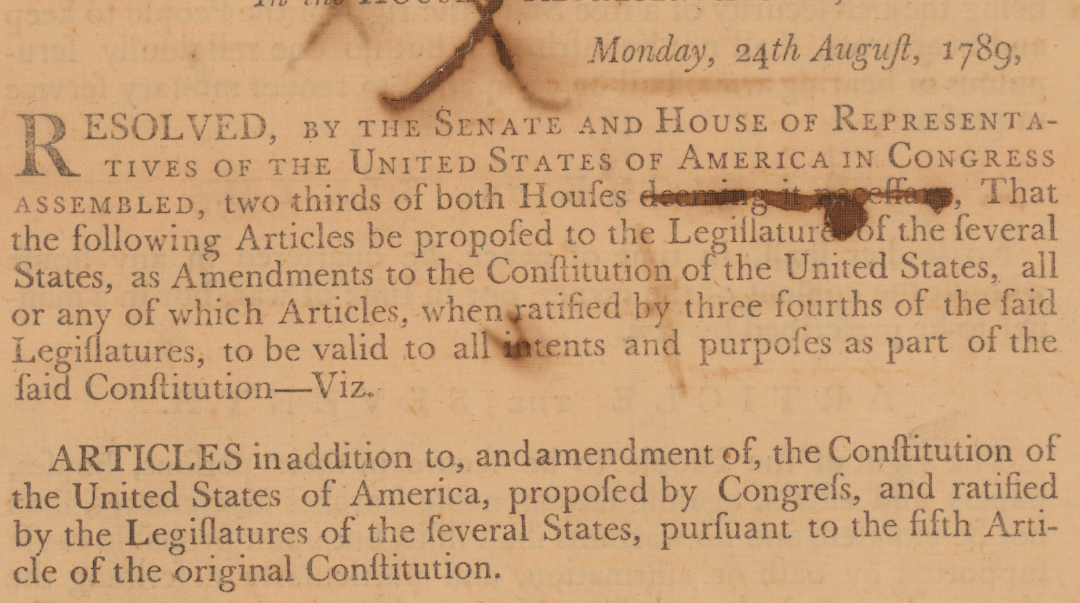
Teaching about the Bill of Rights with Resources from the National Archives and the Center for Legislative Archives

Slide 2
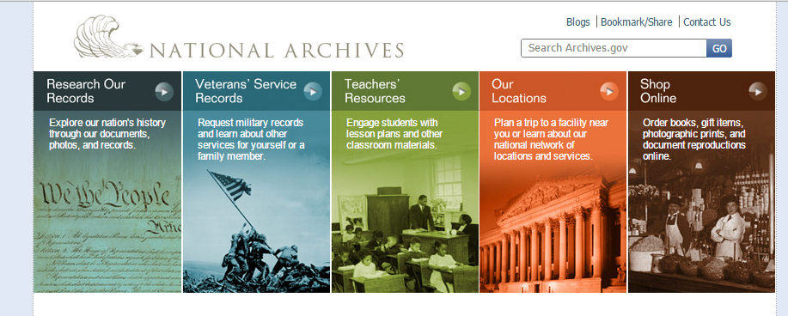
The National Archives preserves the records
that document America’s civic legacy of self government under the Constitution.
http://www.archives.gov/

Slide 3
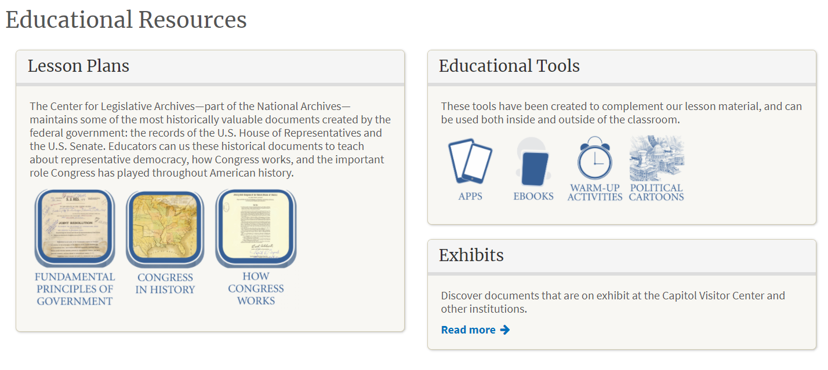
Resources for your students from:
The Center for Legislative Archives
Archives.gov/legislative

Slide 4
Three take-aways from this presentation
Concerns about the powers of government were expressed in the Declaration of Independence and also in the debate about whether the Constitution should include a Bill of Rights
The process of creating a Bill of Rights demonstrates the dynamic interaction of state and federal levels of government. (The call for a Bill of Rights emerged from the states and Congress responded with proposed amendments that states ratified.)
3. Studying a primary source that illustrates how Congress created a proposed Bill of Rights provides students with an opportunity for hands-on, active learning about:
The history of how the states and Congress used constitutional processes to address a serious national debate
The Article V process for amending the Constitution
The experience of studying primary sources to reveal history as a living people making choices.

Slide 5
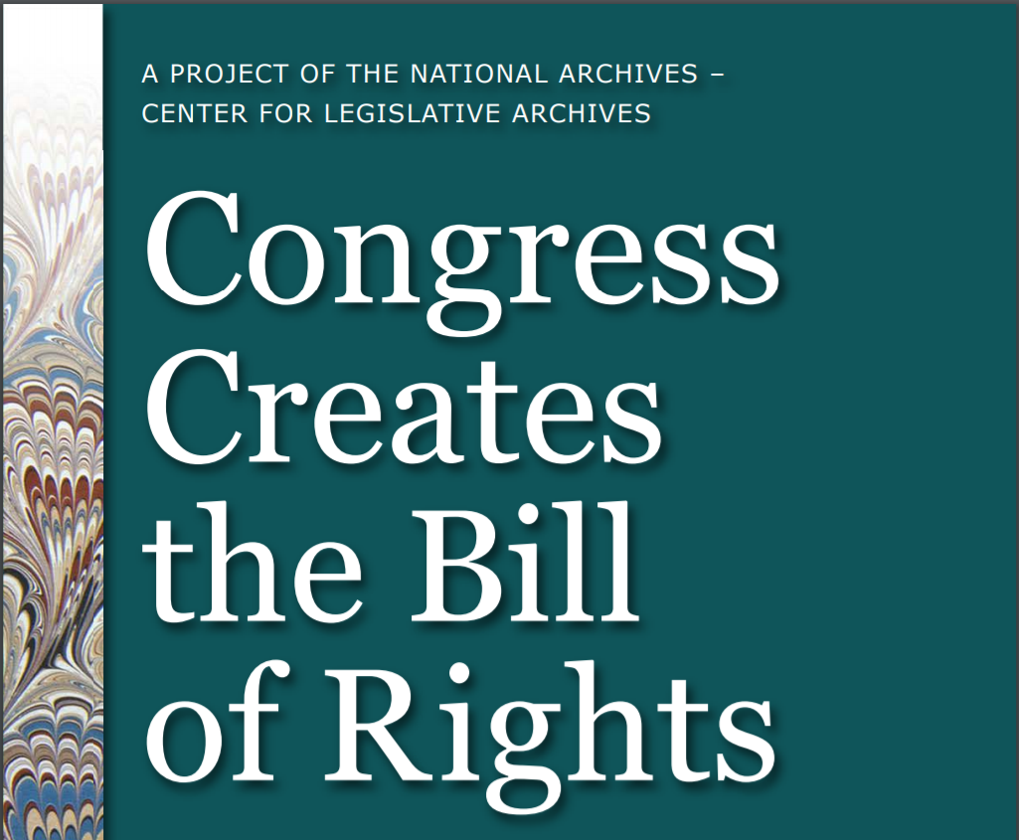
Bring the history of the Bill of Rights to your students: https://www.archives.gov/legislative
Free Digital App
Lesson Plans
Congress Creates the Bill of Rights: Completing the Constitution
The Bill of Rights: Inside the Debate about Rights and the Limits of Government Power

Slide 6
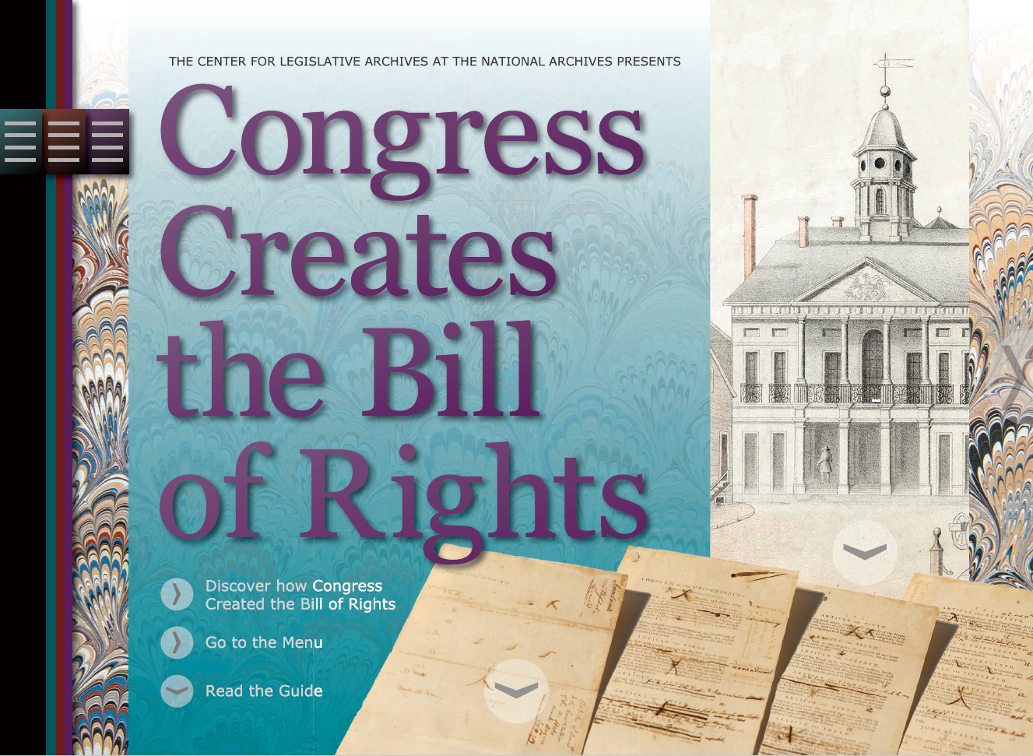

Slide 7
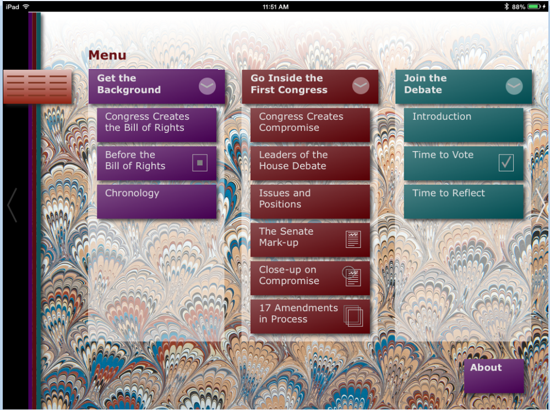
Download this free app from iTunes or get the pdf

Slide 8
TEKS:
15 Government. The student understands the American beliefs and principles reflected in the Declaration of Independence, the U.S. Constitution, and other important historic documents.
15 C: identify colonial grievances listed in the Declaration of Independence and explain how those grievances were addressed in the U.S. Constitution and the Bill of Rights;
16 Government. The student understands the purpose of changing the U.S. Constitution and the impact of amendments on American society. The student is expected to (A) summarize the purposes for amending the U.S. Constitution
Cont.

Slide 9
17 Government. The student understands the dynamic nature of the powers of the national government and state governments in a federal system. The student is expected to (A) analyze the arguments of the Federalists and Anti–Federalists…
19 (B) summarize rights guaranteed in the Bill of Rights

Slide 10
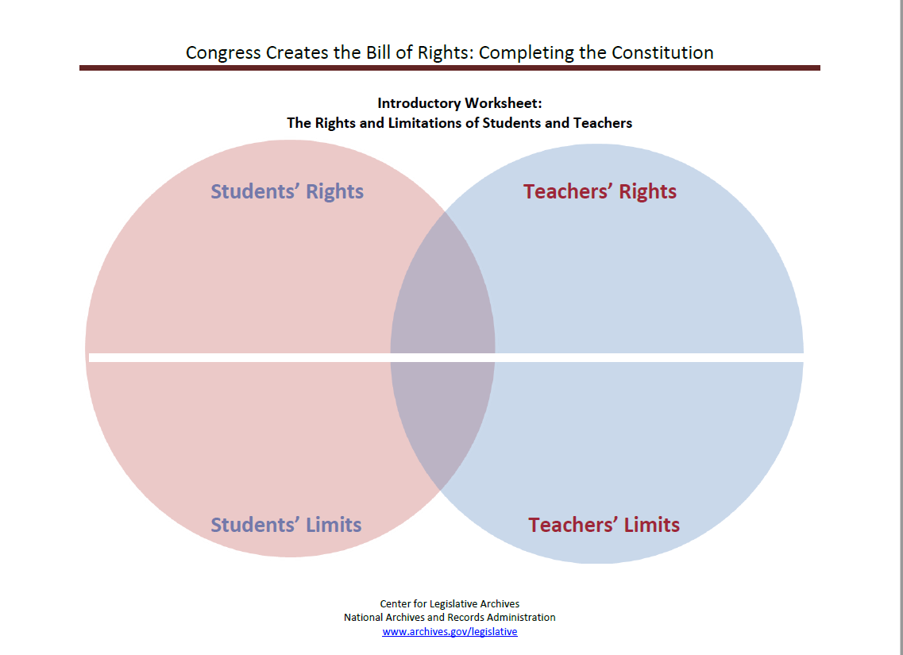
The first challenge: defining a
right.
https://www.archives.gov/files/legislative/resources/congress-creates-bor/introworksheet.pdf

Slide 11
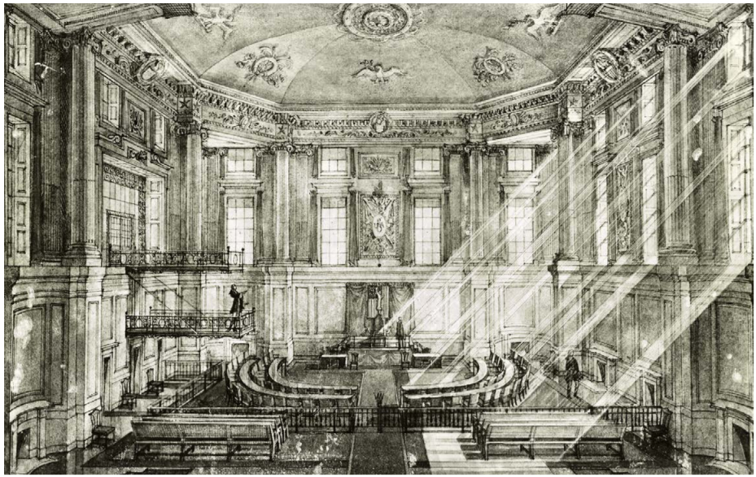
TEKS: 15 C: identify colonial grievances listed in the Declaration of Independence and explain how those grievances were addressed in the U.S. Constitution and the Bill of Rights;

Slide 12
6 Examples
Excerpts from the Declaration of Independence
How this idea appears in proposed amendments:
The right to be governed by representatives
The right to express dissent
Power originates with the people (Popular Sovereignty)
He has dissolved Representative Houses repeatedly, for opposing with manly firmness his invasions on the rights of the people.
2. He has refused for a long time, after such dissolutions, to cause others to be elected; whereby the Legislative powers, incapable of Annihilation, have returned to the People at large for their exercise; the State remaining in the mean time exposed to all the dangers of invasion from without, and convulsions within.

Slide 13
6 Examples of Grievances listed in the Declaration of Independence Addressed in the Bill of Rights
continued
How this idea appears in proposed amendments:
Questions about a standing army in peacetime
No quartering troops in homes
Right to trial by a local jury
Right to know the crime charged; right to have charges lodged by local grand jury
3. He has kept among us, in times of peace, Standing Armies without the Consent of our legislatures.
4. For Quartering large bodies of armed troops among us:
5. For depriving us in many cases, of the benefits of Trial by Jury:
6. For transporting us beyond Seas to be tried for pretended offences

Slide 14
TEKS: The student understands the dynamic nature of the powers of the national government and state governments in a federal system.

Slide 15
A debate between the states and the federal government about a Bill of Rights
Debate Timeline:
September 1787 — the Constitutional Convention votes that the Constitution does not need a Bill of Rights
December, 1787 – July, 1788 — Anti-Federalists in several state ratifying conventions argue that a Bill of Rights is essential to the Constitution
April,1789 – October, 1789 — Congress debates moderate amendments that can be incorporated in a Bill of Rights to satisfy criticisms from the states
October, 1789 – December 1791 — State legislatures debate whether to ratify the Bill of Rights proposed by Congress

Slide 16
What contributions did Anti-Federalists in state ratifying conventions make to the Bill of Rights?

Slide 17
4 Anti-Federalist concepts in the Bill of Rights (as debated in Congress)
Amendments establishing limits on governmental authority
Amendments protecting legal rights
Amendments regulating powers within the government and between federal and state governments
An amendment about the source of rights

Slide 18
Congress Creates the Bill of Rights
Amendments in Process:
See specific proposals from various state ratifying conventions related to 16 proposed amendments debated by Congress.
Congress Creates the Bill of Rights

Slide 19
By what process did Congress create a Bill of Rights?

Slide 20
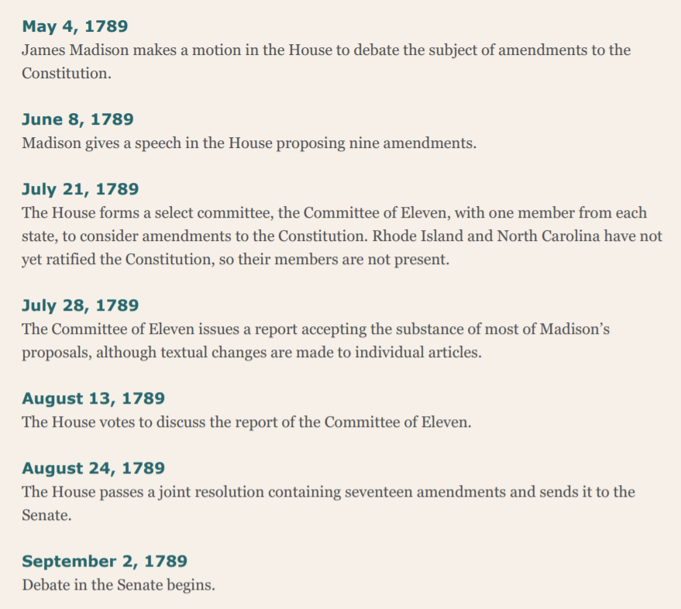
Congressional Timeline
May – August 1789
The House creates proposed amendments

Slide 21
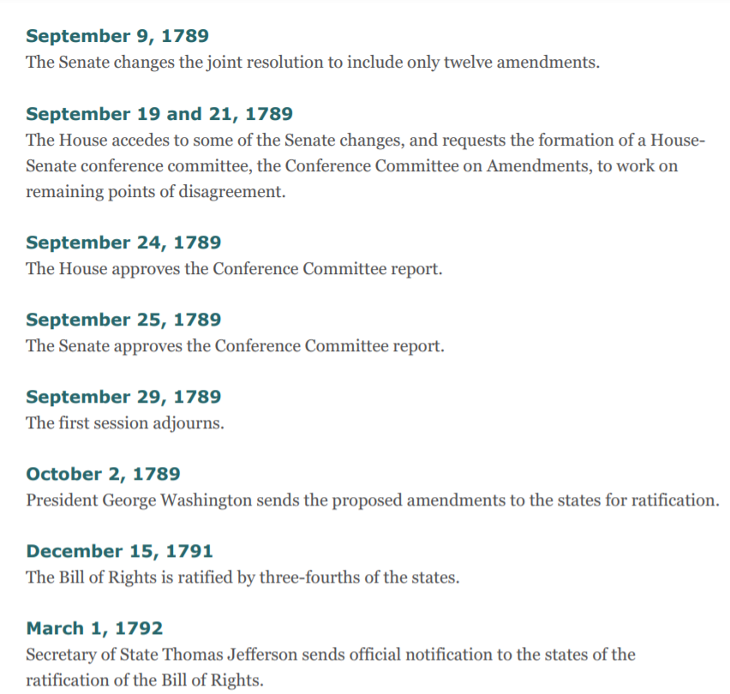
September 3 – 14 the Senate debates and modifies House proposed amendments
September 24 – 25 Conference Committee Report approved
October, 1789 to December 1791
States ratify the proposed amendments

Slide 22
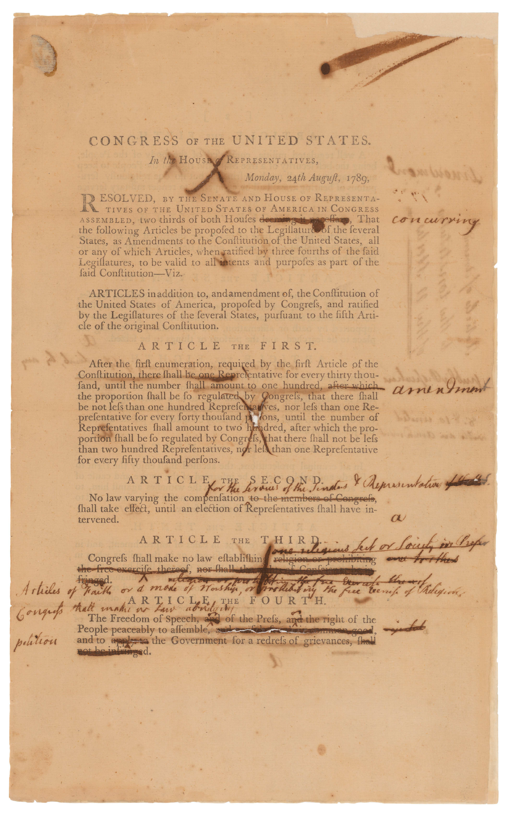
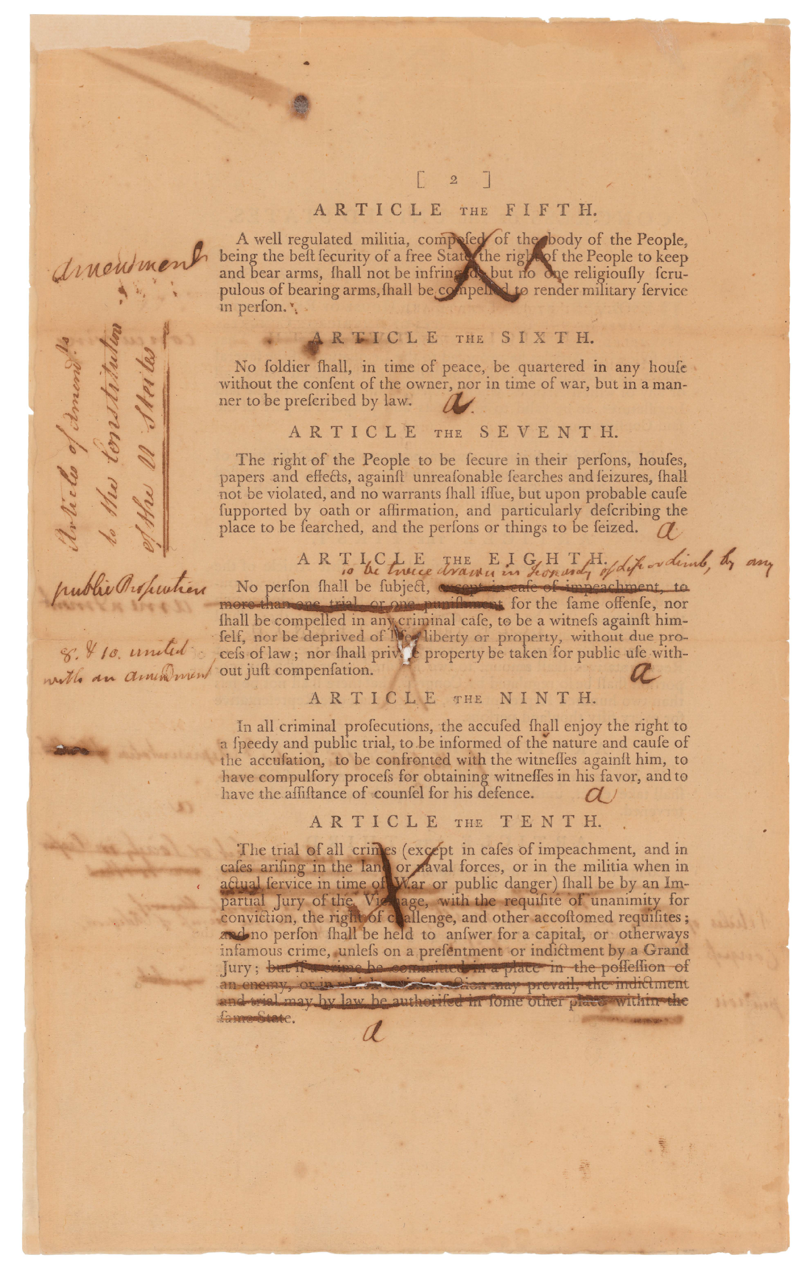
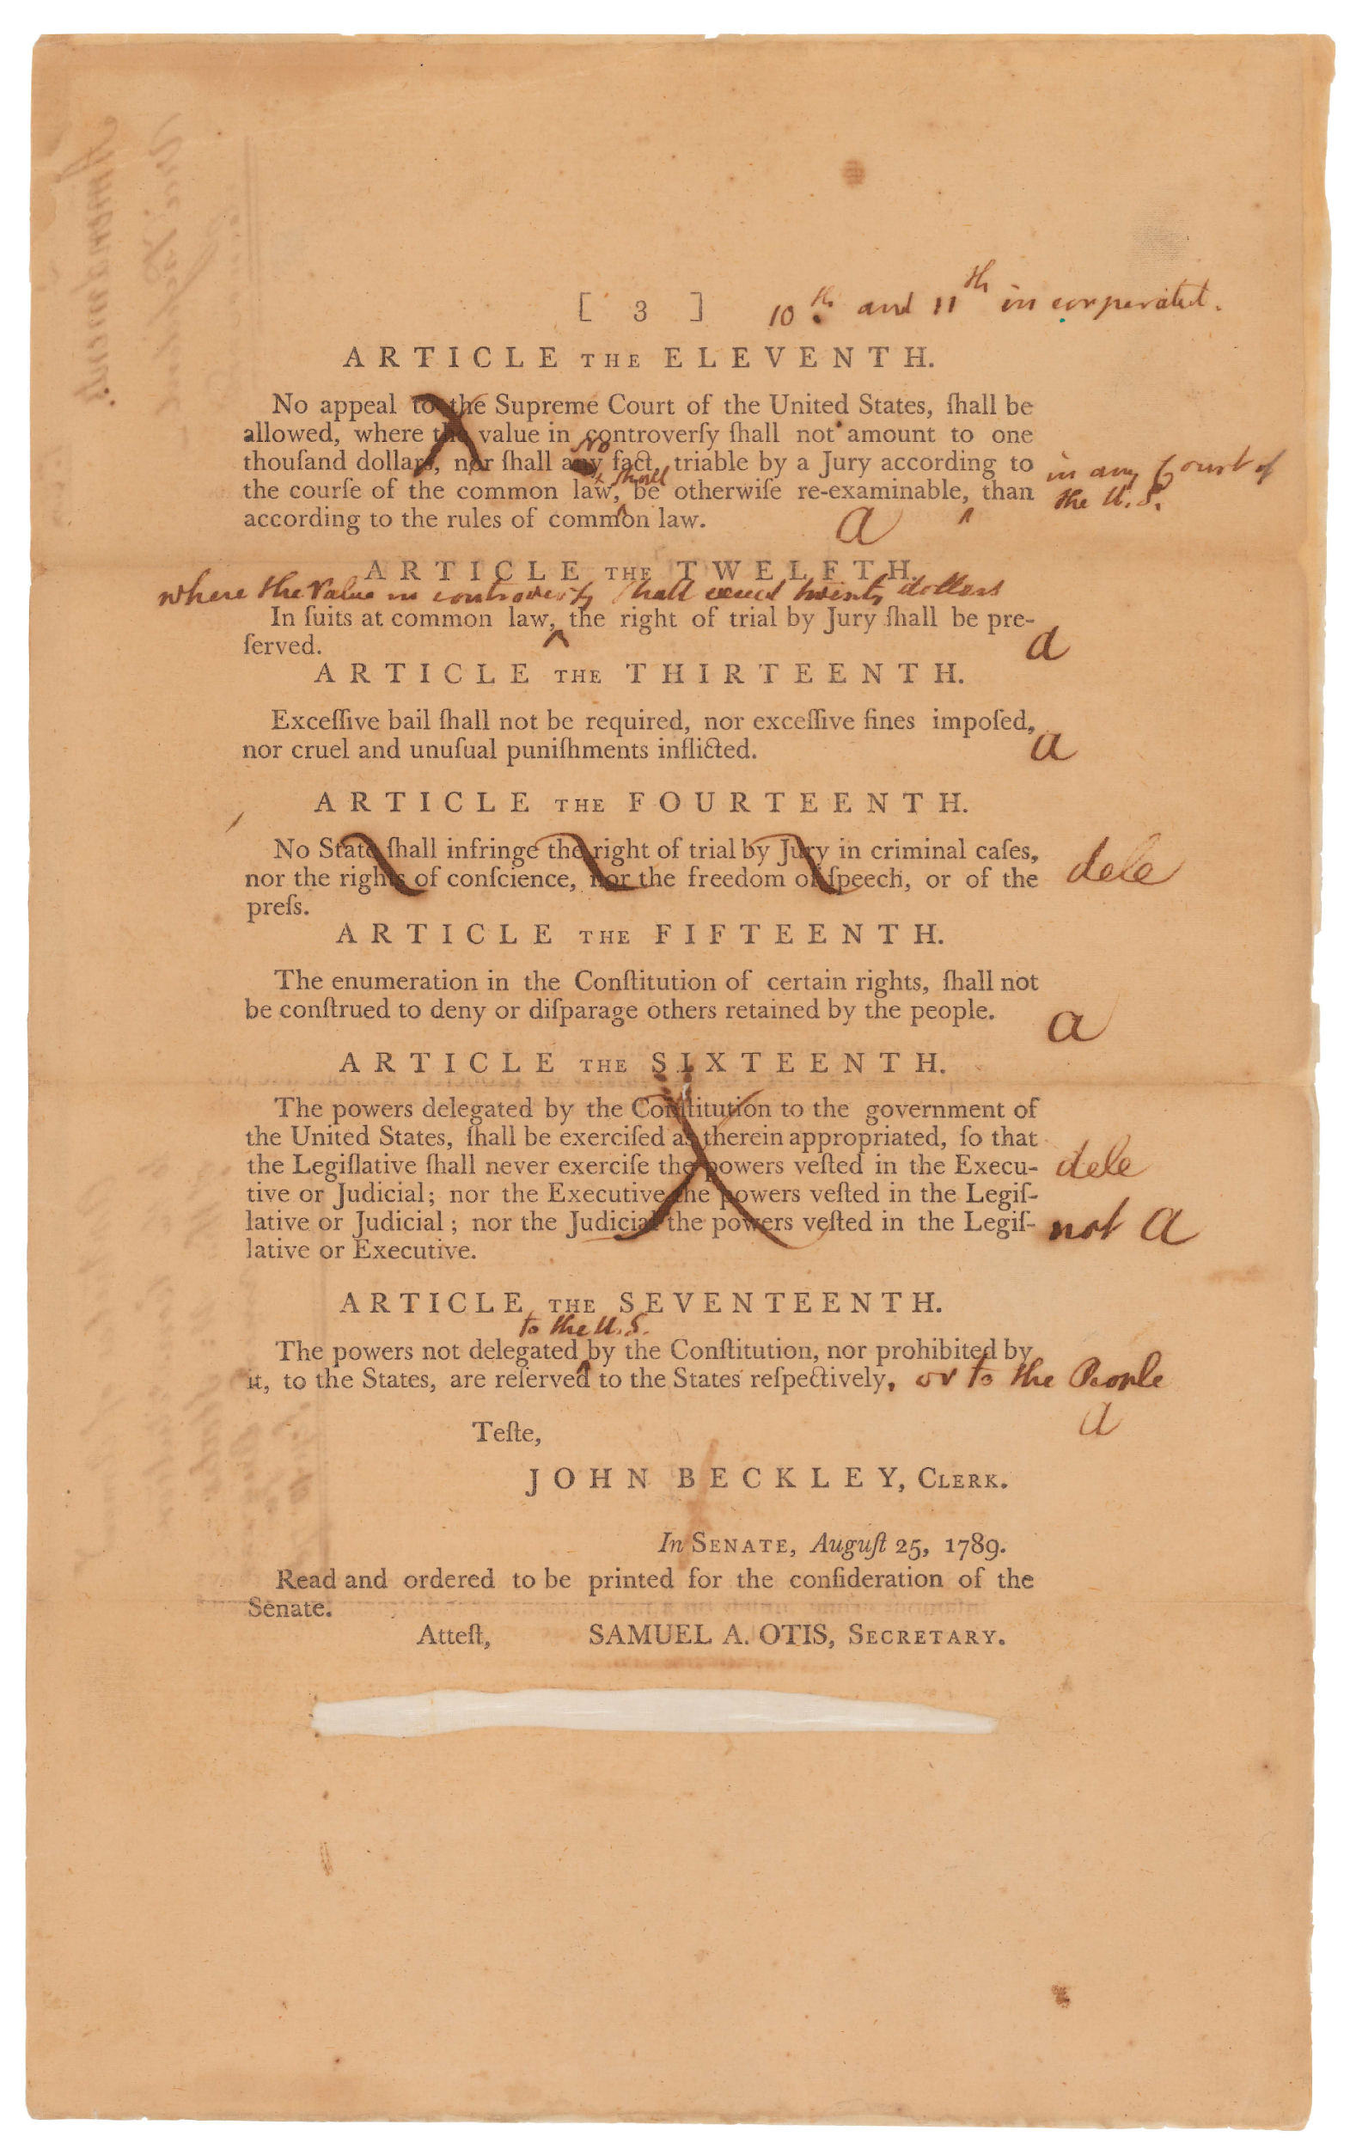
The Senate Markup: the Primary Source that Shows Congress at Work

Slide 23
Concepts from the State Ratifying Conventions organize the Bill of Rights.

Slide 24
The first six proposed Articles assert that government power should be limited.
Ideas:
1 Congress must be representative.
2. Officials cannot increase their own salaries.
3. Congress may not establish an official religion.
4. Speech, the Press, Assembly, and Petition shall be unrestricted

Slide 25
5. On the militia and weapons:
A militia composed of the body of the people will defend the state
The people have the right to keep and bear arms
Those scrupulous of bearing arms shall not be compelled to serve in person
6. The government cannot quarter troops in private homes without the consent of the owner, or as prescribed by law during a war.

Slide 26
Proposed Amendments 7 – 10:
Legal rights must be protected
7. Guarantees:
The right to be secure from unreasonable search and seizure
Warrants must be specific and issued upon probable cause
8. Protections:
No double jeopardy;
No self-incrimination;
c. Guarantee of due process.
d. Protection of property from uncompensated taking

Slide 27
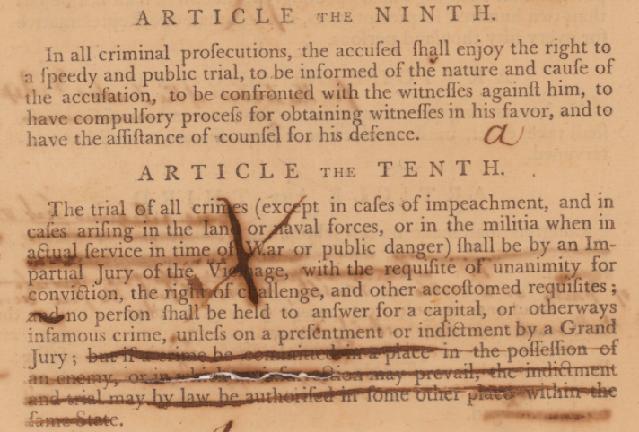
9. Protection of rights to:
a. A speedy, public trial
b. Be informed of the charge
c. Call and to confront witnesses
10. Guarantees:
Charges will be brought only from a Grand Jury
Right to an impartial jury in a criminal trial

Slide 28
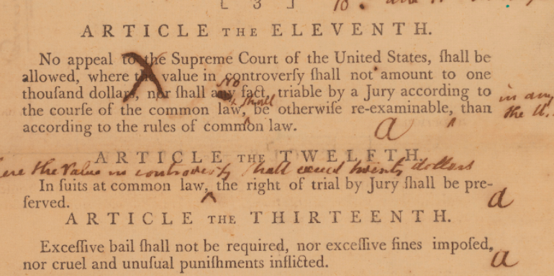
People must be protected from abuses of the legal system:
11. The decisions of local juries must be respected. (In a big country, one must be protected against retrial in a distant court.)
12. The right to a jury trial in a civil case must be guaranteed.
13. No excessive bail or fines; no cruel or unusual punishment.

Slide 29
This is a Federalist idea:
a. This amendment was not proposed by a state ratifying convention
b. James Madison introduced it to give the Federal government veto power over actions by the states.

Slide 30
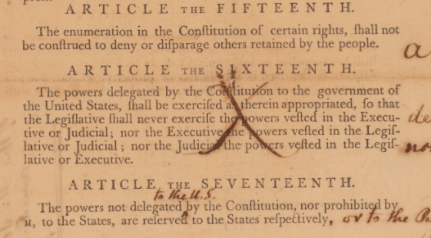
Proposed amendments 15 – 17 regulate balances of power within the federal government and between it and the states.
15. The People invested some of their natural rights in the government, but they retained the rest.
16. The branches of government shall exercise constitutional powers as they were granted.
17. The powers not delegated to the Federal government nor prohibited from the states are reserved to the states.

Slide 31
How does the Content of the Senate Markup of the Bill of Rights Reflect Negotiation?

Slide 32
Congress Creates the Bill of Rights
Close-up on Compromise:
See a step-by-step analysis of how Congress shaped the First Amendment

Slide 33
Articles 3 and 4 were reshaped in the congressional debate.
How do various changes provide insight into the discussion of the five rights protected in today’s First Amendment?
What hooks are there in this text to engage students in a discussion of these rights?

Slide 34
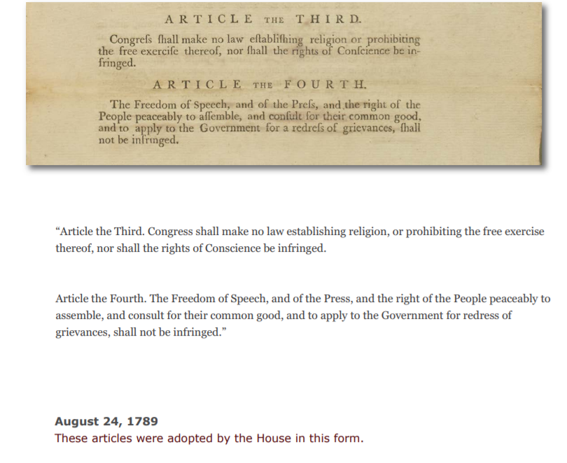
Illustration from
Digital App
Congress Creates the
Bill of Rights
Archives.gov/legislative

Slide 35
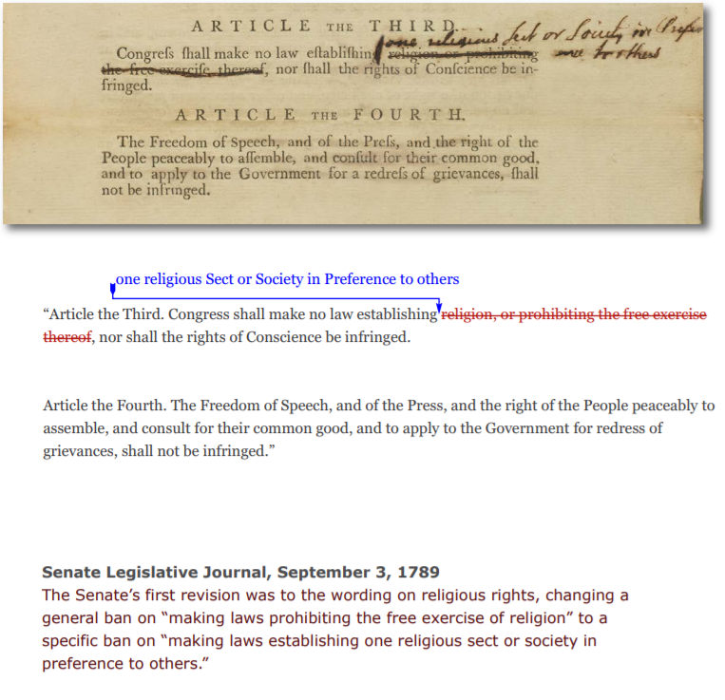

Slide 36
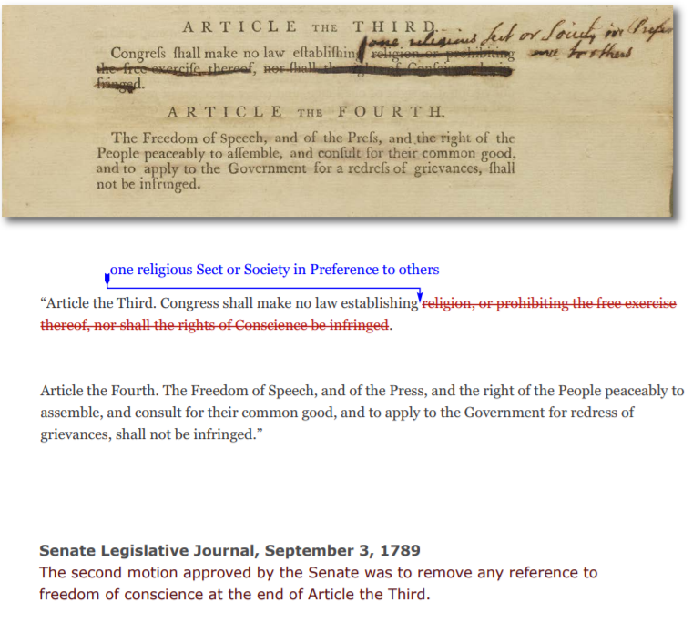

Slide 37
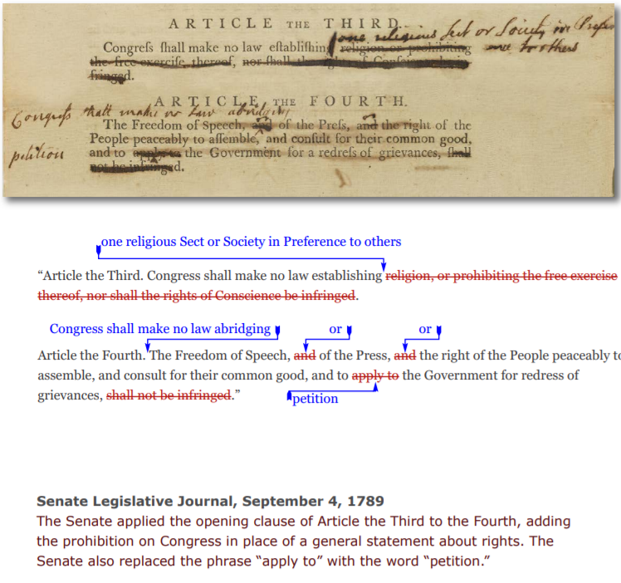

Slide 40
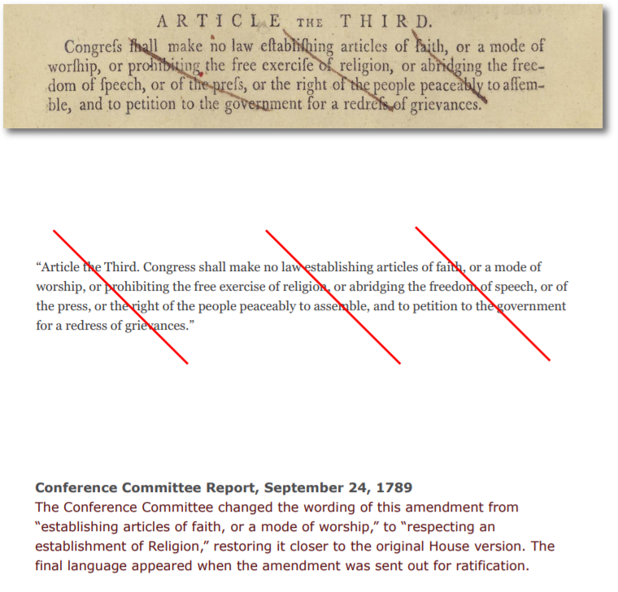

Slide 41
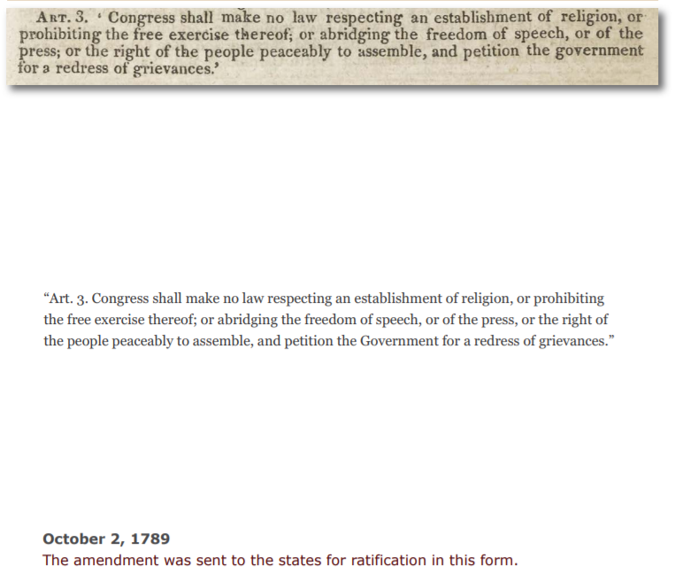

Slide 42
Two Lessons based on the Senate Markup of the Bill of Rights
Congress Creates the Bill of Rights: Completing the Constitution
https://www.archives.gov/legislative/resources/congress-creates-bor
The Bill of Rights: Inside the Debate about Rights and the Limits of Government Power
https://www.archives.gov/legislative/resources/education/inside-first-congress

Slide 43
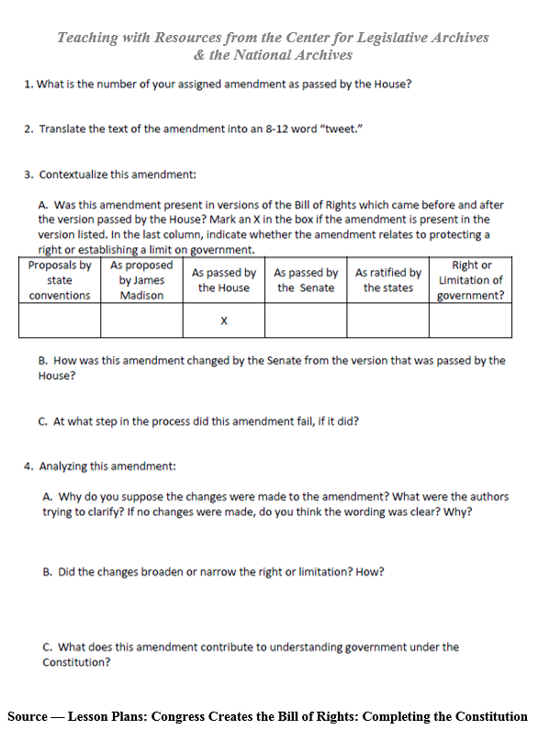
Congress Creates the Bill of Rights: Completing the Constitution
www.archives.gov/legislative/resources/congress-creates-bor

Slide 44
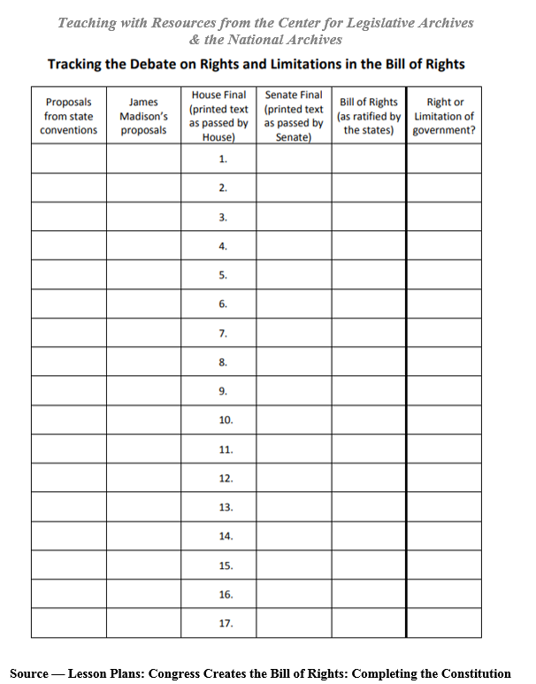

Slide 45
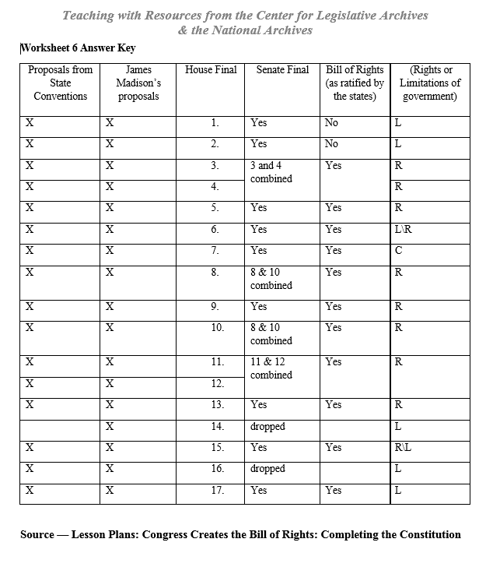

Slide 46
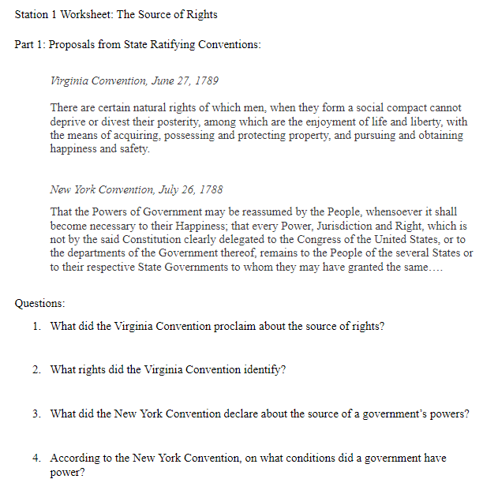
The Bill of Rights: Inside the Debate about Rights and the Limits of Government Power

Slide 47
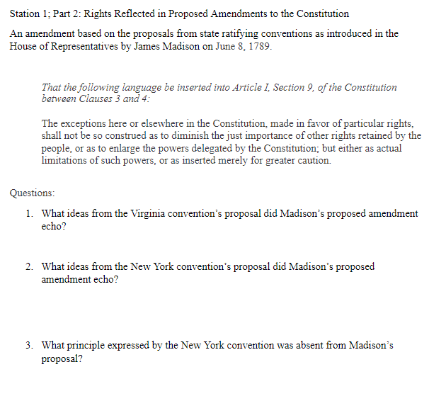

Slide 48
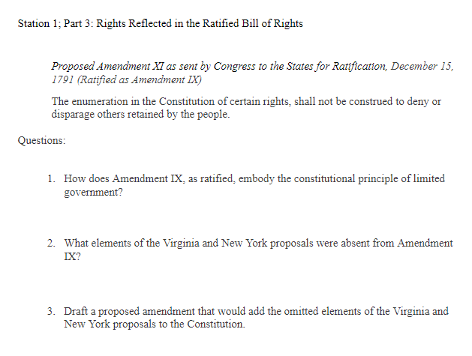

Slide 49
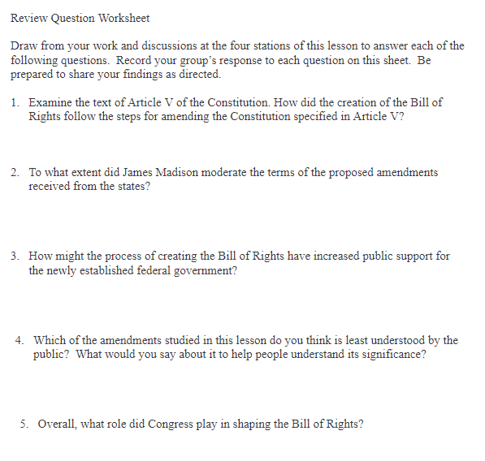

Slide 50
Resources for your students from:
The Center for Legislative Archives
Archives.gov/legislative

