Slide 1
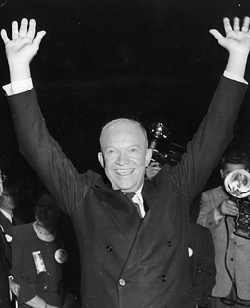
The Eisenhower Presidency
Will Hitchcock
University of Virginia
Humanities Texas 2/9/2021

Slide 2
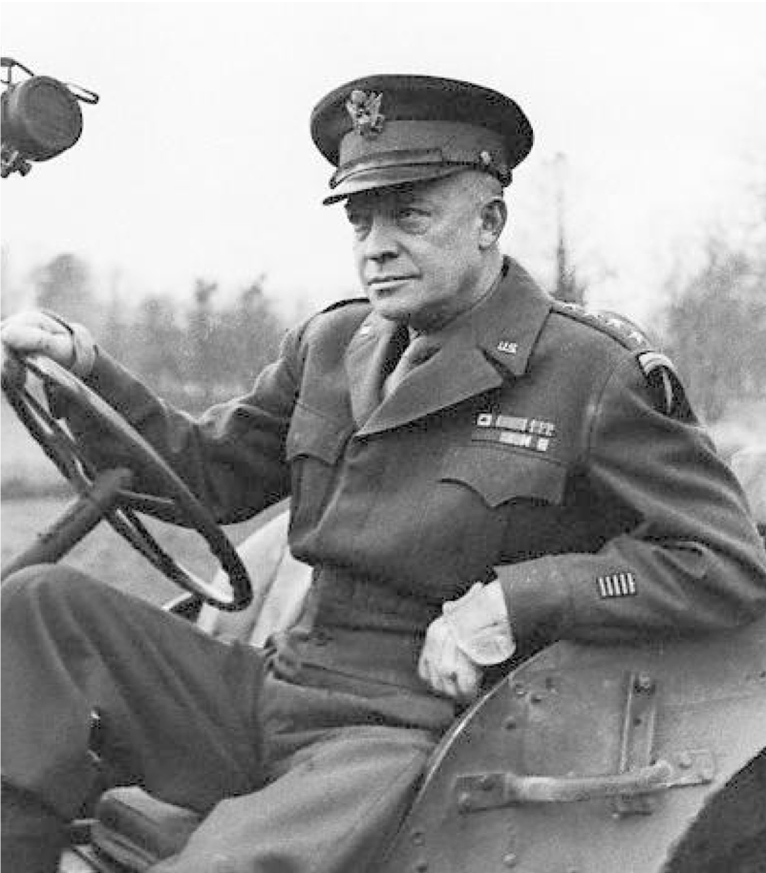
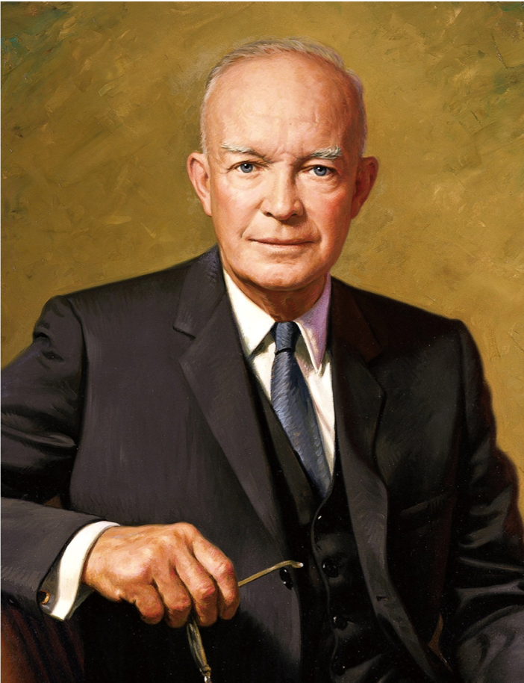

Slide 3
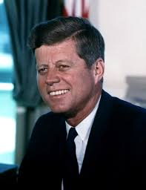

Slide 5
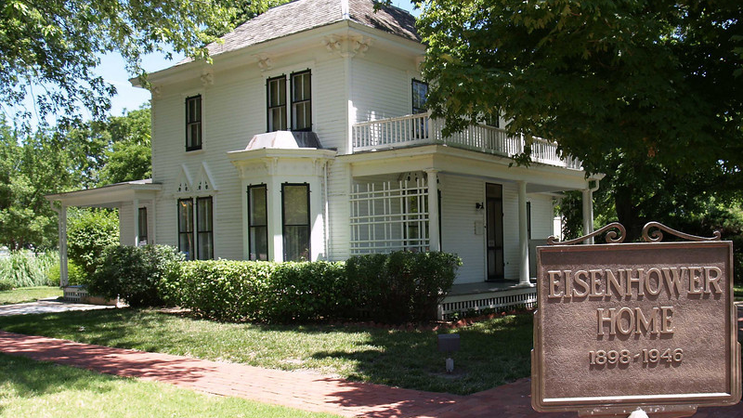

Slide 7
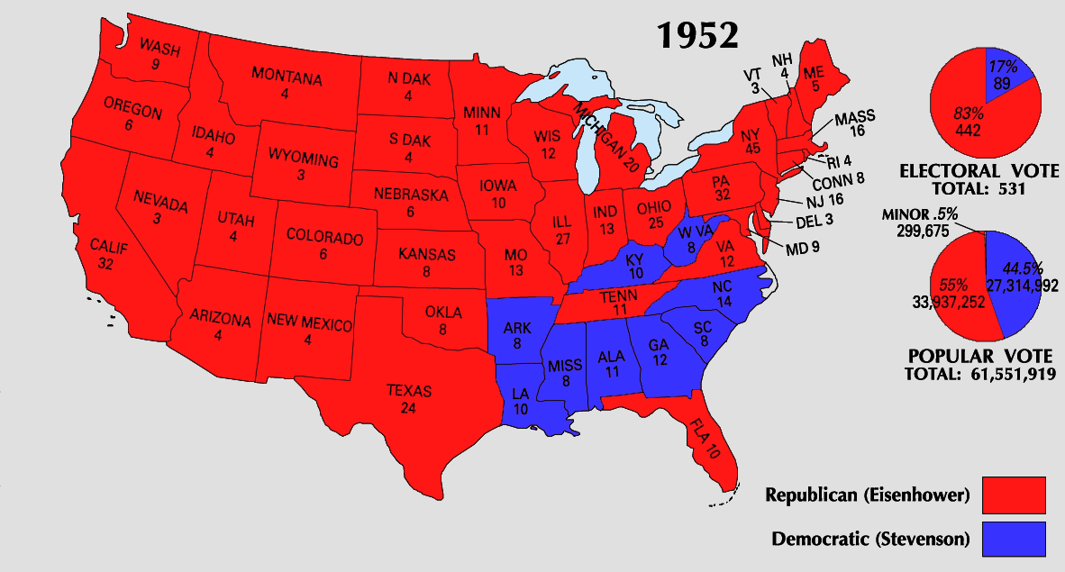
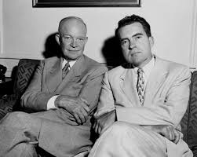

Slide 8
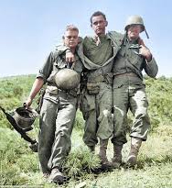
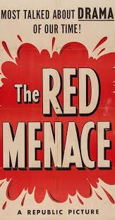
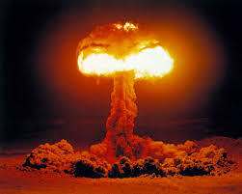
1. The Shadow of War
Korean War (1950-53)
The atomic bomb
Communism and the ‘internal enemy”

Slide 9
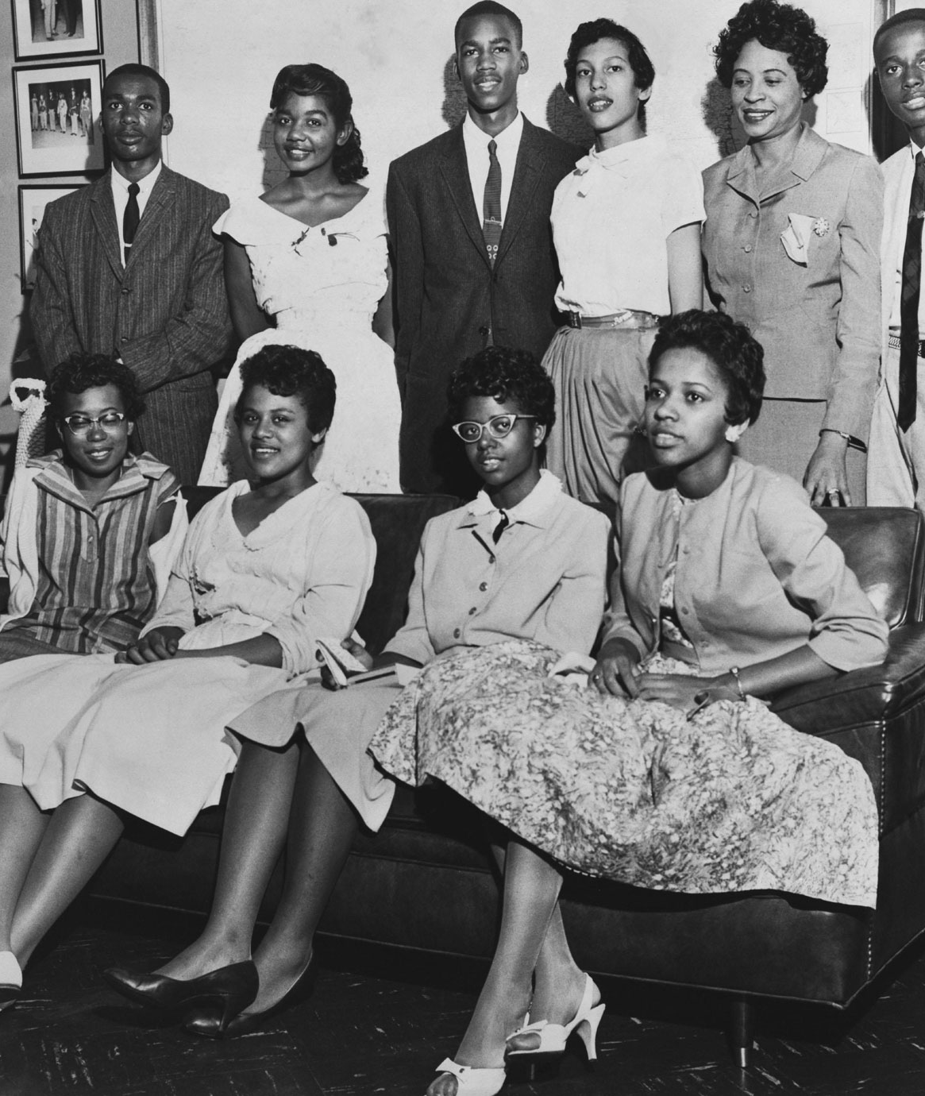
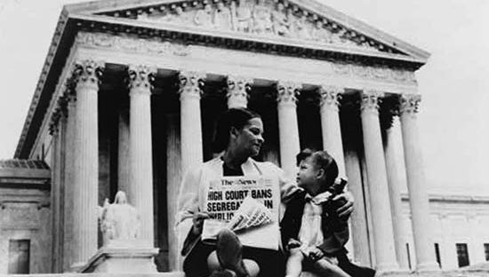
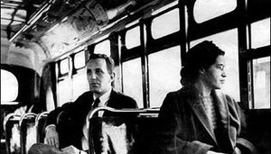
2. The Struggle for Racial Equality
Jim Crow
Brown v. Board of Education (1954)
Montgomery Bus Boycott (1955)
Little Rock 9 (1957)

Slide 10
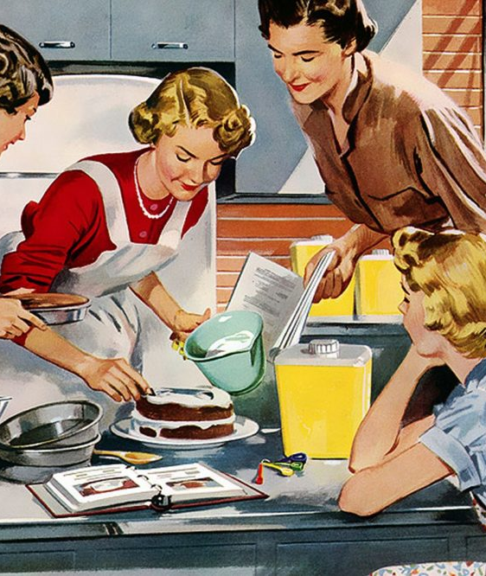
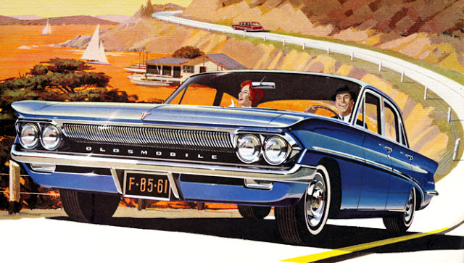
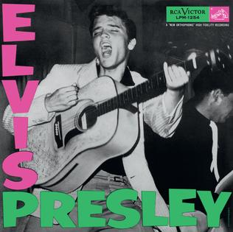
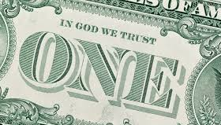
3. “The American Way of Life”
Television
Travel by car
Popular music
The nuclear family
Religion

Slide 11
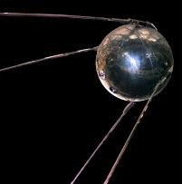
4. Space and Technology
The Sputnik “crisis” 1957
The Missile age
Science Education
NASA, 1958
Wernher von Braun

Slide 12
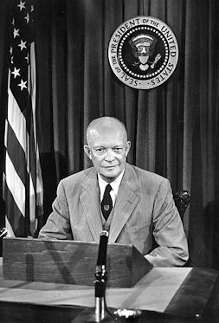
Conclusion: what is the “military-industrial complex”?
January 17, 1961.
What does Ike say about US democracy?
What does he say about the Cold War struggle?
What worries him about the “military-industrial complex”?
Didn’t he sort of create it? Is there some tension here?
Why does he use the word “balance” often?
Is this speech inspiring or frightening?

