Slide 1
The First Texans, Precontact through 1793
Humanities Texas Webinar Series
September 2021

Slide 2
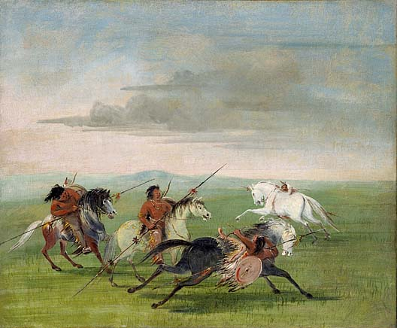

Slide 3
Essential Question #1:
How did the geography of Texas shape the movement and development of American Indian groups in Texas?
And why did that matter when the Spanish arrived?

Slide 4
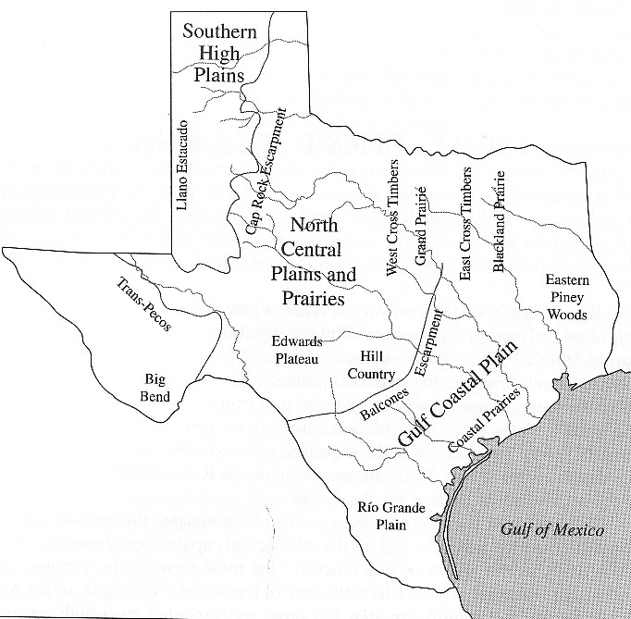

Slide 5
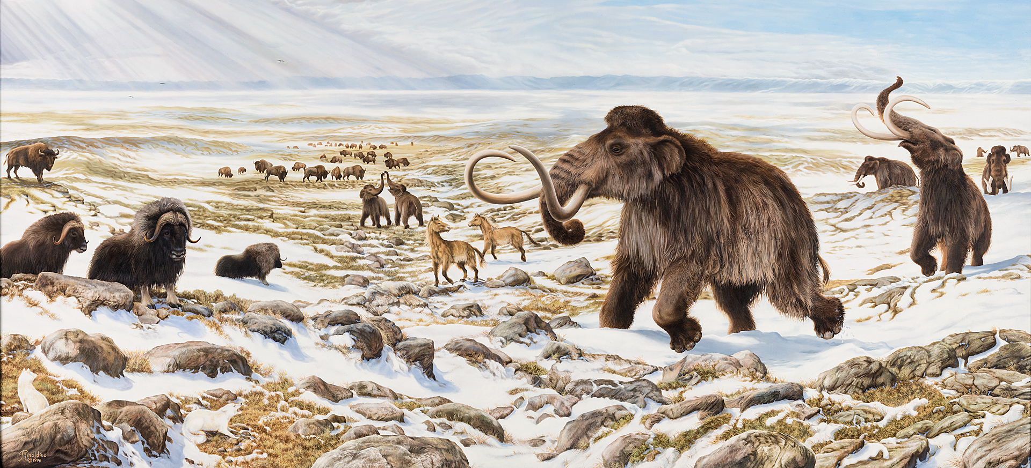

Slide 6
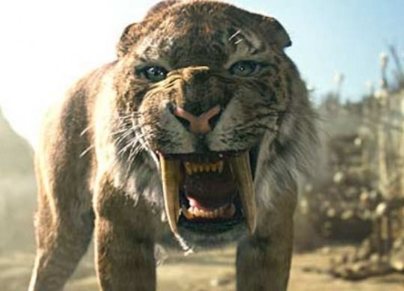

Slide 7
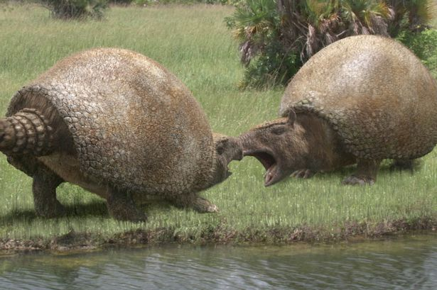

Slide 8
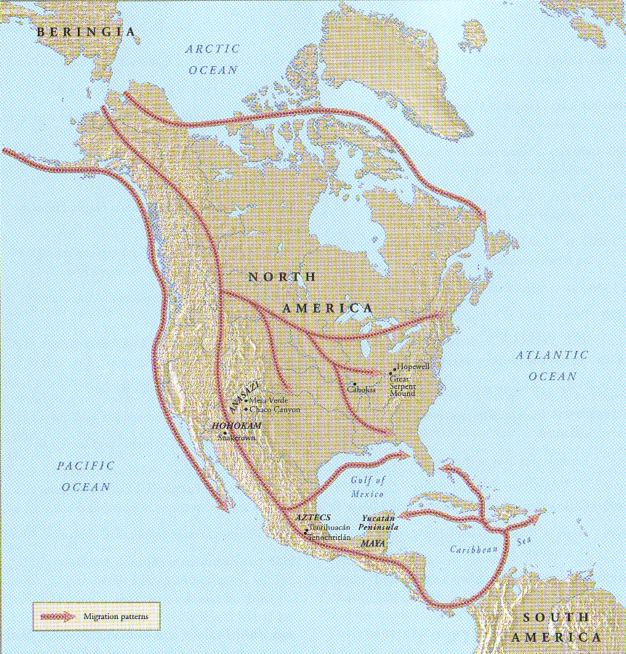

Slide 10
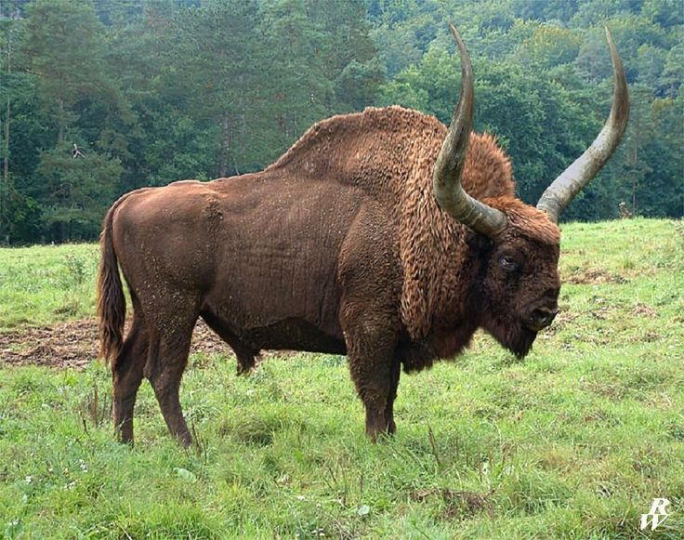

Slide 11
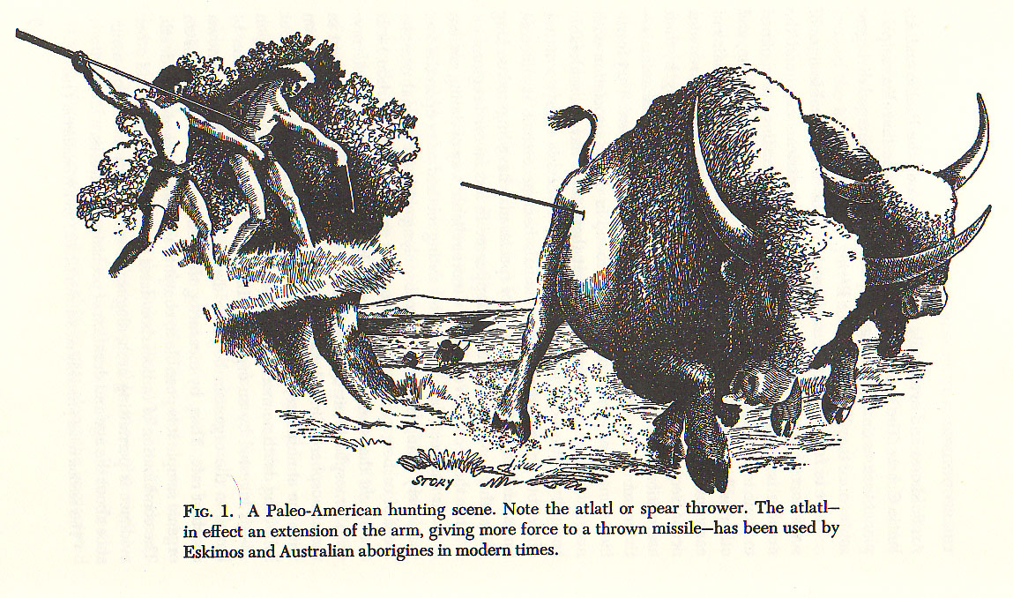

Slide 13
Challenges for American Indians in Texas:

Slide 14
Challenges for American Indians in Texas:
Giant bison began dying out around 8,000 to 9,000 years ago.

Slide 15
Challenges for American Indians in Texas:
Giant bison began dying out around 8,000 to 9,000 years ago.
A terrible drought hit Texas about 7,000 years ago and persisted on and off for about 4,000 years.

Slide 17
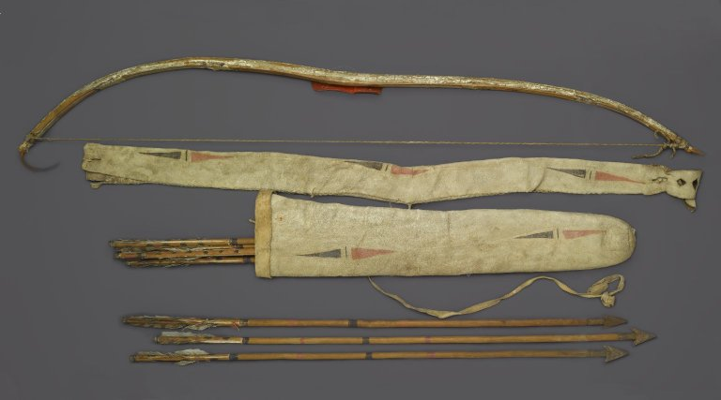

Slide 18
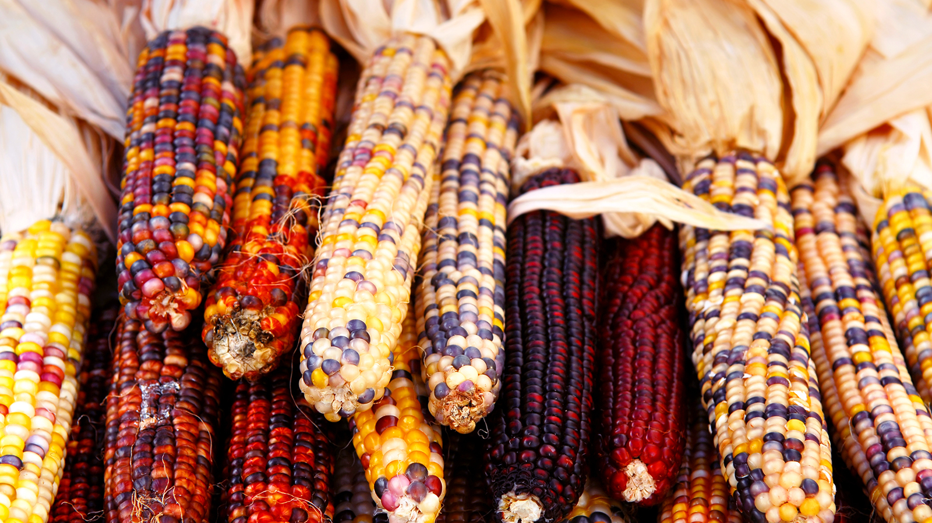

Slide 19
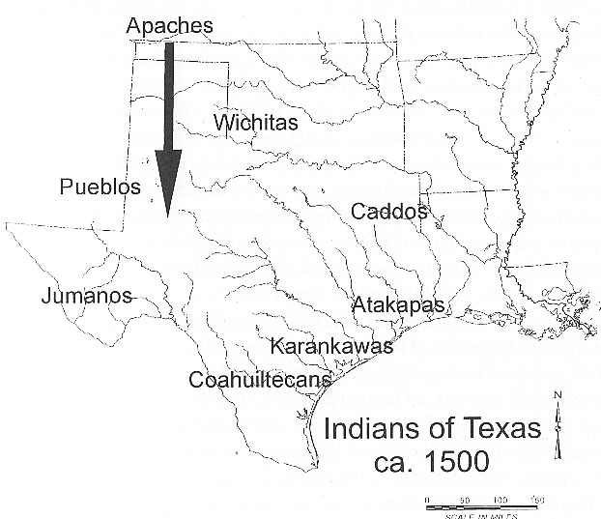

Slide 20
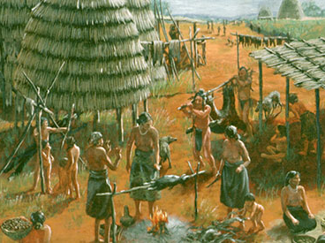

Slide 22
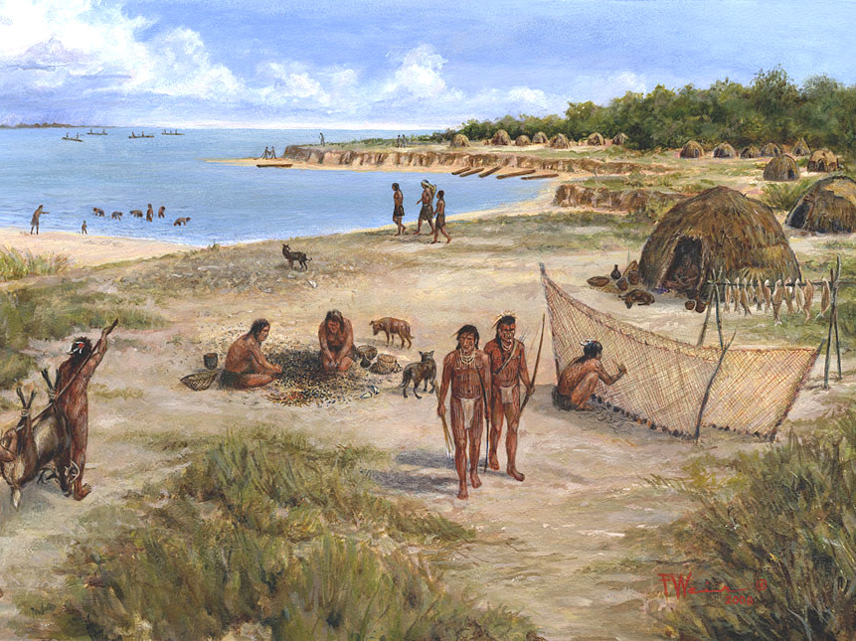

Slide 24
Which major Indian group is NOT in Texas by 1500?

Slide 26
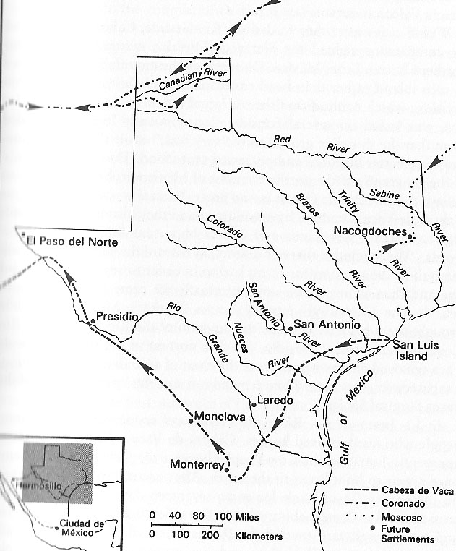

Slide 27
What were the major results of this early period of Spanish exploration?

Slide 29
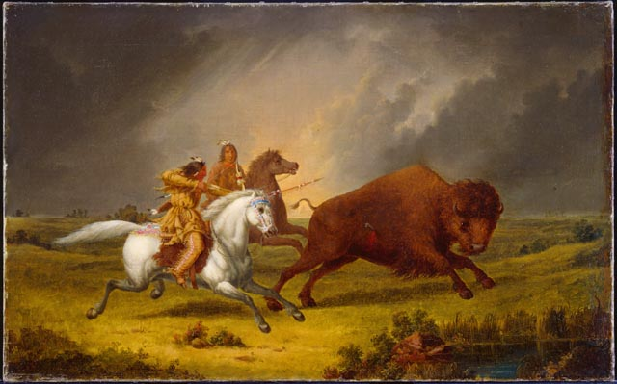

Slide 30
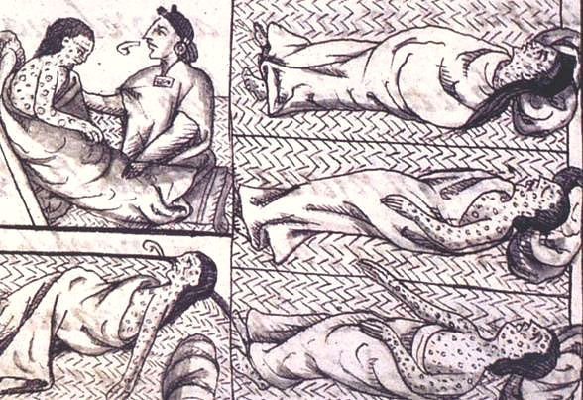

Slide 31
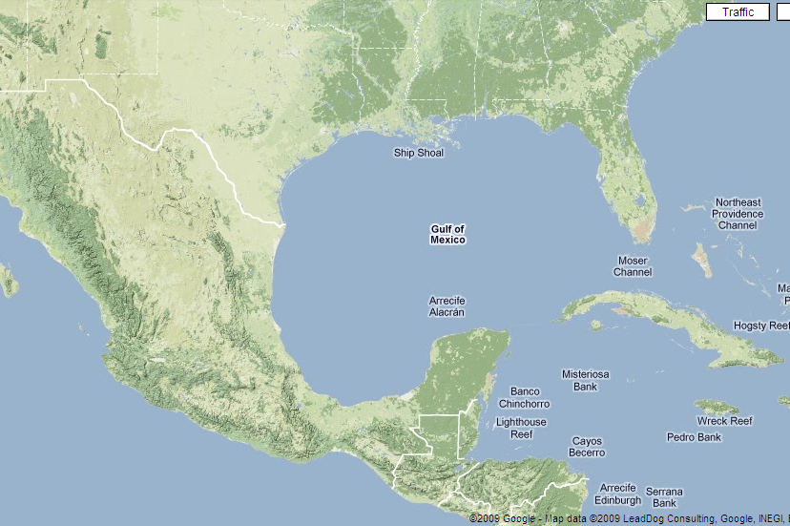

Slide 32
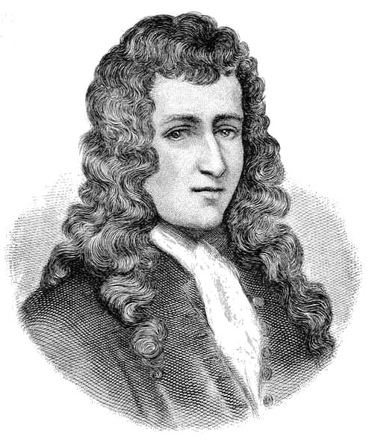

Slide 33
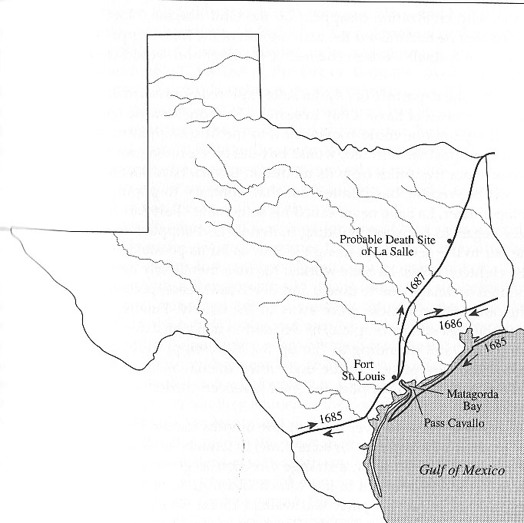

Slide 34
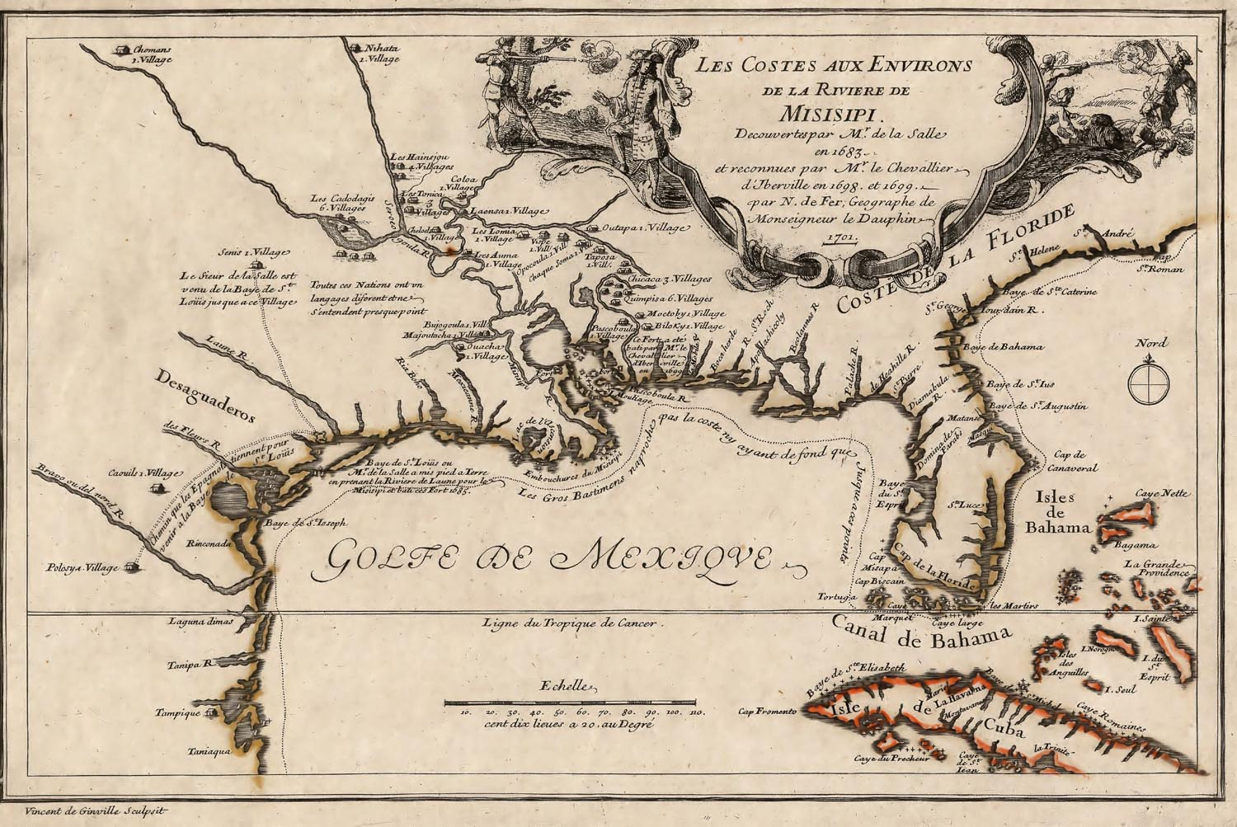

Slide 36
Essential Question #2:
Why did the mission system fail so spectacularly for the Spanish?
And why did the Spanish continue to use missions for more than a century?

Slide 38
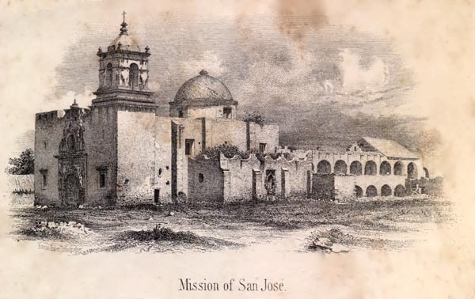

Slide 39
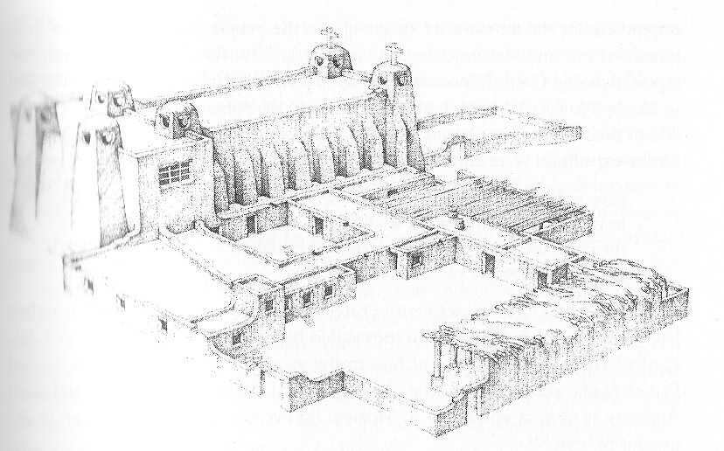

Slide 41
Attempts in 1690-1693

Slide 43
Attempts in 1716-1722

Slide 44
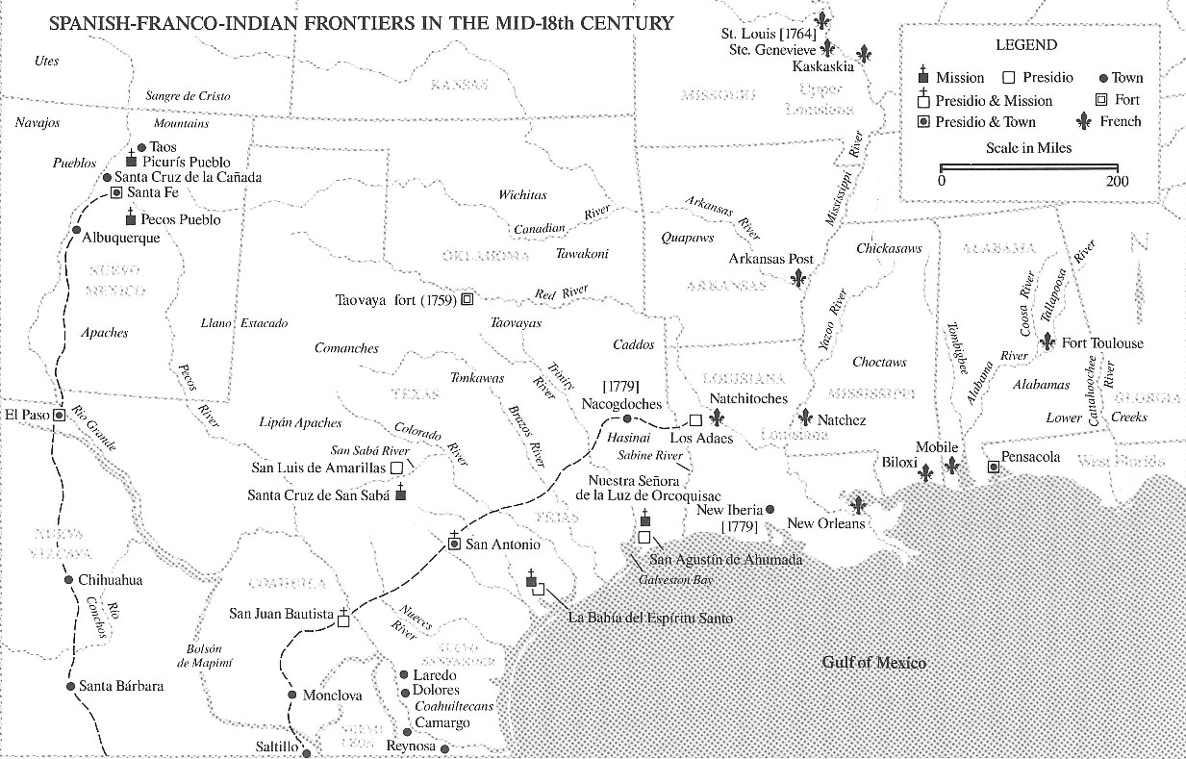

Slide 45
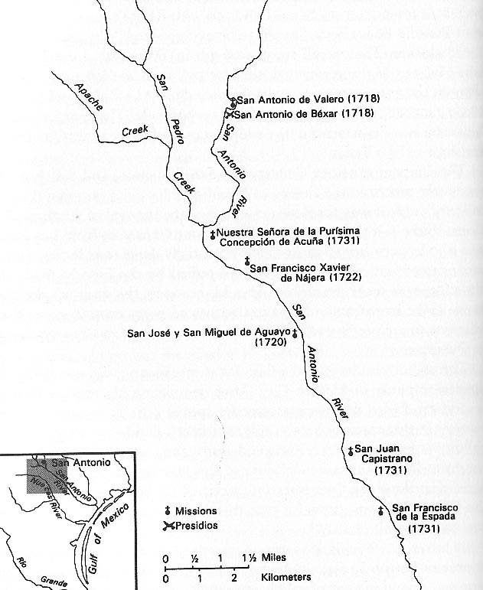

Slide 48
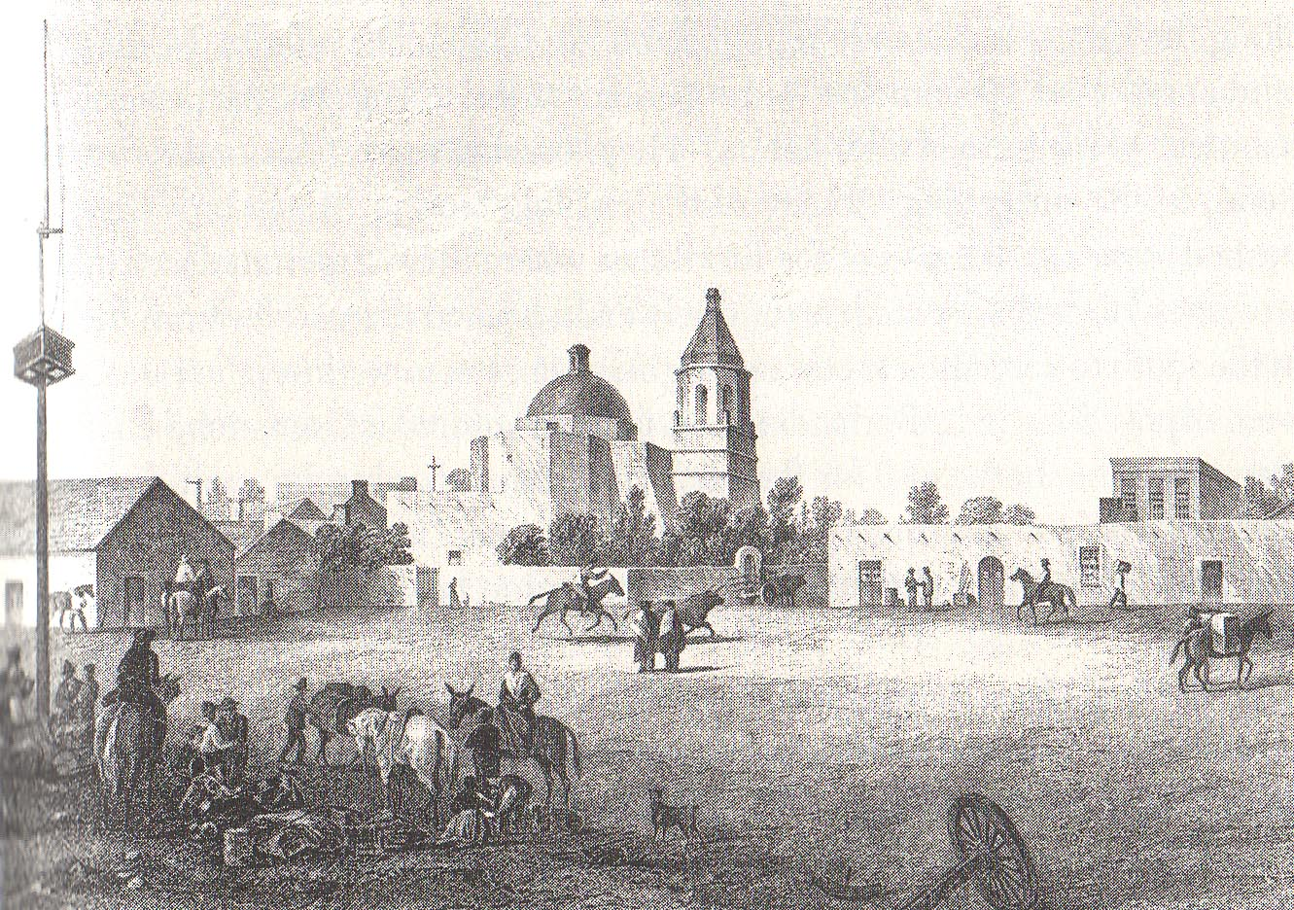

Slide 50
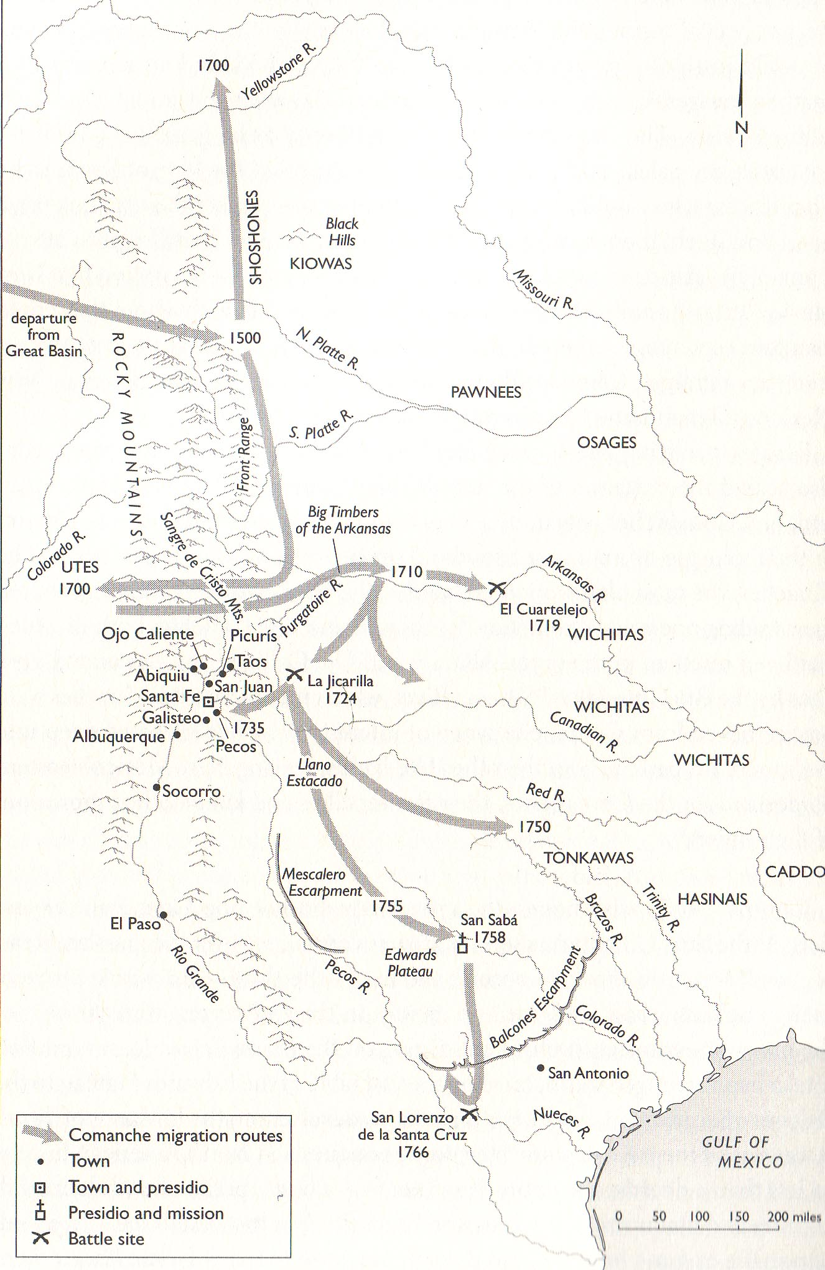

Slide 51
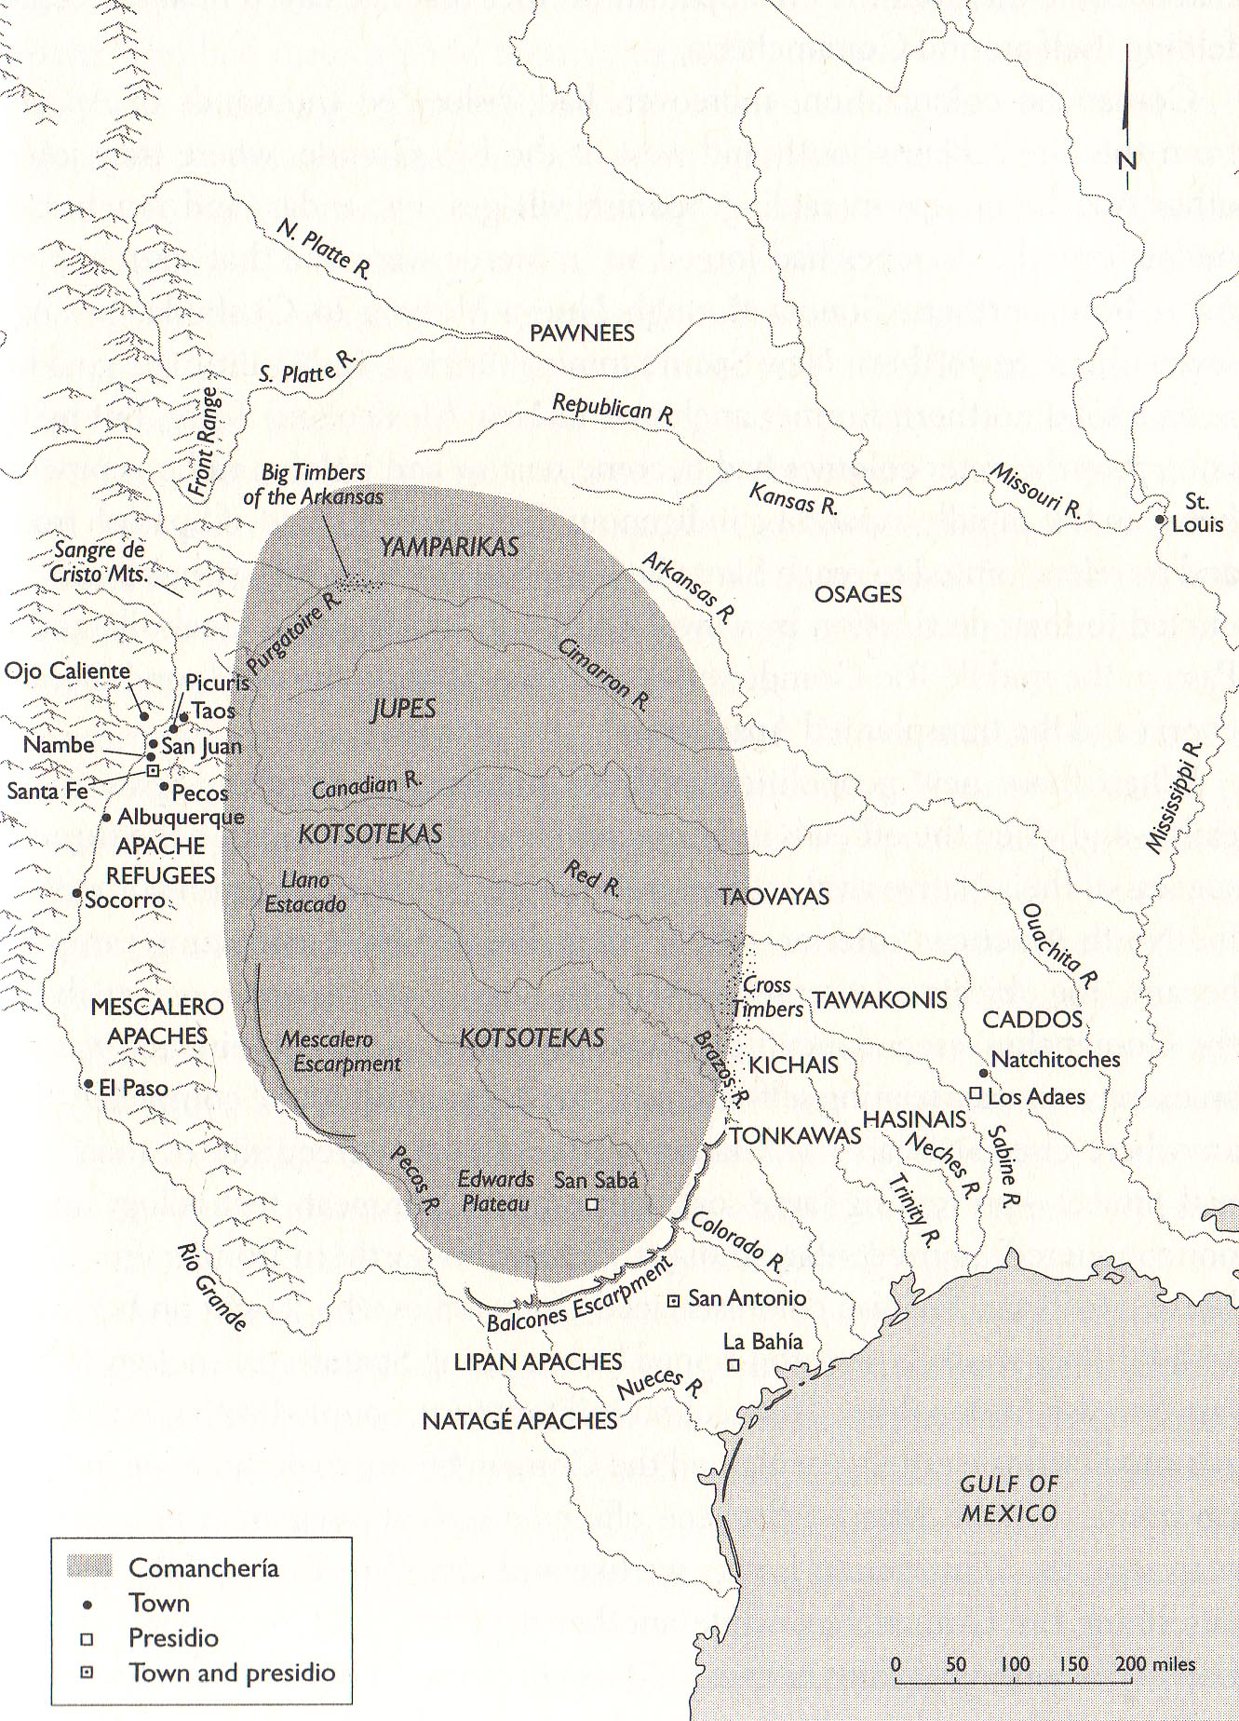

Slide 52
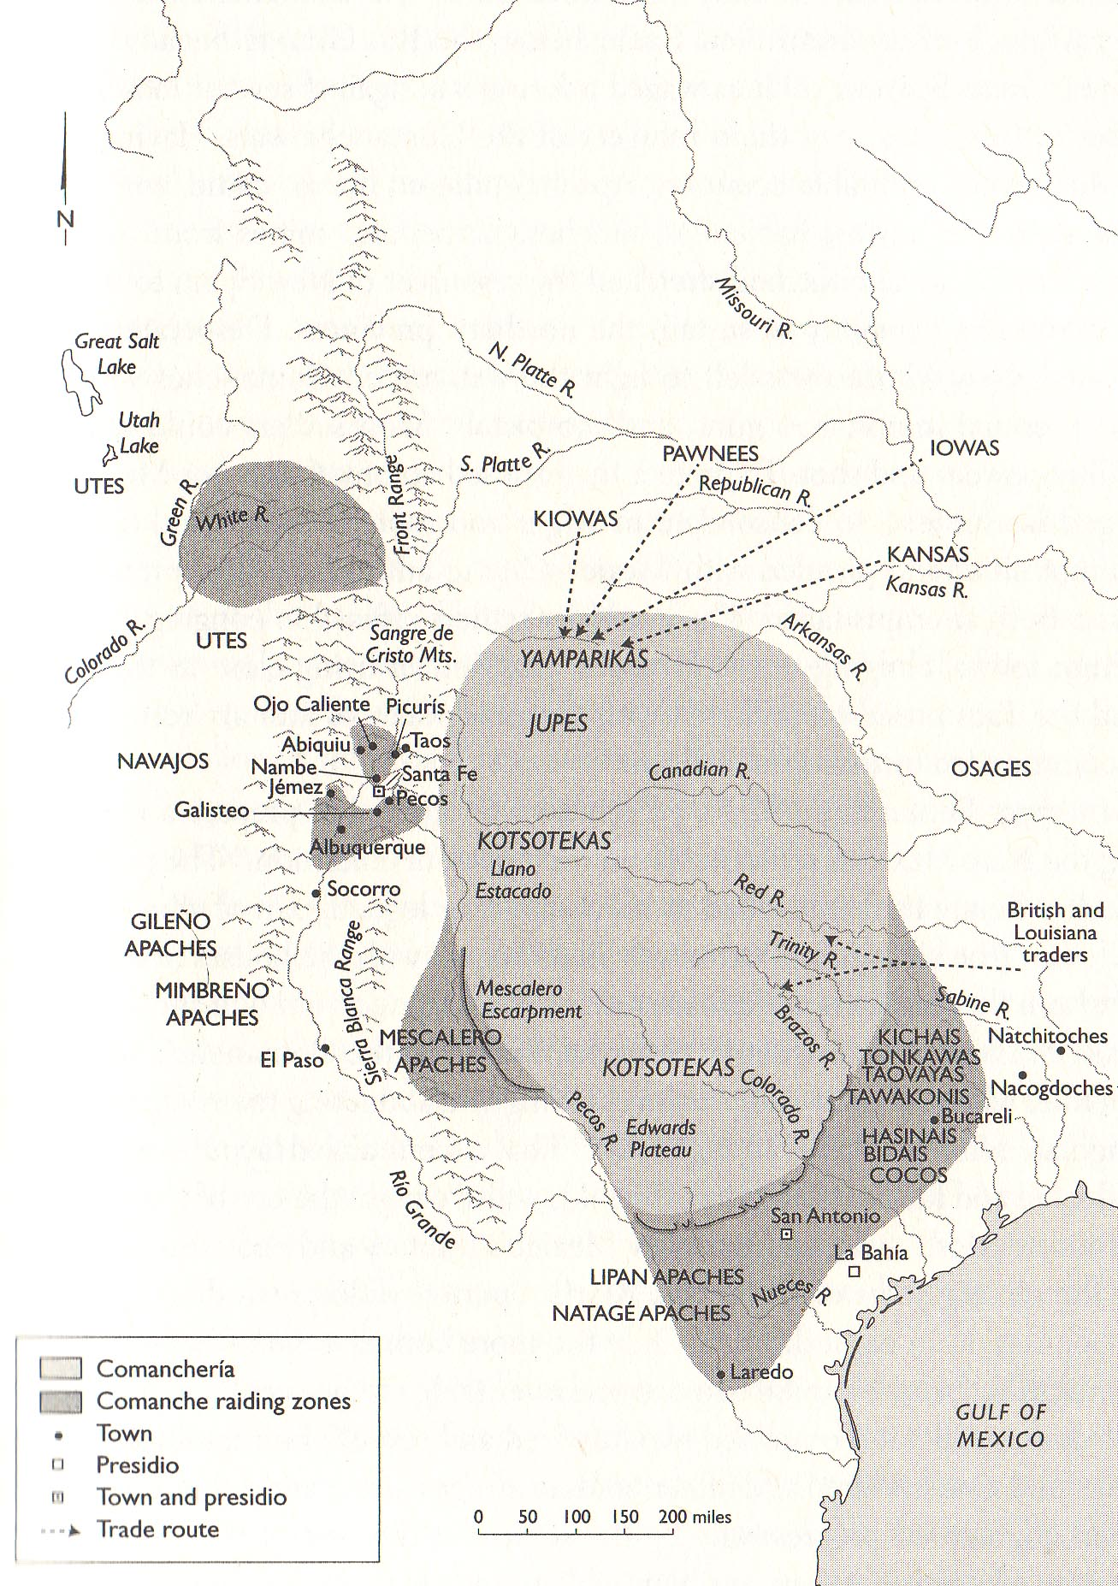

Slide 53
So . . .

Slide 54
So . . .
Comanches and Apaches are running roughshod over the Spaniards.

Slide 55
So . . .
Comanches and Apaches are running roughshod over the Spaniards.
None of the missions are really working.

Slide 56
So . . .
Comanches and Apaches are running roughshod over the Spaniards.
None of the missions are really working.
What’s the next step for the Spaniards?

Slide 57
BUILD MORE MISSIONS!

Slide 58
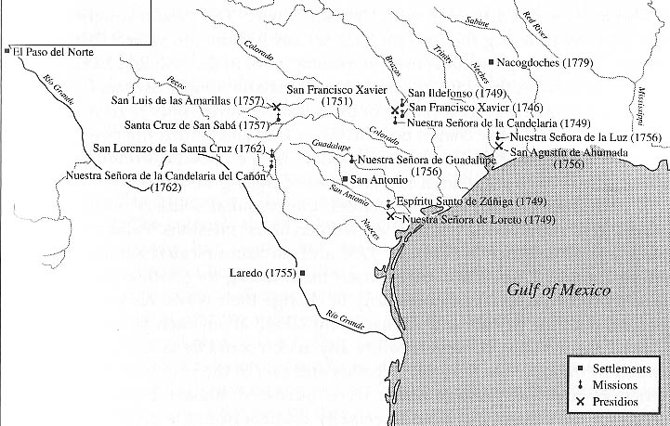

Slide 60
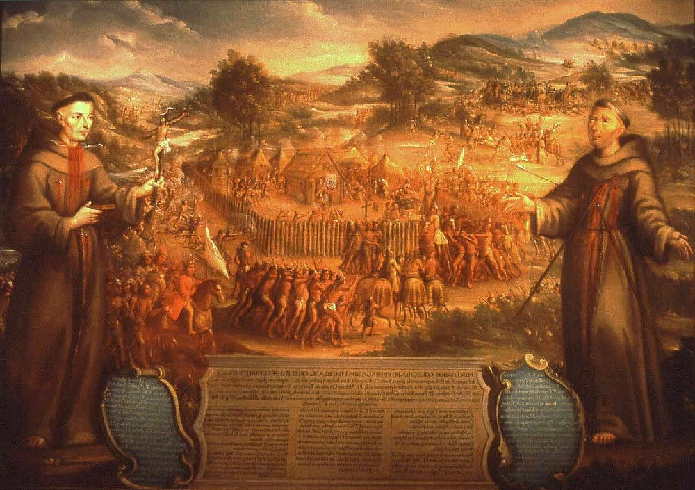

Slide 62
