Slide 1
The Vietnam War
Lien-Hang T. Nguyen
The Making of Modern America
Humanities Texas Spring Webinar Series
23 March 2021

Slide 2
Teaching the Vietnam War
What do we call the war?
Who made the decisions to go to war and why?
When did the war begin and end, and what are the turning points?
How did the war end?

Slide 3
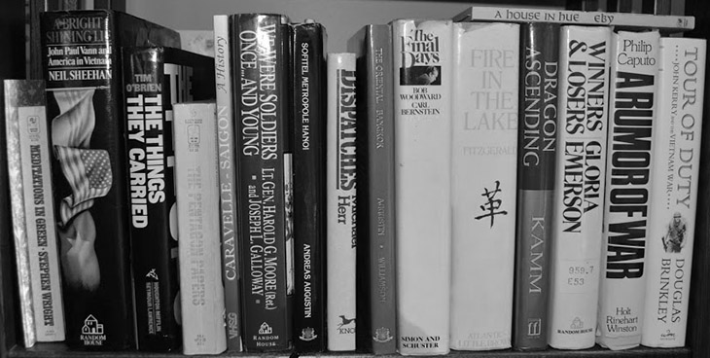
What’s in a name?
The Vietnam War
Second Indochina War
The Vietnamese War
Anti-American Liberation Struggle for Reunification and National Salvation

Slide 4
The Combatants
Democratic Republic of Vietnam (DRV)
United States
National Liberation Front (NLF)/Provisional Revolutionary Government (PRG) of South Vietnam
Republic of Vietnam (RVN)

Slide 5
U.S. Objectives
Containment: Preserve a non-communist government in South Vietnam
Credibility: Not be president to “lose Vietnam”
Connection: One crisis in Asia is intimately connected and influences another crisis in Asia
From left to right: JFK; Johnson; Eisenhower; Truman

Slide 6
Vietnamese Objectives
Democratic Republic of Vietnam (DRV)
National Liberation Front (NLF)/Provisional Revolutionary Government (PRG) of South Vietnam
Republic of Vietnam (RVN)

Slide 7
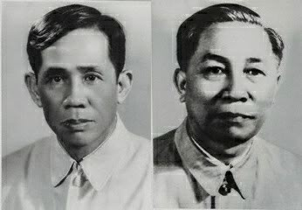
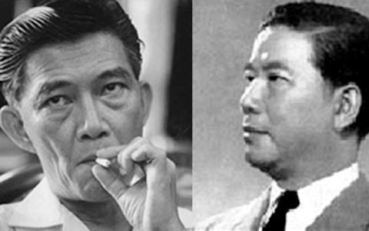
RVN under Ngo Dinh Diem and Ngo Dinh Nhu
DRV under Le Duan and Le Duc Tho
Consolidation of power in authoritarian executive branch
Repression of South Vietnamese society
Sought to annihilate communist insurgency
Consolidation of power in Party apparatchik hands
Repression of North Vietnamese society
Sought to usurp communist insurgency

Slide 8
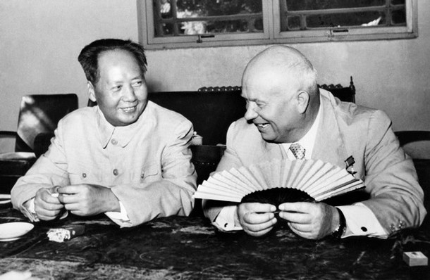
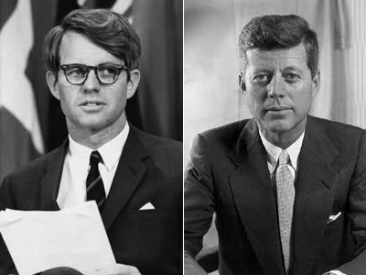
Comrades Lê
Brothers Ngô
International Context Matters:
Importance of Cold War and Sino-Soviet Split in the Vietnam War
Comrades Mao and Khrushchev
Brothers Kennedy

Slide 9
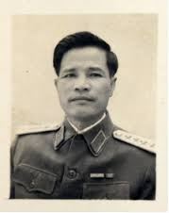
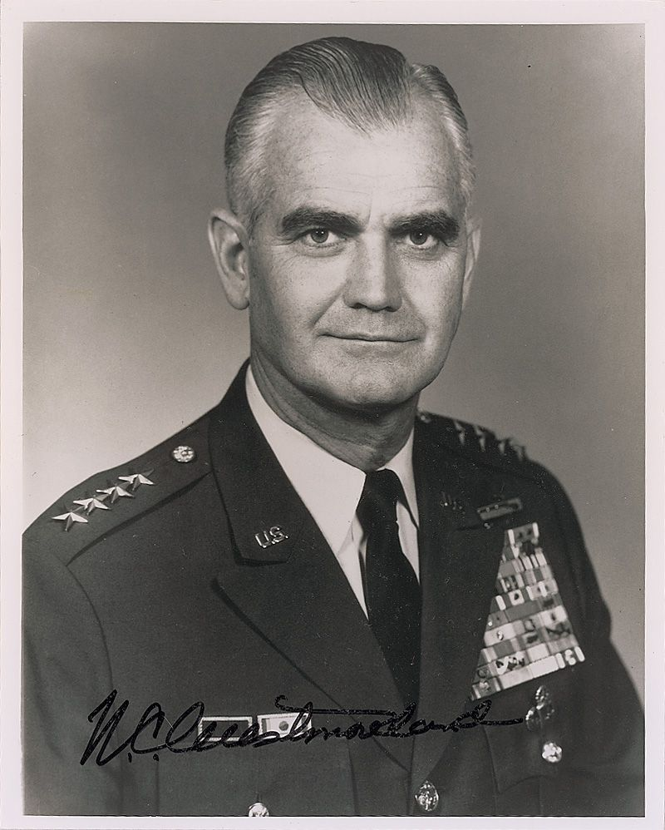
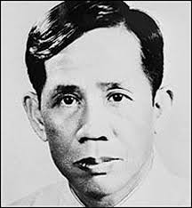
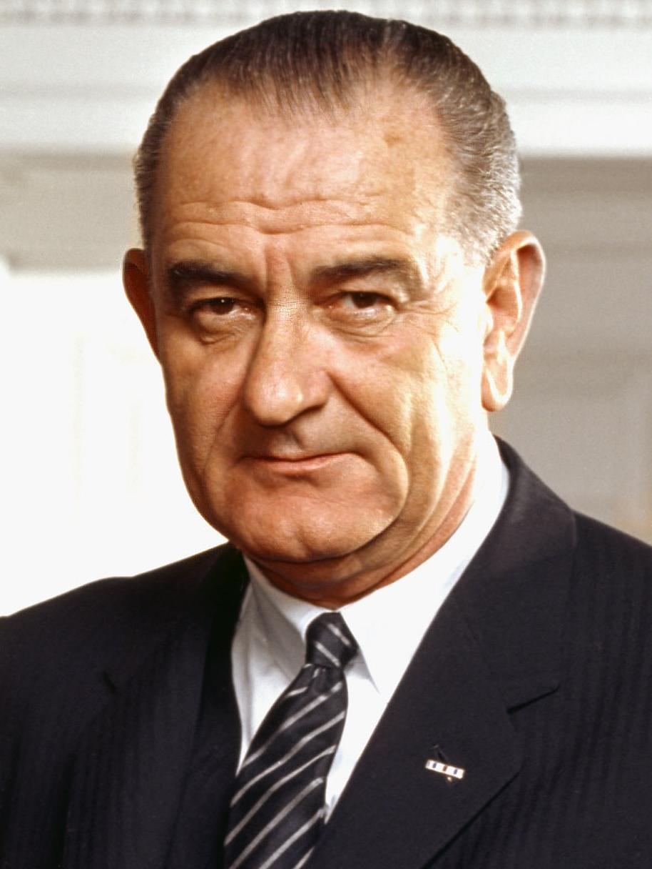
We have to send North Vietnamese boys several hundred miles away to fight a war that South Vietnamese boys aren’t winning themselves
We are not about to send American boys 9 or 10,000 miles away from home to do what Asian boys ought to be doing for themselves
Lê Duẩn
Lyndon B. Johnson
1963 Resolution 9
1964 Gulf of Tonkin Resolution
Full scale southern war vs northern socialist transformation
General Offensive and General Uprising
Tilt toward China
COSVN Commander Nguyen Chi Thanh
Domestic programs vs intervention in Vietnam
Air war: from reprisal strikes to sustained bombing
Fear of Chinese intervention
MACV Commander William Westmoreland

Slide 10
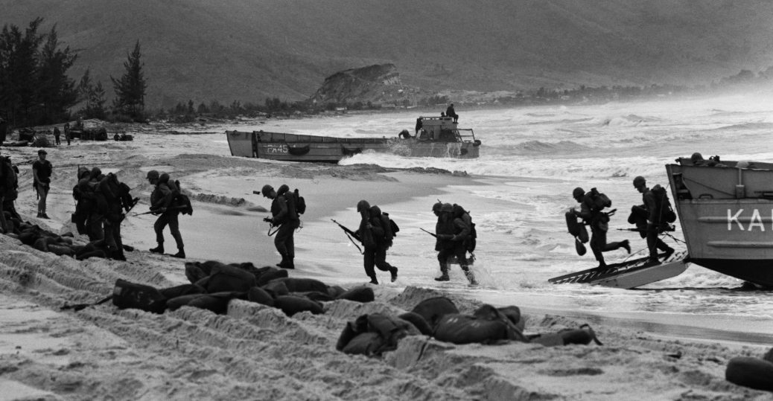
Periodization and Highlights
1954-1959: state- and nation-building
Eisenhower’s decision to replace France at Geneva
Le Duan’s Resolution 15
Diem’s Anti-Communist Campaign

Slide 11
Periodization and Highlights
1954-1959: state- and nation-building
1960-1963: low-level civil conflict
Operation Beef-Up
Assassinations of Ngo Dinh Diem and John F. Kennedy
Le Duan’s Resolution 9 (1963)

Slide 12
Periodization and Highlights
1954-1959: state- and nation-building
1960-1963: low-level civil conflict
1964-1973: internationalization of the war
Gulf of Tonkin Resolution
Operation Rolling Thunder
Introduction of U.S. ground troops
Second Republic of Vietnam
The 1968 Tet Offensive

Slide 13
Periodization and Turning Points
1954-1959: state- and nation-building
1960-1963: low-level civil conflict
1964-1973: internationalization of the war
Post-Tet strategies of Richard Nixon; Le Duan; Nguyen Van Thieu
Sino-Soviet border clashes
Expansion of wars to Cambodia and Laos
Nixon’s visits to China and the Soviet Union and Easter Offensive
Small power diplomacy at the Paris negotiations
Paris Agreement to End the War and Restore the Peace: Ending #1

Slide 14
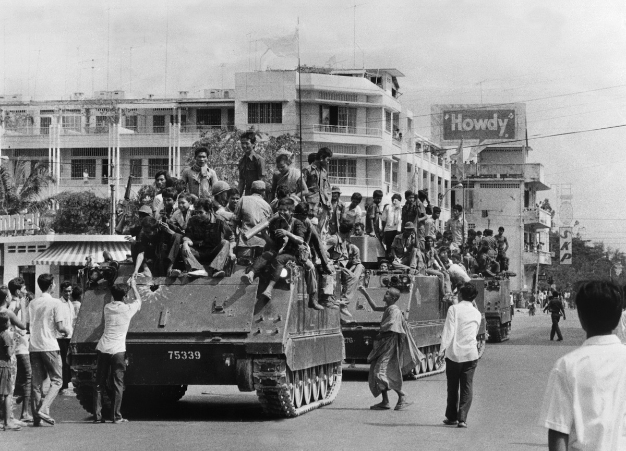
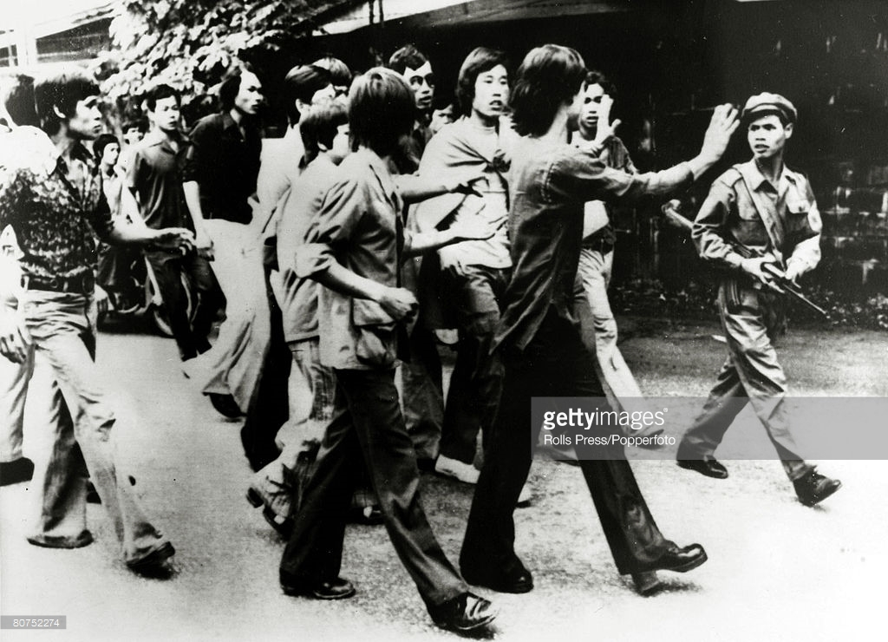
Ending #2
Mid-April 1975: Fall of Phnom Penh
End of April 1975: Fall of Saigon
December 1975: Fall of Vientiane

Slide 15
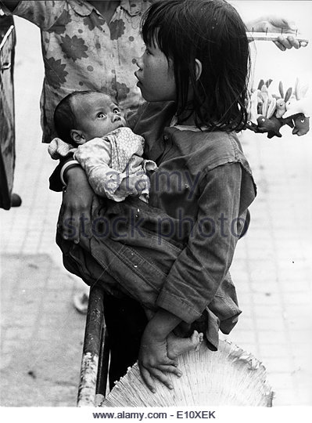
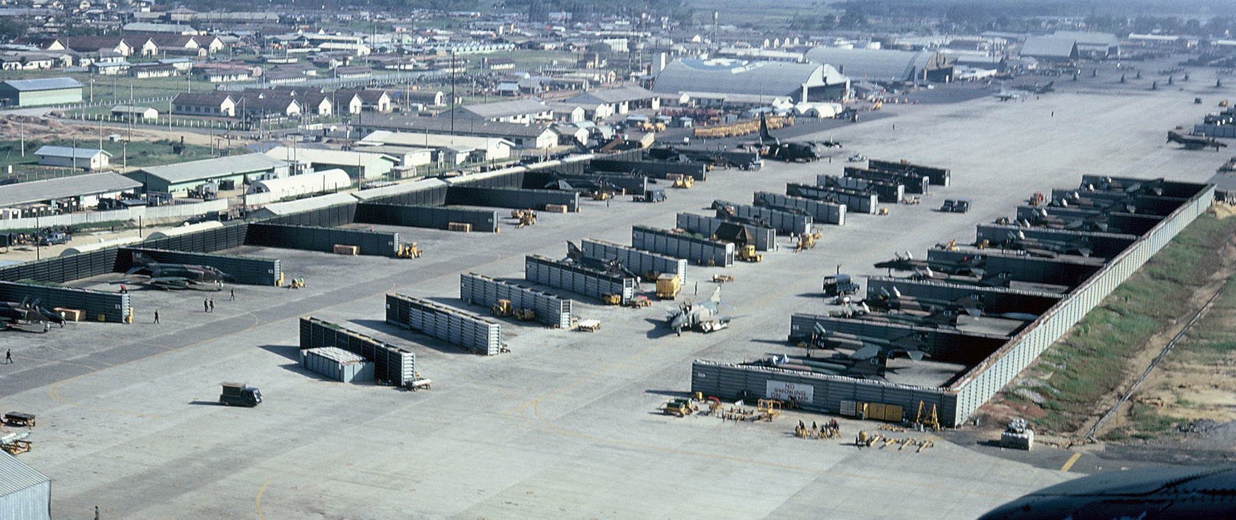
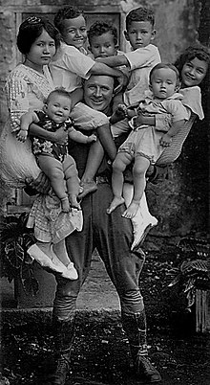
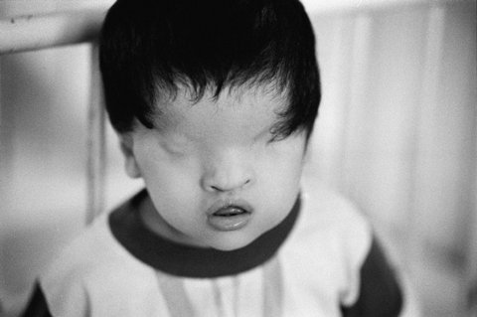
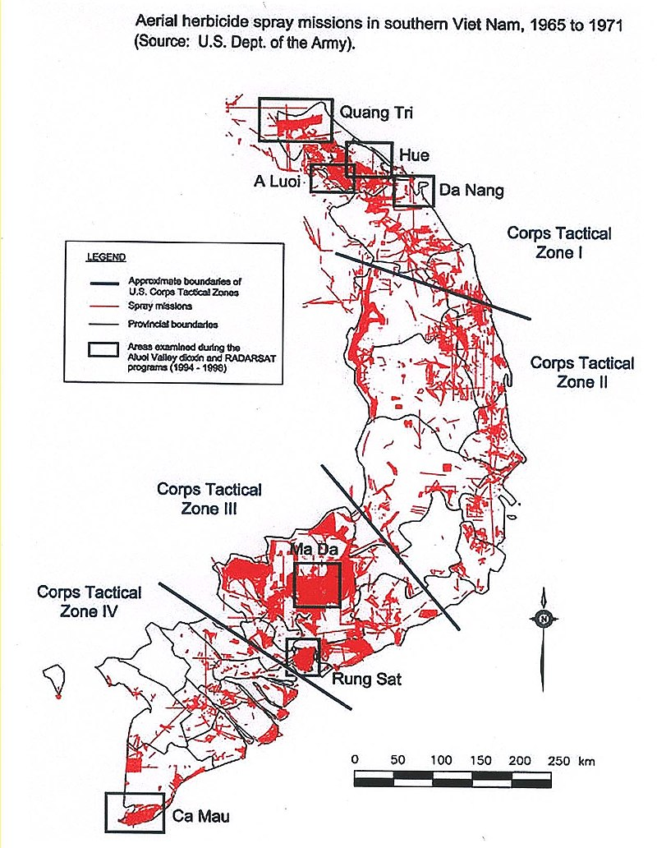
American investment: $110.7 billion in “war costs” with total of $352 billion total
Urbanization and internal displacement: 43% fled to cities by 1975
Countryside: Herbicidal Warfare
Development and modernization
Black market and inflation
Impact on South Vietnamese society: 1million unemployed, 300,000 prostitutes and 800,000 orphans left
“Lost”: Republic of Vietnam

Slide 16
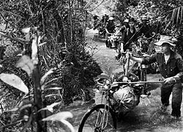
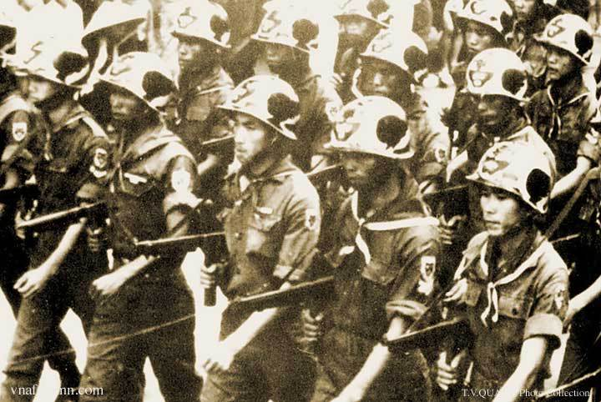
Cambodian Civil War
(1959-1975): 300,000
Vietnamese Civil War
Laotian Civil War
(1953-1975): 62,000
(1965-1975): 3.3 million
Americans deaths account for 1.7%; Vietnamese 98.3%
Bombs Dropped: over 7 million tons total
-Cambodia: 500,000 tons
-North Vietnam: 1 million
-Laos: 2 million
-South Vietnam: 4 million

