Slide 1
Andres Tijerina _______ Tejano Heritage

Slide 2
What is TEXAS HERITAGE?
Fill in the blanks:
_______________
_______________
_______________
_______________
_______________

Slide 3
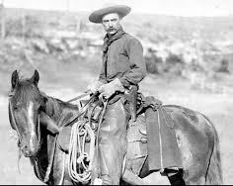
Anglo American Transition
1820
1850

Slide 4
Real Texas Talk
Lasso (rope ?)
Corral (stockade ?)
Ranch (farm ?)
Bronco (colt ?)
Taco (sandwich ?)
Yipee (huzzah ?)
Mustang (wild horse ?)

Slide 5
Tejano Longhorn

Slide 6
Texas Logos

Slide 7
TEKS 113.19. Grade 7
§113.19. Social Studies, Grade 7, Beginning with School Year 2011-2012.
(b) Knowledge and skills.
(1) History. The student understands traditional historical points of reference in Texas history. The student is expected to:
(A) identify the major eras in Texas history, describe their defining
• Spanish Colonial
• Mexican National
(2) History. The student understands how individuals, events, and issues through the Mexican National Era shaped the history of Texas.
(D) identify the individuals, issues, and events
• José Bernardo Gutiérrez de Lara,
• the Battle of Medina,
• the Mexican federal Constitution of 1824, the merger of
• Texas and Coahuila as a state,
• the State Colonization Law of 1825, and slavery;
(E) identify the contributions of significant individuals, including Moses Austin,
• Stephen F. Austin,
• Erasmo Seguín
(F) contrast Spanish, Mexican, and Anglo purposes for and methods of settlement in Texas.
La Reconquista, 711 A.D. - 1492

Slide 8
The Moorish Legacy in Texas
Cattle & horses,
Business Math
Medicine, surgery
Architecture, Moorish arch
Complex wells, music,
Citrus, carrots, alfalfa, watermelon
Almuhada, alfombra, ojalá, acequia, azulejo, azucar, zurco

Slide 9
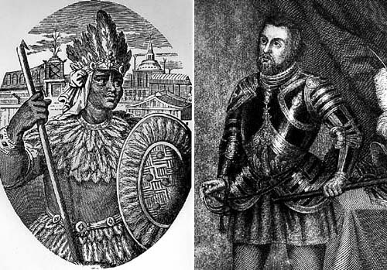
Columbian Exchange (1521) The Two Great Empires Combined

Slide 10
European and Mexican Mestizo
Notes:
§113.50. Ethnic Studies: Mexican American Studies (One Credit). (b) Introduction (5) Throughout social studies in Kindergarten-Grade 12, students build a foundation in history; geography; economics; government; citizenship; culture; science, technology, and society; and social studies skills. The content, as appropriate for the grade level or course, enables students to understand the importance of patriotism, function in a free enterprise society, and appreciate the basic democratic values of our state and nation as referenced in the Texas Education Code (TEC), §28.002(h).

Slide 11
Florentine Codex
Mexican Agronomy
Italian tomato
French vanilla
Dutch chocolate
Hawaiian pineapple
Kentucky bean
American pumpkin
Indian corn
Irish potato
Fr. Bernardino de Sahagún
Notes:
§113.19. Social Studies, Grade 7, Beginning with School Year 2011-2012.
(b) Knowledge and skills.
(13) Economics. The student understands the interdependence of the Texas economy with the United States and the world. The student is expected to:
(A) analyze the impact of national and international markets and events on the production of goods and services in Texas such as agriculture

Slide 12
Spanish Settlements in N. Amer.
Alonzo de Leon
200 cattle, 400 horses, 150 mules
Tejano Longhorn
Béxar - Martin de Alarcon 1718
Nacogdoches(1716)
Texas to California

Slide 13
San Antonio de Bexar
1718 Martin de Alarcon Expedition
Fr. Antonio de San Buenaventura y Oilvares left Sn. Fran. Solano
founded Valero for viceroy, Marques de Valero
Mission San Francisco Solano, 1700

Slide 14
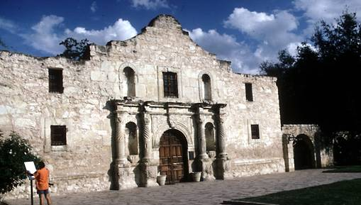
Valero, 1718
San José, Concepcion, Espada, La Bahia

Slide 15
Missions of Texas

Slide 16
Jose de Escandon, 1749
Laredo, Mier, Camargo, Guerrero, Reynosa

Slide 17
Cattle Kingdom
5 mil. longhorns by 1865
Villas del Norte
branding, open range, rodeo, roundup
Family, religion, life/skills

Slide 18
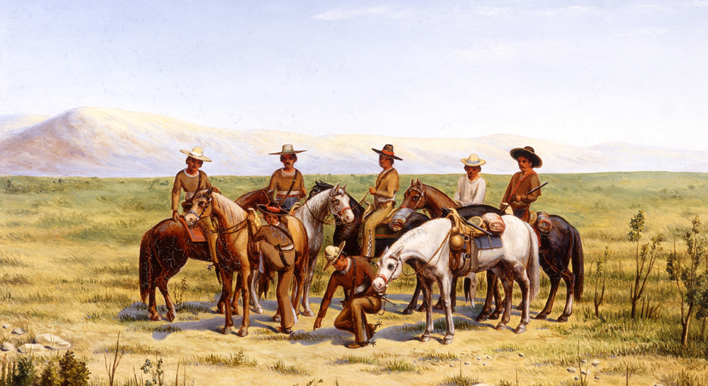
Compañía Volante

Slide 19
Flying Sqdn. features:
caballada, cortadas,
persequir y batir
offensive long-range patrol
local vecinos
deputization
summary justice

Slide 20
Accouterments / weapons

Slide 21
The Tejano Role in Mexican Independence
September 16, 1810
Col. Bernardo Gutierrez de Lara
April 6, 1813 Texas was first Mexican state to declare independence
April 17, First State Constitution

Slide 22
BATTLE OF MEDINA August 18, 1813
Gen. Joaquín de Arredondo
1,830 Spanish Royalist troops
José Bernardo Gutiérrez de Lara
1,400 Anglos, Tejanos, Indians
Less than 100 escaped
Notes:
§113.19. Social Studies, Grade 7, Beginning with School Year 2011-2012.
(b) Knowledge and skills.
(1) History. The student understands traditional historical points of reference in Texas history. The student is expected to:
(A) identify the major eras in Texas history, describe their defining
• Spanish Colonial; Mexican National;
(2) History. The student understands how individuals, events, and issues through the Mexican National Era shaped the history of Texas.
(D) identify the individuals, issues, and events
• José Bernardo Gutiérrez de Lara,
• the Battle of Medina,

Slide 23
Three Global Forces Impact Texas, 1819
Napoleon invaded Spain
Constitution of 1812 led to democratic elections in Texas
Gen. Arredondo pro-colonization
Recommended Moses Austin’s contract to Agustín I
Panic of 1819
Cotton prices collapsed
Southern farmers bankrupt and strapped by debt, fled west

Slide 24
Provincial Deputations

Slide 25
Gov. Agustin Viesca
Constitution of 1824 established Coahuila y Tejas
1825 State Constitution and Colonization Law
Objectives:
Anglo cotton farmers
free enterprise capitalism,
technology
Notes:
§113.50. Ethnic Studies: Mexican American Studies (c) Knowledge and skills. (8) Government. The student understands the significance of political decisions and the struggle for Mexican American political power throughout U.S. history. The student is expected to: (A) describe how Mexican Americans have participated in supporting and changing government;

Slide 26
Tejano Legis. Agenda
“It was the Mexicans of Texas— not the Anglo-Americans —who became the essential powerbrokers in forging political alliances that brought the global cotton market into northern Mexico.”
- Andrew Torget, Seeds of Empire

Slide 27
Saltillo Legislature under Viescas
English as legal language
trial by jury
3 Texas depts. , state representatives
secularized missions and distributed lands
Viescas got repeal of Law of April 6 (May, 1834)

Slide 28
Tejanos in Republic
Declaration of Independence, Republic Congress
Tejanos in Alamo and other battles

Slide 29
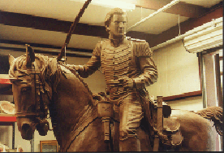
Juan N. Seguin Tejanos in Alamo and Revolution
Notes:
§113.19. Social Studies, Grade 7, Beginning with School Year 2011-2012.
(b) Knowledge and skills.
(3) History. The student understands how individuals, events, and issues related to the Texas Revolution shaped the history of Texas. The student is expected to:
(A) trace the Texas Revolution, including the Mier y Terán Report, the Law of April 6, 1830, the Turtle Bayou Resolutions, and the arrest of Stephen F. Austin;
(B) explain the roles played by significant individuals during the Texas Revolution, including
Lorenzo de Zavala, James Fannin, Sam Houston, Antonio López de Santa Anna, Juan N. Seguín, and William B. Travis;

Slide 30
Land Grants
4,428 Acres - one League
colonists & veterans
Homestead Protection
subsoil minerals; 3 leagues into sea

Slide 31
Water Laws
Irrigation acequias
Doctrine of Prior Appropriation
Pueblo Rights

Slide 32
Tejano Legal Traditions
Land for Education
community property
adoption

Slide 33
Tejano Community

Slide 34
Tejano Monument

Slide 35
TEKS: §113.19. Social Studies,
§113.19. Social Studies, Grade 7, Adopted 2018
(a) Introcuction
(1) In Grade 7, students study the history of Texas from early times to the present. Content is presented
including Natural Texas and its People;
Age of Contact;
Spanish Colonial;
Mexican National;
Revolution and Republic
Students use primary and secondary sources to examine
rich and diverse cultural background of Texas
different racial and ethnic groups that settled in Texas

Slide 36
Sources
Handbook of Texas
Handbook of Tejano History

