Slide 1
Collapse of Spanish Texas, 1800-1820
Andrew J. Torget
University of North Texas
Andrew.Torget@unt.edu

Slide 2
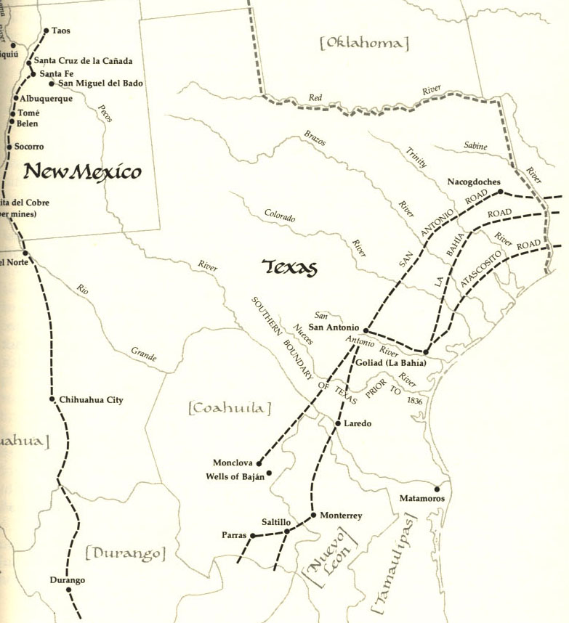

Slide 3
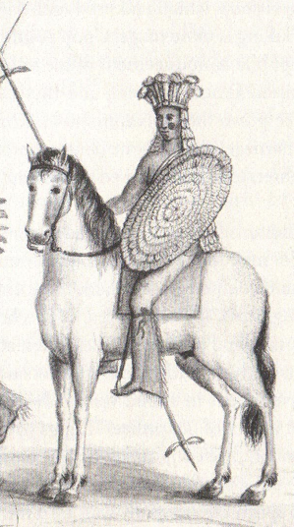

Slide 4
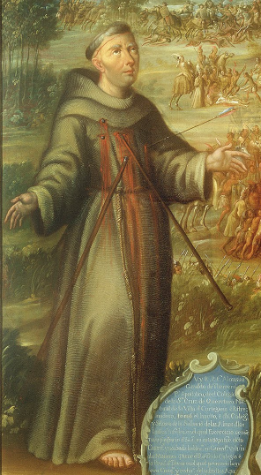

Slide 5
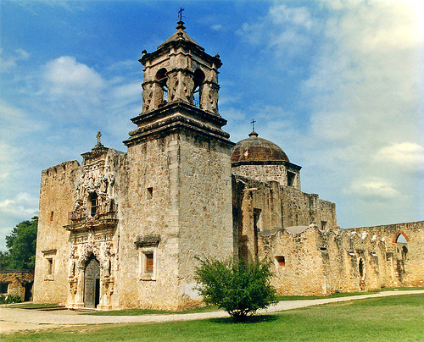

Slide 7
Why did Spain’s presence in Texas go from tremendously weak in 1800 to the brink of complete collapse by 1820?

Slide 9
Major Problem #1:
The United States is your new neighbor!

Slide 10
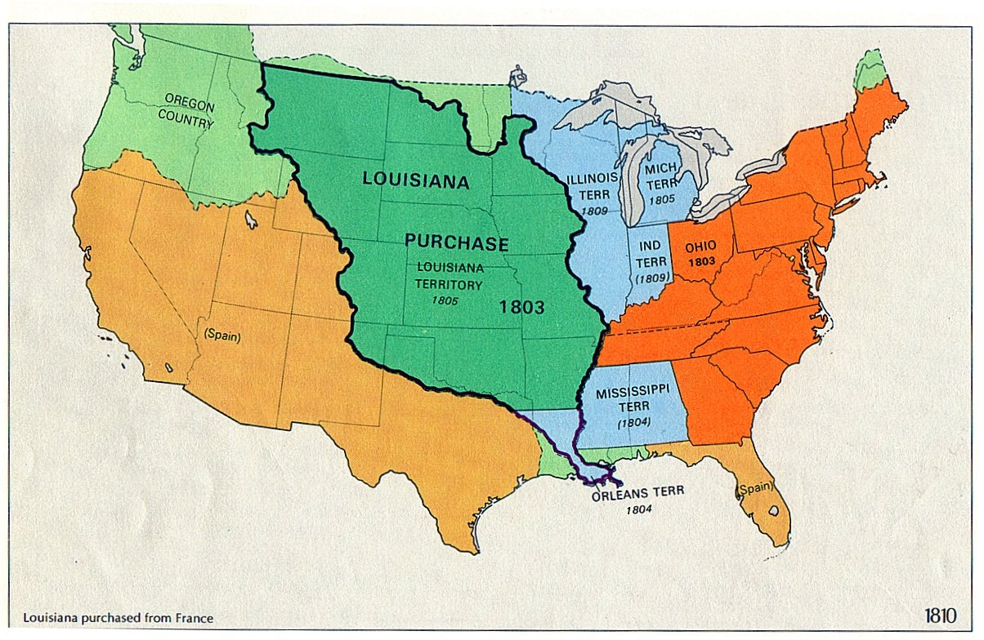

Slide 11
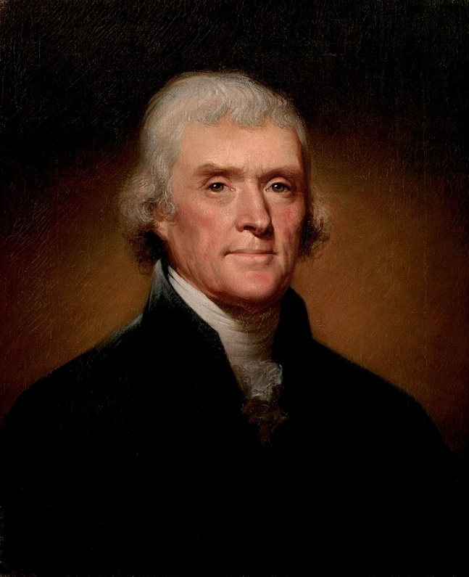

Slide 12
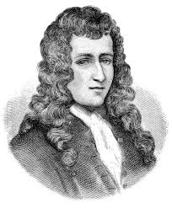

Slide 13
TEKS Supporting Standard 7.2(B): identify … the conflicting territorial claims between France and Spain

Slide 14
Major Problem #2:
Mexican War for Independence!

Slide 15
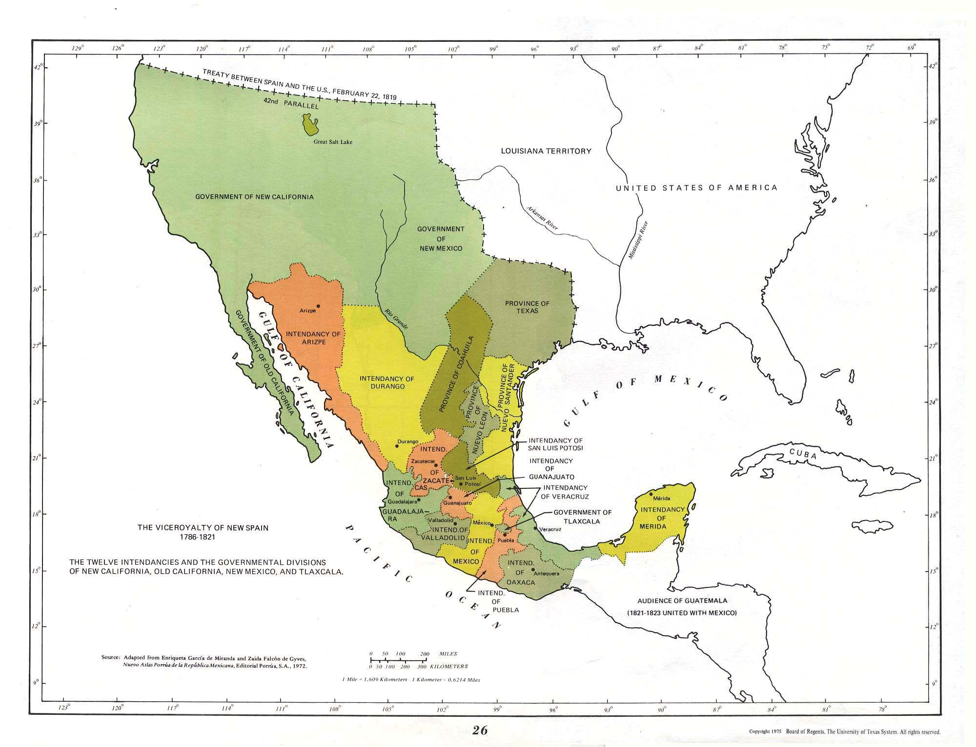

Slide 17
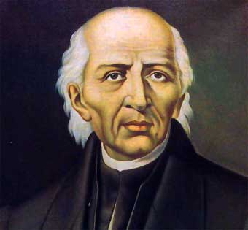

Slide 18
TEKS Supporting Standard 7.2(D): identify individuals, issues, and events related to Mexico becoming independent and its impact on Texas, including Father Miguel Hidalgo

Slide 19
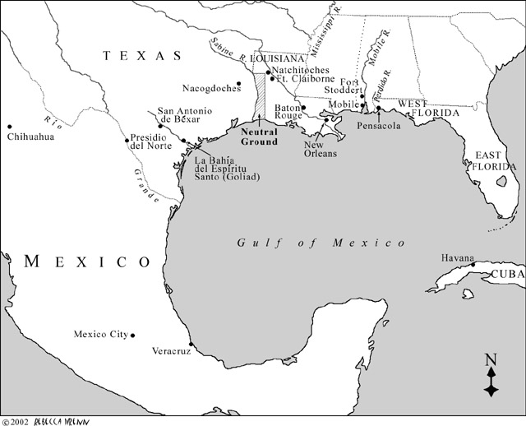

Slide 20
Juan Bautista de las Casas, 1811 Revolt

Slide 22
Jose Bernardo Gutierrez de Lara

Slide 23
Jose Bernardo Gutierrez de Lara
TEKS Supporting Standard 7.2(D): identify individuals, issues, and events related to Mexico becoming independent and its impact on Texas, including Jose Gutierrez de Lara

Slide 25
How do you imagine Spanish authorities in Mexico City reacted?

Slide 27
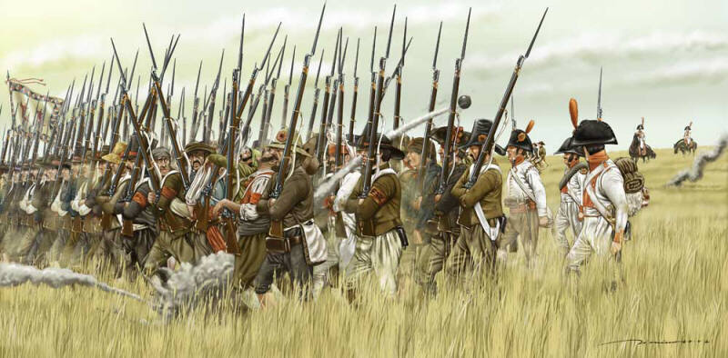

Slide 28
TEKS Supporting Standard 7.2(D): identify individuals, issues, and events related to Mexico becoming independent and its impact on Texas, including the Battle of Medina

Slide 29
Of the 1,400 rebels, only around 100 survived.

Slide 30
Of the 1,400 rebels, only around 100 survived.
Of Arredondo’s 1,800 soldiers, only 50 died.

Slide 31
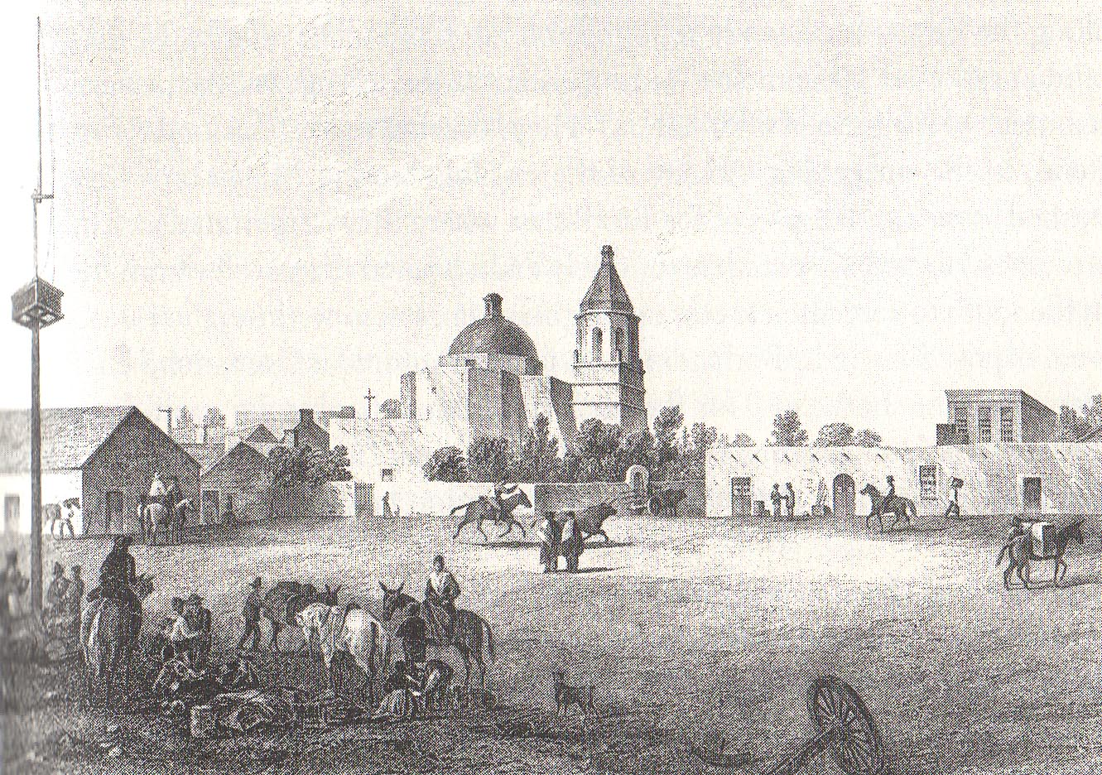

Slide 33
TEKS Supporting Standard 7.2(D): identify individuals, issues, and events related to Mexico becoming independent and its impact on Texas, including Texas involvement in the fight for independence

Slide 34
Major Problem #3:
Indian Raiding Increases Dramatically!

Slide 35
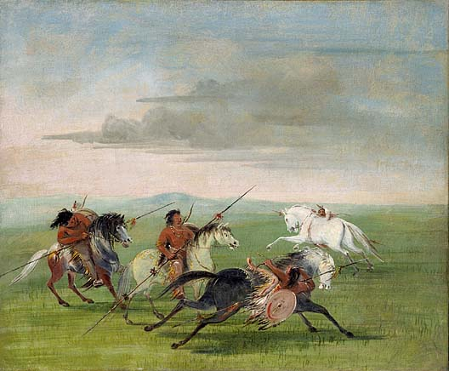

Slide 36
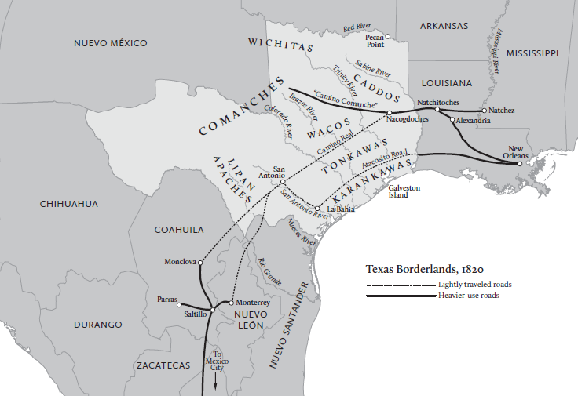

Slide 38
Major Problem #4:
American Filibusters
Come over the Border
(and Spain can do nothing!)

Slide 39
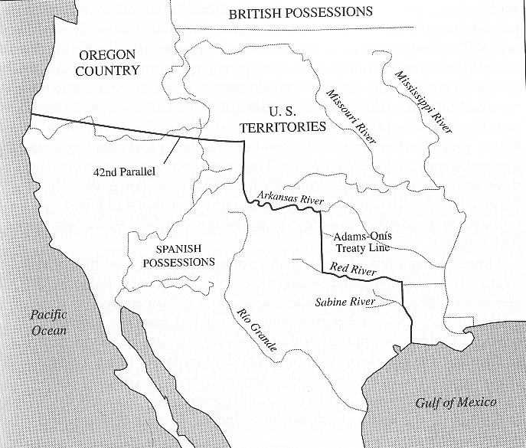

Slide 41
Why did Spain’s presence in Texas go from tremendously weak in 1800 to the brink of complete collapse by 1820?

Slide 42
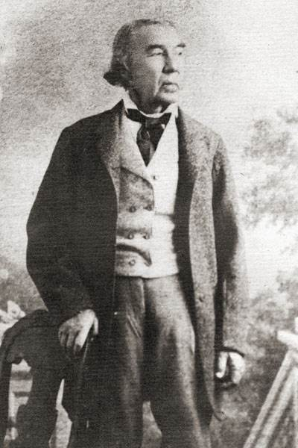

Slide 43
MAJOR PROBLEMS FACING TEJANOS BY THE LATE 1810s:

Slide 44
MAJOR PROBLEMS FACING TEJANOS BY THE LATE 1810s:
They had been decimated by the Mexican War for Independence.

Slide 45
MAJOR PROBLEMS FACING TEJANOS BY THE LATE 1810s:
They had been decimated by the Mexican War for Independence.
They could do nothing to stop any Anglo-Americans from coming into Texas.

Slide 46
MAJOR PROBLEMS FACING TEJANOS BY THE LATE 1810s:
They had been decimated by the Mexican War for Independence.
They could do nothing to stop any Anglo-Americans from coming into Texas.
They were overrun by Indians.

Slide 47
MAJOR PROBLEMS FACING TEJANOS BY THE LATE 1810s:
They had been decimated by the Mexican War for Independence.
They could do nothing to stop any Anglo-Americans from coming into Texas.
They were overrun by Indians.
They were getting pretty much NO support from Mexico City.

Slide 48
And then something happened that changed everything . . .

Slide 50
