Slide 1
Road to Revolution
Andrew J. Torget
University of North Texas
Andrew.Torget@unt.edu

Slide 2
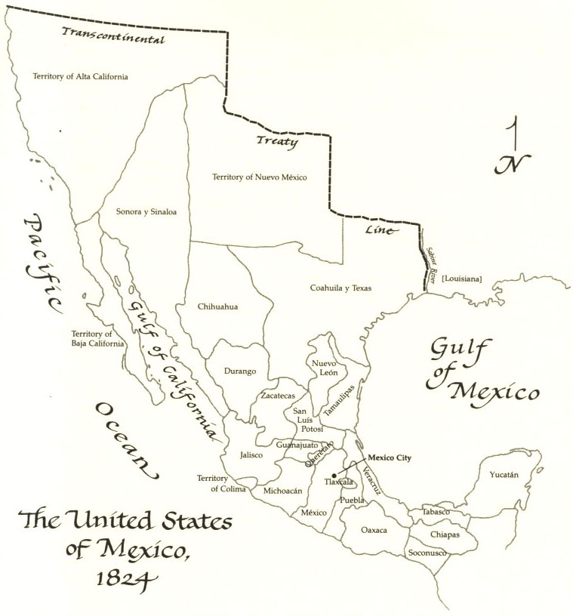

Slide 3
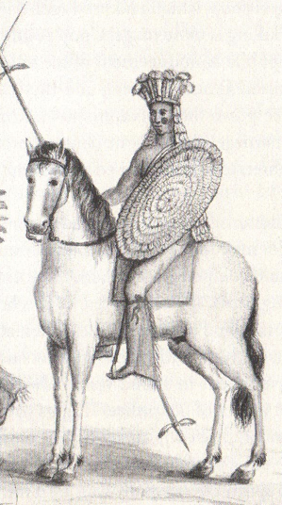

Slide 4
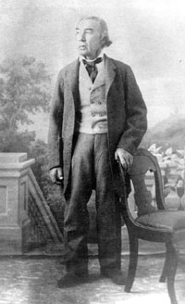

Slide 5
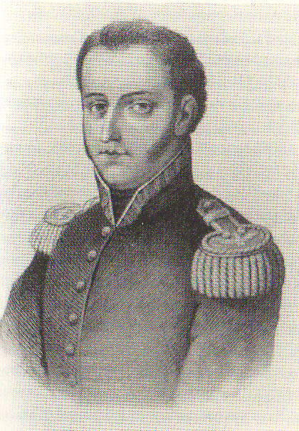

Slide 6
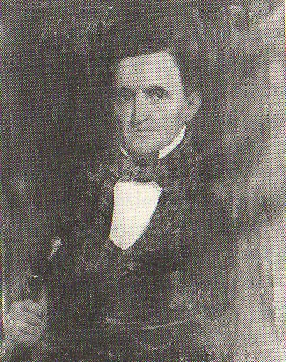

Slide 7
How did the overlap between different peoples and such different perspectives lead to the outbreak of the Texas Revolution by 1835?

Slide 9
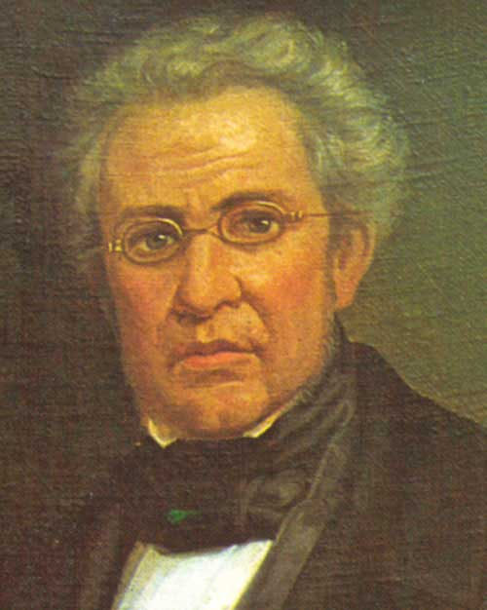

Slide 10
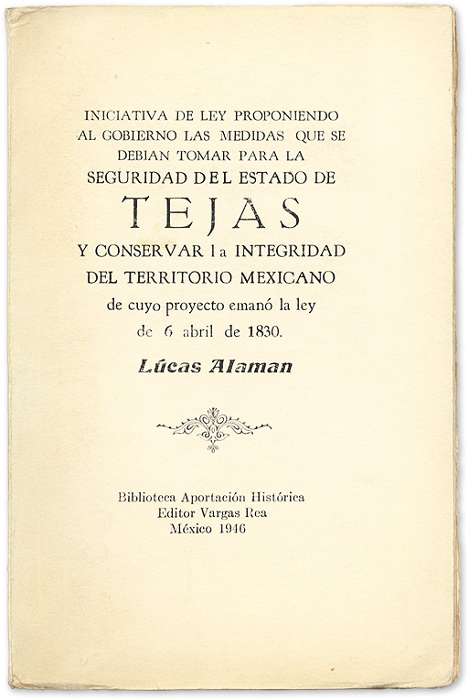

Slide 11
LAW OF APRIL 6, 1830:
No more American immigration into Mexico!
Mexico’s president has the right to establish new forts in Texas to begin collecting taxes.
Mandated that the importation of enslaved people stop.

Slide 12
TEKS Supporting Standard 7.3(A)
Describe the chain of events that led to the Texas Revolution, including the Mier y Teran Report and the Law of April 6, 1830.

Slide 13
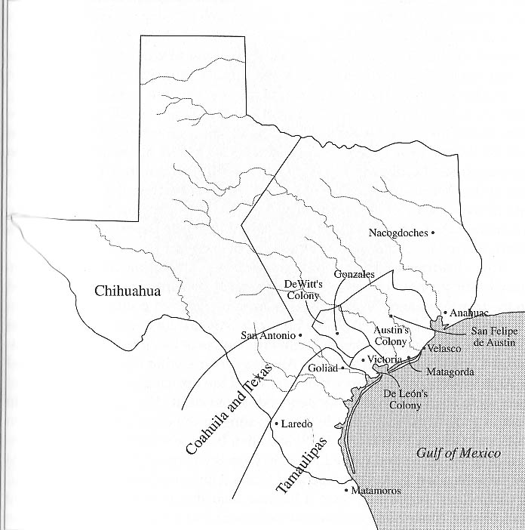

Slide 14
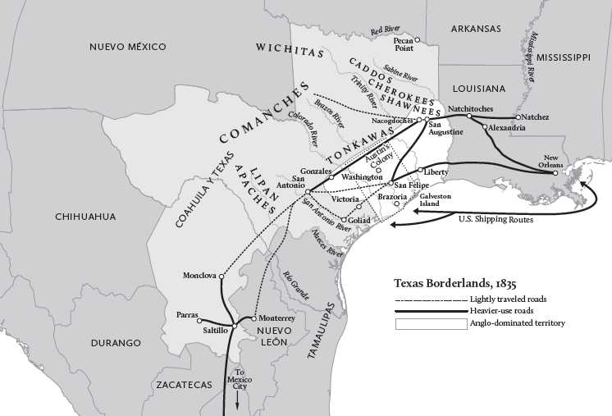

Slide 15
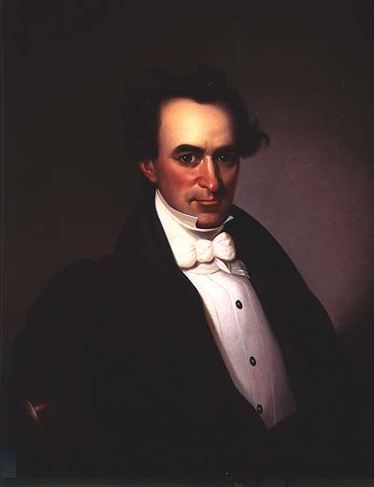

Slide 17
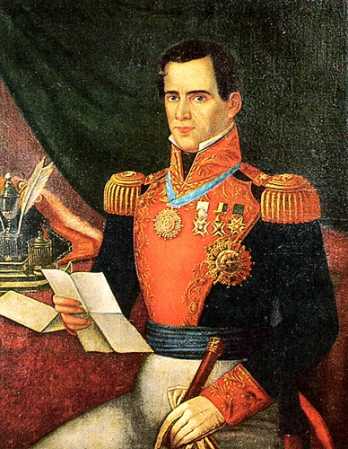

Slide 20
Now Stephen F. Austin is imprisoned in Mexico City!
How do the Texans react?

Slide 22
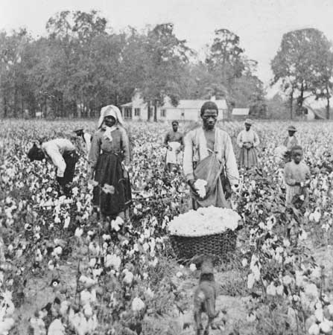

Slide 23
Population results of the cotton boom:
10,000 to 21,000

Slide 25
And then, Mexico erupts in a civil war!

Slide 28
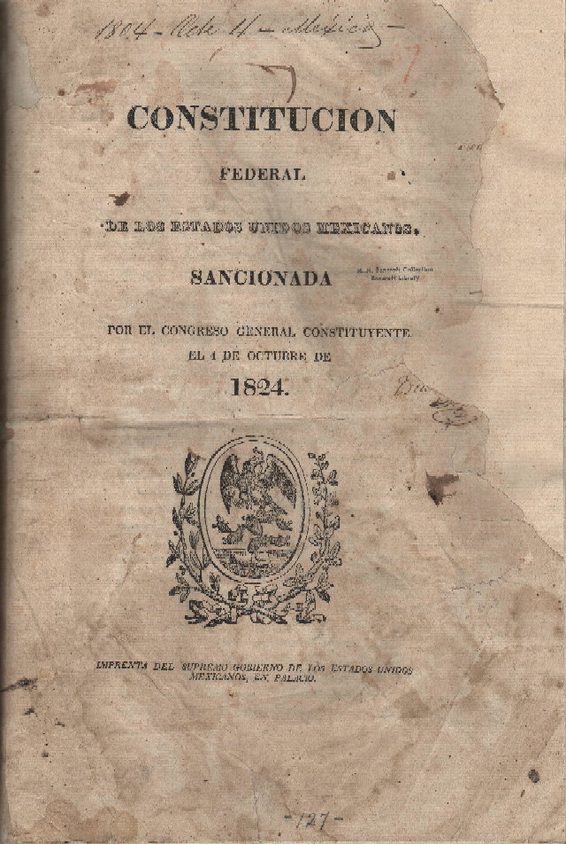

Slide 30
Peace Party Vs. War Party

Slide 31
Peace Party Vs. War Party

Slide 32
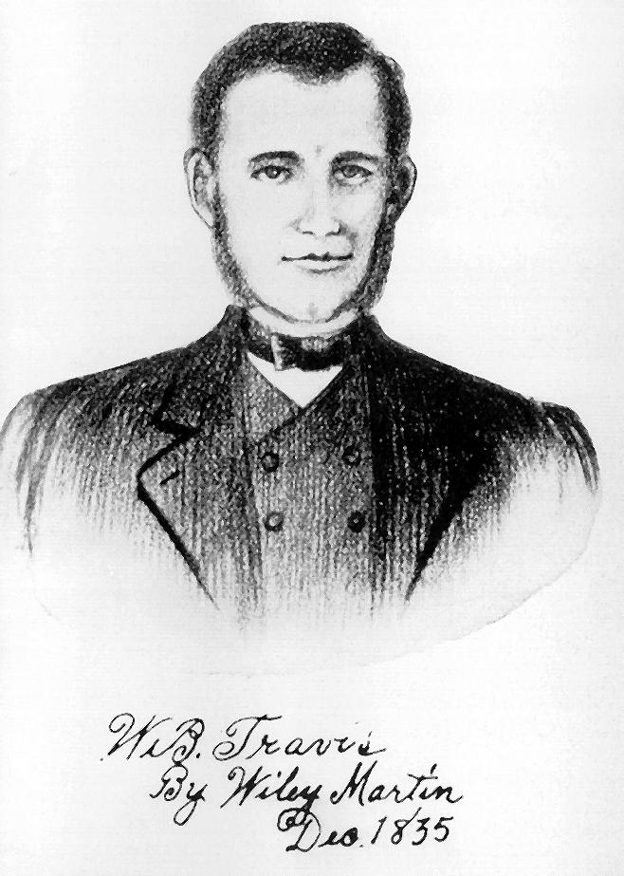
Peace Party Vs. War Party

Slide 33
Peace Party Vs. War Party

Slide 34
TEKS Readiness Standard 7.16(A)
Identify different points of view of political parties and interest groups on important Texas issues.

Slide 36
Gonzales
October 1835

Slide 37
TEKS Readiness Standard 7.3(C)
Explain the issues surrounding significant events in the Texas Revolution, including the Battle of Gonzales.

Slide 39
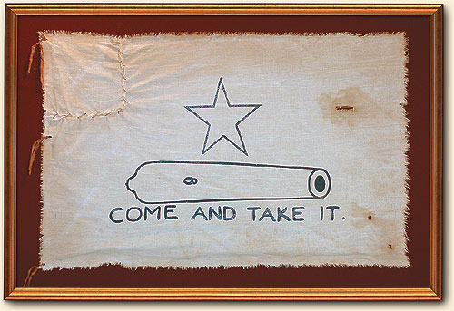

Slide 40
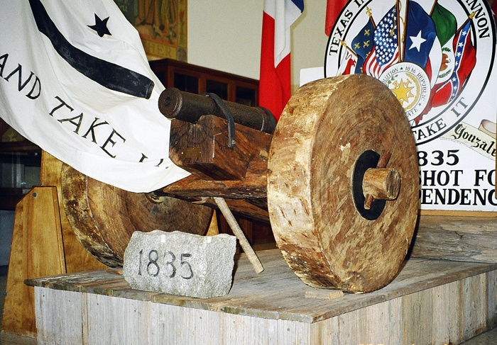

Slide 41
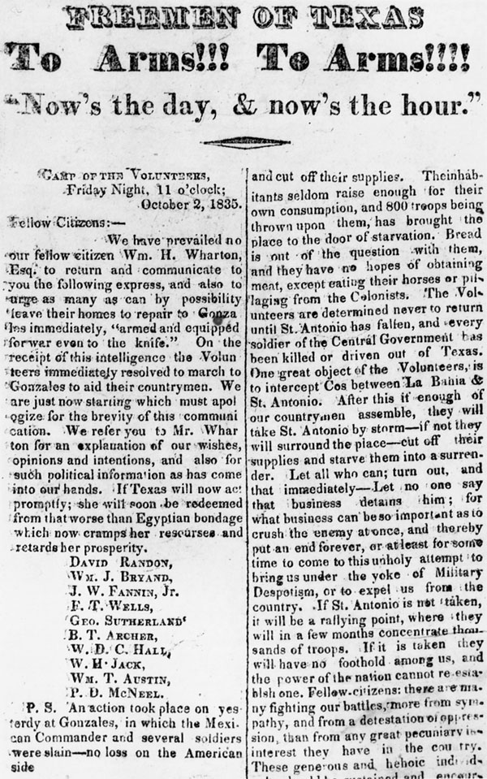

Slide 42
The Consultation:
November 1, 1835

Slide 44
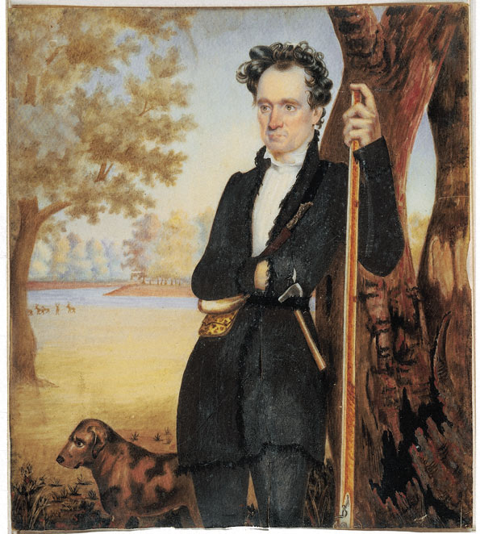

Slide 45
Divisions among Texans, late 1835:

Slide 46
Divisions among Texans, late 1835:
Should we fight at all? War Party vs. Peace Party.

Slide 47
Divisions among Texans, late 1835:
Should we fight at all? War Party vs. Peace Party.
If you want to fight, what are we fighting for? Constitution of 1824 vs. Independence.

Slide 50
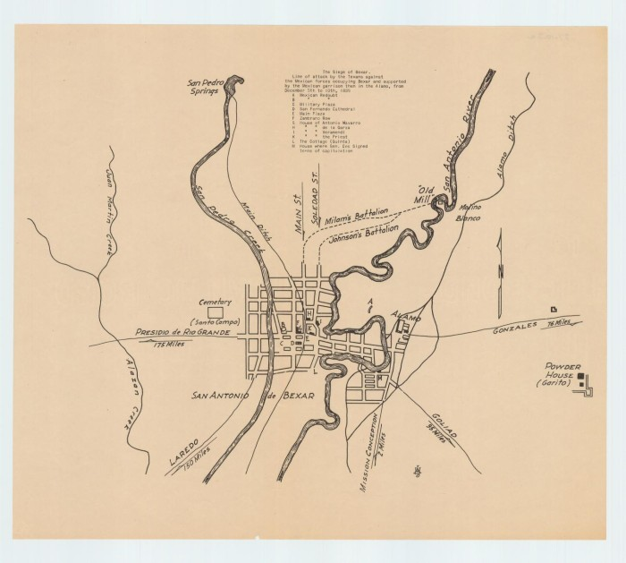

Slide 51
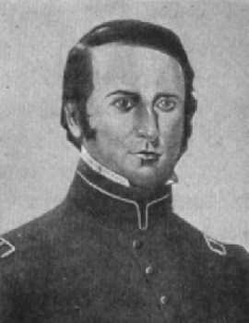
Ben Milam

Slide 53
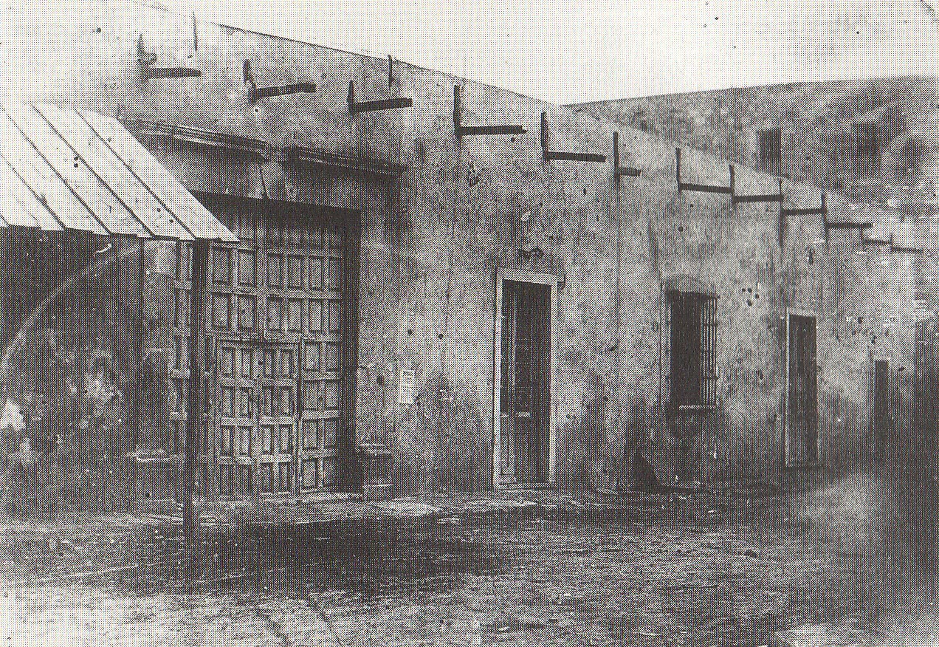

Slide 54
