Slide 1
Annexation and Slavery
Andrew J. Torget
University of North Texas
Andrew.Torget@unt.edu

Slide 2
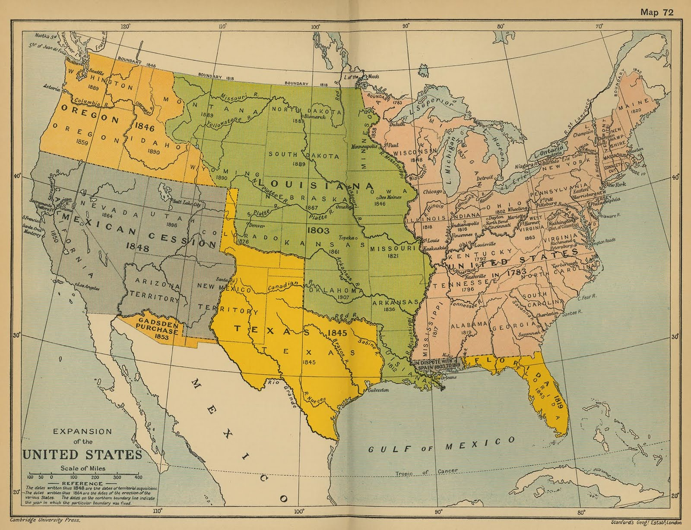

Slide 3
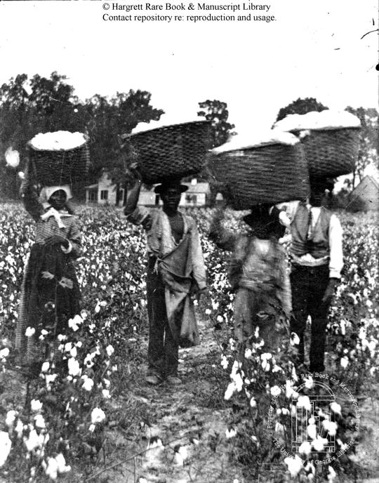

Slide 4
Why did slavery prove to be such a consistent and powerful shaper of Texas from the Republic era, through annexation, and into the 1850s?

Slide 5
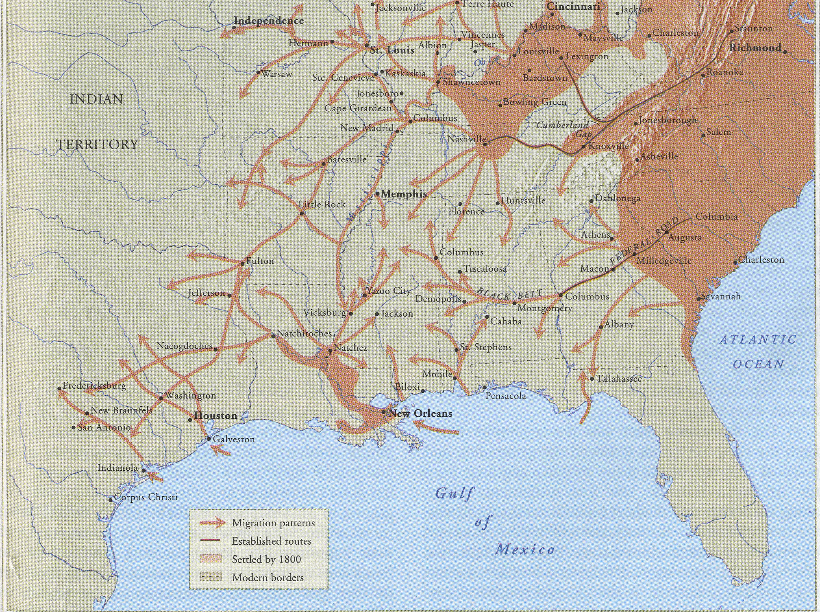

Slide 6
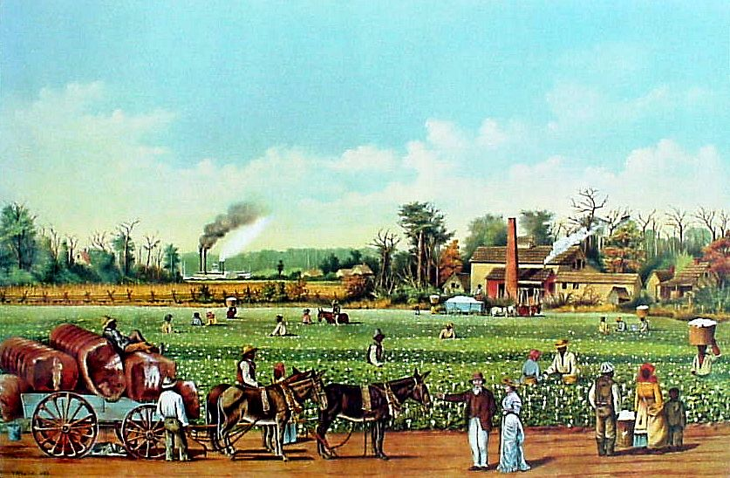

Slide 7
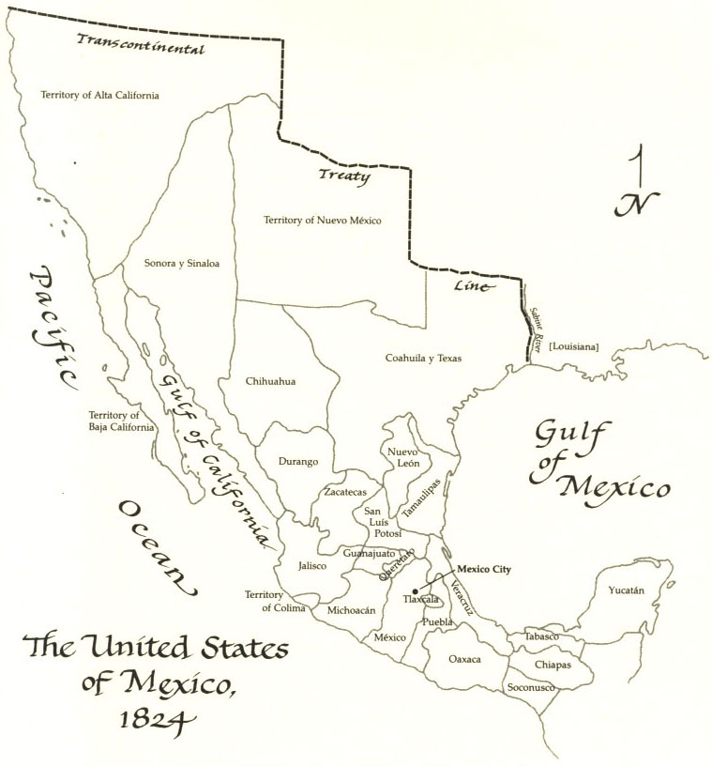
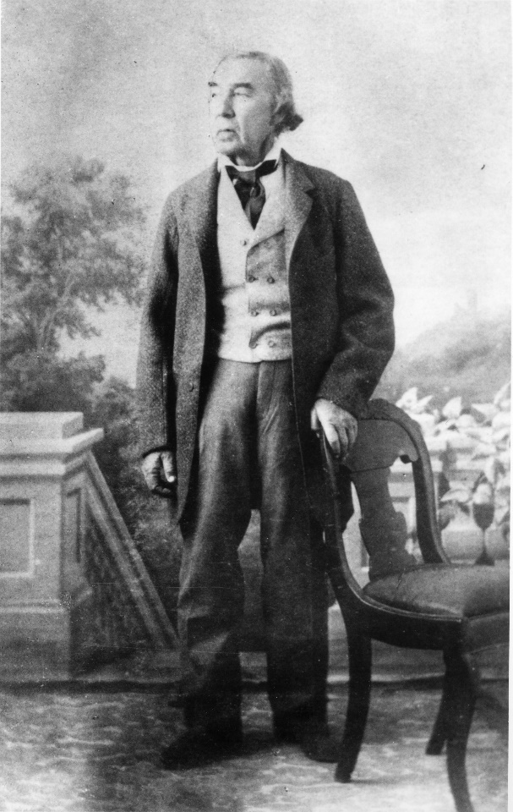
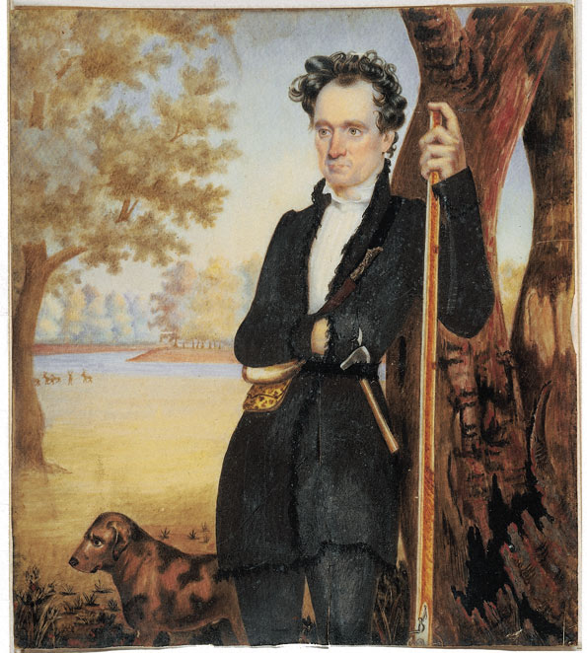

Slide 8
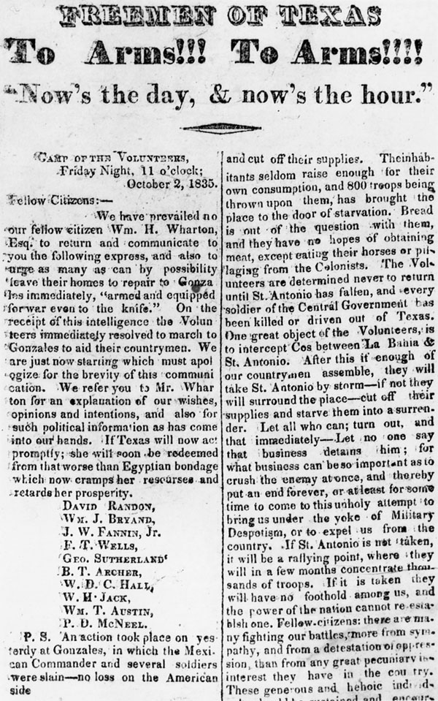

Slide 9
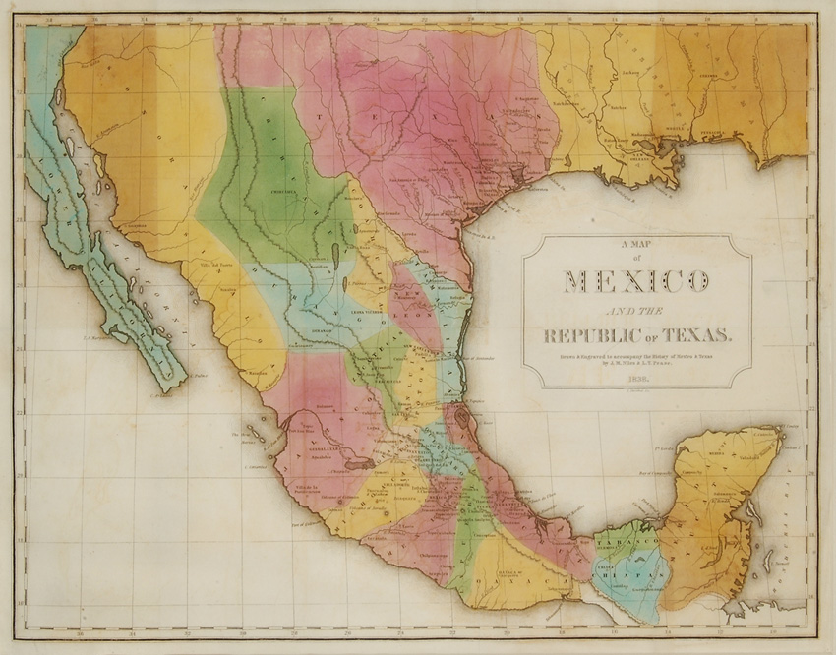

Slide 10
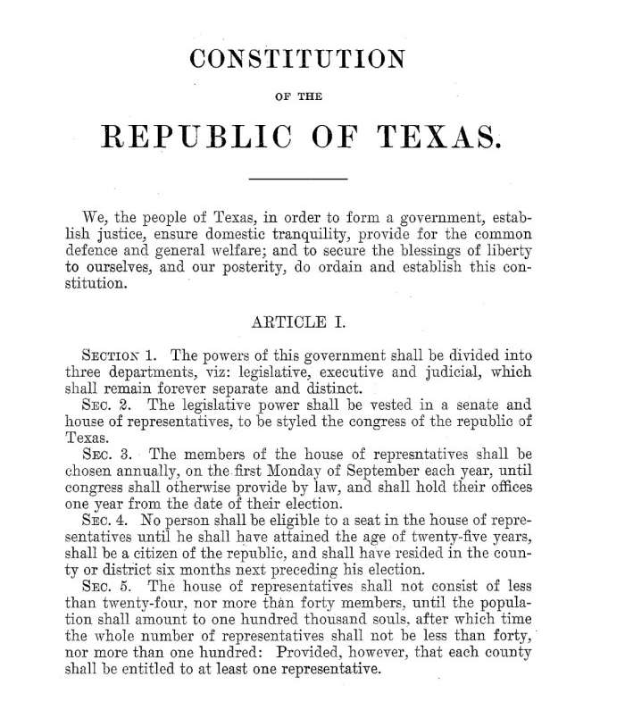

Slide 11
TEKS Readiness Standard 7.4(B): analyze the causes of and events leading to Texas annexation such as security and debt.

Slide 12
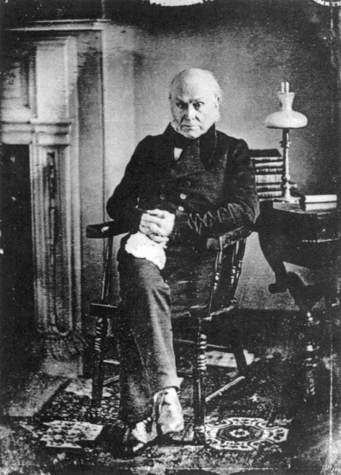
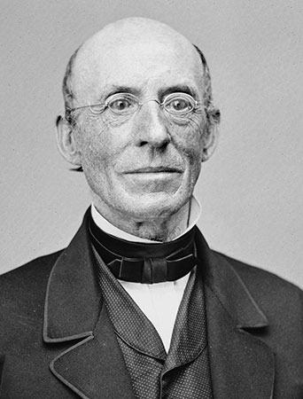

Slide 13
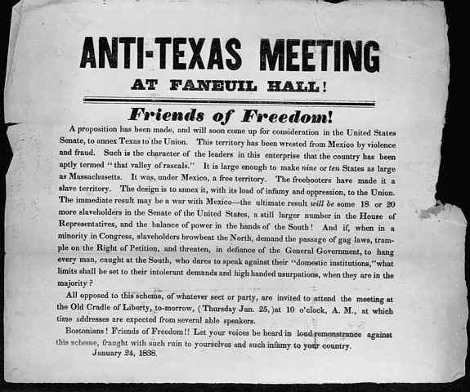

Slide 14
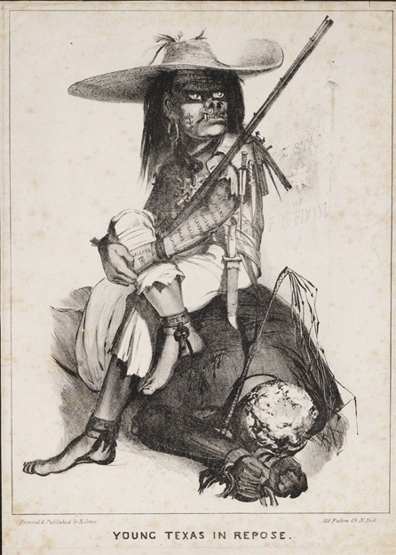

Slide 15
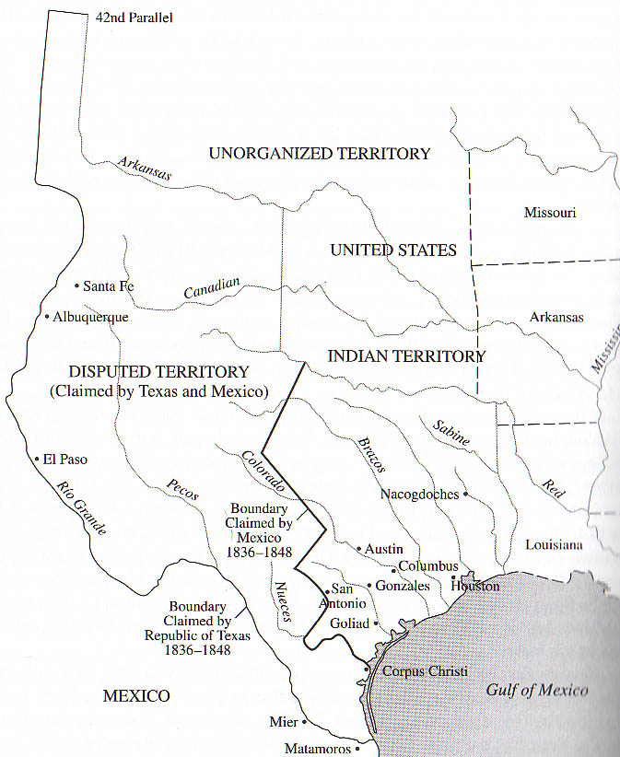

Slide 16
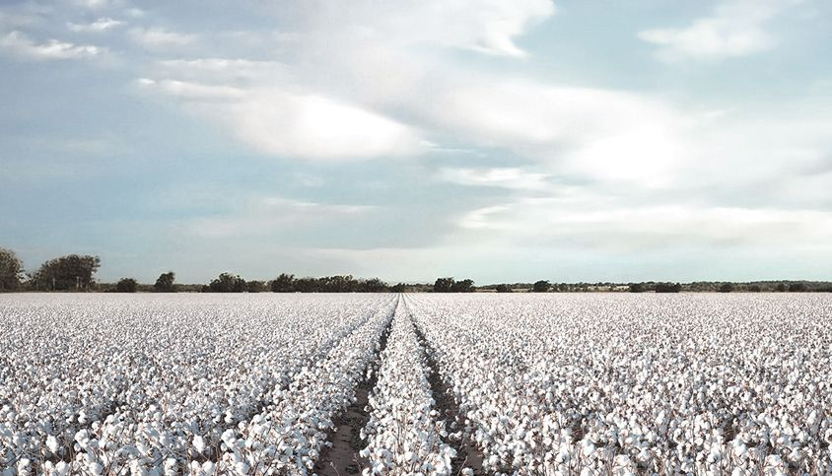

Slide 17
TEKS Readiness Standard 7.4(B): analyze the causes of and events leading to Texas annexation such as security and debt.

Slide 18
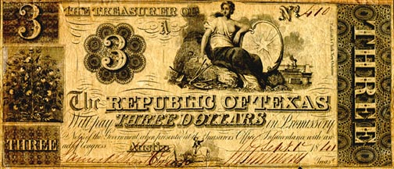

Slide 19
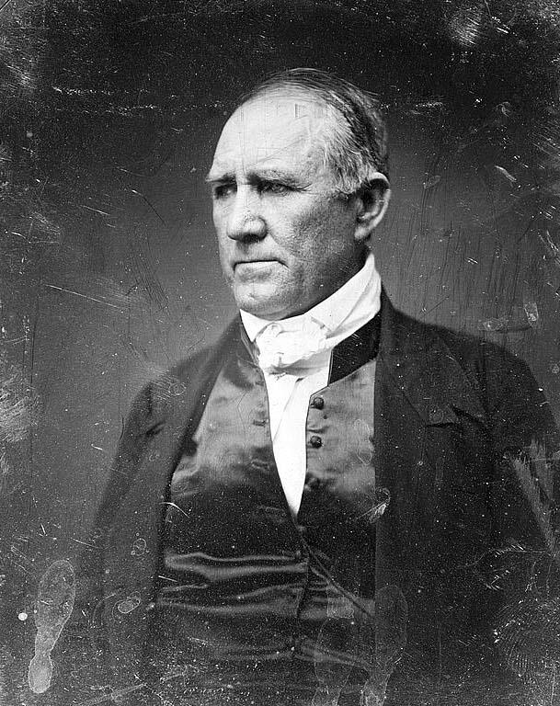
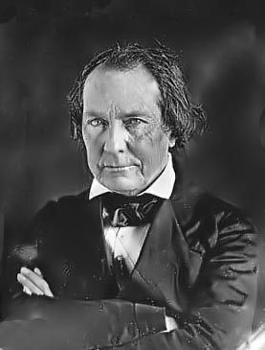

Slide 20
TEKS Readiness Standard 7.4(A): identify individuals, events, and issues during the administrations of Republic of Texas Presidents Houston and Lamar . . .

Slide 21
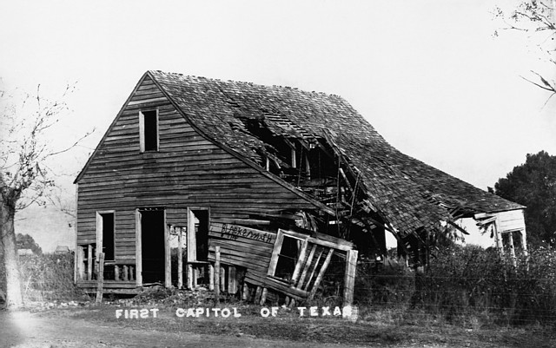

Slide 22
“We are indeed in a most uncertain and precarious condition – without strength and, worse than all, without confidence in ourselves . . . We are in collapse – perfectly prostrate and powerless.”
--Washington Miller,
personal secretary to
Sam Houston, 1842

Slide 24
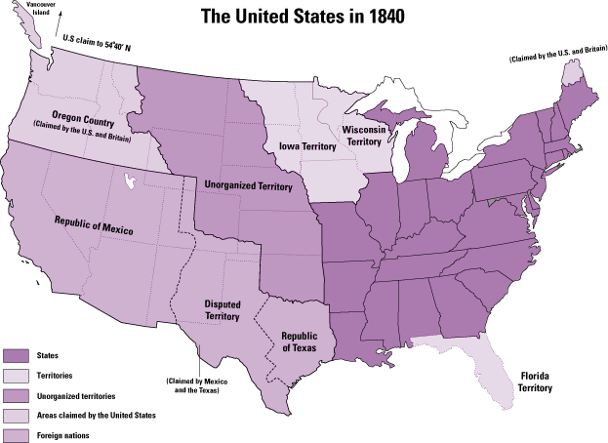

Slide 25
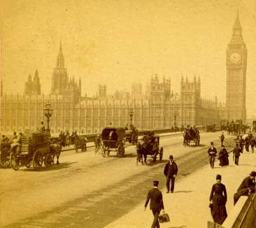

Slide 29
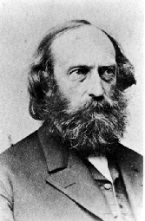
Stephen Pearl Andrews

Slide 31
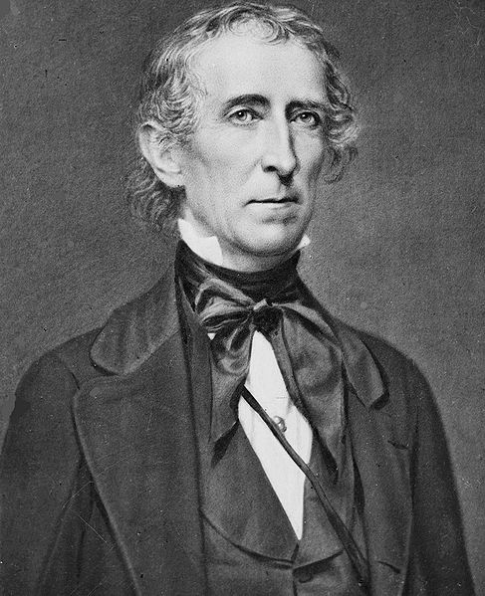

Slide 32
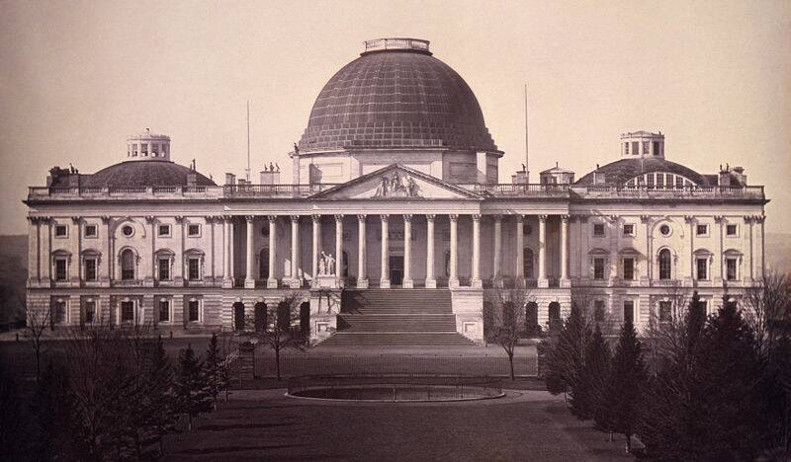

Slide 33
Vote on the Annexation of Texas -- June 8, 1844
35 against – 16 in favor!

Slide 35
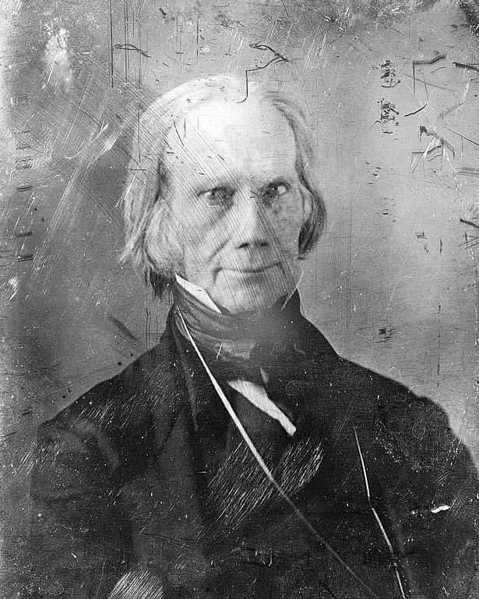

Slide 36
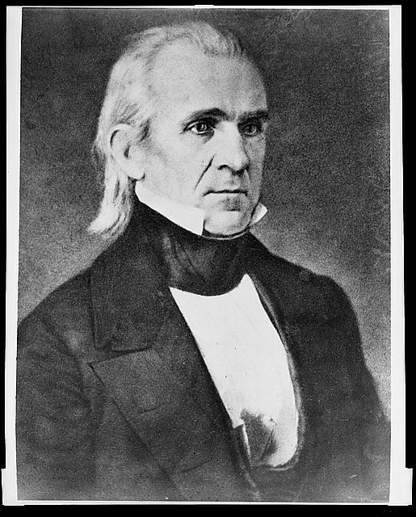

Slide 42
FINAL VOTES ON TEXAS ANNEXATION
IN U.S. CONGRESS:

Slide 43
FINAL VOTES ON TEXAS ANNEXATION
IN U.S. CONGRESS:
January 1845 -- House of Representatives:
120 in favor, 98 against

Slide 44
FINAL VOTES ON TEXAS ANNEXATION
IN U.S. CONGRESS:
January 1845 -- House of Representatives:
120 in favor, 98 against
February 1845 – Senate:
27 in favor, 25 against

Slide 46
TERMS OF THE U.S. OFFER
TO TEXAS FOR ANNEXATION:
Texas would enter the United States as a state, not a territory.
Texas would keep (and be responsible for) its public debt.
Texas would, however, retain its public lands.
Texas would turn over to the U.S. all its public buildings, forts, etc.
The United States promised to resolve the boundary dispute between Texas and Mexico, enforcing the Rio Grande as the border.

Slide 48
Polk signed the Texas Admission Act on December 29, 1845

Slide 49
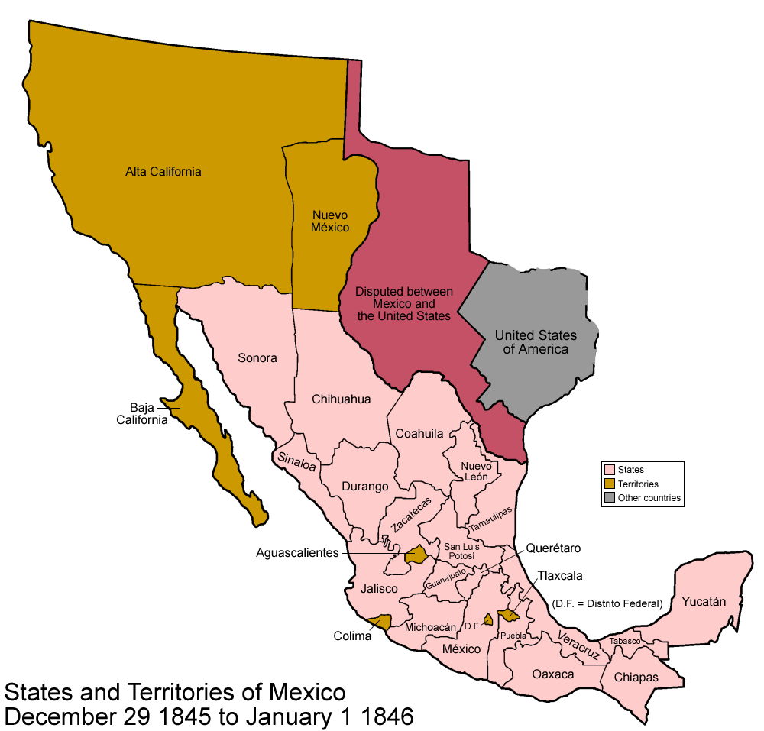

Slide 50
TEKS Supporting Standard 7.1(B): explain the significance of the following dates: . . . 1845, annexation.

Slide 52
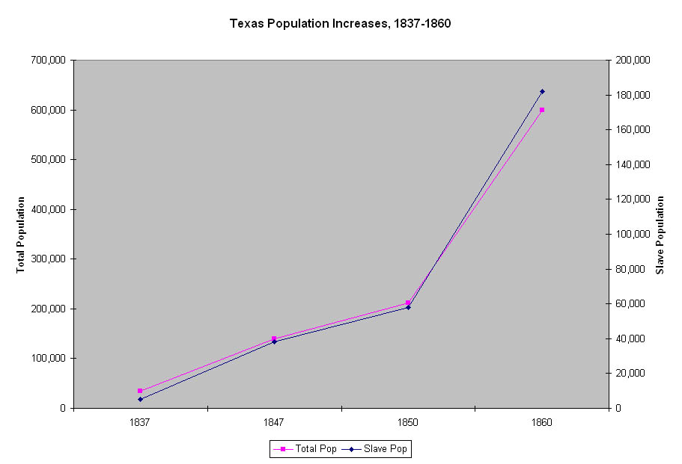

Slide 53
TEKS Supporting Standard 7.10(B): describe how immigration and migration to Texas have influenced Texas.

Slide 54
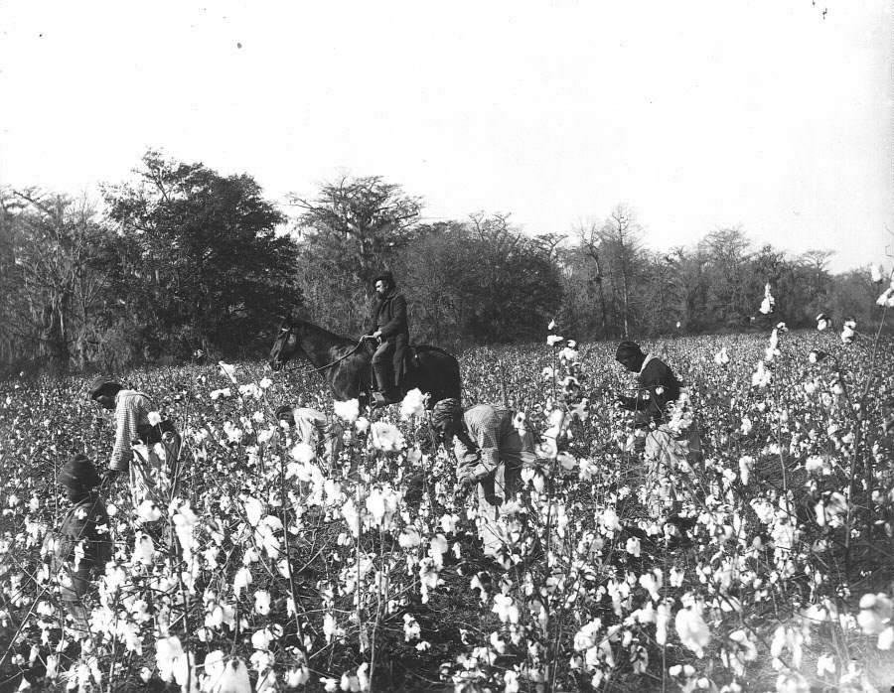

Slide 55
TEKS Readiness Standard 7.4(B): analyze the causes of and events leading to Texas annexation such as security and debt.

Slide 56
TEKS Readiness Standard 7.4(B): analyze the causes of and events leading to Texas annexation such as security and debt.
Why did slavery prove to be such a consistent and powerful shaper of Texas from the Republic era, through annexation, and into the 1850s?

Slide 57
