Slide 1
Turning Points of the Civil War
Dr. Sarah j. purcell
Grinnell college purcelsj@Grinnell.edu

Slide 2
Turning Points of the Civil War
What kind of historical questions are raised by thinking about “turning points?”
“Turning Points” were plural
Situation of War by late 1862
  Lee’s first offensive into North was pushed back
  Lincoln issues preliminary Emancipation Proclamation
  Grant begins difficult Vicksburg Campaign
  Fredericksburg and Chancellorsville go poorly for U.S.

Slide 3
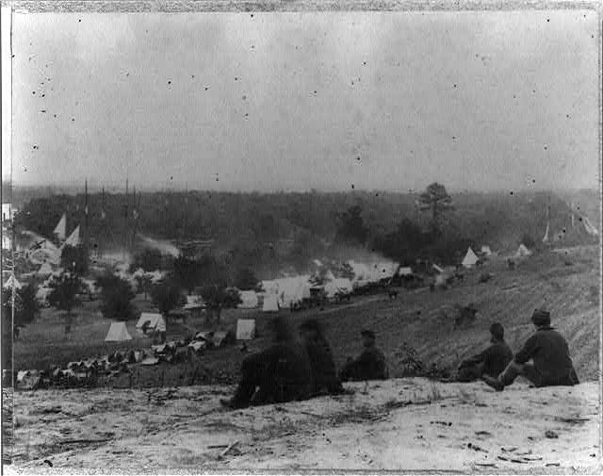
What will cause a change in 1863?
Notes:
Panoramic view of encampment of Army of Potomac at Cumberland Landing, on Pamunkey River, May 1862, Library of Congress Prints and Photographs Division, LC-USZ62-82752

Slide 4
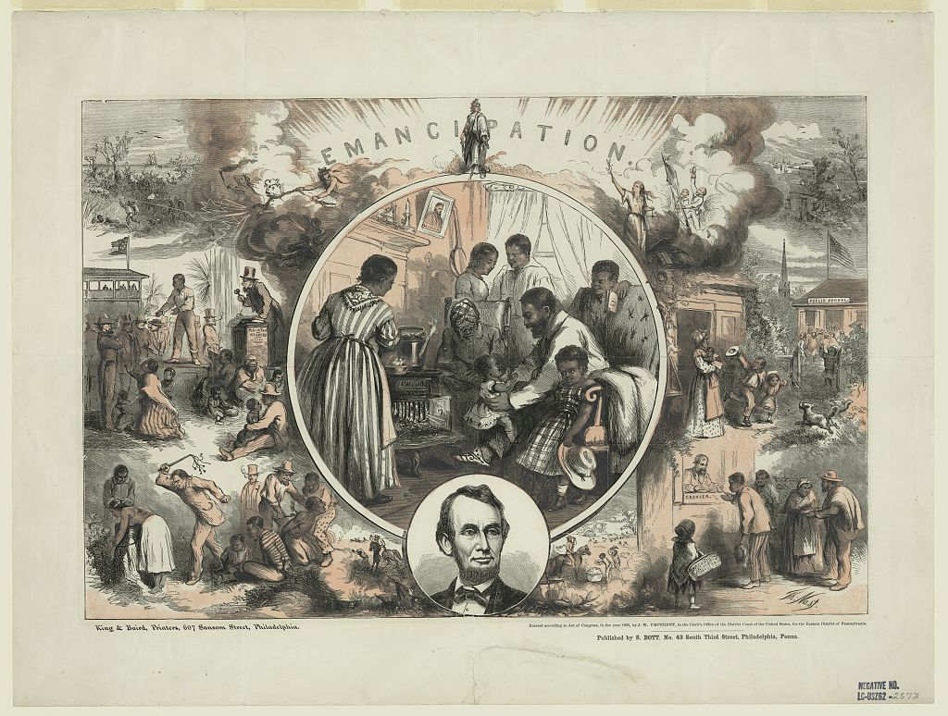
First Turning Point: Emancipation
Notes:
Thomas Nast, Emancipation (Philadelphia: S. Bott, c. 1865), Library of Congress Prints and Photographs Division, LC-DIG-pga-03898.

Slide 5
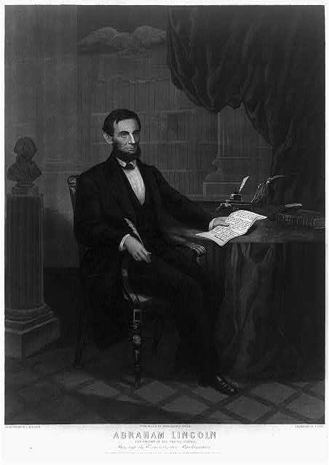
Emancipation as Executive Action
Notes:
J. Serz engraving of W. E. Winner, Abraham Lincoln President of the United States Signing the Emancipation Proclamation, (Philadelphia: John Dainty, c. 1864), Library of Congress Prints and Photographs Division, LC-DIG-pga-08284

Slide 6
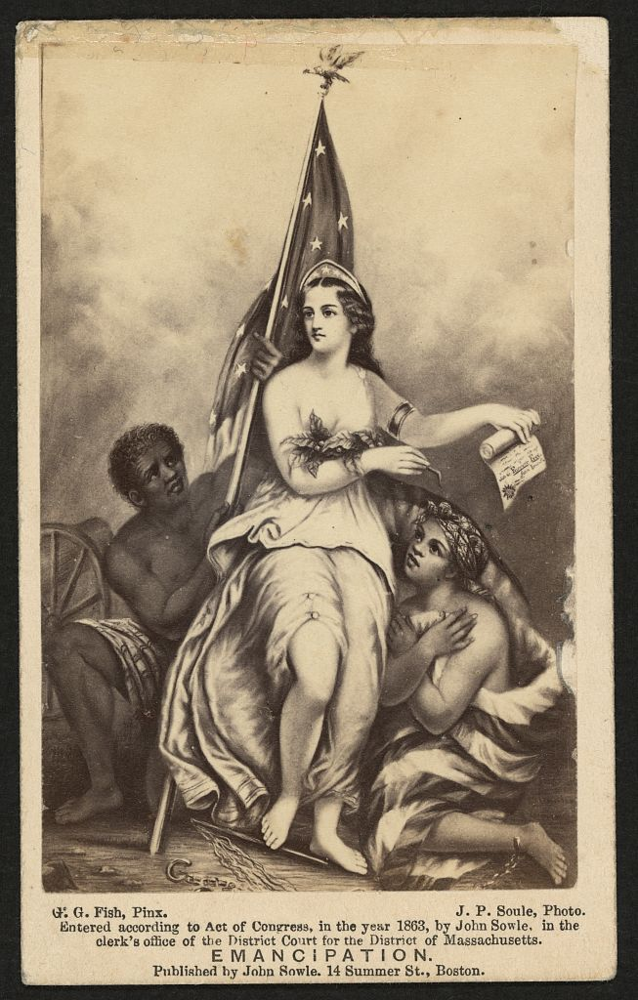
Emancipation & War Aims
Notes:
G. G. Fish, Emancipation (Boston: J. Soule, c. 1863), Library of Congress Prints and Photographs Division, LC-DIG-ppmsca-11278

Slide 7
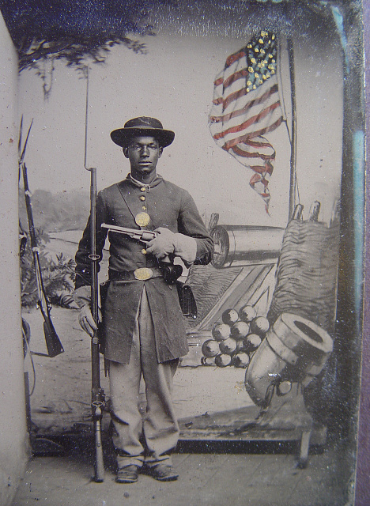
Emancipation shaped by African Americans
Notes:
Enoch Long, [Unidentified African American soldier in Union uniform with a rifle and revolver in front of painted backdrop showing weapons and American flag at Benton Barracks, Saint Louis, Missouri], c.1863-1865, Library of Congress Prints and Photographs Division, LC-DIG-ppmsca-36456.

Slide 8
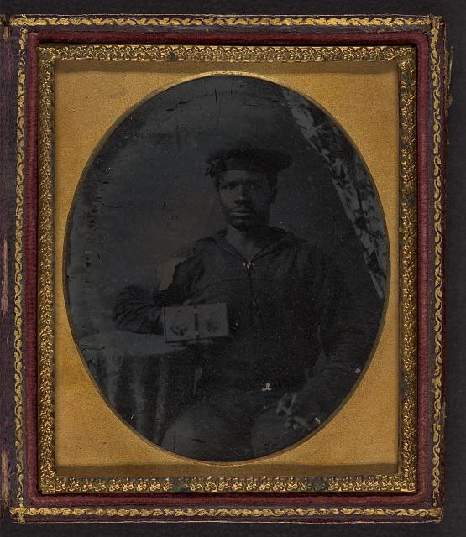
Emancipation and Black Troops
Notes:
[Sailor with cigar in hand holding a double case image of confederate soldiers], ambrotype, c.1860-1870, Library of Congress Prints and Photographs Division, LC-DIG-ppmsca-11292.

Slide 9
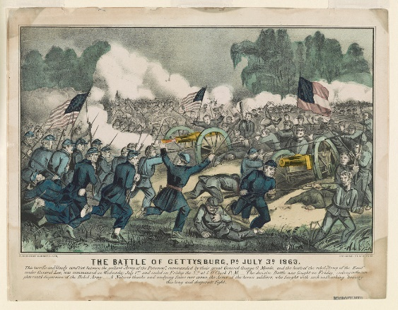
Second Turning Point:
Battle of Gettysburg
Notes:
Currier & Ives, The Battle of Gettysburg, July 3 1863 (New York: Currier & Ives, c. 1863), Library of Congress Prints and Photographs Division, LC-DIG-pga-06132.

Slide 10
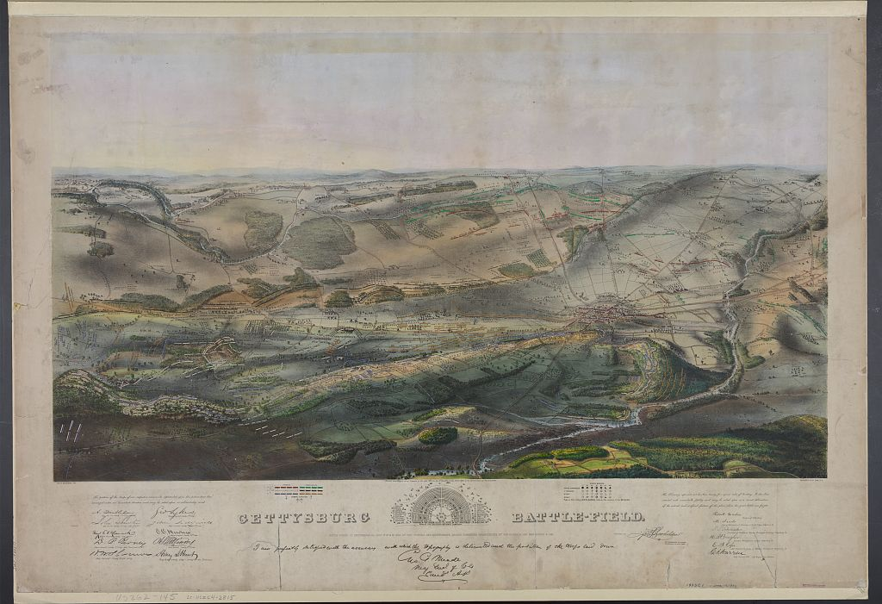
Gettysburg—Scale of Battle
Notes:
John B. Batchelder, Gettysburg Battlefield (New York: Endicott & Co., c. 1863), Library of Congress Prints and Photographs Division, LC-DIG-pga-01158.

Slide 11
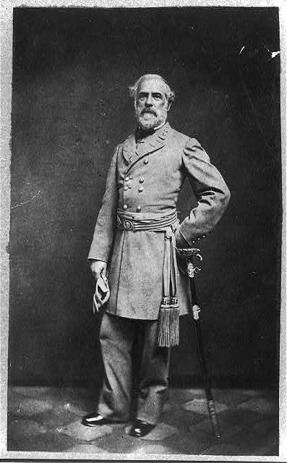
Gettysburg—”High Water Mark?”
Notes:
Julian Vannerson, [General Robert E. Lee, full-length portrait, standing, facing front, with left hand at waist, on sword, wearing military uniform] c. 1864, Library of Congress Prints and Photographs Division, LC-DIG-ppmsca-35446.

Slide 12
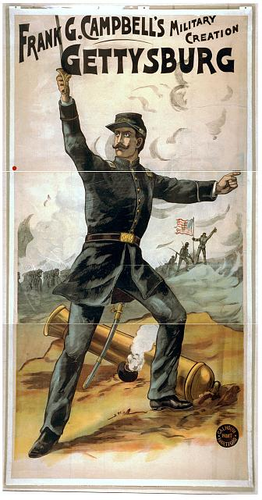
Gettysburg & Morale
Notes:
Frank G. Campbell's military creation, Gettysburg (Hartford: Calhoun Print, 1898), Library of Congress Prints and Photographs Division, POS - TH - 1898 .G48, no. 1.

Slide 13
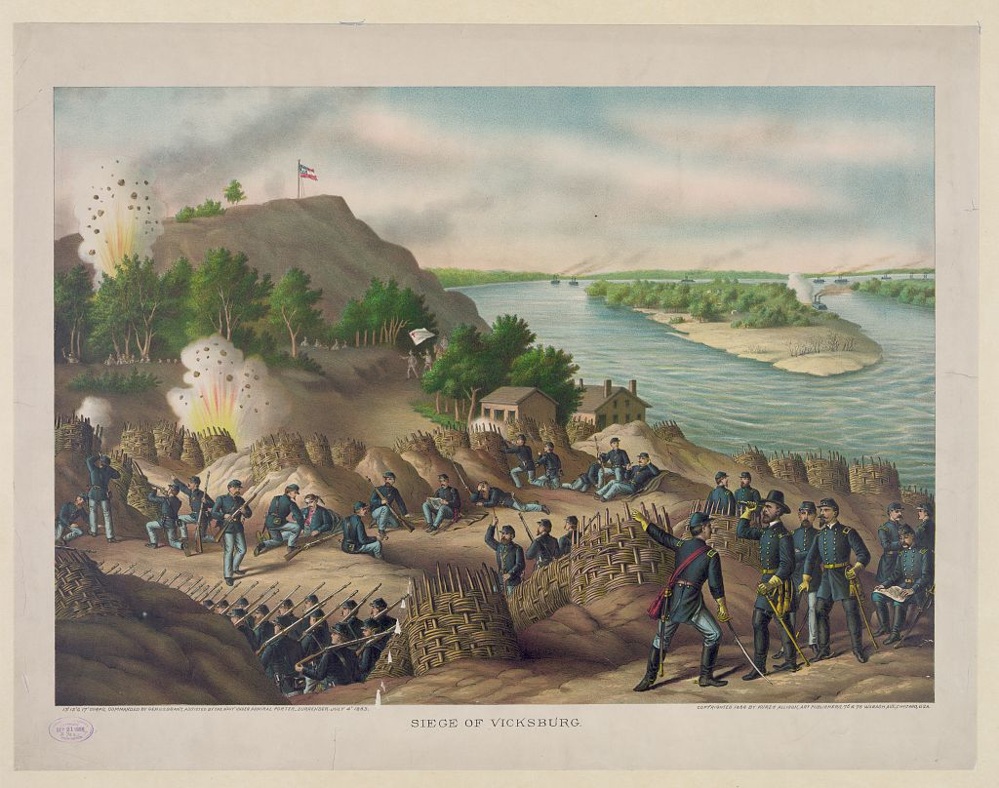
Third Turning Point:
Battle of Vicksburg
Notes:
Kurz & Allision, Siege of Vicksburg--13, 15, & 17 Corps, Commanded by Gen. U.S. Grant, assisted by the Navy under Admiral Porter--Surrender, July 4, 1863, (n.p.: n.p., 1888), LC-DIG-pga-01871.

Slide 14
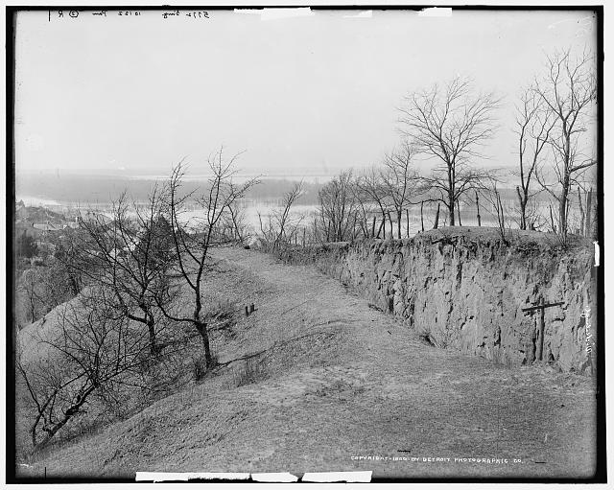
Vicksburg and Supply Lines
Notes:
[General view of battle ground, Vicksburg, Mississippi] (Detroit: Detroit Publishing Co., 1900), Library of Congress Prints and Photographs Division, LC-DIG-det-4a05884.

Slide 15
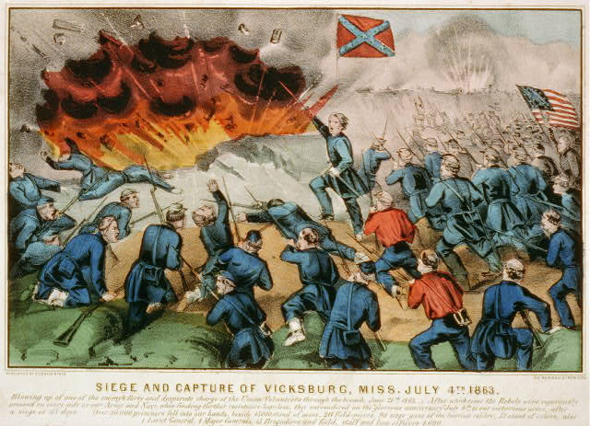
Vicksburg and Total War
Notes:
Currier & Ives, Siege and capture of Vicksburg, Miss. July 4th 1863 (New York: Currier & Ives, n.d.), Library of Congress Prints and Photographs Division, LC-DIG-pga-08904.

Slide 16
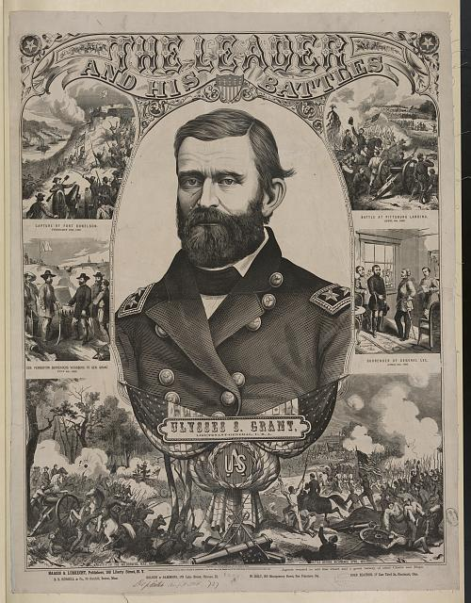
Vicksburg
Notes:
The leader and his battles - Ulysses S. Grant, Lieutenant-General, U.S.A. (New York: Haasis & Lubrecht, c.1866), LC-DIG-pga-03430 .

Slide 17
Turning Points
After July 1863 advantage shifted to the United States
Union victory was NOT inevitable
Turning points allowed long-term Union advantage to be mobilized
Very different war after these turning points

Slide 18
Turning Points & Public Memory
Gettysburg eclipses Vicksburg in public memory
Emancipation is very important in public memory—but military significance is underplayed
Return to historical questions

Slide 19
Helpful Teaching links
Library of Congress Prints and Photographs Catalog: https://www.loc.gov/pictures/
NMAH “Changing America: Military Service”: https://americanhistory.si.edu/changing-america-emancipation-proclamation-1863-and-march-washington-1963/1863/military-service
American Battlefield Trust, “Gettysburg” recommend animated battle map video: https://www.battlefields.org/learn/civil-war/battles/gettysburg
American Battlefield Trust, “Vicksburg” recommend animated battle map video: https://www.battlefields.org/learn/civil-war/battles/vicksburg

Slide 20
Primary Sources: Frederick Douglass
What connections did Frederick Douglass draw between emancipation and military service in his speech to Philadelphians in July 1863?
How did Douglass try to persuade Black men to enlist in the U.S. Army? What would military service do for Black Americans individually and collectively, according to Douglass?
After reading this document: How would you describe the enlistment of Black men in the U.S. Army in 1863 as a “turning point” of the Civil War?

Slide 21
Primary Source: Josiah Gorgas
How would you describe the tone of Gorgas’s journal entry from July 28, 1863?
What kinds of factors does Gorgas cite in claiming that the Confederacy has completely reversed its “point of success” from just one month previous? What is making Gorgas feel like failure is imminent?
How would you compare Gorgas’s assessment of the “turning points” of 1863 to the speech by Frederick Douglass? Compare their use of language and purpose in writing.
What insight does Gorgas’s journal provide about the nature of “turning points” in history?

