Slide 1
Utopia & Dystopia
Jenny C. Mann
Dept. of English and the Gallatin School
NYU

Slide 3
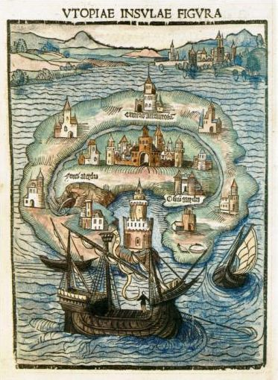
“utopia”
ou-topos, “not place”
AND/OR
eu-topos, “good place”

Slide 4
“dystopia”
(bad place)
Notes:
This mid 20th century dystopian scene linoleum block print is by San Francisco North Beach artist Martin Snipper (1914-2008).

Slide 7
The “idiom” of utopia
(its literary qualities and distinctive set of traits)

Slide 8
The Idiom of Utopia
Traveler’s tale
Description of imaginary society
Isolated physical location
First-person narrator
Philosophical dialogue
Creation through negation

Slide 9
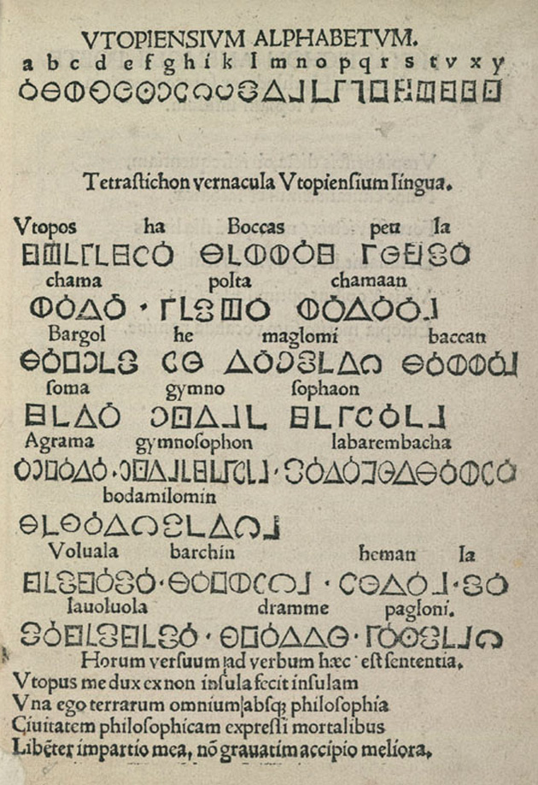

Slide 10
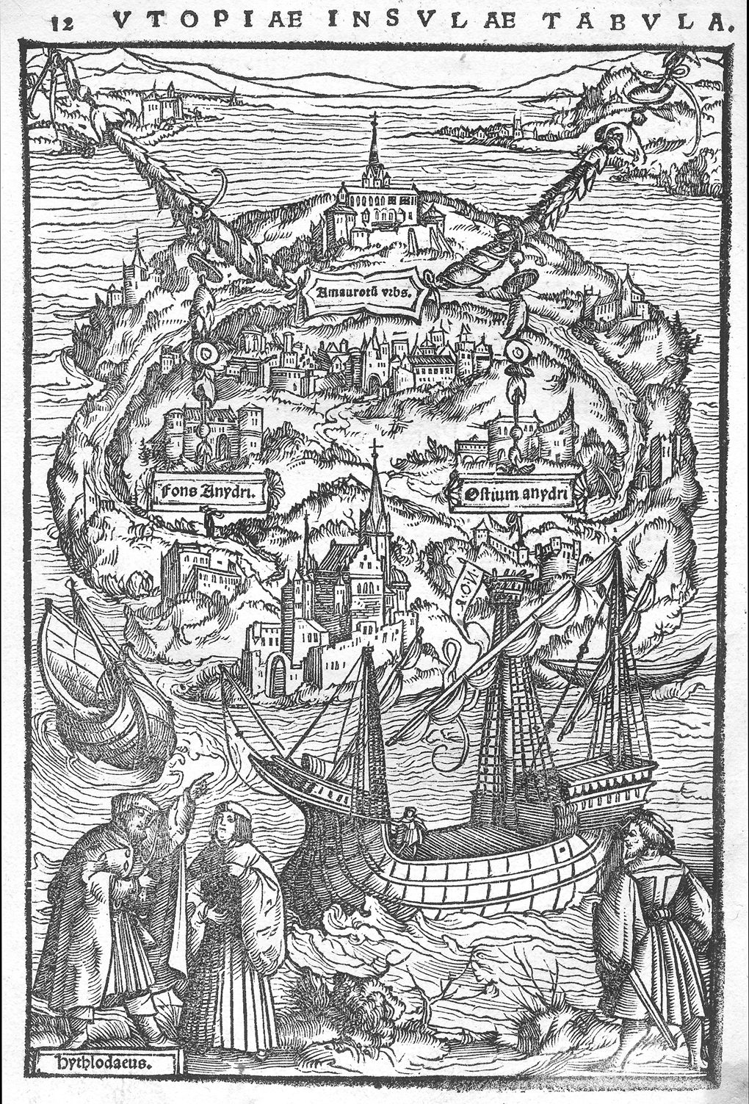

Slide 12
Critical Problems for the Study of Utopia:
Why use fiction to outline a social program?
Where does the author of a utopia stand?
Are utopias ever really “good”?

