Slide 1
Key Binaries of Utopian Fiction:
Real/not-real
Civilized/savage
Human/Animal
Human/Machine
Biological/Mechanical
Freedom/stability
Evolution/Devolution

Slide 2
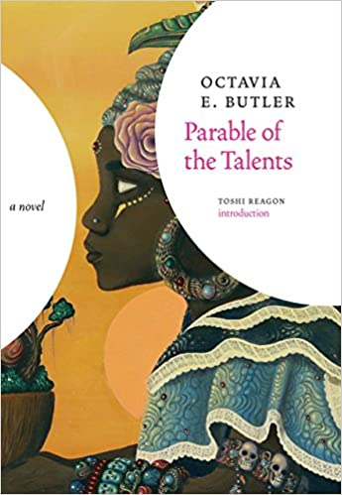

Slide 3
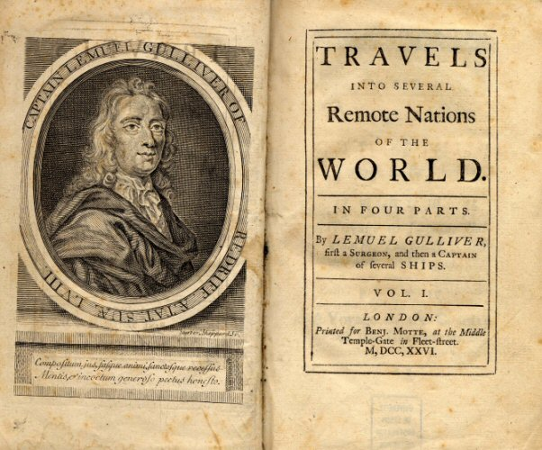
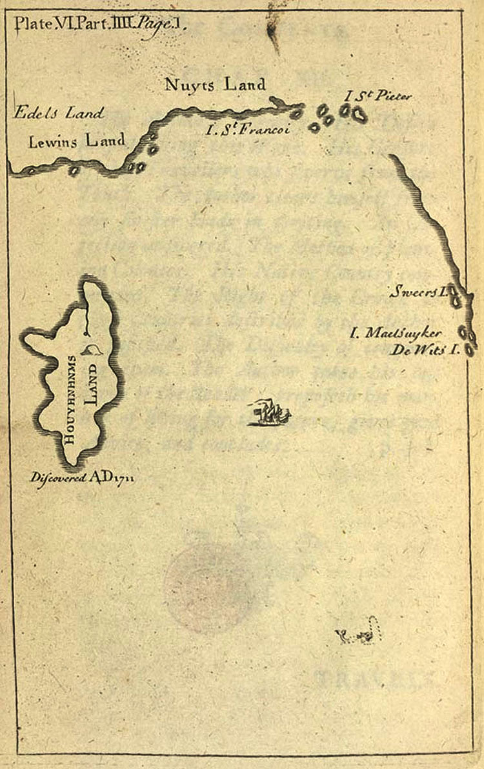

Slide 4
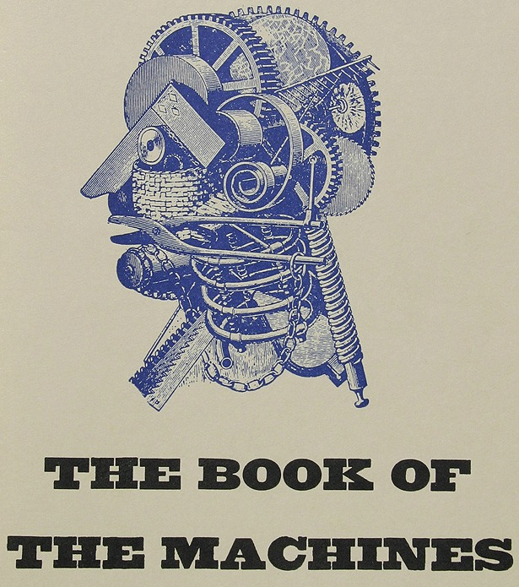

Slide 8
