Slide 1
War and Foreign Engagements of the Cold War
Mary Ann Heiss
Kent State University

Slide 2
Postwar Asia

Slide 3
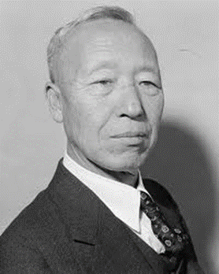
Background to Korean War

Slide 4
“By God, I’m Going to Let Them Have It”
Notes:
Jack Knox, Nashville Banner, https://sharetngov.tnsosfiles.com/tsla/exhibits/veterans/korea.htm; David Low, Daily Herald, https://www.cvce.eu/en/obj/cartoon_by_low_on_the_korean_war_30_june_1950-en-6e0a284f-0ae1-44e3-88f4-07c3f7f8fcc6.html.
Jack Knox, Nashville Banner, https://sharetngov.tnsosfiles.com/tsla/exhibits/veterans/korea.htm;

Slide 5
Regional Dominoes
Notes:
https://www.johndclare.net/cold_war10.htm; https://www.loc.gov/pictures/item/91727234/.

Slide 6
The Shifting War Front

Slide 7
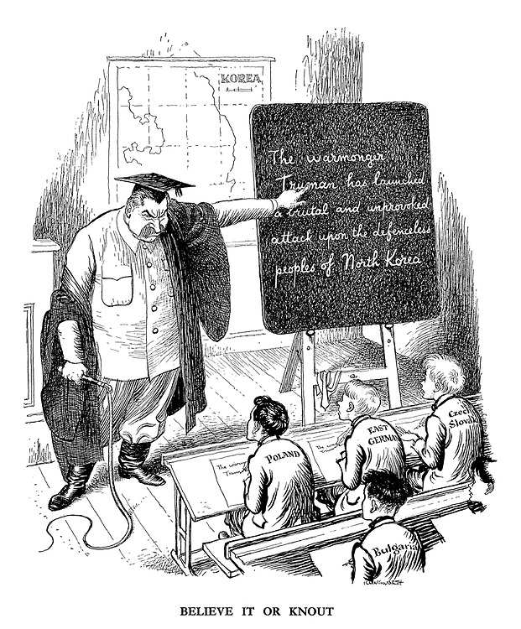
Soviet Pushback
Notes:
Jack Knox, Nashville Banner, https://sharetngov.tnsosfiles.com/tsla/exhibits/veterans/korea.htm; Leslie G. Illingworth, Punch, https://www.researchgate.net/figure/Leslie-G-Illingworth-Believe-It-or-Knout-Punch-12-July-1950-C-Punch-Ltd-All_fig3_286558957.

Slide 8
Widespread Consequences
Notes:
John Chase, New Orleans States, https://www.loc.gov/item/today-in-history/january-05/; Herb Block, Washington Post, https://sites.google.com/site/americanstations/home/second-red-scare-stations/saywhateverhappenedtofreedom-from-fear.

Slide 9
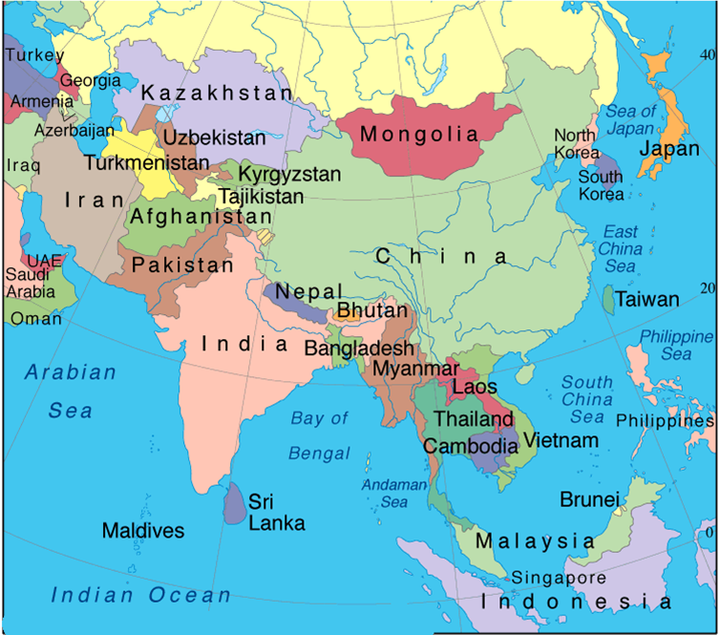

Slide 10
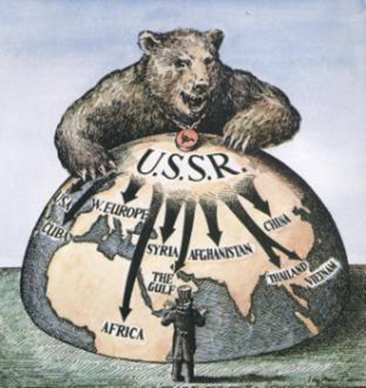
Context/Background
Notes:
Map from Time magazine, 1954.

Slide 11
Gulf of Tonkin Incident and Resolution, Aug 1964
Notes:
Wayne Morse: “I believe this resolution to be a historic mistake. I believe that within the next century, future generations will look with dismay and great disappointment upon a Congress which is now about to make such a historic mistake.” Paul Conrad, Los Angeles Times, https://www.pbs.org/independentlens/paulconrad/gal_22.html.

Slide 12
“Americanization” of the War
Notes:
Ground troops: 184,000 by end of 1965; 389,000 by end of 1966; 486,000 by end of 1967; 537,000 by end of 1968. Herb Block, Washington Post, https://www.loc.gov/exhibits/herblocks-history/ascent.html; Edmund S. Valtman, The Hartford Times, https://iowaculture.gov/history/education/educator-resources/primary-source-sets/cold-war-vietnam/stick-em-june-9-1964.

Slide 13
Tet Offensive, Jan 1968
Notes:
David Levine, New York Review of Books, https://hti.osu.edu/opper/lesson-plans/cold-war-conflict-in-vietnam-the-vietnam-era-presidency/images/johnsons-scar.

Slide 14
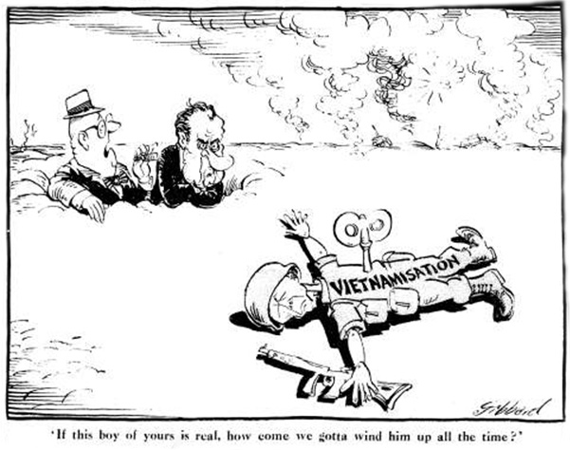
Vietnamization
Notes:
Hugh Haynie, Louisville Courier-Journal, “https://anhxua.net/album/nhung-tranh-biem-hoa-chinh-tri_88.html; "The Slow U.S. Withdrawal,” Issues of our Times in Cartoons (Highsmith Inc. 1995), http://dkobner.blogspot.com/2011/12/two-policies-in-vietnam-americanization.html; Les Gibbard, The Guardian, https://www.tracesofevil.com/p/blog-page_3.html.

Slide 15
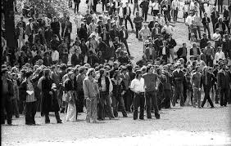
Territorial Expansion of the War

Slide 16
Ending US Involvement
Notes:
Bill Sanders, Milwaukee Journal, https://www.wku.edu/library/news/index.php?view=article&articleid=6954&return=archive.

Slide 17
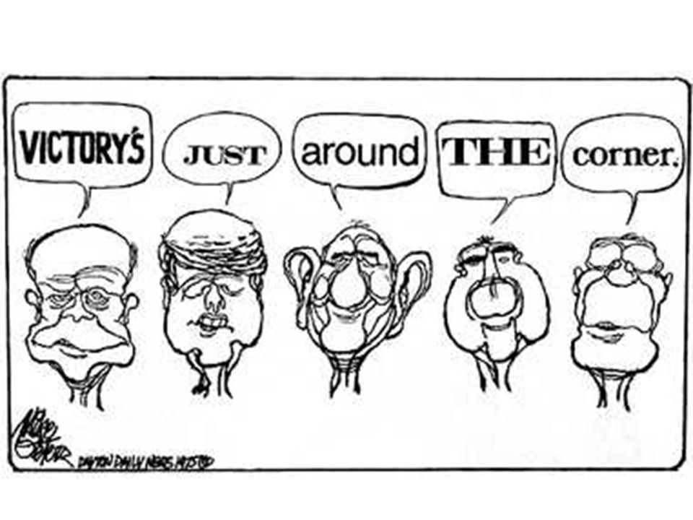
Notes:
Mike Peters, Dayton Daily News, https://slideplayer.com/slide/273731/.

Slide 18
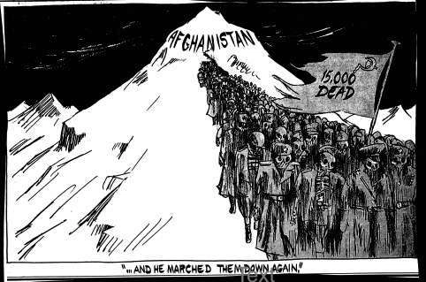
USSR in Afghanistan, Dec 1979
Notes:
https://sovietinvasionofafghanistane.weebly.com/cartoons.html; Nicholas Garland, The Independent, https://www.sutori.com/story/end-of-cold-war-timeline--UAbcrm7qtbNYtVUtF6quDCZG.

Slide 19
US Response
Notes:
The United States was ultimately joined fully in the boycott by some countries — including Japan, West Germany (Schmidt was able to convince its National Olympic Committee (NOC) to support the boycott by a narrow margin), China, the Philippines, Argentina and Canada. Some of these countries competed at the Olympic Boycott Games in Philadelphia. The governments of United Kingdom, France and Australia supported the boycott but left any final decision for their athletes to participate in the Games to their respective NOC's and the decision of their individual athletes. The United Kingdom and France sent a much smaller athletic delegation than what was originally possible. Herb Block, Washington Post, https://www.loc.gov/exhibits/herblocks-history/one.html.

Slide 20
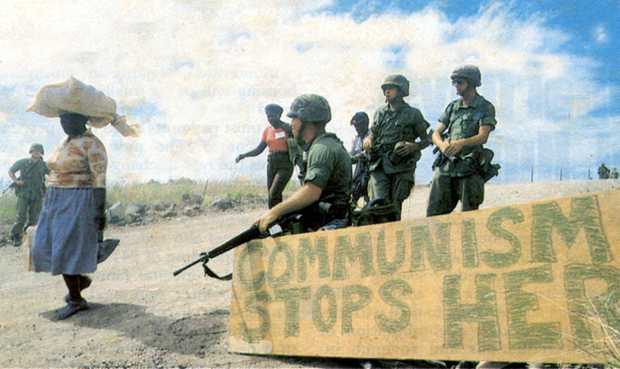
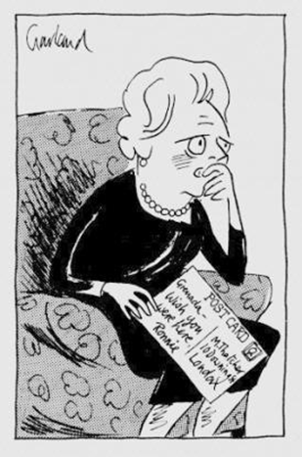
Grenada, Oct 1983
Notes:
Nicholas Garland, Sunday Telegraph, https://valleyadvocate.com/2013/04/19/margaret-thatchers-caricatured-career/.

