Slide 1
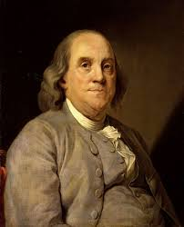
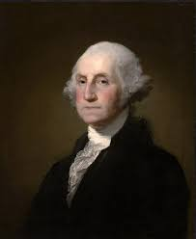
Notes:
Does anyone not know who these two men are?

Slide 2
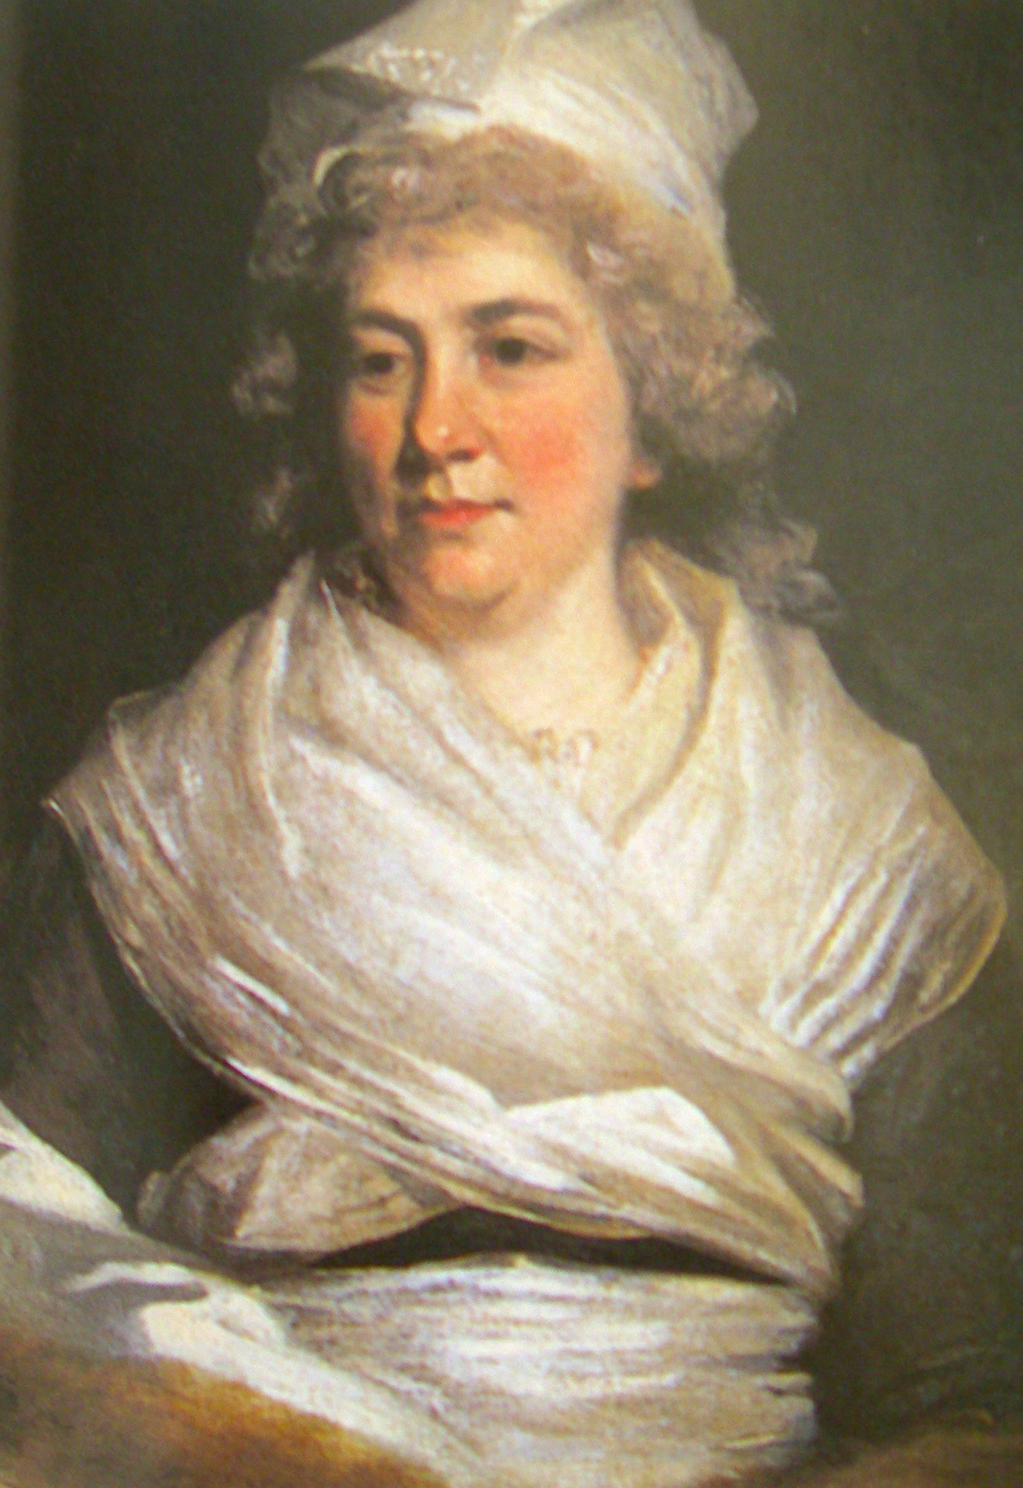
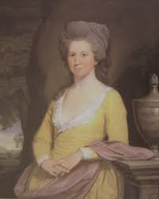
Notes:
Who knows these women? Each played important roles in rev and/or early republic. Why not better remembered?

Slide 3
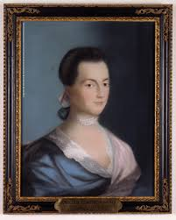
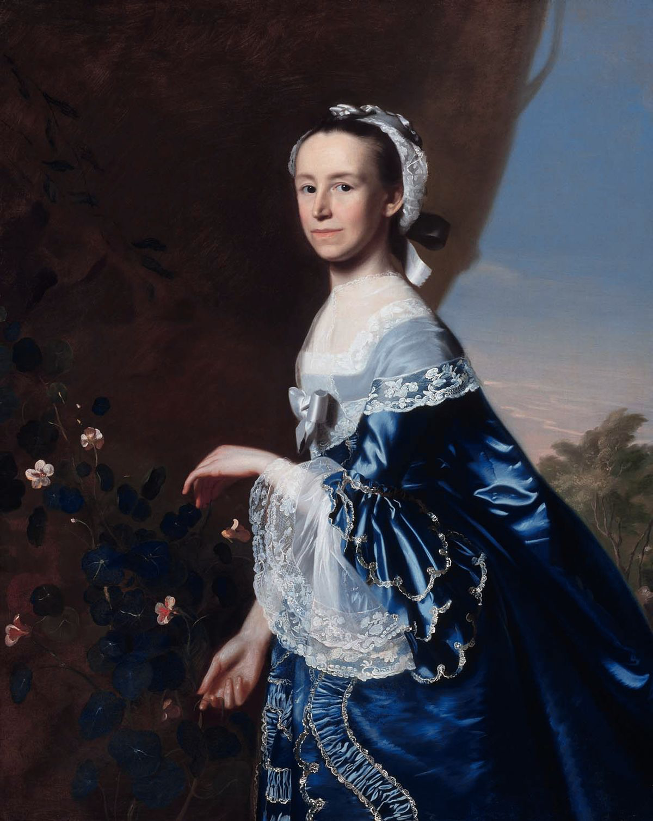
Notes:
And how about them? More will know them: Mercy Otis Warren and Abigail Adams, but a lot of what we will do today is show that, remarkable as they were, not perhaps quite so unusual as we make them out to be, when we look at the larger historical context)
But even they are not as well recognized as this lady

Slide 4
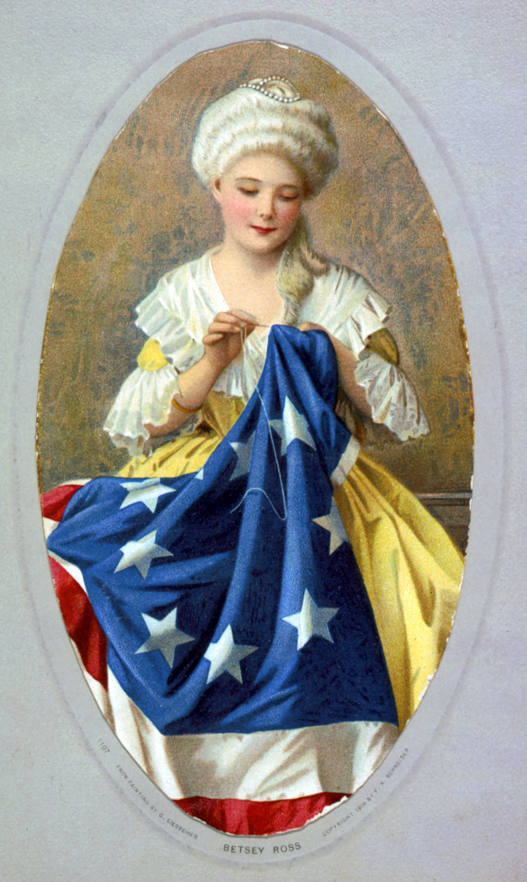
Notes:
But how bout her? Betsy Ross. (1908 rendition)

Slide 5
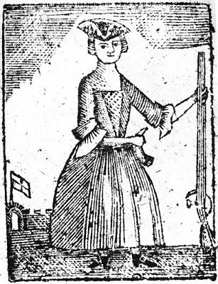
“Remember the ladies”
Notes:
1779 lady liberty
Why did we put down the musket and pick up the needle?
“Remember the Ladies”—why don’t we more?

Slide 6
Notes:
Let’s talk about WHY Each of these other four women arguably much more important and influential in determining the history of the American Revolution. Each important in her own right—for political, ideological, economic, even military history reasons, and also influenced and shed new light on Founding Fathers like BF, GW, John Adams, too
Partly because of how women were allowed—or not allowed to—participate in politics, war, and making war and building a nation. Partly because of HOW historical memory constructed, which stories we choose to tell. A decision about which stories to tell about women in the Revolution that began during the war itself.

Slide 7
How Should We Remember the Ladies?
Boycotters
Manufacturers
Militants
Fundraisers
Politicians
Notes:
So if how we remember the ladies is upholsterer Betsy Ross sewing, how should we remember them? Boycotters and Manufacturers—symbolic and economic actions with political effects; militants—the odd soldier like Deborah Sampson but many women experienced daily violence and actively wrote to galvinize military action (MOW) and ecnouraged children to remember and celebrate batttles and war (Adams); Fundraisers for Continental Army (Bache); politicians who, though shut out of official halls of govt, influenced (or sought to) through their writings personal (Adams), public (MOW), meetings in their homes (MOW and Committess of Correspondence; Powel and Constitution).

Slide 8
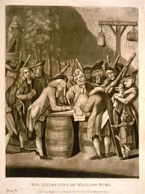
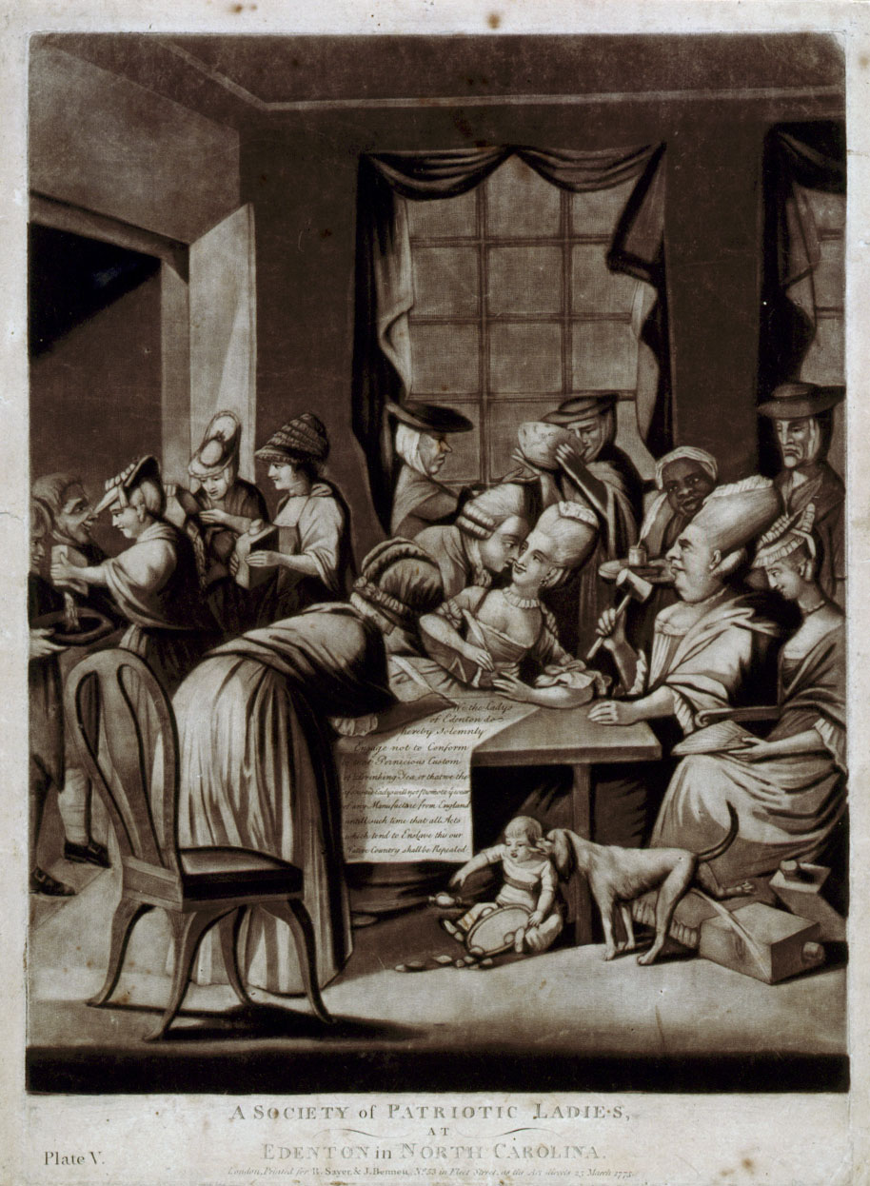
Boycotters
Notes:
Let’s begin with Boycotters. Women influenced the tone and progress of the Revolution from its very first moment of great collective crisis: that revolving around the Stamp Act of 1765
Women, of course, shopped as much if not more than men, So absolutely vital to success of American efforts to boycott British goods as economic pressure to change British imperial policy; women were vital to success of boycott, and women merchants and consumers as well as men signed publicly posted agreements wouldn’t sell—or buy—boycotted goods
Yet—as is evident from the famous ”Edenton Tea Party”—not all agreed with the idea of women participating in public ways (We will dissect this in primary source session). But generally speaking, seen as acceptable and encouraged for women to be politically involved this way

Slide 9
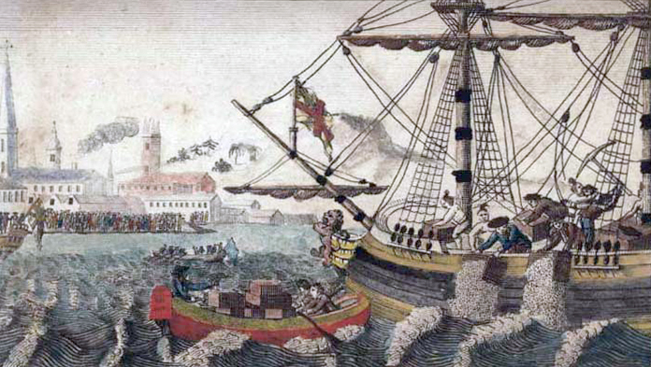
Mercy Otis Warren “The Squabble of the Sea Nymphs”
Notes:
And in ultimate expression of boycott movement--Boston Tea Party—John Adams exhorted her to write “The Squabble of the Sea Nymphs” published in Boston Gazette. Warren “Conscience of the Revolution,” used pen and home to express patriotism--crafted anti-British plays (Anon), this poem, and Cmtes of Correspondence formed/met her house. After the Revtn, a major multi volume history of the Am Rev (which Adams did NOT like)

Slide 10
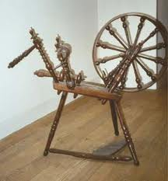
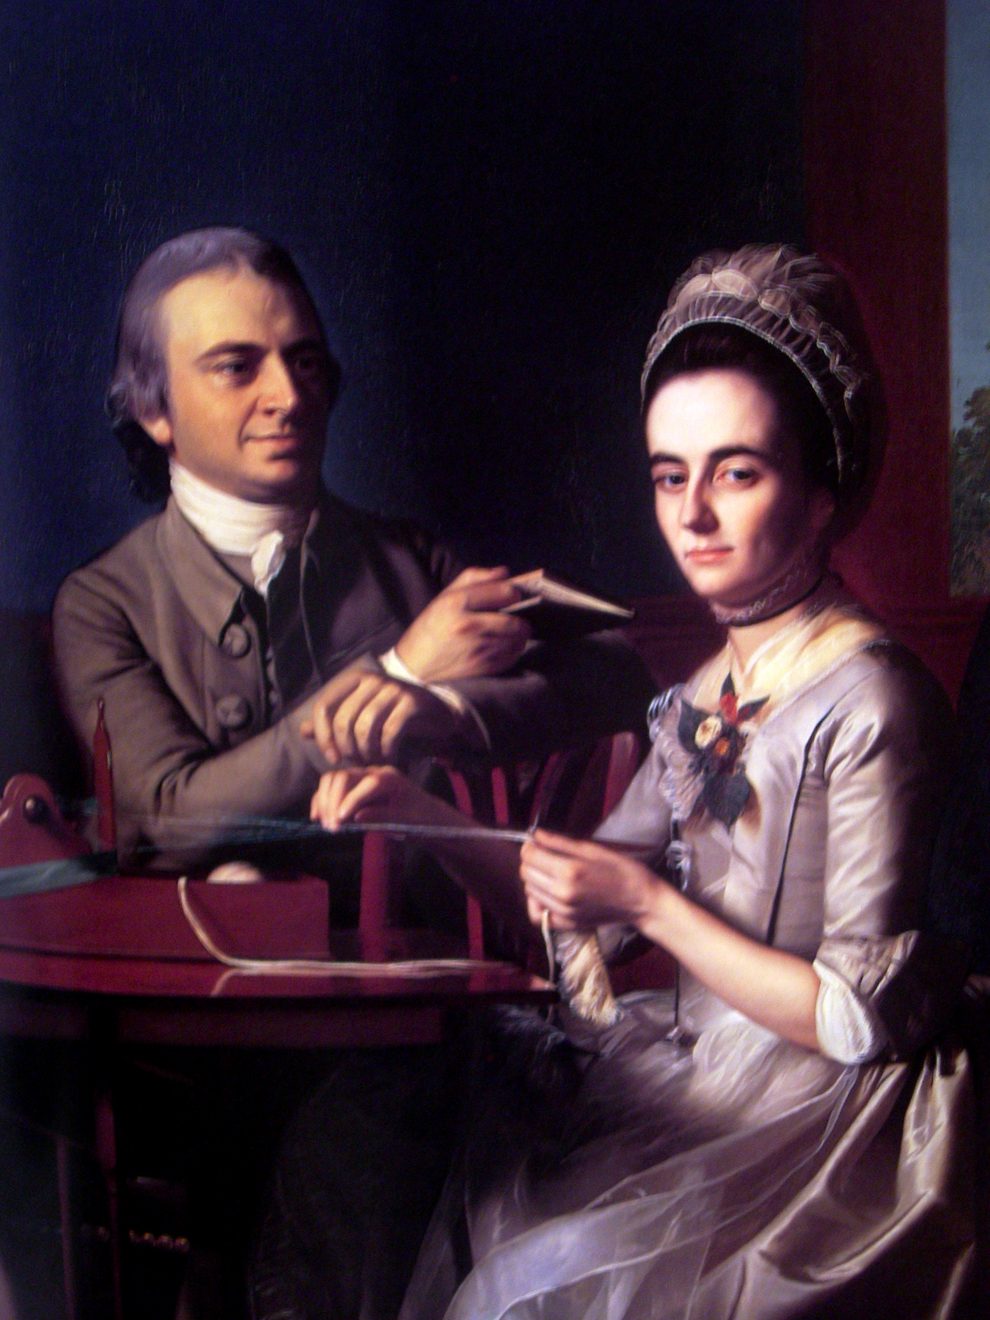
Manufacturers
She cloaths herself and family,
And all the Sons of need;
Were all thus virtuous, soon we’d find
Our Land from Slav’ry free’d.
(New England, 1769)
Notes:
Shift from Boycotters to Makers
In some ways even more natural fit for women; shopping double edge to it (can shop TOO much, after all!) but can’t ever spin too much (ideas of virtue in labor)
And CLOTH had large scale economic importance; one of most important exports to colonies; one of most bought type of goods imported
So economic reason for homespun’s symbolic importance
Between 1768-70 more than 60 spinning meetings described in New England papers
TRIPLE VIRTUE religious, gendered, political; much as boycotts way to exercise individual private virtue as collective political act; producing homespun way for individual women to exercise private virtue as collective political act
BUT women wanted to do more than make cloth

Slide 11
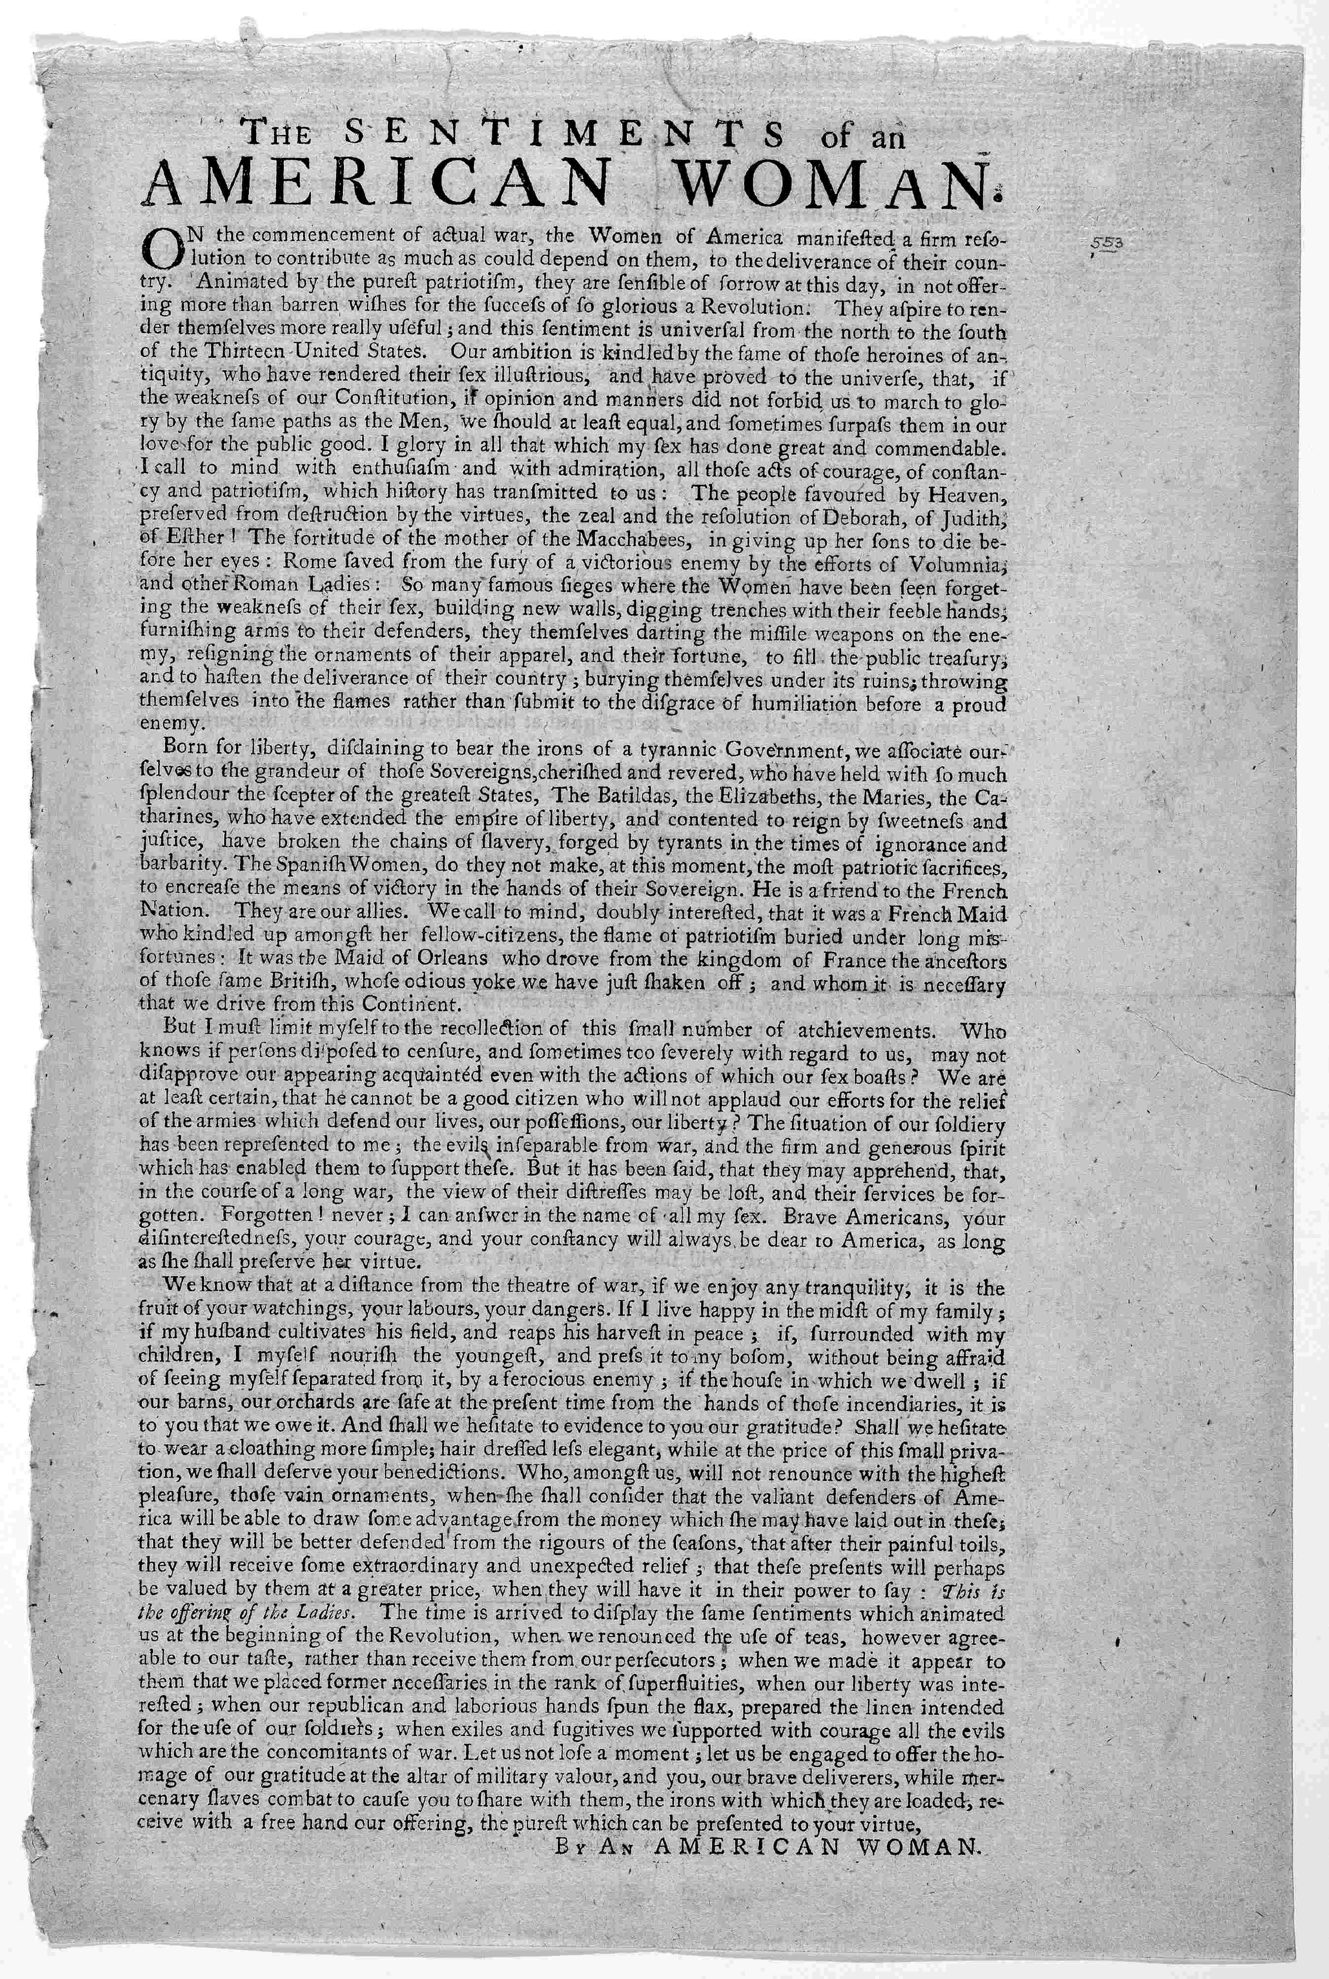
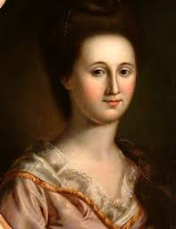
Fundraisers
“This is the offering of the Ladies”
Notes:
Ladies Association of Philadelphia, a group of elite women who led a door-to-door campaign raising money for Washington’s Continental Army. Reed only in America a short time before becoming ardent patriot.
The broadside (another of our primary sources) referenced militant women of the past who had proven the merit of their patriotic contributions, providing a precedent for women’s political activism. Reed reminded Philadelphia’s women how they, along with women across the colonies, had participated in the boycotting of teas, as well as spinning bees, both feats of female political activity performed in the name of the American cause. Working independently and without the assistance of men, the Association collected more than $300,000.

Slide 12
“We began with Mrs. Bache; she deserved this special mark of our attention, for she is the daughter of Mr. Franklin….She conducted us into a room filled with needlework, recently finished by the ladies of Philadelphia. This work consisted…of shirts for the soldiers of Pennsylvania. The ladies had bought the linen from their own purses, and had gladly cut out and stitched the shirts themselves. On each shirt was the name of the married or unmarried lady who made it, and there were 2200 shirts in all.”
--The Marquis de Chastellux, Travels in North America, December 1, 1780
Notes:
Reed sadly died, but not before tussle with GW over what to do with money…women pushed into making shirts—true they were needed (Lafayette) but STILL here women’s politics channeled into safely feminine pursuit

Slide 13
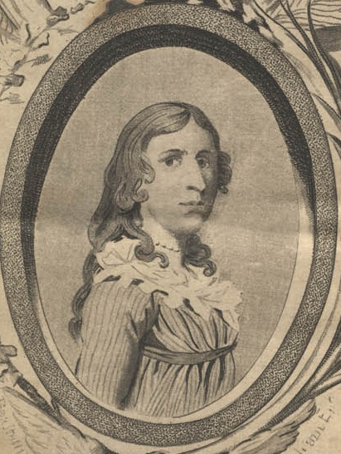
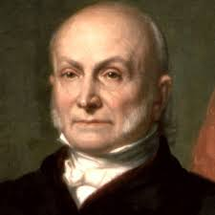
Militants
Notes:
Militants: not just Deborah Sampson
RI and musket ball
Abigail Adams JQA and Bunker Hill—poem to dead in his bed (different spin to Republican Motherhood)

Slide 14
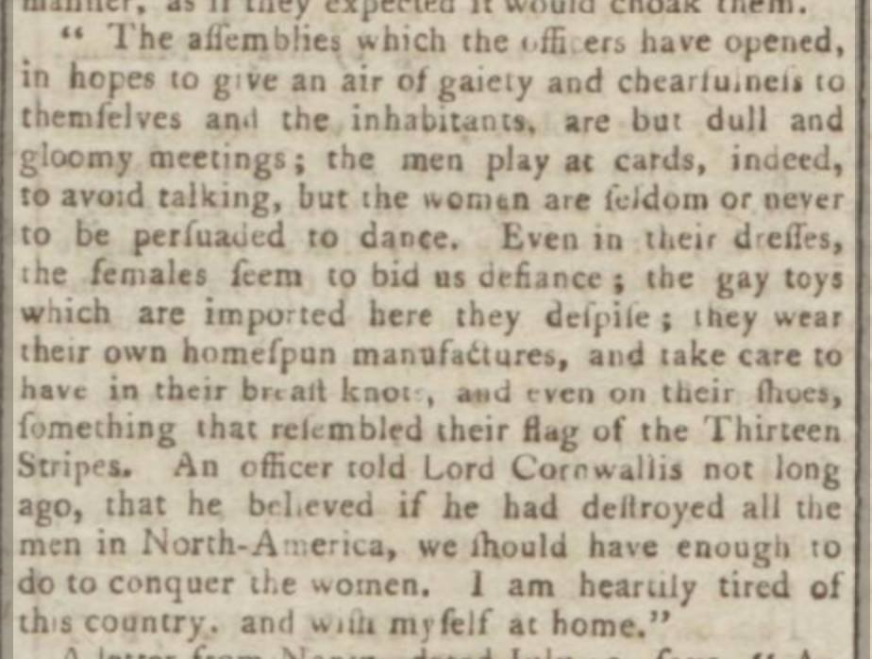
Notes:
Kentish Gazette August 1781
"Even in their dresses, the females seem to bid us defiance…they wear their own homespun manufactures, and take care to have… even on their shoes, something that resemble their flag of Thirteen Stripes. An officer told Lord Cornwallis…that he believed if he had destroyed all the men in North-America, we should have enough to do to conquer the women.”

Slide 15
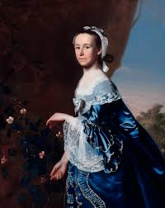
Politicians
“He is very sausy to me in return for a List of Female Grievances which I transmitted to him. I think I will get you to join me in a petition to Congress.” --
Notes:
Career—and historical memory!–of these three women illustrates this well. Adams—”remember the ladies;” (We will discuss in detail)

Slide 16
Politicians
“I sometimes think her Patriotism causes too much Anxiety. Female politicians are always ridiculed by the other Sex.”
--
Notes:
Powel (wife of Philly’s mayor, confidante of GW (author letter exhorting him run second term); hosted famous political salon during Revolution AND Constitutional Convention;
And linked to famous story: Franklin, A Republic if you can keep it” [don’t Pelosi yet]

Slide 17
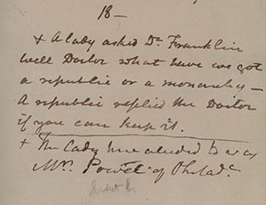
Notes:
A lady asked Dr. [Benjamin] Franklin Well Doctor what have we got a republic or a monarchy. A republic replied the Doctor if you can keep it.To which McHenry (later Secretary of War) added this footnote: The lady here alluded to was Mrs. Powel of Philada.—Dr. james McHenry’s journal on Constitutional Convention likely written 1787 but not published til early 20th century (1906)
McHenry also later published anon political series (1803) recounted different version of this story, called her a lady remarkable for her understanding and wit

Slide 18
”McHenry wrote that when Benjamin Franklin emerged from the building that day, he was accosted by a certain Mrs. Powell of Philadelphia. Whether she was a young women or a dowager we don’t know. He was then eighty-one years old, the oldest delegate. . . . for all we know, he knew this now-mythical and otherwise forgotten Mrs. Powell, who has come to stand for all of America since the day when she spoke to Franklin in a tone that seems to bespeak some degree of familiarity.”
-Eric Metaxas, If You Can Keep It (2016):
Notes:
AND YET But what’s happened since? Powel’s position as wife of a Philadelphia politician, host of important political discussions, and trusted advisor to Washington is erased. She instead appears as a “anxious lady”—plus “now-mythical and otherwise forgotten.”
1814, Powel herself commented on story published in papers. The exchange, rather than happening in Powel’s salon, takes place out in the street, sometimes with a crowd watching. The woman’s role is often transgressive. In one case, she calls out her window. In two others she “accosted” the elderly Franklin with her question.
AND which—remarkably, was just in the news this week (Pelosi)—”Americans gathered”—she is but one in long line gets it wrong SO WHY DOES IT MATTER?

Slide 19
Notes:
Why? Much as our collective historical memory has obscured history of women’s participation in war and nation building—whether as militants, fundraisers, or politicians. Let us think not only about which stories are not being told, but whether the ones that are told even tell the story properly!
And to do so, to understand how we got from a collective memory of women in the Revolution as 1779 lady liberty to Betsy Ross,
why we put down the musket and picked up the needle—we can look deeply at the primary sources to rethink the role of women in the Revolution

