Slide 1
Dr. Daina Ramey Berry
The University of Texas at Austin
Twitter: @DainaRameyBerry
Dr. Anthony Brown
The University of Texas at Austin
Dr. Keffrelyn Brown
The University of Texas at Austin
Twitter: @DrKeffrelynB

Slide 2
Introduction & Overview
What we are Doing
Historical Knowledge: WWII and the Black Experience
Historical Knowledge: Key Constructs in Race and Racism
Breakout Session: Looking at Documents
Q/A

Slide 3
What We are Doing Today (5 min.)
Dr. Anthony Brown & Dr. Keffrelyn Brown

Slide 4
WWII and the Black Experience (10 min.)
Dr. Daina Ramey Berry

Slide 5
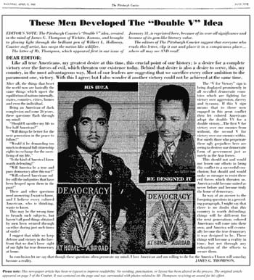
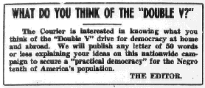
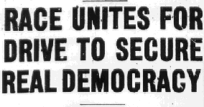
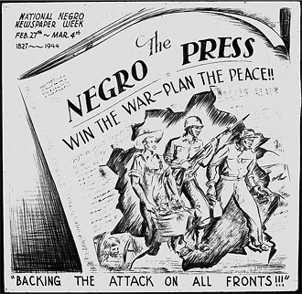
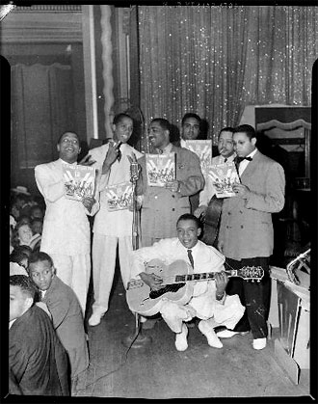
“Double V” Campaign

Slide 6
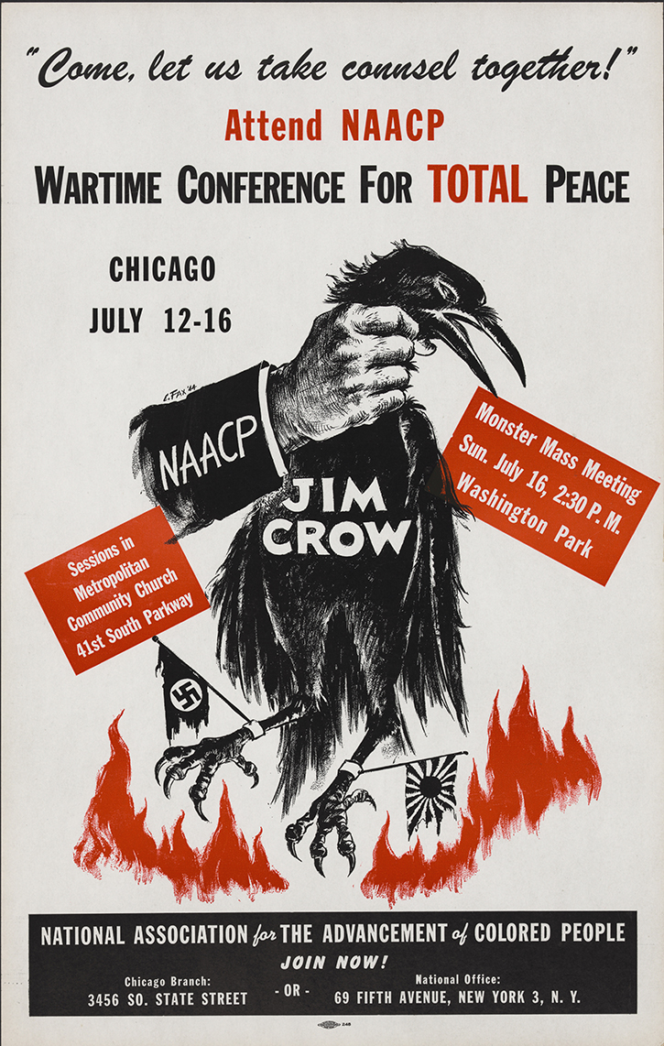
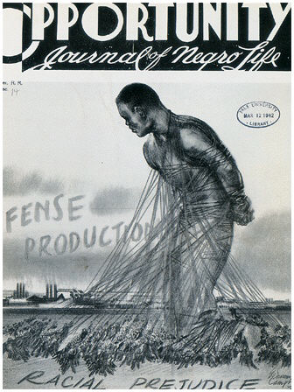

Slide 7
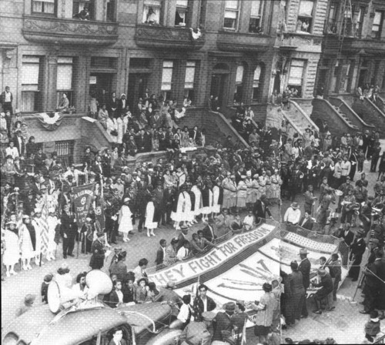
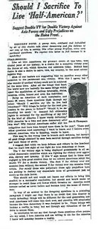
A “Double V” campaign celebration in 1942 on 119th Street, between Lenox and 7th (now Malcolm X Blvd and Adam Clayton Powell Blvd) in Harlem, New York.

Slide 8
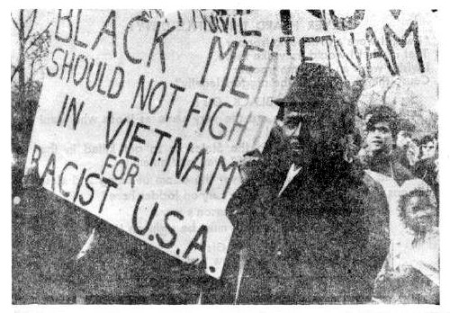

Slide 9
Executive Order 9981 –July 26, 1948

Slide 10
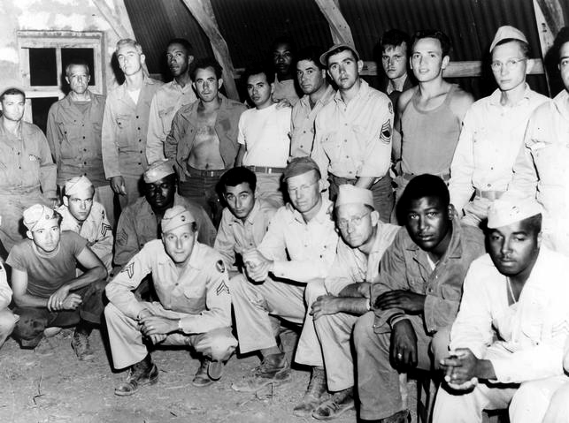

Slide 11
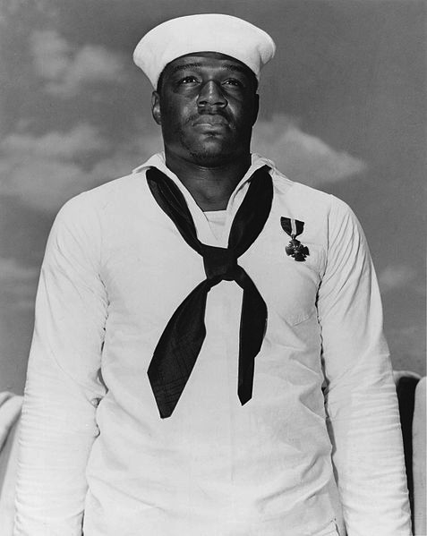
Black Participation in World War II: Couched in the stories of Dorie Miller and the Tuskegee Airmen

Slide 12
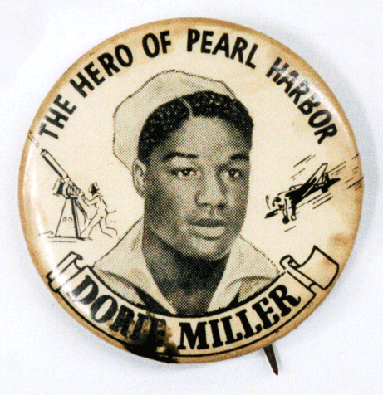
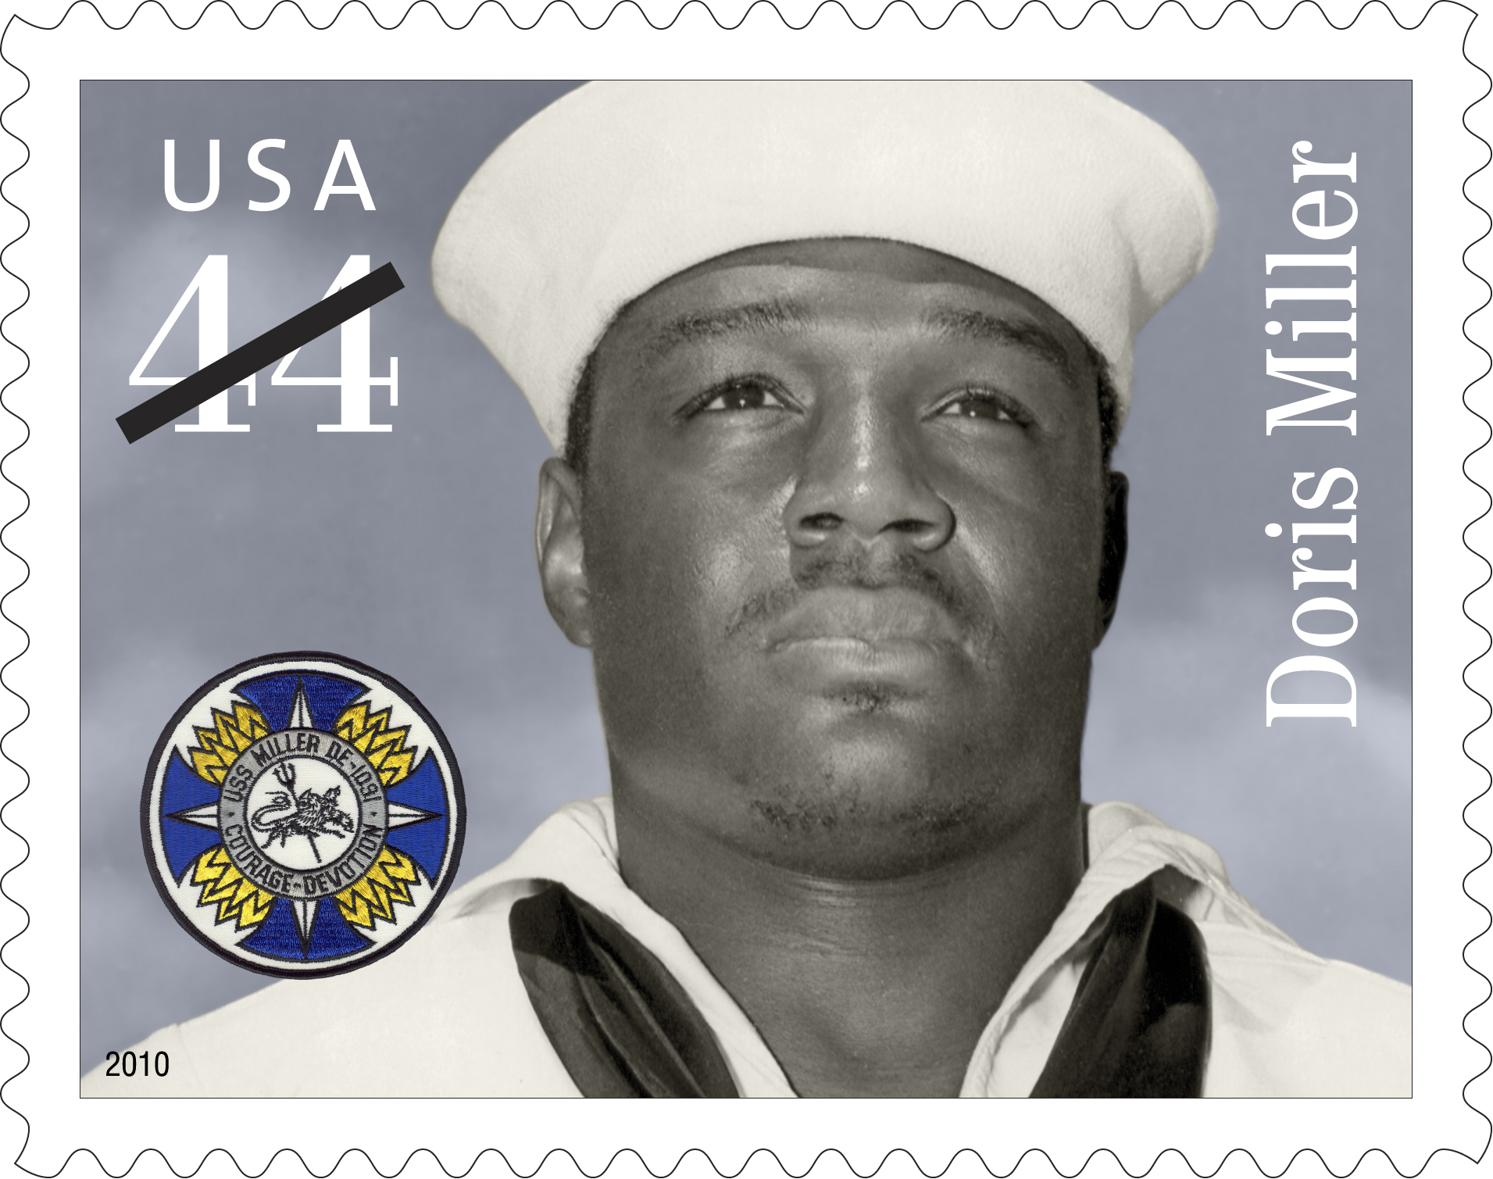
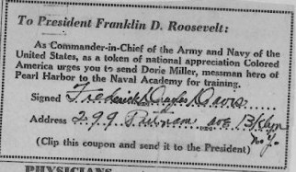

Slide 13
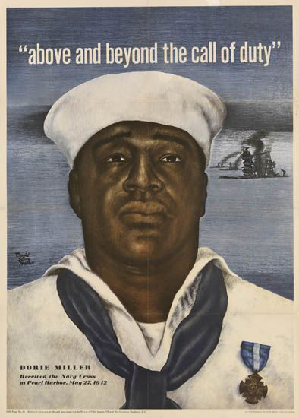
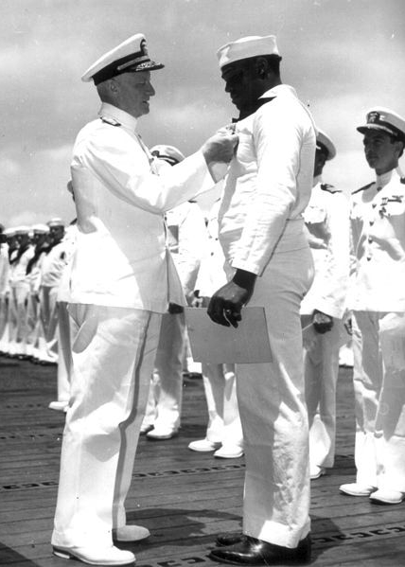

Slide 14
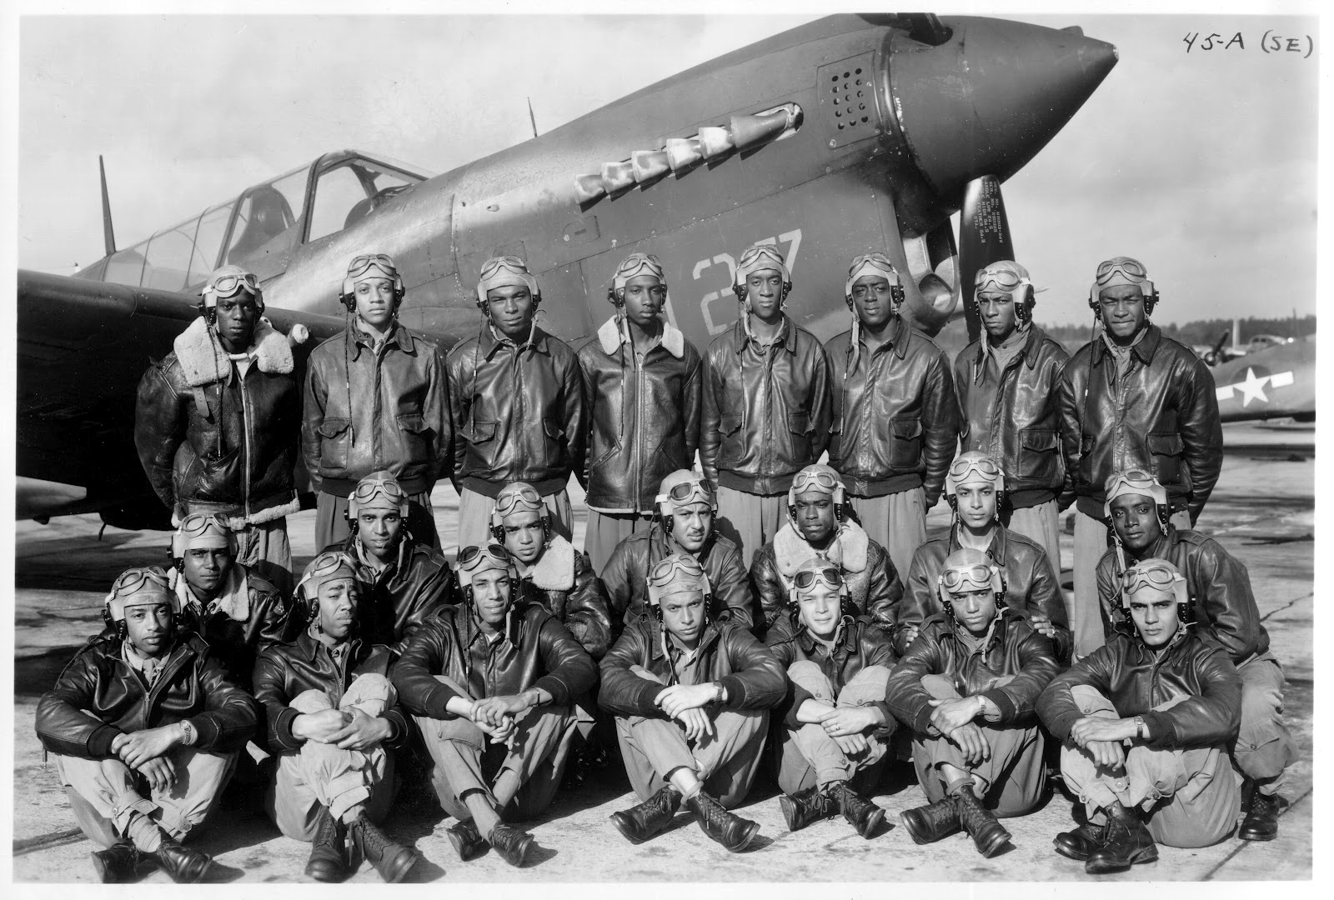

Slide 15
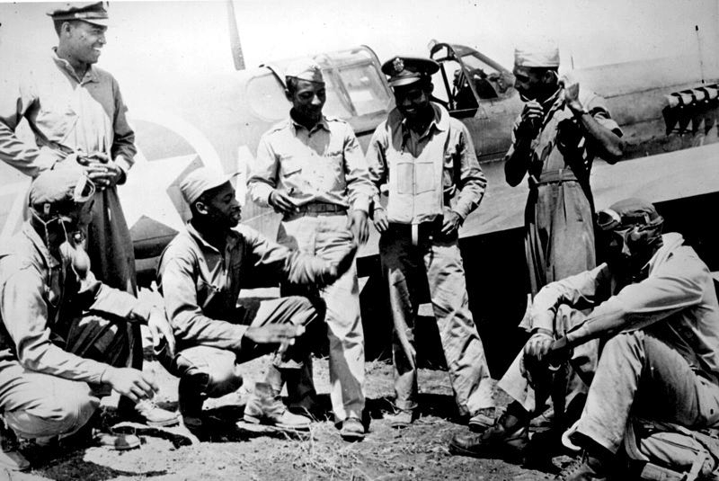
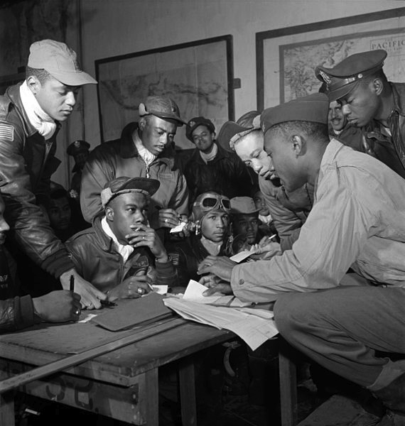
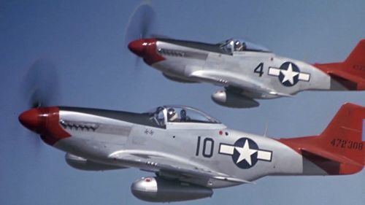
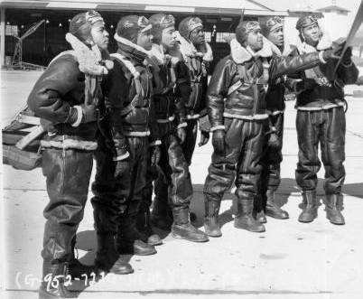

Slide 16
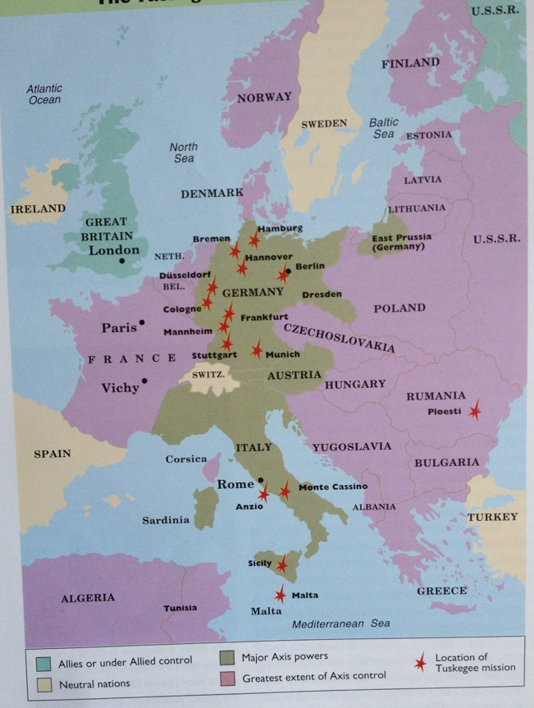
Tuskegee Airmen, 1943-1945

Slide 17
Key Constructs in the Study of Race & Racism (10 min.)
Dr. Anthony Brown & Dr. Keffrelyn Brown

Slide 18
Social Construction of Race
Science
Policy
Popular culture
Everyday practices
Laws
ideologies (stories)

Slide 19
Racial Materialism
Social construction of race
Material consequences of race

Slide 20
Types of Racism
Racism
interpersonal racism (micro)
Structural/
institutional racism
(macro)
Internalized racism

Slide 21
Race, Citizenship, and the Double V Campaign

Slide 22
Racial Realism
Racial Optimism
Racial Reality

Slide 23
U.S. Social Contract
U.S. Racial Contract

Slide 24
U.S. Racial Contract
Applied to particular citizens
Appeals to dominant common sense
Operates covertly and implicitly
Charles Mills, The Racial Contract

Slide 25
Race: The Power of an Illusion

Slide 27
Looking at Documents (15 min.)

Slide 28
Questions to Consider (10 min.)
How do the documents provided illustrate perceptions of race and racial discrimination in the 20th century?
What struck you when looking at the documents? Did you discover a new or deepened insight?
What questions or wonderings do you have after completing this activity?

Slide 31
Thanks!
Dr. Daina Ramey Berry
Email: drb@austin.utexas.edu
Twitter: @DainaRameyBerry
Dr. Anthony Brown
Email: alb@austin.utexas.edu
Dr. Keffrelyn Brown
Email: keffrelyn@austin.utexas.edu
Twitter: @DrKeffrelynB

