Slide 1
Developing Engaging Writing Assignments
Amy E. Earhart
Texas A&M University
http://dhrace.net/earhart/

Slide 2
Who am I?

Slide 3
Writing Philosophy
Stair step writing
Short, informal writing
Interactive p2p assignments
Build Research in components
Variety of genres to write about
Students are authority?
Creative Assignments
Unessay/essay

Slide 4
Stair Step Writing

Slide 5
TEKS
Composition: listening, speaking, reading, writing, and thinking using multiple texts--writing process. The student uses the writing process recursively to compose multiple texts that are legible and use appropriate conventions.

Slide 6
Stair Step WRITING
Multiple Components
Small to Large
p2p
Break Research into small pieces
http://www.giftsbytnc.com/images/31250.jpg

Slide 7
Multiple components

Slide 8
Small to Large

Slide 9
Small to Large
You have had a chance to visit the TAMU archives. In this assignment I would like you to document your experience and to share with your classmates.
I suspect you were surprised at what you found in the archives. In a paragraph please respond to your visit. What surprised you about the archives? Was there anything you learned that was particularly interesting? What did you already know about the archives?
Your response is due x date. Upload to our course blog so others might read your response. This is a graded assignment (A-F) so be sure to construct a coherent paragraph with a clear topic sentence and specific examples.
University Archive Blog Assignment

Slide 10
P2p: Class Responses
Class Response: Each student is required to sign up for 2 class responses. On the days that you are a class respondent, you will come to class prepared to discuss the assigned text. Preparation includes careful reading of the assigned materials; a paragraph that highlights the crucial issue(s)in the text, 1 support item (map, picture, song, etc.) and 3 prepared questions that you will post to the discussion board 24 hours prior to class; and the desire to help direct the class discussion.
Please post all information above 24 hours prior to class.

Slide 11
P2p: Annotation Assignment
Free software
Close readings of the text
Conversation between students
Perfect for Covid land

Slide 13
Break Research into small Pieces
Research Summary Assignment Overview

Slide 14
Break Research into small Pieces
Research Strategy (included in Google Drive)

Slide 15
Break Research into small Pieces
Annotated Bibliography Project (Included in Google Drive)

Slide 16
Break Research into small Pieces
Annotated Bibliography Project (Included in Google Drive) (continued)

Slide 17
Variety of Genres

Slide 18
TEKS
(6) Multiple genres: listening, speaking, reading, writing, and thinking using multiple texts--literary elements. The student recognizes and analyzes literary elements within and across increasingly complex traditional, contemporary, classical, and diverse literary texts.
The student is expected to:
(A) read and analyze world literature across literary periods;
(B) analyze the effects of metrics; rhyme schemes; types of rhymes such as end, internal, slant, and eye; and other conventions in poems across a variety of poetic forms;
(C) analyze the function of dramatic conventions such as asides, soliloquies, dramatic irony, and satire;
(D) analyze characteristics and structural elements of informational texts such as:
(i) clear thesis, relevant supporting evidence, pertinent examples, and conclusion; and
(ii) the relationship between organizational design and thesis;
(E) analyze characteristics and structural elements of argumentative texts such as:
(F) analyze characteristics of multimodal and digital texts.

Slide 19
Contemporary Music assignment: Blog
We will be studying a variety of Texas cultural expressions this semester, including music. In order to properly represent the broad diversity of Texas music I am asking you to contribute one Texas song to our Texas music blog. You will sign up for a specific date by which you will post your contribution. See link on ecampus. In addition, you should place your song and singer beside your name to claim it. I don't want to have any repetition in this assignment, so the first person to claim a song "own" that song. Please check the existing music blog to make sure that no one from a previous semester has written on your song (You may repeat singer/bands, but not songs).
Content: I have added a sample blog post to our blog so that you might see a model. See Lyle Lovett, "This Old Porch." http://dhrace.net/blog/country/lyle-lovett-this-old-porch/

Slide 20
Contemporary Music: Blog
For this assignment you will choose a song that you believe represents some aspect of Texas. It might have Texas content or be performed or written by a Texas artist or band. Any genre of music is welcome, as is any language of performance. The song might be from any time period.
Next, locate a video or soundfile of the song. The easiest place to find a song is on a performer's webpage or Youtube. Make sure the song is accessible to all.
You should clearly identify the title of the song and the singer or band that is performing the song in your post. Be sure to embed the performance in your blog post. The embed function is located within the space that you type your blog. There is an icon of youtube to add a youtube link.
Then you will write a post that discusses the meaning of the song (you are welcome to include references to the video that accompanies the music, if that is useful). Please refer to specific lyrics to prove your point. You will also want to discuss what makes the song representative of a version of Texas. Again, use specific lyrics or images to prove your point. You are also welcome to link to other webpages that you find useful (see my example on Lyle Lovett).

Slide 21
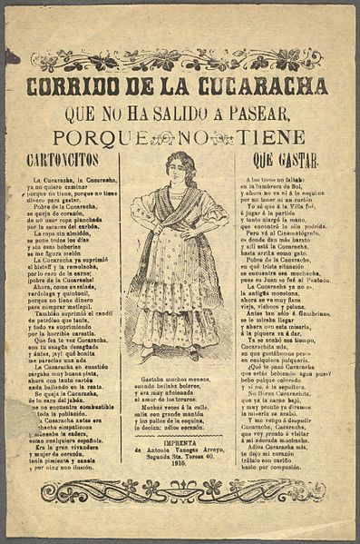
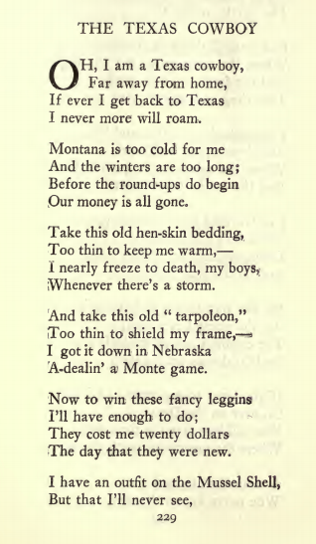
Other Music (to Poetry)
Corridos

Slide 22
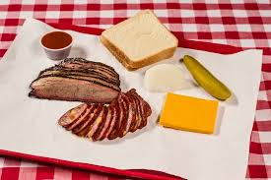
Foodways
It's Garcia's Deluxe Mexican Dinner, at Garcia’s Mexican Restaurant, 842 Fredericksburg Road, and it consists of two cheese enchilada and a pork tamal under chili con carne and yellow cheese; a freshly fried beef crispy taco, Mexican rice and refried beans. MySA

Slide 23
Cookbook discussion
https://archive.org/details/cbk
Small groups
What is the representation of Texas as told through food in your cookbook?
Pick one recipe that your group believes represents Texas foods.
Pick one recipe that the group wants to highlight as unique to the cookbook or to Texas.

Slide 24
Project based learning

Slide 25
Writing: TEKS 10
Composition: listening, speaking, reading, writing, and thinking using multiple texts--genres. The student uses genre characteristics and craft to compose multiple texts that are meaningful. The student is expected to:
(A) compose literary texts such as fiction and poetry using genre characteristics and craft;
(B) compose informational texts such as explanatory essays, reports, resumes, and personal essays using genre characteristics and craft;
(C) compose argumentative texts using genre characteristics and craft;
(D) compose correspondence in a professional or friendly structure;
(E) compose literary analysis using genre characteristics and craft; and
(F) compose rhetorical analysis using genre characteristics and craft.

Slide 26
Writing and the Unessay

Slide 27
Prompt-- Choices
An Unessay is a creative way to engage with topics that we have considered in this course.
Choose your own topic
Present it any way you please
Be evaluated on how compelling and effective your unessay is
Relate a critical reflection on ideas of Texas and Texas literature
Previous projects:
a video that explores the idea of Texas landscape
a song that you write that represents the diversity of Texas’ music tradition
a sewing or knitting project
food that you produce, such as a dinner based on your family’s Texas recipes, or a cookbook
multi-media projects, art projects, 3d board games, or a video game
social media project, such as Instagram or twitter.

Slide 28
Prompt/Examples
Here is an essay that shows some examples of unessays. None of these examples are specific to Texas literature, but they give you some ideas about how broad you may go with this project:
https://catherinedenial.org/blog/uncategorized/the-unessay/
https://earlyamericanists.com/2018/06/26/assigning-the-unessay-in-the-u-s-survey/
https://s18tot.ryancordell.org/assignments/unessay/
Each unessay should include a 1-2 page written document that explains the thinking behind the project. This is a personal reflection on the unessay process and should discuss what the project is considering. Remember that this is also a place to talk about what works or what doesn’t work through the unessay.

Slide 29
Grading
An unessay is compelling when it shows some combination of the following (adopted from Dr. Ryan Cordell):
it is as interesting as its topic and approach allows
it is as complete as its topic and approach allows (it doesn’t leave the audience thinking that important points are being skipped over or ignored)
it is truthful (any questions, evidence, conclusions, or arguments you raise are honestly and accurately presented)
it makes an argument, taking a particular point of view on the topic. A good unessay doesn’t just describe, it synthesizes and analyzes.
In terms of presentation, an unessay is effective when it shows some combination of these attributes:
it is readable/watchable/listenable: i.e. the production values are appropriately high and the audience is not distracted by avoidable lapses in presentation.
it is well crafted: the assignment’s invitation to write in different modes (using slang, etc.) does not mean the unessay needn’t be copyedited. Deliberate stylistic choices can help convey your message, while needless errors will distract from your message.
it is appropriate: i.e. it uses a format and medium that suits its topic and approach.
it is attractive: i.e. it is presented in a way that leads the audience to trust the author and his or her arguments, examples, and conclusions. (Cordell https://s18tot.ryancordell.org/assignments/unessay/)

Slide 30
Breakout Groups
Choose one of the techniques outlined and discuss how you might implement this approach in your course:
Stair step writing
Short, informal writing
Interactive p2p assignments
Build Research in components
Variety of genres to write about
Students are authority?
Creative Assignments
Unessay/essay

